Slide 1
Equipment Mix Optimization
Revenue & Financial Utilization Analysis
EquipmentShare Analyst Assessment
Haley Blair

Slide 2
AGENDA
01
Business Goals & Objectives
02
Data Cleaning & Outliers
03
Revenue
04
Financial Utilization
05
Recommendations
06
Future Opportunities

Slide 3
Question: What equipment mix maximizes market performance?
Objective: Actionable market recommendations
Notes:
We want to know what mix leads to the highest revenue, what mix leads to the best financial utilization, and where we should allocate our capital in the future for existing and new markets

Slide 4
Data Cleaning
Asset is Rented Prior to Asset Acquisition Date
Assumptions
Partially Missing Data
Asset may have been rented in another market
Records were removed
Asset Acquisition Revenue Impact: $618,284
Market IDs in rental data that don’t align with market IDs in asset data. Assumed asset data was correct.
Used OEC to determine the aerial vs dirt mix
Clean dataset only has 10 markets which is a fairly small sample for this analysis
Market IDs in the asset data that aren’t in our market map
14 Market IDs listed in assets that isn’t in the market map.
Rentals before the market open date
Revenue Impact: $3,534,414

Slide 5
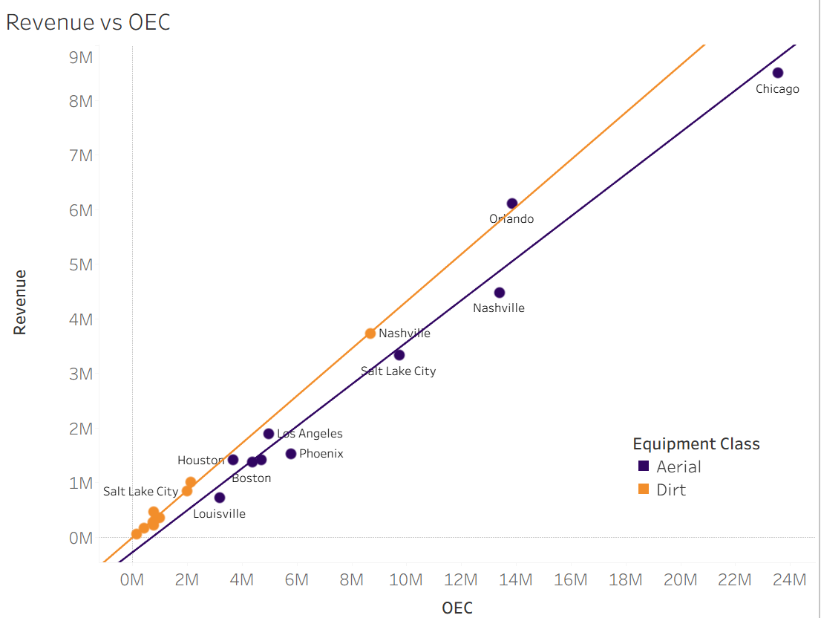
Revenue
Primary Driver: OEC
The age of the market & OEC explain 98% of the variability in revenue. OEC alone explains 97% variability. The more invested in a market, the more revenue.
Modeling showed that equipment class alone can only explain 11% of the variability in revenue

Slide 6
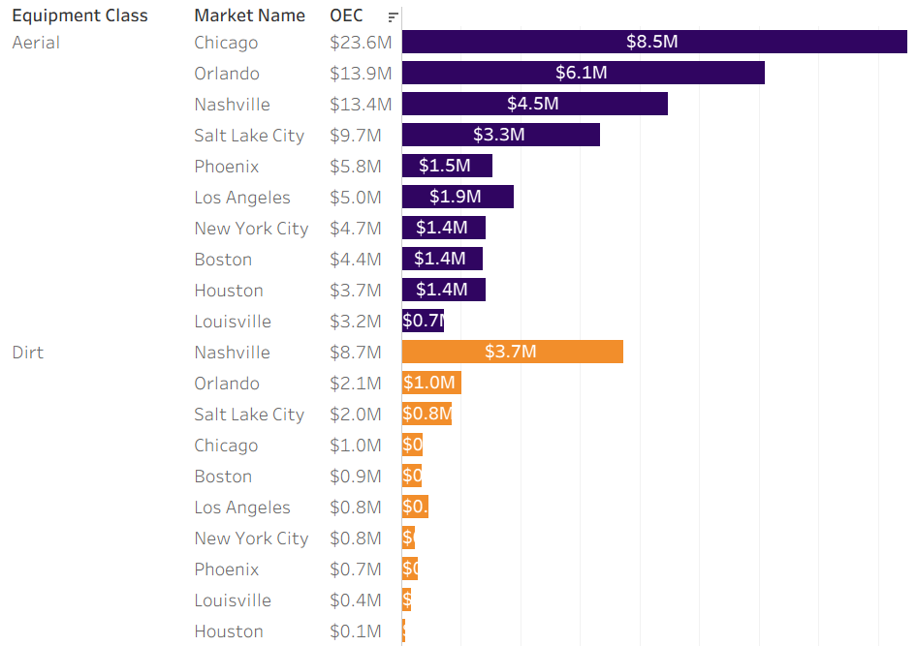
Revenue by Market
Notes:
Stacked bar chart by market

Slide 7

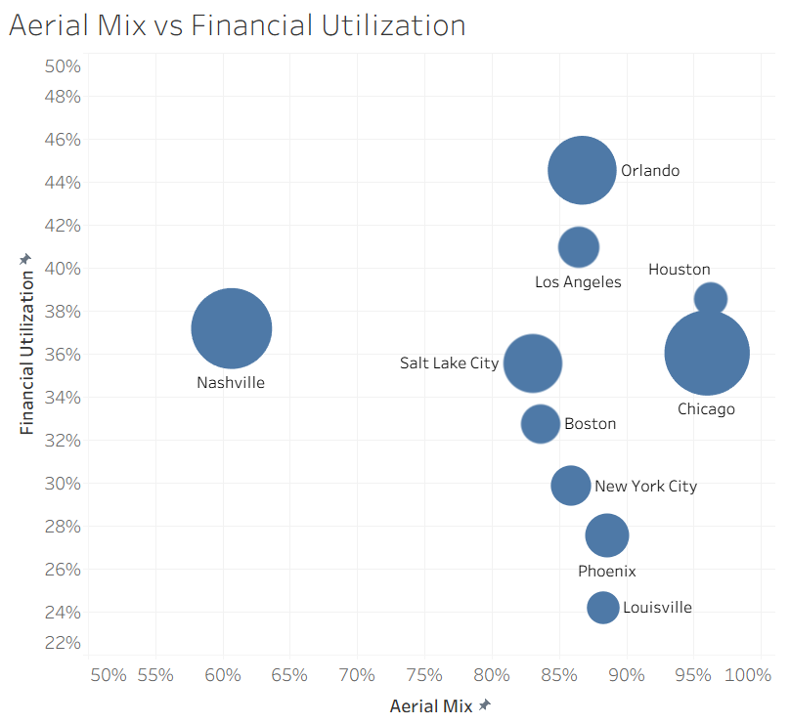
Aerial Mix vs Financial Utilization
Sensitive to equipment mix, but the relationship is not linear
Several high Aerial markets continued to perform well
There hasn’t been as much investment in any of the large markets in dirt as there has been in aerial, with the exception of Nashville.

Slide 8
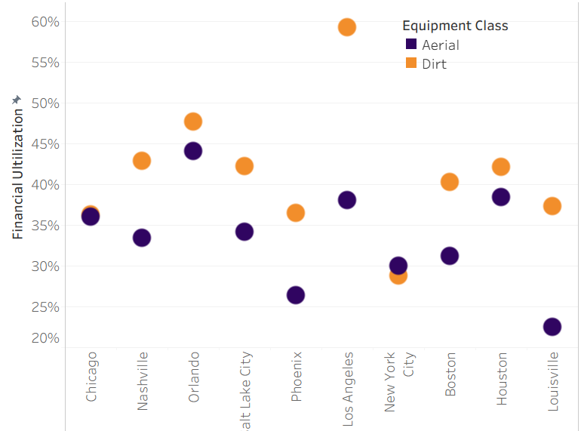
Financial Utilization by Market
Dirt wins in Financial Utilization every time except NYC

Slide 9
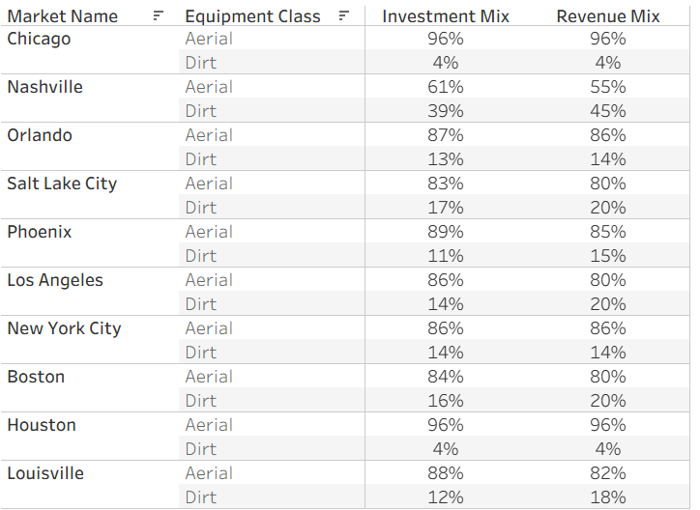
Investment vs Revenue Mix
Chicago, NYC, Houston, & Orlando are fairly equal between Dirt & Aerial
Dirt is performing better in Nashville, Salt Lake City, Phoenix, Los Angeles, Boston, Louisville

Slide 10
Recommendations With Annual Rev Impact
Scale & Increase Dirt by 10%
Increase Dirt by 5%
Los Angeles - $114K
Nashville - $168K
Increase Dirt by 10%
Houston - not a large difference between equipment classes
Hard to predict the impact with very low investment in dirt
Maintain Current Mix
Salt Lake City - $70K
Phoenix - $39K
Boston - $33K
Louisville - $38K
Orlando - $60K
Chicago
New York City

Slide 11
Future Analysis
Additional Variables
Forecasting
Several variables could be impacting the analysis that are not currently available in this dataset
If we opened a new market today, where should it be and where should we put our initial investments?
Geographic variables
Suburban vs rural
Major cities
Climate
Type of equipment
Skid steer vs excavators
Additional costs
Maintenance frequency
Maintenance cost
Advertisement
More variables may lead to better modeling
Is there an area of the country we do best in?
Do we do better in major cities than in rural areas?
Do certain types of equipment do really well in certain areas?
Do certain types of equipment cost more than they are worth to maintain?

Slide 12
THANK YOU
Any questions?

