Slide 1
“The dynamic influence of emotional words on sentence comprehension: An ERP study” by Ding et al.(2016)
Presentation on the experiment in this paper
Jinil Kim
Experimental Linguistics, 25/09/23

Slide 2


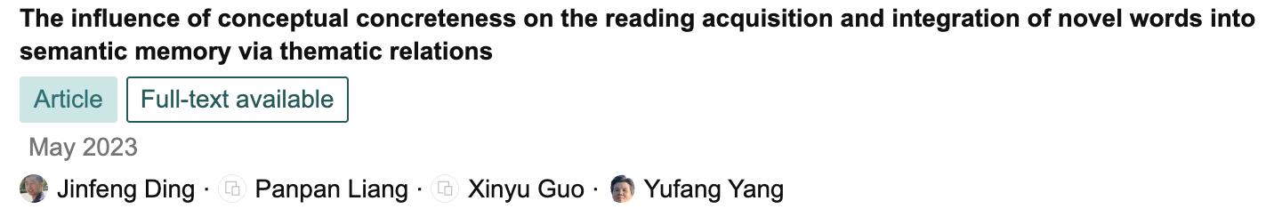
Research Team
Authors: Jinfeng Ding & Lin Wang & Yufang Yang
Yufang Yang’s Research Team
  Institute of Psychology, Chinese Academy of Sciences
  Linguistic sciences and cognitive neurosciences
Notes:
Checking the research team is beneficial
Does couple of biological studies, but also eminent psycholinguist in semantics

Slide 3
Background (I)
Traditionally, emotion and cognition were considered as separate systems
However, in neuroscience, their interaction & integration were considered
  Cognition ⇔ Emotion
Such a relationship is also considered in language
  Besides the controversy on relationship between cognition and language…
How emotional words are processed and influence other processing.

Slide 4
Background (II)
Language processing includes semantic integration & emotional information.
ERP studies show effects of emotional words on comprehension
  capture attentional resources (early P1/N1, P2)
  influence semantic integration (N400) & differs by its valence (positive, negative)
  affect reanalysis (P600)
Research question: How do emotional verbs influence the semantic integration of following neutral nouns?

Slide 5
Research Question
Research question: How do emotional verbs influence the semantic integration of following neutral nouns?
  Inconsistent views on effects of emotional context or words on analysis of neutral information.
Related to two main theories on their effects
  Priority-binding theory: enhancement effect
  Attention narrowing theory: impairment effect
Notes:
Related to the question, there is no consistent point of view

Slide 6
Predictions (I)
Variables: Noun’s congruity, Verb’s Emotionality, Semantic integration
Predictions:
  Neutral context(verbs): Incongruent nouns expected to elicit N400 (integration difficulty) and P600 (reanalysis).
  Negative context(verbs):
    Attention-narrowing hypothesis: Negative verbs capture attention, leaving fewer resources for nouns → reduced N400, diminished P600.
    Priority-binding hypothesis: Emotional verbs enhance processing of following words → amplified N400/P600.
Notes:
N400 (integration difficulty) and P600 (reanalysis).

Slide 7
Method (I)
Participants: 30 Chinese university students (final analysis: 26).
Design: 2 × 2 factorial design
  Verb: Negative vs. Neutral
  Noun: Congruent vs. Incongruent
Stimuli: Chinese sentences structured ‘context + critical verb + critical noun’.
Negative–congruent: steal steel | Negative–incongruent: steal tomatoes
Neutral–congruent: unload steel | Neutral–incongruent: unload tomatoes
Notes:
Negative–congruent: steal steel
Negative–incongruent: steal tomatoes
Neutral–congruent: unload steel
Neutral–incongruent: unload tomatoes

Slide 8
Method (II)
Procedure:
  Participants read sentences word-by-word while EEG was recorded.
  Post-experiment comprehension test ensured attention.
EEG Recording: 64 electrodes, components analyzed: N1, P2, N400, P600.
Controlled variables:
  Emotional valence bias: included corresponding positive verbs as filter
  Word frequency (via SUBTLEX corpus) & Number of strokes
  Sentence order: Pseudo-randomized order without three consecutive same conditions

Slide 9
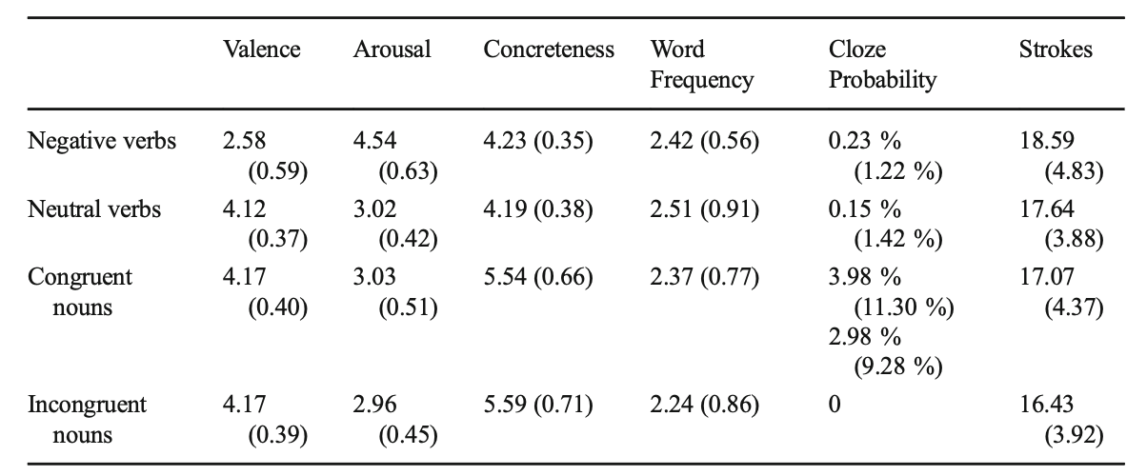
Method (III)
Each measured by participants, except frequency and strokes

Slide 10
Results (I)
Verb-level effects (Negative vs. Neutral)
  P2 (170–240ms): Negative verbs elicited a significantly larger P2 than neutral verbs.
    F(1,25) = 4.67, p < .05.
    Captured more attention in early processing
  N400 (300–470ms): Negative verbs elicited a significantly larger N400 than neutral verbs.
    F(1,25) = 8.21, p < .01.
    Harder to integrate semantically than neutral verbs

Slide 11
Results (II)
Noun-level effects (Semantic congruity & Verb type)
N400 (300–470 ms):
  Neutral verb context: incongruent nouns elicited a larger N400 than congruent ones.
    F(1,25) = 24.96, p < .001
  Negative verb context: N400 congruity effect still significant but weaker.
    F(1,25) = 6.04, p < .05

Slide 12
Results (III)
Noun-level effects (Semantic congruity & Verb type)
P600 (500–700 ms):
  Neutral verb context: incongruent nouns elicited a robust P600 effect.
    F(1,25) = 13.42, p < .01
  Negative verb context: no significant P600 congruity effect.
    F < 1, n.s.

Slide 13
Conclusions
P1 (Neutral context): Incongruent nouns elicit both N400 and P600.
  Supported: Robust N400 & P600 observed.
P2a (Attention-narrowing): Negative verbs → smaller N400/P600.
  Partially supported: Congruity effect on N400 remained but weaker, P600 was absent.
P2b (Priority-binding): Negative verbs → larger N400/P600.
  Not supported: did not find enhanced N400 & reanalysis (P600) was impaired.
Notes:
Prediction 2a (Attention-narrowing): Negative verbs reduce resources for subsequent nouns → smaller or absent N400/P600.
Prediction 2b (Priority-binding): Emotional verbs enhance processing of subsequent nouns → larger N400/P600.

Slide 14
Significance & Limitations
Significance
  Negative verbs disrupted congruity effect on semantic integration
  Results supported the attention-narrowing hypothesis over priority-binding.
  Emotional words affect the processing of subsequent semantic information, leading to shallower reanalysis.
Limitation & Further Research
  Generalizability: The experiment was conducted only in Chinese.
  Task Demands: Participants were asked only to read for comprehension.
    More explicit tasks (e.g., plausibility judgment task) in realistic design (e.g., Minecraft) might reveal other effects

