Slide 1
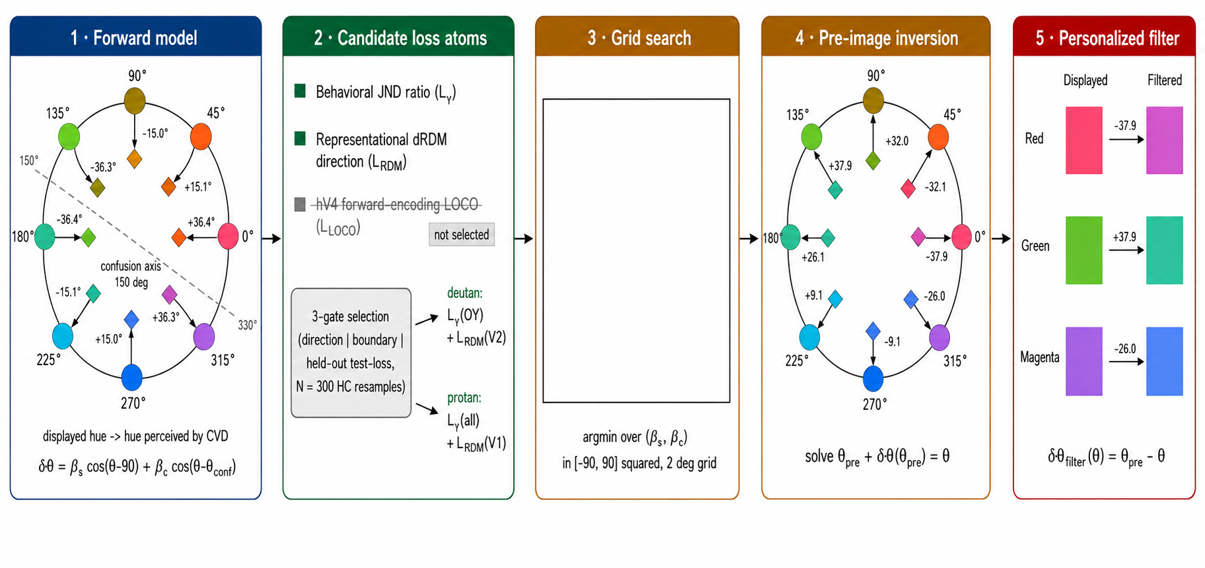
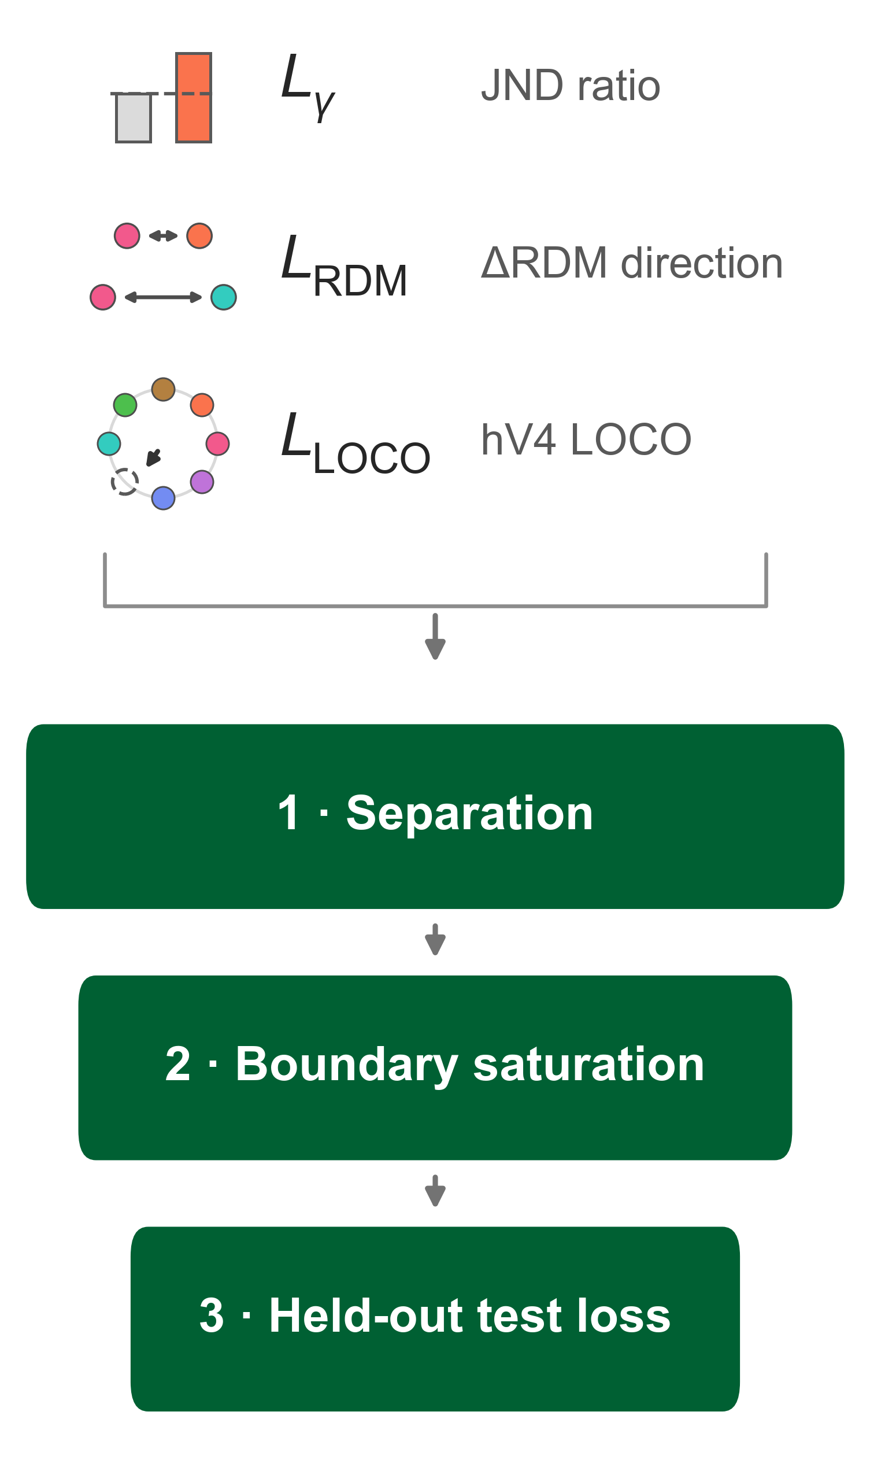
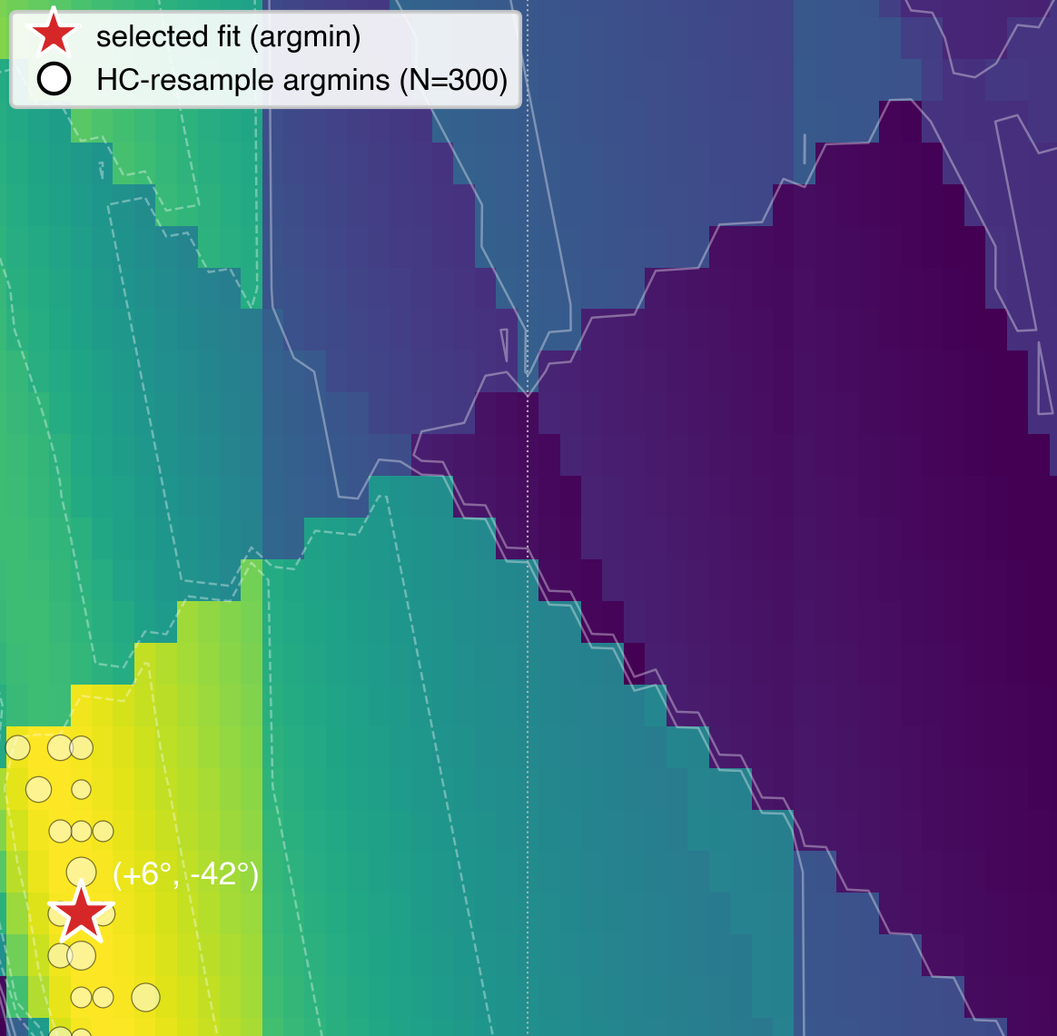
1 · Forward model
2 · Candidate loss atoms
3 · Grid search
4 · Pre-image inversion
5 · Personalized filter
Displayed
Filtered
-37.9
+37.9
-26.0
displayed hue → hue perceived by CVD
δθ = β_{s} cos(θ−90°) + βc cos(θ−θ_{conf})
argmin over (β_{s}, β_{c})
in [−90, 90]², 2° grid
solve θ_{pre} + δθ(θ_{pre}) = θ
δθ_{filter}(θ) = θ_{pre} − θ

