Slide 1
Containers

Slide 2
Agenda
Introduction to containers
Running containers on Azure
Orchestrating container workloads

Slide 3
Introduction to Containers

Slide 4
Containerization
Not new – have existed for decades
Method of slicing up an OS to run multiple applications
Kernel is shared between host and containers
Build with successive “layers” with images
Shifting how applications are built and deployed
Notes:
Shared kernel

Slide 5
Container overview
Virtual Machines
Containers
Application A
Application B
Application A
Application B
Guest OS
Guest OS
Hypervisor
Host OS w/Container Support
Physical Server
Physical Server
Notes:
Ignite - brk3147
https://techcommunity.microsoft.com/t5/Microsoft-Ignite-Content/BRK3147-Accelerate-application-delivery-with-Docker-Containers/m-p/10719/highlight/true#M698
VMs:
Dependencies: Each virtualized app includes the app itself, required binaries and libraries and a guest OS, which may consist of multiple GB of data.
Independent OS: Each VM can have a different OS from other VMs, along with a different OS to the host itself.
Flexible: VMs can be migrated to other hosts to balance resource usage and for host maintenance, without downtime.
Secure: High levels of resource and security isolation for key virtualized workloads.
Containers:
Dependencies: Every application has its own dependencies which include both software (services, libraries) and hardware (CPU, memory, storage).
Virtualization: Container engine is a lightweight virtualization mechanism which isolates these dependencies per each application by packaging them into virtual containers.
Shared host OS: Processes in containers are isolated from other containers in user space, but share the kernel with the host and other containers.
Flexible: Differences in underlying OS and infrastructure are abstracted away, streamlining ‘deploy anywhere’ approach.
Fast: Containers can be created almost instantly, enabling rapid scale-up and scale-down in response to changes in demand.

Slide 6
Challenges between developers & IT
Developers
IT
I need to create applications quickly without worrying about IT
I need to manage servers and maintain compliance with little disruption
Applications run on my machine, but malfunctions on IT’s servers
I am unsure how to integrate unfamiliar applications into my environment
My productivity and innovation become suspended when I have to wait on IT
I am unable to focus on both server protection and application compliance

Slide 7
Monoliths to microservices
Small, “single role” services
Individually built and deployed. Version and update independently
Integrate using published API calls for overall application functionality
Fine-grained, loosely coupled application
Monolithic application approach
Microservices application approach
App 1
App 1
App 2
1
3
2
4

Slide 8
Benefits of containers
Accelerate application development and deployment
Increase consistency between environments
Better utilize resources with increased density
Support microservice architectures
Leverage vibrant community of images and tooling

Slide 9
Windows Server Containers
Container capabilities built directly into Windows Server
Deploy and manage containers with PowerShell or Docker
Deep integrations with Visual Studio
Distributable via Docker Hub

Slide 10
Hyper-V Containers
Hyper-V Container
Hyper-V Container
Higher level of isolation and security for containers
Useful for sensitive workloads
Same image, same commands, same APIs
Does not share kernel
Built on Hyper-V technology
Application A
Application B
Windows Guest OS
Windows Guest OS
Hypervisor
Physical Server

Slide 11

Container workflow
Developers update, iterate, and deploy updated containers
Physical/Virtual Servers
2
3
Operations collaborates with developers to provide app metrics and insights
Developers build and test apps in containers, using development environment
Operations automates deployment and monitors deployed apps from central repository
1
2
Containers pushed to central repository

Slide 12




Some Docker vocabulary
Docker Image
The basis of a Docker container. Represents a full application
Docker Container
The standard unit in which the application service resides and executes
Docker Engine
Creates, ships and runs Docker containers deployable on a physical or virtual, host locally, in a datacenter or cloud service provider
Registry Service (Docker Hub or Docker Trusted Registry)
Cloud or server based storage and distribution service for your images

Slide 13
Basic Docker Commands
$ docker pull nginx
$ docker images $ docker run –d –p 5000:5000 –-name catweb mikegcoleman/catweb:latest
$ docker ps $ docker stop catweb (or <container id>)
$ docker rm catweb (or <container id>)
$ docker rmi mikegcoleman/catweb:latest
$ docker build –t mikegcoleman/catweb:latest .
$ docker push mikegcoleman/catweb:latest

Slide 14
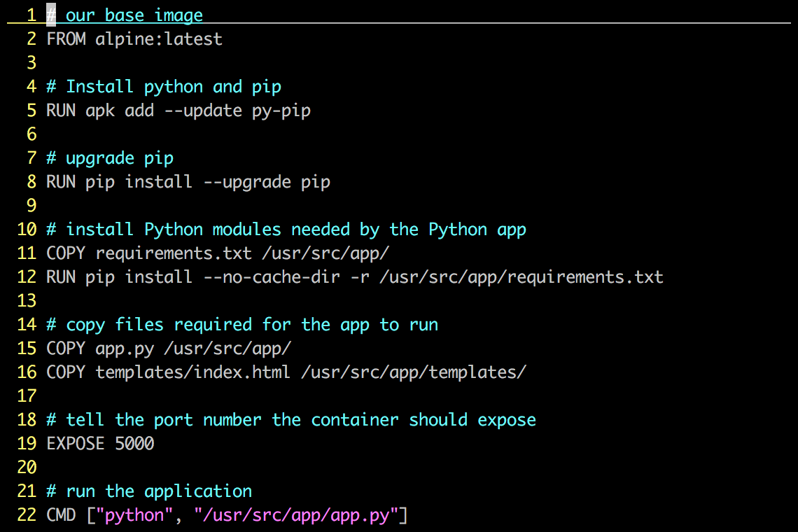
Dockerfile – Linux Example
Instructions on how to build a Docker image
Looks very similar to “native” commands
Important to optimize your Dockerfile

Slide 15
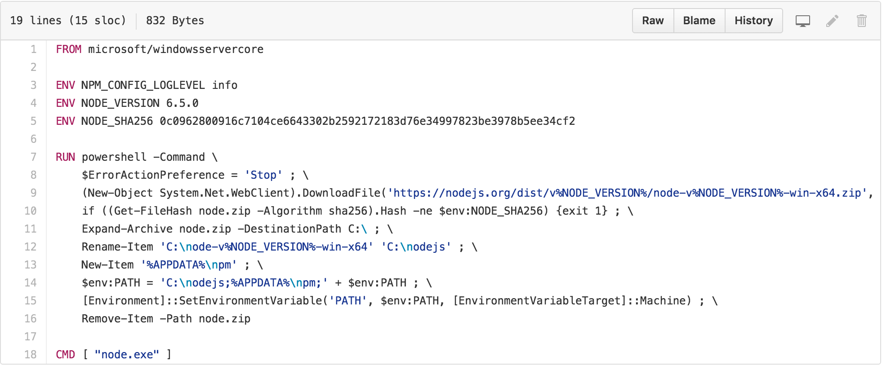
Dockerfile – Windows Example

Slide 16
Demo
Container Hello World
Notes:
Show stuff.
Ross Gardler’s scale up 25 web servers fast.
Pull from registry, Run

Slide 17
Containers on Azure

Slide 18
Containers in Azure
Control
Managed
Manual Install
ARM Template
Docker VM Extension
Azure Marketplace
Azure Container Service
User manually installs and manages Docker
Templates & custom script extensions
Pre-configured extension for VMs
Provision VMs with Docker prepared
Managed VM hosts and orchestrators

Slide 19
Private Docker Registry
Stores Docker container images
Private equivalent to the public Docker Hub
Can use Azure Blob Storage for persistence
Secure a Registry behind NSGs
Increased image pull performance
Notes:
Deploying Your Own Private Docker Registry on Azure
https://azure.microsoft.com/en-us/documentation/articles/virtual-machines-linux-docker-registry-in-blob-storage/#configuring-docker-registry-to-use-azure-blob-storage
The Docker Hub is a great tool for getting started with Docker, but as soon as a company begins to create meaningful images they will need a Docker Private Registry. These registries are a centralized repository for Docker container images. Hosting the Registry on an Azure Virtual Machine gives several benefits. First, Azure Blob Storage can be used to store the image data. Next, the VM used can be locked down with standard Azure networking concepts such as Network Security Groups to give granular control on who can access the machine. With Express Route, the entire VM could be taken off of the public internet, giving intranet-esque connectivity for an organization. Finally, the performance of pulls is improved when the Registry and the Docker machine are hosted within the same region.

Slide 20
Azure File Service Docker Volume Driver
“Volumes” are used to externalize persistent data
Plugin allows Azure File Storage to be used as a volume
Used to share data between multiple containers
Notes:
Persistent Docker volumes with Azure File Storage
https://azure.microsoft.com/en-us/blog/persistent-docker-volumes-with-azure-file-storage/
https://github.com/Azure/azurefile-dockervolumedriver

Slide 21
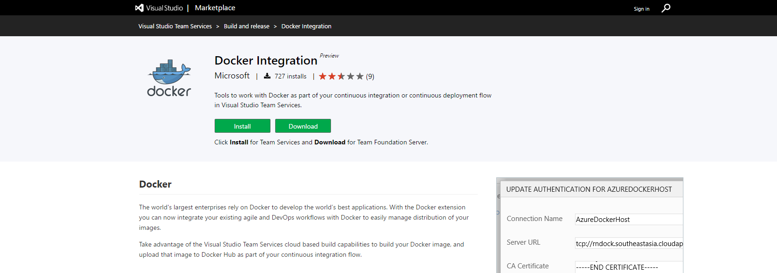
Docker integration with VSTS
VSTS Marketplace extension developed by Microsoft
Integrates Docker workflow into Build Definitions
Includes Tasks to Build, Run, and Publish images
Notes:
https://marketplace.visualstudio.com/items?itemName=ms-vscs-rm.docker

Slide 22
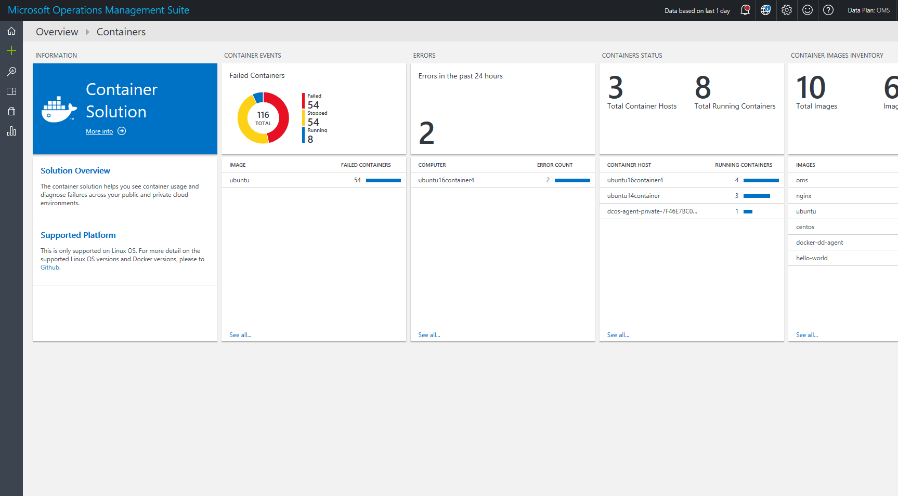
Operations Management Suite

Slide 23
Demo
Legacy application
Notes:
Create Docker VM from portal

Slide 24
Orchestration
Notes:
Higher level this.
Beyond 1 container we need orchestration to juggle.
Azure has ACS to juggle.
ACS isn’t black box – use standard Swarm or DC/OS.
End.

Slide 25
Managing container workloads
Cluster deployment and management
Service Discovery
Container Registry
Container placement and resource management
Continuous Integration & Delivery
Monitoring and Logging
Notes:
Managing one container is easy. Managing hundreds across multiple workloads is difficult.

Slide 26
Orchestration
Running one container locally is easy, running hundreds across a cluster of machines is difficult
Orchestration is a series of tools and processes to automate the lifecycle of a container
Manages creation, placement, update, scaling, and monitoring across nodes
Notes:
http://thenewstack.io/containers-container-orchestration/
Initial placement, depl

Slide 27
Azure Container Service
Optimized creation and management of container clusters
Leverages popular industry tools Docker Swarm, Mesosphere DC/OS, and Google Kubernetes
Docker tooling and API support
Integrated scalability with Virtual Machine Scale Sets
Linux and Windows Server containers
Notes:
Public and private cloud

Slide 28
Demo
Scale a container workload on ACS
Notes:
Scale a container with DC/OS to X instances
Maybe also scale the VMSS?

Slide 29
Conclusion
Containers represent a significant shift in application development and deployment
Azure offers several options for running containerized workloads at scale
Linux and Windows containers are supported by Microsoft

Slide 31
Technology comparison
 | Windows Server containers | Linux containers | Virtual machines
Base image | Same as host | Same as host | Any Windows/Linux
Multi-tenant security | No | No | Yes
Resource managed | Yes | Yes | Yes
Density | Higher | Higher | Lower
Startup time | Shorter | Shorter | Longer
Disk footprint | Smaller | Smaller | Larger
Application compatibility | Medium | Medium | High
Operating System: Containers share same OS as host system, but can run inside virtual machines to enable OS flexibility.
Security: Virtual machines offer a higher level of protection against threats such as kernel exploits.
VM features: Whilst containers have faster startup time, virtual machines benefit from features such as live migration.
App compatibility: For greatest benefit, apps should be designed, architected and written for containers i.e. stateless, componentized versus ports of traditional, monolithic apps.
Notes:
How do the different containers and VM technologies compare?
As mentioned earlier, containers, regardless of Windows or Linux, need to share the same OS as the host they are running on, which is very different from a virtual machine, which can contain a variety of different operating systems, that don’t need to match the host itself. VMs however, do guarantee a higher level of security than containers, providing a level of hardware isolation that cannot be matched by containers today.
All 3 offerings allow resources, such as CPU, memory, disk and network, to be controlled and managed, ensuring that the administrators can deliver expected levels of performance and reliability.
When thinking about density, and the number of applications that can run on a particular server, the lighter weight nature of containers naturally leads to higher levels of density compared to virtual machines, which themselves, provide a much greater level of density versus running a 1:1 app to server consolidation in the physical world. In addition, the lightweight nature leads to reduced startup times for applications, versus starting up a virtual machine from cold, meaning IT can respond even quicker to changing business needs. VM’s however, do benefit from VM-specific features, such as live migration and high availability, both of which would not apply to containers themselves.
Having multiple VMs providing multiple apps, also consumes considerably more storage space. Each VM typically, in a production environment, has it’s own non-shared virtual hard disk, which, if for example, we assume the size of the virtual disk is 20GB, having 20 VMs each with an application inside, would consume well over 400GB. Compare this with containers, which would consume 20GB for the host OS, and only incremental add-ons for the application binaries themselves, on a per application basis, and it’s clear that the savings on storage are considerable.
Finally, from an application perspective, virtual machines, typically have a very high compatibility for running applications that were designed for physical systems. In many cases, most applications that are being developed today, are being developed and tested in virtual environments, however these apps, in their native form, are unlikely to work in containers without significant redevelopment work. To realize the greatest benefit, apps should be designed, architected and written for containers i.e. stateless, componentized versus ports of traditional, monolithic apps.

Slide 32
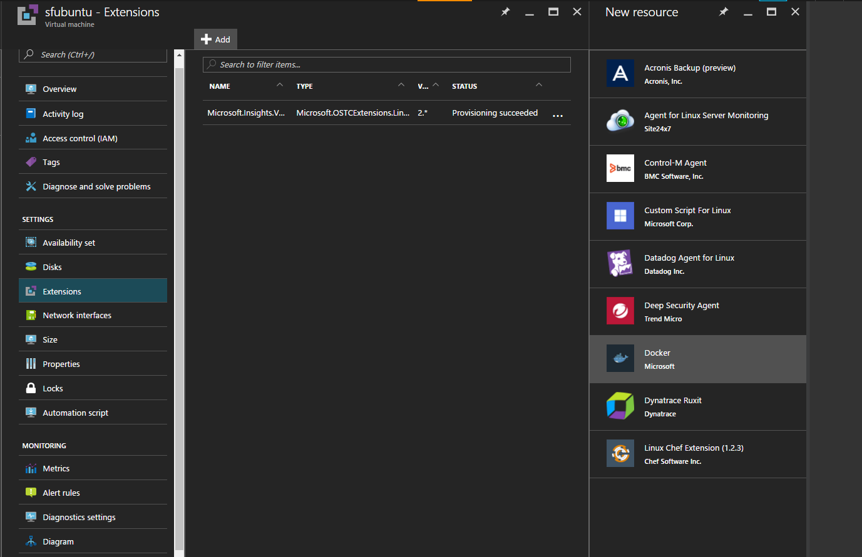
VM Extension

Slide 33
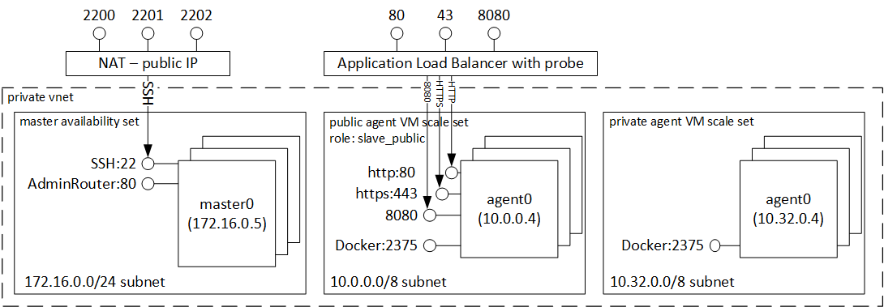
ACS with DC/OS Architecture
Notes:
https://azure.microsoft.com/en-us/documentation/articles/container-service-intro/

Slide 34
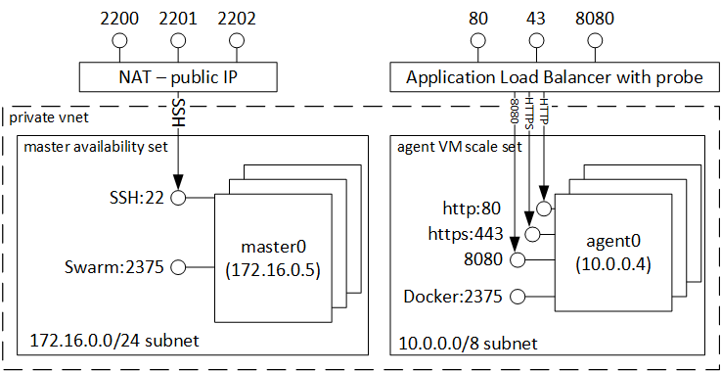
ACS with Docker Swarm Architecture
Notes:
https://azure.microsoft.com/en-us/documentation/articles/container-service-intro/

Slide 35
Challenges with containers
More services mean more network traffic and requires more timeout/retry logic
Difficult to test applications in isolation without dependent services
Hard to monitor across services
Difficult in the short term, beneficial in the long term
Notes:
Service A depends on Services B & C. Can be difficult to debug locally for developers.

