Slide 1
DMA Solution: Moving Data from PL 2 PS
September 2021
Hussam Abdellatif, PhD Candidate
Ultrabroadband Nanonetworking Laboratory
Institute for the Wireless Internet of Things & SMART Center
Northeastern University
www.unlab.tech

Slide 2
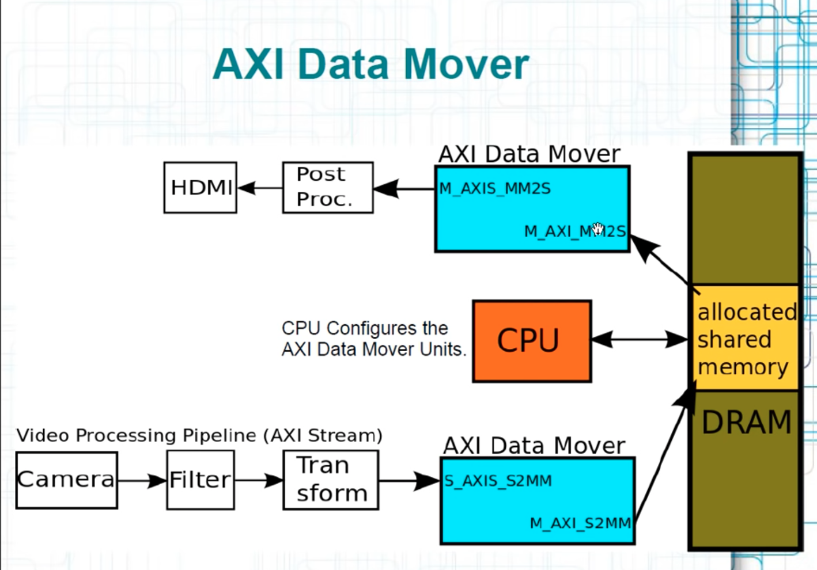
AXI - STREAM
Not Memory Mapped.
For AXI Stream there must be a module to allow for data to be transferred from PL to Memory {DRAM} to CPU
AXI Data Mover responsible of integrating/interfacing stream to MM {S2MM}
Configured by Host CPU
Interrupts when transfer task is done
Customized Versions
AXI Central DMA Engine
AXI Video DMA

Slide 3
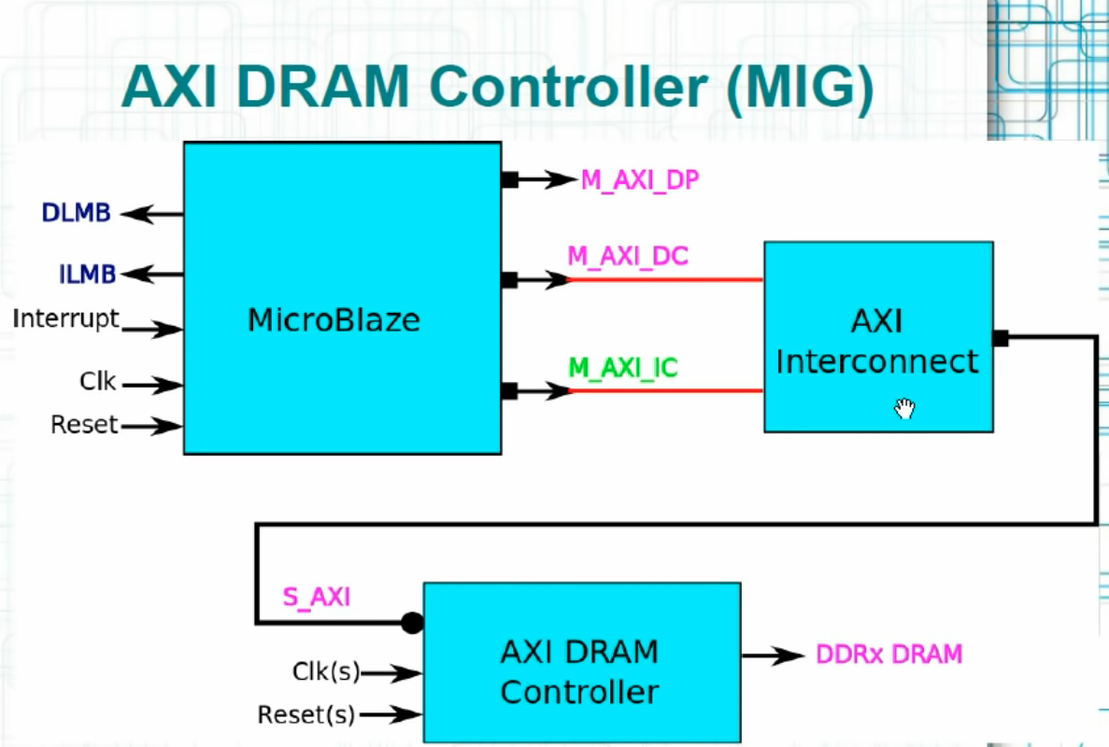
DRAM Controller
AXI DRAM Controller
It is outside the FPGA, used when ”big” chunk of data is needed to be transferred
MIG – Memory Interface Generator {Talks to the DRAM Component}

Slide 4
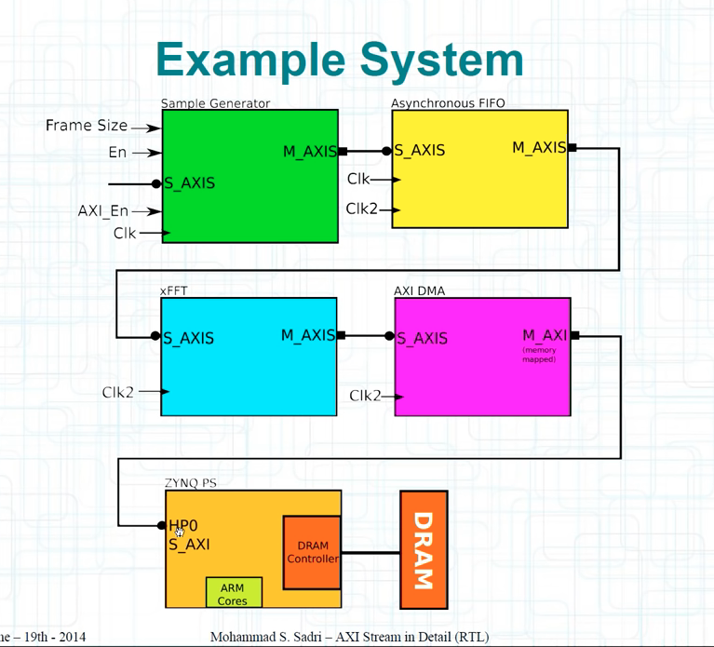
Important Components
CDMA
AXI Interconnect
BRAM Controller {Gives aXI interface to BRAM}
Block Memory Generator
AXI UART { Not really important for us}
AXI Timer { Not sure if we will need this}
Don’t forget to define the mem addresses in Add. Editor
Data –generator -> Asynchronus FIFO -> DMA -> AXI Interconnect [If PS is AXI-X and PL is AXI-Y] -> PS[ DRAM Controller]->DRAM
FIFO used to compact the fact that PL and PS might not be running under the same clock
ARM Core then can access the data on the DRAM
DMA Will put data in the DRAM

Slide 5
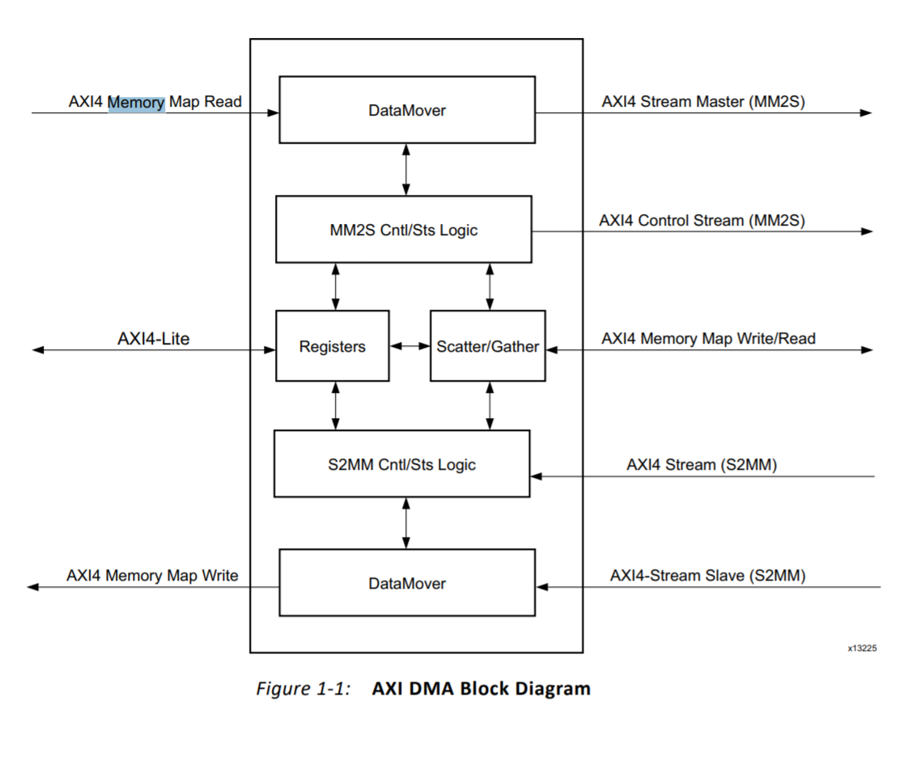

Slide 6
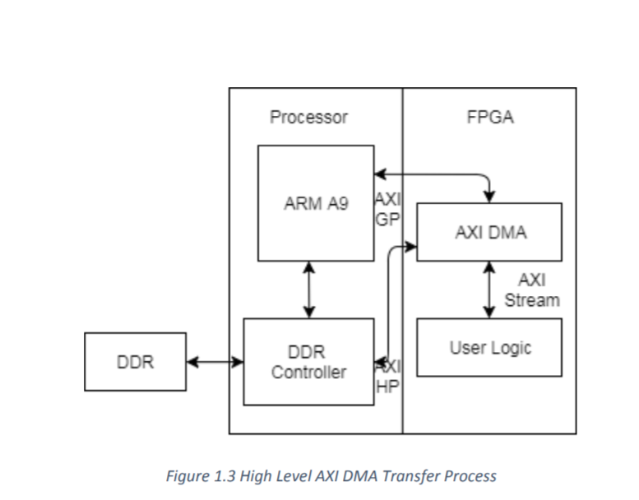
AXI Stream Interface
AXI DMA collects data from user logic and transfers to DDR memory as per instructions given by processor ARM A9
In this, high speed data transfer between memory devices and streaming device is done via AXI4 Read Master Port to AXI4 Memory-Mapped to Stream (MM2S) Master Port,
and AXI Stream to Memory-Mapped (S2MM) Slave Port to AXI4 Write Master Port
S_axi_lite is AXI4-Lite interface signal through which processor is configuring AXI DMA.
M_axi_s2mm_ is memory map write interface signal. S2mm_prmry_reset_out_n and s_axis_s2mm_ are slave stream connection signals. S2mm_sts_reset_out_n and s_axis_s2mm_sts are slave status stream connection signals. M_axis_sg_ and M_axi_sg are scatter gather memory map connection signals for read and write operations respectively

Slide 7
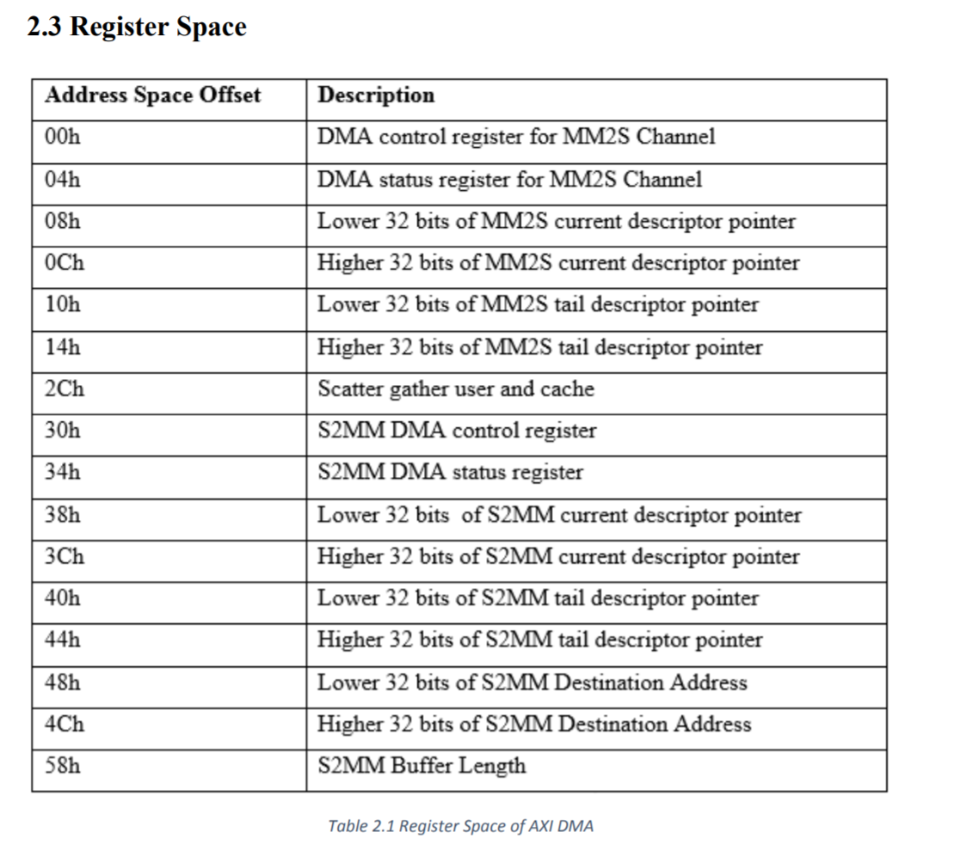

Slide 8
AXI Stream [ARM]
AXI Lite, AXI Full, and AXI Stream.
AXI Lite: light-weight, low throughput Memory Mapped Communication [MM].
AXI: HP MM
AXI-Stream: HP Streaming Data
First, what is a burst?
Multiple data transfers / request. Ex. Master gives write address 0x0000 to slave. Assume each block of data is 32bits wide {Burst Size}. Let burst length be 4. Then Slave will write to 0x0000, 0x0020, 0x0040, and 0x0060. As you can see, burst size is defined, such that Master does not need to provide more than one address.
This Burst type is called INCR [Incremental].
There also exists WRAP, and Fixed {same address for every transfer in the burst}
AXI-Full allows for up to 256 data transfer cycles w/ single address. ARLEN[7:0] for read, AWLEN[7:0] for write.
This burst will be the main differentiator between the AXI Interfaces.
AXI Lite is a single transaction (AW/AR LEN = 1), AXI-FULL allows for up to 256 MM DT, AXI STREAM (no address) allows for unlimited data burst size.

Slide 9
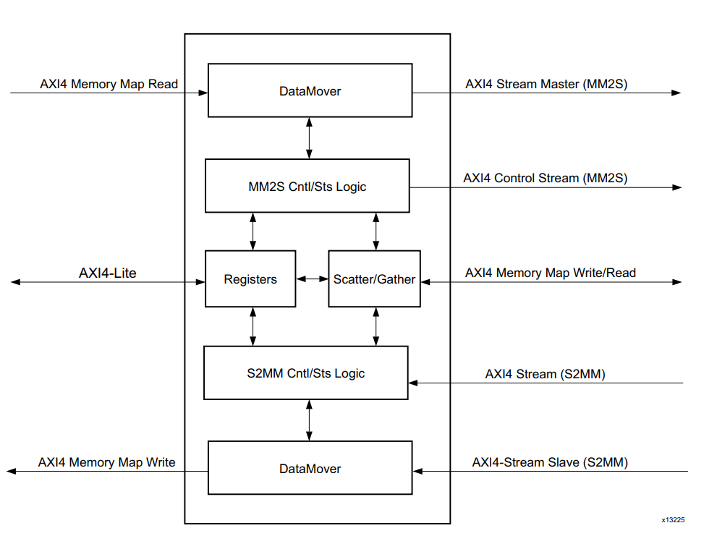
DMA
Direct Memory Access
High BW Memory access between memory and AXI4-Stream Target Peripherals
What Memory?
Any memory! PL or PS side, SoC or outside SoC.
Scatter/Gather?
Just a functionality such that CPU does not need to program DMA engine every transaction [other words gives performance boost, and low CPU utilization]
Data Width Support 32, 64, 128, 256, 512, and 1024 bits [similar in stream w/ addition to 8&16]
S2MM Channel Throughput: 298.59MB/s during a 10,000 Bytes Data Transfer, and a 100 MHz Clock.
All registers are in Little Endian Format [31 … 0] (This is important when writing the driver for the DMA and programming it).
Two Modes: Scatter Gather, and Direct Register Mode. For now, lets ignore Scatter Gather

Slide 10
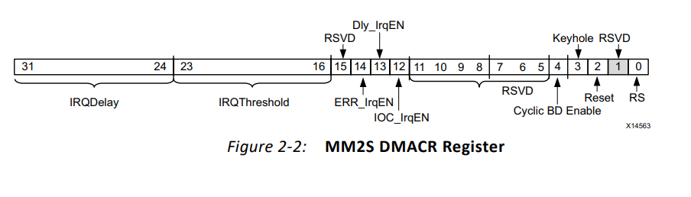
DMA – Register Space
MM2S_DMACR (+0x00) MM2S DMA Control Reg
MM2S_DMASR (0x04) MM2S DMA Status Reg
0x08h → 0x14 {RESERVED}
MM2S_SA (+0x18) MM2S Source Address. Lower 32 bit of address
MM2S_SA_MSB (+0x1C) MM2S Source Address. Upper 32 bits
MM2S_LENGTH (+0x28) MM2S Transfer Length (Bytes)
S2MM_DMACR (+0x30) S2MM DMA Control Reg
S2MM_DMASR (0X34) S2MM DMA Status Reg
0x38h → 0x44 {RESERVED}
S2MM_SA (+0x48) S2MM Source Address. Lower 32 bit of address
S2MM_SA_MSB (+0x4C) S2MM Source Address. Upper 32 bits
S2MM_LENGTH (+0x58) S2MM Transfer Length (Bytes)

Slide 11
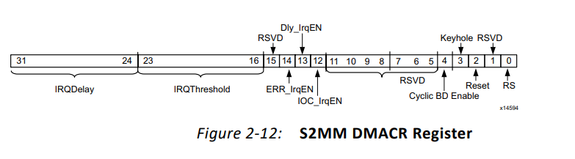
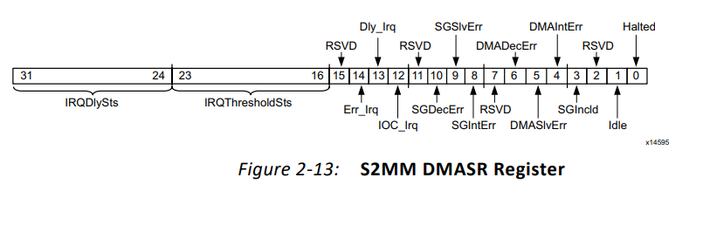
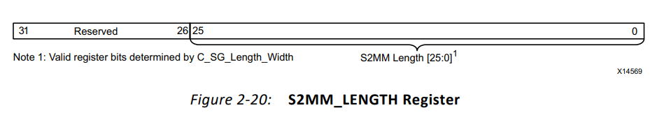
DMA – S2MM [PL → PS]
S2MM_DMACR (S2MM DMA Control Register – Offset 30h)
[0]: bring high to start DMA ops (halt in DMA-SR deasserts to 0 when DMA begins ops)
S2MM_DMASR (S2MM DMA Status Register – Offset 34h)
[12]: bring high to throw an interrupt event when transfer is complete. Otherwise CPU wont know when exactly the task is compelted.
S2MM_LENGTH (S2MM DMA Buffer Length Register – Offset 58h)
2^25 = ~33MB

Slide 12
Clocking & Reset
There are four clock inputs:
m_axi_mm2s_aclk
m_axi_s2mm_aclk
s_axi_lite_aclk
m_axi_sg_clk [scatter/gather]
Two clocking modes: asynchronous (more flexibility for HP users to run data @ higher clock rate) and synchronous
axi_resetn signal needs to be asserted a minimum of 16 of the slowest clock cycles and need to be synchronized to s_axi_lite_aclk.

Slide 13
DMA Operation for the S2MM Channel
Start the S2MM channel running by setting the run/stop bit to 1. The halted bit should dessert indicating the S2MM channel is ready.
iowrite32 ( 0x4 , lp->base_addr + 0x30); // rest is bit 3 and 0x4 -> 100 (shouldn’t we bring down the reset to low after?
tmpVal = ioread32 ( lp->base_addr + 0x30); //reads 32 bits from 0x30 offset into tmpVal
tmpVal = tmpVal | 0x1001; // set bit 0 to high (RUN), and bit 12 to high (IOC_IrqEN) to generate an interrupt on complete
iowrite32 ( tmpVal, lp->base_addr + 0x30); // write value. DMA will read this and act accordingly
Write a valid destination address to the S2MM_DA register.
iowrite32(0, lp->base_addr + 0x4C); //Set S2MM_DA_MSB to zeros (its zeros by default) s.t. to indicate you are using only 32 bit //address. Alternativelly, if you want to use 64 bit address, then iowrite32(upper_32_bit_adderress, lp->base_addr + 0x4C);
iowrite32(lp->dma_buffer_physical_address_s2mm[0], lp->base_addr+0x48); // write destination address that was assigned for the DMA by CPU
iowrite32(4MB, lp->base_addr+0x58); // write length of buffer in bytes to S2MM_Length
If AXI DMA is not configured for Data Re-Alignment then a valid address must be aligned or undefined results occur. What is considered aligned or unaligned is based on the stream data width.

Slide 14
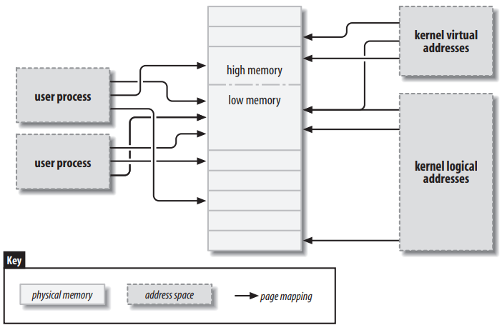
More on DMA from our favorite Book Linux Device Drivers [3rd Edition – Corbet]
Highly recommend reading chapter 15 to learn about Linux memory mapping
When implementing the PCIe platform, a good understanding of memory will come in handy. Retrieving and putting data into memory is not as simple as *ptr = 3 ☺ ;
First, lets look into the data-structures used by the kernel to manage memory.
So we all know that Linux is a virtual memory system
Meaning, addresses seen by user program don’t directly correspond to the physical addresses used by the hardware. [its not a one-to-one mapping]
The linux system deals w/ several types of addresses, each w/ its own semantics
User Virtual Address
Physical Address
Bus Address: The addresses used between peripheral buses and memory. Sometimes theses addresses are the same as a physical address. An implementation of an IOMMU allows to remap addresses between a bus and main memory <scattered memory can appear contiguous to the device>
Kernel Logical Address: Address Space of the kernel. KLA = Physical_Address + offset. Type unsigned long* or void*. Memory returned from kmalloc has a kernel logical address
Kernel Virtual Address: Similar to KLA but does not necessarily have the one-to-one mapping that KLA has. Return vmalloc
Malloc, vmalloc, and kmalloc:
VMALLOC() allocates memory that is only virtually contiguous and not necessarily physical contiguous, malloc() returns memory that is contiguous within the virtual address space of the processor , and kmalloc() guarantees that memory is physically contiguous.

Slide 15
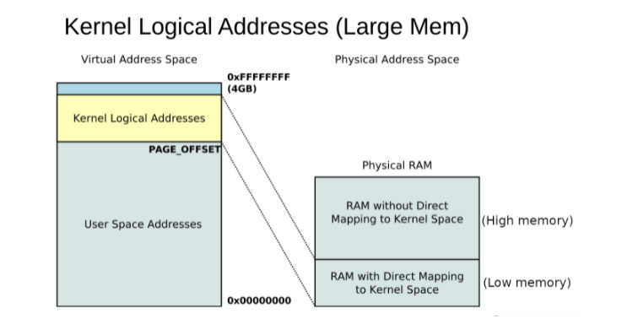
Physical Addresses and Pages , High and Low Memory
Physical Addresses & Pages
Physical Memory is divided into discrete units called pages
Page size varies from one architecture to the next, but most systems use a 4096-byte pages. The constant PAGE_SIZE in asm/page.h gives the page size in the arch.
Virtual or physical mem addr is divisible into a page number and an offset within the page.
If 4096-byte pages are used, the 12 least significant bits are the offset, and upper bits indicate the page number
page_address >> 12 = (page_address / 2^12) = (page_address / 4096) = base_address + (offset=page_number)
If you discard the offset and shift the rest of an offset to the right, the result is called a page frame number (PFN)
The macro PAGE_SHIFT tells how many bits must be shifted to make this conversion
High & Low Memory (ONLY APPLICABLE TO 32 BIT ARCH)
W/ 32-bit system , it is possible to address 4GB of memory {2^32}
The kernel (on x86 arch, in default config) splits the 4-GB virtual address space between user-space and the kernel
A typical split, dedicates 3GB to user space and 1GB for kernel space.
The lowest portion of memory (up to 1 or 2 GB) has logical address the rest (high memory) does not.
Before accessing high memory page, the kernel must set up an explicit virtual mapping to make that page available in the kernels address space.
Many kernel data structures must be place in low-memory, high memory tends to be reserved for user-space process pages (accessing user-space page from kernel)

Slide 16
The Memory Map Structure
The MM <linux/mm.h> Data structure is used to keep track of just about everything the kernel needs to know about physical memory.
There is one struct page for each physical page on the system
Some of the fields in the struct include:
atomic_t count: The # of references there are to this page
Void *virtual: the kernel virtual address of the page (if its mapped, NULL otherwise). Low Mem is usually mapped, high mem is usually not
unsigned long flags : A set of bit flags describing the status of the page

Slide 17
Virtual Memory Areas
The VMA is the kernel data structure used to manage distinct regions of a process’s address space.
A VMA represents a homogenous region in the virtual memory of a process: a contiguous range of virtual addresses that have the same permission flags and are backed by the same object ( a file for example)
The memory map of a process is made up of atleast the following:
An area for the program’s executable code (often called text)
Multiple areas for data, and the program stack
One area for each active memory mapping
When a user space process calls mmap to map device memory into its address space, the system responds by creating a new VMA to represent that mapping.
A driver that supports mmap (implements the mmap functionality) needs to help that process by completing the initialization of that VMA

Slide 18
Virtual Memory Areas (con’t)
Important fields in struct vm_area_struct (defined in <linux/mm.h>)
These fields are often used in device drivers mmap implementation
Fields:
unsigned long vm_start; unsigned long vm_end;
The virtual address range covered by this vma.
struct file *vm_file: a pointer to the struct file structure associated w/ this area if any
unsigned long vm_pgoff : The offset of the area in the file, in pages. When a file or device is mapped, this is the file position of the first page mapped in this area
unsigned long vm_flags: A set of flags describing this area. VM_IO and VM_RESERVED.
VM_IO marks a VMA as being a memory-mapped I/O region
VM_RESERVED tells the memory management system not to attempt to swap out this VMA
struct vm_operations_struct *vm_ops: A set of functions that the kernel may invoke to operate on this memory area. Its presence indicates that the memory area is a kernel “object” … defined in <linux/mm.h>
void *vm_private_data: a field that may be used by the driver to store its own information

Slide 19
vm_operations_struct ops
void (*open)(struct vm_area_struct *vma);
The open method is called by the kernel to allow the subsystem implementing the VMA to initialize the area. This method is invoked any time a new reference to the VMA is made (when a process forks, for example). The one exception happens when the VMA is first created by mmap; in this case the driver’s mmap method is called instead
void (*close)(struct vm_area_struct *vma);
When an area is destroyed, the kernel calls its close operation. The area is opened and closed exactly once by each process using it
struct page *(*nopage)(struct vm_area_struct *vma, unsigned long address, int *type);
When a process tries to access a page that belongs to a valid VMA, but that is currently not in memory, the nopage method is called (if its defined) for the related area

Slide 20
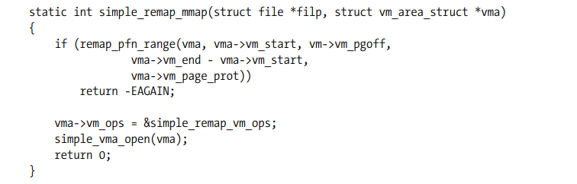
The mmap Device Operation
Memory mapping can be implemented to provide user programs w/ direct access to the device memory
The mmap method is part of the file_operations structure and is invoked when the mmap system call is issued.
The system call (described in the mmap(2) manual page)
mmap (caddr_t addr, size_t len, int prot, int flags, int fd, off_t offset)
The file op is declared as
int (*mmap) (struct file *filp , struct vm_area_struct *vma);
To implement mmap, the driver only has to build suitable page tables for the address range and, if necessary, replace vma->vm_ops with a new set of operations.
There are two ways of building the page tables: doing it all at once with a function called remap_pfn_range or doing it a page at a time via the nopage VMA method
The job of building new page tables to map a range of physical addresses is handled by remap_pfn_range and io_remap_page_range, which have the following prototypes:
int remap_pfn_range(struct vm_area_struct *vma, unsigned long virt_addr, unsigned long pfn, unsigned long size, pgprot_t prot);
int io_remap_page_range(struct vm_area_struct *vma, unsigned long virt_addr, unsigned long phys_addr, unsigned long size, pgprot_t prot);
The first (remap_pfn_range) is intended for situations where pfn refers to actual system RAM, while io_remap_page_range should be used when phys_addr points to I/O memory. I

Slide 21
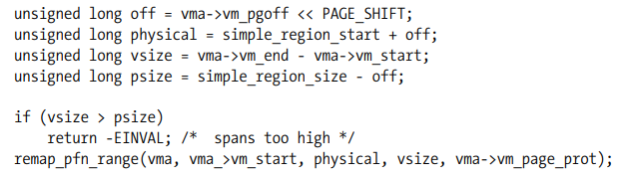
Remapping Specific IO Regions
The typical driver, however, wants to map only the small address range that applies to its peripheral device, not all memory.
In order to map to user space only a subset of the whole memory range, the driver needs only to play with the offsets.
The following does the trick for a driver mapping a region of simple_region_size bytes, beginning at physical address simple_region_start (which should be page-aligned):

Slide 22
https://linux-kernel-labs.github.io/refs/heads/master/labs/memory_mapping.html
Overview:
In linux, it is possible to map a kernel address space to a user address space. This eliminates the overhead of copying user space information into the kernel and vice versa.
This can be done via a device driver
This feature is done by implementing the mmap() op in the device driver, and calling mmap sys call in user space.
The mmap system call:
void *mmap(caddr_t addr, size_t len, int prot,int flags, int fd, off_t offset);
The mmap ops signature:
int (*mmap)(struct file *filp, struct vm_area_struct *vma);
filp: pointer to a struct file
vma field is used to indicate the virtual address space where the mem should be mapped by the device
A driver should allocate mem (using kmalloc(), vmalloc(), alloc_pages()) and then map it to the user address space using helper functions such as remap_pfn_range()
remap_pfn_range() will map a contiguous physical address space into the virtual space represented by vm_area_struct:
int remap_pfn_range (structure vm_area_struct *vma, unsigned long addr, unsigned long pfn, unsigned long size, pgprot_t prot);
addr - the virtual address space from where remapping begins; page tables for the virtual address space between addr and addr + size will be formed as needed
pfn - the page frame number to which the virtual address should be mapped
size - the size (in bytes) of the memory to be mapped
prot - protection flags for this mapping

Slide 23
Our Driver Implementation
Definitions:
driver_dma_size_of_one_buffer: size of one transfer (max val == 4MB)
Originally (4*1024*1024), changed to 4*1024 = 4KB
number_of_buffers_s2mm: total number of buffers we allocate from DRAM to S2MM channel
1 Buffer is enough:
Alternatively, you can do 1024 buffers of 4KB each = 4MB in total but are non-contigous
total_blocks_to_s2mm: total number of blocks to transfer in each s2mm transfer task
Each Memory Buffer is divided to a several memory blocks. The size of one memory block is equal * to size of one DMA data transfer.

Slide 24
Understanding DMA Terminology
Block Size
Number of Blocks
# of Buffers
S2MM ptr
One important thing from Xilinx Doc Sheet “The S2MM_LENGTH register must be written last. All other S2MM registers can be written in any order” …. Once S2MM_LENGTH is written, DMA is good to go and will begin the transactions. PS has no control anymore until the next interrupt.

Slide 25
Step 1 - Define the Mem
User Space: “Hey IOCTL, I want to allocate some memory for my DMA transactions. I need 3 Buffers, and each buffer being of size 10kB. I want my block size to be the size of my buffer (i.e. 10kB as well). This means, w/ every DMA transaction, the DMA will be able to place 10kB of data at a time until interrupt is handled.
Kernel Space: “Hey dma_alloc_coherent(…), allocate me 3 non-contiguous or contiguous (don’t care) of buffer_size (10kB) of contiguous memory.
dma_alloc_coherent(…) ->
0x04C
0xF12
0xF12

Slide 26
Step 1 - Define the Mem
User Space: “Hey IOCTL, I want to allocate some memory for my DMA transactions. I need 3 Buffers, and each buffer being of size 10kB. I want my block size to be the size of my buffer (i.e. 10kB as well). This means, w/ every DMA transaction, the DMA will be able to place 10kB of data at a time until interrupt is handled.
User Space: “Hey interrupt handler, I want you to handle interrupts z # of times before stopping the DMA. Z here is number of blocks. Let Z = 2. So DMA will write 10kB throw an interrupt, interrupt handler will reset the DMA, then DMA will write another 10kB (Z=2) and throw an interrupt, this time the interrupt handler will not reset the DMA and no more write transactions will happen (Z=2).

Slide 27
AXI Stream [ARM]
AXI Lite, AXI Full, and AXI Stream.
AXI Lite: light-weight, low throughput Memory Mapped Communication [MM].
AXI: HP MM
AXI-Stream: HP Streaming Data
First, what is a burst?
Multiple data transfers / request. Ex. Master gives write address 0x0000 to slave. Assume each block of data is 32bits wide {Burst Size}. Let burst length be 4. Then Slave will write to 0x0000, 0x0020, 0x0040, and 0x0060. As you can see, burst size is defined, such that Master does not need to provide more than one address.
This Burst type is called INCR [Incremental].
There also exists WRAP, and Fixed {same address for every transfer in the burst}
AXI-Full allows for up to 256 data transfer cycles w/ single address. ARLEN[7:0] for read, AWLEN[7:0] for write.
This burst will be the main differentiator between the AXI Interfaces.
AXI Lite is a single transaction (AW/AR LEN = 1), AXI-FULL allows for up to 256 MM DT, AXI STREAM (no address) allows for unlimited data burst size.

Slide 28
Data Out {S2MM}
SoC
ARM PS
User Space
Application Code
mmap
FPGA
DMA Driver
Kernel
DSP Engine
AXI Stream
DMA
AXI-Lite Driver
Buffer
M_AXIS
M_AXIS_S2mm
AXI Stream Protocol
Valid
STRB
Data
En
Last
Ready
DRAM
AXI Lite
AXI Lite

Slide 29
