Slide 1
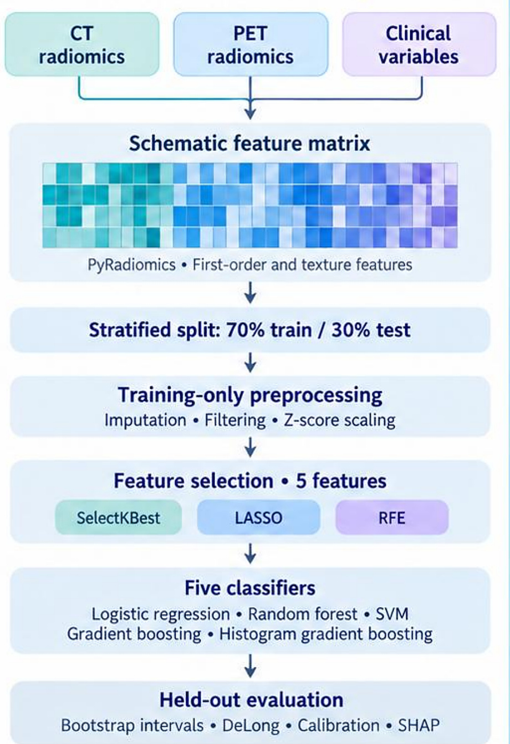
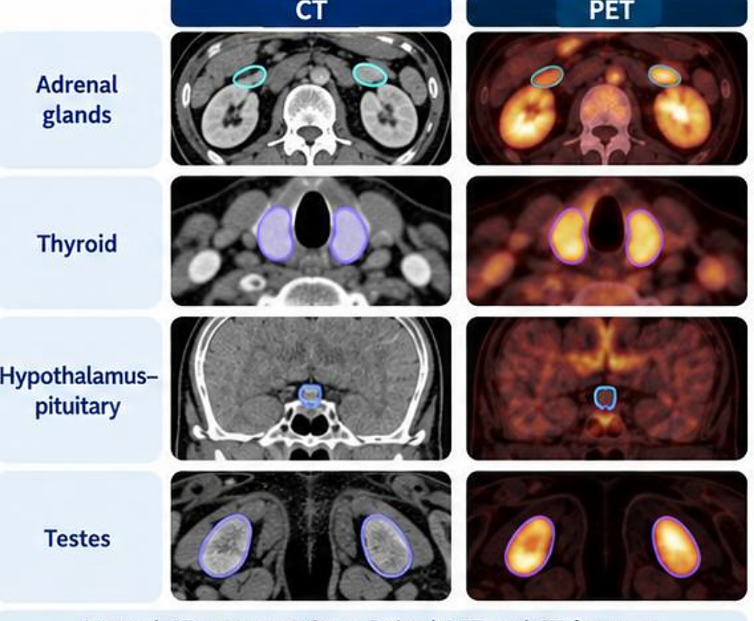
RADIOMICS · SYSTEMIC PHENOTYPING
Endocrine-organ PET/CT radiomics
Results
Test AUC (held-out 30%)
Model | AUC
Clinical only | 0.727
CT + clinical | 0.729
PET + clinical | 0.733
CT + PET + clinical | 0.758
95% CI (best) | 0.653–0.849
ΔAUC vs clinical | 0.031
DeLong p | 0.569
Endocrine organs on PET/CT
CT + PET + clinical fusion model
Retrospective, single centre
Systemic imaging signatures beyond visible lesions
Abdollahi et al., Cancers (2026) 18:1767
1
Notes:
Here we asked whether normal endocrine organs carry signals about disease progression — systemic imaging signatures beyond visible tumour lesions.
Cohort: 101 men with biochemical recurrence after prostatectomy and a negative baseline [18F]DCFPyL PET/CT. 67 developed clinical progression (new lesions on follow-up imaging) and 34 stayed progression-free. We drew regions of interest on normal endocrine organs: adrenal glands, thyroid, hypothalamus–pituitary and testes, with manual CT segmentation and paired PET and CT features. Only baseline predictors were used; post-imaging treatment variables were excluded.
Modeling: CT radiomics, PET radiomics and clinical variables; PyRadiomics first-order and texture features; a stratified 70% train / 30% test split; training-only preprocessing (imputation, filtering, z-score scaling); feature selection to 5 features with SelectKBest, LASSO or RFE; five classifiers (logistic regression, random forest, SVM, gradient boosting, histogram gradient boosting); held-out evaluation with bootstrap intervals, DeLong test, calibration and SHAP.
Results: the best fusion model was testis CT + PET + clinical with RFE and gradient boosting, AUC 0.758 (95% CI 0.653–0.849). Best per category: clinical only 0.727, CT + clinical 0.729, PET + clinical 0.733, CT + PET + clinical 0.758. The incremental gain was ΔAUC 0.031, DeLong p = 0.569 — not a significant improvement over clinical-only.
Interpretation: complementary, modest predictive value; biological mechanisms remain exploratory. Retrospective single-centre cohort, no external validation.

Slide 2
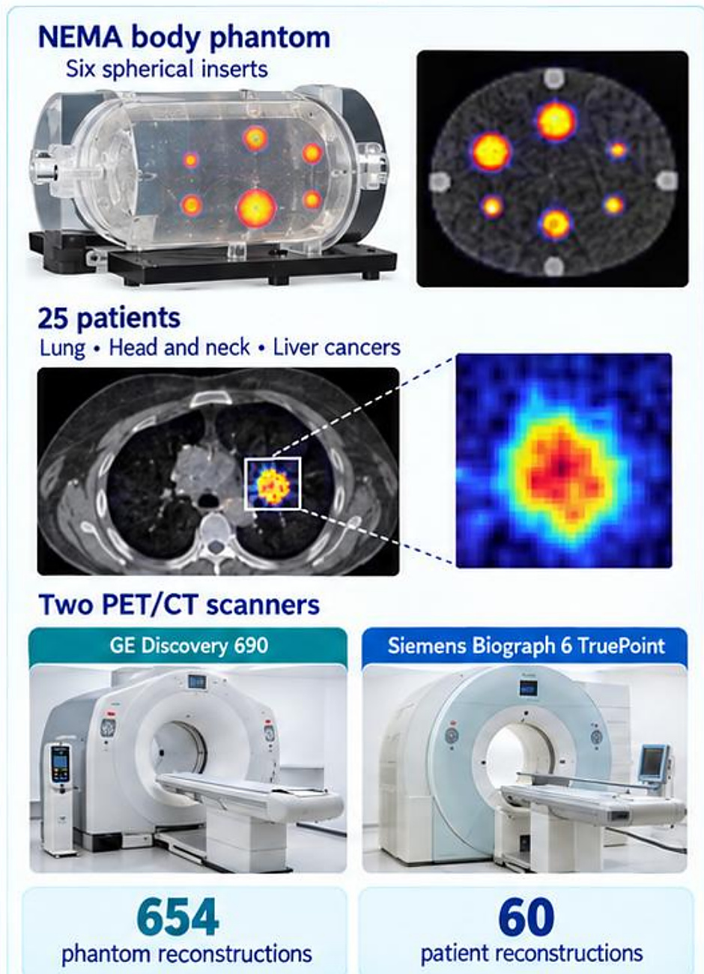
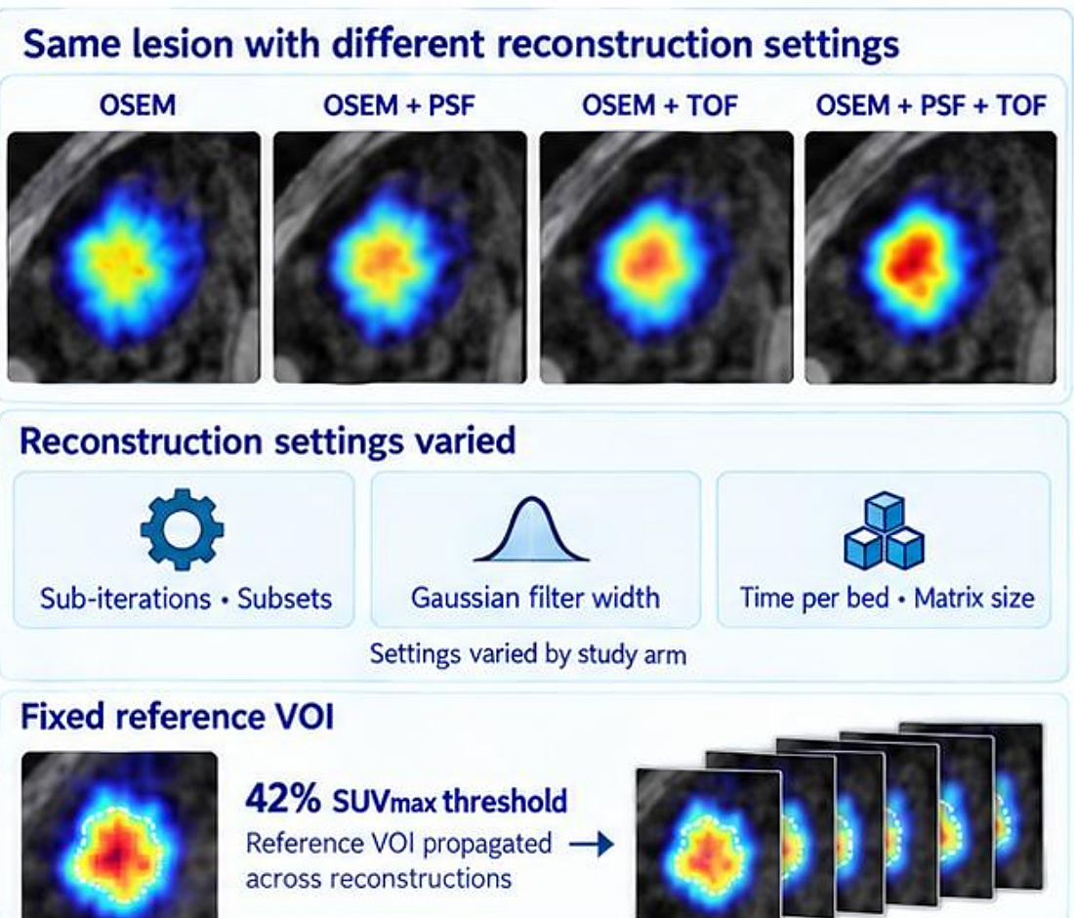
RADIOMICS · ROBUSTNESS
PET reconstruction changes radiomic features
Results
Feature variability (COV)
Measure | Features
COV ≤5% (robust) | 47%
COV >20% (unstable) | 10%
Geometry, COV ≤5% | 100%
Intensity, COV ≤5% | 44%
Texture, COV ≤5% | 41%
Matrix size, COV >20% | 56%
Matrix size, COV ≤5% | 6%
Phantom + patients, 2 scanners
Same lesion, many reconstructions
654 phantom + 60 patient reconstructions
Standardize reconstruction before using radiomics
Shiri et al., Eur Radiol 2017
2
Notes:
Before trusting radiomic features we need to know how robust they are. This study measured the effect of PET reconstruction settings.
Study design: phantom and patient studies. A NEMA body phantom with six spherical inserts, and 25 patients with lung, head and neck and liver cancers. Two PET/CT scanners: GE Discovery 690 and Siemens Biograph 6 TruePoint. In total 654 phantom reconstructions and 60 patient reconstructions.
Reconstruction and analysis: the same lesion reconstructed with OSEM, OSEM + PSF, OSEM + TOF and OSEM + PSF + TOF. Settings varied by study arm: sub-iterations and subsets, Gaussian filter width, time per bed position and matrix size. A fixed reference VOI (42% SUVmax threshold) was propagated across reconstructions. 100 radiomic features (intensity, geometry, texture); variability assessed by the coefficient of variation, COV = SD / mean × 100%, binned as ≤5%, >5–10%, >10–20% and >20%.
Findings: 47% of features had COV ≤5% and 10% had COV >20%. By family, COV ≤5% for geometry 100%, intensity 44%, texture 41% (geometry results reflect the fixed-VOI design). Matrix size, analysed separately, had the largest impact: 56% of features with COV >20% and only 6% with COV ≤5%.
Message: robustness is feature- and setting-dependent. Standardize reconstruction and voxel sampling, and select features validated for the intended protocol.

Slide 3
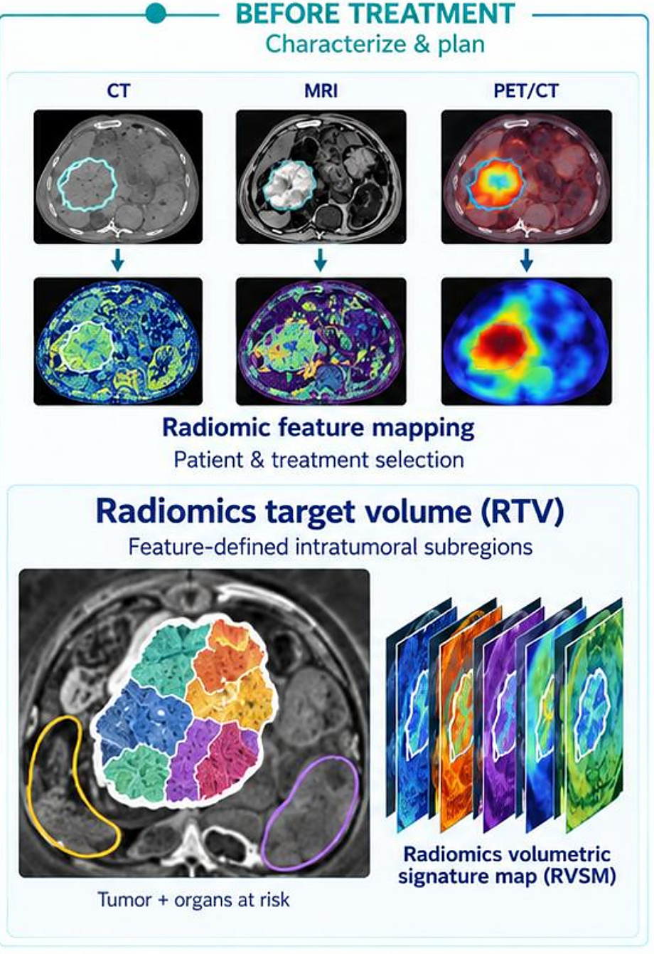
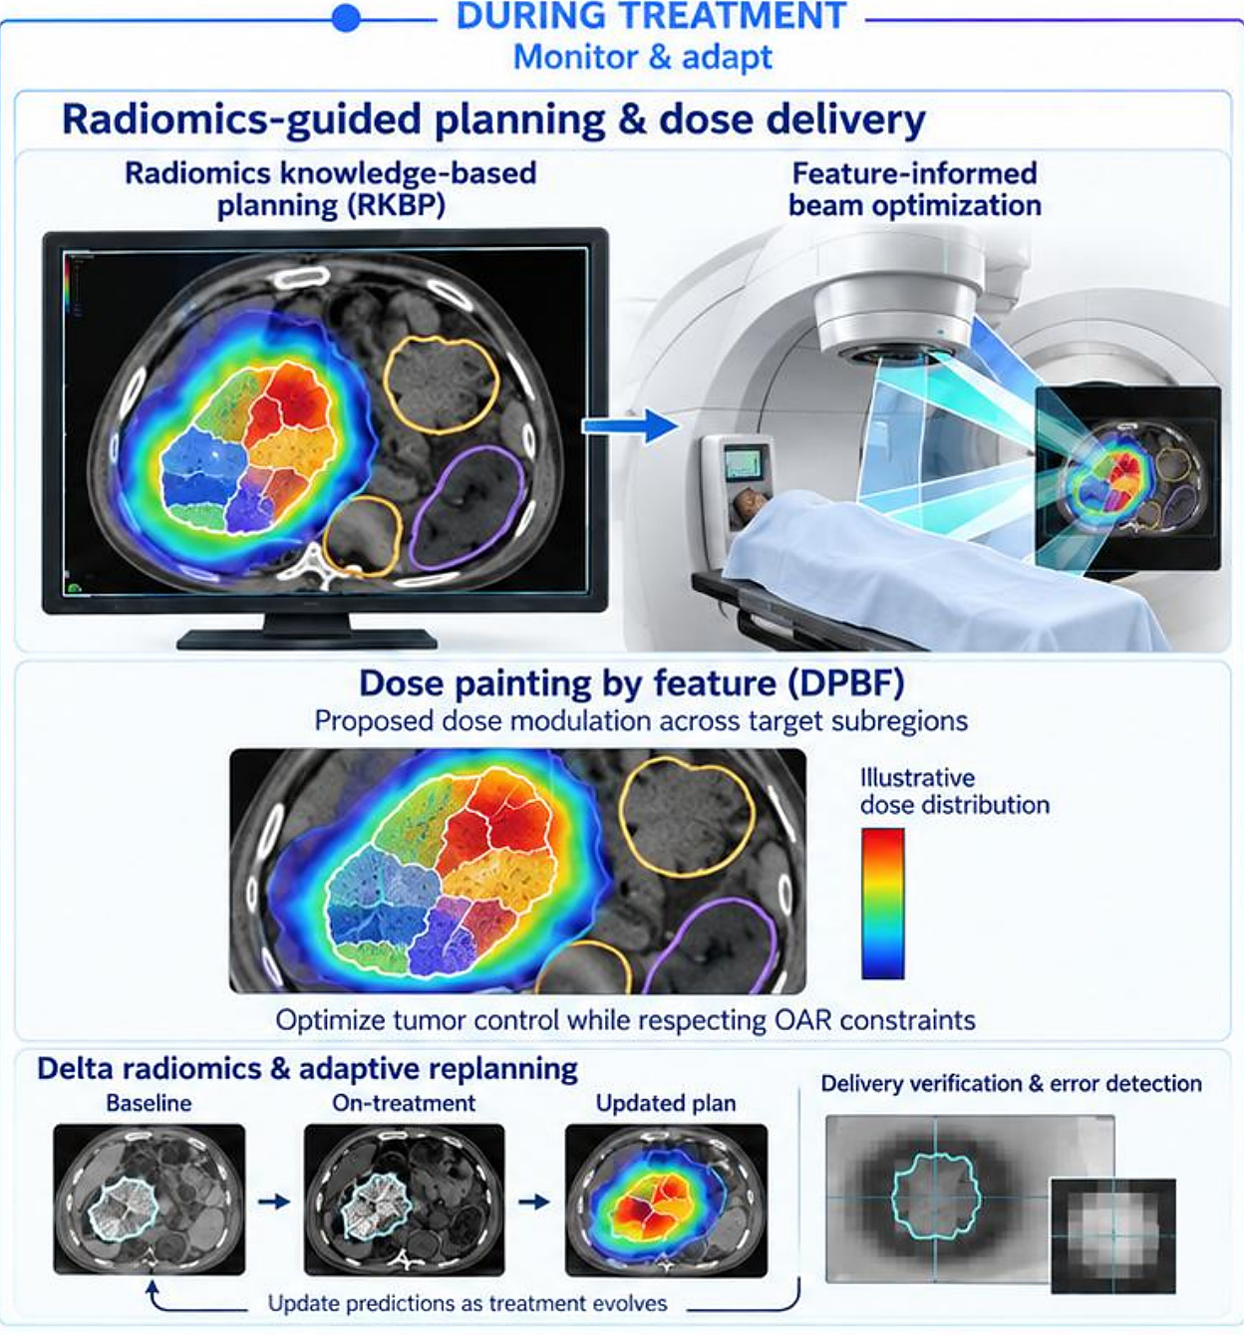
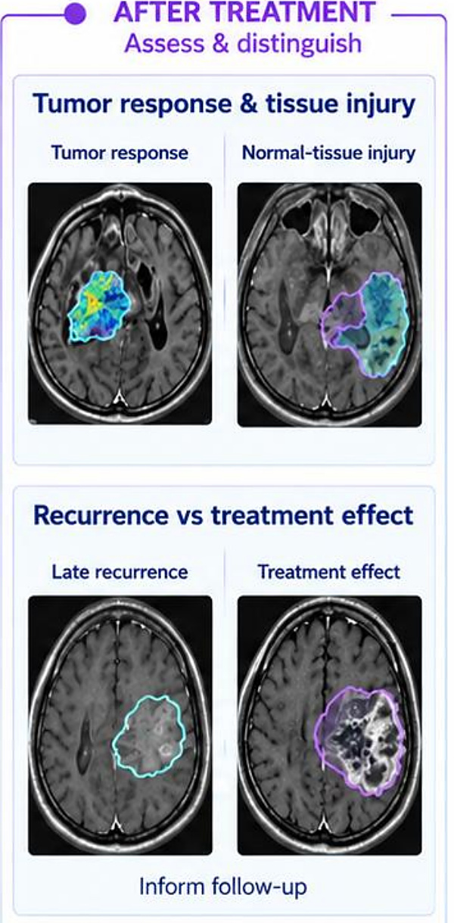
RADIOMICS-GUIDED RADIATION THERAPY
Radiomics across the radiotherapy timeline
Before: characterize and plan
During: monitor and adapt
After: assess response
From feature maps to dose painting and adaptive replanning
Abdollahi et al., Phys Med Biol 2022;67:12TR02
3
Notes:
Radiomics-guided radiation therapy (RGRT) uses radiomics at every stage of radiotherapy.
Before treatment — characterize and plan: radiomic feature mapping of CT, MRI and PET/CT for patient and treatment selection; a radiomics target volume (RTV) made of feature-defined intratumoral subregions; and a radiomics volumetric signature map (RVSM) of the tumour and organs at risk.
During treatment — monitor and adapt: radiomics knowledge-based planning (RKBP) and feature-informed beam optimization; dose painting by feature (DPBF), a proposed dose modulation across target subregions that optimizes tumour control while respecting OAR constraints; delta radiomics and adaptive replanning (baseline → on-treatment → updated plan, updating predictions as treatment evolves); and delivery verification and error detection.
After treatment — assess and distinguish: tumour response versus normal-tissue injury, and late recurrence versus treatment effect, to inform follow-up.
Inputs are longitudinal imaging, radiomic features, clinical data and dosimetry. These are conceptual research applications that require biological and prospective clinical validation. Adapted from Abdollahi et al. (2022), Radiomics-guided radiation therapy: opportunities and challenges, Phys Med Biol 67, 12TR02 (CC BY 4.0).

Slide 4
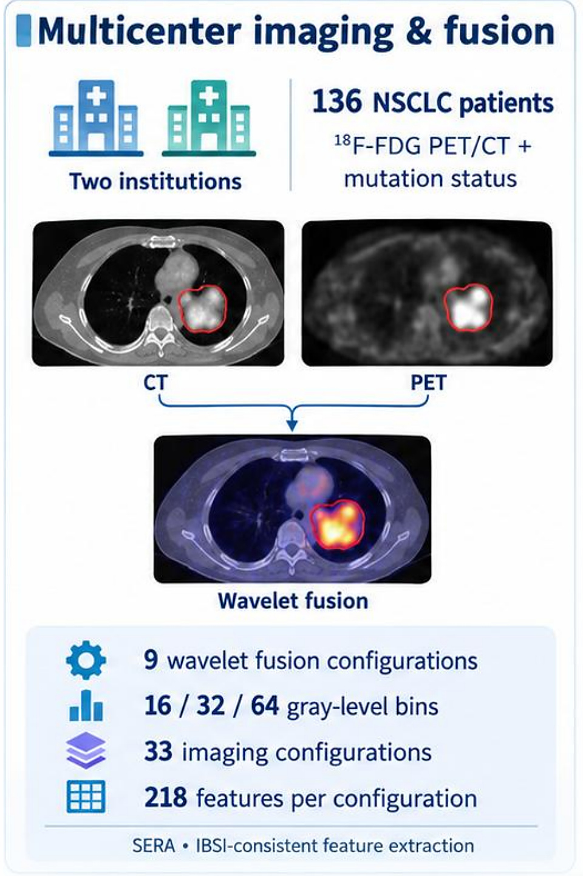
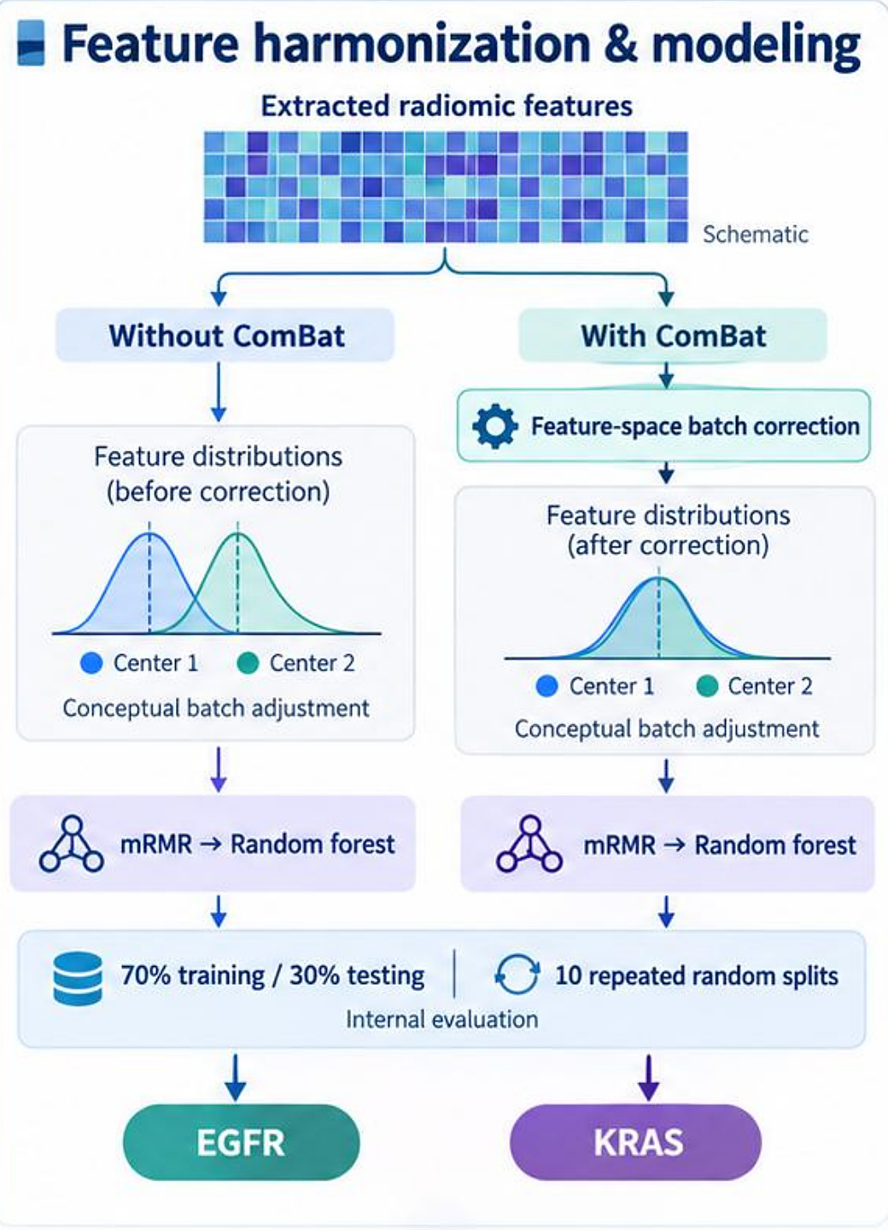
RADIOGENOMICS · MULTICENTRE HARMONIZATION
ComBat harmonization for EGFR and KRAS
Results
Mean model AUC
Gene | Before | After
EGFR | 0.87–0.90 | 0.92–0.94
KRAS | 0.85–0.90 | 0.91–0.94
EGFR, best | — | 0.94
KRAS, best | — | 0.93
136 NSCLC, two centres
Models with and without ComBat
Multivariate improvement q < 0.05
Harmonization makes multicentre radiomics more reliable
Shiri et al., Comput Biol Med 142 (2022) 105230
4
Notes:
Multicentre data bring scanner and protocol differences — “batch effects.” Here we tested ComBat harmonization for predicting EGFR and KRAS mutation status in lung cancer.
Multicentre imaging and fusion: 136 NSCLC patients from two institutions with 18F-FDG PET/CT and mutation status. CT and PET were fused with wavelet fusion: 9 wavelet fusion configurations, 16/32/64 grey-level bins, 33 imaging configurations and 218 features per configuration, extracted with SERA in an IBSI-consistent way.
Feature harmonization and modeling: features were analysed without and with ComBat (feature-space batch correction that aligns the centre 1 and centre 2 distributions). Then mRMR feature selection and a random forest, with 70% training / 30% testing over 10 repeated random splits (internal evaluation).
Results — range of mean model AUCs: EGFR improved from 0.87–0.90 before to 0.92–0.94 after; KRAS from 0.85–0.90 to 0.91–0.94. Multivariate AUC improved across models (q < 0.05). The highlighted harmonized fusion model (R = 0.66, W = 0.75, 64 bins) reached EGFR AUC 0.94 and KRAS AUC 0.93.
Single-feature effects varied: broader improvement for EGFR; most KRAS features showed no significant change. Independent validation remains necessary.

Slide 5
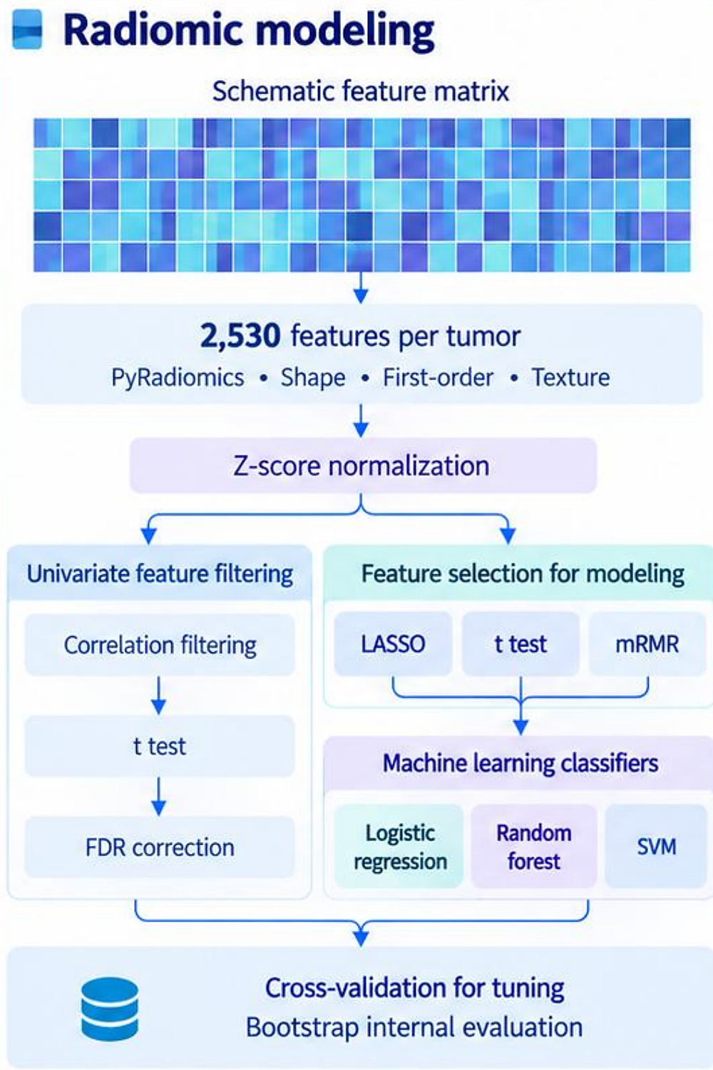
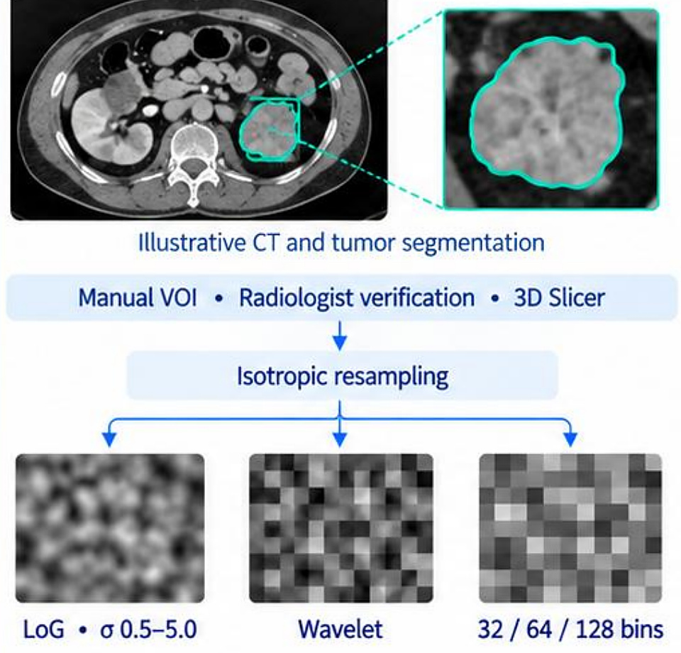
RADIOMICS · TUMOUR GRADING
CT radiomics for Fuhrman grade in ccRCC
Results
AUC by preprocessing
Images | LR | RF | SVM
Original | 0.68 | 0.62 | 0.76
32 bins | 0.73 | 0.56 | 0.70
64 bins | 0.70 | 0.55 | 0.65
128 bins | 0.75 | 0.60 | 0.77
LoG σ 4.5 | 0.62 | 0.62 | 0.83
71 ccRCC CT scans, filtered images
2,530 features → machine learning
4 texture features significant (FDR q < 0.05)
Potential non-invasive preoperative grading
Nazari et al., La Radiologia Medica 2020
5
Notes:
Can CT radiomics predict the Fuhrman nuclear grade of clear-cell renal cell carcinoma before surgery?
CT cohort and preprocessing: 222 TCIA studies were screened, giving 71 ccRCC patients — 31 low grade (I–II) and 40 high grade (III–IV), with Fuhrman grade at nephrectomy. Manual VOI with radiologist verification in 3D Slicer, then isotropic resampling. Images were filtered with LoG (σ 0.5–5.0) and wavelets and discretized at 32, 64 and 128 bins.
Radiomic modeling: 2,530 PyRadiomics features per tumour (shape, first-order, texture), z-score normalization. Two branches: univariate feature filtering (correlation filtering → t-test → FDR correction), and feature selection for modeling (LASSO, t-test, mRMR) feeding machine-learning classifiers (logistic regression, random forest, SVM), with cross-validation for tuning and bootstrap internal evaluation.
Fuhrman grade discrimination (selected AUCs, Table 4 of the paper): Original LR 0.68 / RF 0.62 / SVM 0.76; 32 bins 0.73 / 0.56 / 0.70; 64 bins 0.70 / 0.55 / 0.65; 128 bins 0.75 / 0.60 / 0.77; LoG σ 4.5 0.62 / 0.62 / 0.83. The highest reported AUC was 0.83 with SVM, t-test selection and coarse LoG. Four texture features were significant on 128-bin images (FDR-adjusted q < 0.05): GLRLM, GLCM, NGTDM and GLDM.
Message: potential for non-invasive preoperative ccRCC grading. Exploratory retrospective study, 71 patients, no external validation.

Slide 6
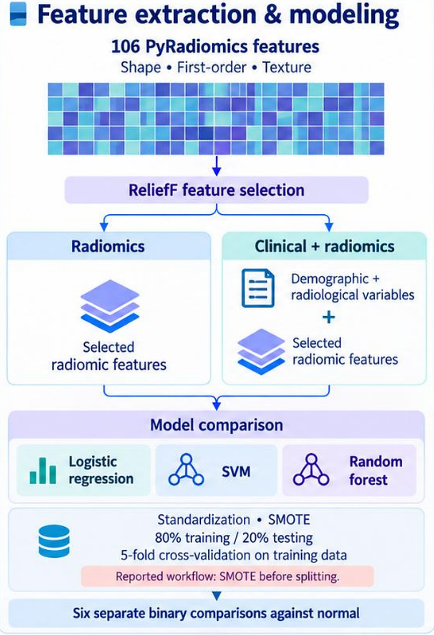
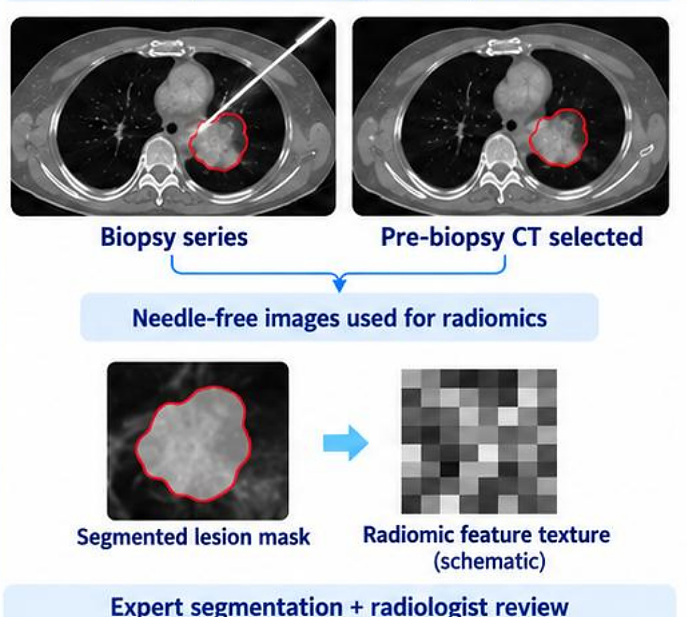
RADIOMICS · VIRTUAL BIOPSY
CT-based virtual biopsy of thoracic lesions
Results
Test AUC vs normal
Lesion | Radiom. | + Clin.
Tumoral | 0.682 | 0.721
Adenocarcinoma | 0.690 | 0.741
SCC | 0.820 | 0.769
SCLC | 0.869 | 0.875
Lymphoma | 0.875 | 0.920
Mesenchymal | 0.861 | 0.852
Pre-biopsy CT, 300 patients
Feature selection + three classifiers
SMOTE before splitting may inflate results
A virtual biopsy alongside tissue diagnosis
Cheraghi et al., J Med Biol Eng 2026
6
Notes:
A “virtual biopsy”: can CT radiomics classify thoracic lesions without a needle?
Cohort: a retrospective study of 300 patients. From the biopsy series, the pre-biopsy CT was selected so that needle-free images were used for radiomics. Expert segmentation plus radiologist review. 189 tumoral and 111 study-defined normal cases: 80 adenocarcinoma, 32 SCC, 20 SCLC, 36 lymphoma and 21 mesenchymal tumours; pathology provided the reference labels. Preprocessing: resampling, grey-level discretization, Gaussian smoothing.
Feature extraction and modeling: 106 PyRadiomics features (shape, first-order, texture), ReliefF feature selection, and two feature sets — radiomics alone, and clinical (demographic and radiological variables) plus radiomics. Model comparison: logistic regression, SVM and random forest; standardization, SMOTE, 80% training / 20% testing, 5-fold cross-validation on the training data; six separate binary comparisons against normal.
Reported test AUCs (best classifier per task and feature set; radiomics vs clinical + radiomics): tumoral 0.682 vs 0.721; adenocarcinoma 0.690 vs 0.741; SCC 0.820 vs 0.769; SCLC 0.869 vs 0.875; lymphoma 0.875 vs 0.920; mesenchymal 0.861 vs 0.852. The highest was 0.920 for lymphoma vs normal with the combined model. Clinical variables did not improve every task — AUC was lower for SCC and mesenchymal. Values follow the detailed Tables 2–7; abstract values differ for lymphoma and mesenchymal.
Caution: the reported workflow applied SMOTE before splitting, which introduces leakage risk and may inflate performance. These are internal exploratory results — potential decision support alongside tissue biopsy, not a validated replacement.

Slide 7
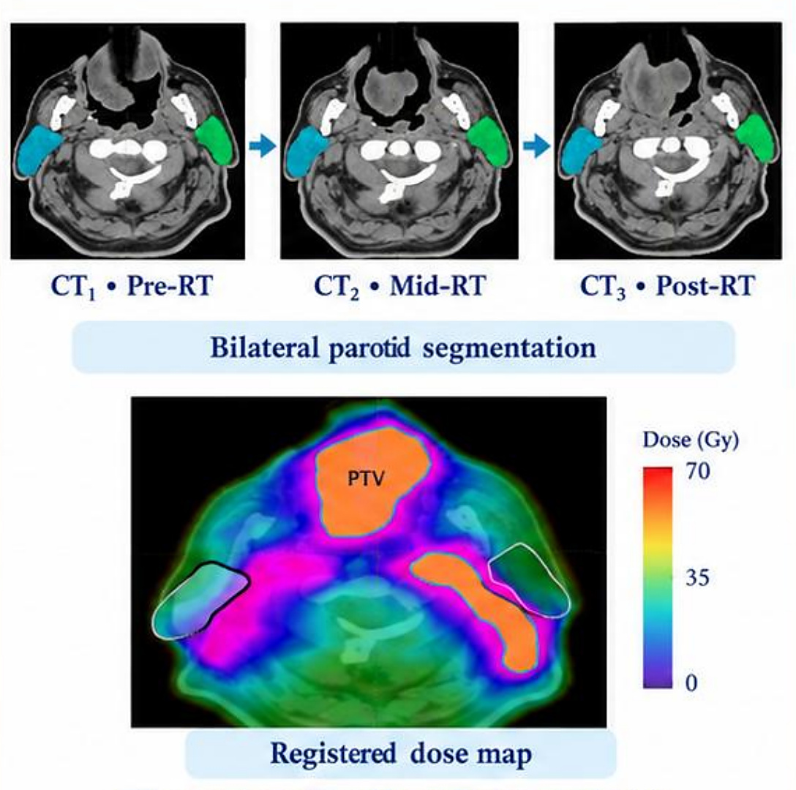
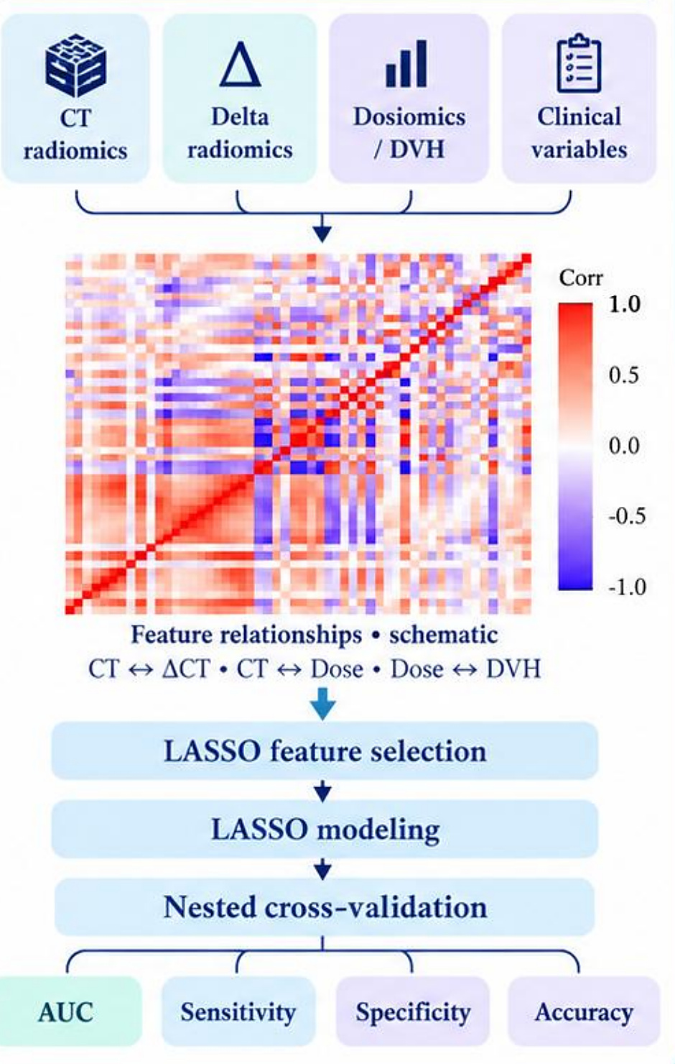
RADIOMICS · TOXICITY PREDICTION
Delta radiomics and dose for late xerostomia
Results
AUC, nested CV
Model | AUC
CT1 (pre-RT) | 0.68
CT2 (mid-RT) | 0.84
CT3 (post-RT) | 0.89
ΔCT2−1 + dose | 0.89
DVH | 0.89
Dose | 0.72
Clinical | 0.88
Parotid CT before, during, after RT
CT, delta, dose and clinical features
31 patients, 59 parotids
Longitudinal imaging and dose predict dry mouth
Abdollahi et al., Int J Radiat Biol 2022
7
Notes:
This study looked at the parotid glands as organs at risk: can longitudinal CT radiomics and dose information predict late xerostomia?
Longitudinal imaging and dose: 31 head-and-neck cancer patients, 59 parotids, treated with VMAT, 58–70 Gy in 30–35 fractions. CT was acquired pre-RT (CT1), mid-RT (CT2) and post-RT (CT3), with bilateral parotid segmentation and a registered dose map; CT contours were reviewed by radiation oncologists. Outcome: late xerostomia assessed 3–6 months after RT.
Feature integration and modeling: CT radiomics, delta radiomics, dosiomics/DVH and clinical variables. We looked at feature relationships (CT vs ΔCT, CT vs dose, dose vs DVH), then LASSO feature selection, LASSO modeling and nested cross-validation, reporting AUC, sensitivity, specificity and accuracy.
Reported AUCs: CT1 0.68; CT2 0.84; CT3 0.89; ΔCT2−1 0.79; ΔCT3−1 0.78; CT1 + dose 0.58; CT2 + dose 0.86; CT3 + dose 0.71; ΔCT2−1 + dose 0.89; ΔCT3−1 + dose 0.78; dose 0.72; DVH 0.89; clinical 0.88. The highest reported AUC, 0.89, was reached by CT3, by ΔCT2−1 + dose and by DVH.
Message: longitudinal parotid imaging plus dose information supports xerostomia risk assessment. (Imaging and correlation matrix in the original were illustrative; AUCs transcribed from the supplied slides.)

Slide 8
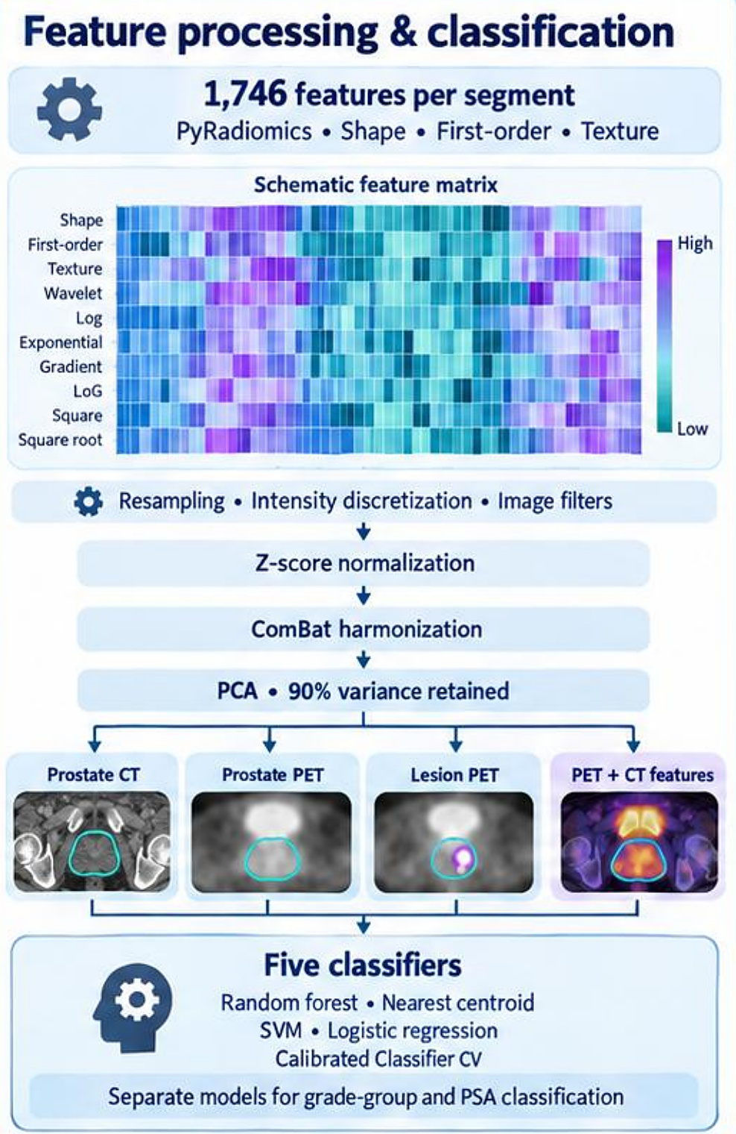
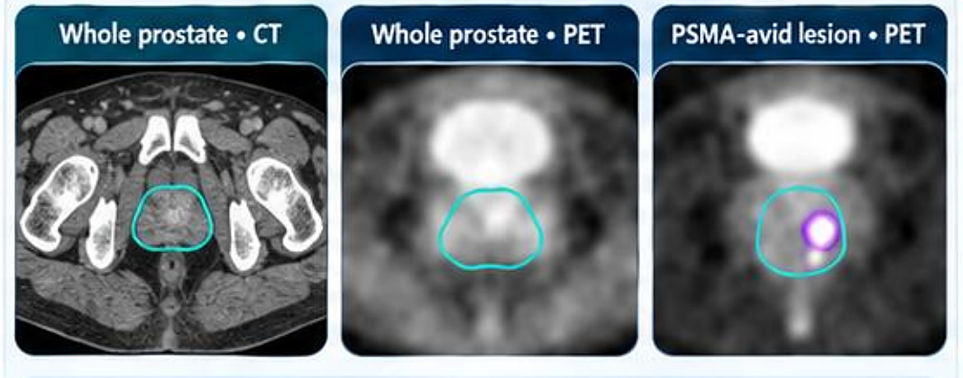
RADIOMICS · PSMA PET/CT
Multicentre PSMA PET/CT radiomics for risk
Results
Mean accuracy
Task | Internal | External
GGG 1–3 vs 4–5 | 78.0% | 73.8%
PSA <20 vs ≥20 | 75.4% | 76.4%
PSMA PET/CT, 243 patients, 4 centres
Harmonized features, five classifiers
186 development, 57 external test; classifier differences p > 0.05
Non-invasive risk stratification from PSMA PET/CT
Jafari et al., BMC Medical Imaging (2025) 25:375
8
Notes:
Here we used PSMA PET/CT radiomics for non-invasive risk characterization of prostate cancer, with independent external testing.
Multicentre cohort: 243 patients from four centres, newly diagnosed and untreated, imaged with [68Ga]Ga-PSMA-11 PET/CT. Expert segmentation in 3D Slicer of the whole prostate on CT and PET, and of the PSMA-avid lesion on PET. Centres 1–2 gave 186 development cases with 10-fold internal cross-validation; centres 3–4 gave 57 external test cases. Two tasks: Gleason grade group 1–3 vs 4–5, and PSA <20 vs ≥20 ng/mL.
Feature processing and classification: 1,746 features per segment (PyRadiomics shape, first-order, texture, plus wavelet, LoG, exponential, gradient, square and square-root filtered images); resampling, intensity discretization and image filters; z-score normalization; ComBat harmonization; PCA retaining 90% of variance. Four inputs: prostate CT, prostate PET, lesion PET and PET + CT features. Five classifiers: random forest, nearest centroid, SVM, logistic regression and calibrated classifier CV, with separate models for grade group and PSA.
Results (reported mean performance): Gleason grade group — internal 78.0% (nearest centroid, whole-prostate PET); external 73.8% (random forest, PSMA-avid lesion PET). PSA — internal 75.4% (nearest centroid, whole-prostate PET); external 76.4% (nearest centroid, concatenated PET + CT). Differences between classifiers were not statistically significant (p > 0.05). PET lesion features and PET/CT fusion showed potential for risk stratification.
Retrospective multicentre study with independent external testing. Percentages follow the narrative results; detailed metric tables were not supplied.

Slide 9
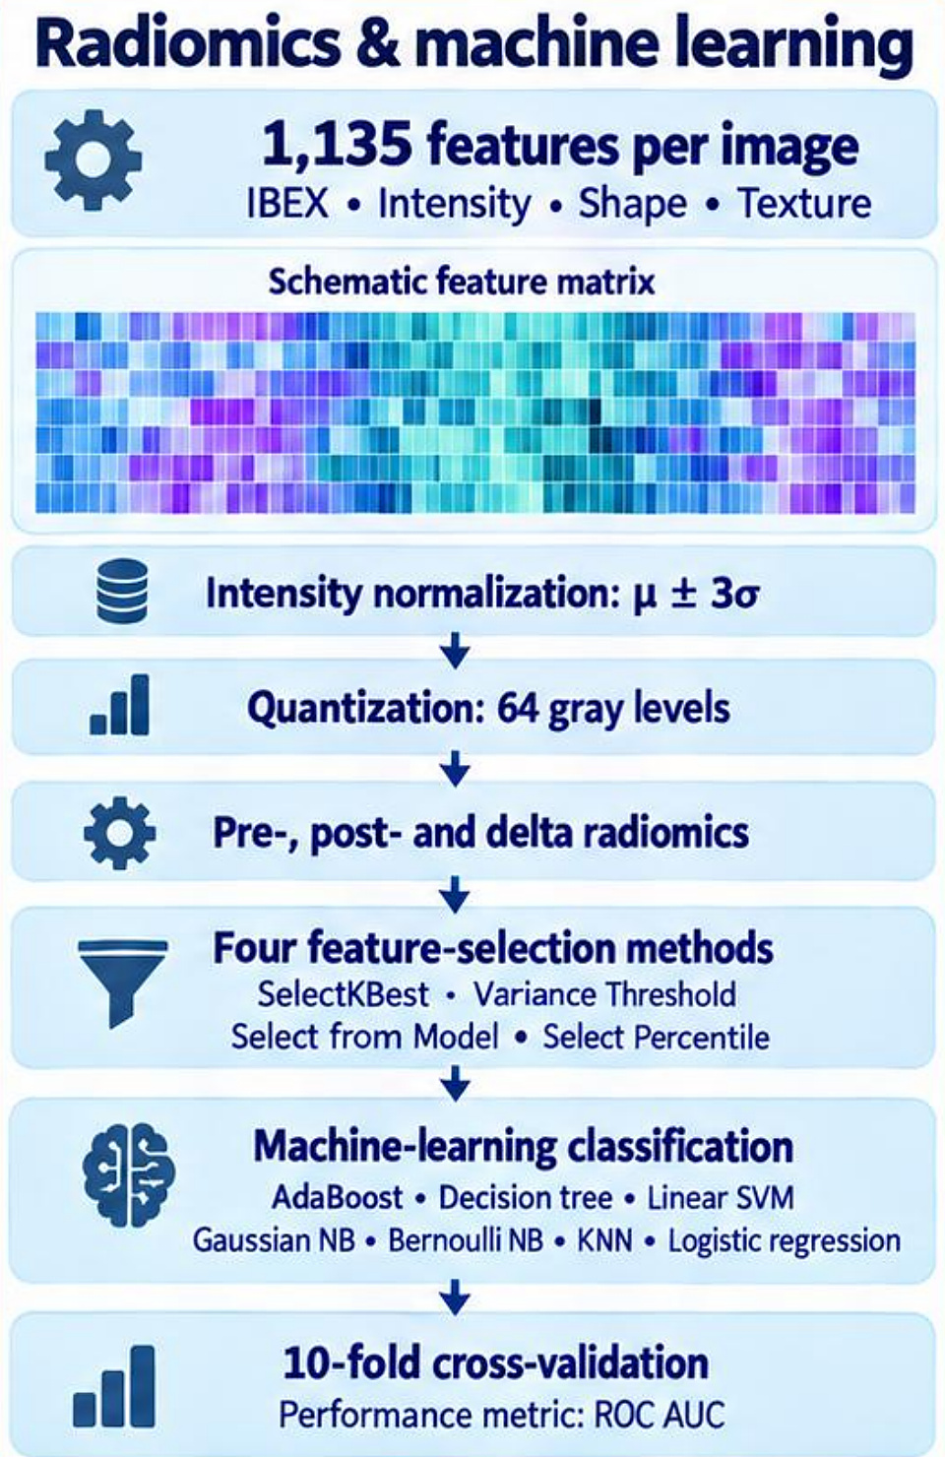
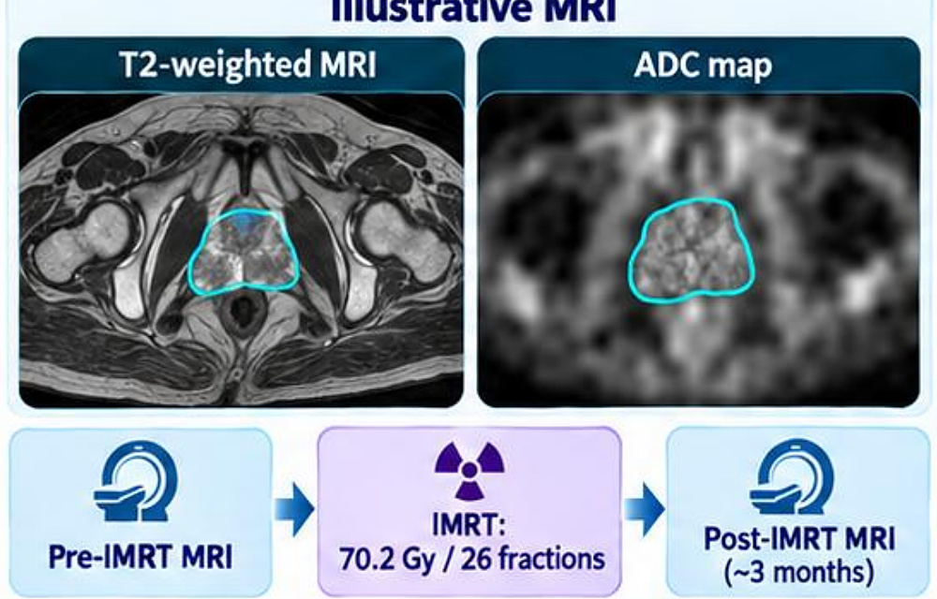
RADIOMICS · TREATMENT RESPONSE
MRI radiomics for IMRT response in prostate
Results
AUC
Task | T2w | ADC
IMRT response | 0.78 | 0.77
Gleason | 0.739 | 0.700
Stage | 0.625 | 0.675
T2 MRI and ADC before and after IMRT
1,135 features, seven classifiers
Response: best model; Gleason, stage: mean AUC. Responder = ADC rise >20%
MRI radiomics for response and tumour characterization
Abdollahi et al., La Radiologia Medica 2019
9
Notes:
MRI radiomics for treatment-response assessment and prostate cancer characterization.
Patient cohort and MRI: 33 prostate cancer patients in a prospective study, all with biopsy-proven adenocarcinoma. T2-weighted MRI and ADC maps were acquired before IMRT (70.2 Gy in 26 fractions) and about 3 months after. Expert 3D segmentation in 3D Slicer. Response was defined by ADC: an ADC increase above 20% — 15 responders (45%) and 18 non-responders. We also classified Gleason score (≤7 vs >7) and stage (T2 vs T3).
Radiomics and machine learning: 1,135 IBEX features per image (intensity, shape, texture); intensity normalization μ ± 3σ; quantization to 64 grey levels; pre-, post- and delta radiomics; four feature-selection methods (SelectKBest, Variance Threshold, Select From Model, Select Percentile); classifiers AdaBoost, decision tree, linear SVM, Gaussian NB, Bernoulli NB, KNN and logistic regression; 10-fold cross-validation with ROC AUC.
Results: early IMRT response — best pre-treatment models AUC 0.78 for T2-weighted and 0.77 for ADC; mean AUC across models post-T2 0.632, pre-ADC 0.626, pre-T2 0.610. Gleason score classification — mean AUC 0.739 (T2-weighted) and 0.700 (ADC). Stage classification — mean AUC 0.675 (ADC) and 0.625 (T2-weighted).
Exploratory cohort, no independent external validation; response is defined by ADC change.

Slide 10
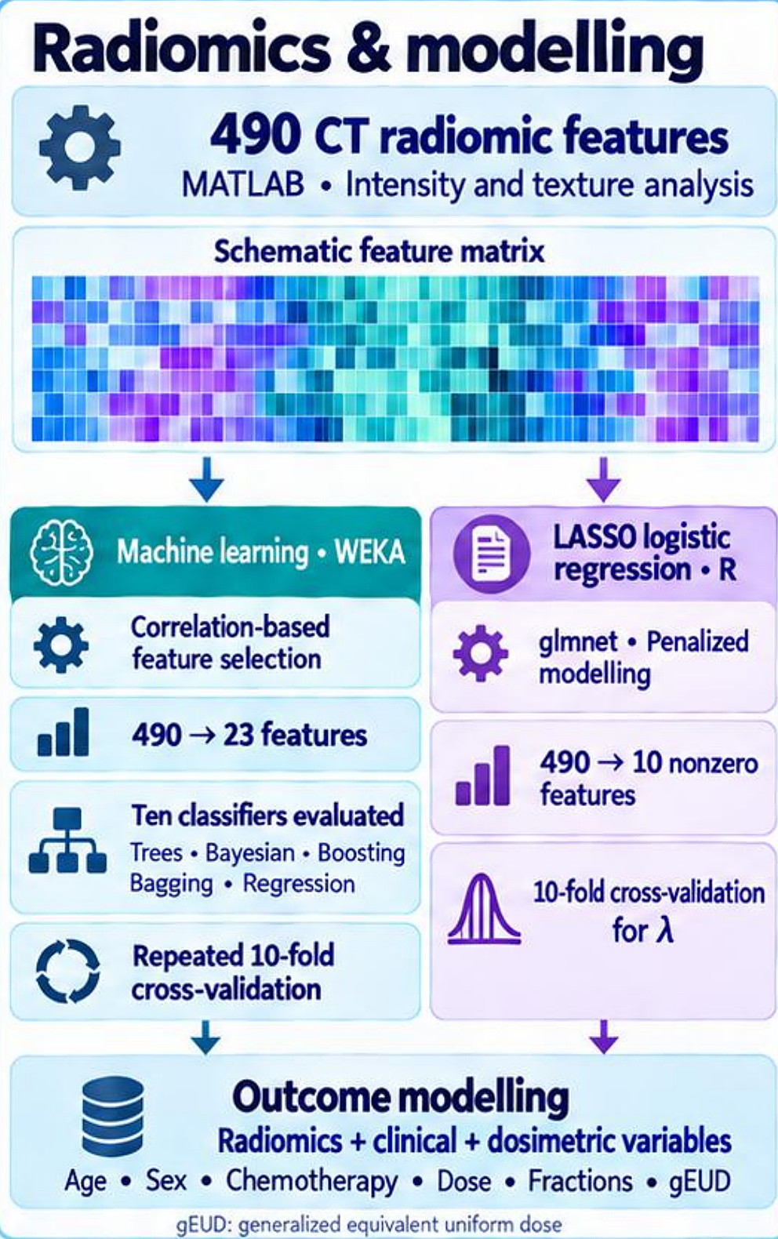
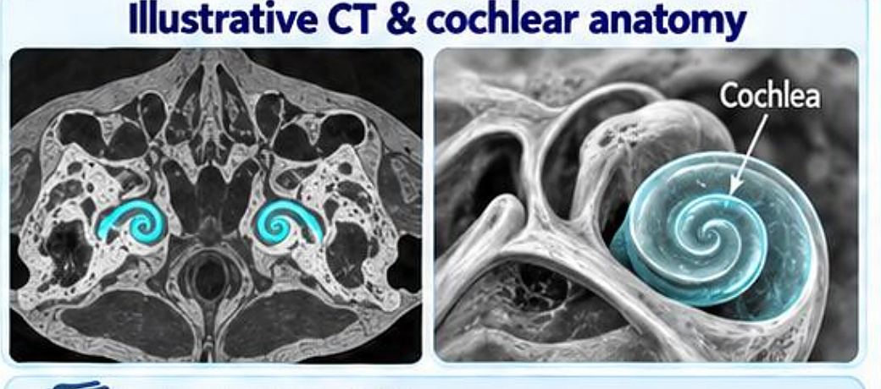
COCHLEAR CT RADIOMICS · TOXICITY
Predicting radiation-induced hearing loss
Results
Hearing-loss prediction
Model | Result
LASSO radiomics, AUC | 0.885
ML accuracy | 76.1%
ML precision | 75.9%
gEUD only, AUC | 0.79
gEUD only, accuracy | 72%
Cochlear CT, 47 patients
490 features, ML and LASSO
37 of 94 ears with SNHL
Imaging the cochlea to predict hearing loss
Abdollahi et al., Physica Medica · doi:10.1016/j.ejmp.2017.10.008
10
Notes:
Can CT radiomics of the cochlea predict treatment-related hearing loss?
Patient cohort and cochlea CT: 47 patients, 94 cochleae, in a prospective study of head and neck irradiation. Pre-treatment CT with 1 mm slices; manual cochlear segmentation by a radiation oncologist, verified by two experts. 3D conformal radiotherapy, 50–70 Gy in 28–38 fractions, with or without concurrent chemotherapy. Pure-tone audiometry at baseline, mid-treatment, 3 months and 6 months, graded with CTCAE v4.03. 37 of 94 ears (~40%) developed sensorineural hearing loss (SNHL).
Radiomics and modelling: 490 CT radiomic features (MATLAB intensity and texture analysis). Two branches: machine learning in WEKA — correlation-based feature selection (490 → 23 features), ten classifiers evaluated (trees, Bayesian, boosting, bagging, regression), repeated 10-fold cross-validation; and LASSO logistic regression in R (glmnet, penalized modelling), 490 → 10 non-zero features, 10-fold cross-validation for λ. Outcome modelling combined radiomics with clinical and dosimetric variables: age, sex, chemotherapy, dose, fractions and gEUD (generalized equivalent uniform dose).
Results: LASSO radiomic model AUC 0.885 with 10 selected features, cross-validation misclassification error 0.205, selected λ 0.0328. Leading radiomic ML classifiers (Decision Stump and Hoeffding): accuracy 76.08%, precision 75.9%. gEUD-only model: AUC 0.79, accuracy 72%, precision 74%. Adding gEUD improved ML precision and AUC; accuracy was similar.
Small cohort; further validation needed.

Slide 11
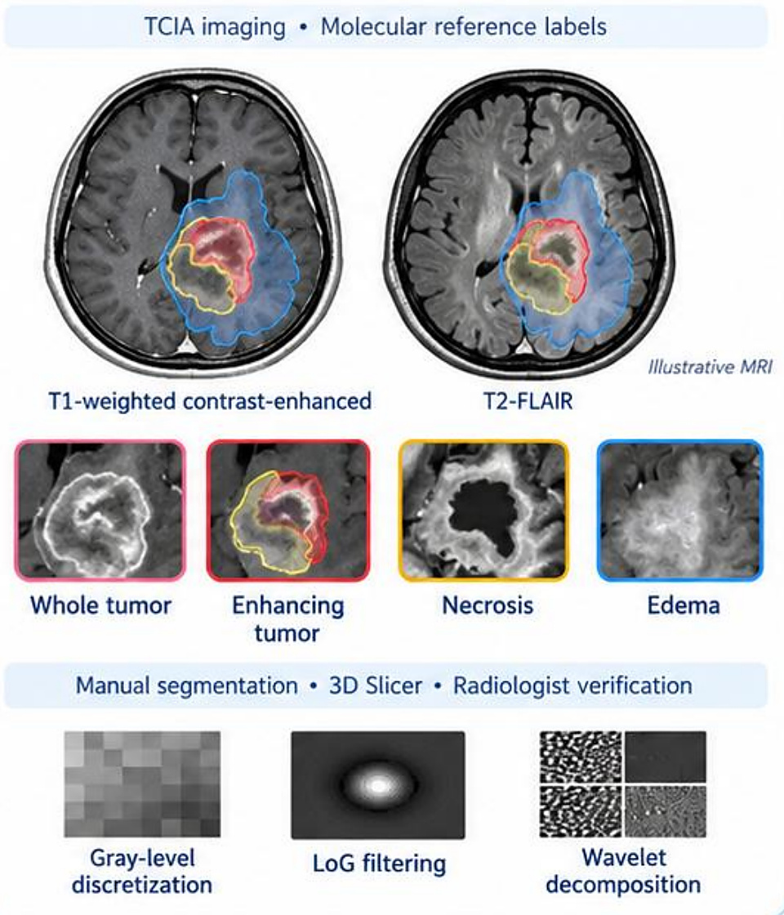
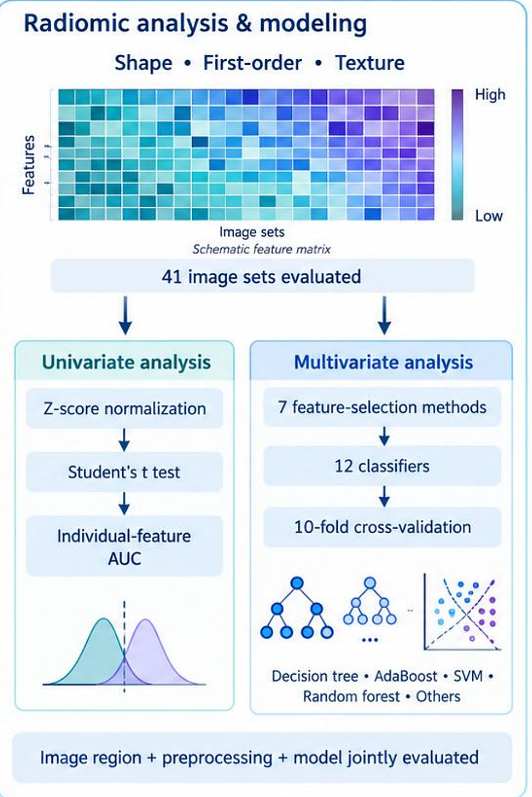
RADIOGENOMICS · GLIOBLASTOMA
MRI radiomics for MGMT promoter methylation
Results
AUC, 10-fold CV
Model | AUC
Decision tree, edema | 0.78
AdaBoost, edema | 0.74
Best single feature (GLCM) | 0.71
MRI tumour sub-regions, 82 patients
41 image sets, 12 classifiers
45 methylated, 37 unmethylated
Non-invasive MGMT status from MRI
Hajianfar et al., World Neurosurgery 2019
11
Notes:
A radiogenomics example: non-invasive imaging signatures of MGMT promoter methylation in glioblastoma.
MRI cohort and regional segmentation: 122 GBM cases screened in TCIA, 82 with MGMT status — 45 methylated and 37 unmethylated, with molecular reference labels. T1-weighted contrast-enhanced and T2-FLAIR MRI. Regions: whole tumour, enhancing tumour, necrosis and edema; manual segmentation in 3D Slicer with radiologist verification. Preprocessing: grey-level discretization, LoG filtering and wavelet decomposition.
Radiomic analysis and modeling: shape, first-order and texture features over 41 image sets. Univariate analysis: z-score normalization, Student’s t-test, individual-feature AUC. Multivariate analysis: 7 feature-selection methods, 12 classifiers (decision tree, AdaBoost, SVM, random forest and others), 10-fold cross-validation. Image region, preprocessing and model were evaluated jointly.
MGMT methylation prediction: best multivariate model AUC 0.78 — decision tree with Select From Model, edema region, LoG features. Second-best AUC 0.74 — AdaBoost with Select From Model, edema region, LoG features. Best individual feature AUC 0.71 — GLCM inverse variance, whole tumour, LoG σ = 4.5 mm. The strongest multivariate result arose from the edema region.
Exploratory retrospective study, 82 patients, internal cross-validation.

Slide 12
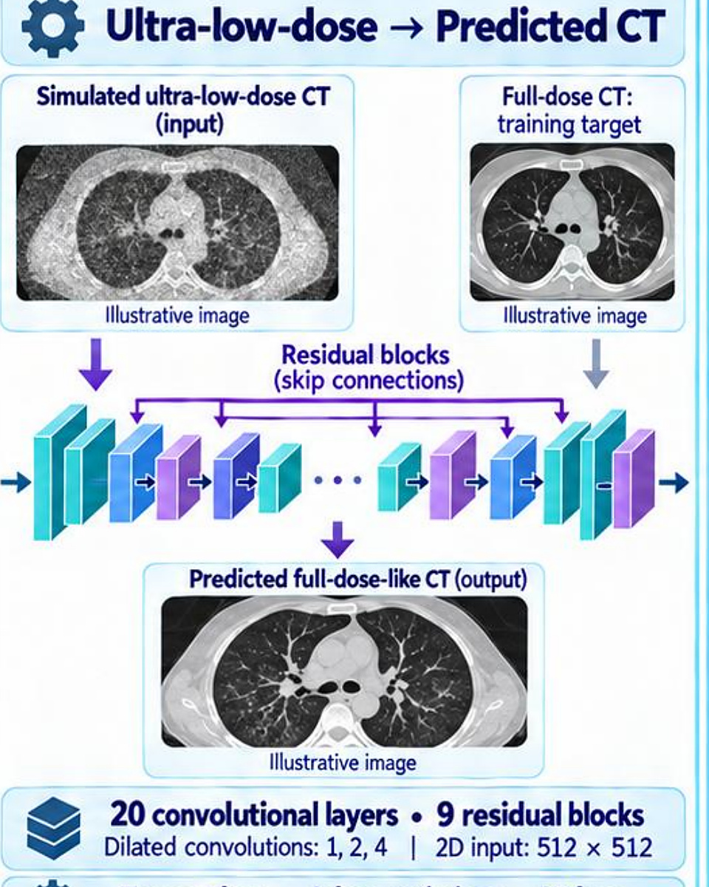
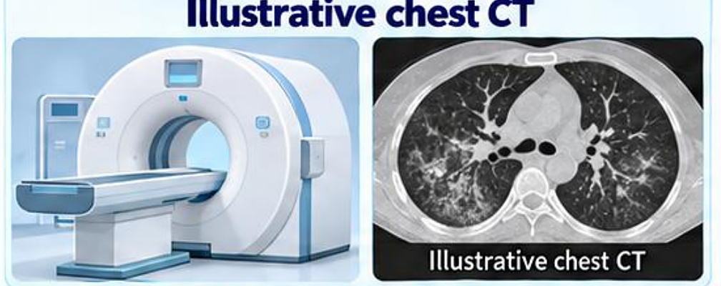
DEEP LEARNING · IMAGE QUALITY
Deep learning for ultra-low-dose chest CT
Results
External validation
Metric | ULD CT | DL CT
RMSE | 0.16 | 0.08
SSIM | 0.89 | 0.97
PSNR (dB) | 29.40 | 33.60
Reader score /5 | 2.78 | 4.42
1,141 chest CTs, 9 centres
Residual network: low → full dose
Full-dose reader score 4.72; all p < 0.0001
Lower dose with preserved image quality
Shiri et al., Eur Radiol (2021) 31:1420–1431
12
Notes:
Deep learning can also improve the images themselves. Here we predicted full-dose-like chest CT from ultra-low-dose CT.
Multicentre chest CT cohort: 1,141 CT exams from 9 centres, retrospective, including 312 COVID-19-positive exams. Training 800 (112 COVID-19), test 170 (100 COVID-19), external validation 171 (100 COVID-19). Ultra-low-dose CT was simulated: full-dose CT → projection-domain noise (Poisson + Gaussian) → FBP, calibrated to a real ultra-low-dose protocol. Reference CTDIvol fell from 6.5 to 0.72 mGy — up to 89% reduction.
Deep residual learning: ultra-low-dose input → predicted CT, with full-dose CT as the training target. 20 convolutional layers, 9 residual blocks with skip connections, dilated convolutions (1, 2, 4), 2D 512 × 512 input; TensorFlow, Adam optimizer, L2 loss. Evaluation was quantitative plus radiologist-based: RMSE, SSIM, PSNR, image quality, lesion visibility and morphology.
Results — external validation (ultra-low-dose → predicted): RMSE 0.16 → 0.08; SSIM 0.89 → 0.97; PSNR 29.40 → 33.60 dB (mean values, all p < 0.0001). Test-set improvement: RMSE 0.16 → 0.09; SSIM 0.89 → 0.97. Overall image quality, radiologist score out of 5: ultra-low-dose 2.78, predicted 4.42, full-dose reference 4.72.
Caveat: lesion fidelity remains critical. Some outliers showed altered lesion structure or density; improved appearance does not guarantee diagnostic fidelity.

Slide 13
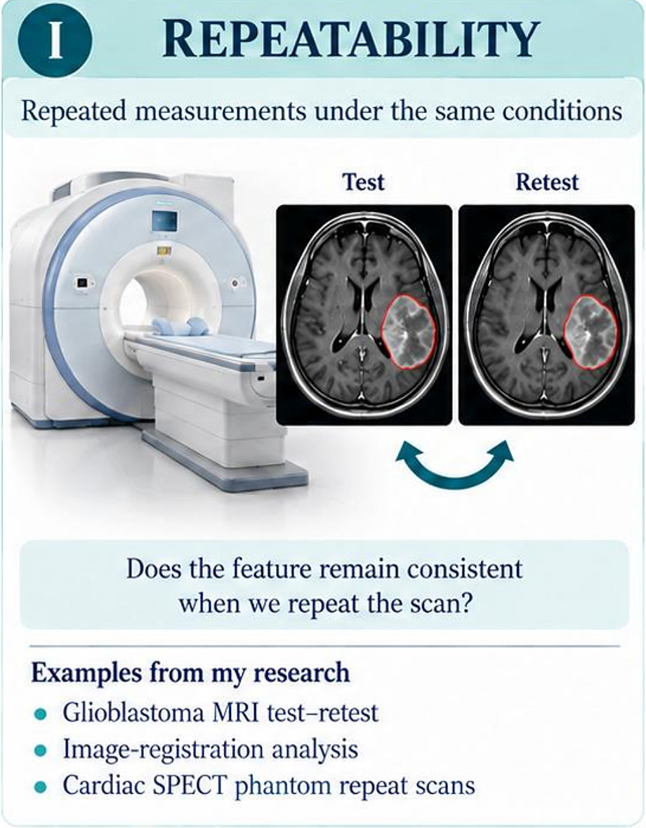
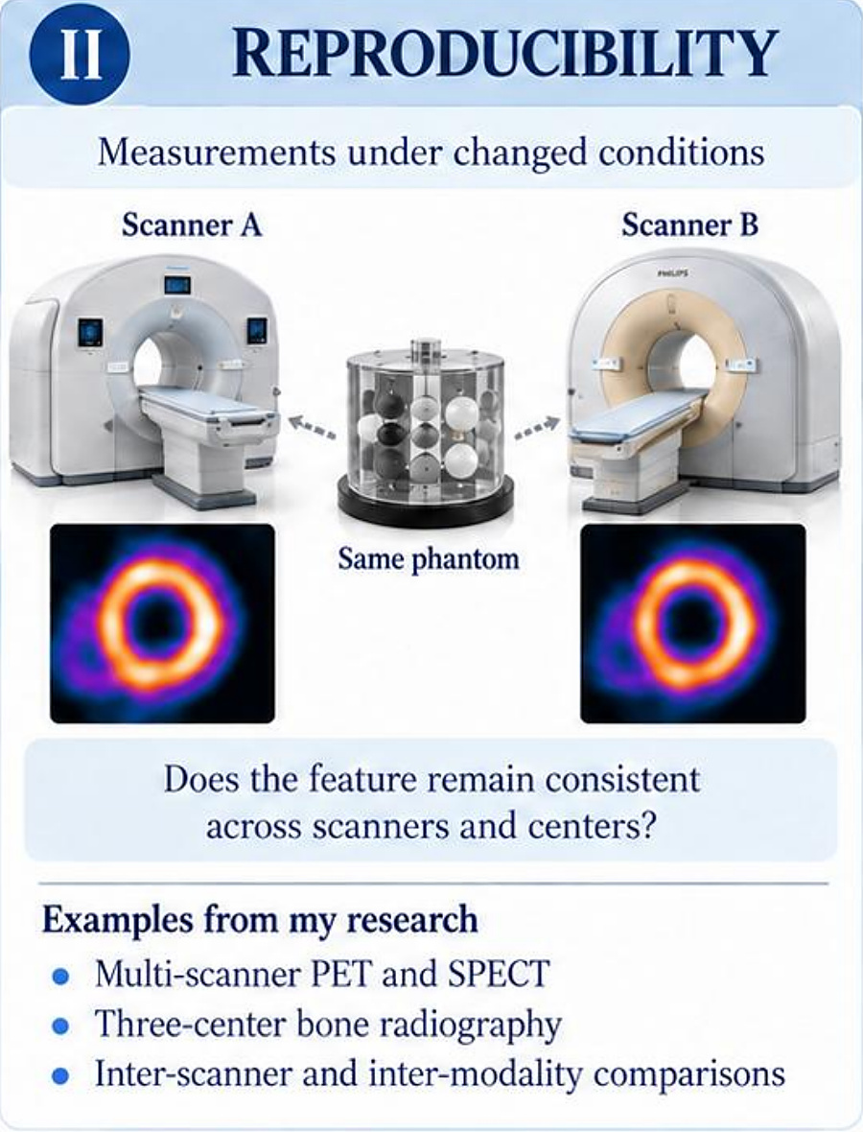
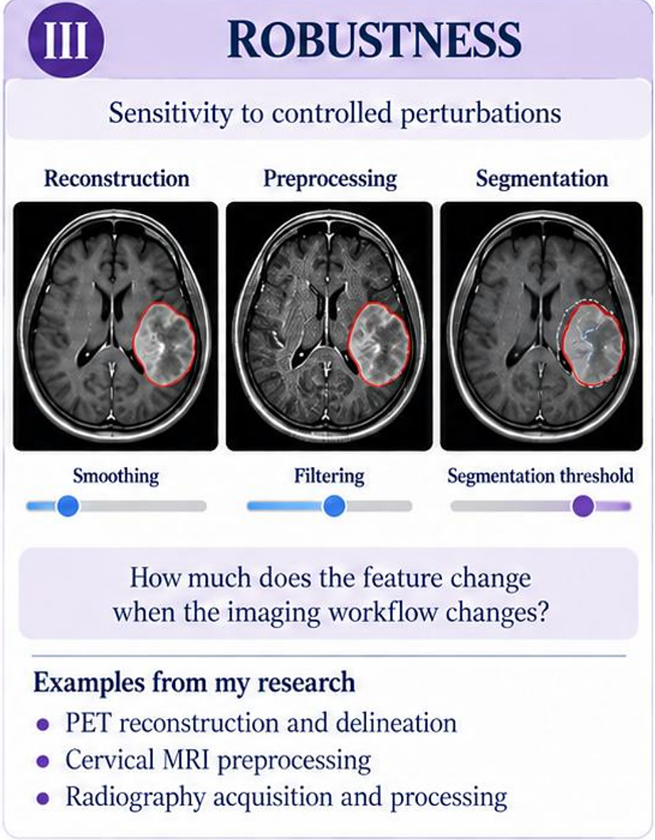
RADIOMICS · FEATURE RELIABILITY
Repeatability, reproducibility and robustness
Repeatability: same conditions
Reproducibility: across scanners
Robustness: workflow changes
Goal: find stable features and the sources of variability
Abdollahi et al., Phys Med Biol 2022
13
Notes:
A recurring theme in my work is radiomic feature reliability, which has three parts.
I. Repeatability — repeated measurements under the same conditions (test and retest on the same scanner). The question: does the feature remain consistent when we repeat the scan? Examples from my research: glioblastoma MRI test–retest, image-registration analysis, and cardiac SPECT phantom repeat scans.
II. Reproducibility — measurements under changed conditions (scanner A vs scanner B, the same phantom). The question: does the feature remain consistent across scanners and centres? Examples: multi-scanner PET and SPECT, three-centre bone radiography, and inter-scanner and inter-modality comparisons.
III. Robustness — sensitivity to controlled perturbations in reconstruction, preprocessing (smoothing, filtering) and segmentation (threshold). The question: how much does the feature change when the imaging workflow changes? Examples: PET reconstruction and delineation, cervical MRI preprocessing, and radiography acquisition and processing.
Research aim: identify stable features and quantify sources of variability. (This is a conceptual grouping of my publication portfolio; study terminology may overlap.)

Slide 14
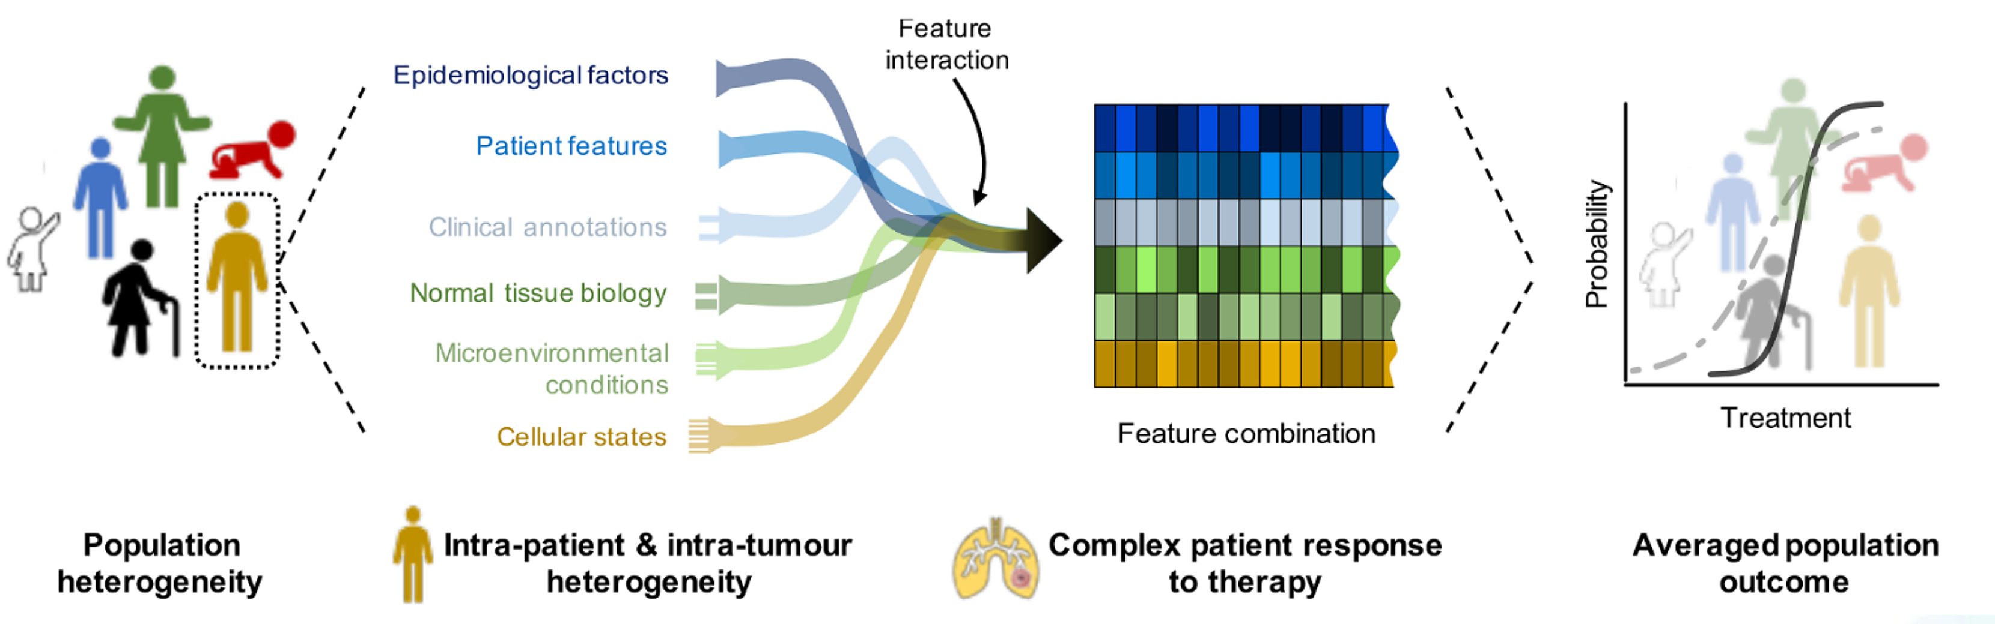
THE CHALLENGE
Treatment is designed for the average patient
Averaging hides the individual patient
DREAM team vision, Radiother Oncol 2024
14
Notes:
So what’s the challenge? Averaging.
We start from population heterogeneity — children, adults, older people; every patient is different. Within each patient there is intra-patient and intra-tumour heterogeneity, shaped by epidemiological factors, patient features, clinical annotations, normal tissue biology, microenvironmental conditions and cellular states. These features interact and combine into a complex patient response to therapy.
But clinical evidence is usually summarized as an averaged population outcome — a single probability-versus-treatment curve. The individual patient’s curve can be very different from that dashed average. Designing treatment around the average patient therefore misses many real patients.
Source: DREAM team vision, Radiotherapy and Oncology, 2024.

Slide 15
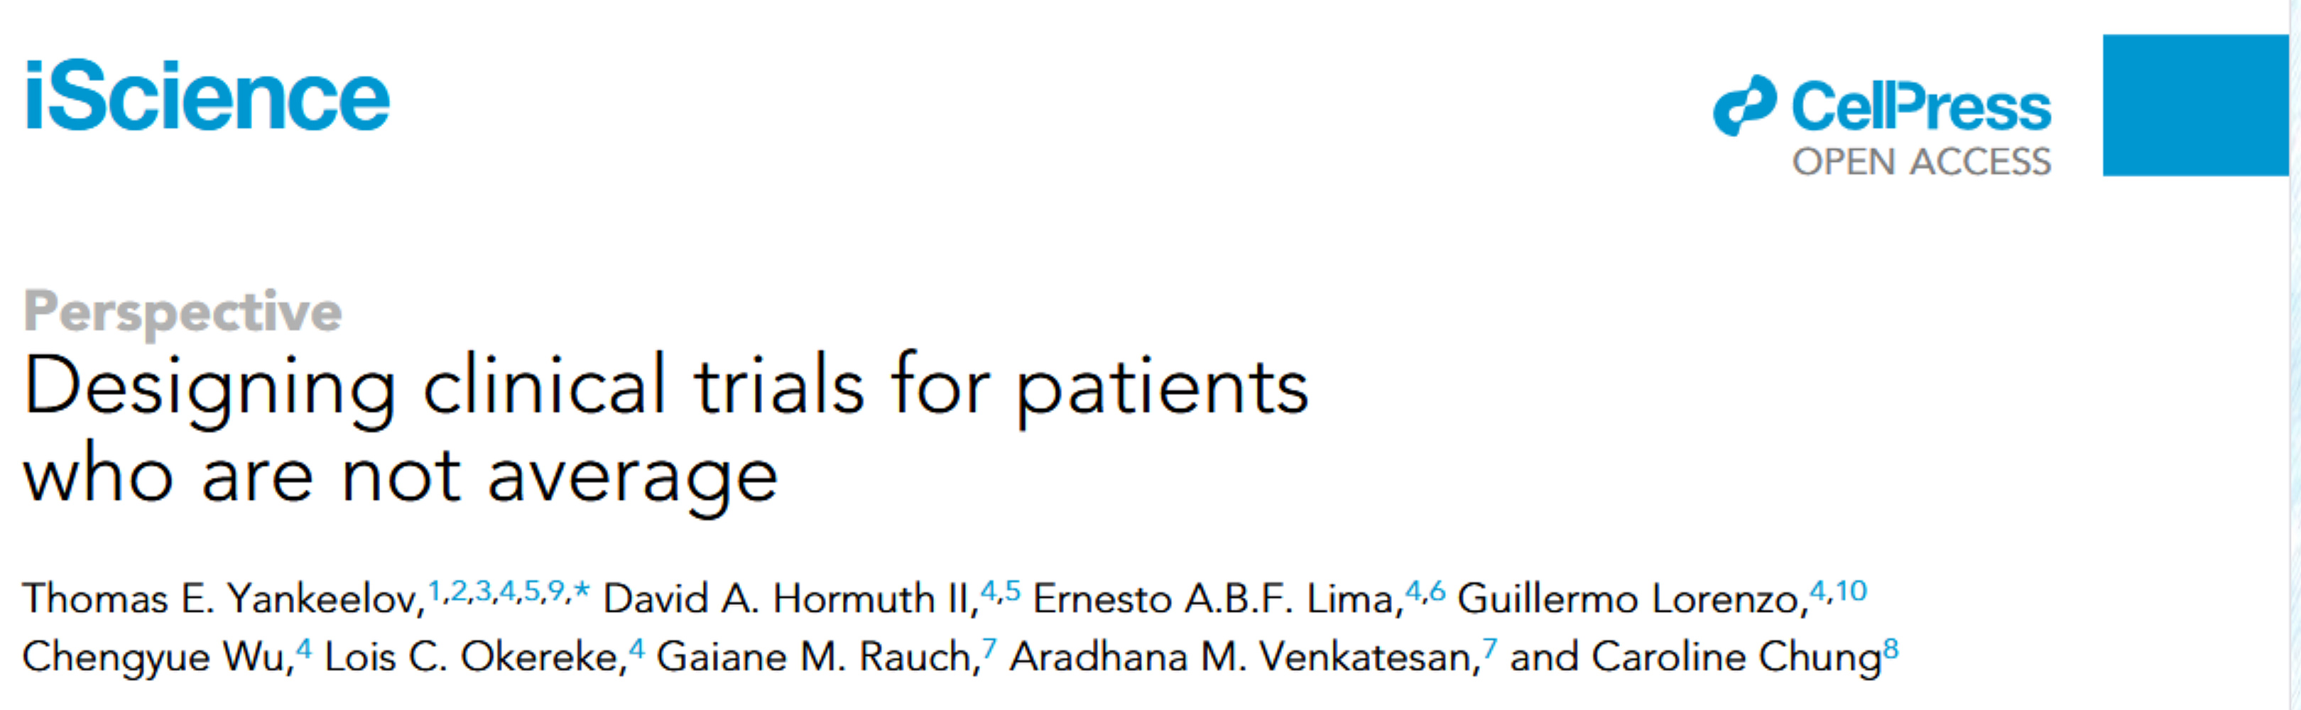
THE SOLUTION · DIGITAL TWINNING
Trials for patients who are not average
The idea
• Model each patient, not the average
• Calibrate with their own data
• Update as treatment proceeds
From averaged evidence to personalized, adaptive decisions
Yankeelov et al., iScience 2023
15
Notes:
So what’s the solution? Digital twinning. This perspective by Thomas Yankeelov and colleagues — David Hormuth II, Ernesto Lima, Guillermo Lorenzo, Chengyue Wu, Lois Okereke, Gaiane Rauch, Aradhana Venkatesan and Caroline Chung — puts it well: we need to design clinical trials for patients who are not average. Instead of fitting each patient to a population curve, we build a patient-specific model that is calibrated and updated with that patient’s own data.
Reference: Yankeelov et al., 2023, “Designing clinical trials for patients who are not average,” iScience (Cell Press, open access).

Slide 16
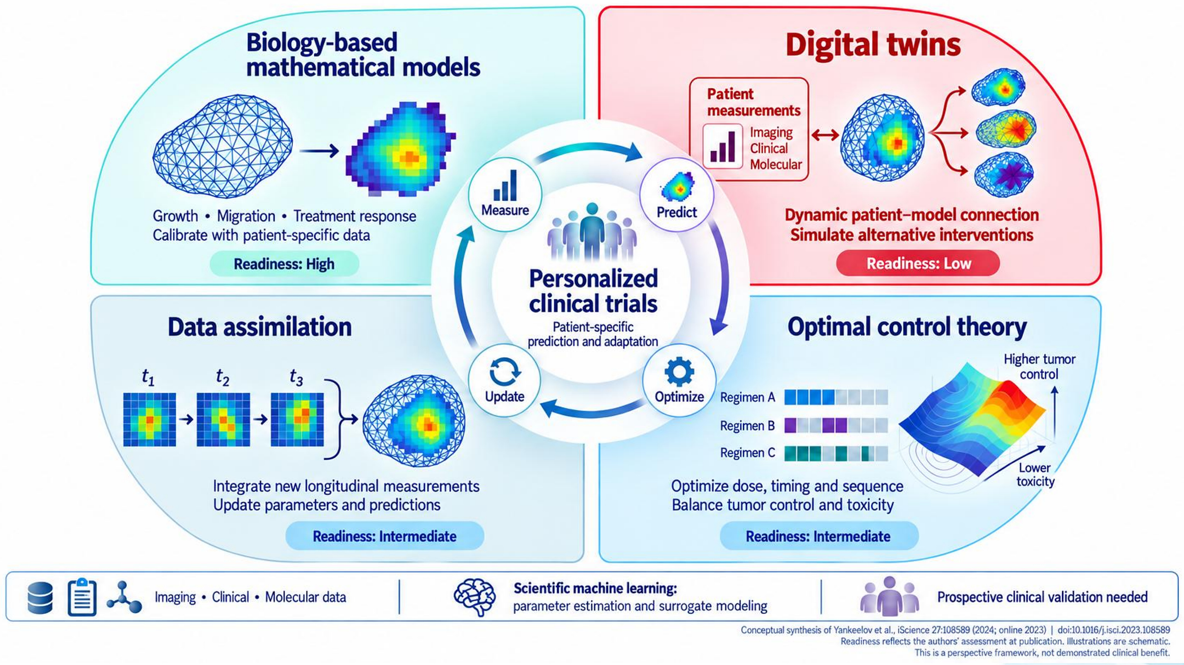
THE SOLUTION · DIGITAL TWINNING
Four building blocks for personalized trials
Building blocks
• Biology-based models
• Data assimilation
• Optimal control
• Digital twins
Measure → predict → optimize → update
Yankeelov et al., iScience 27:108589 (2024)
16
Notes:
Yankeelov and colleagues describe four building blocks around a loop of measure → predict → optimize → update, aimed at personalized clinical trials with patient-specific prediction and adaptation.
Biology-based mathematical models describe growth, migration and treatment response, calibrated with patient-specific data (for example a tumour mesh turned into a cellularity map). Readiness: high.
Data assimilation integrates new longitudinal measurements (t1, t2, t3) to update parameters and predictions. Readiness: intermediate.
Optimal control theory optimizes dose, timing and sequence — for example comparing regimens A, B and C — to balance higher tumour control against lower toxicity. Readiness: intermediate.
Digital twins create a dynamic patient–model connection: patient measurements (imaging, clinical, molecular) flow into the model, which simulates alternative interventions. Readiness: low.
Enablers: imaging, clinical and molecular data; scientific machine learning for parameter estimation and surrogate modeling; and prospective clinical validation is needed. Readiness reflects the authors’ assessment at publication; this is a perspective framework, not demonstrated clinical benefit. Conceptual synthesis of Yankeelov et al., iScience 27:108589 (2024; online 2023), doi:10.1016/j.isci.2023.108589.

Slide 17
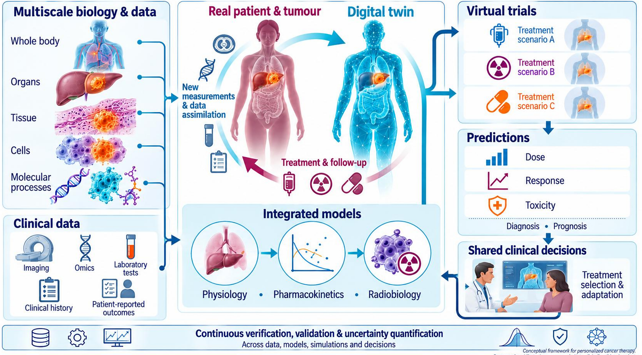
THE SOLUTION · DIGITAL TWINNING
What is a digital twin?
Definition
• A virtual copy of one patient
• Updated with that patient’s data
• Predicts and guides decisions
A two-way link between patient and model
Laubenbacher et al., Personalized Medicine 2021 · NASEM 2024
17
Notes:
What exactly is a digital twin? Paraphrasing the National Academies of Sciences, Engineering, and Medicine (2024): a digital twin is a virtual representation of a specific real-world system that is dynamically updated with data from that system, predicts its behaviour, and informs decisions affecting its physical counterpart. The key is bidirectional interaction between the physical system and its digital representation.
In cancer care: multiscale biology and data — whole body, organs, tissue, cells, molecular processes — plus clinical data (imaging, omics, laboratory tests, clinical history, patient-reported outcomes) feed the twin. The real patient and tumour and the digital twin are linked: new measurements and data assimilation flow in, and treatment and follow-up flow back. Integrated models cover physiology, pharmacokinetics and radiobiology. The twin runs virtual trials of treatment scenarios A, B and C, produces predictions of dose, response and toxicity (and supports diagnosis and prognosis), and informs shared clinical decisions — treatment selection and adaptation.
All of this sits on continuous verification, validation and uncertainty quantification across data, models, simulations and decisions. This is a conceptual framework for personalized cancer therapy, for research and illustration, not a clinically validated product. Reference: Laubenbacher et al., Personalized Medicine 2021.

Slide 18
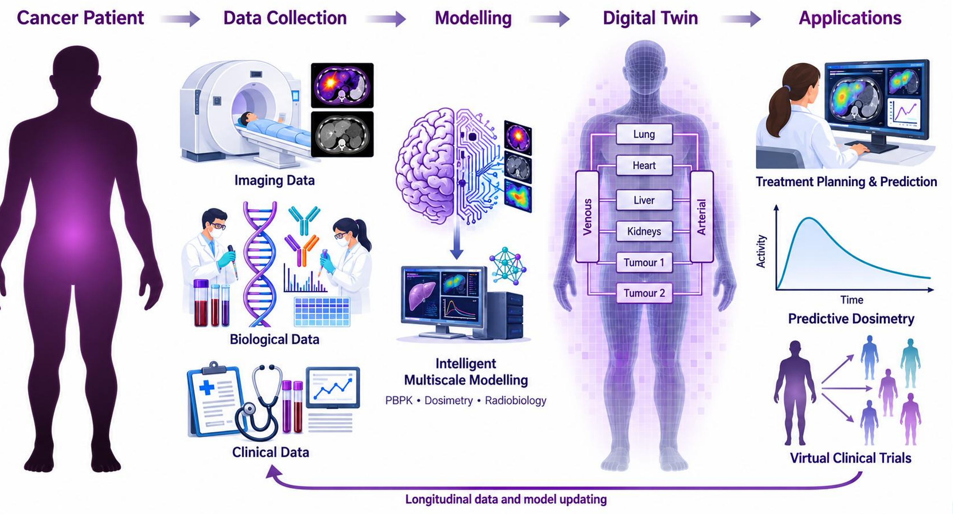
THERANOSTIC DIGITAL TWINNING
From the patient to a theranostic digital twin
Steps
• Imaging, biological, clinical data
• PBPK, dosimetry, radiobiology
• Planning and virtual trials
Longitudinal data keep updating the twin
Abdollahi et al., Theranostics 2024
18
Notes:
Now to my own work: theranostic digital twinning, the idea we proposed in Theranostics 2024.
We start with the cancer patient. Data collection brings together imaging data (PET/CT and SPECT/CT), biological data (blood samples, genomics, molecular biomarkers) and clinical data. Modelling is intelligent multiscale modelling — PBPK, dosimetry and radiobiology — combining AI with mechanistic models. The digital twin is a whole-body compartmental model with lung, heart, liver, kidneys, tumour 1 and tumour 2, linked by venous and arterial blood.
Applications: treatment planning and prediction, predictive dosimetry (activity–time curves for each organ and tumour), and virtual clinical trials across virtual patients. Longitudinal data and model updating close the loop back to data collection.

Slide 19
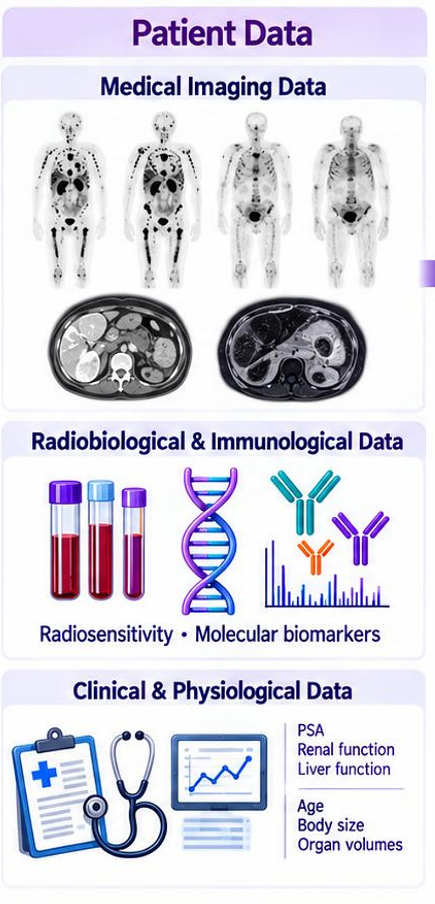
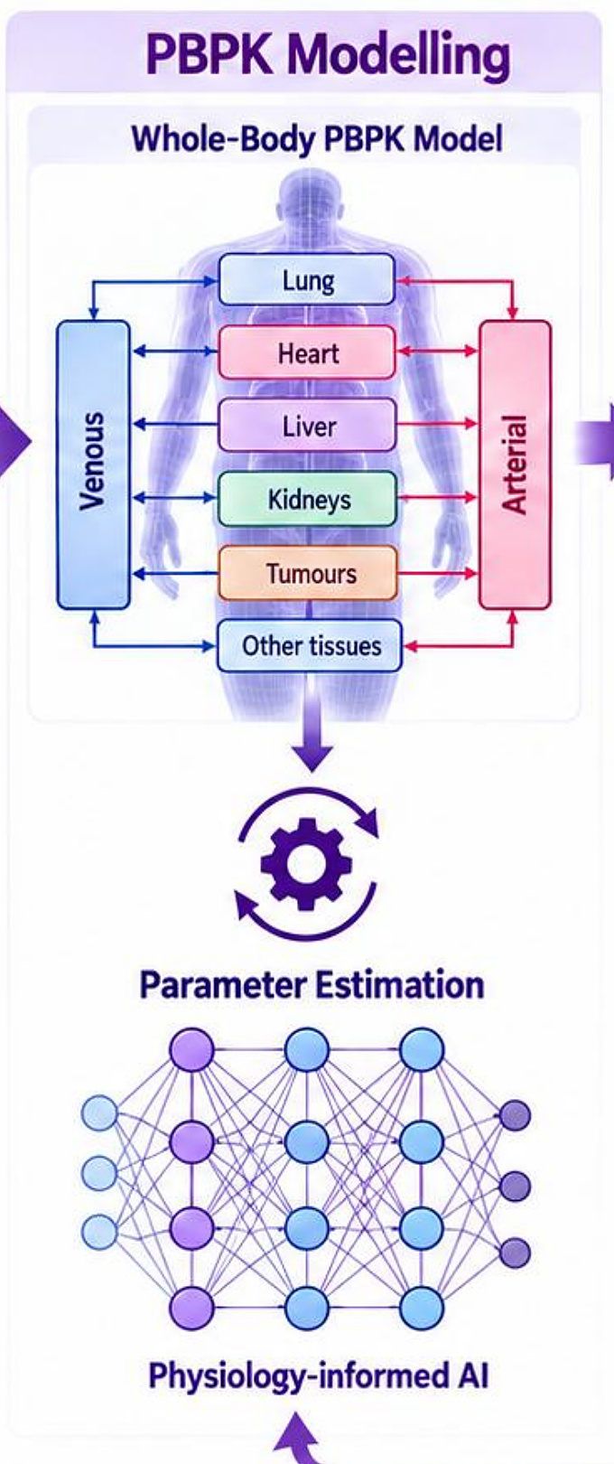
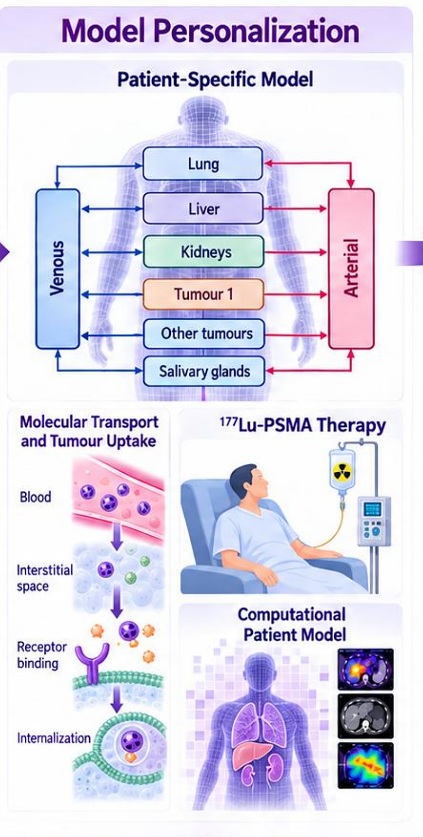
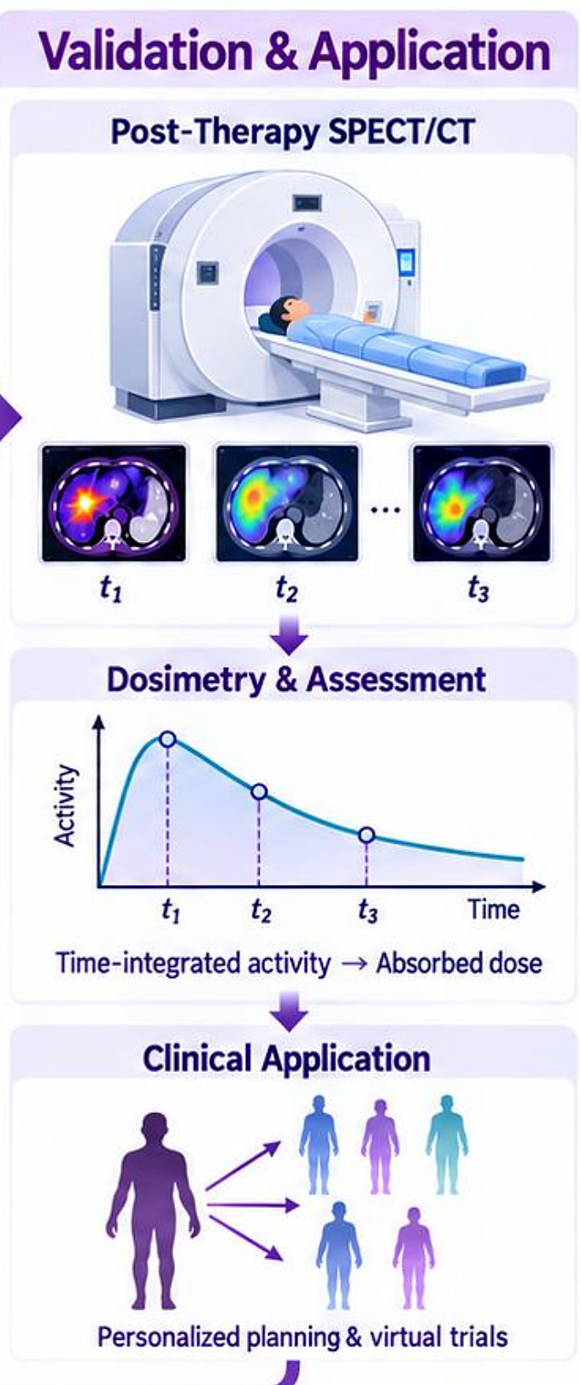
THERANOSTIC DIGITAL TWINNING
Building the twin: PBPK model for ¹⁷⁷Lu-PSMA
Patient data
PBPK model
Personalization
Validation & use
Model refinement with longitudinal data closes the loop
Abdollahi et al., Theranostics 2024
19
Notes:
Here is how the theranostic twin is built, step by step.
Patient data: medical imaging data (whole-body scans, CT and MRI); radiobiological and immunological data (radiosensitivity, molecular biomarkers); clinical and physiological data (PSA, renal function, liver function, age, body size, organ volumes).
PBPK modelling: a whole-body physiologically based pharmacokinetic model with lung, heart, liver, kidneys, tumours and other tissues between venous and arterial blood. Parameter estimation uses physiology-informed AI.
Model personalization: a patient-specific model (lung, liver, kidneys, tumour 1, other tumours, salivary glands) that includes molecular transport and tumour uptake — from blood to interstitial space, receptor binding and internalization — applied to 177Lu-PSMA therapy to give a computational patient model.
Validation and application: post-therapy SPECT/CT at t1, t2, t3; dosimetry and assessment — activity over time, time-integrated activity, absorbed dose; and clinical application in personalized planning and virtual trials. Model refinement with longitudinal data closes the loop.

Slide 20
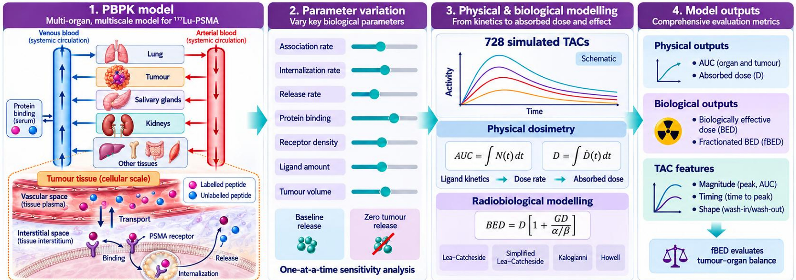
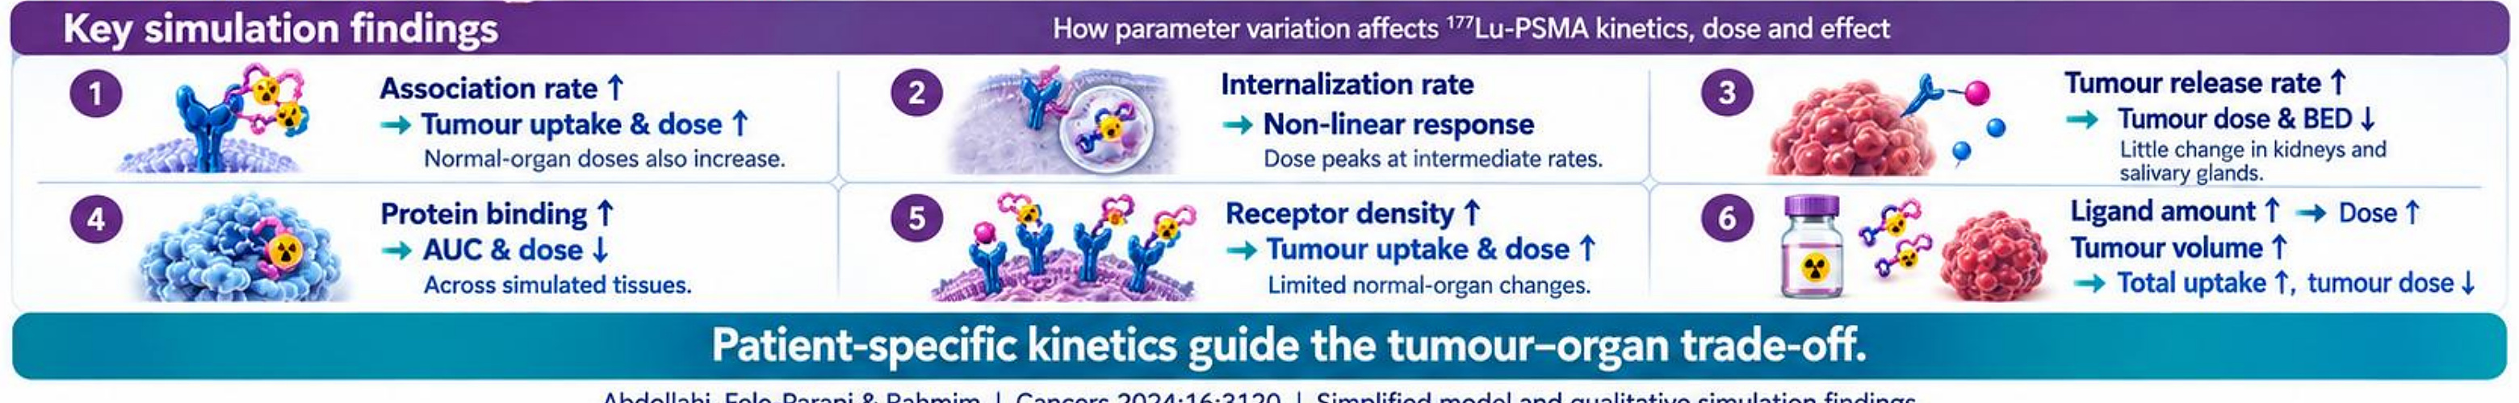
THERANOSTIC DIGITAL TWINNING
Model-informed ¹⁷⁷Lu-PSMA optimization
Patient-specific kinetics guide the tumour–organ trade-off
Abdollahi, Fele-Paranj & Rahmim, Cancers 2024;16:3120
20
Notes:
Using the twin, we studied how biological parameters change 177Lu-PSMA kinetics, dose and effect.
1. PBPK model: a multi-organ, multiscale model for 177Lu-PSMA — venous and arterial blood (systemic circulation), lung, tumour, salivary glands, kidneys and other tissues, plus serum protein binding. At the cellular scale in tumour tissue: vascular space (tissue plasma), transport to interstitial space, binding to the PSMA receptor, internalization and release, with labelled and unlabelled peptide.
2. Parameter variation: association rate, internalization rate, release rate, protein binding, receptor density, ligand amount and tumour volume, each varied one at a time, with baseline release and zero tumour release scenarios.
3. Physical and biological modelling: 728 simulated time–activity curves. Physical dosimetry from ligand kinetics → dose rate → absorbed dose: AUC = ∫N(t)dt and D = ∫Ḋ(t)dt. Radiobiological modelling with BED = D[1 + GD/(α/β)], using the Lea–Catcheside, simplified Lea–Catcheside, Kalogianni and Howell formulations.
4. Model outputs: physical outputs (organ and tumour AUC, absorbed dose D); biological outputs (biologically effective dose, BED, and fractionated BED, fBED); TAC features (magnitude — peak and AUC; timing — time to peak; shape — wash-in/wash-out). fBED evaluates the tumour–organ balance.
Key findings: (1) association rate ↑ → tumour uptake and dose ↑, but normal-organ doses also increase; (2) internalization rate → non-linear response, dose peaks at intermediate rates; (3) tumour release rate ↑ → tumour dose and BED ↓, little change in kidneys and salivary glands; (4) protein binding ↑ → AUC and dose ↓ across simulated tissues; (5) receptor density ↑ → tumour uptake and dose ↑ with limited normal-organ changes; (6) ligand amount ↑ → dose ↑, and tumour volume ↑ → total uptake ↑ but tumour dose ↓.
Message: patient-specific kinetics guide the tumour–organ trade-off. Simplified model and qualitative simulation findings.

Slide 21
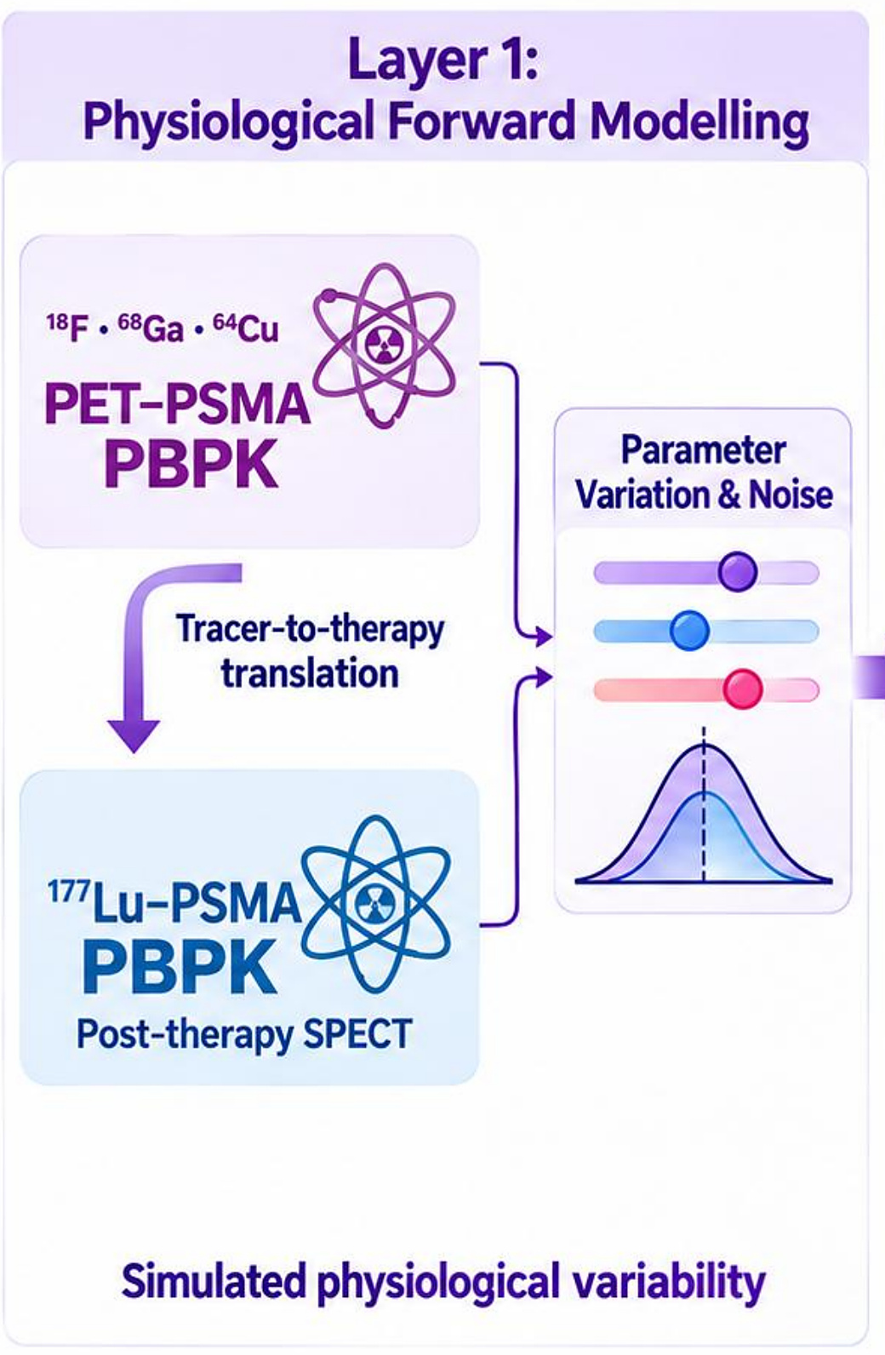
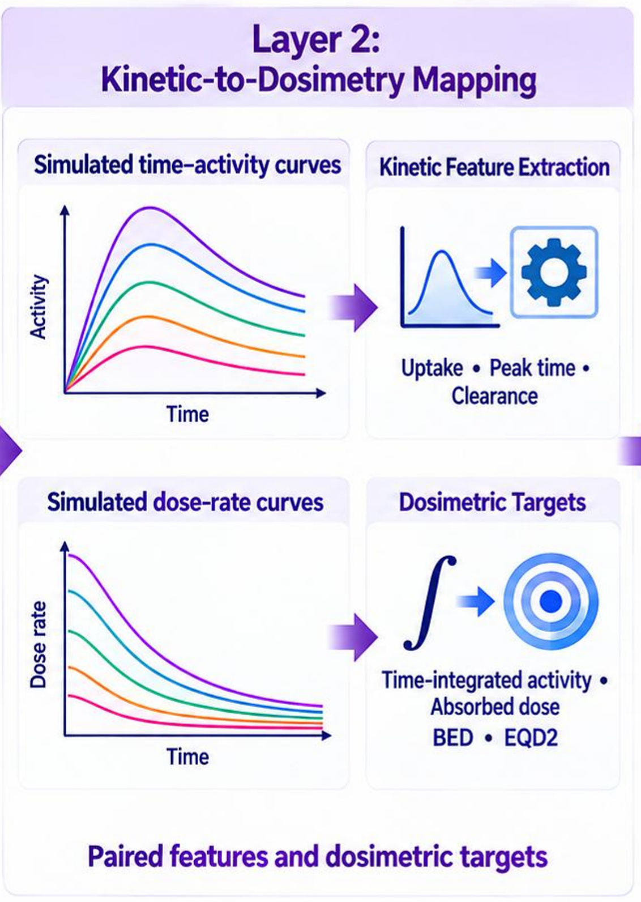
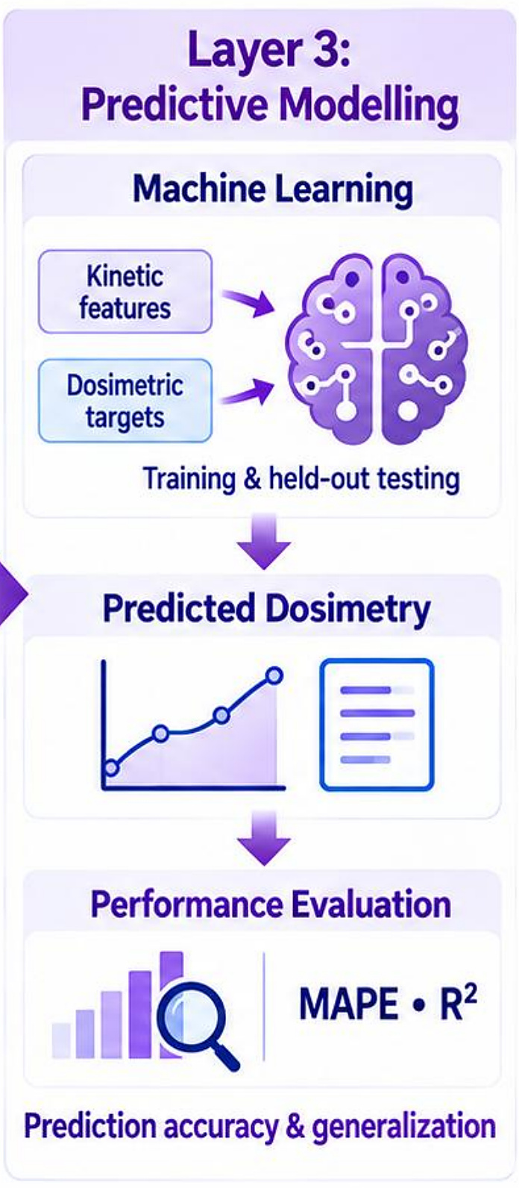
APPLICATION · PREDICTIVE DOSIMETRY
Predicting ¹⁷⁷Lu dosimetry from PET kinetics
Layer 1: physiological modelling
Layer 2: kinetics → dosimetry
Layer 3: machine learning
Pre-therapy PET kinetics → predicted therapy dose
Abdollahi et al., IEEE Trans Radiat Plasma Med Sci 2026
21
Notes:
An application of the twin: predictive dosimetry. Can we predict 177Lu-PSMA therapy dosimetry from pre-therapy PET kinetics? The pipeline has three layers.
Layer 1 — physiological forward modelling: a PET-PSMA PBPK model for 18F, 68Ga and 64Cu tracers, translated (tracer-to-therapy) to a 177Lu-PSMA PBPK model consistent with post-therapy SPECT. Parameter variation and noise create simulated physiological variability.
Layer 2 — kinetic-to-dosimetry mapping: from simulated time–activity curves we extract kinetic features (uptake, peak time, clearance); from simulated dose-rate curves we compute dosimetric targets (time-integrated activity, absorbed dose, BED, EQD2). This gives paired features and dosimetric targets.
Layer 3 — predictive modelling: machine learning maps kinetic features to dosimetric targets with training and held-out testing, giving predicted dosimetry, evaluated with MAPE and R² for prediction accuracy and generalization.

Slide 22
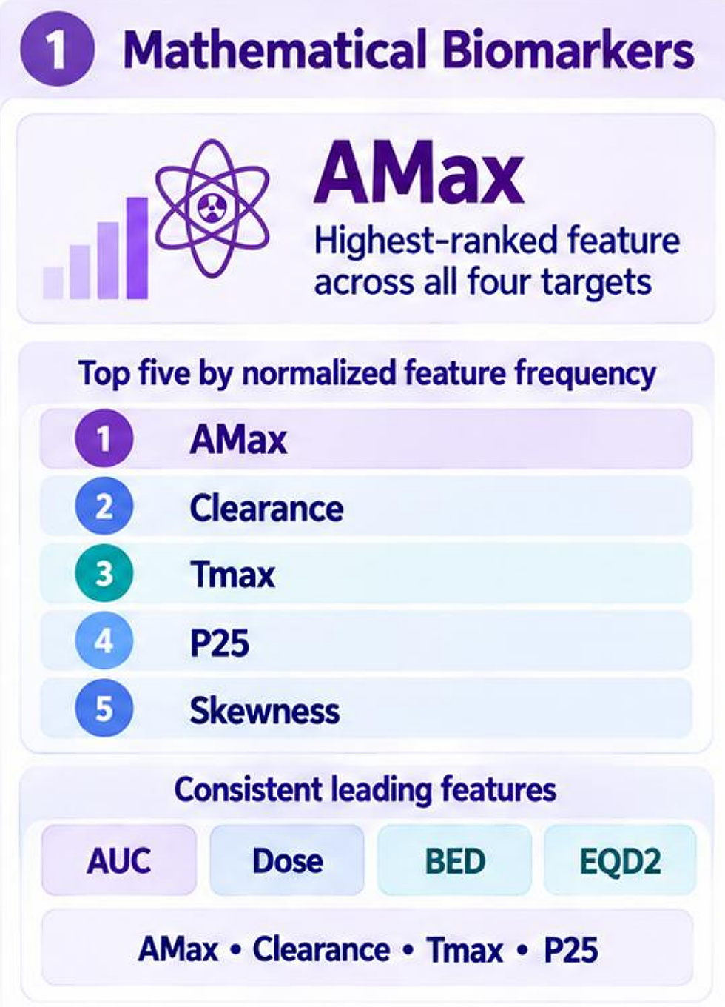
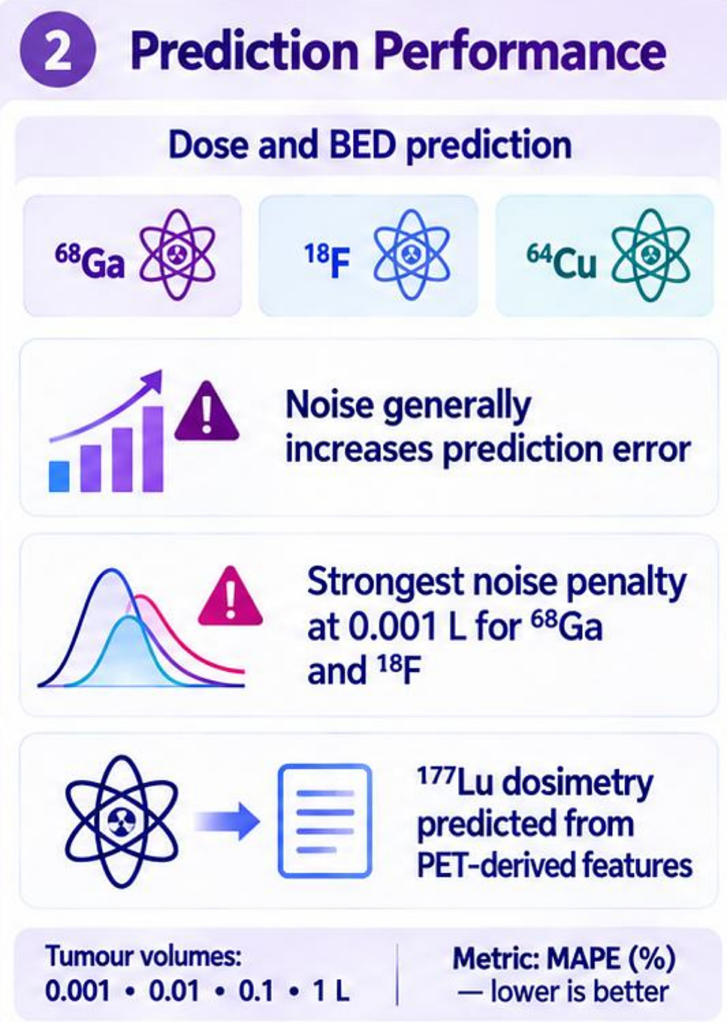
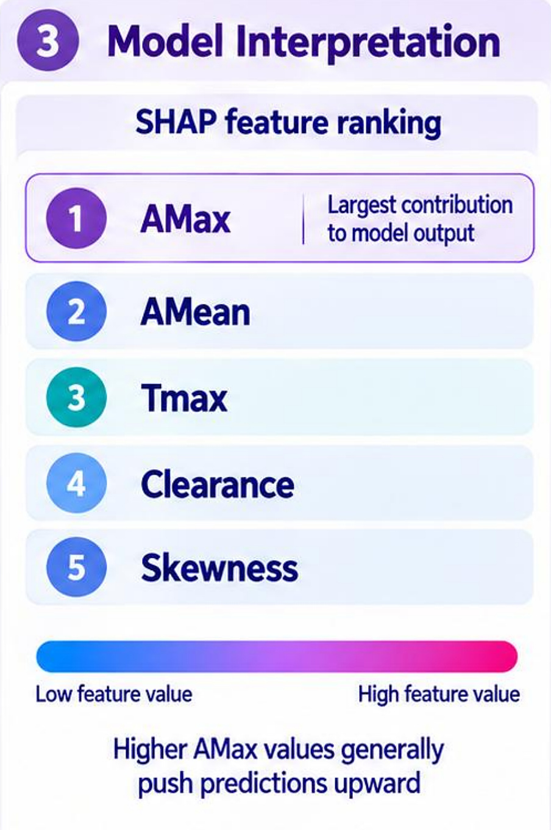
APPLICATION · PREDICTIVE DOSIMETRY
Predictive dosimetry: key findings
Peak uptake (AMax) leads
Noise matters most in small tumours
Model interpretation (SHAP)
Uptake magnitude and kinetics support dosimetry prediction
Abdollahi et al., IEEE Trans Radiat Plasma Med Sci 2026
22
Notes:
Key results of the predictive dosimetry study.
1. Mathematical biomarkers: AMax was the highest-ranked feature across all four targets. The top five by normalized feature frequency were AMax, Clearance, Tmax, P25 and Skewness. Consistent leading features for AUC, dose, BED and EQD2 were AMax, Clearance, Tmax and P25.
2. Prediction performance: dose and BED prediction using 68Ga, 18F and 64Cu tracers. Noise generally increases prediction error, with the strongest noise penalty at 0.001 L tumour volume for 68Ga and 18F. 177Lu dosimetry can be predicted from PET-derived features. Tumour volumes simulated: 0.001, 0.01, 0.1 and 1 L. Metric: MAPE (%), lower is better.
3. Model interpretation (SHAP feature ranking): 1 AMax (largest contribution to model output), 2 AMean, 3 Tmax, 4 Clearance, 5 Skewness. Higher AMax values generally push predictions upward.
Message: uptake magnitude and kinetics support dosimetry prediction; noise sensitivity depends on tracer and tumour volume. (Qualitative synthesis of the supplied results.)

