Slide 1
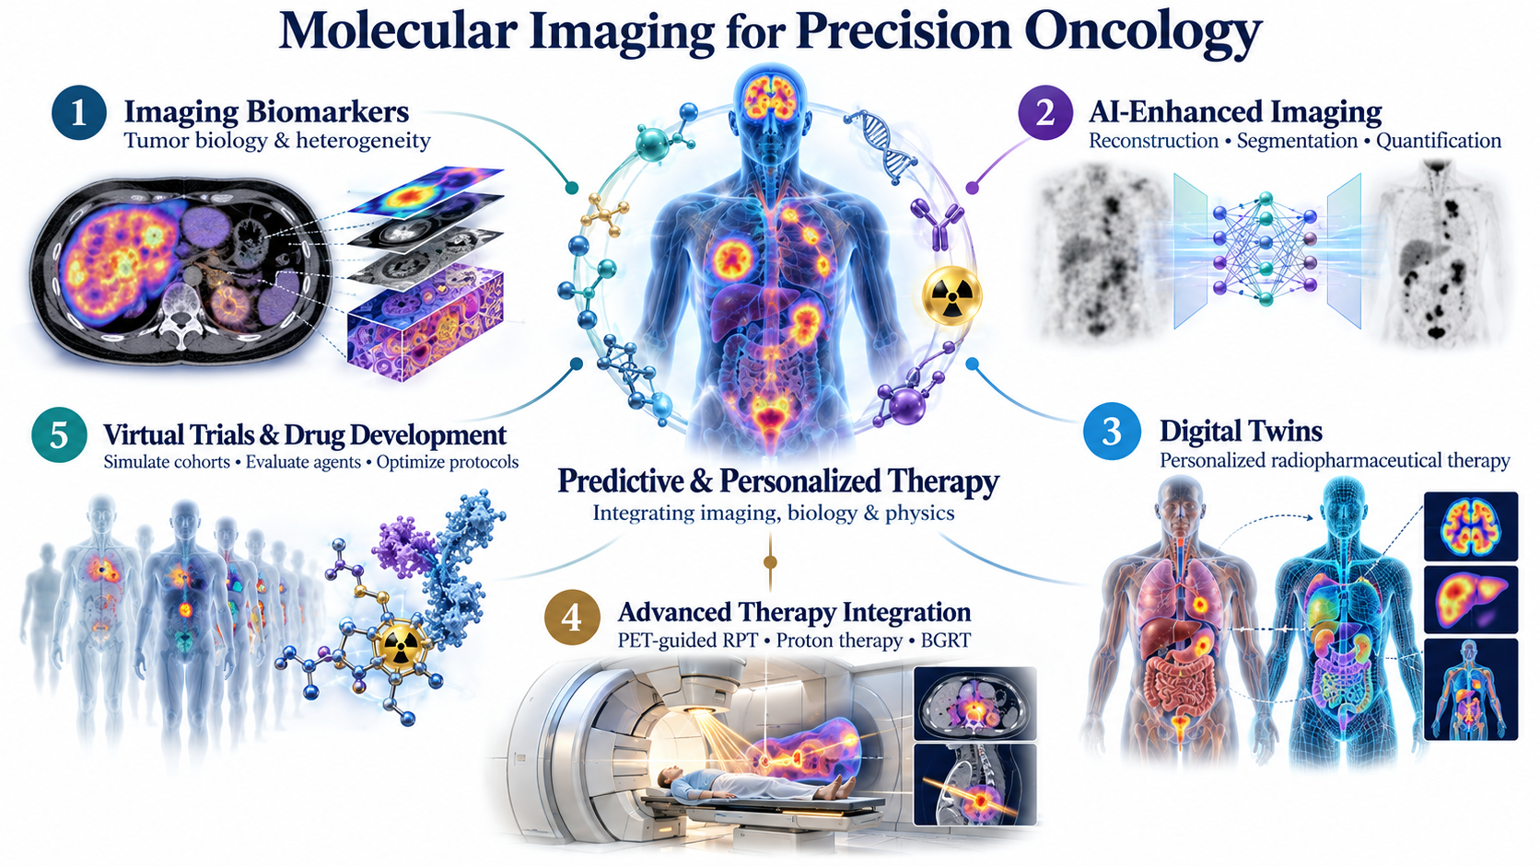
FACULTY / CRC TIER 2 RESEARCH VISION
Imaging-Informed Virtual Trials
Molecular imaging as a predictive platform for patient-specific therapy
Hamid Abdollahi, PhD
Medical physics · quantitative imaging · AI · radiopharmaceutical therapy
Conceptual illustration
Notes:
TIME: 0:45 (main talk totals 15:00 across slides 1–13)
SAY:
My research vision is to make molecular imaging a predictive platform that can guide patient-specific therapy. This figure brings together five connected aims: imaging biomarkers describe tumour and normal-tissue biology; AI makes the measurements reliable and efficient; digital twins combine those measurements with pharmacokinetics and radiobiology; integration with treatment technologies connects the models to therapy; and virtual trials test strategies and prioritize new agents before prospective studies. The central question is how we can capture biological heterogeneity and use it to design better therapy for each patient. I will start with a tractable radiopharmaceutical therapy use case and expand as evidence and partnerships mature.
TRANSITION:
Let me start with where imaging already sits in therapy.
SOURCES:
Illustration: AI-generated conceptual art, not clinical images or results.

Slide 2





Theranostics closes the loop, except for planning
WHY THIS PROGRAM
Which treatment strategy is best for this patient, at this time?
Missing in routine care: activity is mostly fixed
1 · See the target
2 · Select
3 · Plan
4 · Treat
5 · Monitor and adapt
PET maps target expression and tumour burden
Treat when disease expresses the target
Predict tumour and organ dose; choose the strategy
Same target, β, α or Auger emitter
Post-therapy SPECT/PET guide the next cycle
every cycle
PROVEN PAIRS
Diagnostic and therapeutic agents share a target but not always kinetics: predictions must be checked per pair.
PSMA: 68Ga-PSMA-11 PET → 177Lu-PSMA-617 in prostate cancer
SSTR: 68Ga-DOTATATE PET → 177Lu-DOTATATE in neuroendocrine tumours
Notes:
TIME: 1:00
SAY:
Theranostics is where molecular imaging already guides therapy. One target, two isotopes: we see the target with PET, select patients whose disease expresses it, treat with a beta, alpha or Auger emitter, and monitor with post-therapy imaging. PSMA in prostate cancer and DOTATATE in neuroendocrine tumours prove the concept. But step 3, Plan, outlined in orange, is still mostly missing: activity is largely fixed. And diagnostic and therapeutic agents can share a target without being kinetically interchangeable, so imaging-based predictions must be verified for each pair. Planning is the research opportunity.
TRANSITION:
Why hasn't planning caught up? The evidence points to three gaps.
SOURCES:
Yazdani E, et al. Theranostics 2026;16(15):8775–8807.

Slide 3



The missing link is validated treatment planning
WHY THIS PROGRAM
AI and dosimetry are advancing, but few models are tested where decisions are made
AI in theranostics: 73 full journal reports mapped
Heterogeneity
33% vs 18%
variability in effective half-life: lesions vs kidneys
Dosimetry
3–4 scans
over 4–7 days; 30–60 min segmentation; hours of Monte Carlo
Integration
3.4%
Number of the 73 reports meeting each criterion. Categories overlap; narrative evidence map, not a systematic review. Banala et al., Front Nucl Med 2026.
of oncology drugs entering Phase 1 reach approval
Gap figures: Yazdani et al., Theranostics 2026; Wong, Siah & Lo, Biostatistics 2019.
Notes:
TIME: 1:15
SAY:
On the left is the motivation from a recent review. Across 73 full journal reports on AI in theranostics, seven reported an external-type held-out evaluation, one explicit calibration, and none evaluated a prospective AI-guided treatment policy. These categories overlap; it was a narrative evidence map, so I would not claim the numbers describe every study. The message still holds: an accurate segmentation or a promising model does not establish better treatment decisions. On the right are the three gaps my program addresses. Heterogeneity: lesion effective half-life varies about twice as much as kidney half-life. Dosimetry: patient-specific dosimetry needs three to four scans over four to seven days, plus segmentation and Monte Carlo time. Integration: only 3.4 percent of oncology drugs entering Phase 1 reach approval. My program connects quantitative fidelity, practical workflow and decision validation, with clinician oversight.
TRANSITION:
Here is how the five aims answer these gaps.
SOURCES:
Banala M, et al. Front Nucl Med 2026;6:1935247.
Yazdani E, et al. Theranostics 2026;16(15):8775–8807.
Wong CH, Siah KW, Lo AW. Biostatistics 2019.

Slide 4





Five connected aims, one predictive engine
MY VISION
How can molecular imaging capture heterogeneity and guide patient-specific therapy?
RELIABLE INPUTS
PREDICTION
DECISIONS
1 · Imaging biomarkers
2 · AI-enhanced imaging
3 · Digital twins
4 · Therapy integration
5 · Virtual trials
Answers: Heterogeneity
Answers: Heterogeneity · dosimetry
Answers: Dosimetry
Answers: Integration
Answers: Integration
Output: a validated engine that plans activity, cycles, timing and adaptation, and tests them in virtual trials first
Notes:
TIME: 1:00
SAY:
My vision is imaging that predicts, not just sees. Five aims answer the three gaps. Aims 1 and 2 produce reliable inputs: biomarkers of heterogeneity, and AI that makes measurement fast without distorting it. Aim 3, the digital twin, turns those inputs into predictions of dose and response. Aims 4 and 5 turn predictions into decisions: integration with therapy workflows, and virtual trials of agents and protocols. All five feed one output: a validated engine that plans the treatment for each patient and tests strategies in virtual trials before real ones. I'll take each aim in turn.
TRANSITION:
Starting with heterogeneity: Aim 1.

Slide 5
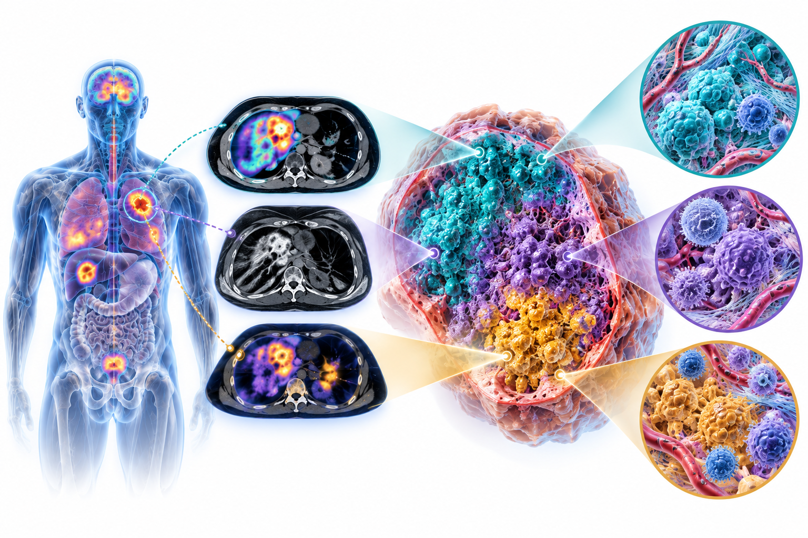


Imaging biomarkers of heterogeneity
AIM 1 · HETEROGENEITY
Which imaging features capture clinically relevant heterogeneity?
Approach
Combine PET, SPECT and MRI with radiomics, kinetics and biological correlates.
Test of success
Test PSMA and SSTR biomarkers against uptake, burden and clinical outcomes, beating simple baselines.
Conceptual illustration
Output: an interpretable biomarker panel for patient stratification and as inputs to the digital twin
Notes:
TIME: 1:15
SAY:
I begin by distinguishing what an image measures from the biology we hope to infer. PET uptake reflects target expression, delivery and clearance; it is not a direct measurement of every element of the microenvironment. The first project quantifies within-lesion, between-lesion and longitudinal heterogeneity, initially in a PSMA-targeted therapy cohort. I will compare radiomic and kinetic features with simple baselines such as SUV and total disease burden. Repeatability, reconstruction sensitivity and segmentation uncertainty decide which features move forward. Where tissue or complementary imaging is available, I will test biological associations, with patient-level splits and independent evaluation. Success is an interpretable panel that adds reproducible information, not a high-dimensional signature.
TRANSITION:
Biomarkers are only useful if measurement is fast and robust: Aim 2.
SOURCES:
Illustration: AI-generated conceptual art, not clinical images or results.

Slide 6
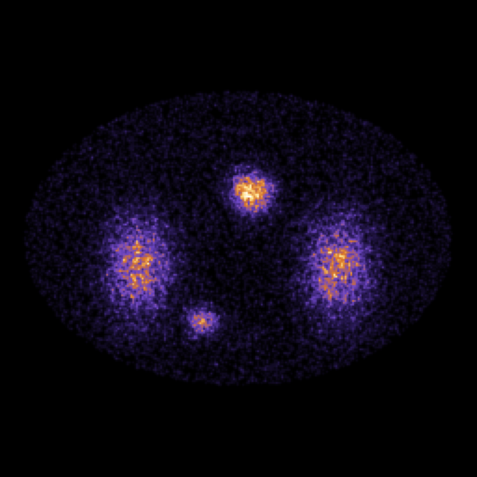
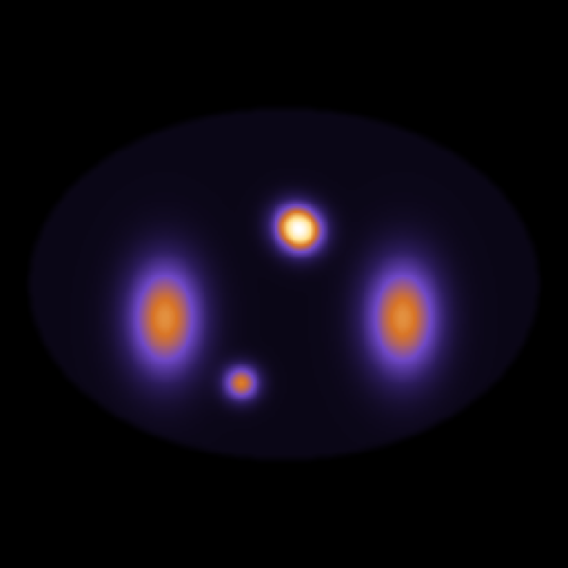
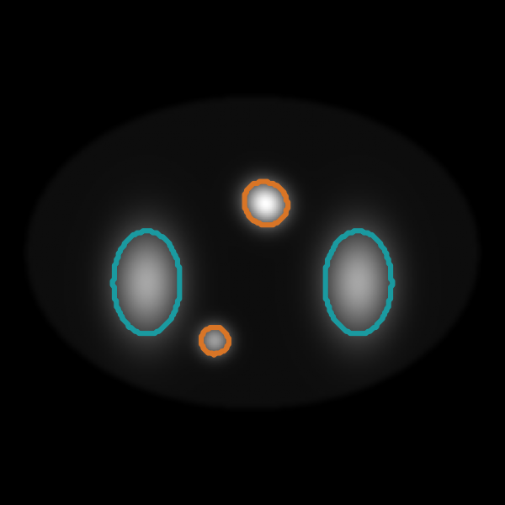
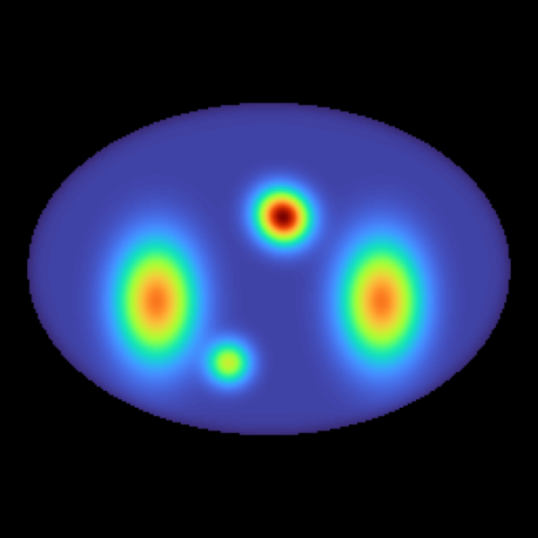
AI that preserves quantitative meaning
AIM 2 · HETEROGENEITY · DOSIMETRY
Can AI reduce imaging workload without distorting the signal?
Approach
1 · Low-count SPECT
2 · AI denoising
Automate reconstruction, corrections, segmentation and serial registration.
Test of success
Measure activity and dose bias, small-lesion recovery and failure detection on phantoms and reference scans.
3 · Organs + lesions
4 · Voxel dose
Schematic, synthetic phantom
Evidence: deep learning can cut 177Lu SPECT time by 50–75%; transformer dosimetry takes ~3 s vs hours of Monte Carlo; lesion segmentation still needs caution.
Notes:
TIME: 1:15
SAY:
This aim supports every downstream model. I investigate AI reconstruction, denoising and automated segmentation with physical consistency as a design constraint; the figure shows the chain on a synthetic phantom, from low-count SPECT to a voxel dose map. Visually attractive images are not enough: a method that smooths a lesion or shifts activity concentration can change dosimetry even when image-quality scores improve. So I evaluate activity recovery, small-lesion behaviour and downstream dose error on phantoms and clinical reference acquisitions, and distinguish shorter scans from fewer time points. The literature is encouraging: 50 to 75 percent shorter 177Lu SPECT, and dosimetry in seconds rather than hours. Outputs are reviewable and flag unfamiliar data. The first deliverable is a measurement tool a clinician can audit, with quantified limits across scanners.
TRANSITION:
With reliable, fast inputs, we can turn images into plans: Aim 3.
SOURCES:
Yazdani E, et al. Theranostics 2026;16(15):8775–8807. (Table 3).

Slide 7
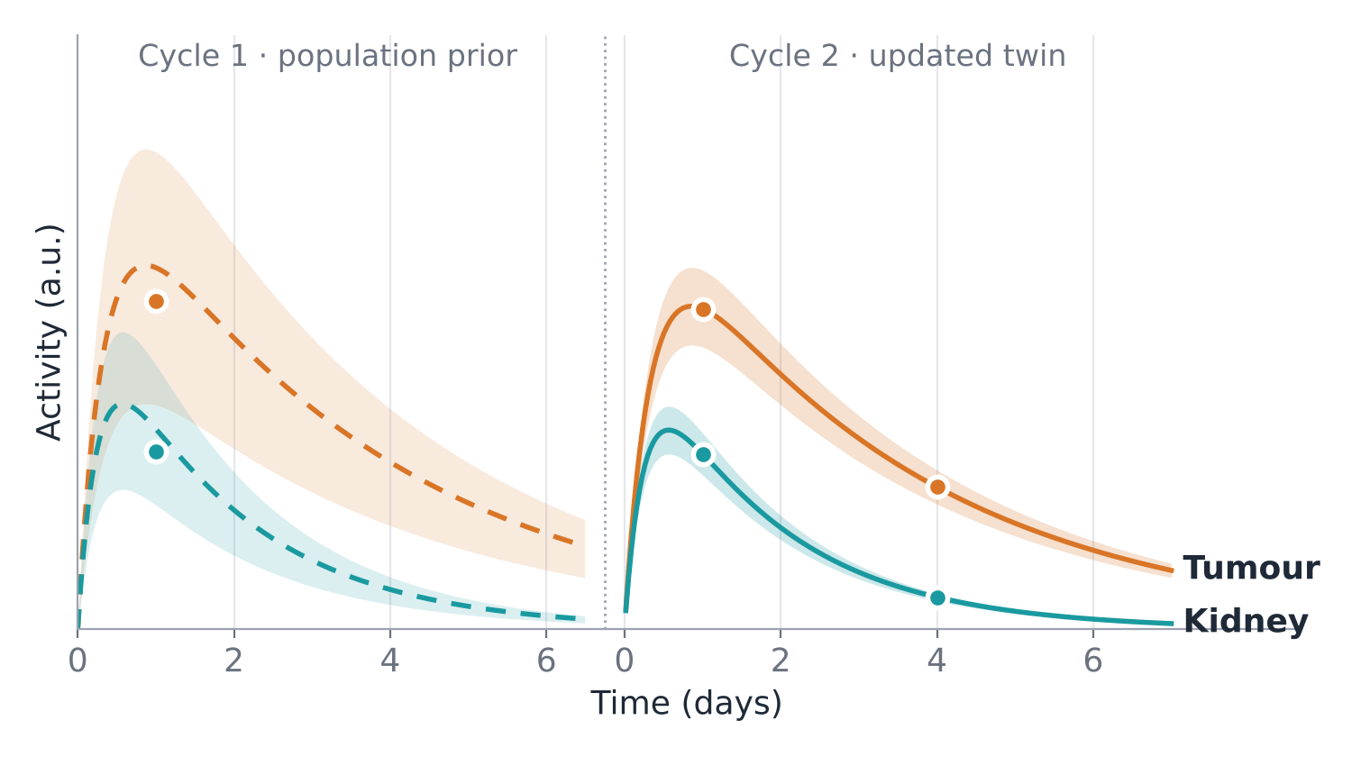
Digital twins for personalized RPT
AIM 3 · DOSIMETRY
Can we predict patient-specific dose and update it across cycles?
Approach
Link PET/SPECT to PBPK or population kinetics, voxel dose and radiobiology.
Test of success
Update the model after each cycle. Validate dose first, then response, separately.
Schematic: sparse post-therapy measurements (dots) narrow the prediction band from cycle 1 to cycle 2. Not patient data.
Builds on: Abdollahi et al., theranostic digital twins (Theranostics 2024); PBPK in 177Lu-PSMA (Cancers 2024); low-dose-rate radiobiology (IEEE TRPMS 2025).
Notes:
TIME: 1:30
SAY:
A digital twin here is a patient-specific model that updates as new measurements arrive. PBPK models describe delivery and retention in organs and tumours; dosimetry turns time-integrated activity into absorbed dose; radiobiology explores how dose rate and tissue sensitivity affect response. The schematic shows the idea: cycle 1 starts from a population prior with a wide band, and a few post-therapy measurements tighten the cycle-2 prediction for tumour and kidney. I validate dose prediction first, then the harder response problem. Baseline PET alone may not identify every parameter, and diagnostic and therapeutic agents can differ in kinetics, so I use identifiability analysis, population priors and well-chosen post-therapy scans. Outputs support research and clinical review; they do not prescribe autonomously. This builds directly on my published work on digital twins, PBPK and low-dose-rate radiobiology.
TRANSITION:
What does the twin let us ask for one patient?
SOURCES:
Yazdani E, et al. Theranostics 2026;16(15):8775–8807.

Slide 8



Therapy is a design space, not one number
AIM 3 IN ACTION
Today activity is mostly fixed (e.g., 7.4 GBq per cycle in VISION and NETTER-1)
DECISIONS TO COMPARE
BIOLOGY AND PHYSICS TO REPRESENT
Activity alone (illustrative 177Lu-PSMA twin)
Administered activity
Kinetics, organ function, tumour sink effect
7.4 GBq
Organs safe · tumour refractory
Cycles and intervals
Dose rate, repair (G factor), BED/EQD2
8.3 GBq
Organs safe · tumour responds
Infusion and ligand
Bolus vs metronomic; hot/cold ligand competition
10 GBq
Tumour responds · organ toxicity
Cycle-by-cycle adaptation
Changing burden, kinetics and sensitivity
A fixed activity can under-treat one patient and harm another.
After Yazdani et al., Theranostics 2026 (Fig. 5); Abdollahi et al., Theranostics 2024. Illustrative, not a recommendation.
Hypothesis to test: circadian timing, first in silico and preclinically.
Notes:
TIME: 1:15
SAY:
Planning is not one number. Most radiopharmaceutical therapy is given at a fixed activity, for example 7.4 GBq per cycle as in VISION and NETTER-1. On the left is an illustrative 177Lu-PSMA twin from the literature: at 7.4 GBq organs are safe but the tumour is refractory; at 8.3 it responds safely; at 10 there is organ toxicity. But activity is only one decision. On the right are the decisions we can change, and the biology the model must represent: cycles and intervals, where dose rate and repair matter; infusion and ligand amount; and adaptation from cycle to cycle. These factors are coupled, so the twin compares whole strategies with uncertainty. Circadian timing is a hypothesis I would test first in silico and preclinically. These are research comparisons, not clinical recommendations.
TRANSITION:
The same engine connects to treatment workflows beyond RPT: Aim 4.
SOURCES:
Yazdani E, et al. Theranostics 2026;16(15):8775–8807.

Slide 9
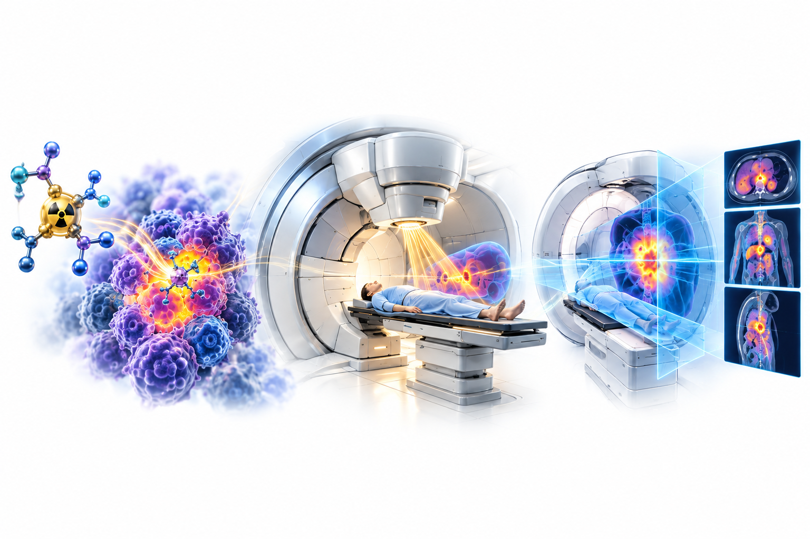
Molecular imaging within therapy workflows
AIM 4 · INTEGRATION
Where can molecular information improve treatment adaptation?
Approach
Start with PET-informed RPT planning. Then explore combined RPT and external-beam therapy.
Test of success
Validate pair-specific kinetics, biological dose models and workflow feasibility.
Conceptual illustration
Later, partner-led extensions: proton therapy with PET and biology-guided radiotherapy (BGRT)
Notes:
TIME: 1:00
SAY:
This aim is staged to keep the program feasible. The near-term priority is PET-informed radiopharmaceutical treatment planning, supported by measured post-therapy dosimetry. Combined RPT and external-beam therapy can follow, but only under explicit tissue, repair and dose-rate assumptions; simply adding BED across therapies does not establish safety. Longer term, molecular imaging could inform proton therapy verification and biology-guided radiotherapy, with partners who have those systems. These need different validation: proton-activation PET is not a direct dose or range measurement, and BGRT raises questions of signal reliability and latency. I would build one well-defined integration project at a time.
TRANSITION:
And the same models can test strategies before patients are treated: Aim 5.
SOURCES:
Illustration: AI-generated conceptual art, not clinical images or results.

Slide 10
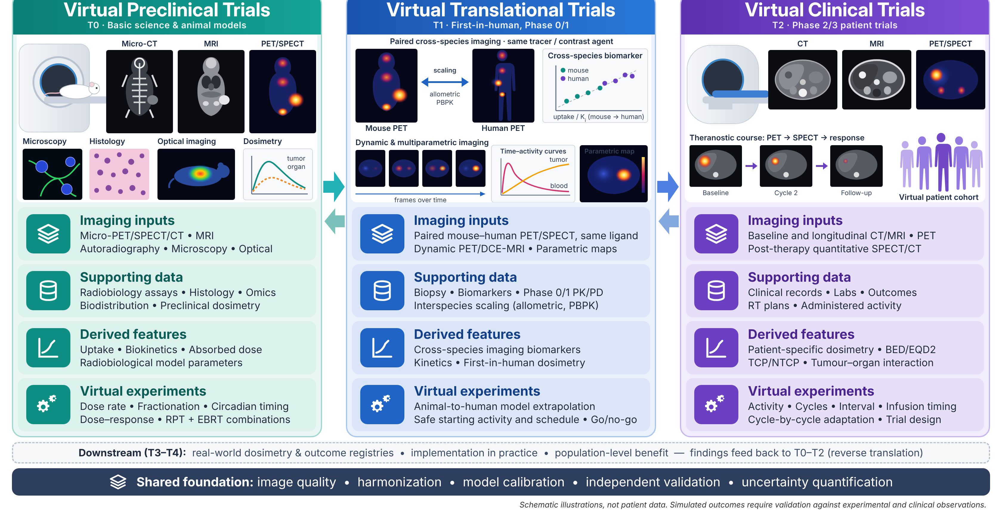
Virtual trials across the translational pathway
AIM 5 · INTEGRATION
T0 preclinical → T1 first-in-human → T2 patient trials; T3–T4 practice and population are later extensions
Notes:
TIME: 1:30
SAY:
Please focus on the three column headings. Validated patient models become virtual cohorts that represent observed variability in anatomy, kinetics, tumour burden and response. At T0, virtual preclinical trials test dose-rate and biological mechanisms against experimental data. At T1, virtual translational trials explore cross-species scaling and a safe first-in-human activity and schedule, with explicit uncertainty. At T2, virtual clinical trials compare agents and adaptive protocols in patient-derived cohorts. Their immediate value is prioritization and trial design, not replacing clinical trials. I separate parameter uncertainty from between-patient variation, check that virtual cohorts reproduce observed distributions, and use held-out outcomes where available. T3 practice and T4 population studies are longer-term extensions, and clinical findings recalibrate earlier models. Only 3.4 percent of oncology drugs entering Phase 1 reach approval; this is where virtual trials can help.
TRANSITION:
None of this matters unless the models are trusted.

Slide 11




Validation before treatment adaptation
SHARED ACROSS ALL FIVE AIMS
Step 3
Prospective evaluation
Step 2
Silent workflow testing, then clinician-reviewed decision support
Conceptual illustration
External testing
Reference: observed response and toxicity
Step 1
Held-out site, scanner or time period; calibration and dataset shift
Technical fidelity
Reference: independent cohorts
Activity and dose agreement; uncertainty that matches observed error
Human review, explicit uncertainty and simple comparators at every stage
Notes:
TIME: 1:00
SAY:
All five aims share this validation pathway, shown as a staircase. Step 1, technical fidelity: does the measurement preserve activity and clinically relevant dose, and do uncertainty estimates match the errors we observe? Step 2, external testing on a held-out site, scanner or time period, evaluating calibration as well as discrimination. Step 3, prospective silent evaluation in the real workflow without changing care; only then clinician-reviewed decision support and eventually patient outcomes. Acceptance limits depend on intended use and are set before evaluation: a segmentation model, a dose predictor and a treatment policy never share one definition of success. Credibility follows ASME V&V 40 and the FDA guidance, and federated learning can reduce data transfer, though it does not remove every privacy risk.
TRANSITION:
Here is how this unfolds over five years.
SOURCES:
Illustration: AI-generated conceptual art, not clinical images or results.

Slide 12
A staged five-year research program
PROPOSED DELIVERY PLAN
Overlapping workstreams with evidence gates; expansion follows validated results
Year 1
Year 2
Year 3
Year 4
Year 5
Biomarkers and AI
Data quality · reproducibility
External testing
Prospective workflow
Digital twins
PBPK and dose models
Patient updates · uncertainty
Decision-support pilot
Therapy integration
RPT use case
Workflow prototype
Partner-led extensions
Virtual trials
Cohort specification
Validated simulations
Study prioritization
Gate 1: reproducible measurements
Gate 2: independently validated models
Launch condition: data access, clinical partners and approved governance.
Notes:
TIME: 1:15
SAY:
This is a proposed implementation, not five separate large projects. In years one and two I establish data agreements, governance and a reproducible imaging pipeline, then biomarker and dose-model baselines in a focused RPT use case. In years two and three the emphasis shifts to independent testing, model updating and uncertainty; the virtual-trial work reuses this infrastructure. Years four and five target prospective workflow evaluation and a clinician-reviewed decision-support pilot, contingent on earlier validation. The diamonds are evidence gates. Proton and BGRT extensions depend on access and partners and do not decide whether the core program succeeds. Trainees own connected, well-scoped projects: MSc on imaging reproducibility, PhD on pharmacokinetic or radiobiological modelling. Proposed partners include UBC/BC Cancer, Geneva, Johns Hopkins and Iranian centres.
TRANSITION:
Let me close with the contribution I aim to make.

Slide 13

The contribution I aim to make
RESEARCH VISION
Molecular imaging that helps plan the next treatment
Reliable measurements
Patient-specific predictions
Tested clinical decisions
Conceptual illustration
Thank you
Aims 1–4 build the predictive models; Aim 5 tests strategies across virtual cohorts before real trials
Notes:
TIME: 1:00
SAY:
I close by returning to the central figure. The strength of this program is the connection between the aims: better measurements improve models, models identify the most informative measurements, and virtual experiments show which hypotheses deserve prospective testing. My contribution is a rigorous bridge between molecular imaging and patient-specific treatment design, drawing on medical physics, quantitative imaging, AI and radiopharmaceutical therapy, with natural collaborations in biology, mathematics, computer science and clinical oncology. The near-term impact is more reliable, practical quantification; the longer-term goal is evidence that these predictions improve treatment decisions. Thank you; I welcome discussion on the best initial clinical use case and partnerships.
TRANSITION:
End of the 15-minute talk. Slides 14–18 are backup.
SOURCES:
Illustration: AI-generated conceptual art, not clinical images or results.

Slide 14



Backup: proposed collaboration network
Partners span T0 to T3, from animal imaging to multicentre clinical data
QURIT lab · BC Cancer / UBC, Vancouver
Digital twins, PBPK and AI quantification · Aims 2, 3, 5
PIN lab · Geneva University Hospital
AI quantitative imaging, Monte Carlo and DL dosimetry · Aims 2, 3
United Theranostics · Johns Hopkins University
Clinical translation, real-world data; RPT dosimetry and radiobiology
Tehran, Iran and Bushehr Universities of Medical Sciences
Clinical cohorts, 177Lu-PSMA dosimetry, therapy clinic and animal imaging
Proposed collaboration pathways: confirm roles, data access and commitments before describing formal partnerships.
Notes:
TIME: Backup
SAY:
Use only for questions. Distinguish existing co-authorship from committed data access or formal agreements. International data work depends on institutional approvals; federated learning keeps patient data local but does not remove every privacy risk.

Slide 15





Backup: independent leadership and training
MY CONTRIBUTION
Linking quantitative imaging to mechanistic prediction of therapy
MSc
PhD
Imaging reproducibility and biomarkers
PK or radiobiological modelling, uncertainty
FOUNDATION: PUBLISHED WORK
Shared, reproducible platform
Theranostic digital twins: concept, framework and roadmap
Abdollahi et al., Theranostics 2024;14:3404–22
Model-informed RPT optimization: PBPK in 177Lu-PSMA therapy
Abdollahi et al., Cancers 2024;16:3120
Low-dose-rate radiobiology in RPT: modelling and challenges
Abdollahi et al., IEEE TRPMS 2025;9:843–56
Partners
Culture
Clinical, radiochemistry and computing
Shared code review, clinical mentorship
Notes:
TIME: Backup
SAY:
Students own bounded questions on one shared, reproducible platform. MSc projects focus on measurement reliability; PhD projects on coupled models, uncertainty and optimization. Transparent recruitment and clear expectations support an inclusive group whose methods others can reuse.

Slide 16
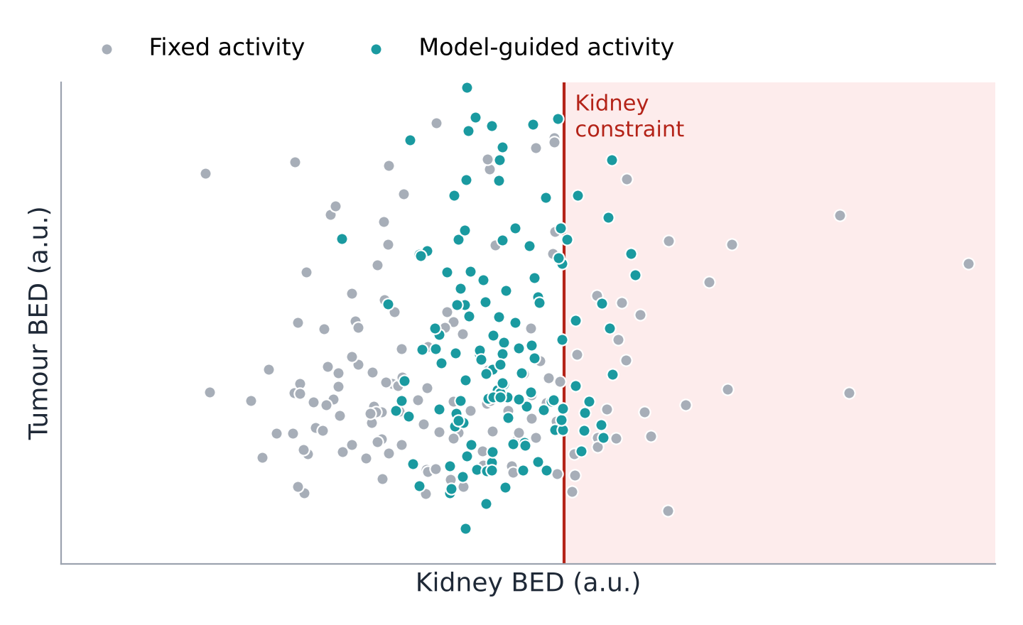
Backup: what a virtual trial compares
Fixed vs model-guided activity across a simulated cohort
Fixed activity: many patients far below the kidney limit, some above it.
Model-guided: patients cluster just below the limit, with more tumour dose where safe.
Schematic virtual cohort (n = 140); each dot is one simulated patient. Illustrates the comparison, not a result.
Notes:
TIME: Backup
SAY:
Use if asked what a virtual trial outputs. Each dot is a simulated patient. A virtual trial cannot prove clinical benefit by simulation alone; it prioritizes which real studies to run and which measurements most reduce uncertainty.

Slide 17
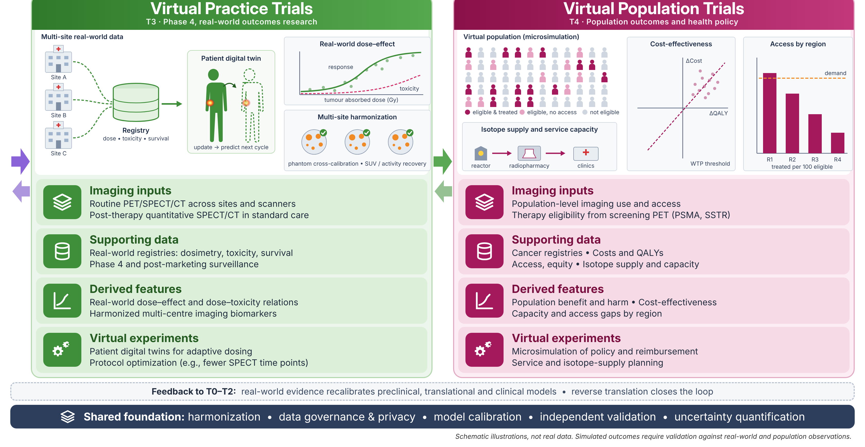
Backup: practice and population extensions
Longer-term T3–T4 extensions; findings feed back to T0–T2 models
Notes:
TIME: Backup
SAY:
T3 evaluates implementation with real-world registries; T4 examines cost, access and isotope supply. The figure's curves and bars are schematic, not study results. There are almost no health-economic studies comparing dosimetry-guided and fixed-activity treatment.

Slide 18


Backup: risks and practical alternatives
RISK
RESPONSE
Sparse serial measurements
Simplify the model; choose informative post-therapy time points
Poor transfer between sites
Study protocol effects and keep robust simple baselines
Uncertain dose–response relation
Validate dosimetry before claiming response prediction
Limited access to new technologies
Prioritize available RPT cohorts; staged partnerships
Notes:
TIME: Backup
SAY:
Biggest risk: clinical validation of digital twins. Reduce it by starting where kinetics are stable, reporting uncertainty, and validating prospectively before predictions guide decisions. A model that cannot predict response may still support a strong dosimetry project.

