Slide 1
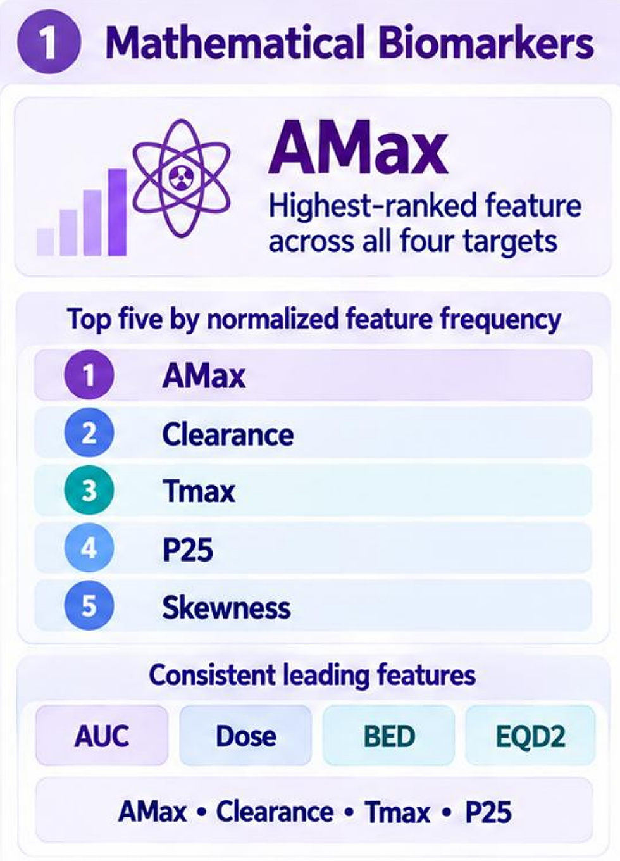
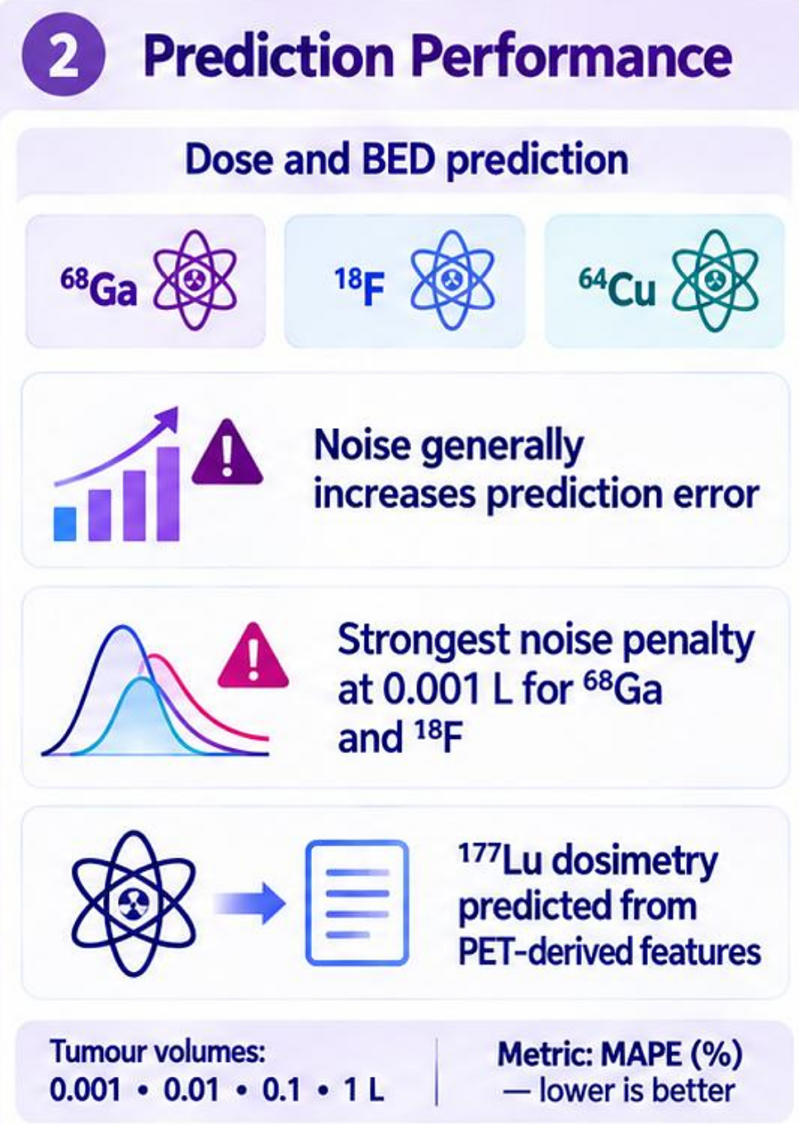
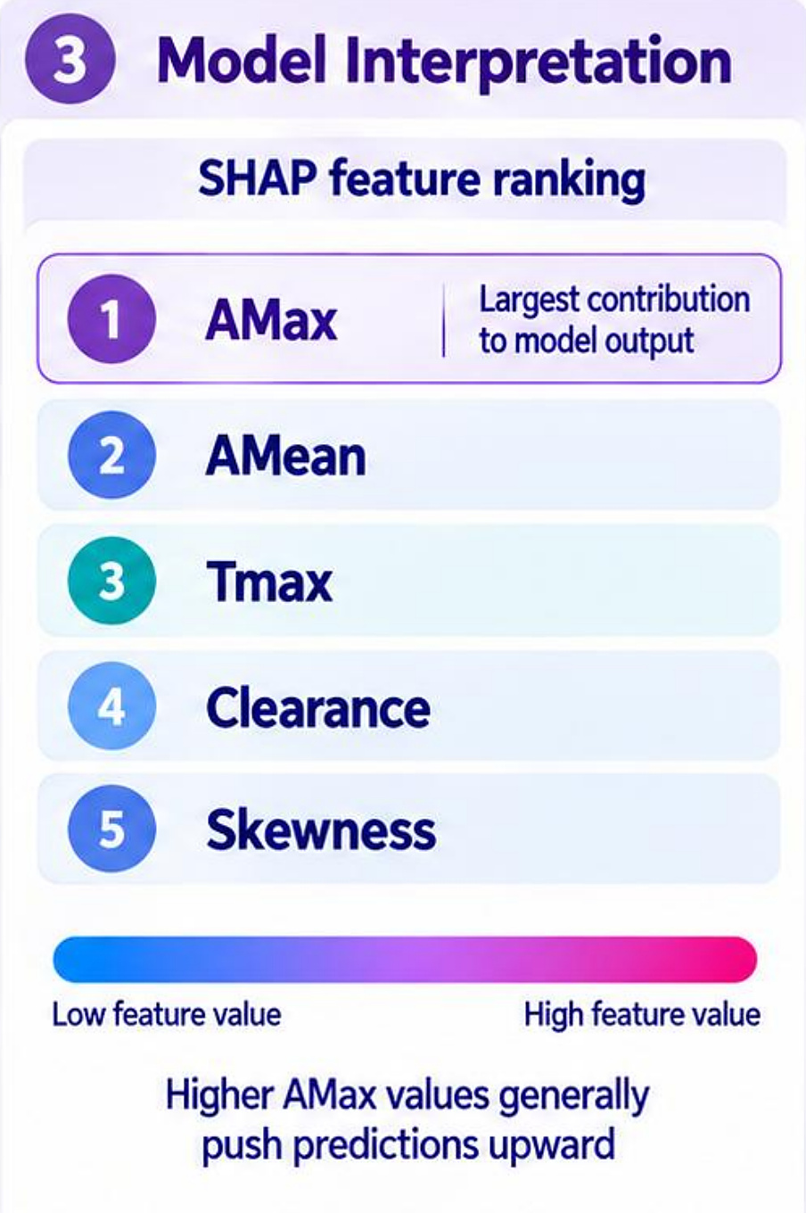
APPLICATION · PREDICTIVE DOSIMETRY
Predictive dosimetry: key results
640
virtual patients
15,360 TACs · 3 PET tracers → ¹⁷⁷Lu
r = 0.996
AMax vs tumour AUC
r > 0.96 vs dose, BED and EQD2
8%
tumour dose MAPE
⁶⁴Cu PET · 1 L tumour
10–16%
organ dose MAPE
⁶⁴Cu PET · 4 of 5 organs
Simulated ¹⁷⁷Lu dosimetry
Normal-organ dose error by PET tracer
What drives prediction
Small tumour → 1 L tumour
MAPE (%) with PET-like noise · 0.1 L tumour · lower is better
Top features (frequency + SHAP)
Tumour dose
48.3 → 31.6 Gy
1
AMax
peak uptake, #1 for all targets
Tumour BED
58.4 → 36.5 Gy
2
Clearance
washout kinetics
Kidney dose
≈ 4.7 Gy
3
Tmax
time to peak
Spleen, marrow
< 0.1 Gy
Kidney / tumour
27.7 → 0.029
Error falls as tumour volume rises; noise hurts most at 0.001 L (⁶⁸Ga, ¹⁸F).
Tumour sink: larger tumours absorb more while organ doses stay low
⁶⁴Cu PET and peak uptake (AMax) give the most robust ¹⁷⁷Lu dose predictions; error falls as tumours grow
Abdollahi, Fowler, Uribe & Rahmim · Predictive dosimetry in PSMA-targeted RPT · IEEE Trans Radiat Plasma Med Sci 2026
34
Notes:
Key results of the predictive dosimetry study, on one slide.
Design: 640 virtual patients from our validated PSMA PBPK model, each simulated with three PET tracers (18F-DCFPyL, 68Ga-PSMA-11, 64Cu-PSMA-617) paired with 177Lu-PSMA therapy: 15,360 time-activity curves for tumours (0.001-1 L) and five organs. Kinetic features from noisy PET curves were used to predict AUC, absorbed dose, BED and EQD2, with patient-level 5-fold cross-validation and MAPE as the primary endpoint.
Simulated dosimetry (left): tumour dose went from 48.3 Gy at 0.01 L to 31.6 Gy at 1 L, BED from 58.4 to 36.5 Gy. The kidney received the highest organ dose (about 4.7 Gy); spleen and marrow stayed below 0.1 Gy. The kidney-to-tumour ratio fell from 27.7 to 0.029: the tumour sink effect.
Prediction accuracy (middle): 64Cu-PSMA-617 gave the lowest errors in most organs - kidney 11.3%, salivary 15.8%, liver 14.4%, marrow 10.4% - versus 16-31% for 18F and 68Ga. Spleen was hardest for all tracers (29-37%). For tumours, 64Cu dose MAPE fell from about 12% to 8% as volume increased. Without noise, errors were roughly halved. Ridge and XGBoost were the most robust models.
Drivers (right): AMax correlated with AUC at r = 0.996 and above 0.96 with dose, BED and EQD2. AMax, clearance and Tmax were the most stable and influential features in both feature selection and SHAP.
Message: 64Cu PET and peak uptake give the most robust 177Lu dose predictions; error falls as tumours grow and noise matters most for very small tumours. Limitation: simulation study; clinical validation is next.

