Slide 1
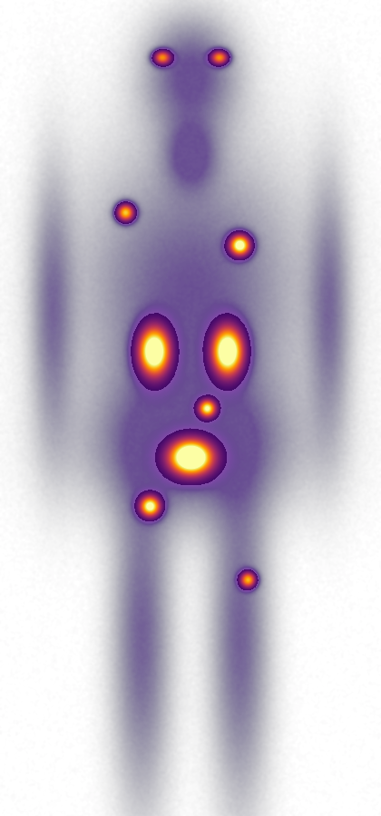



FACULTY / CRC TIER 2 RESEARCH VISION
Predictive Molecular Imaging
& Virtual Theranostic Trials
Patient-specific models for treatment planning
Image
Model
Plan
Hamid Abdollahi, PhD
Medical physics · quantitative imaging · AI · radiopharmaceutical therapy
Schematic PET MIP
Notes:
TIME: 0.5 min (main talk totals 15 minutes across slides 1–13)
SAY:
My research vision is to make molecular imaging a quantitative basis for predicting and planning therapy. I will connect imaging biomarkers to patient-specific models, and then use those models to test treatment strategies in virtual trials. The initial clinical focus is radiopharmaceutical therapy. This program brings together my work in quantitative imaging, pharmacokinetic modelling and radiobiology around one question: how can we make better treatment decisions for an individual patient?
TRANSITION:
The opportunity begins with the treatment-planning question.

Slide 2



The opportunity: predictive treatment planning
Theranostics already links seeing a target to treating it; the planning step is still missing
Which treatment strategy is best for this patient, at this time?
INITIAL FOCUS
PSMA-targeted therapy
DOTATATE-based therapy
Missing in routine care: activity is mostly fixed
1 · See the target
2 · Select
3 · Plan
4 · Treat
5 · Monitor and adapt
PET maps target expression and tumour burden
Treat when disease expresses the target
Predict tumour and organ dose; choose the strategy
Same ligand with a β, α or Auger emitter
Post-therapy SPECT/PET guide the next cycle
every cycle
Imaging observations inform models. Measured outcomes test their predictions.
Notes:
TIME: 1 min
SAY:
Molecular imaging gives us measurements of tracer distribution and disease burden. Theranostics creates a setting in which those measurements can help inform treatment: we see the target, select patients, treat with the same ligand, and monitor. My interest is step 3, the planning decision, outlined in orange: what treatment strategy is appropriate for this patient, and how should it change when new information arrives? In routine care that step is still mostly missing; activity is largely fixed. I will focus initially on PSMA-targeted therapy, with DOTATATE-based therapy as a complementary application. The aim is to estimate exposure and absorbed dose, then test whether those estimates improve predictions of response. Diagnostic and therapeutic agents can have different kinetics, so imaging-based predictions must be checked using measurements relevant to the therapeutic agent.
TRANSITION:
Three scientific gaps define the program.

Slide 3



The question that connects the program
How can molecular imaging capture heterogeneity and guide patient-specific therapy?
Heterogeneity
Dosimetry
Integration
Biology varies within and between tumours, and over time
Exposure varies, and measurement noise can look like biological change
Decisions need a credible link from measurement to prediction
33% vs 18%
3–4 scans
3.4%
variability (CV) in effective half-life: lesions vs kidneys
over 4–7 days for patient-specific dosimetry today
of oncology drugs entering Phase 1 reach approval
Yazdani et al., Theranostics 2026 (half-life variability; imaging burden); Wong, Siah & Lo, Biostatistics 2019 (3.4%).
Notes:
TIME: 1 min
SAY:
The central question is how molecular imaging can capture biological heterogeneity and guide patient-specific therapy. Three gaps sit inside that question. First, heterogeneity: tumours differ within a patient and change over time; lesion effective half-life varies about twice as much as kidney half-life, 33 versus 18 percent. Second, dosimetry: imaging and dose estimates have uncertainty, measurement variation can look like biological change, and patient-specific dosimetry still needs three to four scans over four to seven days. Third, integration: we need a credible link between what we measure and the treatment decision; only 3.4 percent of oncology drugs entering Phase 1 reach approval. My working hypothesis is that quantitative imaging interpreted through biological and physical models can improve predictions of dose and response. Each part of that hypothesis will be tested, rather than assuming that a more complex model is better.
TRANSITION:
I address these gaps through five connected directions.

Slide 4




Five directions, one connected program
Reliable inputs feed a predictive model, which supports treatment decisions
RELIABLE INPUTS
PREDICTION
DECISIONS
Imaging biomarkers
AI-enhanced imaging
Digital twins
Therapy integration
Virtual trials
Characterize biological heterogeneity
Make measurements reliable and efficient
Predict exposure, dose and response
Evaluate planning and adaptation
Compare agents and protocols
Staged: start with radiopharmaceutical therapy; broader therapy integration follows data and partnerships
Notes:
TIME: 1 min
SAY:
The five directions in my research statement form a connected program. Imaging biomarkers describe disease and normal tissue. AI supports reliable reconstruction, segmentation and quantification. Together these are the reliable inputs. Digital twins connect those observations to pharmacokinetics, dose and response: the prediction. Therapy integration applies the models to specific treatment questions, and virtual trials compare candidate agents and protocols across plausible patient populations: the decisions. I will develop these in stages. The immediate emphasis is reliable imaging and predictive models for radiopharmaceutical therapy. Broader treatment integration follows when the relevant data and clinical partnerships are available.
TRANSITION:
The first two directions provide reliable inputs.

Slide 5
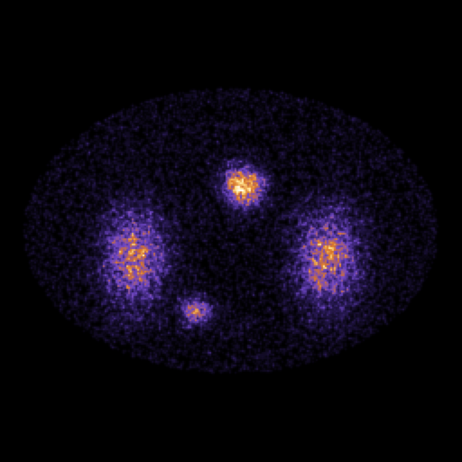
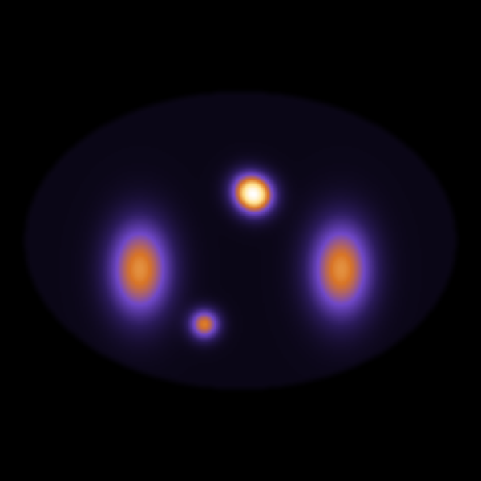
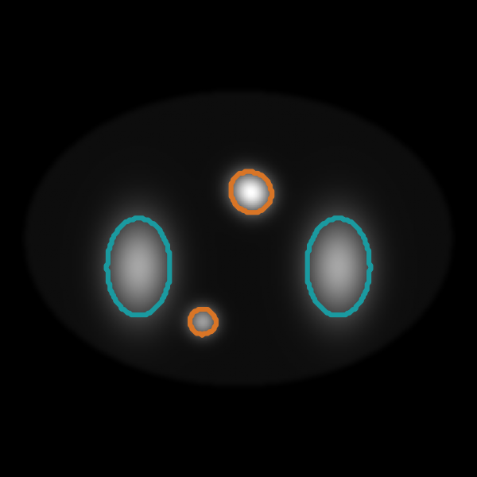
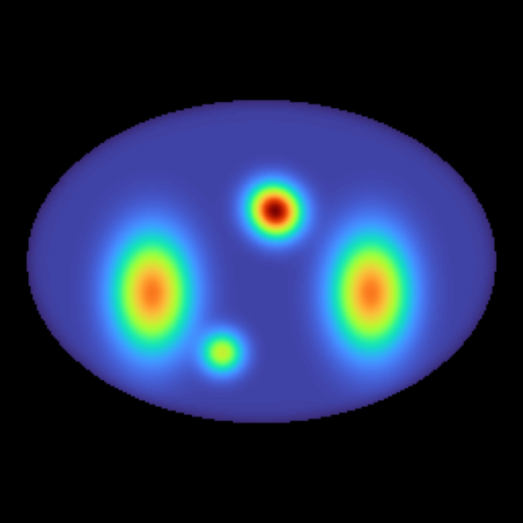



Reliable imaging is the foundation
Which measurements are reliable enough to support a treatment model?
Low-count SPECT
AI denoising
Organs + lesions
Voxel dose
Schematic, synthetic phantom
Measure biology
Improve measurement
Test reliability
Tracer uptake · lesion heterogeneity · disease burden · longitudinal change
Reconstruction · segmentation · registration · quantification
Repeatability · protocol sensitivity · quantitative bias · external performance
Planned output: a validated imaging pipeline and a compact biomarker panel
Notes:
TIME: 1.5 min
SAY:
I begin with a practical question: which measurements are sufficiently reliable to support a treatment model? The strip at the top is the chain I mean, shown on a synthetic phantom: a low-count SPECT image, AI denoising, organ and lesion segmentation, and a voxel dose map. The biomarker work combines PET, SPECT and complementary CT or MRI information. I will examine within-lesion and between-lesion heterogeneity, whole-body disease burden and change over time. Biological interpretation requires independent validation when possible, because uptake alone does not uniquely establish receptor density, hypoxia or another mechanism. AI will support reconstruction, segmentation and quantitative analysis, but I will evaluate its effect on the downstream measurement. A cleaner image is useful only if it preserves the information needed for dosimetry or prediction. The literature is encouraging: deep learning can shorten 177Lu SPECT acquisitions by 50 to 75 percent, and transformer-based dosimetry runs in seconds instead of hours of Monte Carlo, but lesion-level reliability still needs care. The first deliverable is a reproducible measurement pipeline and a compact biomarker panel, tested across protocols and independent data.
TRANSITION:
Those measurements become inputs to a patient-specific model.

Slide 6
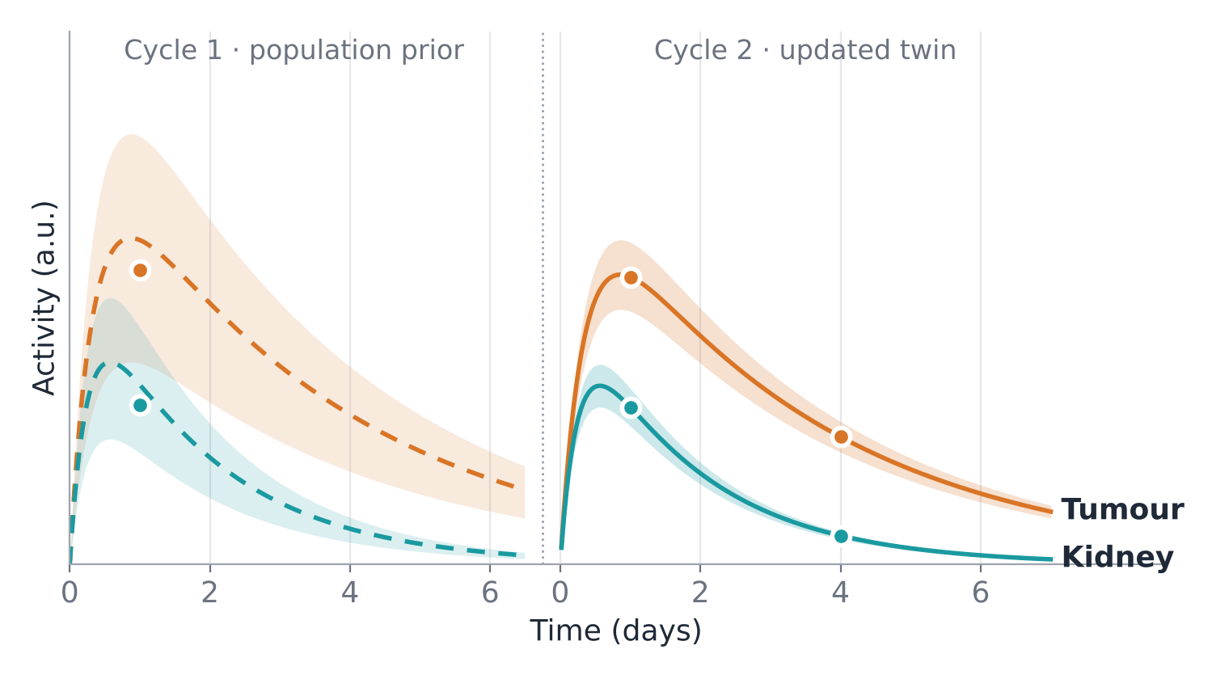


The patient-specific digital twin
A model that updates when new observations arrive, and predicts before the next cycle
Observe
Serial imaging, organ function and treatment history constrain the model
Predict
Pharmacokinetics, dosimetry and radiobiology estimate future outcomes
Update
New measurements revise the model before the next treatment cycle
Schematic: sparse post-therapy measurements (dots) narrow the prediction band (shaded) from cycle 1 to cycle 2. Not patient data.
First test: prediction of tumour and organ absorbed dose in PSMA-targeted therapy
Notes:
TIME: 1.5 min
SAY:
A digital twin is a patient-specific model that updates when new observations become available. Its value comes from prediction and testing alternatives, not simply representing the patient in three dimensions. In this program, imaging and clinical data constrain pharmacokinetic models of distribution and clearance. Dosimetry converts the activity history into absorbed-dose estimates. Radiobiological models then explore response, with their uncertainty made explicit. The schematic on the right shows the idea: in cycle 1 the twin starts from a population prior with a wide uncertainty band; sparse post-therapy measurements, the dots, update it, so the cycle-2 prediction is much tighter for both tumour and kidney. I will start with a limited number of identifiable parameters and a well-defined prediction task. Sparse imaging can help constrain a model, but it cannot identify every unknown. Population information may support estimation, and serial therapy measurements will provide an important validation reference.
TRANSITION:
The model then allows us to compare treatment choices.

Slide 7



The treatment choices I will study
Therapy is a design space: separate the decisions we can change from the biology the model must represent
DECISIONS TO COMPARE
BIOLOGY AND PHYSICS TO REPRESENT
Activity alone (illustrative 177Lu-PSMA twin)
Administered activity
Distribution, clearance and organ exposure
7.4 GBq
Organs safe · tumour refractory
Cycles and intervals
Dose rate, repair and cumulative response
8.3 GBq
Organs safe · tumour responds
Infusion and ligand conditions
Binding, saturation, tumour–organ interactions
10 GBq
Tumour responds · organ toxicity
Cycle-by-cycle adaptation
Changing disease burden and treatment sensitivity
Fixed activity would under-treat this patient; a higher fixed activity would harm them.
After Yazdani et al., Theranostics 2026 (Fig. 5); Abdollahi et al., Theranostics 2024.
Exploratory: circadian timing in preclinical models. All strategies require validation.
Notes:
TIME: 1.5 min
SAY:
On the left is an illustrative digital-twin case for 177Lu-PSMA from the literature. At the standard 7.4 GBq, organs are safe but the tumour is refractory; at 8.3 GBq the tumour responds and organs remain safe; at 10 GBq there is organ toxicity. So one fixed activity can under-treat one patient and harm another. But activity is only one decision. On the right, I separate the decisions we can change from the biology the model must represent. We can investigate activity, number and spacing of cycles, infusion or ligand conditions, and adaptation rules. Their effects depend on kinetics, dose rate, radiobiology and tumour–organ interactions. These factors are coupled; for example, changing the schedule may change repair and accumulated exposure. I will compare candidate strategies within a constrained, validated model and report the uncertainty around each prediction. Circadian timing remains an exploratory hypothesis for preclinical work. These are research comparisons rather than clinical recommendations, and any change to patient care requires prospective evidence.
TRANSITION:
Virtual trials extend these comparisons to patient populations.

Slide 8
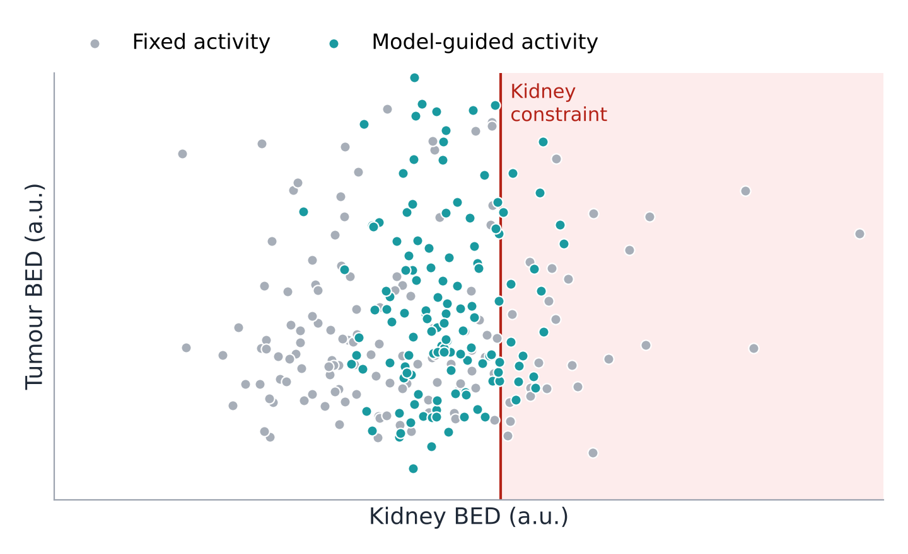


Virtual trials for agents and protocols
How does a candidate strategy behave across a population of plausible patients?
Virtual population
Imaging-informed variation in target expression, kinetics and organ sensitivity
Candidate strategies
Alternative agents, activities, schedules and adaptation rules
Evidence for real trials
Sensitivity analyses, prioritized protocols and the most informative measurements
Schematic virtual cohort (n = 140); each dot is one simulated patient. Illustrates the comparison, not a result.
Purpose: prioritize experiments and clinical studies using testable predictions
Notes:
TIME: 1.25 min
SAY:
A virtual trial asks how a candidate strategy behaves across a population of plausible patients. I will describe variation in imaging features, kinetics and relevant biological parameters, then compare candidate protocols and agent properties. The schematic on the right shows the kind of comparison: each dot is a simulated patient. With a fixed activity, grey, many patients sit far below the kidney constraint and some cross it. With model-guided activity, teal, patients cluster just below the constraint, with more tumour dose where it is safe. The aim is to identify which strategies remain promising when assumptions change, and which measurements would most reduce uncertainty. This can help prioritize real studies, refine eligibility criteria and choose informative endpoints. A virtual trial cannot establish clinical benefit by simulation alone. Its credibility depends on the model, the population it represents and the specific decision it is intended to support.
TRANSITION:
This creates a research framework across translation.

Slide 9
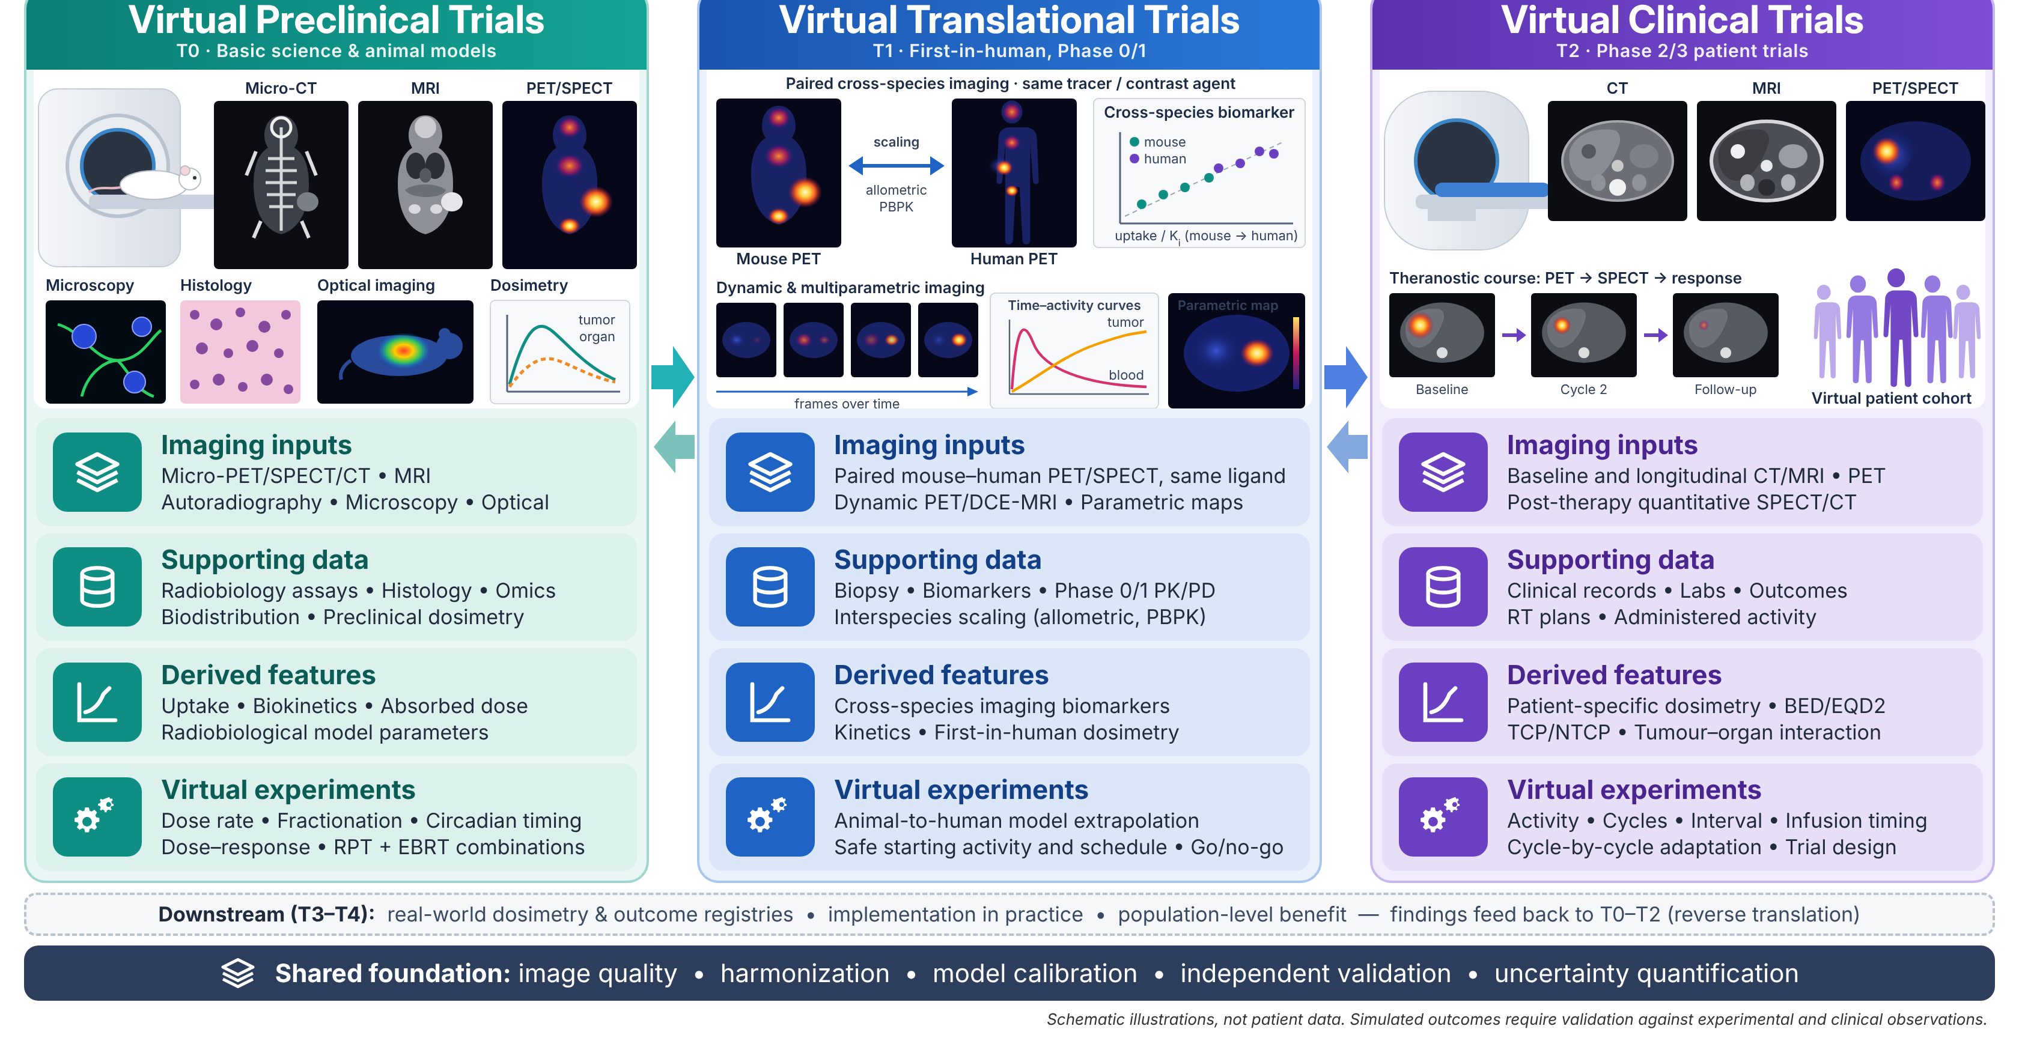
Virtual trials across translation
Same loop at each stage: observations constrain the model, the model predicts, new evidence tests it
Notes:
TIME: 1.5 min
SAY:
This figure shows the broader framework. Please focus on the three column headings. In virtual preclinical trials, imaging and laboratory measurements support studies of kinetics, dose rate and response. In virtual translational trials, species-specific models help explore how evidence might transfer to humans, with substantial uncertainty that must be tested. In virtual clinical trials, patient-specific models compare candidate schedules and adaptation rules. The same principle applies across these settings: observations constrain the model, the model generates a prediction, and new evidence tests or revises it. I would begin with focused applications in the first three stages. Practice and population modelling are longer-term extensions, rather than simultaneous commitments at launch.
TRANSITION:
The common requirement is credible validation.

Slide 10


Evidence before clinical use
Each component is validated against a reference appropriate to its intended use
Gate to each next step: added complexity must beat a simple comparator on a relevant endpoint
Step 3
Clinical evaluation
Credibility framework: ASME V&V 40; FDA 2023 guidance; EANM uncertainty guidance.
Step 2
Prospective feasibility and usefulness for a defined decision
Model prediction
Independent dose or outcome prediction, with calibration
Reference: observed response and toxicity
Step 1
Measurement
Calibration, repeatability and protocol effects
Reference: Monte Carlo, serial imaging, held-out sites
Uncertainty, external evaluation and simple comparators run through every stage
Notes:
TIME: 1 min
SAY:
I will validate each component against a reference appropriate to its intended use, as a staircase. Imaging requires quantitative calibration and repeatability assessment, against phantoms and test–retest data. Kinetic and dose models require comparisons with serial measurements and established calculations such as Monte Carlo, including uncertainty in those references. Predictive models require evaluation on independent patients and sites where feasible. Only after those stages would I move into prospective observational evaluation. Simple comparator models are essential: added complexity must improve a relevant endpoint. If response prediction remains unstable, validated dosimetry is still a useful scientific deliverable.
TRANSITION:
The roadmap makes these gates concrete.

Slide 11
A focused five-year roadmap
Overlapping workstreams with evidence gates, not rigid calendar boundaries
Year 1
Year 2
Year 3
Year 4
Year 5
Foundation
Cohort and imaging QA · biomarker pipeline · baseline kinetic models
Prediction
Patient-specific models · independent validation · calibrated uncertainty
Evaluation
Virtual protocol studies · prospective evaluation · next-stage trial design
Gate 1: reproducible measurements
Gate 2: independently validated predictions
Expansion follows validated performance and access to the required clinical resources.
Notes:
TIME: 1.25 min
SAY:
The first two years establish data access, imaging quality assurance and reproducible baseline models. I will focus on a suitable PSMA therapy cohort and carefully scoped trainee projects. In years two and three, I will develop patient-specific kinetics and dose models, evaluate them independently, and establish where uncertainty limits prediction. In years three to five, the strongest models support virtual protocol comparisons and prospective observational evaluation with clinical partners. These are overlapping workstreams, not rigid calendar boundaries, and the two diamonds are evidence gates: reproducible measurements, then independently validated predictions. The decision to expand depends on evidence. Combined radiopharmaceutical and external-beam therapy, proton PET and biology-guided radiotherapy are later collaborative extensions. The first five-year outcome is a validated foundation and evidence for the next clinical study.
TRANSITION:
An independent scientific identity and a strong training plan make this sustainable.

Slide 12





Independent leadership and training
MY CONTRIBUTION
Linking quantitative imaging to mechanistic prediction of therapy
MSc
PhD
Reliable measurements and biomarkers
Predictive models, uncertainty, optimization
FOUNDATION: PUBLISHED WORK
Shared, reproducible platform
Theranostic digital twins: concept, framework and roadmap
Abdollahi et al., Theranostics 2024;14:3404–22
Model-informed RPT optimization: PBPK in 177Lu-PSMA therapy
Abdollahi et al., Cancers 2024;16:3120
Low-dose-rate radiobiology in RPT: modelling and challenges
Abdollahi et al., IEEE TRPMS 2025;9:843–56
Partners
Culture
Clinical, radiochemistry and computing
Inclusive mentoring and open methods
Notes:
TIME: 1 min
SAY:
The independent scientific contribution is the connection between molecular imaging, mechanistic models and therapeutic prediction. My prior work in theranostic digital twins, PBPK modelling and low-dose-rate radiobiology provides the foundation. I would build a team in which students own bounded questions while contributing to a shared reproducible platform. MSc projects can focus on imaging reliability and measurement design. PhD projects can address coupled models, uncertainty and optimization. Clinical and radiochemistry collaborators bring complementary expertise. Transparent recruitment, clear expectations and accessible training support an inclusive research culture. The goal is a research group with a recognizable scientific direction and methods that others can evaluate and reuse.
TRANSITION:
I will close with the outcome this program is designed to pursue.

Slide 13
THE RESEARCH VISION
Molecular imaging that supports predictive treatment planning
Reliable measurements
Patient-specific predictions
Virtual trials
Validated imaging pipeline and biomarker panel
Digital twins of exposure, dose and response
That inform the next real study
T0
T1
T2
T3
T4
From bench to population, starting with radiopharmaceutical therapy
Thank you
Notes:
TIME: 1 min
SAY:
My vision is a research program in which molecular imaging supports predictive treatment planning. Reliable imaging provides measurements of the patient. Digital twins connect those measurements to models of exposure, dose and response. Virtual trials compare strategies and help select the most informative next experiment or study. The immediate focus is radiopharmaceutical therapy, with a staged route toward broader integration. Success in the first five years means reproducible methods, independently tested predictions and prospective feasibility evidence, together with researchers trained across imaging, physics and computation. The longer-term clinical goal is better patient selection and treatment adaptation. Thank you.
TRANSITION:
End of 15-minute talk. Slides 14–17 are backup material.

Slide 14



Backup: proposed collaboration network
Partners span T0 to T3, from animal imaging to multicentre clinical data
QURIT lab · BC Cancer / UBC, Vancouver
Digital twins, pharmacokinetics and quantitative imaging
PIN lab · Geneva University Hospital
Imaging methods and computational dosimetry
Johns Hopkins University · United Theranostics
Radiobiology and clinical translation
Tehran, Iran and Bushehr Universities of Medical Sciences
Clinical cohorts, dosimetry and preclinical research
Project-specific roles and data access depend on agreed collaborations.
Notes:
TIME: Backup
SAY:
Use only for questions. The supplied deck lists these groups as collaborators or planned partners. Describe the status of each relationship accurately and distinguish existing coauthorship from committed data access or formal agreements. International data work remains conditional on institutional approvals and applicable governance; federated learning keeps patient data local.

Slide 15
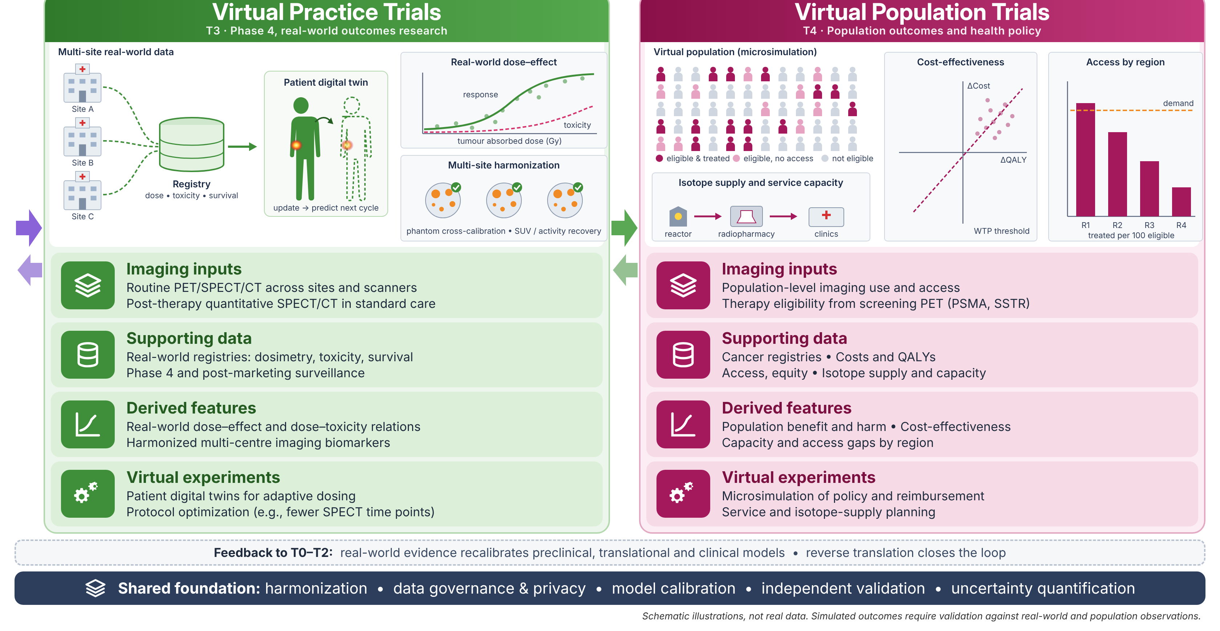
Backup: practice and population extensions
Longer-term T3–T4 extensions; findings feed back to T0–T2 models
Notes:
TIME: Backup
SAY:
T3 and T4 are longer-term extensions. The figure illustrates potential real-world registries, model updates, access and health-economic questions. Its curves and bars are schematic, not study results. Feasibility depends on mature clinical evidence and appropriate population data.

Slide 16


Backup: broader therapy integration
The same imaging, dosimetry and radiobiology models, applied beyond RPT
RPT with external-beam radiotherapy
Proton therapy with PET
Biology-guided radiotherapy
Can local treatment complement heterogeneous systemic exposure?
How can measured activity inform range assessment?
How can molecular signals support treatment models?
Each application needs its own data, partnerships and validation
Notes:
TIME: Backup
SAY:
Initial scope remains radiopharmaceutical therapy. Combining RPT and external-beam radiotherapy requires compatible biological assumptions and attention to dose-rate effects, uncertainty and organ endpoints. Proton-induced PET activity is not a direct absorbed-dose measurement. Biology-guided delivery and adaptive planning are distinct processes that require application-specific models and validation.

Slide 17


Backup: risks and practical alternatives
RISK
RESPONSE
Sparse serial measurements
Simplify the model and optimize sampling
Poor transfer between sites
Study protocol effects and retain robust baselines
Uncertain dose–response relation
Validate dosimetry before claiming response prediction
Limited access to new technologies
Prioritize available RPT cohorts and staged partnerships
Notes:
TIME: Backup
SAY:
Sparse imaging requires identifiable models, population information and informative sampling. Poor site transfer motivates simpler comparators and protocol studies. A model that cannot predict response may still support a strong dosimetry project. Expand only when the evidence and resources justify the next step.

