Slide 1
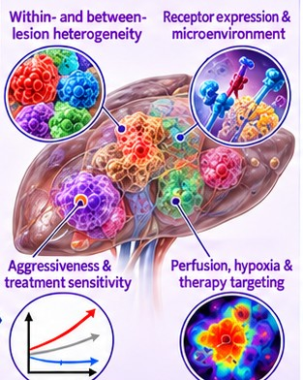
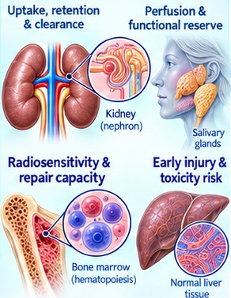
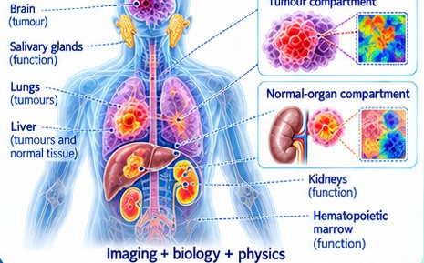
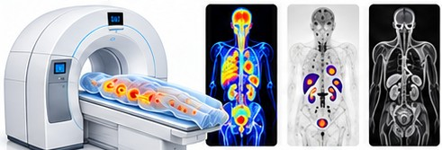
AIM I
Quantitative molecular imaging biomarkers
1 Measure disease
2 Characterize biology
3 Predict and personalize
• Combine PET/CT, SPECT and MRI
• Burden, target expression, tracer kinetics
• Change over time; PSMA and SSTR theranostics
• Heterogeneity within and between lesions
• Receptors, perfusion, hypoxia; normal-organ uptake and clearance
• Radiomics/AI + molecular and clinical data → stratification and targeting
• Digital twin of tumour + normal organs
• Predictive dosimetry: tumour control vs toxicity
• Virtual trials; models updated with new imaging
Goal: a predictive, therapy-guiding imaging platform — reproducible and clinically validated.
Concept adapted from Tharmaseelan et al., Cancers 2022;14:3349 (CC BY 4.0), extended to the proposed research vision
Notes:
My first research aim is to transform molecular imaging into a predictive, therapy-guiding platform by integrating imaging, biology, and physics.
I will combine complementary information from PET/CT, SPECT, and MRI to assess disease burden, target expression, tracer kinetics, and changes over time. Radiotheranostic approaches, including PSMA- and somatostatin-receptor-targeted imaging and therapy, provide a direct connection between disease characterization and treatment.
A central focus will be understanding biological heterogeneity within and between lesions, alongside normal-tissue physiology. By integrating radiomics and AI with molecular and clinical data, I will investigate biomarkers of receptor expression, perfusion, hypoxia, and the tumour microenvironment, together with normal-organ uptake and clearance. These biomarkers will support patient stratification, response prediction, and biopsy or therapy targeting.
I will translate this information into patient-specific digital twins that connect tumour and normal-organ models, enabling predictive dosimetry and investigation of the balance between tumour control and toxicity. Virtual trials will support comparison of treatment options, while longitudinal imaging will update the models as disease and response evolve.
Throughout this work, reproducibility, uncertainty quantification, and independent clinical validation will guide the development of reliable tools for personalized treatment decisions.

Slide 2
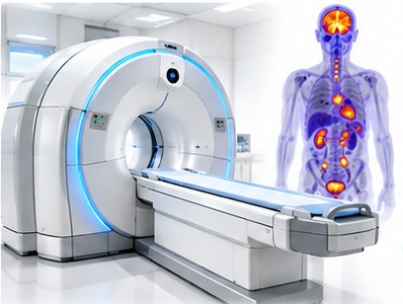
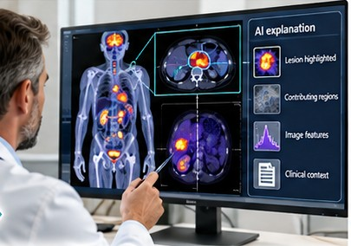
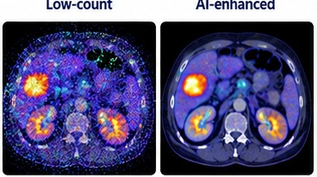
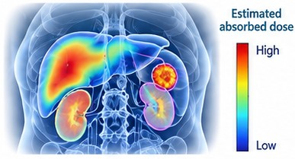
AIM II
AI-enhanced molecular imaging
1 Acquire
2 Enhance
3 Quantify
4 Support
• Physics-informed reconstruction
• Lower-dose, faster PET/SPECT
• Quantitative accuracy kept
• AI denoising
• Lesion detection and segmentation
• Registration over time
• Disease burden and heterogeneity
• Radiomics + clinical + biology
• Personalized dosimetry
• Therapy-response prediction
• Patient stratification
• Interpretable decision support
Priorities: physical consistency · biological interpretability · robust validation — less repetitive work for clinicians.
Proposed research framework · informed by Herskovits (2021) and Mansouri et al. (2026)
Notes:
My second research direction focuses on AI-enhanced molecular imaging, from image acquisition to clinical decision support.
First, I will develop physics-informed reconstruction and denoising methods for next-generation PET and SPECT systems, aiming to enable lower-dose and faster imaging while preserving quantitative accuracy. Second, automated lesion detection, segmentation, and registration will support consistent tumor delineation and monitoring over time.
Third, I will combine quantitative imaging and radiomic features with clinical and biological data to characterize disease burden and heterogeneity, discover meaningful biomarkers, and support personalized dosimetry. These measurements will inform models for therapy-response prediction and patient stratification.
Across this workflow, my priorities are physical consistency, biological interpretability, and robust validation. The goal is to produce reliable measurements and interpretable predictions that support clinicians, while reducing repetitive work and improving workflow efficiency.

Slide 3
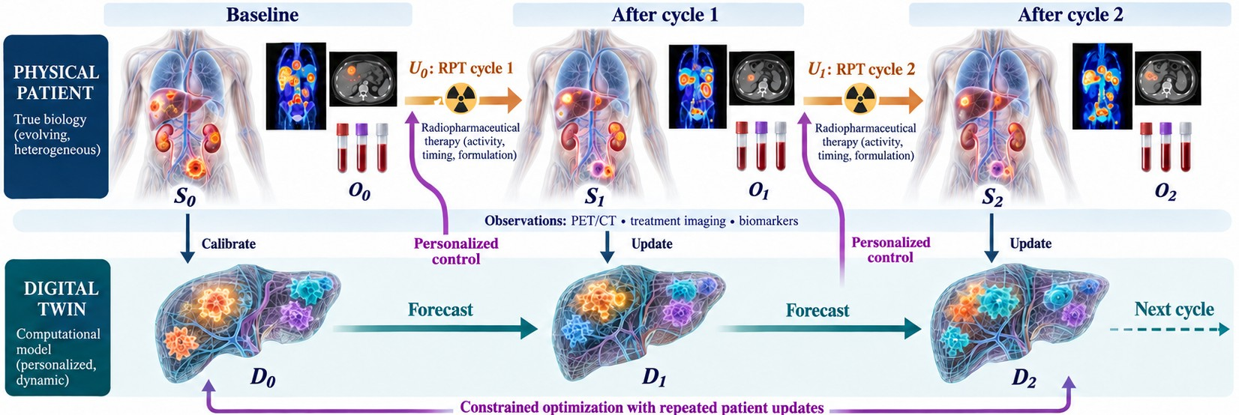
AIM III
Digital twins for radiopharmaceutical therapy
1 Mechanistic core
Pharmacokinetics → dose and dose rate → tumour growth, damage, repair, resistance
2 AI supports the model
Patient-specific parameters from imaging; fast surrogate simulations
3 Predict → optimize → treat
Predict response and toxicity → best activity, timing and number of cycles
Imaging and biomarkers calibrate the twin at baseline and update it after every cycle; the twin forecasts and sends back personalized control.
Feedback loop: measure → predict → optimize → update — then validate prospectively.
Proposed RPT adaptation of Lorenzo et al., Annu Rev Biomed Eng 2024;26:529–560 (Figs. 4–6)
Notes:
This figure shows how I plan to connect a patient’s evolving disease with a digital twin that learns from each treatment cycle. Building on Lorenzo and colleagues’ framework, imaging and biomarkers will initialize the model at baseline and update it after treatment.
The model combines radiopharmaceutical pharmacokinetics, absorbed dose and dose rate, and tumor biology—including growth, damage, repair, and resistance. AI will help extract patient-specific parameters and accelerate simulations.
The twin will then test alternative treatment strategies, predicting tumor response and organ toxicity. These predictions will guide optimization of administered activity, treatment timing, and number of cycles within clinically feasible constraints.
The key is the feedback loop: measure, predict, optimize, and update. My goal is to develop and prospectively validate this framework so that each treatment decision can reflect the individual patient’s changing biology and response.

Slide 4
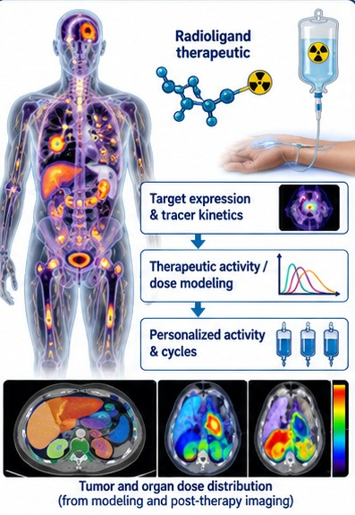
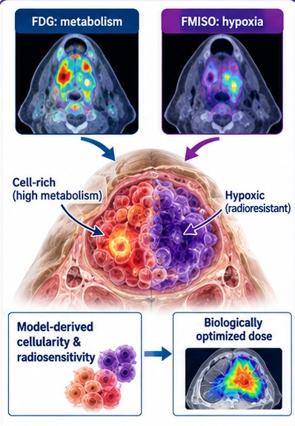
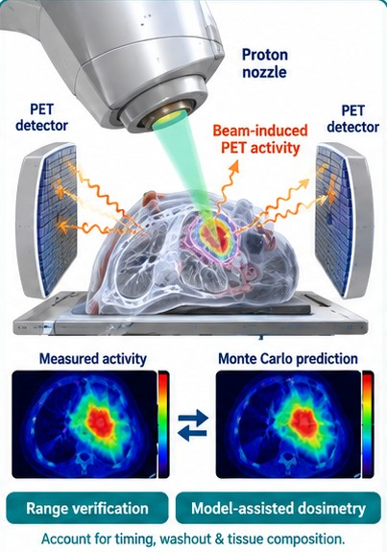
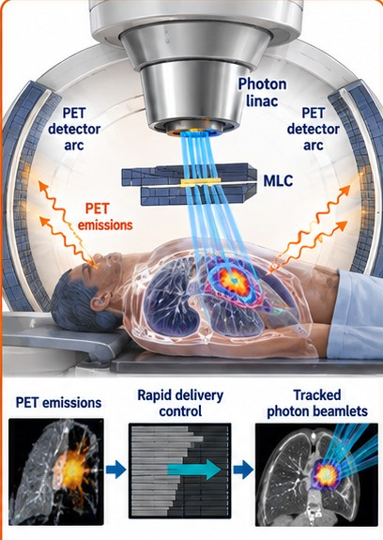
AIM IV
Advanced therapeutic technologies
RPT planning
Dose painting
Proton therapy
Biology-guided RT
• PET target expression and kinetics
• Personalized activity and cycles
• Checked by post-therapy dosimetry
• FDG metabolism + FMISO hypoxia
• Map cellularity and radiosensitivity
• Respect normal-tissue limits
• Beam-induced PET for range checks
• Model-assisted dosimetry
• PET activity ≠ absorbed dose
• Fast PET signals guide the beam
• Follows moving targets
• Within a planned dose envelope
Shared goal: plan, verify, measure response and adapt — including RPT + external-beam combinations.
Oderinde et al. (2021) · Lazzeroni et al. (2026) · Abdel-Wahab & Giammarile (2026)
Notes:
My fourth research direction connects molecular imaging with advanced treatment technologies through four complementary approaches.
In radiopharmaceutical therapy, I will investigate how PET-derived target expression and tracer kinetics can inform personalized treatment planning and dose–response models, validated against post-therapy dosimetry.
For biological dose painting, I will explore combining metabolic and hypoxia imaging to estimate spatial differences in tumor cellularity and radiosensitivity, guiding dose distributions while respecting normal-tissue constraints.
In proton therapy, I will investigate beam-induced PET activity for range verification and model-assisted dosimetry. This requires accounting for tissue composition, imaging timing, and biological washout because PET activity does not directly represent absorbed dose.
Finally, in biology-guided radiotherapy, I will explore how rapidly acquired PET signals can guide radiation delivery to moving targets within a planned treatment framework.
These approaches share a common goal: use molecular information to plan treatment, verify delivery, measure response, and guide adaptation, including opportunities to combine systemic radiopharmaceutical therapy with external-beam treatment.

Slide 5
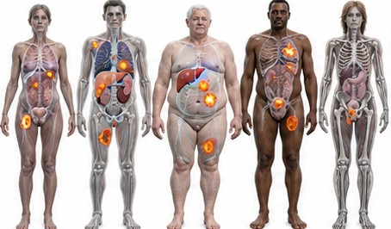
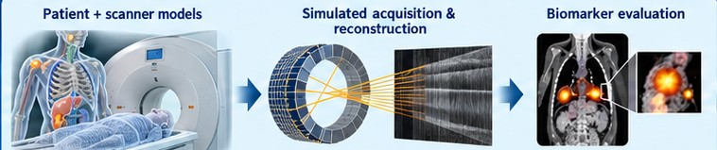

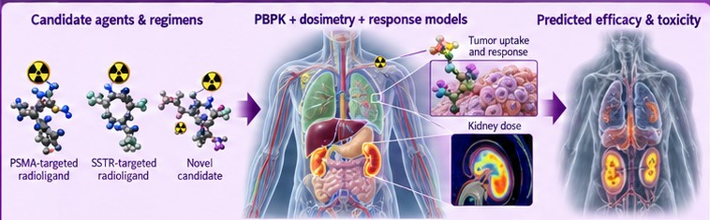
AIM V
Virtual trials and drug development
2 Imaging trials: scanners, protocols, reconstruction; when is dynamic Ki better than static SUV?
1 Virtual cohorts
4 Real-world studies
• Imaging, biology and clinical data
• Anatomy, burden, kinetics, treatment sensitivity
• Prioritize promising strategies
• Design more informative prospective trials
3 Therapy trials: PBPK + dosimetry + response for agents, activities and schedules
Credible simulation: physiological plausibility · uncertainty analysis · independent validation
Lindner & Link (2018) · Wangerin et al. (2017) · Kleeberger (2025) · Samei et al. (2025)
Notes:
My fifth research direction uses molecular imaging to build virtual trials that inform imaging protocols, radiopharmaceutical development, and clinical study design.
I will combine imaging, biological measurements, and clinical data to develop virtual patient cohorts that capture differences in anatomy, disease burden, tracer kinetics, and treatment sensitivity.
These cohorts will support two complementary pathways. Virtual imaging trials will compare scanner configurations, acquisition protocols, reconstruction methods, and response biomarkers—for example, testing when dynamic PET kinetic measures provide more useful information than static SUV measurements.
Virtual therapy trials will combine PBPK, dosimetry, and response models to evaluate candidate radiopharmaceuticals, administered activities, treatment schedules, and combinations across diverse patient groups.
The goal is to prioritize promising strategies and design more informative prospective studies. Throughout this work, I will emphasize physiological plausibility, uncertainty analysis, and independent validation, using virtual trials to complement and strengthen clinical evidence.

