Slide 1
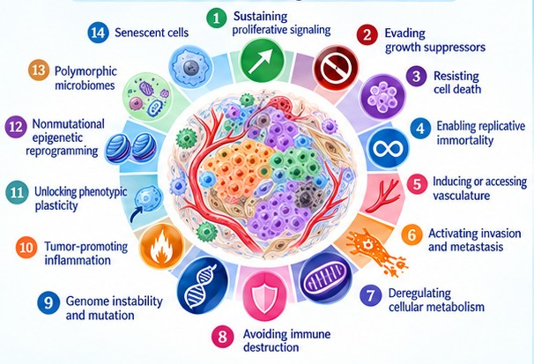
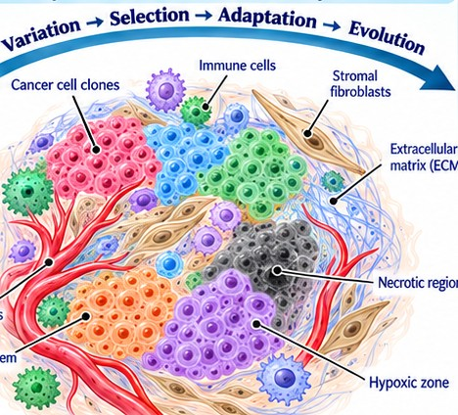
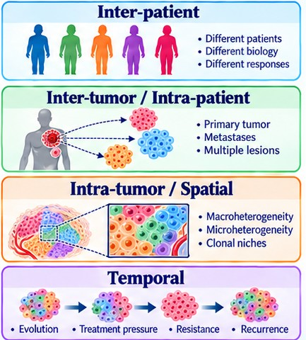
INTRODUCTION · CANCER COMPLEXITY
A complex, dynamic and heterogeneous disease
1 Complex biology
2 Dynamic ecosystem
3 Heterogeneous
• 14 hallmarks and enabling characteristics
• Genetic and epigenetic alterations
• Shaped by the microenvironment
• Cancer, immune, stromal cells and vessels
• Variation → selection → adaptation → evolution
• Hypoxia, immunity and treatment drive change
• Between patients
• Between lesions in one patient
• Within a tumour and over time
Clinical consequences: variable prognosis · differential treatment response · resistance · metastasis · recurrence
Hanahan & Weinberg, Cell 144, 2011 · Kashyap et al., Trends in Biotechnology, 2022
1
Notes:
This figure highlights three defining features of cancer: complexity, heterogeneity, and continuous change.
Cancer is complex because its behavior emerges from interactions among cancer cells, immune cells, blood vessels, and the surrounding tissue. Genetic alterations, epigenetic changes, and the microenvironment shape these interactions.
Cancer is heterogeneous at several levels: between patients, between lesions in the same patient, and between regions within a single tumor. These differences extend from molecules and cells to tissues and whole patients.
Cancer is also dynamic. Cell populations evolve over time under pressures such as limited oxygen, immune surveillance, and treatment. Therapy can eliminate sensitive cells while allowing resistant populations to survive and expand.
Together, these features help explain differences in treatment response, progression, and recurrence. They also motivate my research vision: using quantitative imaging and computational models to characterize this variability, predict its evolution, and support personalized, adaptive treatment.

Slide 2
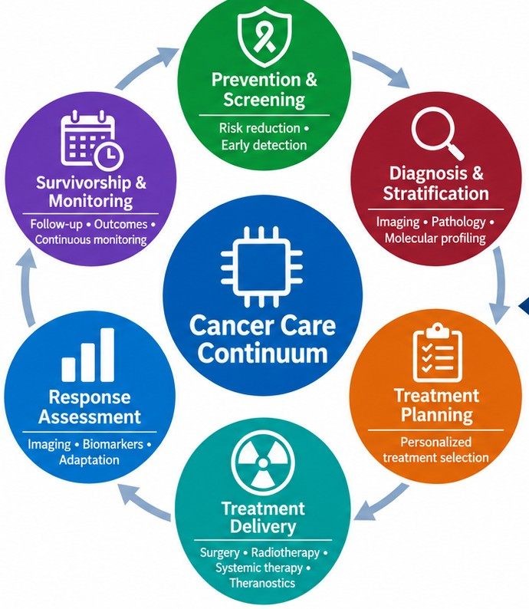
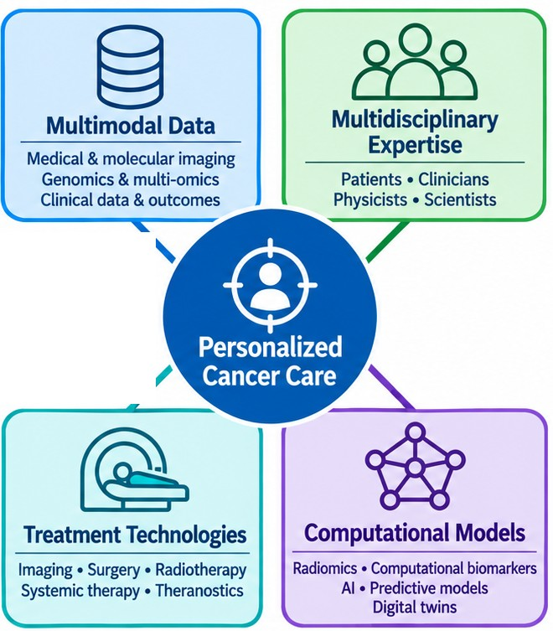
INTRODUCTION · CANCER TECHNOLOGY ECOSYSTEM
From the care continuum to personalized care
1 Care continuum
2 Personalized care
• Prevention and screening
• Diagnosis and stratification
• Treatment planning and delivery
• Response assessment
• Survivorship and monitoring
• Multimodal data: imaging, omics, outcomes
• Multidisciplinary expertise
• Treatment technologies
• Computational models: radiomics, AI, digital twins
Multimodal · multiscale · multipurpose · multidisciplinary — evidence → decisions → outcomes → learning
2
Notes:
The good news is that we have a strong cancer technology ecosystem.
On the left is the cancer care continuum: prevention and screening, diagnosis and stratification, treatment planning, treatment delivery, response assessment, and survivorship and monitoring. Each step generates data and decisions.
On the right are the four pillars of personalized cancer care: multimodal data — medical and molecular imaging, genomics and clinical outcomes; multidisciplinary expertise — patients, clinicians, physicists and scientists; treatment technologies — imaging, surgery, radiotherapy, systemic therapy and theranostics; and computational models — radiomics, AI, predictive models and digital twins.
Connecting them must be multimodal, multiscale, multipurpose and multidisciplinary, and it works as a learning loop: evidence leads to decisions, decisions to outcomes, and outcomes back to learning.

Slide 3
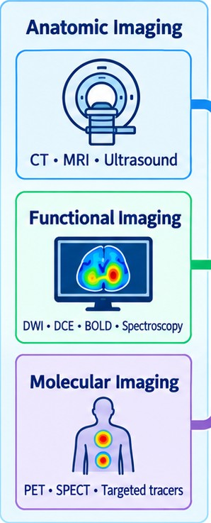
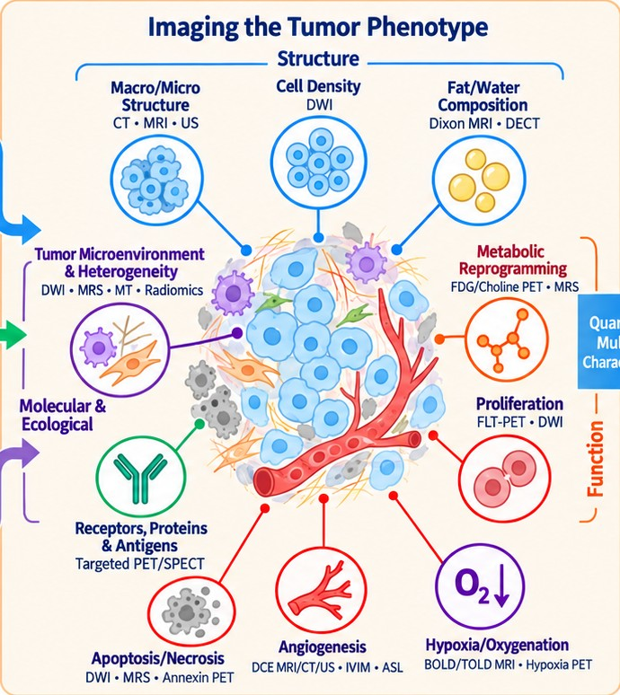
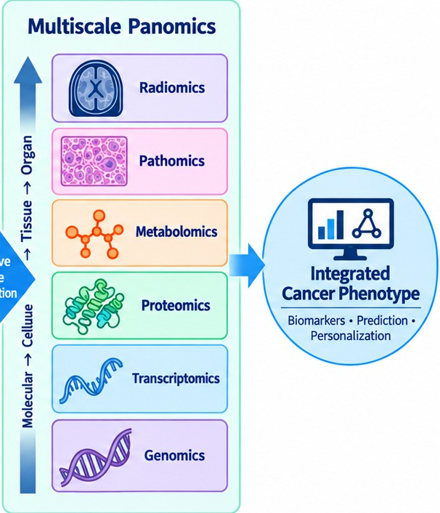
INTRODUCTION · CANCER IMAGING
Imaging the tumour phenotype
1 Imaging modalities
2 Tumour hallmarks we can image
3 Multiscale panomics
• Anatomic: CT, MRI, ultrasound
• Functional: DWI, DCE, BOLD, MRS
• Molecular: PET, SPECT, tracers
• Structure: cell density, fat/water
• Function: metabolism, proliferation, hypoxia, angiogenesis
• Receptors, apoptosis, microenvironment
• Radiomics, pathomics, metabolomics, proteomics, genomics
• → integrated cancer phenotype
Quantitative, multiscale imaging → biomarkers, prediction and personalization
García-Figueiras et al., Insights into Imaging (2019) 10:28
3
Notes:
Imaging lets us measure the tumour phenotype non-invasively and repeatedly.
We have three families of imaging: anatomic imaging with CT, MRI and ultrasound; functional imaging with diffusion, perfusion, BOLD and spectroscopy; and molecular imaging with PET, SPECT and targeted tracers.
Together they capture tumour hallmarks: structure, such as cell density and fat and water composition; and function, such as metabolism, proliferation, hypoxia and angiogenesis, receptor expression, apoptosis and the microenvironment.
These quantitative, multiscale measurements connect with the other ‘omics’ — radiomics, pathomics, metabolomics, proteomics, transcriptomics and genomics — to build an integrated cancer phenotype for biomarkers, prediction and personalization.

Slide 4
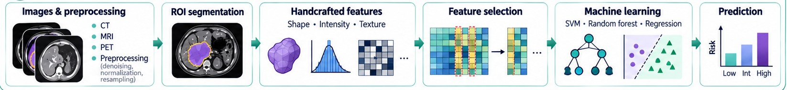
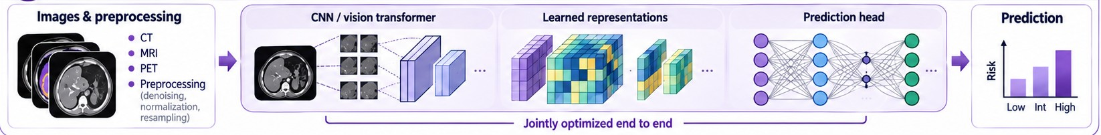
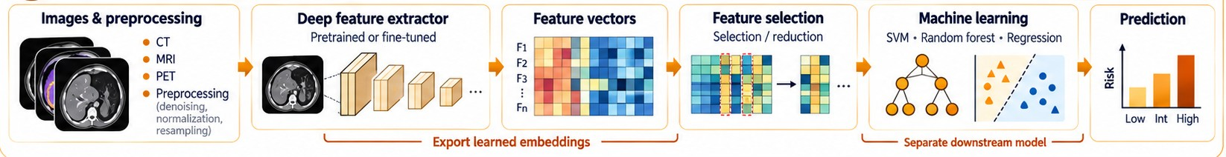
IMAGING BIOMARKER · RADIOMICS
Three radiomics workflows
A Handcrafted radiomics
• ROI → shape, intensity, texture features
• Feature selection + machine learning
B End-to-end deep learning
• CNN / transformer learns the features
• Optimized end to end, image → risk
C Deep features + ML
• Pretrained network exports embeddings
• Separate ML model predicts risk
Applications: diagnosis · prognosis · treatment response — independent validation required
Abdollahi et al., Phys Med Biol 2022
4
Notes:
There are three main ways to build radiomics models.
A, handcrafted radiomics: we preprocess the images, segment the tumour, extract predefined shape, intensity and texture features, select the most informative ones, and train a machine-learning model such as SVM, random forest or regression to predict risk.
B, end-to-end deep learning: a convolutional network or vision transformer learns its own features directly from the images, and the whole chain from image to risk is optimized jointly.
C, deep features plus machine learning: a pretrained or fine-tuned network is used only as a feature extractor; its embeddings are selected and passed to a separate machine-learning model.
All three can support diagnosis, prognosis and treatment-response prediction, but each needs independent validation.

Slide 5
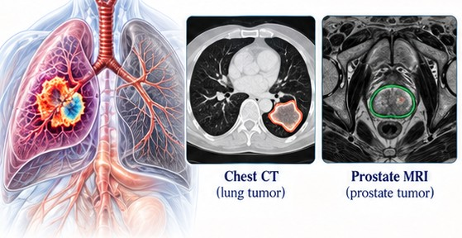
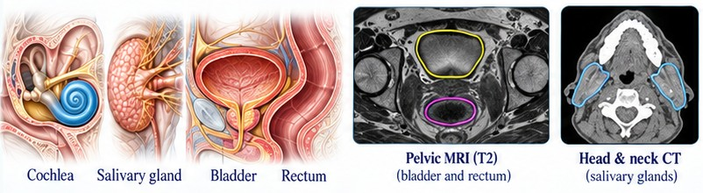
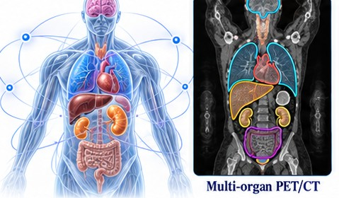
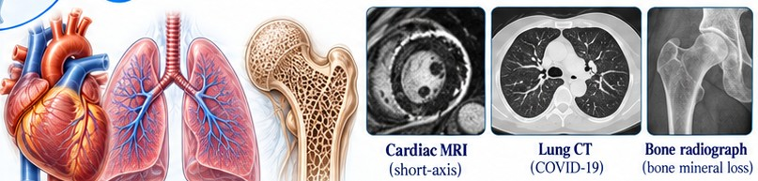
IMAGING BIOMARKER · RADIOMICS
Radiomics: from tumour to whole patient
I Tumour phenotype
II Normal tissue
• Prostate, lung, brain, kidney
• Grade, molecular status, prognosis
• Treatment-response prediction
• Cochlea, salivary glands, rectum, bladder
• Changes after radiotherapy
• Toxicity-risk prediction
III Systemic, multi-organ
IV Non-oncologic
• Host beyond the tumour
• Endocrine-organ signatures
• PSMA-negative prostate cancer
• Myocardial infarction (cardiac MRI)
• COVID-19 lung disease (CT)
• Bone mineral loss (radiograph)
Cross-cutting: multimodal imaging · radiogenomics · longitudinal / delta radiomics
Abdollahi, radiomics potentials
5
Notes:
My radiomics work uses four complementary, patient-centred perspectives.
First, tumour phenotyping — characterizing the cancer itself in prostate, lung, brain and kidney: grade, molecular status, prognosis and treatment response.
Second, normal-tissue response and toxicity — characterizing organs at risk such as the cochlea, salivary glands, rectum and bladder, their changes after radiotherapy, and toxicity risk.
Third, systemic and multi-organ phenotyping — characterizing the host beyond the tumour, for example multi-organ and endocrine-organ signatures in PSMA-negative prostate cancer.
Fourth, non-oncologic disease — myocardial infarction on cardiac MRI, COVID-19 lung disease on CT, and bone mineral loss on radiographs.
Cross-cutting approaches are multimodal imaging, radiogenomics and longitudinal or delta radiomics.

Slide 6
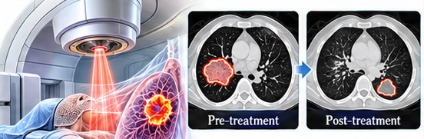
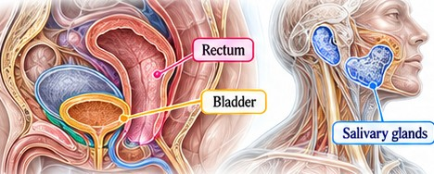
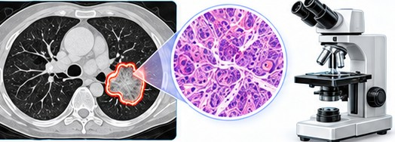
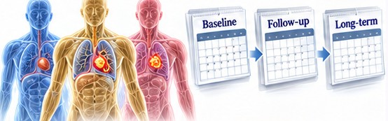
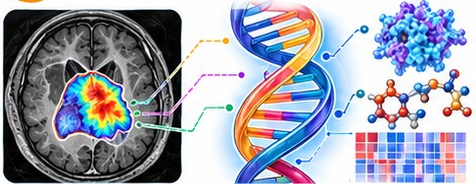
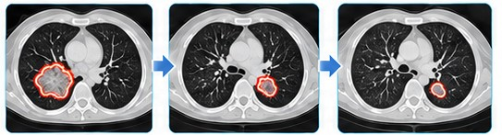
IMAGING BIOMARKER · RADIOMICS
Applications of radiomics
I RT response
II Toxicity
III Diagnosis
• Predict tumour response to RT
• Identify resistance patterns
• Normal-tissue injury risk
• Salivary glands, rectum, bladder
• Tumour type, grade, aggressiveness
• Support lesion characterization
IV Prognosis
V Radiogenomics
VI Monitoring
• Progression and recurrence risk
• Stratify patients by outcome
• Link features to tumour biology
• Molecular signatures
• Track change during and after therapy
• Delta radiomics
Beyond the tumour: systemic and non-cancer disease · needs reproducible features and external validation
Abdollahi, radiomics potentials
6
Notes:
Radiomics has six main applications, from image features to prediction and monitoring.
One, radiotherapy response prediction — predicting tumour response and identifying resistance patterns.
Two, radiation toxicity prediction — estimating normal-tissue injury risk in organs such as the salivary glands, rectum and bladder.
Three, diagnosis and tumour characterization — assessing tumour type, grade and aggressiveness alongside pathology.
Four, prognosis and recurrence prediction — estimating progression risk and stratifying patients over follow-up.
Five, molecular characterization — radiogenomics, linking imaging features with tumour biology.
Six, treatment monitoring — tracking change during and after therapy with delta radiomics.
Radiomics also extends beyond the tumour to systemic and non-cancer disease. All of these need multimodal imaging, reproducible features and external validation.

