Slide 1
Money LAUNDRY
Dr / Mohamed Mostafa Abbasy
AI SECURITY ISSUES

Slide 2
CONTENTS OF THIS Project
Money Laundry Definition
Money Laundry Consequences
Dataset Description
Necessary Libraries
Data Preprocessing
Exploratory Data Analysis (EDA)
Threshold-Based Alert Simulation
Threshold Optimization
Threshold Validation
Scenario Effectiveness Evaluation
Machine Learning Models
Model Comparison
Model Visualization

Slide 3
Money laundry definition !
Money laundering is a global financial crime that involves disguising the origins of money obtained through illegal activities to make it appear legitimate. This process is critical for criminals to integrate illicit funds into the legal economy without attracting attention from law enforcement or financial regulators.
Money laundering is defined as the process of converting "dirty money" (proceeds from crimes such as drug trafficking, corruption, terrorism, and embezzlement) into "clean money" that can be freely used in legitimate financial systems

Slide 4
money laundry consequence :
01
02
03
04
Economic:
Social:
It undermines legitimate businesses by giving unfair advantages to criminal enterprises.
Corruption linked to money laundering weakens citizens’ trust in institutions.
Financial:
Government:
Large illicit financial flows can destabilize banks and financial markets.
Tax evasion through laundering deprives governments of crucial funds for public services.

Slide 5
DATASET DESCRIPTION:
IBM AMLSim
IBM AMLSim: The AMLSim project is intended to provide a multi-agent based simulator that generates synthetic banking transaction data together with a set of known money laundering patterns - mainly for the purpose of testing machine learning models and graph algorithms.
This dataset is an example dataset generated from IBM AMLSim.
Content
There are 2 datasets mentioned here: transactions and accounts:
Accounts dataset: Contains the information about all the bank accounts whose transactions are monitored. (ACCOUNT_ID,CUSTOMER_ID,INIT_BALANCE,COUNTRY,ACCOUNT_TYPE,IS_FRAUD,TX_BEHAVIOR_ID ) →10000 rows × 7 columns
Transactions dataset: Contains the list of all the transactions with information about sender and receiver accounts.(TX_ID,SENDER_ACCOUNT_ID,RECEIVER_ACCOUNT_ID,TX_TYPE,TX_AMOUNT,TIMESTAMP,IS_FRAUD, ALERT_ID ) → 1323234 rows × 8 columns

Slide 6
NECESSARY LIBRARIEs:
PANDAS
NuMPY
MATPLOTLIB
For dataframes, cleaning, transforming, and exploring data
For efficient numerical operations and array manipulations.
For creating static, interactive, and animated visualizations.
SEABORN
SKLEARN
JOBLIB
For statistical data visualization, with easier syntax and built-in
For machine learning algorithms, evaluation, and preprocessing tools.
For saving and loading trained machine learning models efficiently.

Slide 7
DATA PREPROCESSING

Slide 8
1.Data Loading & Initial Inspection
2. Feature Engineering Credit
Load accounts.csv and transactions.csv. Check for missing values, correct data types, and remove duplicates.
Credit (Receiver):Total amount, count, and unique senders.
Debit (Sender):Total amount, count, and unique receivers.
Merge summaries with accounts, fill missing values with 0.
3.Feature Scaling (For ML Models)
4.Target Variable Preparation
5. Handling Skewed Data
Standardization:
. Scale features (e.g., CREDIT_AMT, DEBIT_AMT) to have mean=0 and variance=1.
. Critical for neural networks and distance-based algorithms.
Labeling: Convert IS_FRAUD (boolean) to binary SUSPICIOUS (1 for fraud, 0 for clean).
Class Imbalance Check: Verify the ratio of suspicious vs. non-suspicious accounts (often highly skewed).
Apply log transformation to large values; use class weighting to handle imbalance.

Slide 9
Exploratory Data Analysis (eda):
Train-Test Split
Statistical Analysis
Data Visualization
Split the dataset into training (60%) and test (40%) sets, stratified by the SUSPICIOUS column to maintain class distribution. This ensures balanced representation of fraudulent and non-fraudulent accounts.
Compute descriptive statistics for the training set to understand the distribution of features. Analyze skewness to identify potential biases in the data.
Visualize feature distributions using histograms and overlaid plots to compare non-suspicious and suspicious accounts. Use subplots to analyze multiple features simultaneously.

Slide 10
Threshold-Based Alert SIMULATION
01
02
03
Manual Threshold Simulation
Fallacy of Mean + 3SD
Percentile-Based Threshold Simulation
Test predefined thresholds (e.g., $100,000, $500,000, $1,000,000) for CREDIT_AMT to count alerts. Identify minimum and maximum thresholds based on the feature's distribution.
Ve Critique the empirical rule (mean + 3 standard deviations) for threshold setting. Compute the proportion of accounts flagged at various standard deviation thresholds (0 to 5 SD). nus has a beautiful name but it’s hot
Simulate thresholds at the 75th percentile for CREDIT_AMT. Compute confusion matrix metrics (TP, FP, TN, FN) and visualize results using heatmaps. Extend the simulation to all percentiles (1% to 99%) to evaluate alert performance.

Slide 11
Threshold OPTIMIZATION:
01
02
03
J Statistic Optimization
F1 Score Optimization
Comparison of J Statistic and F1 Score
Calculate the true positive rate (TPR), false positive rate (FPR), and J statistic (TPR - FPR) for each percentile. Identify the threshold with the maximum J statistic and visualize its relationship with percentile and FPR vs. TPR.
Calculate precision, recall, and F1 score for each percentile. Identify the threshold with the maximum F1 score and visualize its relationship with percentile, precision, and recall.
Compare metrics (percentile, threshold, alert counts, confusion matrix) for J statistic and F1 score recommendations. Adopt the F1 score threshold to minimize false negatives.

Slide 12
Threshold Validation
Test Set Evaluation :
Apply the F1-optimized threshold to the test set.
Compute confusion matrix metrics, TPR, FPR, J statistic, precision, recall, and F1 score.
Compare train and test set performance, including percentage change in metrics.

Slide 13

Scenario Effectiveness evaluation:
ROC and AUC Analysis:
Compute the Area Under the ROC Curve (AUC) for CREDIT_AMT using trapezoidal integration. Plot the ROC curve with AUC annotation. Extend ROC analysis to all features and compare multiple ROC curves.
Feature-Wise ROC Curves:
Calculate TPR and FPR for each feature across percentiles. Visualize ROC curves for all features with AUC values in the legend.

Slide 14
Machine Learning Models :
Random Forest Classifier:
Define features such as CREDIT_AMT, CREDIT_COUNT, CREDIT_CTPY, DEBIT_AMT, DEBIT_COUNT, and DEBIT_CTPY. Train a Random Forest model with balanced class weights. Evaluate performance using precision, recall, F1 score, ROC-AUC, and classification reports. Visualize feature importance.
Neural Network (MLP) Classifier:
Define features such as CREDIT_AMT, DEBIT_AMT, CREDIT_COUNT, and DEBIT_COUNT. Train a Multi-Layer Perceptron (MLP) with two hidden layers (64, 32 nodes). Evaluate performance using confusion matrix, classification report, and AUC score. Visualize results using heatmaps.

Slide 15
Model comparison:
 | Random forest classfier | Neural network (mlp)
precision | 0.8923 | 0.7550
recall | 0.4585 | 0.4506
F1-score | 0.6057 | 0.5644
Roc-auc | 0.8904 | 0.8509

Slide 16
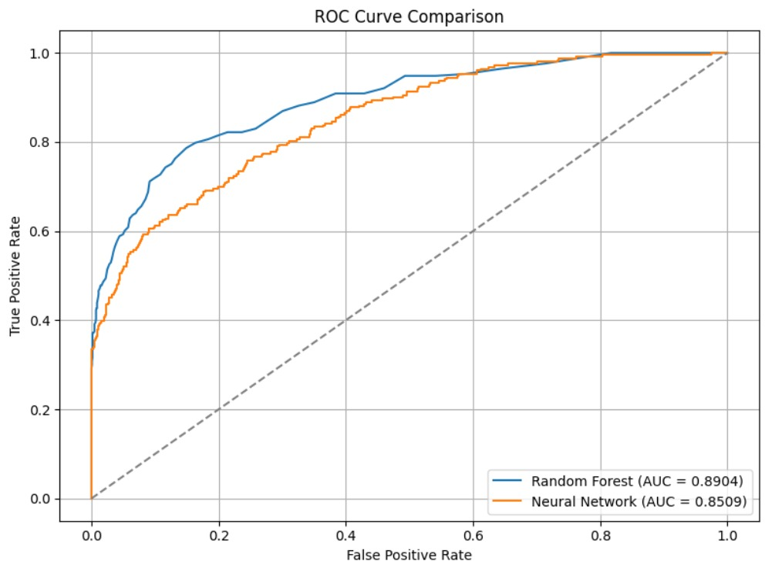
Model visualization:
ROC CURVE COMPARISON

Slide 17
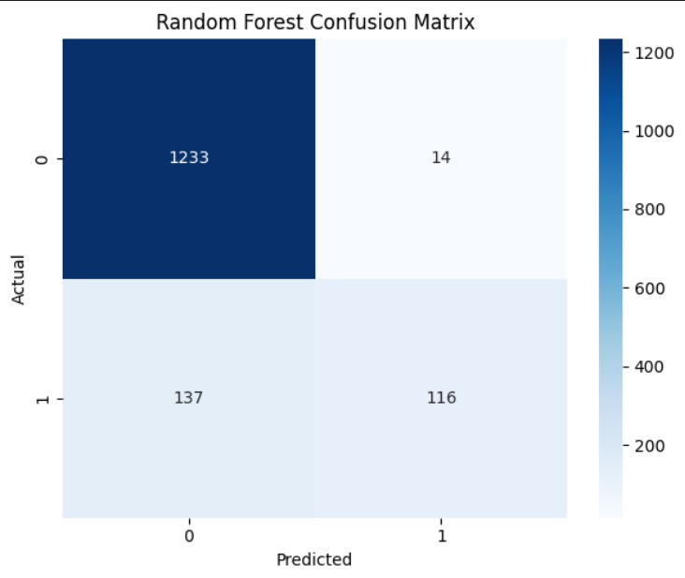
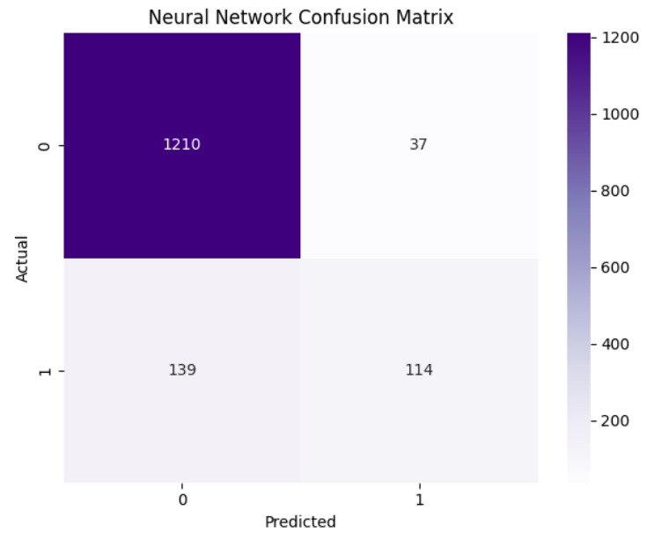
CONFUSION MATRIX COMPARISON:

Slide 18
Thanks
A’laa Omar Ali 2205013
Nour Sherif Mohamed Salah 2205061
Shimaa Said Hosny 2205187
Habiba Tarek Nassar 2205188
]]

