Slide 1
Stale Opportunity Notification
Henock Abebe

Slide 2
Introduction
My name is Henock Abebe.
I am a software engineer with over 15 years experience architecting, designing and developing software applications.
Over the last 6 years I have been on focused on developing distributed applications using Java.

Slide 3
Presentation Outline
Problem Statement and Motivation
Constraints
Solution / Demo
System Overview
User Interface
Demonstration
Questions

Slide 4
Problem Statement
Initial Problem Statement
“We've noticed that we have a problem with some of the opportunities we've captured in Salesforce "getting stale". So we're thinking we need a real-time notification; something that keeps us informed before they become stale. In asking around there is some disagreement on when something becomes stale, so that should be something our managers can easily change.”
Problem Statement Breakdown
Opportunities that are captured in SalesForce are becoming stale.
A notification system is required to notify the interested members before this happens.
The criteria for determining when an opportunity is about to become stale must be one that is configurable.

Slide 5
Motivation
Lost opportunities result in lost revenue to the organization.
Identifying the opportunities before they become stale allows the organization to take some action to remedy the situation.
There could be several reasons for why an opportunity is going to be stale. For example a sales representative is busy pursuing several other opportunities that they have neglected others.
If the organization has the ability to detect when these opportunities are about to be stale, the organization could take some action like reassigning these neglected opportunities to some other sales representative, resulting in more wins for the organization.

Slide 6
Solution Constraints
Solution must execute within the Java Virtual Machine and function within a Tomcat server.
Short development time.

Slide 7
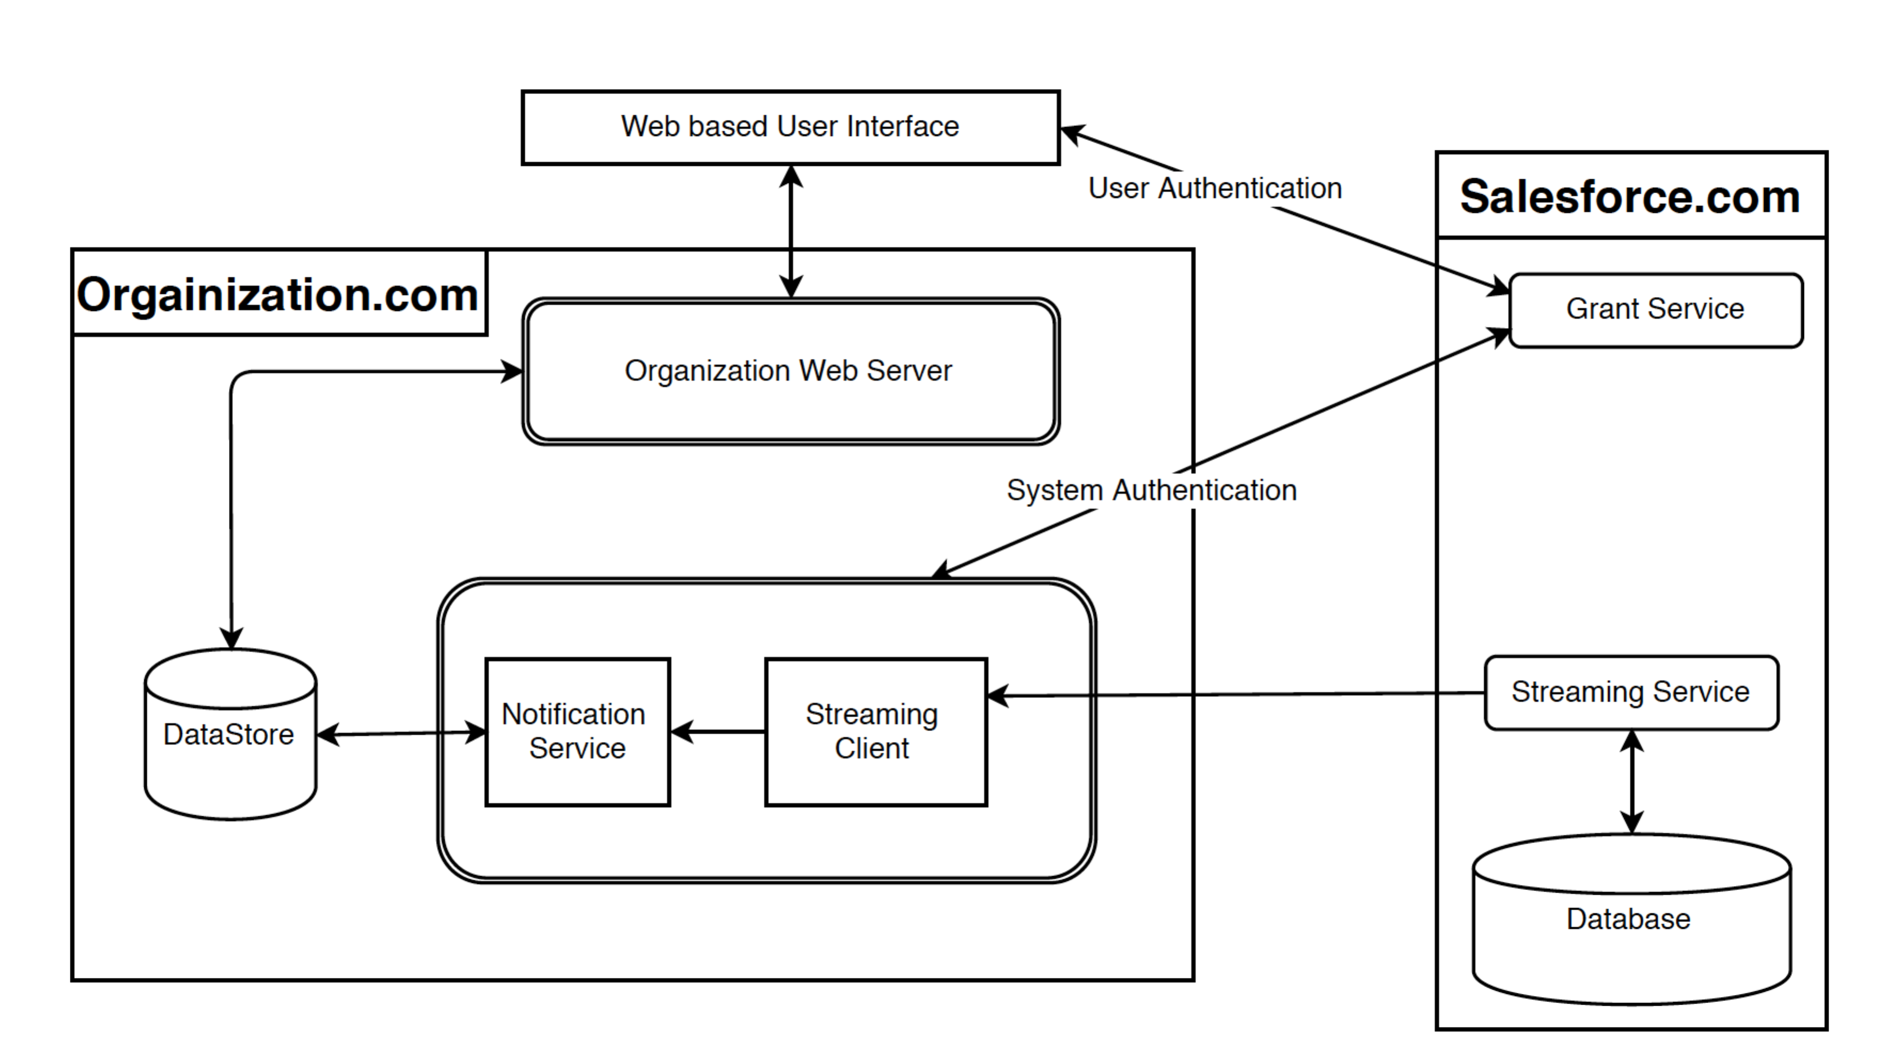
Solution – System Overview

Slide 8
Solution – Simplified Data Model

Slide 9
Solution – Simplified Data Model
A user inherits all their manager’s criteria.
If an opportunity matches a criterion the owner will receive a notification.
A manager receives a notification of an employee’s opportunity when the criterion belongs to the manager.

Slide 10
Solution – User Interface
Motivations:
Simple
Functional
Usable
Demonstration.

Slide 11
Question
Code can be found on github. It is private repository. To get access please send me an email at:
hay.knock@gmail.com
https://github.com/habebe/fpx-salesforce-notification.git

