Slide 1

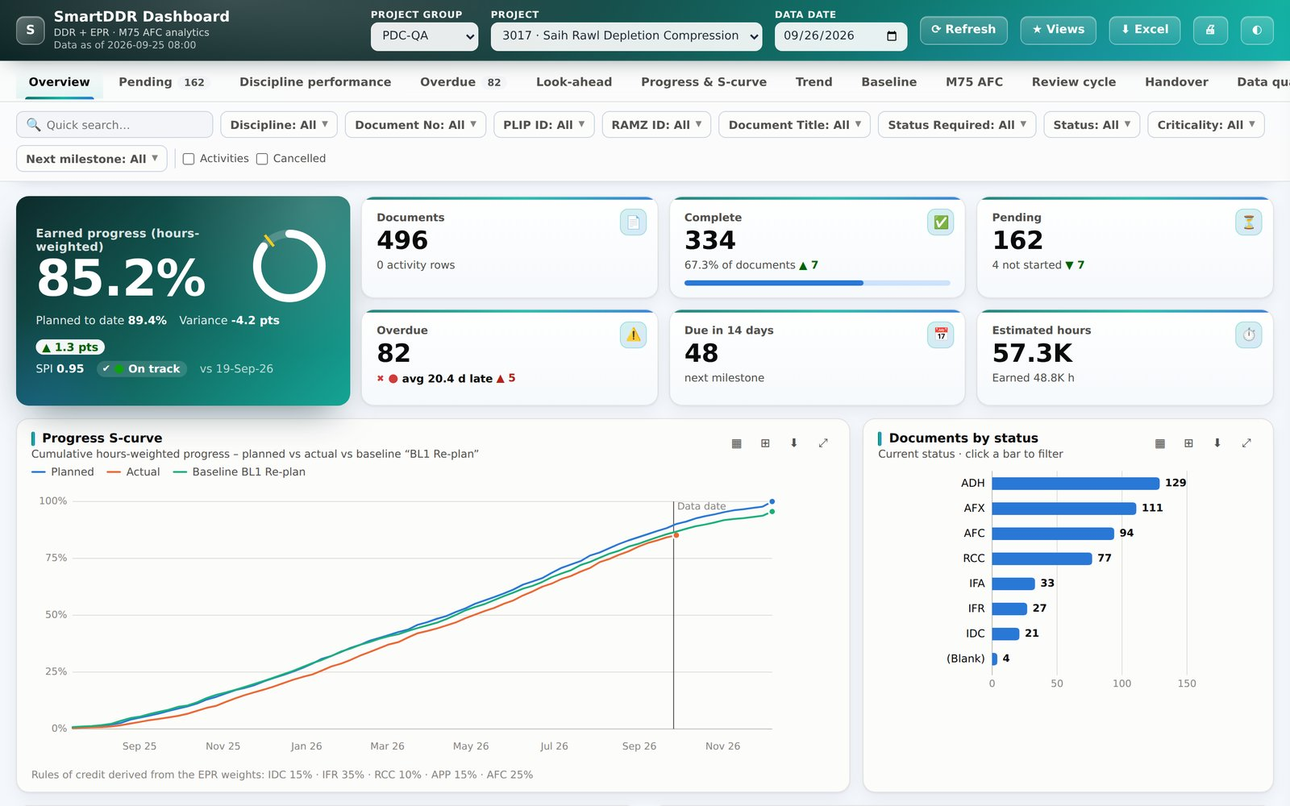
S
SMARTDDR
SmartDDR v3
& DDR Dashboard
One place to track every engineering deliverable, from plan to AFC, and to see what needs attention today.
Document control · Project controls · Engineering leads
Notes:
Introduce SmartDDR v3, the reporting hub for DDR, EPR, M75 and Aconex data, and the new DDR Dashboard, which turns the same data into KPIs, charts and drill-down reports. Screenshots throughout use sample data.

Slide 2




Plenty of data, too little insight
Document control teams spend their time assembling reports instead of acting on them
Scattered registers
Manual reconciliation
Late warning
DDR, EPR, M75 AFC and Aconex live in separate reports. Answering one question means opening four.
Overdue lists, discipline summaries and missing documents are rebuilt by hand in Excel every week.
Slippage becomes visible only after a milestone is missed, when it is already expensive to recover.
Goal: one trusted view of every deliverable, with the problems surfaced first.
SmartDDR v3 · DDR Dashboard · DDR Developer
2
Notes:
Frame the problem: the data exists, but it is spread across reports and needs manual work before anyone can act on it.

Slide 3


Two tools, one data source
The report hub and the analytics dashboard read the same DDR, EPR, M75 and Aconex tables
SmartDDR v3
DDR Dashboard
The report hub
Power BI-style analytics
21 reports in 5 collapsible groups
Find-a-report search, sort, discipline filter
Excel (.xlsx) and CSV export on every grid
Check reports for missing and dummy documents
Shareable link to any report
13 report tabs with KPI cards and charts
Excel-like filters on 7 key fields
Pending, overdue and discipline performance
Trend history and baseline comparison
Saved views, Aconex links, Excel export
SmartDDR v3 · DDR Dashboard · DDR Developer
3
Notes:
SmartDDR v3 is where people run and export registers. The Dashboard opens from the Progress & Status group in one click and analyses the same data.

Slide 4
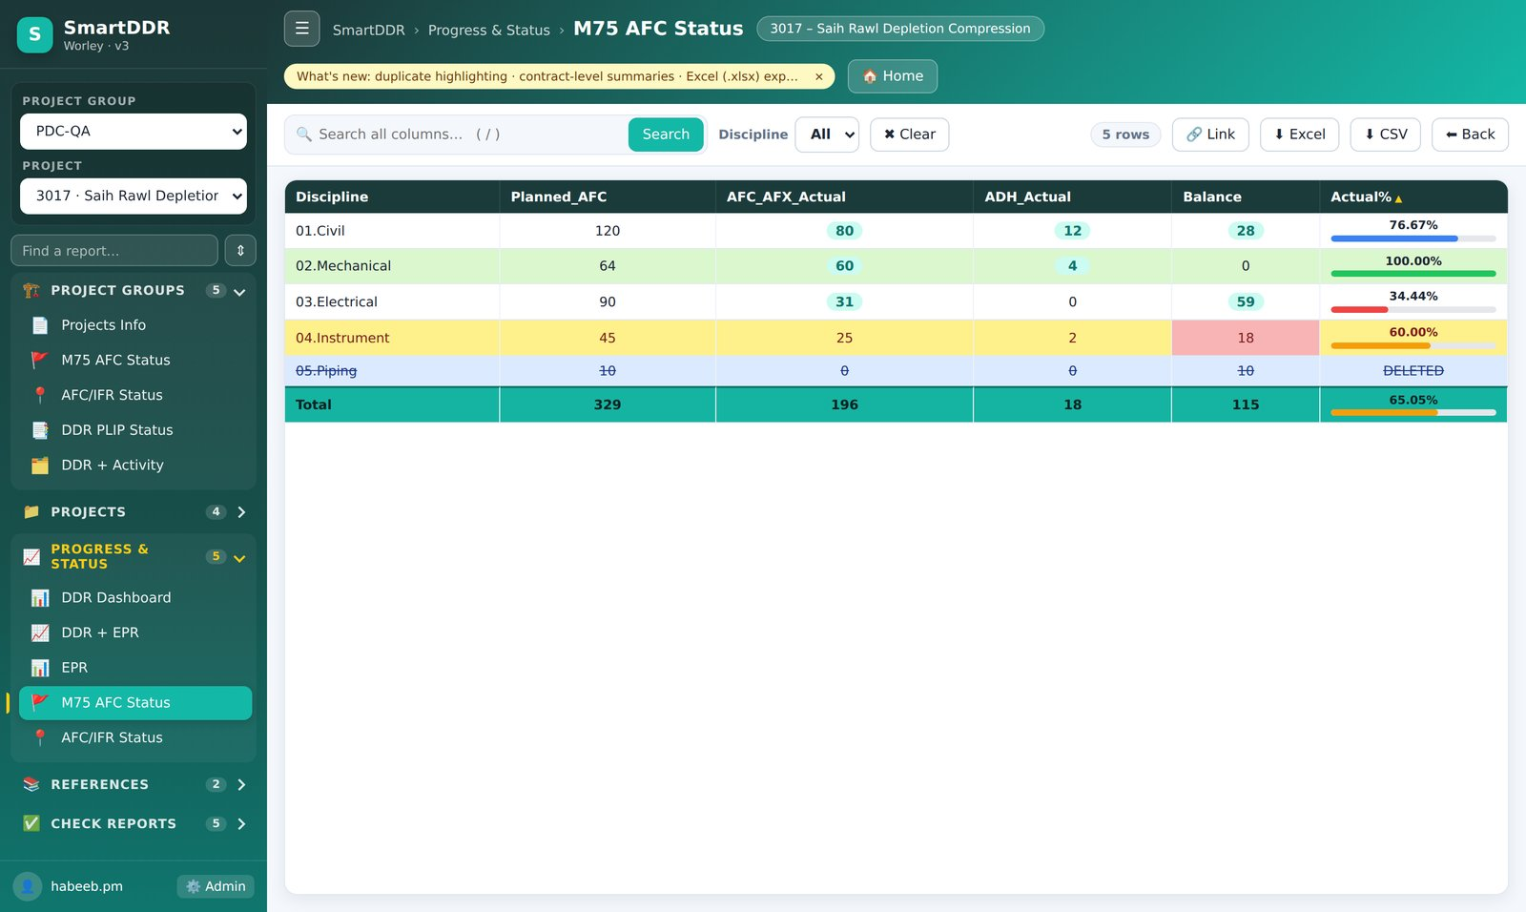





SmartDDR v3: reports grouped by purpose
The flat list of buttons became five collapsible groups; the menu remembers what you open
Project Groups 5 reports
Projects info, M75 AFC and AFC/IFR status across the group
Projects 4 reports
Approved CTD, DDR + Activity, Activities, PDO format
Progress & Status 5 reports
DDR Dashboard, DDR + EPR, EPR, M75 AFC, AFC/IFR
References 2 reports
Aconex all revisions and latest revision
Check Reports 5 reports
CTD vs DDR, CTD vs DOC, dummy serials, missing docs
SmartDDR v3 · DDR Dashboard · DDR Developer
4
Notes:
Walk through the five groups. The find box filters the menu as you type, and the group open/closed state is remembered per user.

Slide 5






What changed in SmartDDR v3
Bugs fixed across markup and code-behind, plus features people asked for
Find a report
Sort, search, filter
Real Excel export
Type in the sidebar to filter 21 reports instantly.
Click any header to sort; search all columns; filter by discipline.
Formatted .xlsx alongside CSV, straight from the grid.
Visual cues
Safer by design
Deep links
Duplicates, deleted rows, balances and progress bars stand out.
CTD editing removed; parameterised queries; admin-only actions.
Copy a link that reopens the same report and project.
SmartDDR v3 · DDR Dashboard · DDR Developer
5
Notes:
Highlight that the CTD edit option was removed on request, and that queries are parameterised. Export now produces a proper Excel file.

Slide 6
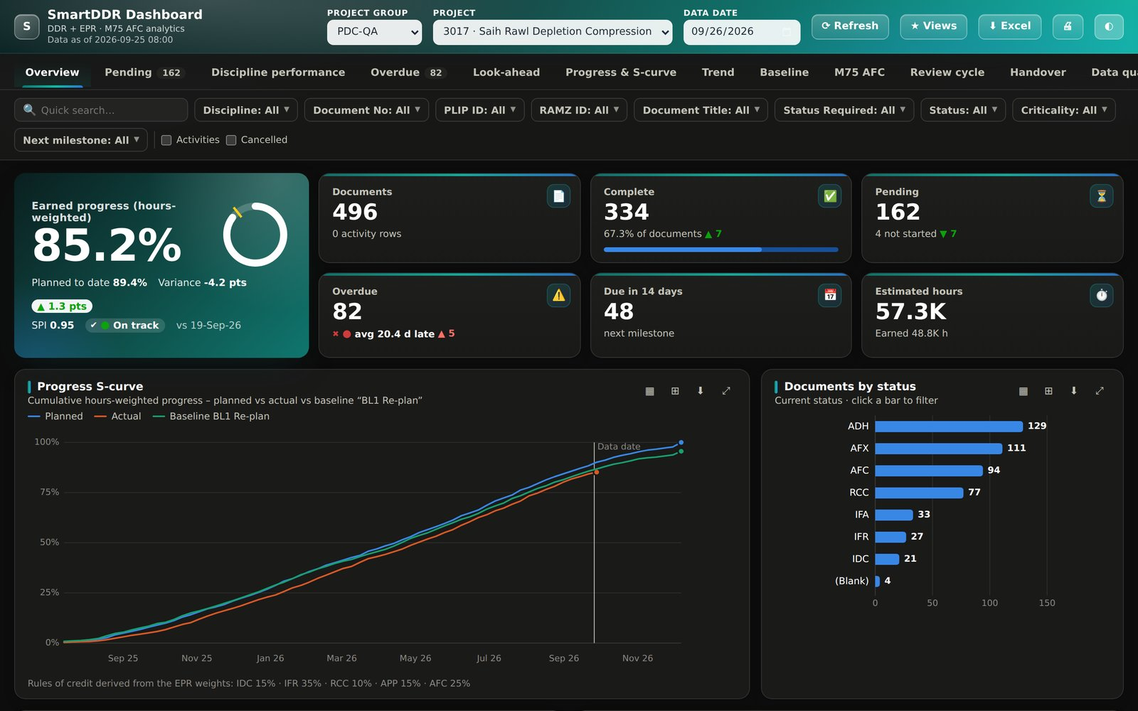
02
DDR Dashboard
Power BI-style analytics on DDR_EPR and M75_AFC, one click from SmartDDR v3. No add-ins, no licences, no external libraries.
SmartDDR v3 · DDR Dashboard · DDR Developer
6
Notes:
Transition to the dashboard. It is a new ASPX page in the same application, reading the same tables.

Slide 7




The overview answers "where are we?" in seconds
KPI tiles, an S-curve against plan and baseline, and status breakdowns
Earned progress
Hours-weighted, with variance to plan
SPI
Earned ÷ planned, flagged on/off track
Pending & overdue
With change since last week
Due in 14 days
Next milestones coming up
Click to drill down
Every tile and bar filters the page
SmartDDR v3 · DDR Dashboard · DDR Developer
7
Notes:
Progress uses rules of credit per milestone (IDC, IFR, RCC, APP, AFC). The data date control lets you view the position as at any past date.

Slide 8

13 report tabs, three questions
Each tab is built for a specific decision, not just a table of rows
What needs action?
Are we on plan?
Is it clean and closing?
Overview
KPIs and S-curve
Discipline performance
SPI and on-time rate
Review cycle
Client turnaround
Pending
Open documents by stage
Progress & S-curve
Planned vs actual
Handover
Readiness to close out
Overdue
Ageing, heatmap, criticality
Trend
Nightly history
Data quality
Missing and suspect dates
Look-ahead
Due in the next weeks
Baseline
Plan drift
Data date control
Replay any tab as it stood on a past date.
Register
Every document, filterable
M75 AFC
AFC delivery status
SmartDDR v3 · DDR Dashboard · DDR Developer
8
Notes:
The three core reports requested (Pending, Discipline performance, Overdue) sit alongside ten more drawn from common oil and gas document control dashboards.

Slide 9
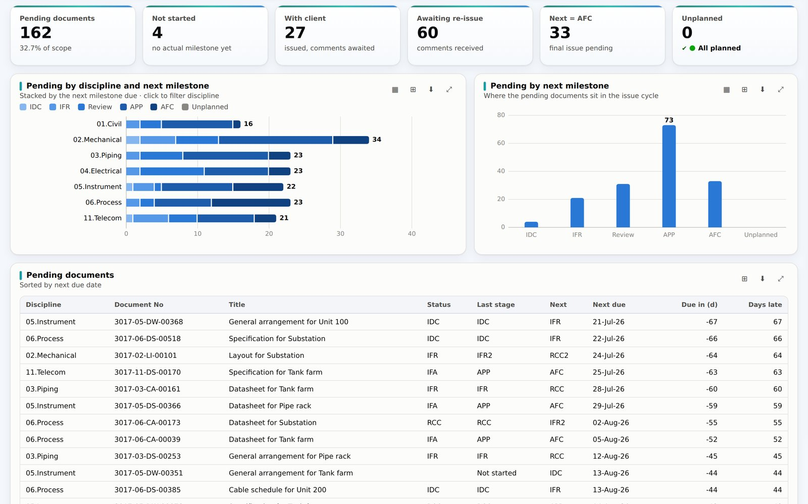
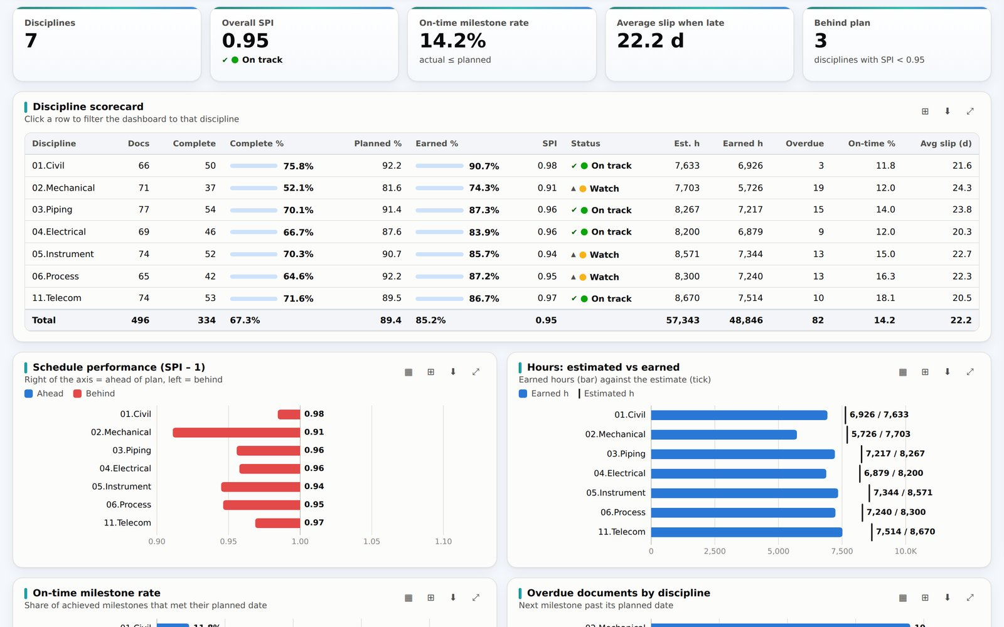
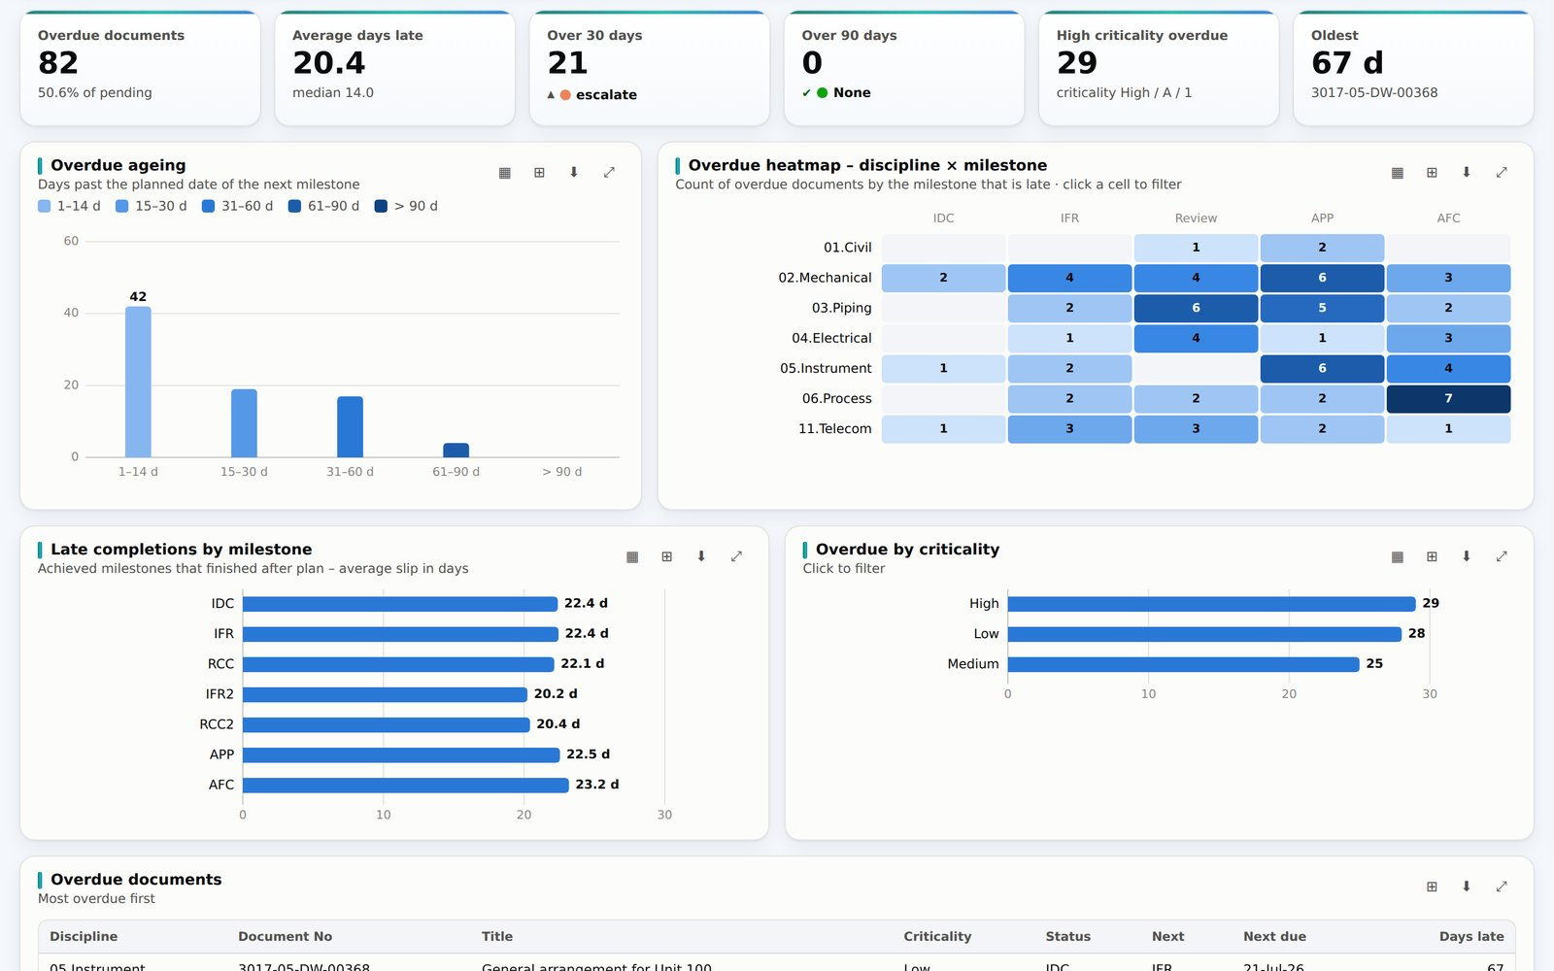
Pending, discipline performance and overdue
The three core reports, each with its own KPIs and drill-down charts
Pending
Discipline performance
Overdue
Open documents by discipline and next milestone, stacked by stage.
Scorecard with SPI, on-time rate, earned vs estimated hours.
Ageing buckets, discipline × milestone heatmap, criticality.
Overdue = the next planned milestone (_PLN) has passed without an actual date (_ACT).
SmartDDR v3 · DDR Dashboard · DDR Developer
9
Notes:
Explain the overdue rule: we look at the first milestone after the last achieved one; if its planned date is before the data date, the document is overdue.

Slide 10
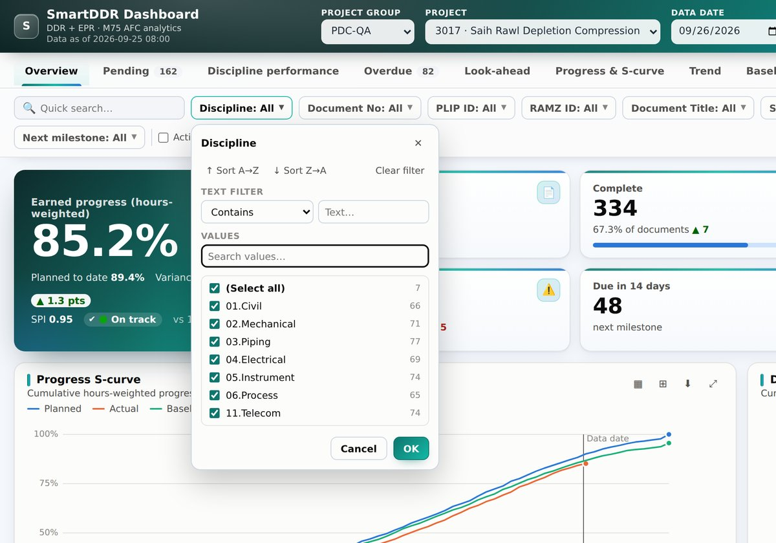
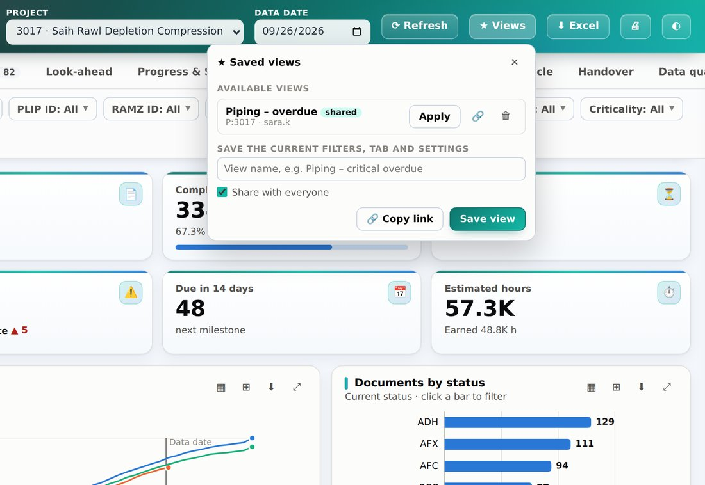


Excel-like filters, saved and shared
Filter the way people already work in Excel, then save the result for the whole team
Seven key fields
Discipline, Document_No, PLIP_ID, RAMZ_ID, Document_Title, Status_Required, Status. Values cascade as you filter.
Saved views
Sort A→Z or Z→A
Text rules: contains, begins with
Searchable value list with counts
Save filters and tab, private or shared. Copy a link that opens exactly that view.
SmartDDR v3 · DDR Dashboard · DDR Developer
10
Notes:
Each filter supports sort, text rules and a searchable value list with counts. A view such as "Piping – critical overdue" can be shared as a link in an email.

Slide 11
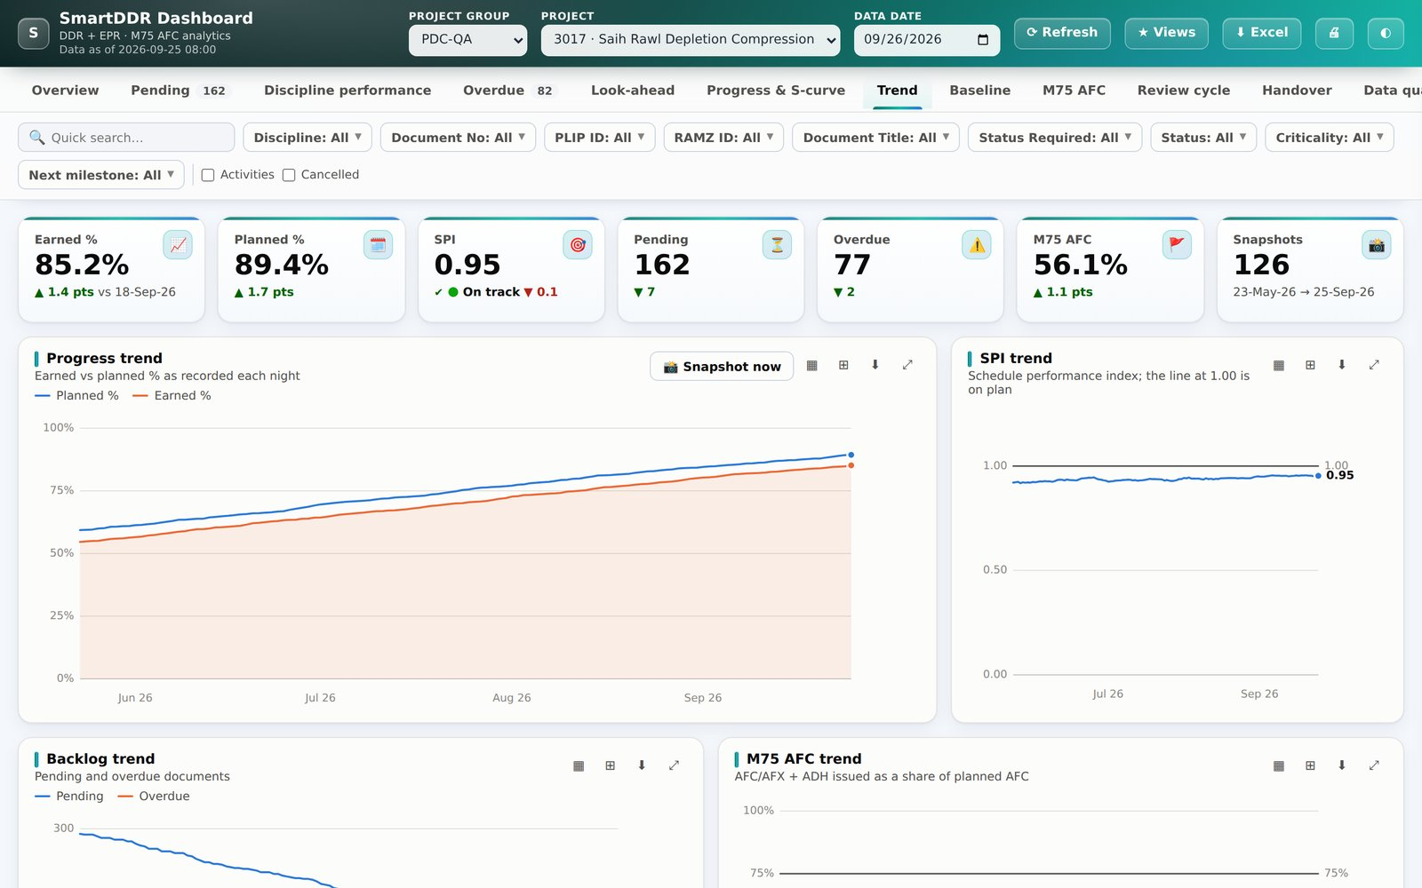
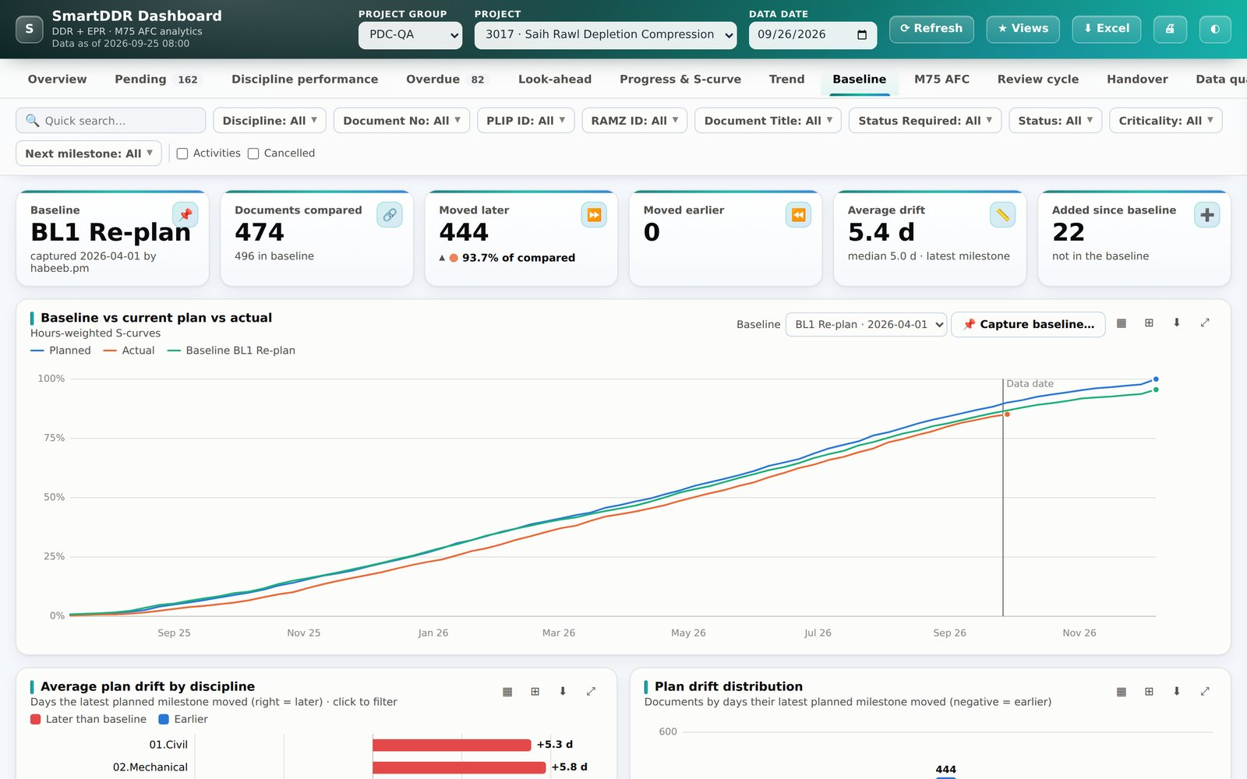

See the direction, not just the position
Nightly snapshots build a history; named baselines show how the plan has moved
Trend history
Baseline vs current plan
A nightly job records progress, SPI, backlog and M75 per discipline, so trends and week-on-week changes need no manual tracking.
Capture a named baseline, then compare: S-curves, drift by discipline and milestone, and the most re-planned documents.
SmartDDR v3 · DDR Dashboard · DDR Developer
11
Notes:
Trend history needs the SQL Agent job enabled. Baselines are captured by an admin from the Baseline tab; drift is measured in days per milestone.

Slide 12
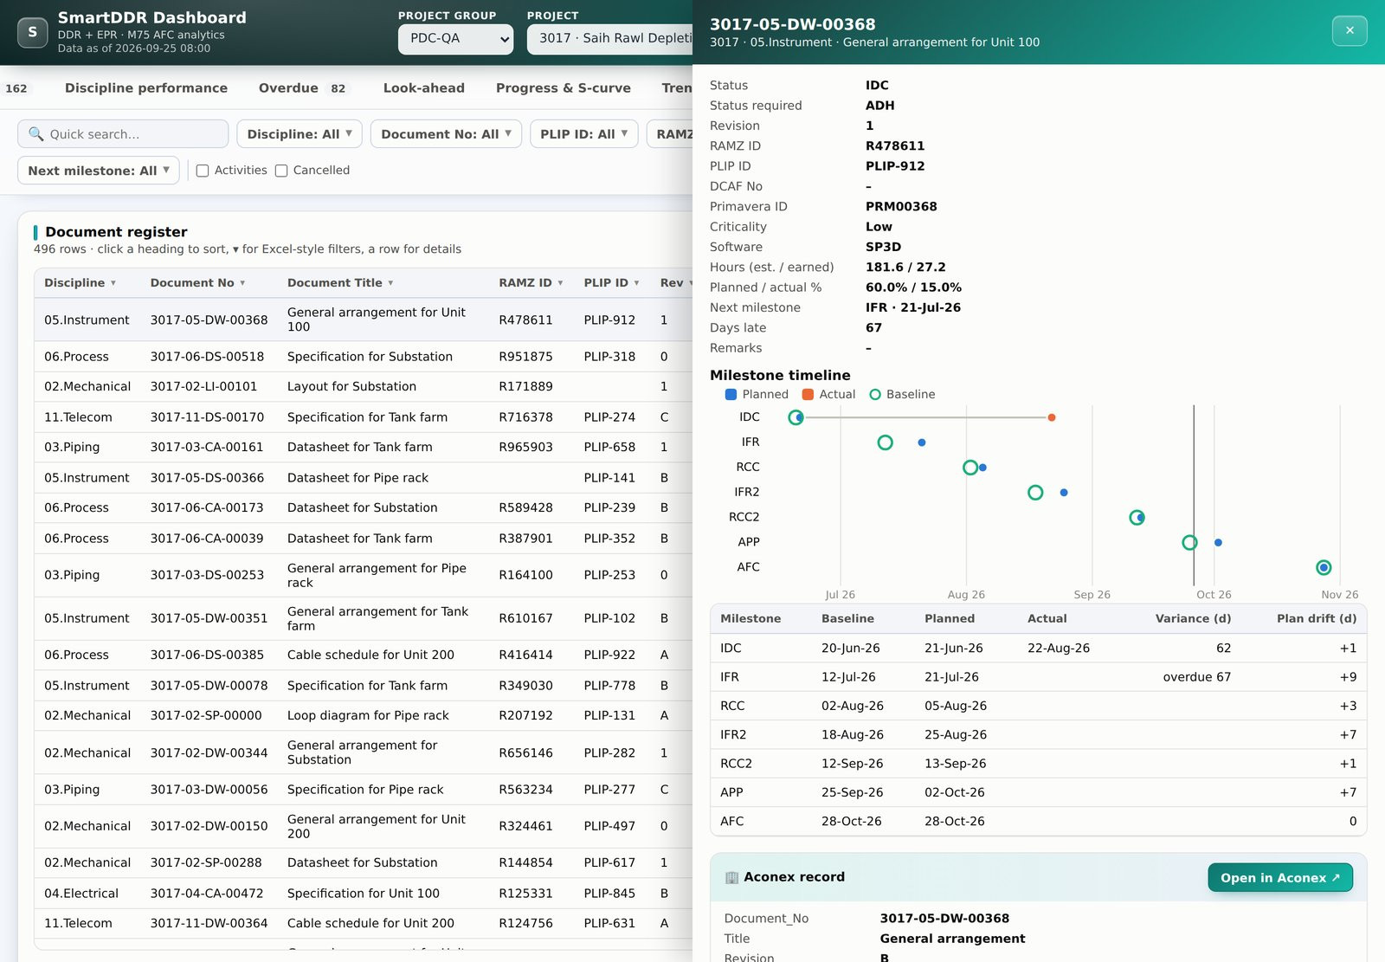

From a chart to the document in one click
Every row opens a document drawer with its full history and Aconex record
Milestone timeline
Planned, actual and baseline dates for IDC through AFC, with drift in days.
Aconex record
Latest revision details and an "Open in Aconex" link.
Formatted Excel export
Any card, any tab or the full register: frozen headers, filters, real dates.
SmartDDR v3 · DDR Dashboard · DDR Developer
12
Notes:
The Aconex link is configured in web.config, so it can point at the right Aconex instance without code changes.

Slide 13
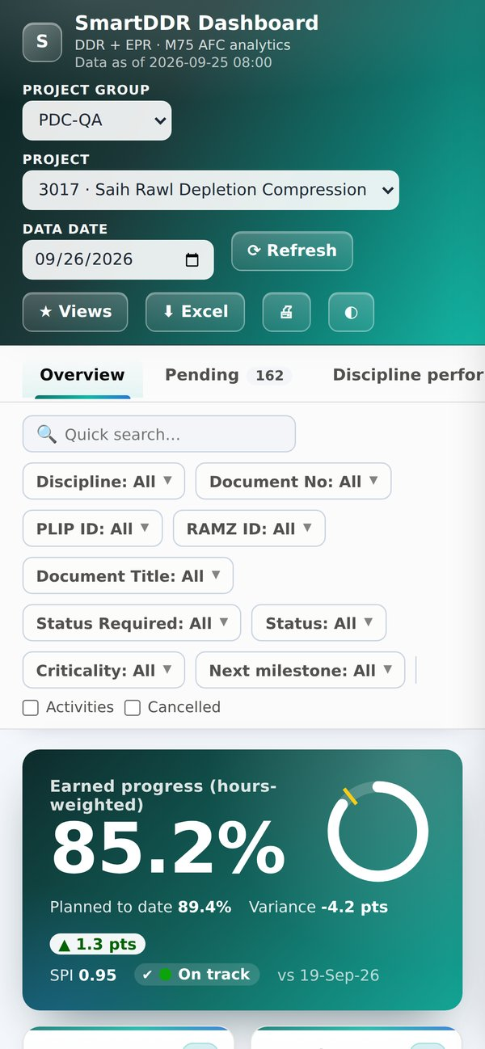



Works in the office, on site and at night
Responsive layout, dark mode and keyboard access, with no plug-ins to install
Dark mode
Phone and tablet
Any modern browser
SmartDDR v3 · DDR Dashboard · DDR Developer
13
Notes:
The whole dashboard is one page with no external libraries or CDN, so it works on locked-down corporate networks.

Slide 14



How it fits together
Existing tables feed a small JSON API; the browser does the charting
SQL Server
ASP.NET page
Browser
SDDR_ACON_DDR_EPR
SDDR_ACON_AFC_STATUS_01 (M75)
PDC_ACON_LATEST_DATE (Aconex)
New: snapshot, baseline and views tables
JSON API in VB code-behind
Parameterised queries
POST + header guard on changes
Admin-only snapshot and baseline
Charts drawn as SVG
Filters, views and drill-down
Excel file built in the browser
No external libraries or CDN
Nightly at 02:00 a SQL Agent job records the day's KPIs for the trend history.
SmartDDR v3 · DDR Dashboard · DDR Developer
14
Notes:
One setup script creates three tables and two stored procedures. Nothing changes in the existing source tables.

Slide 15
Fast enough for the largest project groups
Measured in the test harness with synthetic data
~1.3 s
< 0.4 s
0
13
to load a 47,000-row project group
to switch between report tabs
external libraries, add-ins or licences
report tabs from one data load
Admin-only changes
Parameterised SQL
All output escaped
Real timings depend on the server and network; validate during the pilot.
SmartDDR v3 · DDR Dashboard · DDR Developer
15
Notes:
Be clear these timings are from the test harness with synthetic data, not production. The pilot should confirm them.

Slide 16


Rollout in five steps
No change to existing tables; each step can be done independently
STEP 1
STEP 2
STEP 3
STEP 4
STEP 5
Run setup script
Grant access
Enable nightly job
Configure Aconex
Pilot and capture baseline
Creates 3 tables and 2 procedures in ACAD_DATA (SQL Server 2016 SP1+)
SELECT / EXECUTE for the site's database login
SQL Agent snapshot at 02:00 starts the trend history
Add the Aconex link template to web.config
Start with one project, capture BL0, gather feedback
Works from day one: until steps 3 and 4 are done, the Trend and Aconex panels simply show a setup message.
SmartDDR v3 · DDR Dashboard · DDR Developer
16
Notes:
The dashboard works without steps 3 and 4; trend and Aconex panels simply show a setup message until they are done.

Slide 17
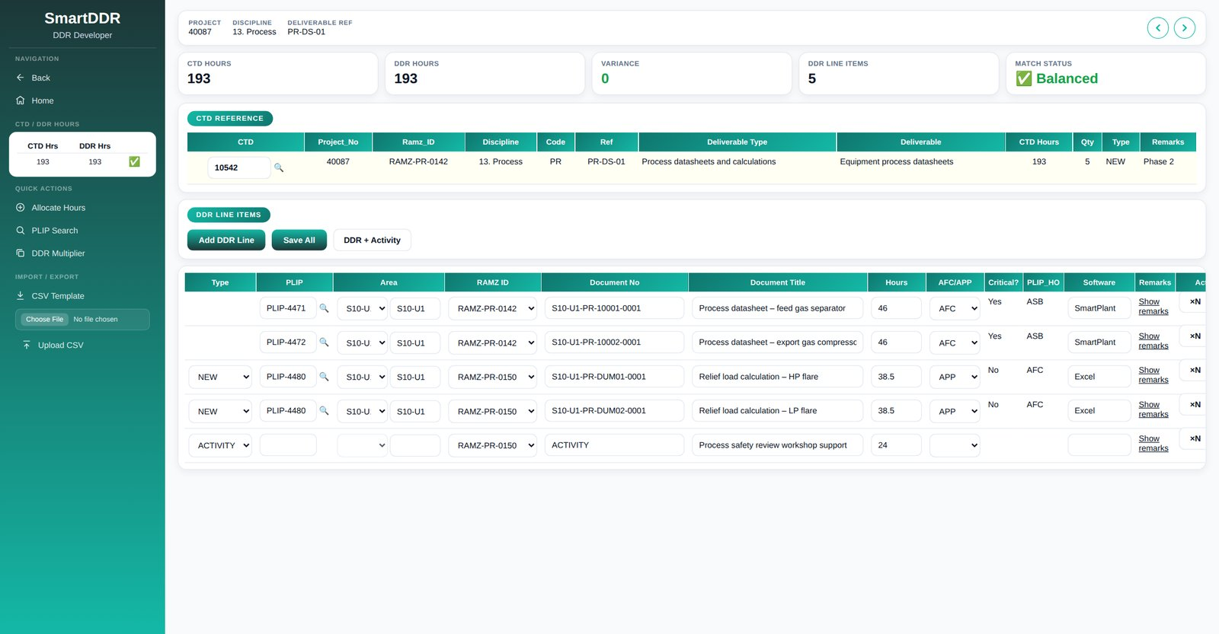
03
DDR Developer
Where the DDR is built: turn each CTD deliverable into document and activity lines, with hours that always add up.
SmartDDR v3 · DDR Dashboard · DDR Developer
17
Notes:
DDR_DeveloperV3 is the latest version of the DDR Developer page: engineers open a CTD and build its DDR line items here, and SmartDDR and the Dashboard report on the result.

Slide 18
From CTD to DDR in five steps
Everything for one CTD on one screen, with a live scorecard that shows when hours match
1. Open the CTD
Search, or step through with Previous / Next.
2. Add the lines
Add DDR Line, DDR + Activity, or upload a CSV.
3. Pick the PLIP
Critical, HO status and AFC/APP fill in.
4. Balance the hours
Allocate Hours splits the CTD total exactly.
5. Save All
Every row is checked before anything is saved.
SmartDDR v3 · DDR Dashboard · DDR Developer
18
Notes:
Walk the flow. The KPI row (CTD hours, DDR hours, variance, line items, match status) refreshes on every change, so the engineer sees immediately whether the DDR matches the CTD.

Slide 19

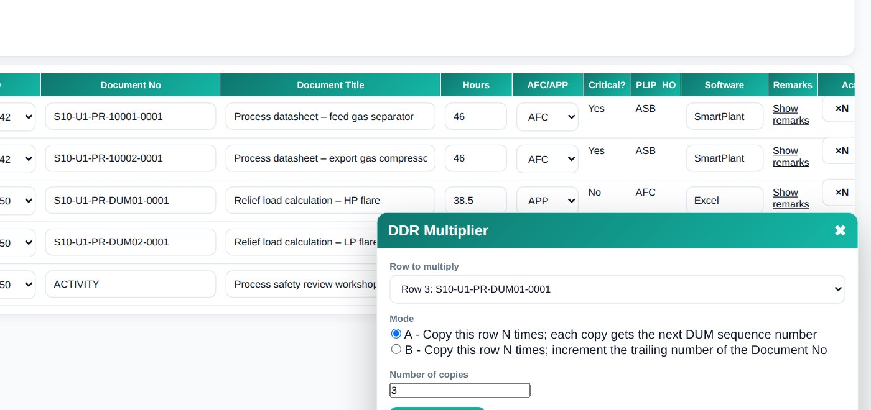
Less typing, fewer mistakes
New tools in the latest DDR Developer
DDR Multiplier
Copy a row N times, with the next DUM number or the next document number.
Smart dummy numbers
DUM01…DUM99, then DU100+, never a flat "DUMMY".
Allocate Hours
Even split; rounding goes to the first row.
PLIP details on pick
Title, doc type, critical, HO status, DCAF.
CSV template and upload
Seven fields, checked row by row in one transaction.
SmartDDR v3 · DDR Dashboard · DDR Developer
19
Notes:
The multiplier opens from Quick Actions or from any row. Mode A uses the DUM sequence, Mode B increments the trailing digits (0001 to 0002 and so on). The PLIP footer appears whenever a PLIP is picked or typed.

Slide 20
Rebuilt to be reliable
The page was audited end to end; problems in the original were fixed, not worked around
18
bugs fixed, including a page crash
Highlights
Add DDR Line then Save All no longer duplicates saved rows
Editing an existing line now updates it (Save All only inserted before)
Delete works, for saved and unsaved rows
Activity rows stay activity rows; Prev goes to the previous CTD
Buttons no longer fire twice from double event wiring
All lookups parameterised; error messages safely encoded
5
new tools to build DDRs faster
1
code path that loads the grid
Follow-up: Previous / Next CTD is still fixed to project 40087 and 13. Process, as in the original; it should follow the open project.
SmartDDR v3 · DDR Dashboard · DDR Developer
20
Notes:
Like the other pages, DDR_DeveloperV3 was reviewed by hand against the original but not compiled or run against the real database. The Prev/Next scoping is the one known open item.

Slide 21
Next steps
Agree the pilot project and users
Run the setup script and enable the nightly job
Capture the first baseline
Review after two weeks of trend data
Scope DDR Developer Prev / Next to the open project
Thank you
Notes:
Close with the ask: agree a pilot project and the people who will use it.

