Slide 1
Sources of Perceptual Bistability in the Ascending Auditory Pathway
David Little

Slide 2
Background/Motivation

Slide 3
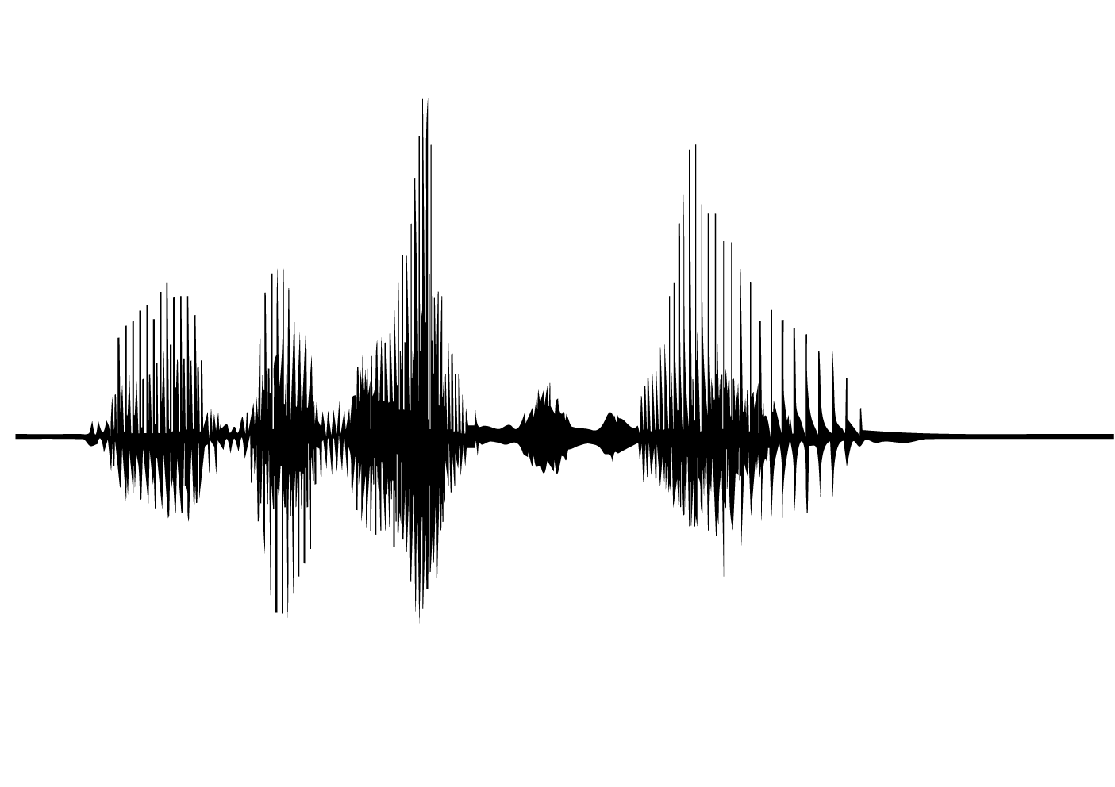
Auditory Scene Analysis
Ear by H Alberto Gongora
Glass by Visual Glow
Noun Project

Slide 4
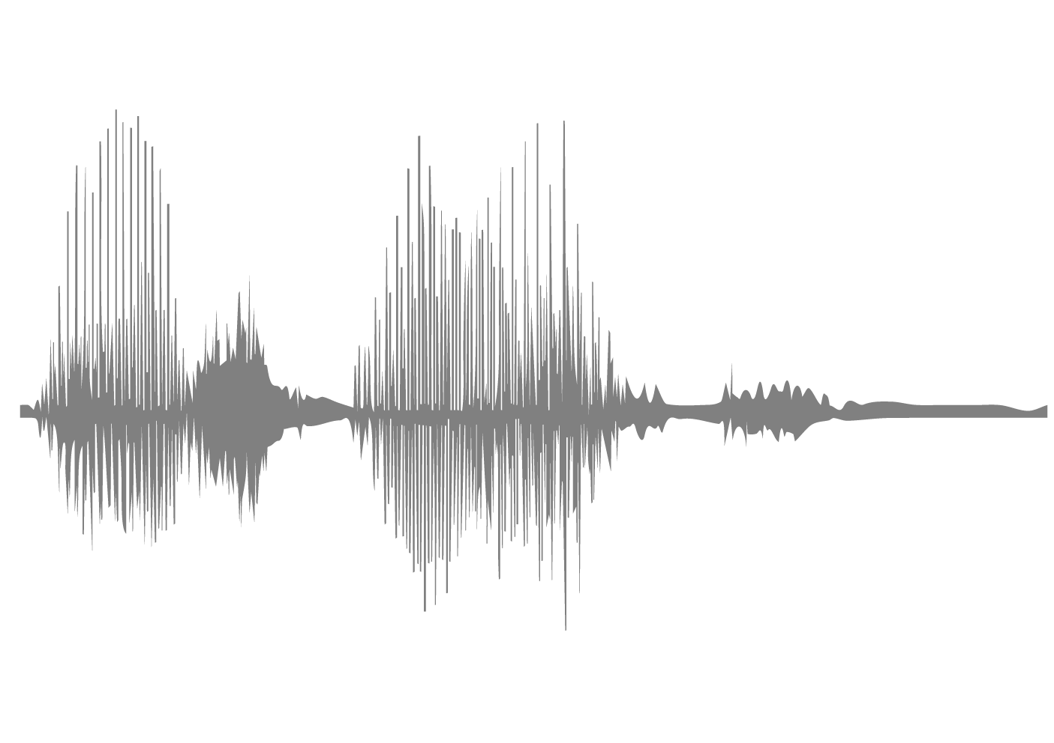
Auditory Scene Analysis
Ear by H Alberto Gongora
Glass by Visual Glow
Noun Project

Slide 5
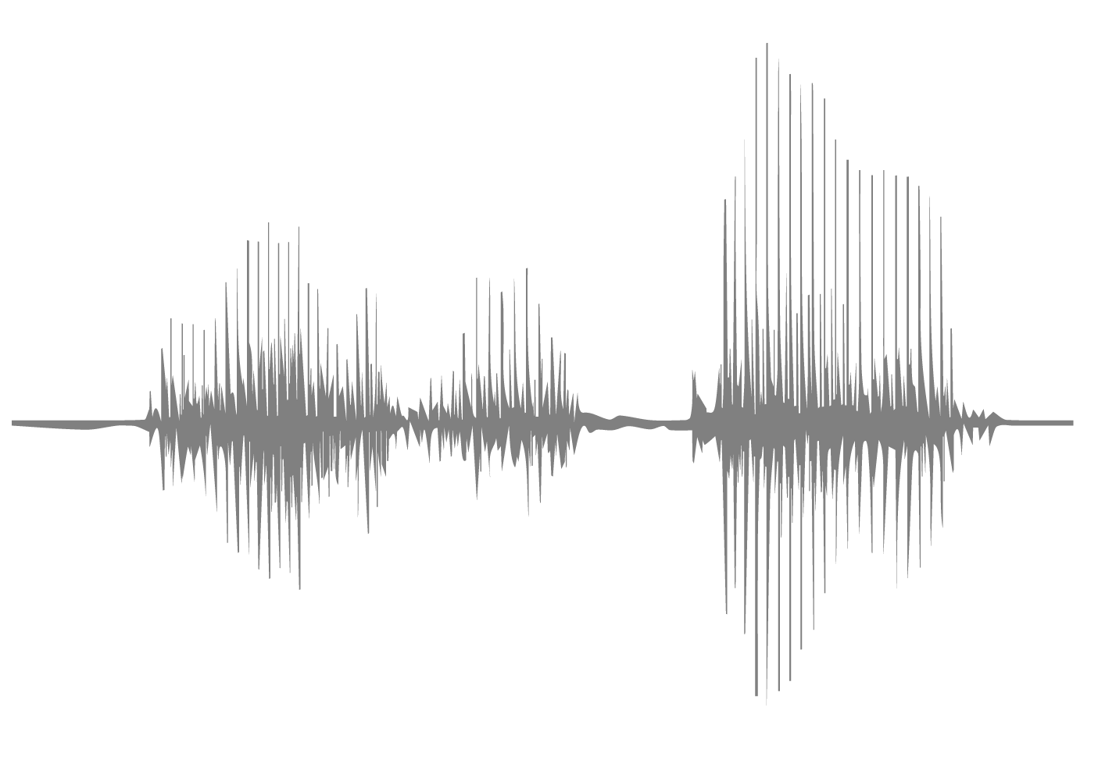
Auditory Scene Analysis
Ear by H Alberto Gongora
Glass by Visual Glow
Noun Project

Slide 6
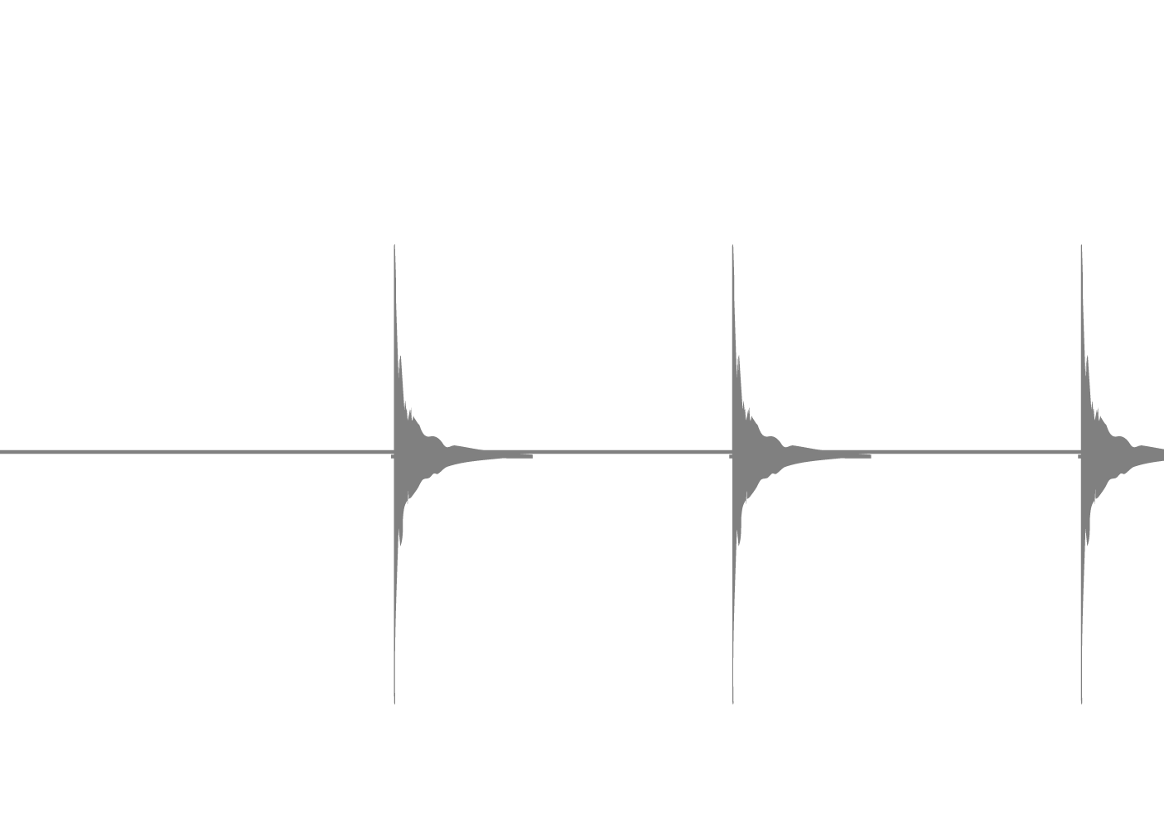
Auditory Scene Analysis
Ear by H Alberto Gongora
Glass by Visual Glow
Noun Project

Slide 7
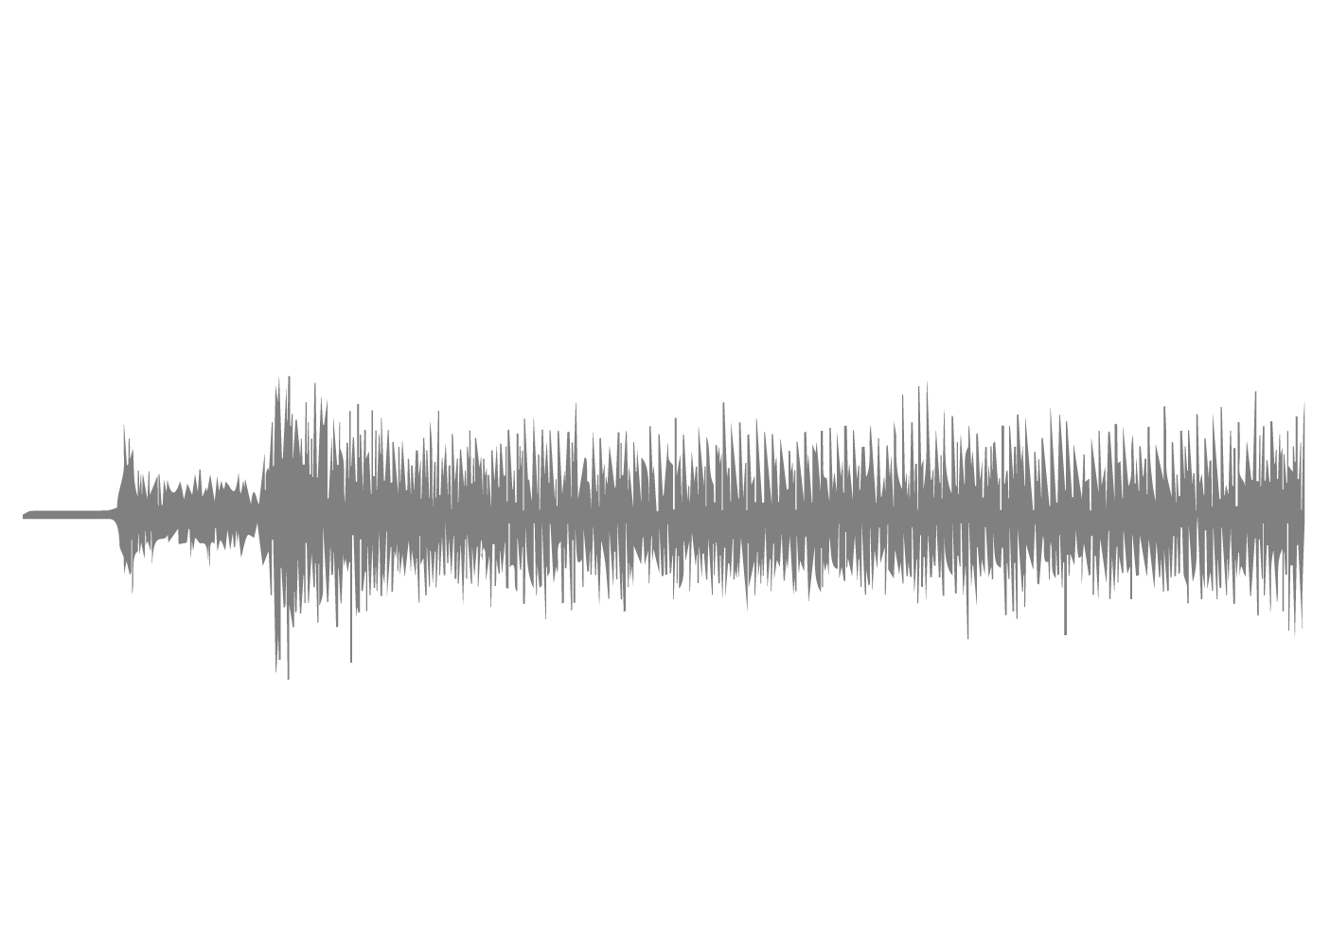
Auditory Scene Analysis
Icons by H Alberto Gongora
Wira and Visual Glow from the
Noun Project

Slide 8
Broad Question How do humans generate a single scene interpretation?

Slide 9
ABA Tone Patterns
Real Problem

Slide 10
ABA Tone Patterns
Real Problem
Simplified Problem

Slide 11
ABA Tone Patterns
Real Problem
Simplified Problem
Freq
Time

Slide 12
ABA Tone Patterns
Real Problem
Simplified Problem
Freq
Time
1 Sound

Slide 13
ABA Tone Patterns
Real Problem
Simplified Problem
Freq
Time
1 Sound
or
2 Sounds

Slide 14
Streaming depends on Frequency Separation
Data from Snyder et al. 2009

Slide 15
Streaming depends on Frequency Separation
Data from Snyder et al. 2009
% streaming

Slide 16
Streaming depends on Frequency Separation
Data from Snyder et al. 2009
% streaming
1 sound

Slide 17
Streaming depends on Frequency Separation
2 sounds
Data from Snyder et al. 2009
% streaming
1 sound

Slide 18
Streaming depends on Frequency Separation
2 sounds
Data from Snyder et al. 2009
% streaming
1 sound
semitones

Slide 19
Streaming depends on Frequency Separation
2 sounds
Data from Snyder et al. 2009
% streaming
1 sound
semitones

Slide 20
Streaming depends on Frequency Separation
2 sounds
Data from Snyder et al. 2009
% streaming
1 sound
semitones

Slide 21
Streaming depends on Frequency Separation
2 sounds
Data from Snyder et al. 2009
% streaming
1 sound
semitones

Slide 22
Ambiguous ABA tones are Bistable

Slide 23
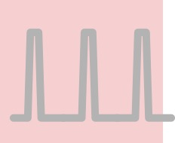
Ambiguous ABA tones are Bistable
1 Sound

Slide 24
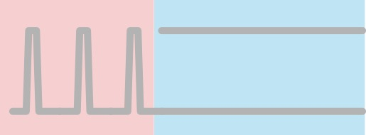
Ambiguous ABA tones are Bistable
1 Sound
2 Sounds

Slide 25
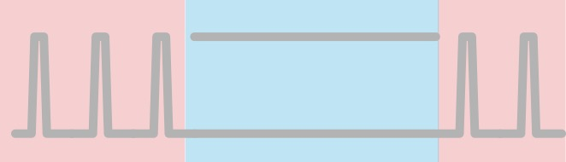

Ambiguous ABA tones are Bistable
1 Sound
2 Sounds
1 Sound

Slide 26
What causes bistability?
Perhaps:
multiple perceptual hypotheses compete for conscious access
(if true, bistability could help us answer our broad question)
early sensory channels compete leading to fluctuations in perception

Slide 27
What causes bistability?
Perhaps:
multiple perceptual hypotheses compete for conscious access
(if true, bistability could help us answer our broad question)
early sensory channels compete leading to fluctuations in perception

Slide 28
What causes bistability?
Perhaps:
multiple perceptual hypotheses compete for conscious access
(if true, bistability could help us answer our broad question)
early sensory channels compete leading to fluctuations in perception

Slide 29
What causes bistability?
Perhaps:
multiple perceptual hypotheses compete for conscious access
(if true, bistability could help us answer our broad question)
early sensory channels compete leading to fluctuations in perception
Notes:
be clear about early vs. late in the hierarchy

Slide 30
Existing Models of Auditory Bistability
Competition between features

Slide 31
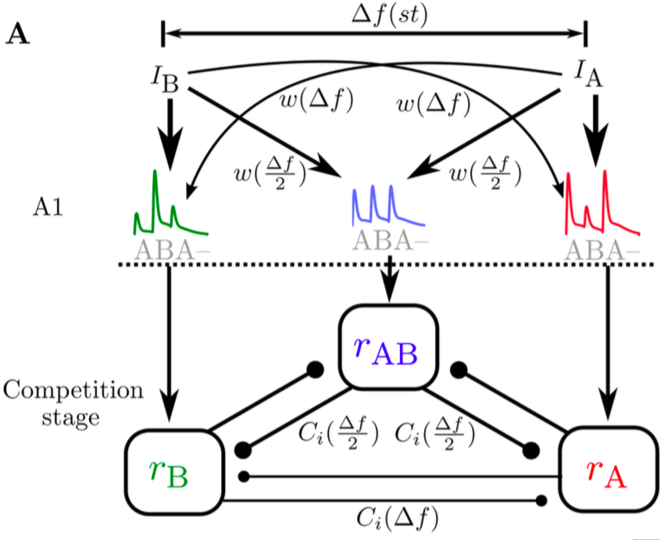
Existing Models of Auditory Bistability
Competition between features
Rankin et al 2015

Slide 32
Existing Models of Auditory Bistability
Competition between features
Rankin et al 2015
Broadly tuned frequency channels compete with one another

Slide 33
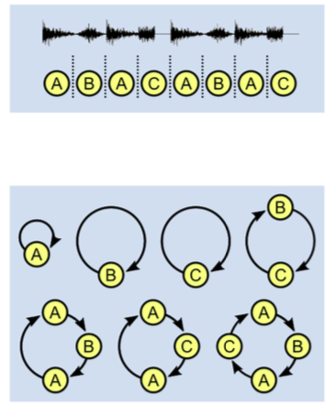
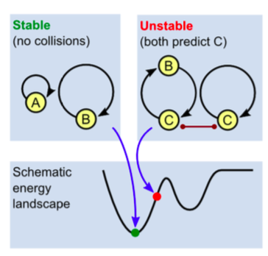
Existing Models of Auditory Bistability
Competition between features
Competition between interpretations
Rankin et al 2015
Mill et al 2013
Broadly tuned frequency channels compete with one another

Slide 34
Existing Models of Auditory Bistability
Competition between features
Competition between interpretations
Rankin et al 2015
Mill et al 2013
Multiple hypothesized objects compete with one another to explain discrete elements of an acoustic scene
Broadly tuned frequency channels compete with one another

Slide 35
Specific Question Where, within the auditory system can bistability plausibly arise?

Slide 36
Approach Overview

Slide 37
Peripheral-level
Analysis

Slide 38
Peripheral-level
Analysis
Cortical-level
Analysis

Slide 39
Peripheral-level
Analysis
Cortical-level
Analysis
Object-level
Analysis

Slide 40
Peripheral-level
Analysis
Cortical-level
Analysis
Object-level
Analysis

Slide 41
Peripheral-level
Analysis
Cortical-level
Analysis
Object-level
Analysis
or

Slide 42
Peripheral-level
Analysis
Cortical-level
Analysis
Object-level
Analysis
or
or

Slide 43
Model Evaluation

Slide 44
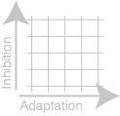
Model Evaluation
x 3 (1 for each analysis level)

Slide 45
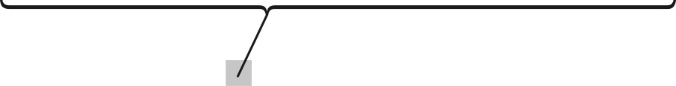
Model Evaluation
x 3 (1 for each analysis level)

Slide 46
Model Evaluation
x 3 (1 for each analysis level)

Slide 47
Model Evaluation
x 3 (1 for each analysis level)

Slide 48
Key Claims and Results

Slide 49
Key Claims
Bistability can arise within each level of analysis
The later in the analysis pipeline, the more model plausible model variants there are.

Slide 50
Key Claims
Bistability can arise within each level of analysis
The later in the analysis pipeline, the more model plausible model variants there are.

Slide 51
Key Claims
Bistability can arise within each level of analysis
The later in the analysis pipeline, the greater the number of plausible model variants

Slide 52
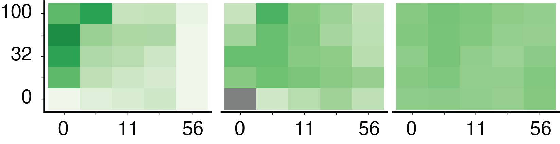
Model Fits
Peripheral-level
Analysis
Cortical-level
Analysis
Object-level
Analysis
Inhibition Strength
Adaptation Strength
Selectivity
Manhattan Distance to
Perfectly Selective Bistability
Notes:
show the optimal color (green not perfect)
the dark gray confusing
levels - show what
- random
- what 1 stream and what 2 stream always would look like
- where are people

Slide 53
Conclusions

Slide 54
Conclusions
Bistability can plausibly arise throughout the ascending auditory pathway
Bistability may more readily arise from object-level processing
Supports the idea that there are multiple competing interpretations of an auditory scene
Notes:
possible punch line - there is nothing special bistability, noise, competition and noise will generate bistability

