Slide 1
Adapting Attention in a Dynamic Three-Speaker Auditory Scene
David Little, Emine Merve Kaya and Mounya Elhilali
Laboratory for Computation Auditory Perception

Slide 2
Introduction
**TODO**

Slide 3
Stimulus

Slide 4
Stimulus

Slide 5
Stimulus

Slide 6
Stimulus

Slide 7
Stimulus

Slide 8
Stimulus
German Sentences

Slide 9
Stimulus
German Sentences

Slide 10
Stimulus
German Sentences

Slide 11
Stimulus
Task: Target detection
German Sentences

Slide 12
Stimulus
Task: Target detection
German Sentences

Slide 13
Stimulus
Task: Target detection
German Sentences

Slide 14
Stimulus
Task: Target detection
German Sentences

Slide 15
Listening Conditions

Slide 16
Listening Conditions

Slide 17
Listening Conditions
Global
attend to all voice

Slide 18
Listening Conditions
Global
Object
attend to all voice
attend to one voice

Slide 19
Listening Conditions
Global
Object
Spatial
attend to all voice
attend to one voice
attend to one side

Slide 20
Listening Conditions
Global
Object
Spatial
attend to all voice
attend to one voice
attend to one side
Identical stimuli

Slide 21
Target meaning changes across conditions

Slide 22
Target meaning changes across conditions
Global

Slide 23
Target meaning changes across conditions
Global

Slide 24
Target meaning changes across conditions
Target
Target
Target
Global

Slide 25
Target meaning changes across conditions
Target
Target
Target
Global
Object

Slide 26
Target meaning changes across conditions
Target
Target
Target
Global
Object

Slide 27
Target meaning changes across conditions
Target
Target
Target
Target
Target
Global
Object

Slide 28
Target meaning changes across conditions
Target
Target
Target
Target
Target
False
Target
Global
Object

Slide 29
Target meaning changes across conditions
Target
Target
Target
Target
Target
False
Target
Global
Object
Spatial

Slide 30
Target meaning changes across conditions
Target
Target
Target
Target
Target
False
Target
Global
Object
Spatial

Slide 31
Target meaning changes across conditions
Target
Target
Target
Target
Target
Target
False
Target
Target
Global
Object
Spatial

Slide 32
Target meaning changes across conditions
Target
Target
Target
Target
False
Target
Target
Target
False
Target
Target
Global
Object
Spatial

Slide 33
Selective Listening Improves Accuracy

Slide 34
Selective Listening Improves Accuracy

Slide 35
Selective Listening Improves Accuracy

Slide 36
Selective Listening Improves Accuracy

Slide 37
Selective Listening Improves Accuracy

Slide 38
Selective Listening Improves Accuracy

Slide 39
EEG Classification Pipeline
EEG image courtesy of wikimedia commons: Andrii Cherninskyi

Slide 40
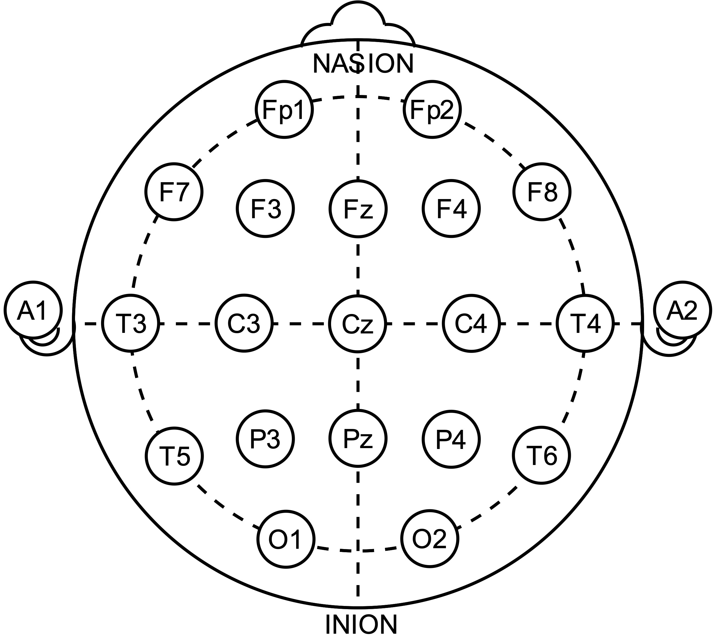
EEG Classification Pipeline
EEG image courtesy of wikimedia commons: Andrii Cherninskyi
64-electrode EEG

Slide 41
EEG Classification Pipeline
EEG image courtesy of wikimedia commons: Andrii Cherninskyi
Data Cleaning
64-electrode EEG

Slide 42
EEG Classification Pipeline
EEG image courtesy of wikimedia commons: Andrii Cherninskyi
Data Cleaning
64-electrode EEG
Data Cleaning
64-electrode EEG
…

Slide 43
EEG Classification Pipeline
EEG image courtesy of wikimedia commons: Andrii Cherninskyi
Data Cleaning
64-electrode EEG
Data Cleaning
64-electrode EEG
…
(24 subjects)

Slide 44
EEG Classification Pipeline
EEG image courtesy of wikimedia commons: Andrii Cherninskyi
Data Cleaning
MCCA
64-electrode EEG
Data Cleaning
64-electrode EEG
…
(24 subjects)

Slide 45
EEG Classification Pipeline
EEG image courtesy of wikimedia commons: Andrii Cherninskyi
Data Cleaning
MCCA
MCCA Channels
64-electrode EEG
Data Cleaning
64-electrode EEG
…
(24 subjects)

Slide 46
EEG Classification Pipeline
EEG image courtesy of wikimedia commons: Andrii Cherninskyi
Data Cleaning
MCCA
MCCA Channels
64-electrode EEG
Data Cleaning
MCCA Channels
64-electrode EEG
…
…
(24 subjects)

Slide 47
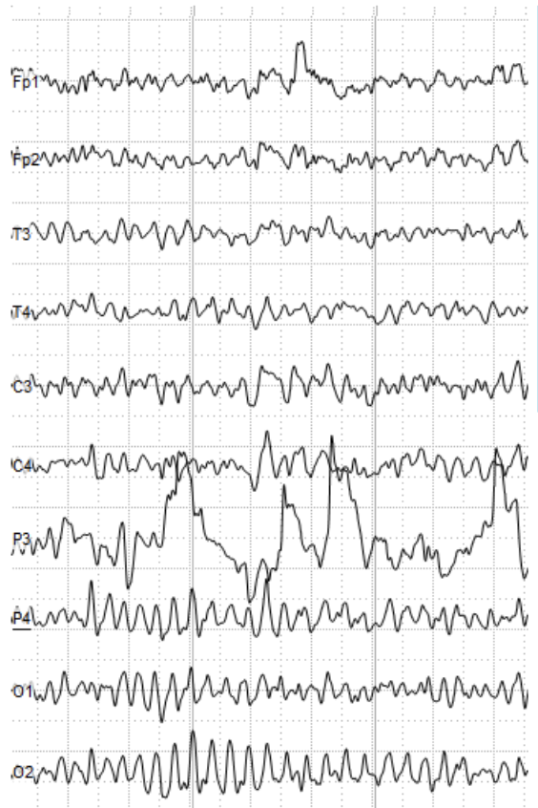
EEG Classification Pipeline
EEG image courtesy of wikimedia commons: Andrii Cherninskyi
Data Cleaning
MCCA
MCCA Channels
64-electrode EEG
Data Cleaning
MCCA Channels
64-electrode EEG
…
…
(24 subjects)

Slide 48
EEG Classification Pipeline
EEG image courtesy of wikimedia commons: Andrii Cherninskyi
Data Cleaning
MCCA
MCCA Channels
64-electrode EEG
Data Cleaning
MCCA Channels
64-electrode EEG
…
…
(24 subjects)

Slide 49
EEG Classification Pipeline
EEG image courtesy of wikimedia commons: Andrii Cherninskyi
Data Cleaning
MCCA
MCCA Channels
Target Onset
64-electrode EEG
Data Cleaning
MCCA Channels
64-electrode EEG
…
…
(24 subjects)

Slide 50
EEG Classification Pipeline
EEG image courtesy of wikimedia commons: Andrii Cherninskyi
Data Cleaning
MCCA
MCCA Channels
Target Onset
64-electrode EEG
Data Cleaning
MCCA Channels
64-electrode EEG
…
…
Classification window
near target
(selected through cross-validation)
(24 subjects)

Slide 51
EEG Classification Pipeline
EEG image courtesy of wikimedia commons: Andrii Cherninskyi
Frequency
Analysis
Data Cleaning
MCCA
MCCA Channels
Target Onset
64-electrode EEG
Ch. 1
Data Cleaning
MCCA Channels
64-electrode EEG
…
…
Classification window
near target
(selected through cross-validation)
(24 subjects)

Slide 52
EEG Classification Pipeline
EEG image courtesy of wikimedia commons: Andrii Cherninskyi
Frequency
Analysis
Data Cleaning
MCCA
MCCA Channels
Target Onset
64-electrode EEG
Ch. 1
Ch. 2
Data Cleaning
MCCA Channels
64-electrode EEG
…
…
Classification window
near target
(selected through cross-validation)
(24 subjects)

Slide 53
EEG Classification Pipeline
EEG image courtesy of wikimedia commons: Andrii Cherninskyi
Frequency
Analysis
Data Cleaning
MCCA
MCCA Channels
Target Onset
64-electrode EEG
Ch. 1
Ch. 2
Data Cleaning
MCCA Channels
Ch. 3
64-electrode EEG
…
…
Classification window
near target
(selected through cross-validation)
(24 subjects)

Slide 54
EEG Classification Pipeline
EEG image courtesy of wikimedia commons: Andrii Cherninskyi
Frequency
Analysis
Data Cleaning
MCCA
MCCA Channels
Target Onset
64-electrode EEG
Ch. 1
Ch. 2
Data Cleaning
MCCA Channels
Ch. 3
64-electrode EEG
…
…
…
Classification window
near target
(selected through cross-validation)
(24 subjects)

Slide 55
MCCA: Multi-way canonical correlation analysis
EEG (S1)

Slide 56
MCCA: Multi-way canonical correlation analysis
EEG (S1)
PCA Whitening

Slide 57
MCCA: Multi-way canonical correlation analysis
EEG (S1)
EEG (S2)
PCA Whitening
PCA Whitening

Slide 58
MCCA: Multi-way canonical correlation analysis
EEG (S1)
EEG (S2)
…
PCA Whitening
PCA Whitening

Slide 59
MCCA: Multi-way canonical correlation analysis
EEG (S1)
EEG (S2)
EEG (SN)
…
PCA Whitening
PCA Whitening
PCA Whitening

Slide 60
MCCA: Multi-way canonical correlation analysis
EEG (S1)
EEG (S2)
EEG (SN)
…
PCA Whitening
PCA Whitening
PCA Whitening
Concatenate

Slide 61
MCCA: Multi-way canonical correlation analysis
EEG (S1)
EEG (S2)
EEG (SN)
…
PCA Whitening
PCA Whitening
PCA Whitening
Concatenate
PCA

Slide 62
MCCA: Multi-way canonical correlation analysis
EEG (S1)
EEG (S2)
EEG (SN)
Goal:
…
Find shared subspace of components shared across all subjects
PCA Whitening
PCA Whitening
PCA Whitening
Concatenate
PCA

Slide 63
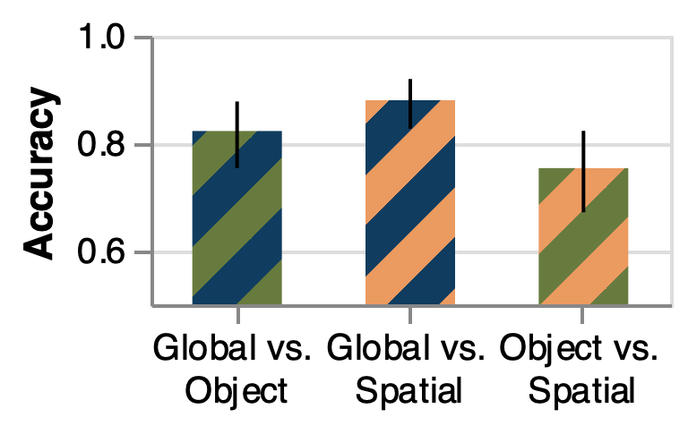
Classification Results

Slide 64
Classification Results

Slide 65
Classification Results

Slide 66
Classification Results

