Slide 1
Decoding roving attention in a dynamic auditory scene
David Little, Emine Merve Kaya and Mounya Elhilali
Laboratory for Computational Auditory Perception

Slide 2
Question: How is attention distributed across multiple sound sources?

Slide 3
2 Hypotheses
Focused
Distributed

Slide 4
2 Hypotheses
Focused
Distributed

Slide 5
2 Hypotheses
Focused
Distributed

Slide 6
2 Hypotheses
Focused
Distributed

Slide 7
2 Hypotheses
Focused
Distributed

Slide 8
2 Hypotheses
Focused
Distributed

Slide 9
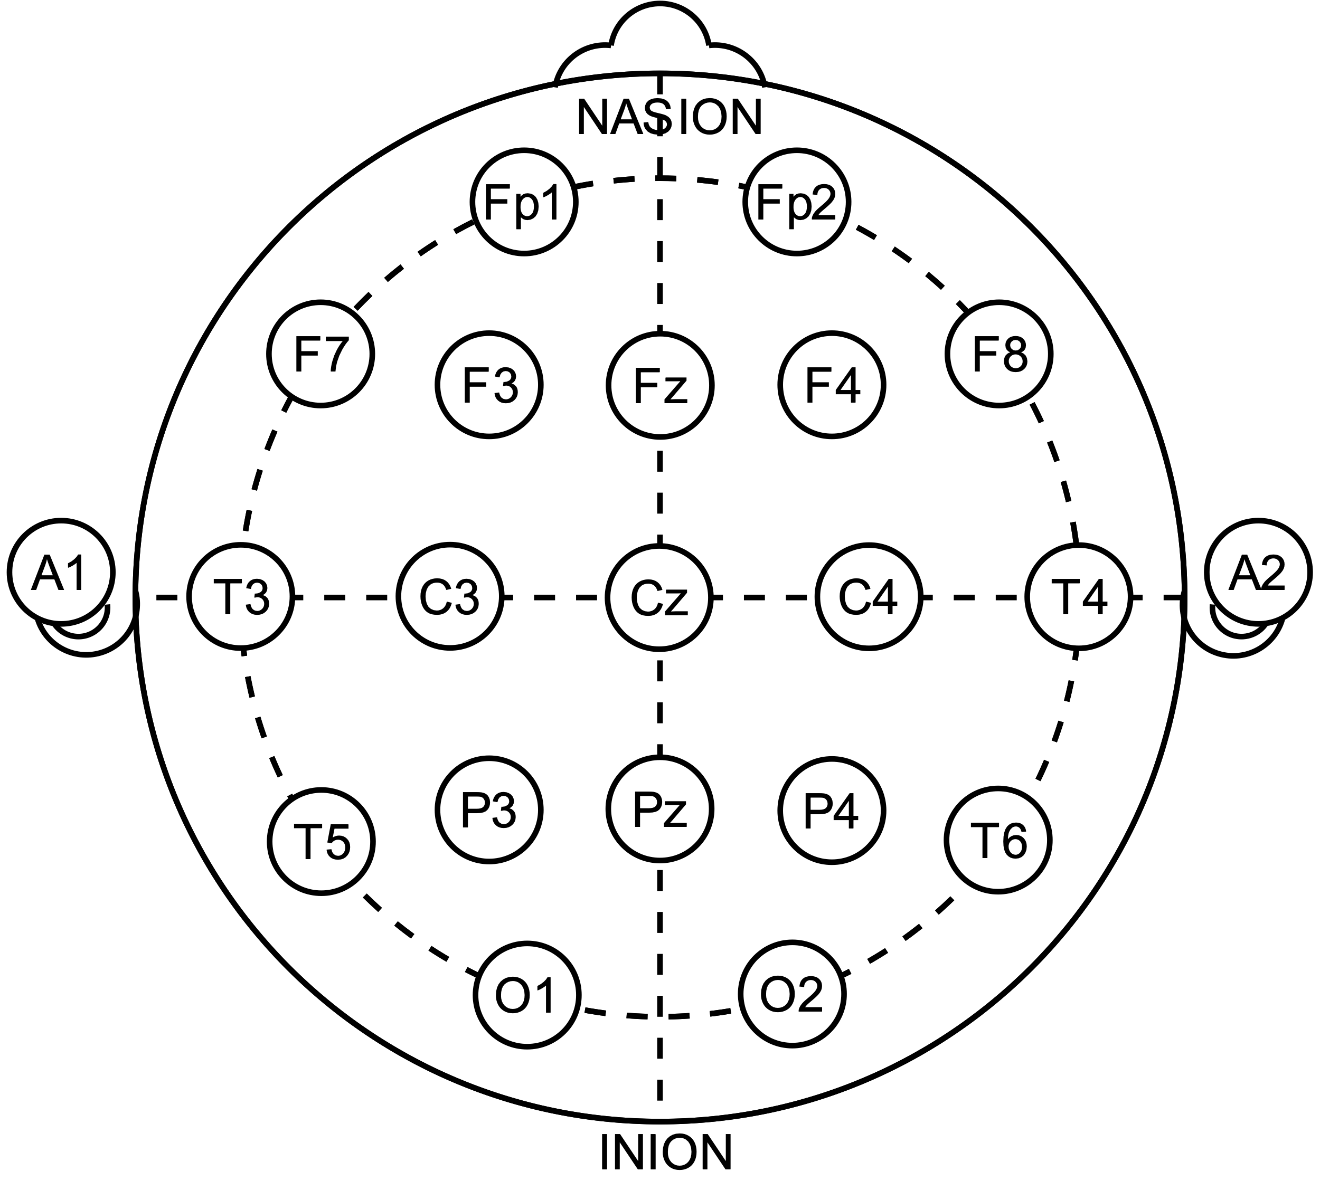
EEG Decoding

Slide 10
EEG Decoding
Decoder

Slide 11
EEG Decoding
Stimulus Features
Decoder

Slide 12
EEG Decoding
Stimulus Features
Decoder
(e.g. Envelope)

Slide 13
Decoding can estimate attentional locus in stable auditory scenes

Slide 14
Decoding can estimate attentional locus in stable auditory scenes
Typical Decoding Setup
Speaker 1
Speaker 2

Slide 15
Decoding can estimate attentional locus in stable auditory scenes
Typical Decoding Setup
Speaker 1
Attentional
Locus
Speaker 2

Slide 16
Decoding can estimate attentional locus in stable auditory scenes
Typical Decoding Setup
Attended speaker is enhanced
Speaker 1
Attentional
Locus
Speaker 2

Slide 17
Decoding can estimate attentional locus in stable auditory scenes
Typical Decoding Setup
Attended speaker is enhanced
Speaker 1
Attentional
Locus
Speaker 2
e.g. Ding and Simon 2012, O’Sullivan et al 2015

Slide 18
Stimulus

Slide 19
Stimulus

Slide 20

Stimulus
Simulated HRTF over headphones

Slide 21
Stimulus

Slide 22
Stimulus

Slide 23
Stimulus

Slide 24
Stimulus

Slide 25
Stimulus

Slide 26
Stimulus
German Sentences to Non-German Speakers

Slide 27
Stimulus
German Sentences to Non-German Speakers

Slide 28
Stimulus
Task: Target detection
German Sentences to Non-German Speakers

Slide 29
Listening Conditions

Slide 30
Listening Conditions

Slide 31
Listening Conditions
Global
attend to all voice

Slide 32
Listening Conditions
Global
Spatial
attend to all voice
attend to one side

Slide 33
Listening Conditions
Global
Spatial
Object
attend to all voice
attend to one side
attend to one voice

Slide 34
Listening Conditions
Global
Spatial
Object
attend to all voice
attend to one side
attend to one voice
Identical stimuli

Slide 35
Target meaning changes across conditions

Slide 36
Target meaning changes across conditions
Global

Slide 37
Target meaning changes across conditions
Global

Slide 38
Target meaning changes across conditions
Target
Target
Target
Global

Slide 39
Target meaning changes across conditions
Target
Target
Target
Global
Object

Slide 40
Target meaning changes across conditions
Target
Target
Target
Global
Object

Slide 41
Target meaning changes across conditions
Target
Target
Target
Target
Target
Global
Object

Slide 42
Target meaning changes across conditions
Target
Target
Target
Target
Target
False
Target
Global
Object

Slide 43
Target meaning changes across conditions
Target
Target
Target
Target
Target
False
Target
Global
Object
Spatial

Slide 44
Target meaning changes across conditions
Target
Target
Target
Target
Target
False
Target
Global
Object
Spatial

Slide 45
Target meaning changes across conditions
Target
Target
Target
Target
Target
Target
False
Target
Target
Global
Object
Spatial

Slide 46
Target meaning changes across conditions
Target
Target
Target
Target
False
Target
Target
Target
False
Target
Target
Global
Object
Spatial

Slide 47
Selective Listening Improves Accuracy

Slide 48
Selective Listening Improves Accuracy
N = 74

Slide 49
Selective Listening Improves Accuracy
N = 74

Slide 50
Selective Listening Improves Accuracy
N = 74

Slide 51
Selective Listening Improves Accuracy
N = 74

Slide 52
Selective Listening Improves Accuracy
***
***
n.s.
~
N = 74

Slide 53
Decoder Training
EEG image courtesy of wikimedia commons: Andrii Cherninskyi

Slide 54
Decoder Training
EEG image courtesy of wikimedia commons: Andrii Cherninskyi
Raw EEG Data
64-channels (N = 24)
…

Slide 55
Decoder Training
EEG image courtesy of wikimedia commons: Andrii Cherninskyi
Raw EEG Data
64-channels (N = 24)
…
MCCA
de Cheveigné et al 2019

Slide 56
Decoder Training
EEG image courtesy of wikimedia commons: Andrii Cherninskyi
Raw EEG Data
64-channels (N = 24)
…
MCCA
MCCA Components
shared subspace
…
MCCA Comp.
MCCA Comp.
MCCA Comp.
de Cheveigné et al 2019

Slide 57
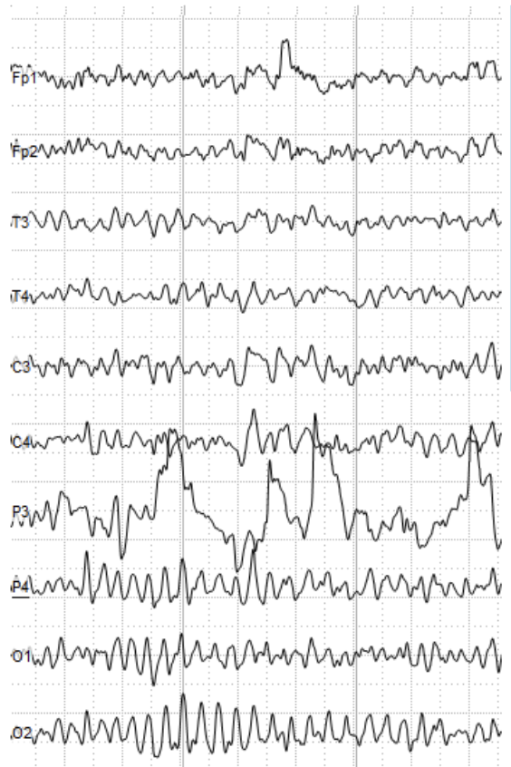
Decoder Training
EEG image courtesy of wikimedia commons: Andrii Cherninskyi
Raw EEG Data
64-channels (N = 24)
…
MCCA
MCCA Components
shared subspace
…
MCCA Comp.
MCCA Comp.
MCCA Comp.
de Cheveigné et al 2019

Slide 58
Decoder Training
EEG image courtesy of wikimedia commons: Andrii Cherninskyi
Stimulus
Raw EEG Data
64-channels (N = 24)
…
MCCA
MCCA Components
shared subspace
…
MCCA Comp.
MCCA Comp.
MCCA Comp.
de Cheveigné et al 2019

Slide 59
Decoder Training
EEG image courtesy of wikimedia commons: Andrii Cherninskyi
Stimulus
Raw EEG Data
64-channels (N = 24)
Target Hit
…
MCCA
MCCA Components
shared subspace
…
MCCA Comp.
MCCA Comp.
MCCA Comp.
de Cheveigné et al 2019

Slide 60
Decoder Training
EEG image courtesy of wikimedia commons: Andrii Cherninskyi
Stimulus
Raw EEG Data
64-channels (N = 24)
Target Hit
…
MCCA
MCCA Components
shared subspace
…
MCCA Comp.
MCCA Comp.
MCCA Comp.
de Cheveigné et al 2019

Slide 61
Decoder Training
EEG image courtesy of wikimedia commons: Andrii Cherninskyi
Stimulus
Raw EEG Data
64-channels (N = 24)
Target Hit
…
MCCA
MCCA Components
shared subspace
Decoding: Envelope
…
MCCA Comp.
MCCA Comp.
MCCA Comp.
3-layer 64 hidden-unit neural network
de Cheveigné et al 2019

Slide 62
Decoder Training
EEG image courtesy of wikimedia commons: Andrii Cherninskyi
Stimulus
Raw EEG Data
64-channels (N = 24)
Target Hit
…
MCCA
MCCA Components
shared subspace
Decoding: Envelope
Decoding:
Pitch Surprisal
…
MCCA Comp.
MCCA Comp.
MCCA Comp.
3-layer 64 hidden-unit neural network
de Cheveigné et al 2019

Slide 63
Decoder Training
EEG image courtesy of wikimedia commons: Andrii Cherninskyi
Stimulus
Raw EEG Data
64-channels (N = 24)
Target Hit
…
MCCA
MCCA Components
shared subspace
Decoding: Envelope
Decoding:
Pitch Surprisal
Decoding: Azimuth
…
MCCA Comp.
MCCA Comp.
MCCA Comp.
3-layer 64 hidden-unit neural network
de Cheveigné et al 2019

Slide 64
Decoding reveals attention outside switches

Slide 65
Decoding reveals attention outside switches

Slide 66
Decoding reveals attention outside switches

Slide 67
Decoding reveals attention outside switches

Slide 68
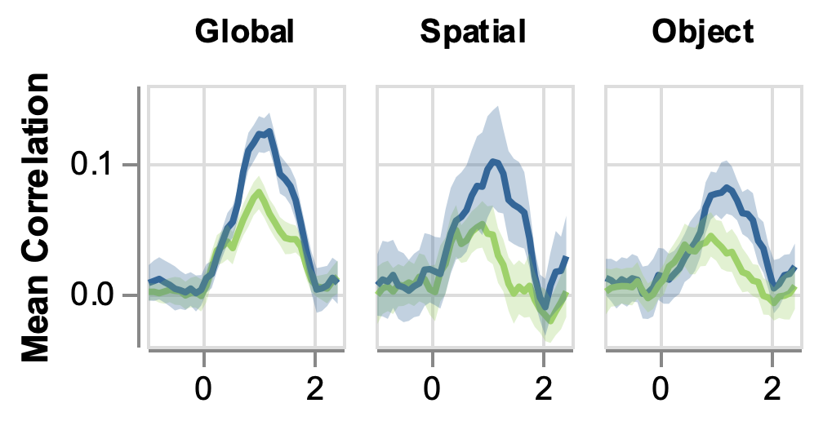
Decoding reveals attention to the target
Time

Slide 69
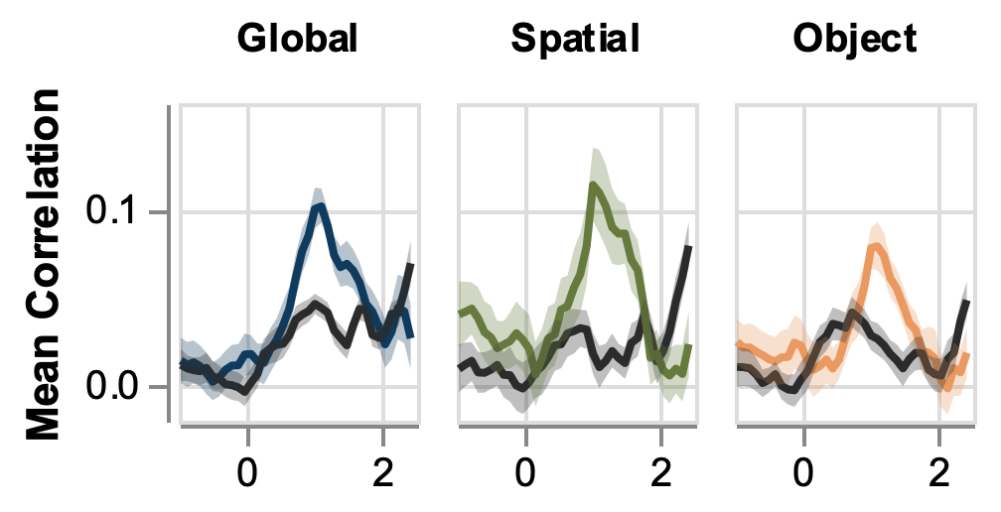
Decoding reveals attention to the target
Time relative to target onset (s)

Slide 70
Decoding reveals attention to the target
Time relative to target onset (s)

Slide 71
Decoding reveals attention to the target
Worse
Decoding
Time relative to target onset (s)

Slide 72
Decoding reveals attention to the target
Better
Decoding
Worse
Decoding
Time relative to target onset (s)

Slide 73
Decoding reveals attention to the target
Better
Decoding
Worse
Decoding
Time relative to target onset (s)

Slide 74
Decoding reveals attention to the target
Better
Decoding
Target
Worse
Decoding
Time relative to target onset (s)

Slide 75
Decoding reveals attention to the target
Better
Decoding
Target
Other
Worse
Decoding
Time relative to target onset (s)

Slide 76
Decoding reveals attention to the target
Better
Decoding
Target
Other
Worse
Decoding
Time relative to target onset (s)

Slide 77
Decoding reveals attention to the target
Better
Decoding
Target
Other
Worse
Decoding
Time relative to target onset (s)

Slide 78
Decoding reveals attention to the target
Better
Decoding
***
***
***
Target
Other
Worse
Decoding
Time relative to target onset (s)

Slide 79
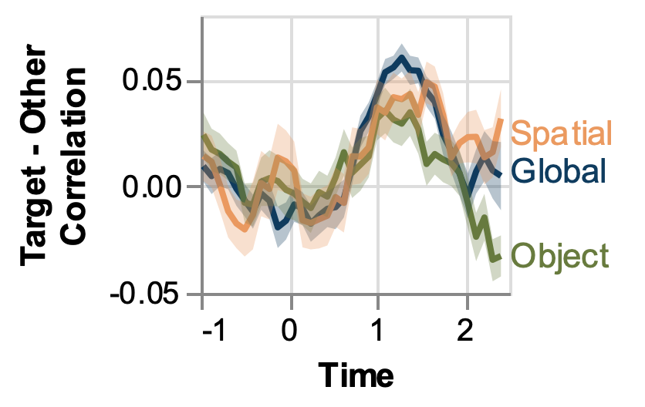
Attention signal is similar across conditions
n.s.
(s)

Slide 80
Attention signal is similar across conditions
Target Focused
Attention
n.s.
(s)

Slide 81
Attention signal is similar across conditions
Target Focused
Attention
n.s.
Distributed
Attention
(s)

Slide 82
Attention signal is similar across conditions
Target Focused
Attention
n.s.
Distributed
Attention
(s)

Slide 83
Conclusion: No evidence for distributed attention
Target Focused
Attention
n.s.
Distributed
Attention
(s)

Slide 84
Computing Focus Lengths (Trial by Trial)
Decoding
Correlation
Source 2
Focus Lengths

Slide 85
Computing Focus Lengths (Trial by Trial)
Decoding
Correlation
Source 1
Decoding
Correlation
Source 2

Slide 86
Computing Focus Lengths (Trial by Trial)
Decoding
Correlation
Source 1
Decoding
Correlation
Source 2
Focus Lengths

Slide 87
Focus lengths differ by condition

Slide 88
Conclusion: Attention appears to rove

Slide 89
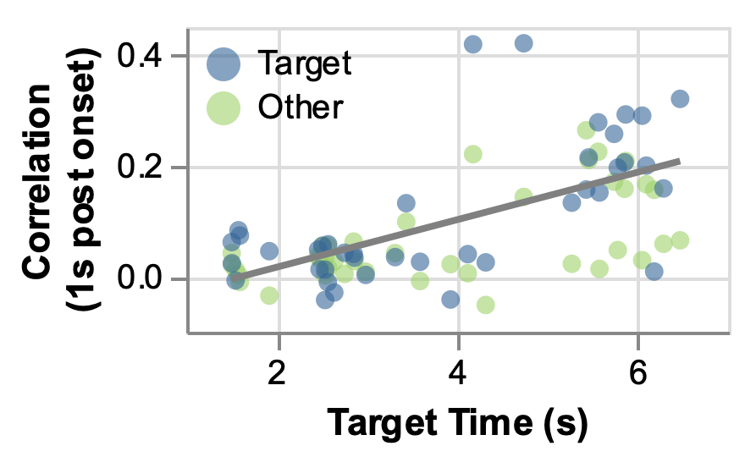
Later target = Better decoding
Better
Decoding
Worse
Decoding

Slide 90
Later target = Better decoding
Better
Decoding
Worse
Decoding

Slide 91
Later target = Better decoding
Better
Decoding
Worse
Decoding

Slide 92
Later target = Better decoding
Better
Decoding
***
Worse
Decoding

Slide 93
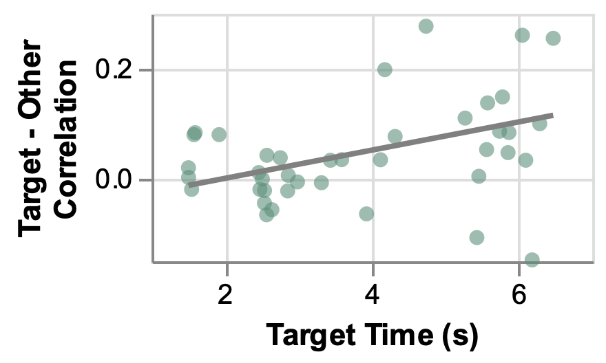
Later target = More focused attention
Target Focused
Attention
Other Focused
Attention

Slide 94
Conclusions
1. Attention-related signal was distributed similarly across condition
No evidence for spreading of attention
2. Attention-related signal had different focus lengths across conditions
Possible evidence for attention roving

