Slide 1
Adapting Attention in a Dynamic Three-Speaker Auditory Scene
David Little, Emine Merve Kaya and Mounya Elhilali
Laboratory for Computational Auditory Perception

Slide 2
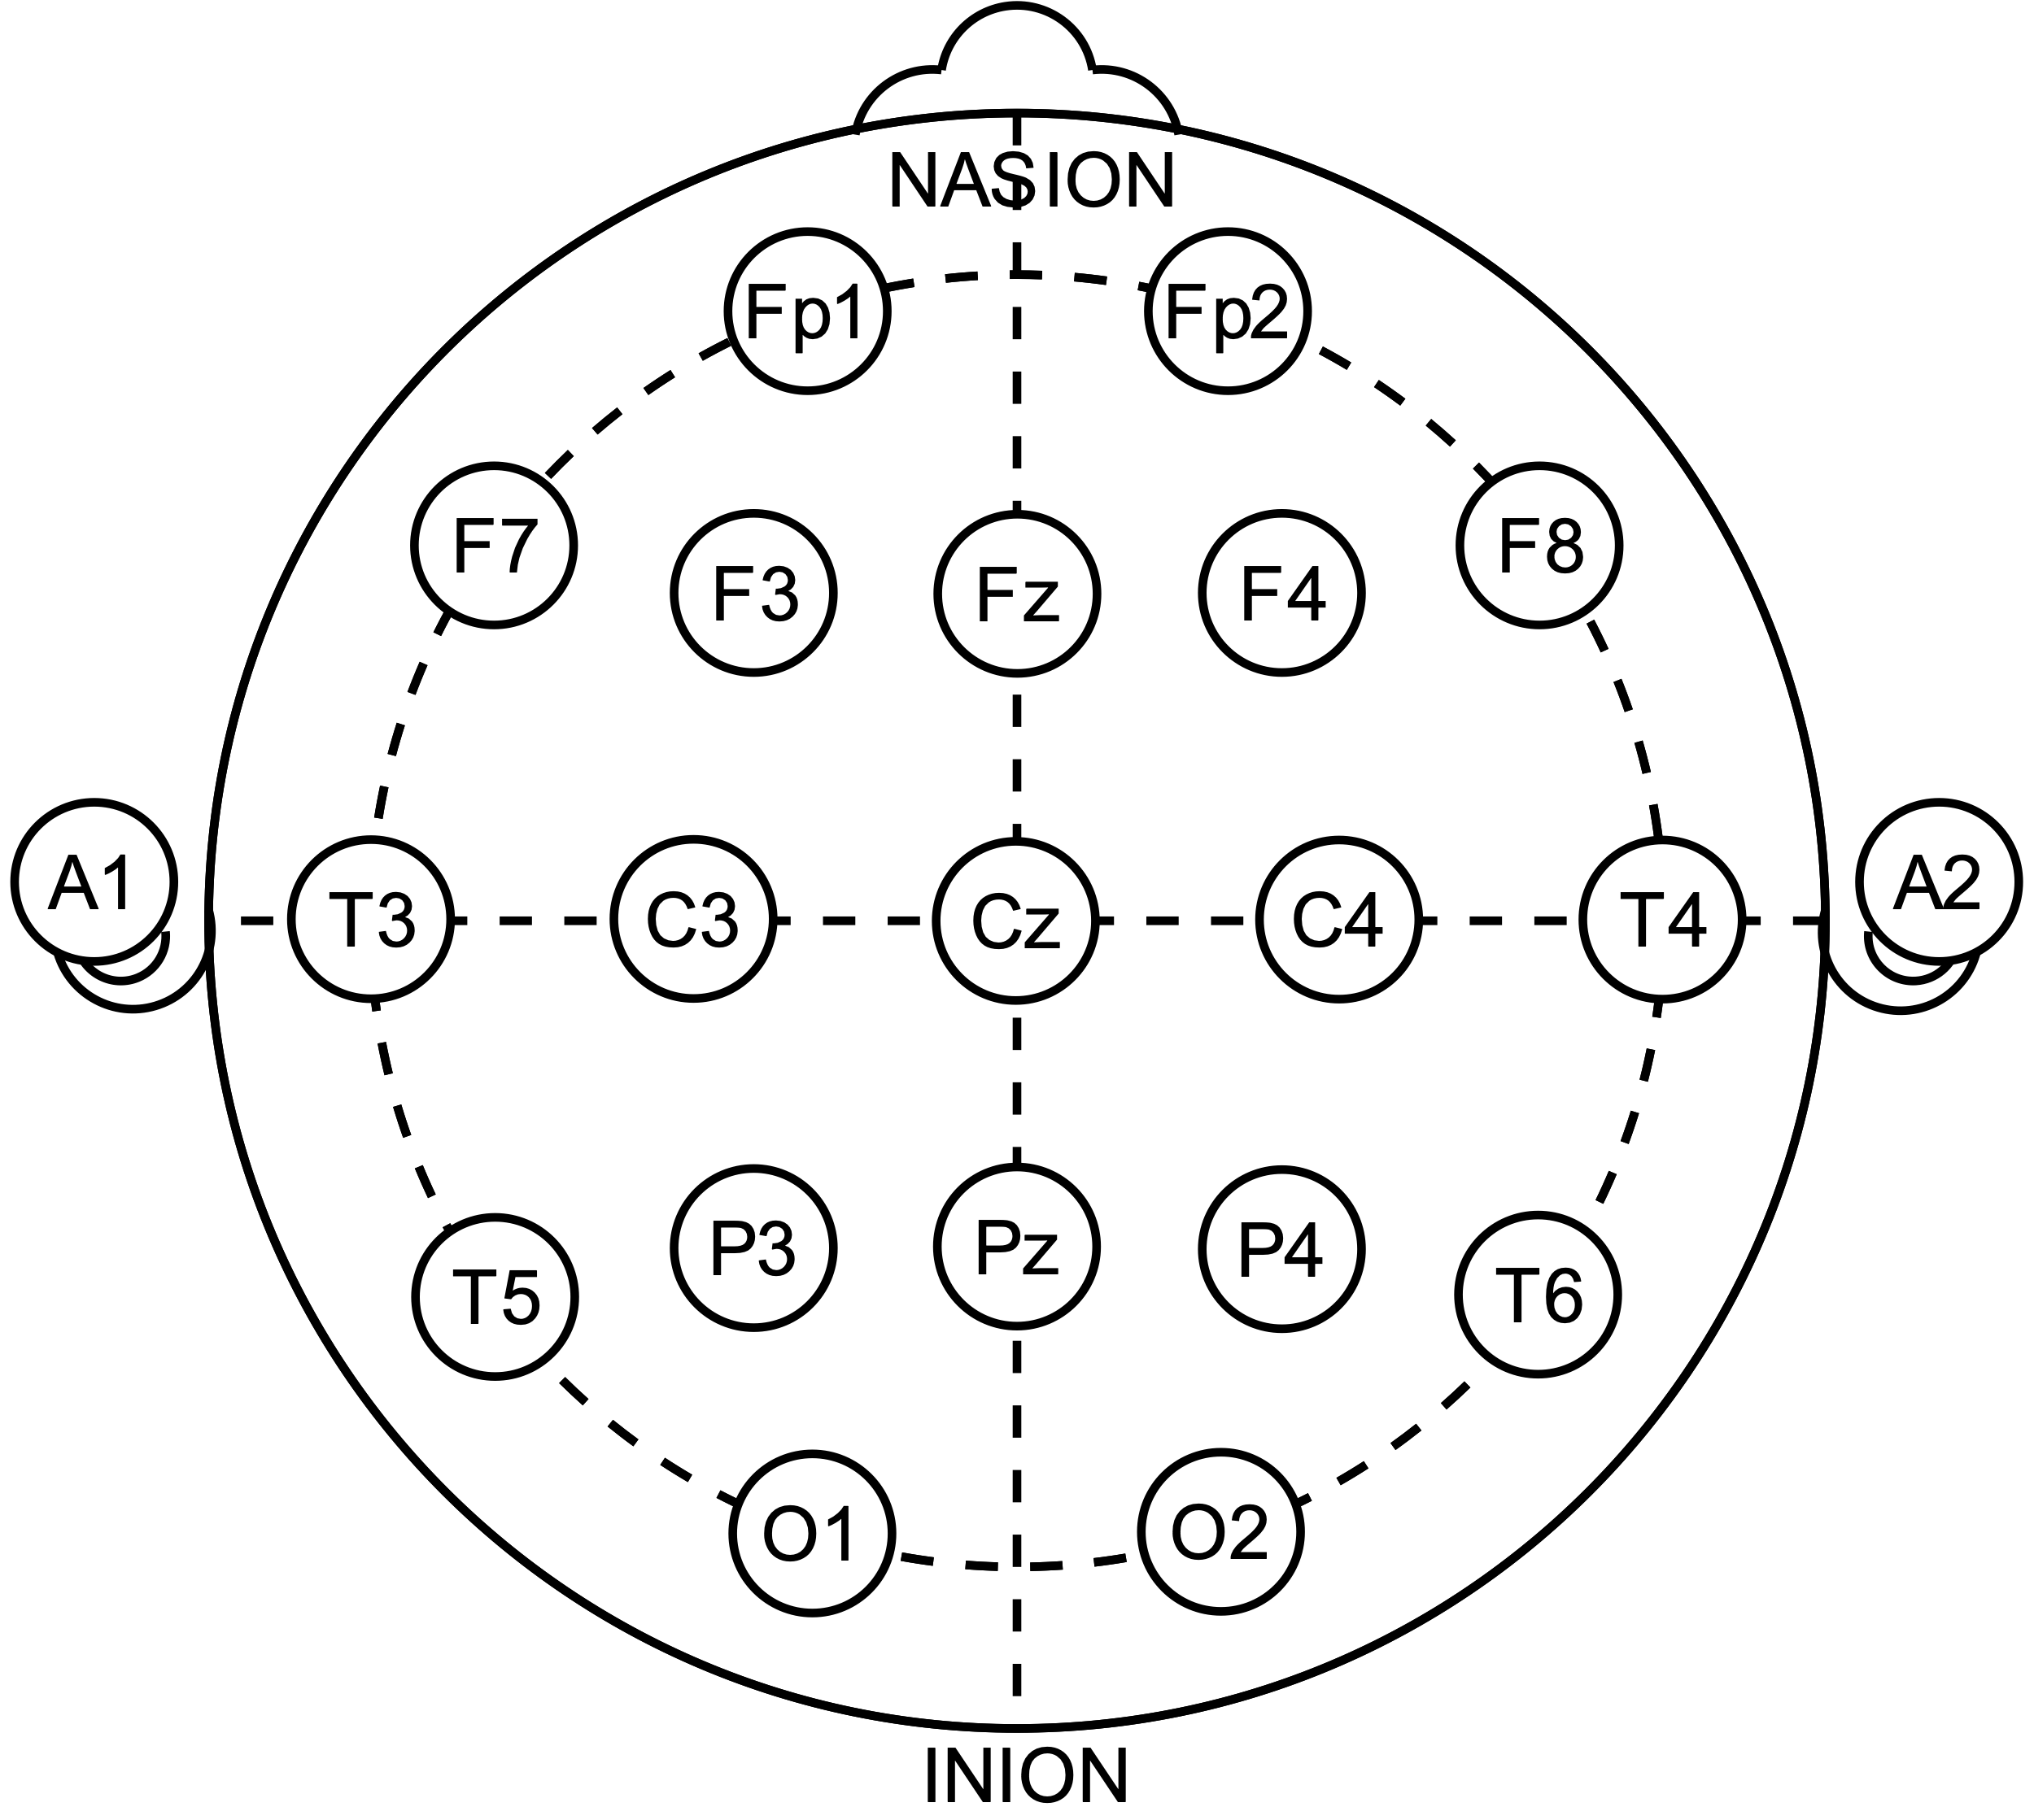
EEG Decoding

Slide 3
EEG Decoding
Decoder

Slide 4
EEG Decoding
Stimulus Features
Decoder

Slide 5
EEG Decoding
Stimulus Features
Decoder
(e.g. Envelope)

Slide 6
Decoding can estimate attentional locus in stable auditory scenes

Slide 7
Decoding can estimate attentional locus in stable auditory scenes
Typical Decoding Setup
Speaker 1
Speaker 2

Slide 8
Decoding can estimate attentional locus in stable auditory scenes
Typical Decoding Setup
Speaker 1
Attentional
Locus
Speaker 2

Slide 9
Decoding can estimate attentional locus in stable auditory scenes
Typical Decoding Setup
Attended speaker is enhanced
Speaker 1
Attentional
Locus
Speaker 2

Slide 10
Decoding can estimate attentional locus in stable auditory scenes
Typical Decoding Setup
Attended speaker is enhanced
Speaker 1
Attentional
Locus
Speaker 2
e.g. Ding and Simon 2012, O’Sullivan et al 2015

Slide 11
Stimulus

Slide 12
Stimulus

Slide 13

Stimulus
Simulated HRTF over headphones

Slide 14
Stimulus

Slide 15
Stimulus

Slide 16
Stimulus

Slide 17
Stimulus

Slide 18
Stimulus

Slide 19
Stimulus
German Sentences to Non-German Speakers

Slide 20
Stimulus
German Sentences to Non-German Speakers

Slide 21
Stimulus
Task: Target detection
German Sentences to Non-German Speakers

Slide 22
Listening Conditions

Slide 23
Listening Conditions

Slide 24
Listening Conditions
Global
attend to all voice

Slide 25
Listening Conditions
Global
Spatial
attend to all voice
attend to one side

Slide 26
Listening Conditions
Global
Spatial
Object
attend to all voice
attend to one side
attend to one voice

Slide 27
Listening Conditions
Global
Spatial
Object
attend to all voice
attend to one side
attend to one voice
Identical stimuli

Slide 28
Target meaning changes across conditions

Slide 29
Target meaning changes across conditions
Global

Slide 30
Target meaning changes across conditions
Global

Slide 31
Target meaning changes across conditions
Target
Target
Target
Global

Slide 32
Target meaning changes across conditions
Target
Target
Target
Global
Object

Slide 33
Target meaning changes across conditions
Target
Target
Target
Global
Object

Slide 34
Target meaning changes across conditions
Target
Target
Target
Target
Target
Global
Object

Slide 35
Target meaning changes across conditions
Target
Target
Target
Target
Target
False
Target
Global
Object

Slide 36
Target meaning changes across conditions
Target
Target
Target
Target
Target
False
Target
Global
Object
Spatial

Slide 37
Target meaning changes across conditions
Target
Target
Target
Target
Target
False
Target
Global
Object
Spatial

Slide 38
Target meaning changes across conditions
Target
Target
Target
Target
Target
Target
False
Target
Target
Global
Object
Spatial

Slide 39
Target meaning changes across conditions
Target
Target
Target
Target
False
Target
Target
Target
False
Target
Target
Global
Object
Spatial

Slide 40
Selective Listening Improves Accuracy

Slide 41
Selective Listening Improves Accuracy
N = 74

Slide 42
Selective Listening Improves Accuracy
N = 74

Slide 43
Selective Listening Improves Accuracy
N = 74

Slide 44
Selective Listening Improves Accuracy
N = 74

Slide 45
Selective Listening Improves Accuracy
***
***
n.s.
~
N = 74

Slide 46
Decoder Training
EEG image courtesy of wikimedia commons: Andrii Cherninskyi

Slide 47
Decoder Training
EEG image courtesy of wikimedia commons: Andrii Cherninskyi
Raw EEG Data
64-channels (N = 24)
…

Slide 48
Decoder Training
EEG image courtesy of wikimedia commons: Andrii Cherninskyi
Raw EEG Data
64-channels (N = 24)
…
MCCA
de Cheveigné et al 2019

Slide 49
Decoder Training
EEG image courtesy of wikimedia commons: Andrii Cherninskyi
Raw EEG Data
64-channels (N = 24)
…
MCCA
MCCA Components
shared subspace
…
MCCA Comp.
MCCA Comp.
MCCA Comp.
de Cheveigné et al 2019

Slide 50
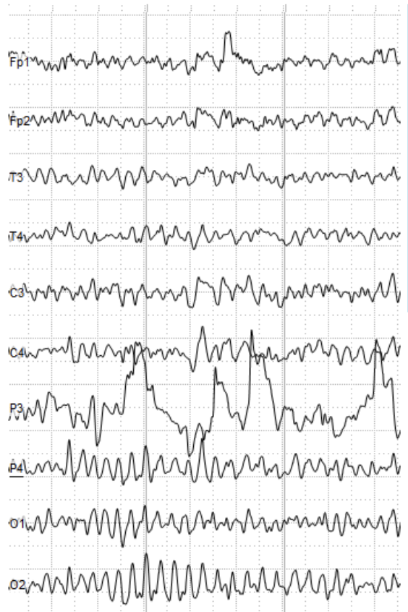
Decoder Training
EEG image courtesy of wikimedia commons: Andrii Cherninskyi
Raw EEG Data
64-channels (N = 24)
…
MCCA
MCCA Components
shared subspace
…
MCCA Comp.
MCCA Comp.
MCCA Comp.
de Cheveigné et al 2019

Slide 51
Decoder Training
EEG image courtesy of wikimedia commons: Andrii Cherninskyi
Raw EEG Data
64-channels (N = 24)
…
MCCA
MCCA Components
shared subspace
…
MCCA Comp.
MCCA Comp.
MCCA Comp.
de Cheveigné et al 2019

Slide 52
Decoder Training
EEG image courtesy of wikimedia commons: Andrii Cherninskyi
Raw EEG Data
64-channels (N = 24)
…
Target Hit
MCCA
MCCA Components
shared subspace
…
MCCA Comp.
MCCA Comp.
MCCA Comp.

Slide 53
Decoder Training
EEG image courtesy of wikimedia commons: Andrii Cherninskyi
Raw EEG Data
64-channels (N = 24)
…
Target Onset
Target Hit
MCCA
MCCA Components
shared subspace
…
MCCA Comp.
MCCA Comp.
MCCA Comp.
de Cheveigné et al 2019

Slide 54
Decoder Training
EEG image courtesy of wikimedia commons: Andrii Cherninskyi
Raw EEG Data
64-channels (N = 24)
1s
…
Target Onset
Target Hit
MCCA
MCCA Components
shared subspace
…
MCCA Comp.
MCCA Comp.
MCCA Comp.
de Cheveigné et al 2019

Slide 55
Decoder Training
EEG image courtesy of wikimedia commons: Andrii Cherninskyi
Raw EEG Data
64-channels (N = 24)
1s
…
Target Onset
Target Hit
MCCA
MCCA Components
shared subspace
Decoding: Envelope
…
MCCA Comp.
MCCA Comp.
MCCA Comp.
de Cheveigné et al 2019

Slide 56
Decoder Training
EEG image courtesy of wikimedia commons: Andrii Cherninskyi
Raw EEG Data
64-channels (N = 24)
1s
…
Target Onset
Target Hit
MCCA
MCCA Components
shared subspace
Decoding: Envelope
Decoding:
Pitch Surprisal
…
MCCA Comp.
MCCA Comp.
MCCA Comp.
de Cheveigné et al 2019

Slide 57
Decoder Training
EEG image courtesy of wikimedia commons: Andrii Cherninskyi
Raw EEG Data
64-channels (N = 24)
1s
…
Target Onset
Target Hit
MCCA
MCCA Components
shared subspace
Decoding: Envelope
Decoding:
Pitch Surprisal
…
MCCA Comp.
MCCA Comp.
MCCA Comp.
3-layer 64 hidden-unit neural network
de Cheveigné et al 2019

Slide 58
Decoder Training
EEG image courtesy of wikimedia commons: Andrii Cherninskyi
Raw EEG Data
64-channels (N = 24)
1s
…
Target Onset
Target Hit
MCCA
MCCA Components
shared subspace
Decoding: Envelope
Decoding:
Pitch Surprisal
…
MCCA Comp.
MCCA Comp.
MCCA Comp.
3-layer 64 hidden-unit neural network
Cross-validated across subjects
de Cheveigné et al 2019

Slide 59
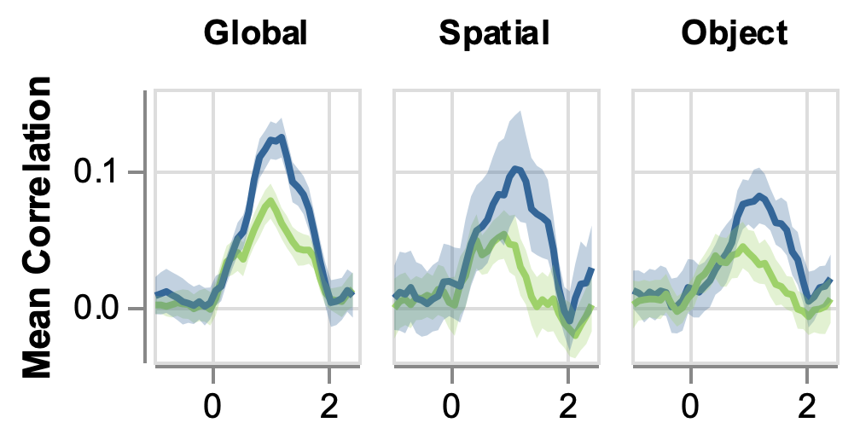
Decoding reveals attention to the target
Time

Slide 60
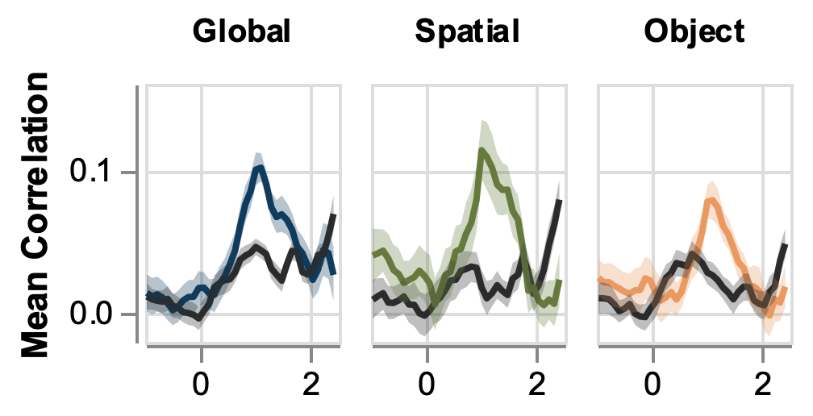
Decoding reveals attention to the target
Time relative to target onset (s)

Slide 61
Decoding reveals attention to the target
Time relative to target onset (s)

Slide 62
Decoding reveals attention to the target
Worse
Decoding
Time relative to target onset (s)

Slide 63
Decoding reveals attention to the target
Better
Decoding
Worse
Decoding
Time relative to target onset (s)

Slide 64
Decoding reveals attention to the target
Better
Decoding
Worse
Decoding
Time relative to target onset (s)

Slide 65
Decoding reveals attention to the target
Better
Decoding
Target
Worse
Decoding
Time relative to target onset (s)

Slide 66
Decoding reveals attention to the target
Better
Decoding
Target
Other
Worse
Decoding
Time relative to target onset (s)

Slide 67
Decoding reveals attention to the target
Better
Decoding
Target
Other
Worse
Decoding
Time relative to target onset (s)

Slide 68
Decoding reveals attention to the target
Better
Decoding
Target
Other
Worse
Decoding
Time relative to target onset (s)

Slide 69
Decoding reveals attention to the target
Better
Decoding
***
***
***
Target
Other
Worse
Decoding
Time relative to target onset (s)

Slide 70
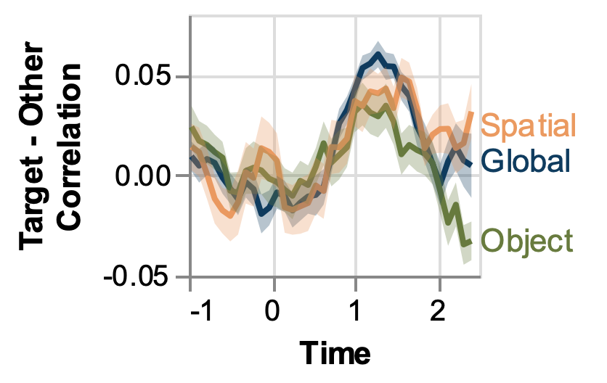
Attention signal is similar across conditions
n.s.
(s)

Slide 71
Attention signal is similar across conditions
Target Focused
Attention
n.s.
(s)

Slide 72
Attention signal is similar across conditions
Target Focused
Attention
n.s.
Distributed
Attention
(s)

Slide 73
Attention signal is similar across conditions
Target Focused
Attention
n.s.
Distributed
Attention
(s)

Slide 74
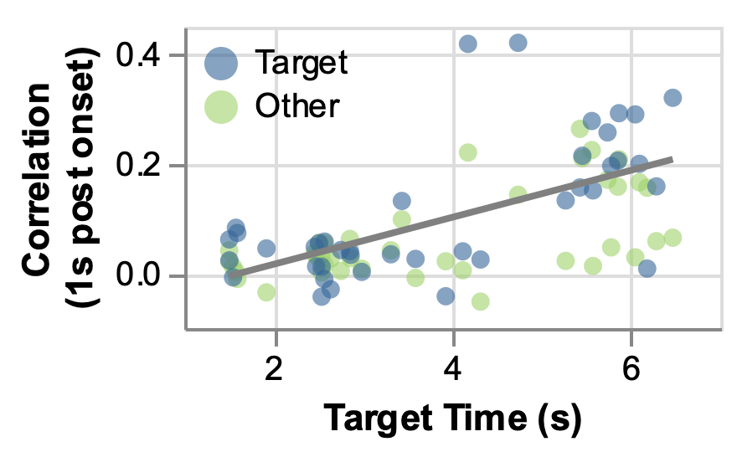
Later target = Better decoding
Better
Decoding
Worse
Decoding

Slide 75
Later target = Better decoding
Better
Decoding
Worse
Decoding

Slide 76
Later target = Better decoding
Better
Decoding
Worse
Decoding

Slide 77
Later target = Better decoding
Better
Decoding
***
Worse
Decoding

Slide 78
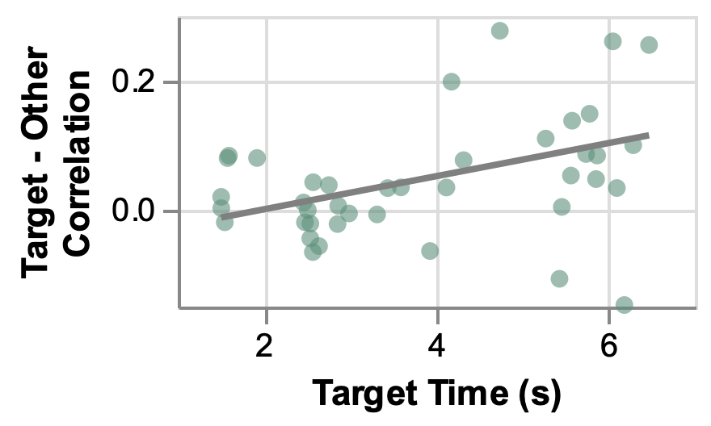
Later target = More focused attention
Target Focused
Attention
Other Focused
Attention

Slide 79
Later target = More focused attention
Target Focused
Attention
***
Other Focused
Attention

Slide 80
Conclusions

Slide 81
Conclusions
1. Attention-related stimulus enhancement was similar across conditions

Slide 82
Conclusions
1. Attention-related stimulus enhancement was similar across conditions
Additional selectivity (seen in behavior) may arise after the attentional enhancement observed by decoding

Slide 83
Conclusions
1. Attention-related stimulus enhancement was similar across conditions
Additional selectivity (seen in behavior) may arise after the attentional enhancement observed by decoding
2. Target attention > later in trial

Slide 84
Conclusions
1. Attention-related stimulus enhancement was similar across conditions
Additional selectivity (seen in behavior) may arise after the attentional enhancement observed by decoding
2. Target attention > later in trial
Attentional stimulus enhancement may rapidly tunes to specific scene dynamics

Slide 85
Questions?

Slide 86
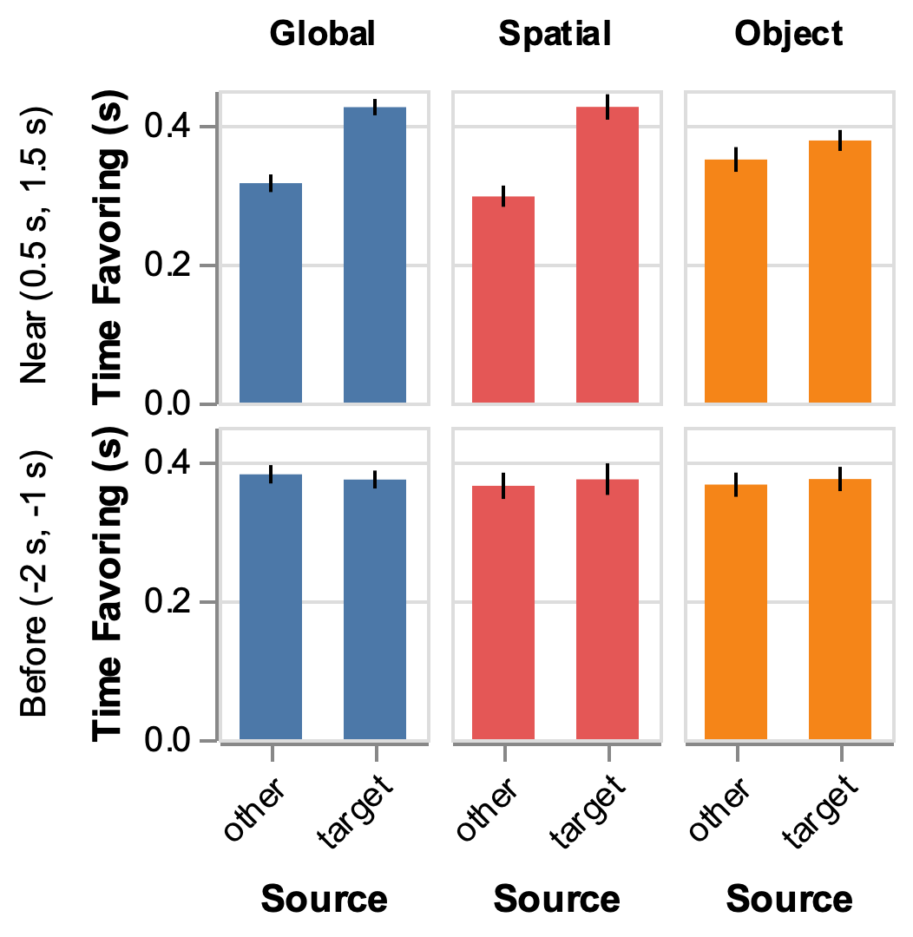
Tentative conclusion: decoder can
“see” attention outside of the target window
Favoring =
Correlation
difference > 0.1

