Slide 1
Adapting Attention in a Dynamic Three-Speaker Auditory Scene
David Little, Emine Merve Kaya and Mounya Elhilali
Laboratory for Computation Auditory Perception

Slide 2
How do we distribute auditory attention?
Selective

Slide 3
How do we distribute auditory attention?
Selective

Slide 4
How do we distribute auditory attention?
Selective

Slide 5
How do we distribute auditory attention?
Selective

Slide 6
How do we distribute auditory attention?
Selective
Distributed

Slide 7
How do we distribute auditory attention?
Selective
Distributed

Slide 8
How do we distribute auditory attention?
Selective
Distributed

Slide 9
Flicker: Global variance - local variance

Slide 10
Spread: target:non-target ratio

Slide 11
Stimulus

Slide 12
Stimulus

Slide 13

Stimulus
Simulated HRTF over headphones

Slide 14
Stimulus

Slide 15
Stimulus

Slide 16
Stimulus

Slide 17
Stimulus

Slide 18
Stimulus

Slide 19
Stimulus
German Sentences to Non-German Speakers

Slide 20
Stimulus
German Sentences to Non-German Speakers

Slide 21
Stimulus
German Sentences to Non-German Speakers

Slide 22
Stimulus
Task: Target detection
German Sentences to Non-German Speakers

Slide 23
Listening Conditions

Slide 24
Listening Conditions

Slide 25
Listening Conditions
Global
attend to all voice

Slide 26
Listening Conditions
Global
Spatial
attend to all voice
attend to one side

Slide 27
Listening Conditions
Global
Spatial
Object
attend to all voice
attend to one side
attend to one voice

Slide 28
Listening Conditions
Global
Spatial
Object
attend to all voice
attend to one side
attend to one voice
Identical stimuli

Slide 29
Target meaning changes across conditions

Slide 30
Target meaning changes across conditions
Global

Slide 31
Target meaning changes across conditions
Global

Slide 32
Target meaning changes across conditions
Target
Target
Target
Global

Slide 33
Target meaning changes across conditions
Target
Target
Target
Global
Object

Slide 34
Target meaning changes across conditions
Target
Target
Target
Global
Object

Slide 35
Target meaning changes across conditions
Target
Target
Target
Target
Target
Global
Object

Slide 36
Target meaning changes across conditions
Target
Target
Target
Target
Target
False
Target
Global
Object

Slide 37
Target meaning changes across conditions
Target
Target
Target
Target
Target
False
Target
Global
Object
Spatial

Slide 38
Target meaning changes across conditions
Target
Target
Target
Target
Target
False
Target
Global
Object
Spatial

Slide 39
Target meaning changes across conditions
Target
Target
Target
Target
Target
Target
False
Target
Target
Global
Object
Spatial

Slide 40
Target meaning changes across conditions
Target
Target
Target
Target
False
Target
Target
Target
False
Target
Target
Global
Object
Spatial

Slide 41
Selective Listening Improves Accuracy

Slide 42
Selective Listening Improves Accuracy

Slide 43
Selective Listening Improves Accuracy

Slide 44
Selective Listening Improves Accuracy

Slide 45
Selective Listening Improves Accuracy

Slide 46
Selective Listening Improves Accuracy
***
***
n.s.
~

Slide 47
EEG Classification Pipeline
EEG image courtesy of wikimedia commons: Andrii Cherninskyi

Slide 48
EEG Classification Pipeline
EEG image courtesy of wikimedia commons: Andrii Cherninskyi
Raw EEG Data
64-channels (N = 24)

Slide 49
EEG Classification Pipeline
EEG image courtesy of wikimedia commons: Andrii Cherninskyi
Raw EEG Data
64-channels (N = 24)
MCCA

Slide 50
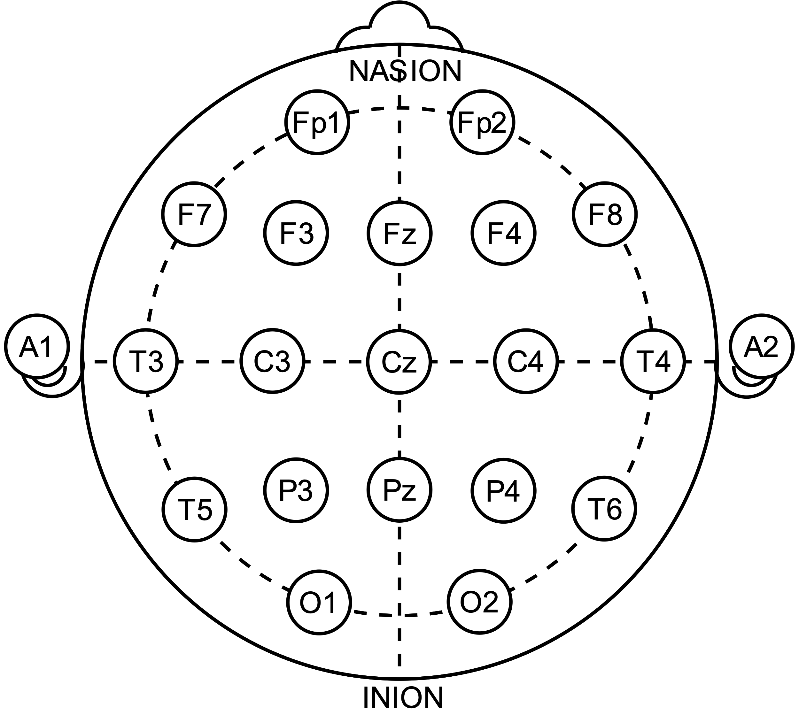
EEG Classification Pipeline
EEG image courtesy of wikimedia commons: Andrii Cherninskyi
Raw EEG Data
64-channels (N = 24)
MCCA

Slide 51
EEG Classification Pipeline
EEG image courtesy of wikimedia commons: Andrii Cherninskyi
Raw EEG Data
64-channels (N = 24)
MCCA

Slide 52
EEG Classification Pipeline
EEG image courtesy of wikimedia commons: Andrii Cherninskyi
Raw EEG Data
64-channels (N = 24)
…
MCCA

Slide 53
EEG Classification Pipeline
EEG image courtesy of wikimedia commons: Andrii Cherninskyi
Raw EEG Data
64-channels (N = 24)
…
MCCA
MCCA Components
shared subspace

Slide 54
EEG Classification Pipeline
EEG image courtesy of wikimedia commons: Andrii Cherninskyi
Raw EEG Data
64-channels (N = 24)
…
MCCA
MCCA Components
shared subspace
MCCA Comp.

Slide 55
EEG Classification Pipeline
EEG image courtesy of wikimedia commons: Andrii Cherninskyi
Raw EEG Data
64-channels (N = 24)
…
MCCA
MCCA Components
shared subspace
…
MCCA Comp.
MCCA Comp.

Slide 56
EEG Classification Pipeline
EEG image courtesy of wikimedia commons: Andrii Cherninskyi
Raw EEG Data
64-channels (N = 24)
…
MCCA
MCCA Components
shared subspace
…
MCCA Comp.
MCCA Comp.
MCCA Comp.

Slide 57
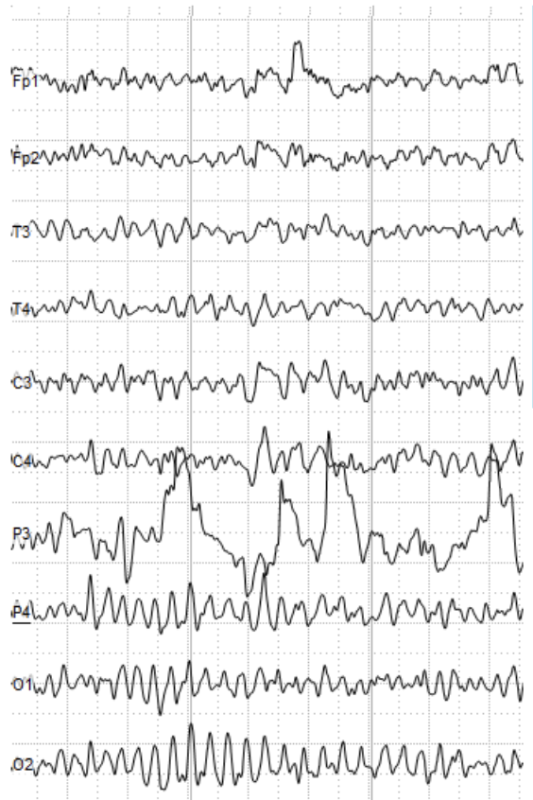
EEG Classification Pipeline
EEG image courtesy of wikimedia commons: Andrii Cherninskyi
Raw EEG Data
64-channels (N = 24)
…
MCCA
MCCA Components
shared subspace
…
…
MCCA Comp.
MCCA Comp.
MCCA Comp.
Top 30

Slide 58
EEG Classification Pipeline
EEG image courtesy of wikimedia commons: Andrii Cherninskyi
Raw EEG Data
64-channels (N = 24)
…
MCCA
MCCA Components
shared subspace
…
…
MCCA Comp.
MCCA Comp.
MCCA Comp.

Slide 59
EEG Classification Pipeline
EEG image courtesy of wikimedia commons: Andrii Cherninskyi
Raw EEG Data
64-channels (N = 24)
…
MCCA
MCCA Components
shared subspace
…
Target Onset
…
MCCA Comp.
MCCA Comp.
MCCA Comp.

Slide 60
EEG Classification Pipeline
EEG image courtesy of wikimedia commons: Andrii Cherninskyi
Raw EEG Data
64-channels (N = 24)
…
MCCA
MCCA Components
shared subspace
…
Target Onset
…
MCCA Comp.
MCCA Comp.
MCCA Comp.
Classification window
(position & length selected through cross-validation)

Slide 61
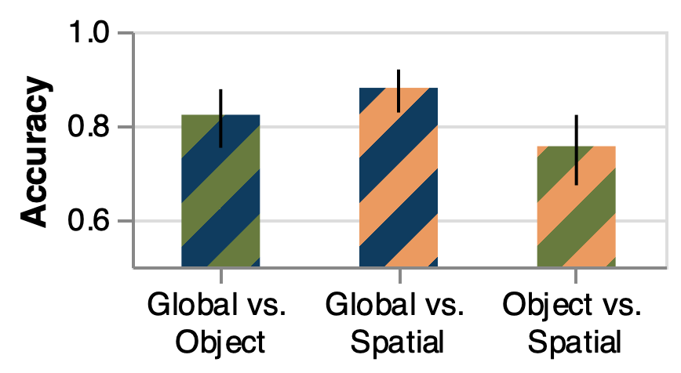
EEG Differences Across Condition

Slide 62
EEG Differences Across Condition
Chance
Performance

Slide 63
EEG Differences Across Condition
Perfect
Classification
Chance
Performance

Slide 64
EEG Differences Across Condition
Perfect
Classification
Chance
Performance

Slide 65
EEG Differences Across Condition
Perfect
Classification
Chance
Performance

Slide 66
EEG Differences Across Condition
Perfect
Classification
Chance
Performance

Slide 67
EEG Differences Across Condition
Perfect
Classification
***
***
***
Chance
Performance

Slide 68
EEG Categorization surpasses baseline classifiers

Slide 69
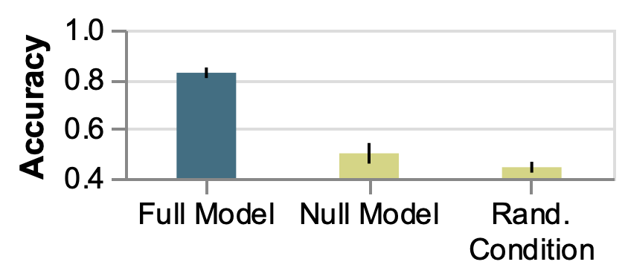
EEG Categorization surpasses baseline classifiers

Slide 70
EEG Categorization surpasses baseline classifiers

Slide 71
EEG Categorization surpasses baseline classifiers

Slide 72
EEG Categorization surpasses baseline classifiers
***
***

Slide 73
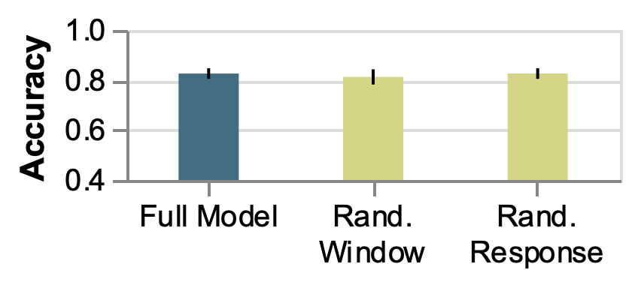
EEG Categorization captures condition “preparation”

Slide 74
EEG Categorization captures condition “preparation”

Slide 75
EEG Categorization captures condition “preparation”

Slide 76
EEG Categorization captures condition “preparation”
n.s.
n.s.

