Slide 1
Adapting Attention in a Dynamic Three-Speaker Auditory Scene
David Little, Emine Merve Kaya and Mounya Elhilali
Laboratory for Computation Auditory Perception

Slide 2
How do we distribute auditory attention?
Selective

Slide 3
How do we distribute auditory attention?
Selective

Slide 4
How do we distribute auditory attention?
Selective

Slide 5
How do we distribute auditory attention?
Selective

Slide 6
How do we distribute auditory attention?
Selective
Distributed

Slide 7
How do we distribute auditory attention?
Selective
Distributed

Slide 8
How do we distribute auditory attention?
Selective
Distributed

Slide 9
Flicker: Global variance - local variance

Slide 10
Spread: target:non-target ratio

Slide 11
Stimulus

Slide 12
Stimulus

Slide 13

Stimulus
Simulated HRTF over headphones

Slide 14
Stimulus

Slide 15
Stimulus

Slide 16
Stimulus

Slide 17
Stimulus

Slide 18
Stimulus

Slide 19
Stimulus
German Sentences to Non-German Speakers

Slide 20
Stimulus
German Sentences to Non-German Speakers

Slide 21
Stimulus
German Sentences to Non-German Speakers

Slide 22
Stimulus
Task: Target detection
German Sentences to Non-German Speakers

Slide 23
Listening Conditions

Slide 24
Listening Conditions

Slide 25
Listening Conditions
Global
attend to all voice

Slide 26
Listening Conditions
Global
Spatial
attend to all voice
attend to one side

Slide 27
Listening Conditions
Global
Spatial
Object
attend to all voice
attend to one side
attend to one voice

Slide 28
Listening Conditions
Global
Spatial
Object
attend to all voice
attend to one side
attend to one voice
Identical stimuli

Slide 29
Target meaning changes across conditions

Slide 30
Target meaning changes across conditions
Global

Slide 31
Target meaning changes across conditions
Global

Slide 32
Target meaning changes across conditions
Target
Target
Target
Global

Slide 33
Target meaning changes across conditions
Target
Target
Target
Global
Object

Slide 34
Target meaning changes across conditions
Target
Target
Target
Global
Object

Slide 35
Target meaning changes across conditions
Target
Target
Target
Target
Target
Global
Object

Slide 36
Target meaning changes across conditions
Target
Target
Target
Target
Target
False
Target
Global
Object

Slide 37
Target meaning changes across conditions
Target
Target
Target
Target
Target
False
Target
Global
Object
Spatial

Slide 38
Target meaning changes across conditions
Target
Target
Target
Target
Target
False
Target
Global
Object
Spatial

Slide 39
Target meaning changes across conditions
Target
Target
Target
Target
Target
Target
False
Target
Target
Global
Object
Spatial

Slide 40
Target meaning changes across conditions
Target
Target
Target
Target
False
Target
Target
Target
False
Target
Target
Global
Object
Spatial

Slide 41
Selective Listening Improves Accuracy

Slide 42
Selective Listening Improves Accuracy

Slide 43
Selective Listening Improves Accuracy

Slide 44
Selective Listening Improves Accuracy

Slide 45
Selective Listening Improves Accuracy

Slide 46
Selective Listening Improves Accuracy
***
***
n.s.
~

Slide 47
Decoder

Slide 48
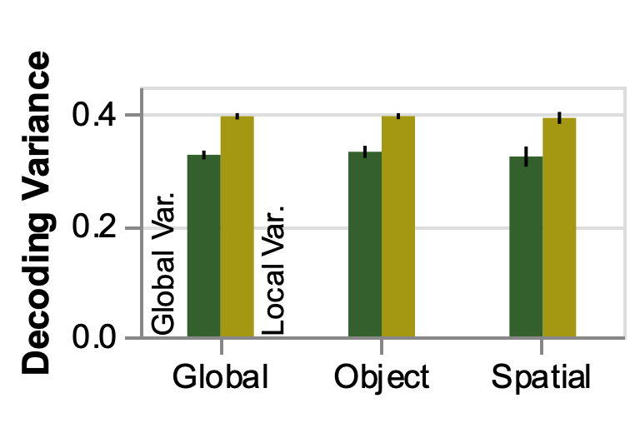
Attention flickers, but similarly across conditions

Slide 49
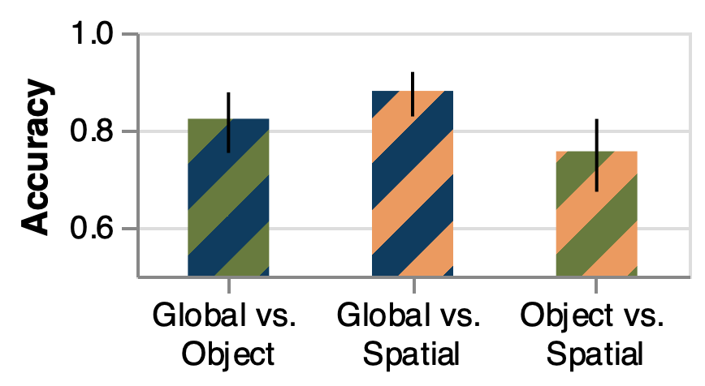
EEG Differences Across Condition

Slide 50
EEG Differences Across Condition
Chance
Performance

Slide 51
EEG Differences Across Condition
Perfect
Classification
Chance
Performance

Slide 52
EEG Differences Across Condition
Perfect
Classification
Chance
Performance

Slide 53
EEG Differences Across Condition
Perfect
Classification
Chance
Performance

Slide 54
EEG Differences Across Condition
Perfect
Classification
Chance
Performance

Slide 55
EEG Differences Across Condition
Perfect
Classification
***
***
***
Chance
Performance

Slide 56
EEG Categorization surpasses baseline classifiers

Slide 57
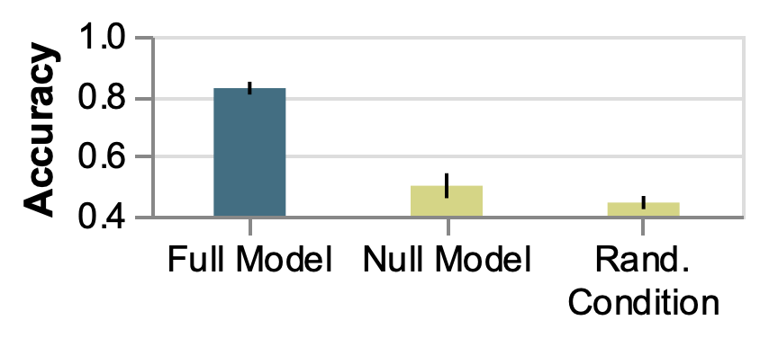
EEG Categorization surpasses baseline classifiers

Slide 58
EEG Categorization surpasses baseline classifiers

Slide 59
EEG Categorization surpasses baseline classifiers

Slide 60
EEG Categorization surpasses baseline classifiers
***
***

Slide 61
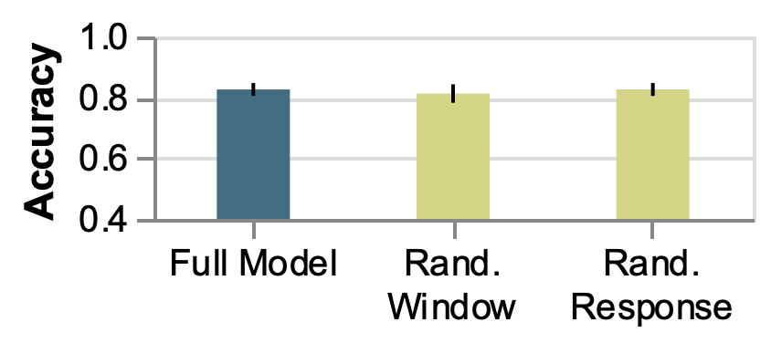
EEG Categorization captures condition “preparation”

Slide 62
EEG Categorization captures condition “preparation”

Slide 63
EEG Categorization captures condition “preparation”

Slide 64
EEG Categorization captures condition “preparation”
n.s.
n.s.

