Slide 1
Adapting Attention in a Dynamic Three-Speaker Auditory Scene
David Little, Emine Merve Kaya and Mounya Elhilali
Laboratory for Computational Auditory Perception

Slide 2
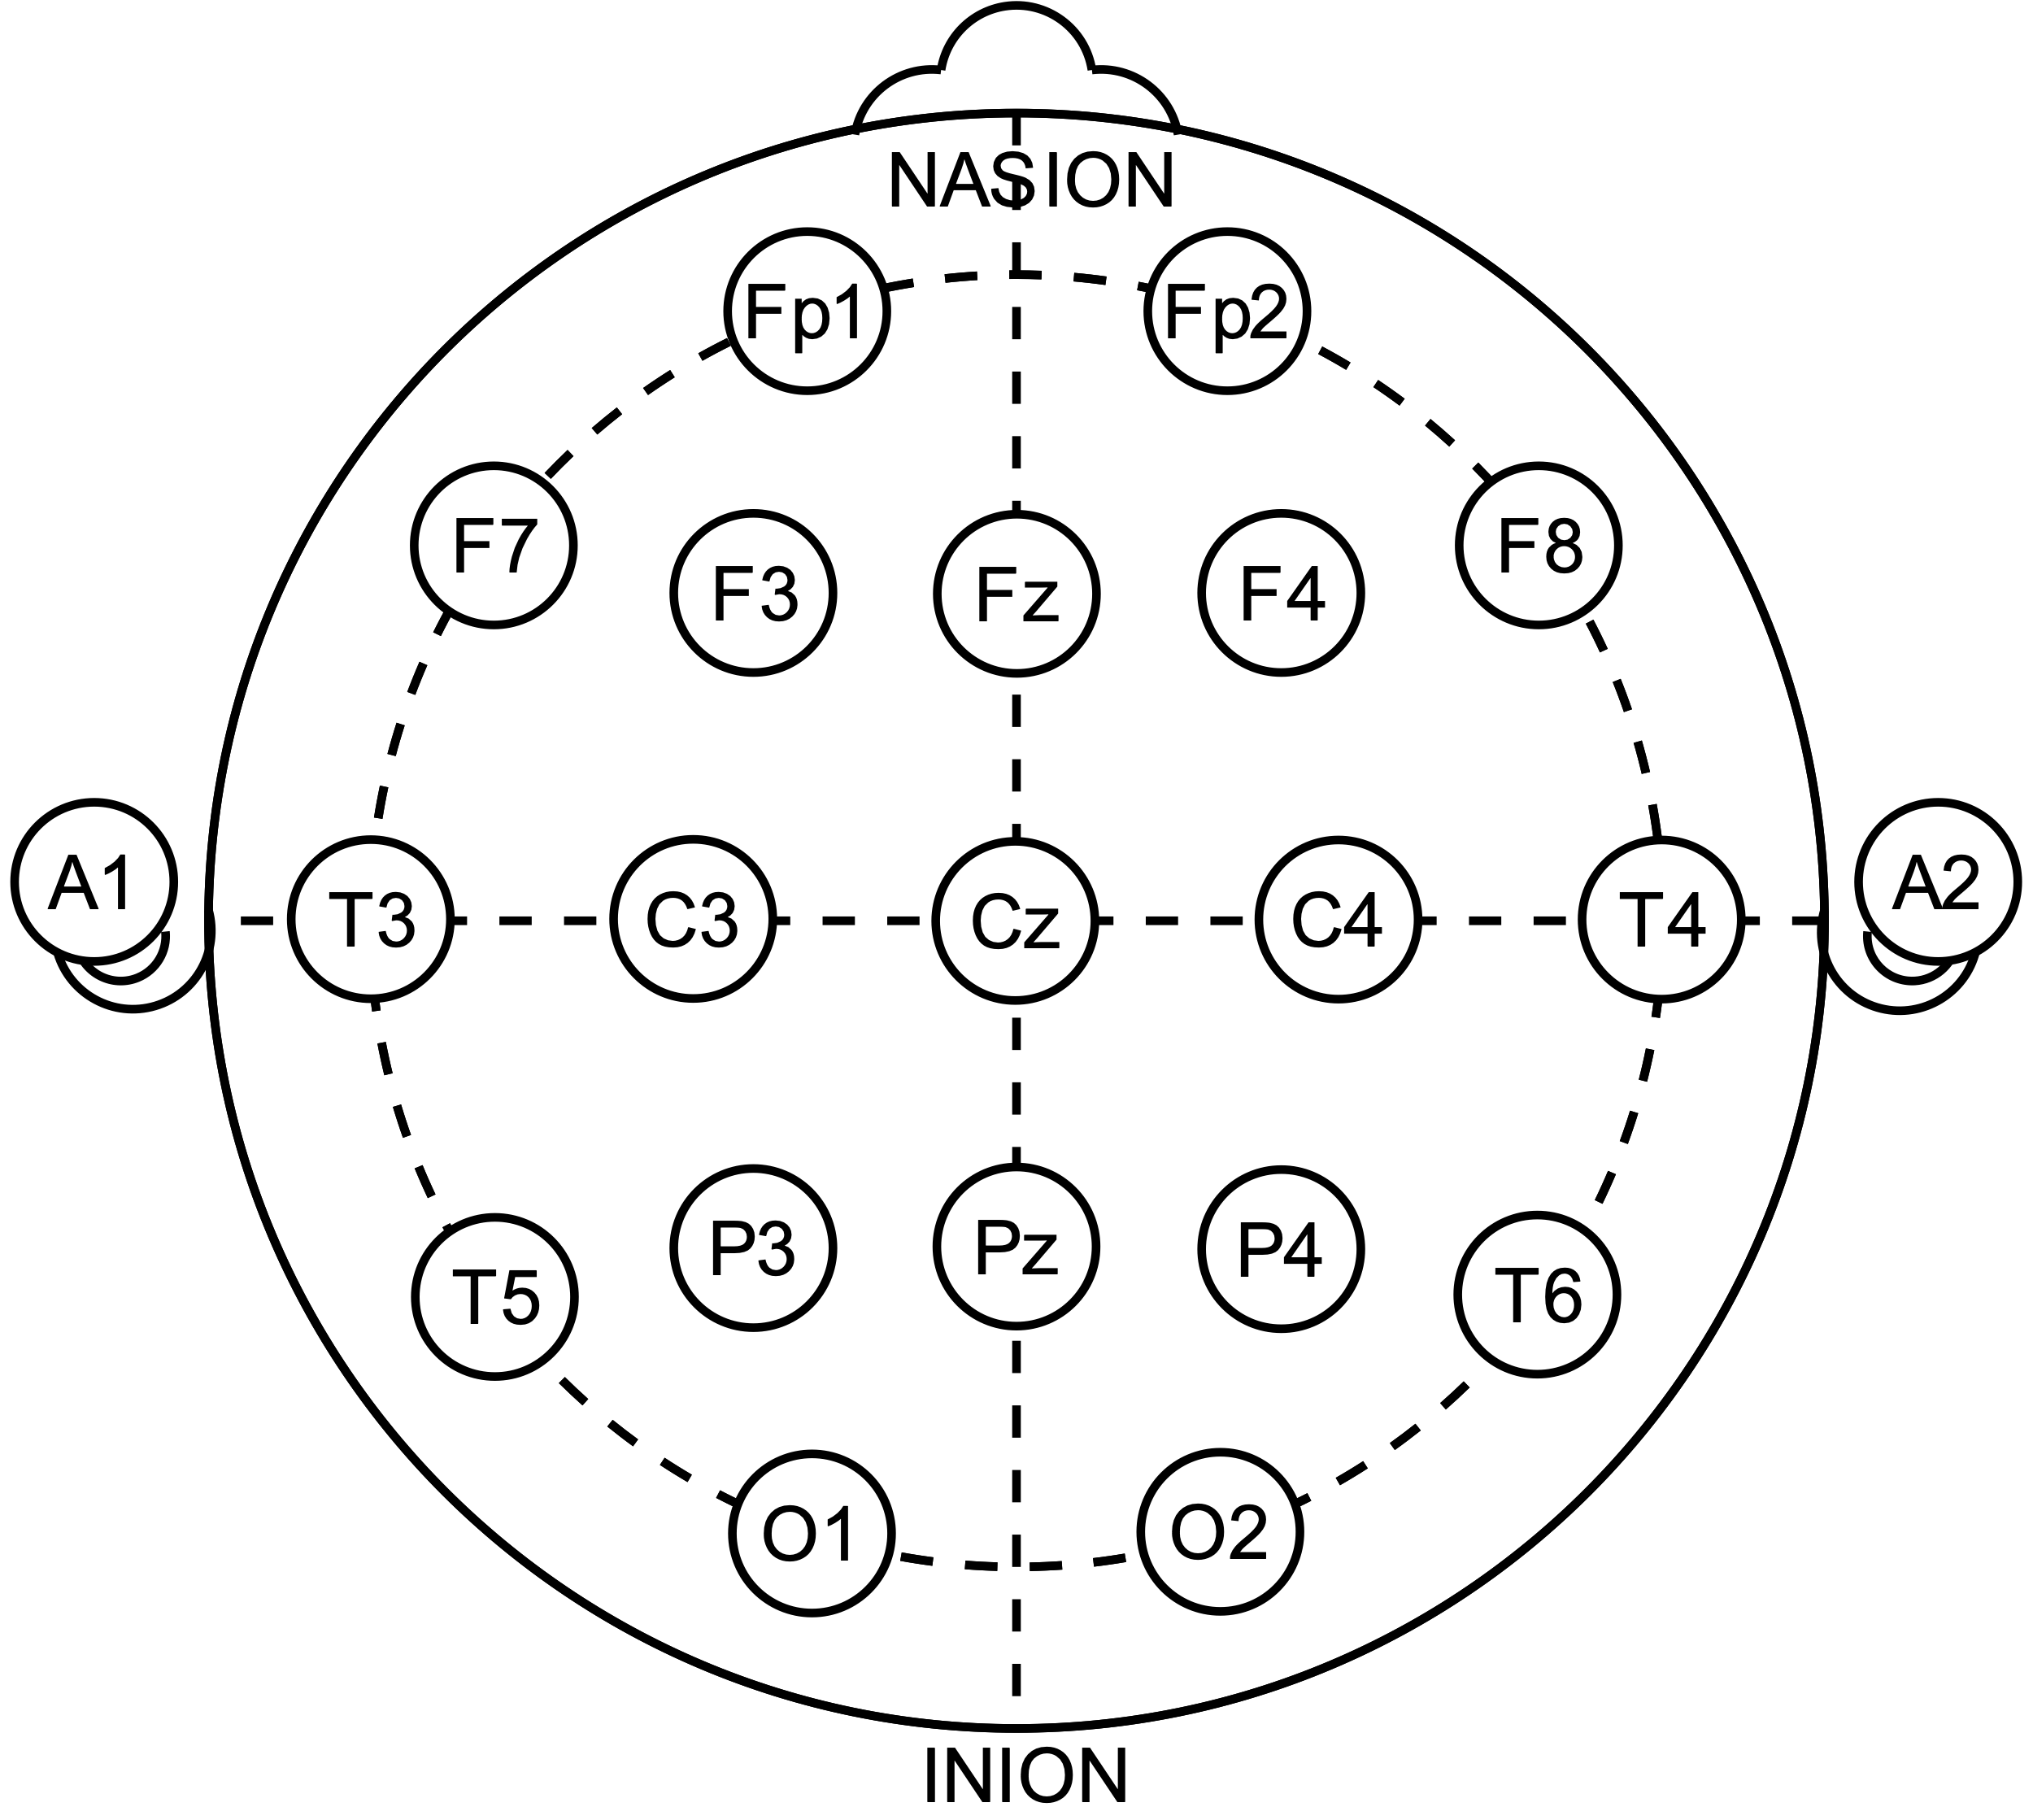
EEG Decoding

Slide 3
EEG Decoding
Decoder

Slide 4
EEG Decoding
Stimulus Features
Decoder

Slide 5
EEG Decoding
Stimulus Features
Decoder
(e.g. Envelope)

Slide 6
Decoding can estimate attentional locus in stable auditory scenes

Slide 7
Decoding can estimate attentional locus in stable auditory scenes
Typical Decoding Setup
Speaker 1
Speaker 2

Slide 8
Decoding can estimate attentional locus in stable auditory scenes
Typical Decoding Setup
Speaker 1
Attentional
Locus
Speaker 2

Slide 9
Decoding can estimate attentional locus in stable auditory scenes
Typical Decoding Setup
Attended speaker is enhanced
Speaker 1
Attentional
Locus
Speaker 2

Slide 10
Decoding can estimate attentional locus in stable auditory scenes
Typical Decoding Setup
Attended speaker is enhanced
Speaker 1
Attentional
Locus
Speaker 2

Slide 11
Stimulus

Slide 12
Stimulus

Slide 13

Stimulus
Simulated HRTF over headphones

Slide 14
Stimulus

Slide 15
Stimulus

Slide 16
Stimulus

Slide 17
Stimulus

Slide 18
Stimulus

Slide 19
Stimulus
German Sentences to Non-German Speakers

Slide 20
Stimulus
German Sentences to Non-German Speakers

Slide 21
Stimulus
German Sentences to Non-German Speakers

Slide 22
Stimulus
German Sentences to Non-German Speakers

Slide 23
Stimulus
Task: Target detection
German Sentences to Non-German Speakers

Slide 24
Listening Conditions

Slide 25
Listening Conditions

Slide 26
Listening Conditions
Global
attend to all voice

Slide 27
Listening Conditions
Global
Spatial
attend to all voice
attend to one side

Slide 28
Listening Conditions
Global
Spatial
Object
attend to all voice
attend to one side
attend to one voice

Slide 29
Listening Conditions
Global
Spatial
Object
attend to all voice
attend to one side
attend to one voice
Identical stimuli

Slide 30
Target meaning changes across conditions

Slide 31
Target meaning changes across conditions
Global

Slide 32
Target meaning changes across conditions
Global

Slide 33
Target meaning changes across conditions
Target
Target
Target
Global

Slide 34
Target meaning changes across conditions
Target
Target
Target
Global
Object

Slide 35
Target meaning changes across conditions
Target
Target
Target
Global
Object

Slide 36
Target meaning changes across conditions
Target
Target
Target
Target
Target
Global
Object

Slide 37
Target meaning changes across conditions
Target
Target
Target
Target
Target
False
Target
Global
Object

Slide 38
Target meaning changes across conditions
Target
Target
Target
Target
Target
False
Target
Global
Object
Spatial

Slide 39
Target meaning changes across conditions
Target
Target
Target
Target
Target
False
Target
Global
Object
Spatial

Slide 40
Target meaning changes across conditions
Target
Target
Target
Target
Target
Target
False
Target
Target
Global
Object
Spatial

Slide 41
Target meaning changes across conditions
Target
Target
Target
Target
False
Target
Target
Target
False
Target
Target
Global
Object
Spatial

Slide 42
Selective Listening Improves Accuracy

Slide 43
Selective Listening Improves Accuracy
N = 74

Slide 44
Selective Listening Improves Accuracy
N = 74

Slide 45
Selective Listening Improves Accuracy
N = 74

Slide 46
Selective Listening Improves Accuracy
N = 74

Slide 47
Selective Listening Improves Accuracy
***
***
n.s.
~
N = 74

Slide 48
Decoder Training
EEG image courtesy of wikimedia commons: Andrii Cherninskyi

Slide 49
Decoder Training
EEG image courtesy of wikimedia commons: Andrii Cherninskyi
Raw EEG Data
64-channels (N = 24)

Slide 50
Decoder Training
EEG image courtesy of wikimedia commons: Andrii Cherninskyi
Raw EEG Data
64-channels (N = 24)
MCCA

Slide 51
Decoder Training
EEG image courtesy of wikimedia commons: Andrii Cherninskyi
Raw EEG Data
64-channels (N = 24)
MCCA

Slide 52
Decoder Training
EEG image courtesy of wikimedia commons: Andrii Cherninskyi
Raw EEG Data
64-channels (N = 24)
MCCA

Slide 53
Decoder Training
EEG image courtesy of wikimedia commons: Andrii Cherninskyi
Raw EEG Data
64-channels (N = 24)
…
MCCA

Slide 54
Decoder Training
EEG image courtesy of wikimedia commons: Andrii Cherninskyi
Raw EEG Data
64-channels (N = 24)
…
MCCA
MCCA Components
shared subspace

Slide 55
Decoder Training
EEG image courtesy of wikimedia commons: Andrii Cherninskyi
Raw EEG Data
64-channels (N = 24)
…
MCCA
MCCA Components
shared subspace
MCCA Comp.

Slide 56
Decoder Training
EEG image courtesy of wikimedia commons: Andrii Cherninskyi
Raw EEG Data
64-channels (N = 24)
…
MCCA
MCCA Components
shared subspace
…
MCCA Comp.
MCCA Comp.

Slide 57
Decoder Training
EEG image courtesy of wikimedia commons: Andrii Cherninskyi
Raw EEG Data
64-channels (N = 24)
…
MCCA
MCCA Components
shared subspace
…
MCCA Comp.
MCCA Comp.
MCCA Comp.

Slide 58
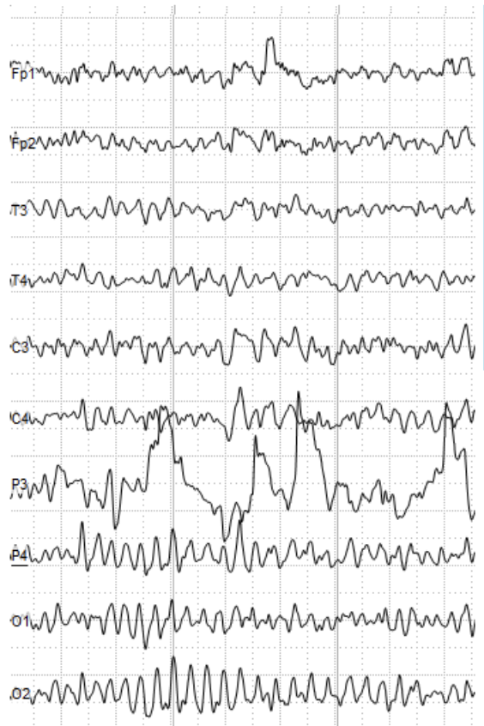
Decoder Training
EEG image courtesy of wikimedia commons: Andrii Cherninskyi
Raw EEG Data
64-channels (N = 24)
…
MCCA
MCCA Components
shared subspace
…
MCCA Comp.
MCCA Comp.
MCCA Comp.

Slide 59
Decoder Training
EEG image courtesy of wikimedia commons: Andrii Cherninskyi
Raw EEG Data
64-channels (N = 24)
…
MCCA
MCCA Components
shared subspace
…
MCCA Comp.
MCCA Comp.
MCCA Comp.

Slide 60
Decoder Training
EEG image courtesy of wikimedia commons: Andrii Cherninskyi
Raw EEG Data
64-channels (N = 24)
…
Target Onset
MCCA
MCCA Components
shared subspace
…
MCCA Comp.
MCCA Comp.
MCCA Comp.

Slide 61
Decoder Training
EEG image courtesy of wikimedia commons: Andrii Cherninskyi
Raw EEG Data
64-channels (N = 24)
1s
…
Target Onset
MCCA
MCCA Components
shared subspace
…
MCCA Comp.
MCCA Comp.
MCCA Comp.

Slide 62
Decoder Training
EEG image courtesy of wikimedia commons: Andrii Cherninskyi
Raw EEG Data
64-channels (N = 24)
1s
…
Target Onset
MCCA
MCCA Components
shared subspace
Decoding: Envelope
…
MCCA Comp.
MCCA Comp.
MCCA Comp.

Slide 63
Decoder Training
EEG image courtesy of wikimedia commons: Andrii Cherninskyi
Raw EEG Data
64-channels (N = 24)
1s
…
Target Onset
MCCA
MCCA Components
shared subspace
Decoding: Envelope
Decoding:
Pitch Surprisal
…
MCCA Comp.
MCCA Comp.
MCCA Comp.

Slide 64
Decoder Training
EEG image courtesy of wikimedia commons: Andrii Cherninskyi
Raw EEG Data
64-channels (N = 24)
1s
…
Target Onset
MCCA
MCCA Components
shared subspace
Decoding: Envelope
Decoding:
Pitch Surprisal
…
MCCA Comp.
MCCA Comp.
MCCA Comp.
3-layer 64 hidden-unit neural network

Slide 65
Decoder Training
EEG image courtesy of wikimedia commons: Andrii Cherninskyi
Raw EEG Data
64-channels (N = 24)
1s
…
Target Onset
MCCA
MCCA Components
shared subspace
Decoding: Envelope
Decoding:
Pitch Surprisal
…
MCCA Comp.
MCCA Comp.
MCCA Comp.
3-layer 64 hidden-unit neural network
Trained on target hits

Slide 66
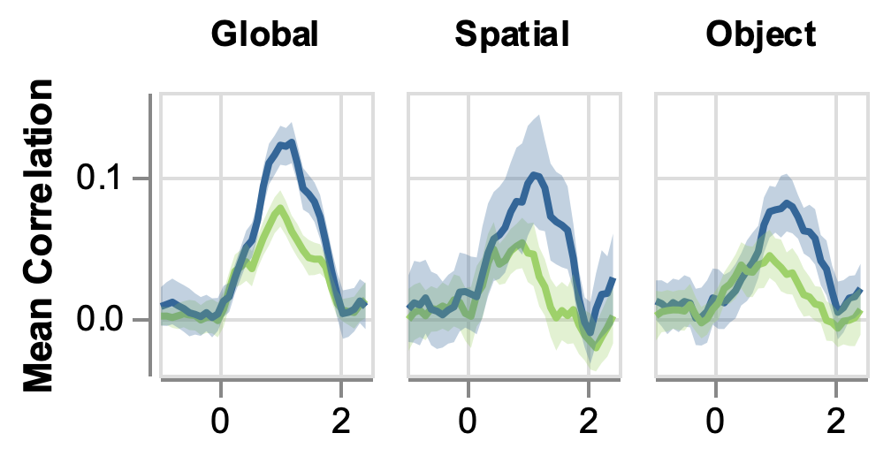
Decoding reveals attention to the target
Time

Slide 67
Decoding reveals attention to the target
Time relative to target onset (s)

Slide 68
Decoding reveals attention to the target
Time relative to target onset (s)

Slide 69
Decoding reveals attention to the target
Worse
Decoding
Time relative to target onset (s)

Slide 70
Decoding reveals attention to the target
Better
Decoding
Worse
Decoding
Time relative to target onset (s)

Slide 71
Decoding reveals attention to the target
Better
Decoding
Worse
Decoding
Time relative to target onset (s)

Slide 72
Decoding reveals attention to the target
Better
Decoding
Target
Worse
Decoding
Time relative to target onset (s)

Slide 73
Decoding reveals attention to the target
Better
Decoding
Target
Other
Worse
Decoding
Time relative to target onset (s)

Slide 74
Decoding reveals attention to the target
Better
Decoding
Target
Other
Worse
Decoding
Time relative to target onset (s)

Slide 75
Decoding reveals attention to the target
Better
Decoding
Target
Other
Worse
Decoding
Time relative to target onset (s)

Slide 76
Decoding reveals attention to the target
Better
Decoding
***
***
***
Target
Other
Worse
Decoding
Time relative to target onset (s)

Slide 77
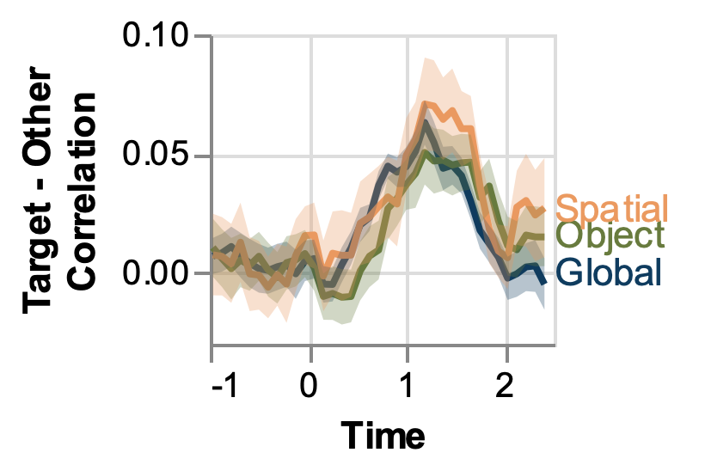
Attention signal is similar across conditions
n.s.

Slide 78
Attention signal is similar across conditions
Target Focused
Attention
n.s.

Slide 79
Attention signal is similar across conditions
Target Focused
Attention
n.s.
Evenly Distributed
Attention

Slide 80
Attention signal is similar across conditions
Target Focused
Attention
n.s.
Evenly Distributed
Attention
(s)

Slide 81
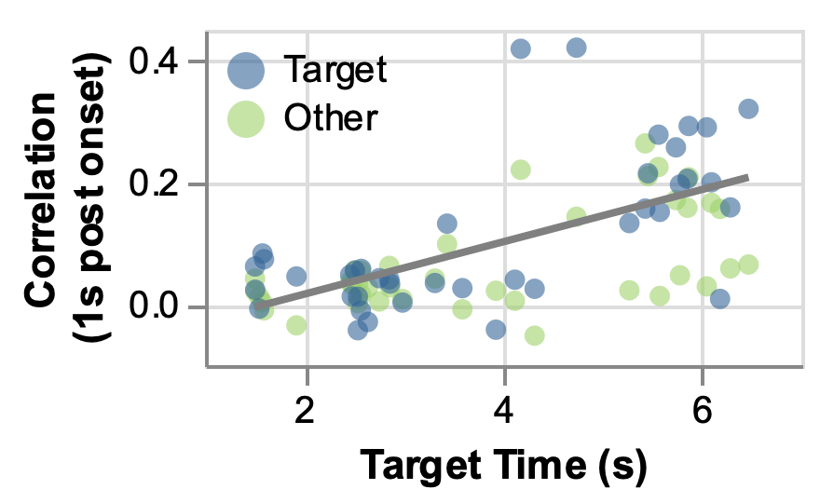
Later target = Better decoding
Better
Decoding
Worse
Decoding

Slide 82
Later target = Better decoding
Better
Decoding
***
Worse
Decoding

Slide 83
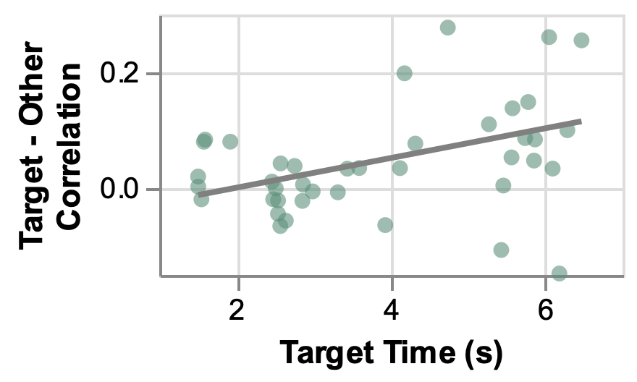
Later target = More focused attention
Target Focused
Attention
Other Focused
Attention

Slide 84
Later target = More focused attention
Target Focused
Attention
***
Other Focused
Attention

Slide 85
Conclusions

Slide 86
Conclusions
1. Target decoding advantage similar across conditions

Slide 87
Conclusions
1. Target decoding advantage similar across conditions
Additional selectivity arises following attended-stimulus enhancement

Slide 88
Conclusions
1. Target decoding advantage similar across conditions
Additional selectivity arises following attended-stimulus enhancement
2. Target decoding advantage > later in trial

Slide 89
Conclusions
1. Target decoding advantage similar across conditions
Additional selectivity arises following attended-stimulus enhancement
2. Target decoding advantage > later in trial
Attended-stimulus enhancement rapidly tunes to scene dynamics

