Slide 1
Adapting Attention in a Dynamic Three-Speaker Auditory Scene
David Little, Emine Merve Kaya and Mounya Elhilali
Laboratory for Computation Auditory Perception

Slide 2
Introduction
**TODO**

Slide 3
Stimulus

Slide 4
Stimulus

Slide 5

Stimulus
Simulated HRTF over headphones

Slide 6
Stimulus

Slide 7
Stimulus

Slide 8
Stimulus

Slide 9
Stimulus

Slide 10
Stimulus

Slide 11
Stimulus
German Sentences

Slide 12
Stimulus
German Sentences

Slide 13
Stimulus
German Sentences

Slide 14
Stimulus
Task: Target detection
German Sentences

Slide 15
Stimulus
Task: Target detection
German Sentences

Slide 16
Stimulus
Task: Target detection
German Sentences

Slide 17
Stimulus
Task: Target detection
German Sentences

Slide 18
Listening Conditions

Slide 19
Listening Conditions

Slide 20
Listening Conditions
Global
attend to all voice

Slide 21
Listening Conditions
Global
Spatial
attend to all voice
attend to one side

Slide 22
Listening Conditions
Global
Spatial
Object
attend to all voice
attend to one side
attend to one voice

Slide 23
Listening Conditions
Global
Spatial
Object
attend to all voice
attend to one side
attend to one voice
Identical stimuli

Slide 24
Target meaning changes across conditions

Slide 25
Target meaning changes across conditions
Global

Slide 26
Target meaning changes across conditions
Global

Slide 27
Target meaning changes across conditions
Target
Target
Target
Global

Slide 28
Target meaning changes across conditions
Target
Target
Target
Global
Object

Slide 29
Target meaning changes across conditions
Target
Target
Target
Global
Object

Slide 30
Target meaning changes across conditions
Target
Target
Target
Target
Target
Global
Object

Slide 31
Target meaning changes across conditions
Target
Target
Target
Target
Target
False
Target
Global
Object

Slide 32
Target meaning changes across conditions
Target
Target
Target
Target
Target
False
Target
Global
Object
Spatial

Slide 33
Target meaning changes across conditions
Target
Target
Target
Target
Target
False
Target
Global
Object
Spatial

Slide 34
Target meaning changes across conditions
Target
Target
Target
Target
Target
Target
False
Target
Target
Global
Object
Spatial

Slide 35
Target meaning changes across conditions
Target
Target
Target
Target
False
Target
Target
Target
False
Target
Target
Global
Object
Spatial

Slide 36
Selective Listening Improves Accuracy

Slide 37
Selective Listening Improves Accuracy

Slide 38
Selective Listening Improves Accuracy

Slide 39
Selective Listening Improves Accuracy

Slide 40
Selective Listening Improves Accuracy

Slide 41
Selective Listening Improves Accuracy

Slide 42
EEG Classification Pipeline
EEG image courtesy of wikimedia commons: Andrii Cherninskyi

Slide 43
EEG Classification Pipeline
EEG image courtesy of wikimedia commons: Andrii Cherninskyi
Raw EEG Data
64-channels (N = 24)

Slide 44
EEG Classification Pipeline
EEG image courtesy of wikimedia commons: Andrii Cherninskyi
Raw EEG Data
64-channels (N = 24)
MCCA

Slide 45
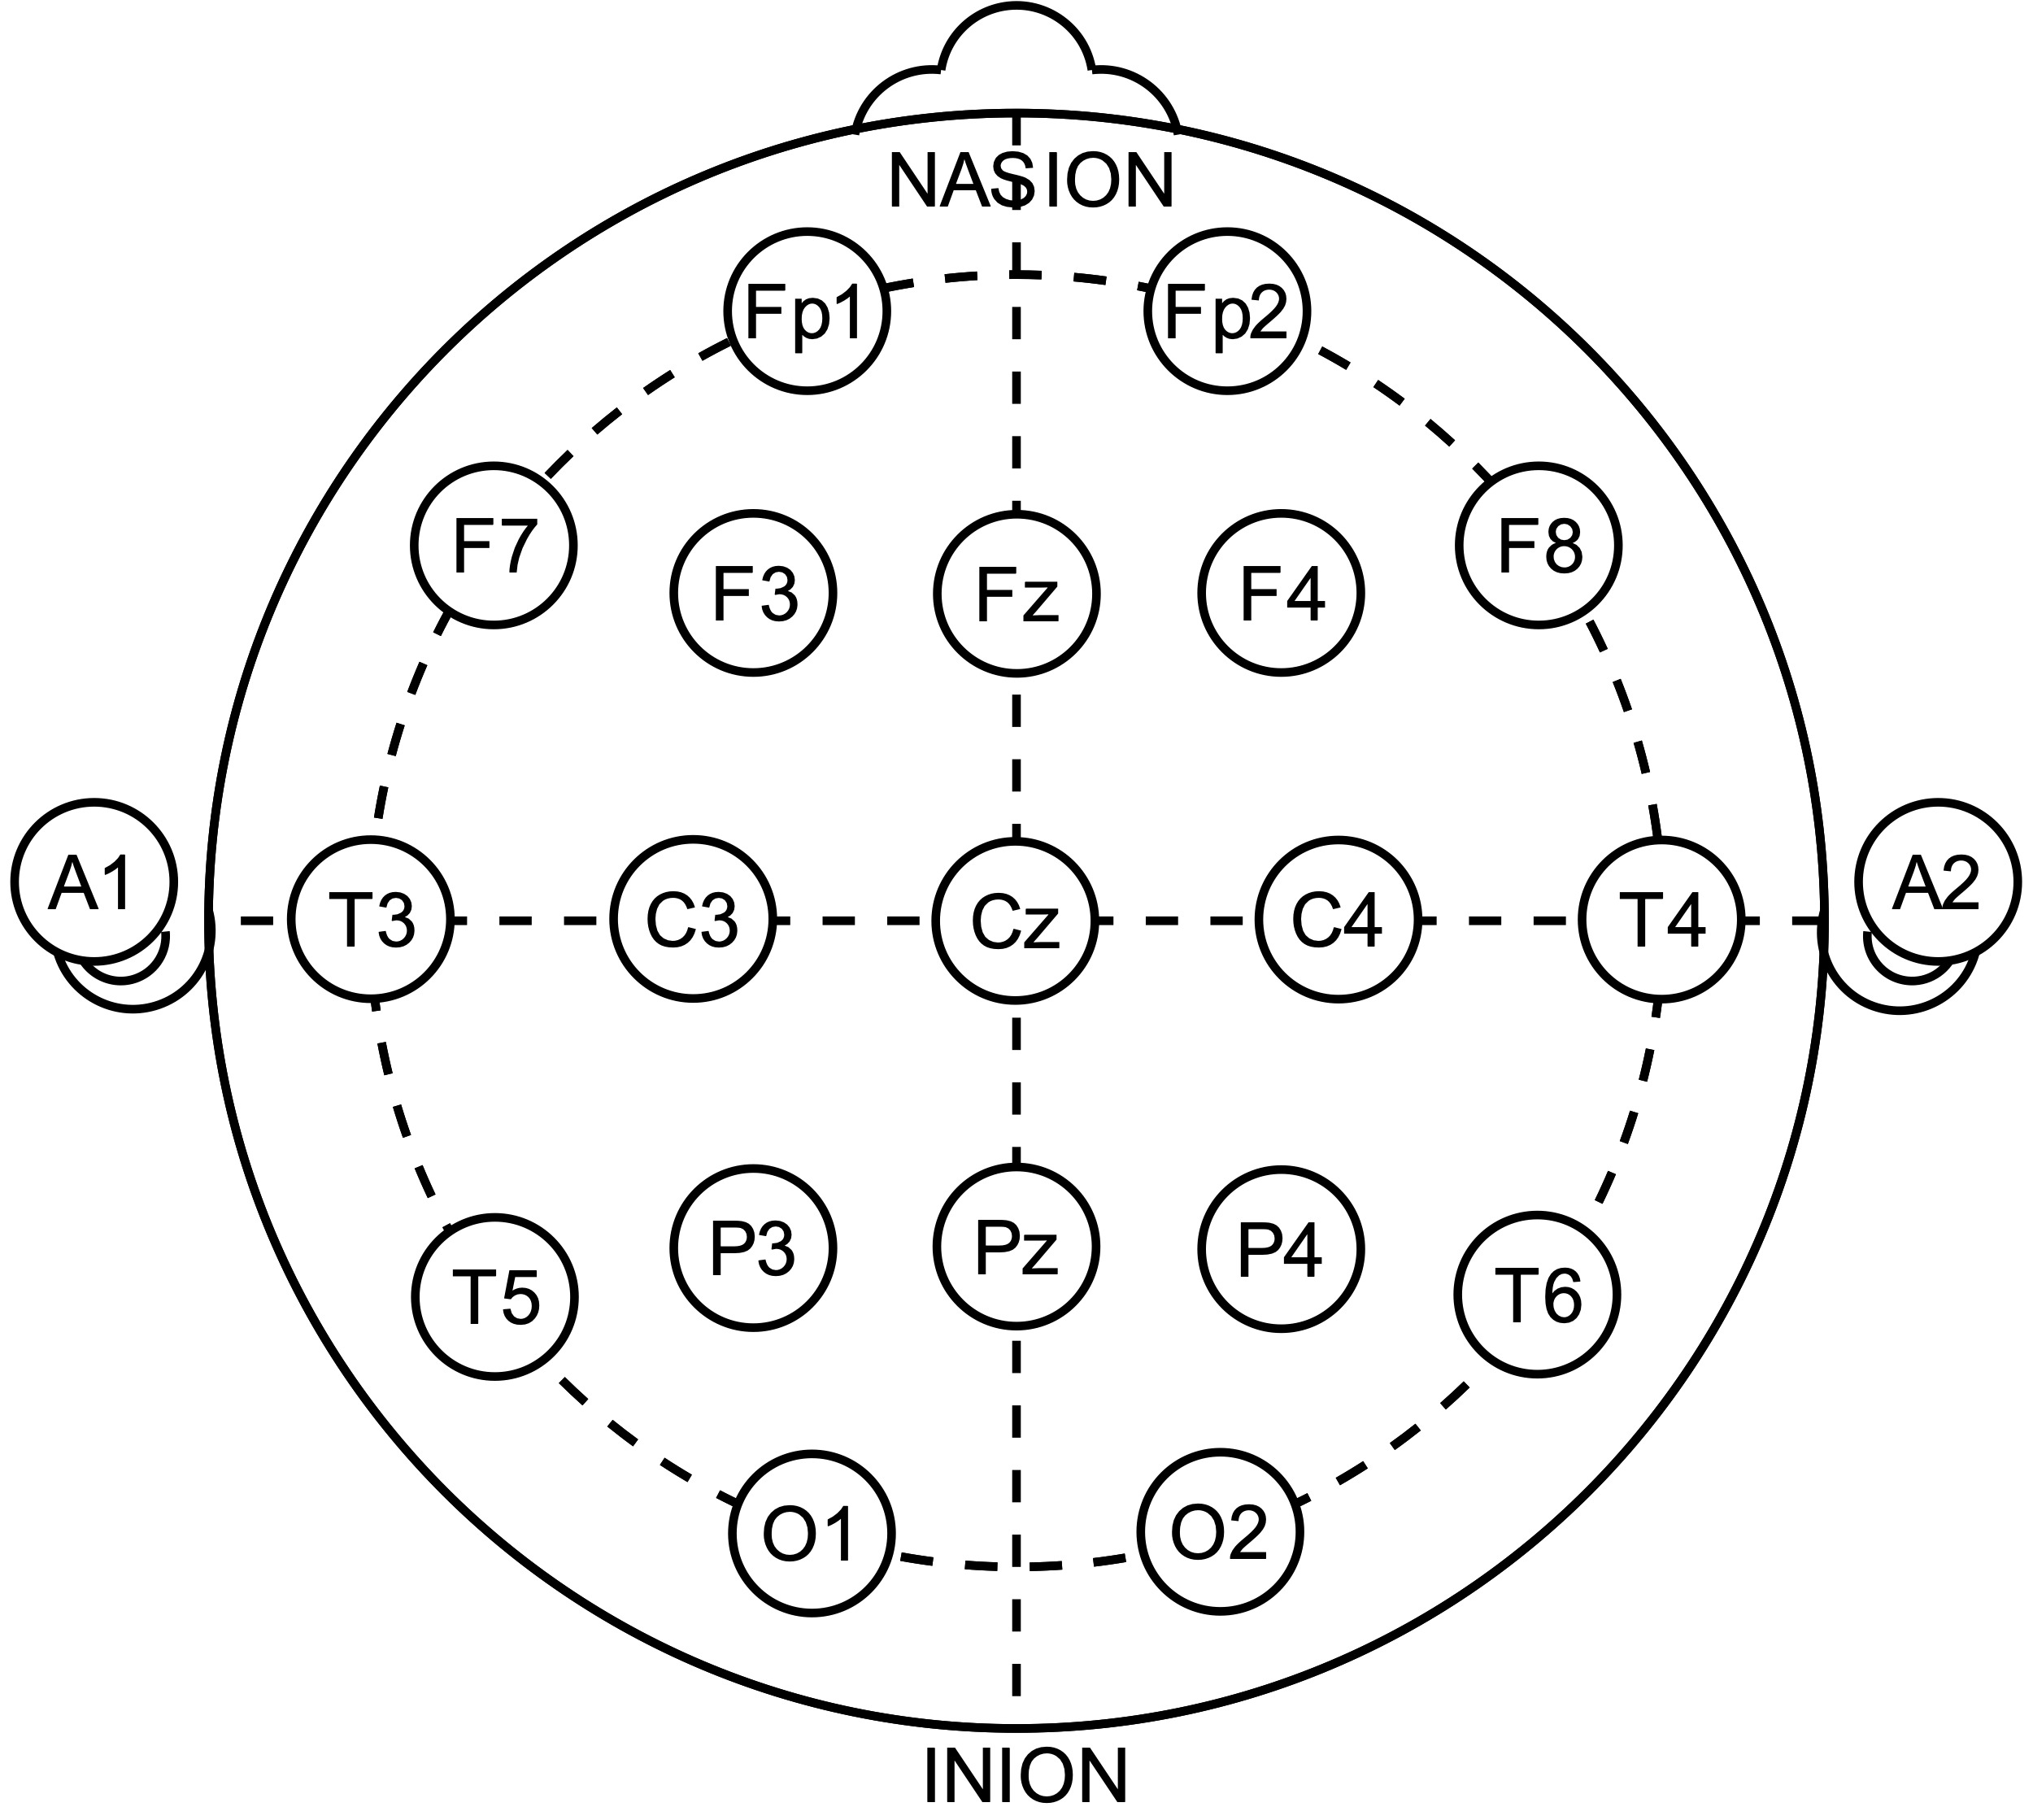
EEG Classification Pipeline
EEG image courtesy of wikimedia commons: Andrii Cherninskyi
Raw EEG Data
64-channels (N = 24)
MCCA

Slide 46
EEG Classification Pipeline
EEG image courtesy of wikimedia commons: Andrii Cherninskyi
Raw EEG Data
64-channels (N = 24)
MCCA

Slide 47
EEG Classification Pipeline
EEG image courtesy of wikimedia commons: Andrii Cherninskyi
Raw EEG Data
64-channels (N = 24)
…
MCCA

Slide 48
EEG Classification Pipeline
EEG image courtesy of wikimedia commons: Andrii Cherninskyi
Raw EEG Data
64-channels (N = 24)
…
MCCA
MCCA Components
shared subspace

Slide 49
EEG Classification Pipeline
EEG image courtesy of wikimedia commons: Andrii Cherninskyi
Raw EEG Data
64-channels (N = 24)
…
MCCA
MCCA Components
shared subspace
MCCA Comp.

Slide 50
EEG Classification Pipeline
EEG image courtesy of wikimedia commons: Andrii Cherninskyi
Raw EEG Data
64-channels (N = 24)
…
MCCA
MCCA Components
shared subspace
…
MCCA Comp.
MCCA Comp.

Slide 51
EEG Classification Pipeline
EEG image courtesy of wikimedia commons: Andrii Cherninskyi
Raw EEG Data
64-channels (N = 24)
…
MCCA
MCCA Components
shared subspace
…
MCCA Comp.
MCCA Comp.
MCCA Comp.

Slide 52
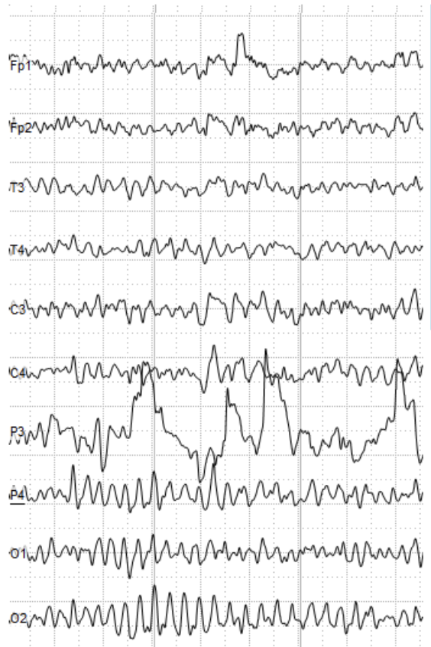
EEG Classification Pipeline
EEG image courtesy of wikimedia commons: Andrii Cherninskyi
Raw EEG Data
64-channels (N = 24)
…
MCCA
MCCA Components
shared subspace
…
…
MCCA Comp.
MCCA Comp.
MCCA Comp.
Top 30

Slide 53
EEG Classification Pipeline
EEG image courtesy of wikimedia commons: Andrii Cherninskyi
Raw EEG Data
64-channels (N = 24)
…
MCCA
MCCA Components
shared subspace
…
…
MCCA Comp.
MCCA Comp.
MCCA Comp.

Slide 54
EEG Classification Pipeline
EEG image courtesy of wikimedia commons: Andrii Cherninskyi
Raw EEG Data
64-channels (N = 24)
…
MCCA
MCCA Components
shared subspace
…
Target Onset
…
MCCA Comp.
MCCA Comp.
MCCA Comp.

Slide 55
EEG Classification Pipeline
EEG image courtesy of wikimedia commons: Andrii Cherninskyi
Raw EEG Data
64-channels (N = 24)
…
MCCA
MCCA Components
shared subspace
…
Target Onset
…
MCCA Comp.
MCCA Comp.
MCCA Comp.
Classification window
(position & length selected through cross-validation)

Slide 56
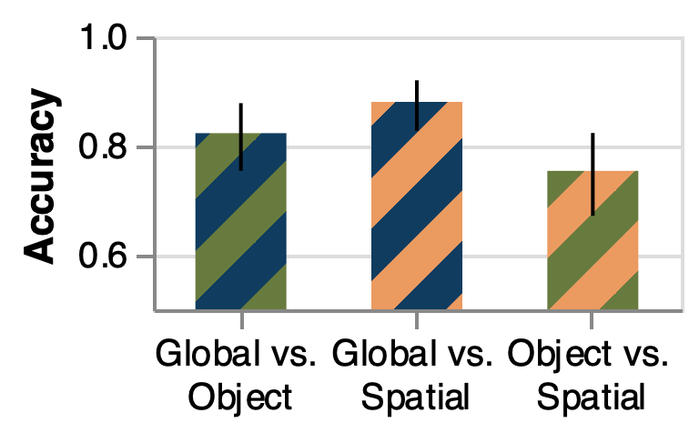
Classification Results

Slide 57
Classification Results

Slide 58
Classification Results

Slide 59
Classification Results

