Slide 1

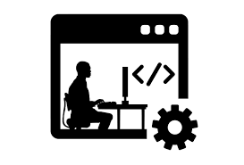



Improve project environment
Continuous integration
Packaging the project

Slide 2
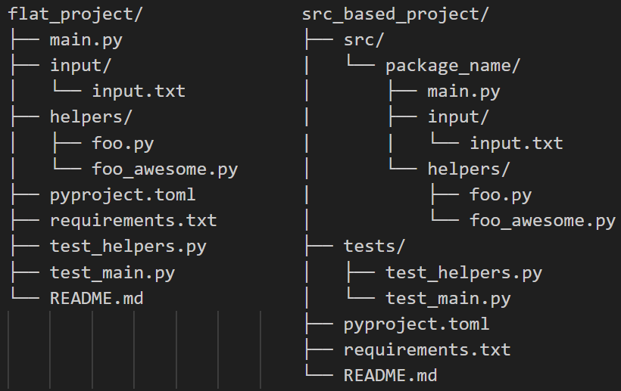
Packaging the project: Restructure
Adds unwanted project files
Requires installation

Slide 3
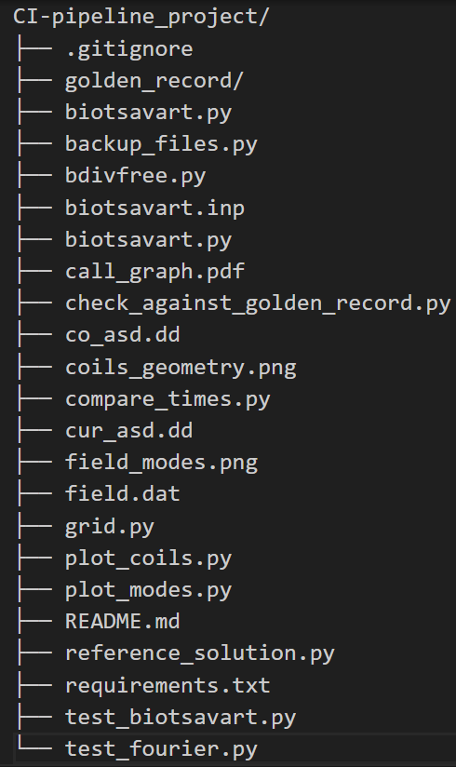
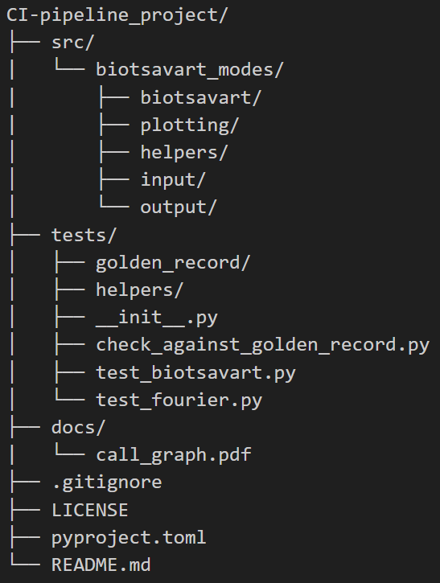

Slide 4
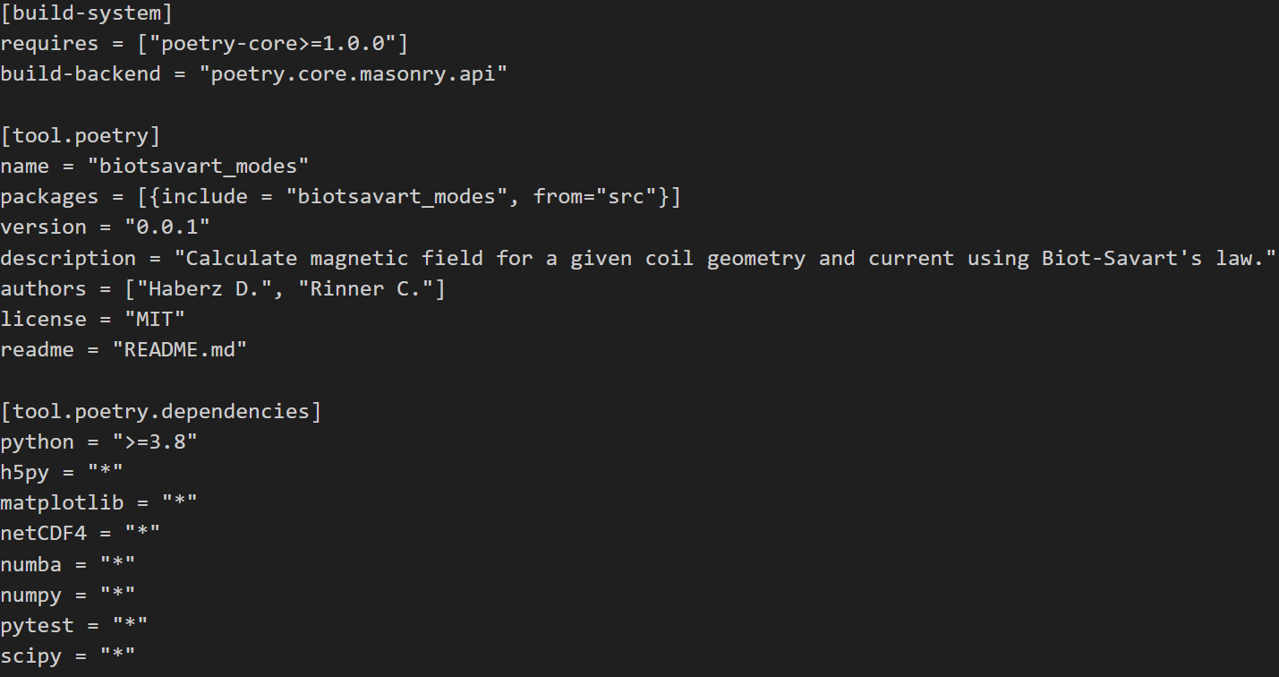
Packaging the project: pyproject.toml
PEP 518
PEP 621
PEP 631

Slide 5
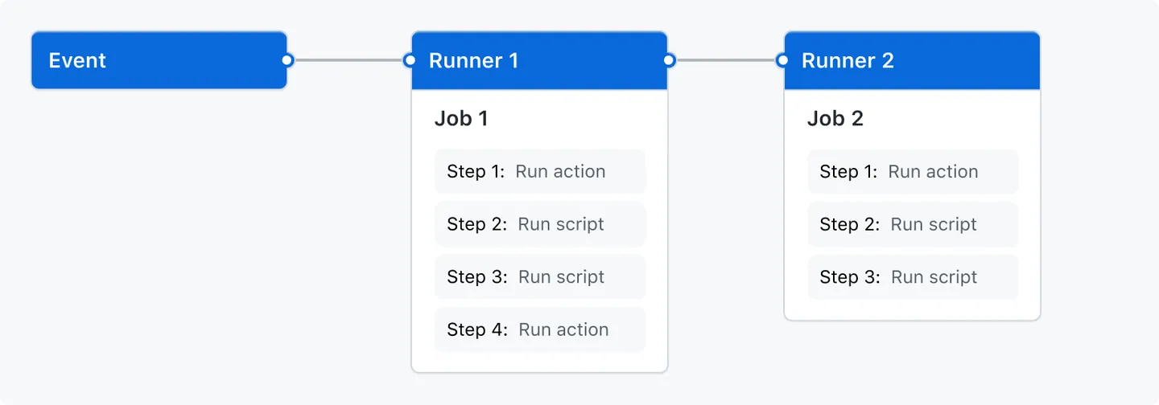
Workflows in GitHub Actions
GitHub Workflows are automated processes that run on a virtual machine and activate when certain conditions are fulfilled
Events: Conditions under which the workflow is triggered. In this example the trigger is a push event
Jobs: A workflow can contain several jobs, which are performed by separate runners. This means that all jobs can run in parallel. Each job consists of one or more steps, which are carried out one after the other.

Slide 6
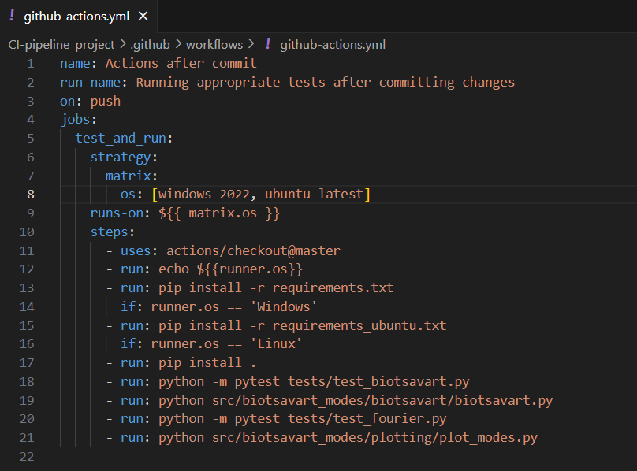
YAML-files
The specifications of the workflow are defined in a YAML-file, designated with .yml
on: push specifies, that the triggering event is pushing a commit
The runs-on attribute determines what kind of virtual machine the job is carried out in – Windows, Linux, MacOS
The steps are listed under the steps attribute. Each step is predicated by a minus sign. They can have additional attributes such as if conditions.

Slide 7
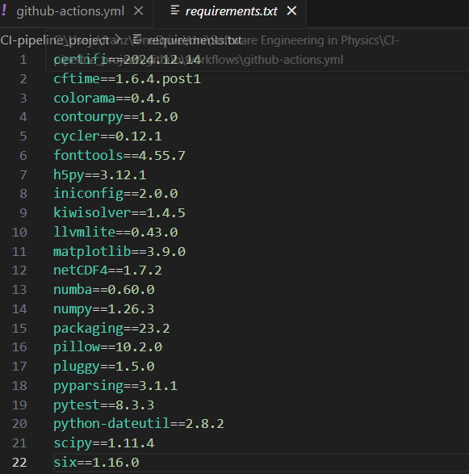
Usage of requirements.txt
Since the workflow runs on a separate virtual machine, most of the necessary packages aren’t installed. They have to be installed within the workflow.
A requirements.txt file lets you conveniently install all the packages listed within with only one command line.
pip freeze > requirements.txt – This command generates a list of all needs packages in the current folder and saves it in requirements.txt
pip install –r requirements.txt – installs the packages in the list

Slide 8
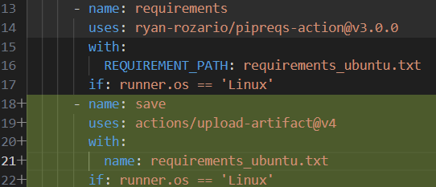
Actions and Artifacts
In a workflow actions made by other people can be accessed and used
An example is the pipreqs action that generates a requirements.txt file
actions/checkout lets you access the repository within the workflow
A file generated within a workflow disappears once the workflow is done
In order to access the file created with pipreqs-action it is uploaded as an artifact
The file can then be downloaded and used

Slide 9

Matrices
Matrix: inside a single job definition it generates multiple jobs with slight variations – similar to a for loop
In this example: matrix elements are the machines the code is tested on – windows, ubuntu(Linux)
The matrix elements are inserted into the runs-on attribute via matrix.os

Slide 10
Complications that occurred when implementing this
Executing pytest – occurrence of plot.show() in the code interfered with the test
Generation of requirements.txt – Windows and Linux required different methods of file generation
Adjustment of requirements.txt – versions listed in the file and versions accessible in the virtual machine didn’t match up

Slide 11
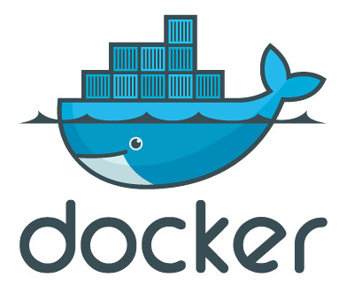
Think globally, act locally!
Install docker
Run: winget install nektos.act
That’s it! → Run: act push
Disadvantages:
It is not Github Actions
Limited runners: Ubuntu, self-host
Still needs internet connection

