Slide 1
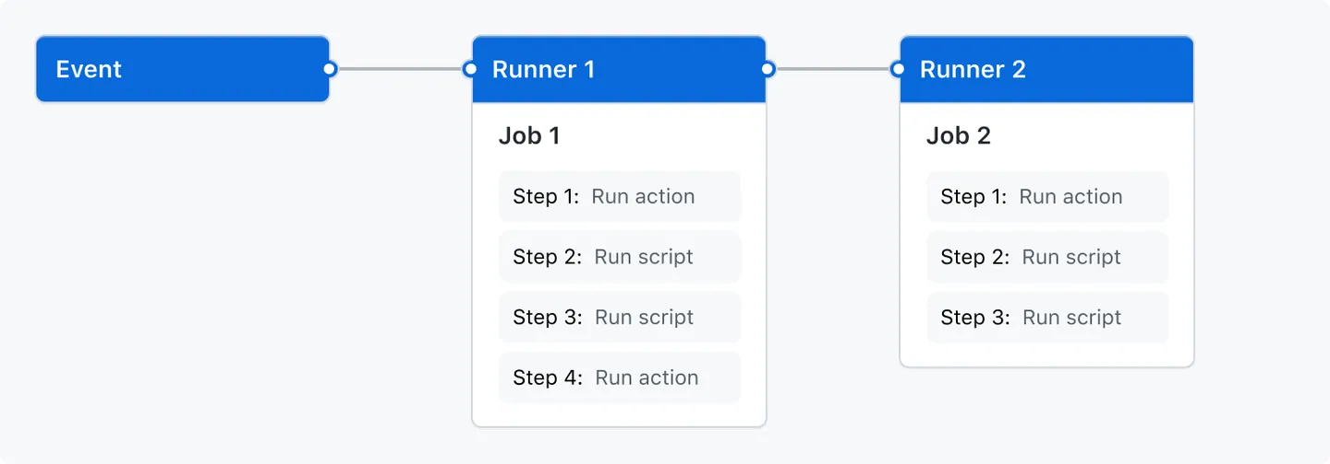
Workflows in GitHub Actions

Slide 2
YAML-files

Slide 3
Usage of requirements.txt

Slide 4
Artifacts

Slide 5
Matrices

Slide 6
Complications that occurred when implementing this

