Slide 1
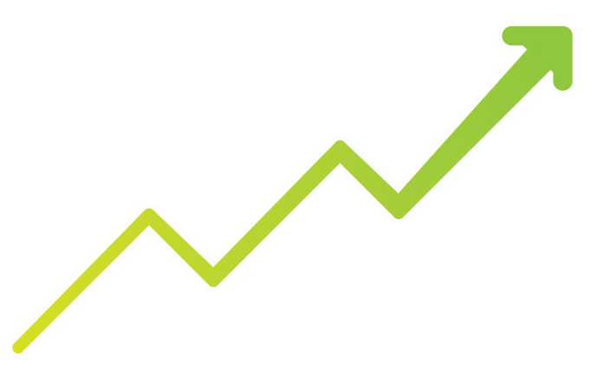
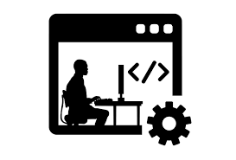
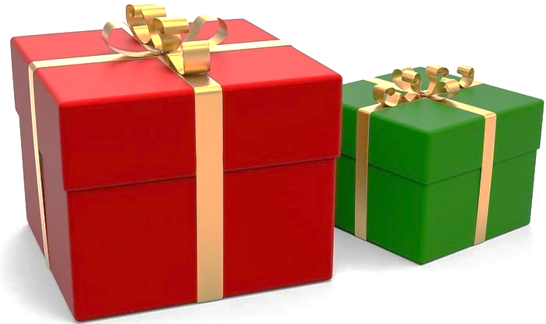

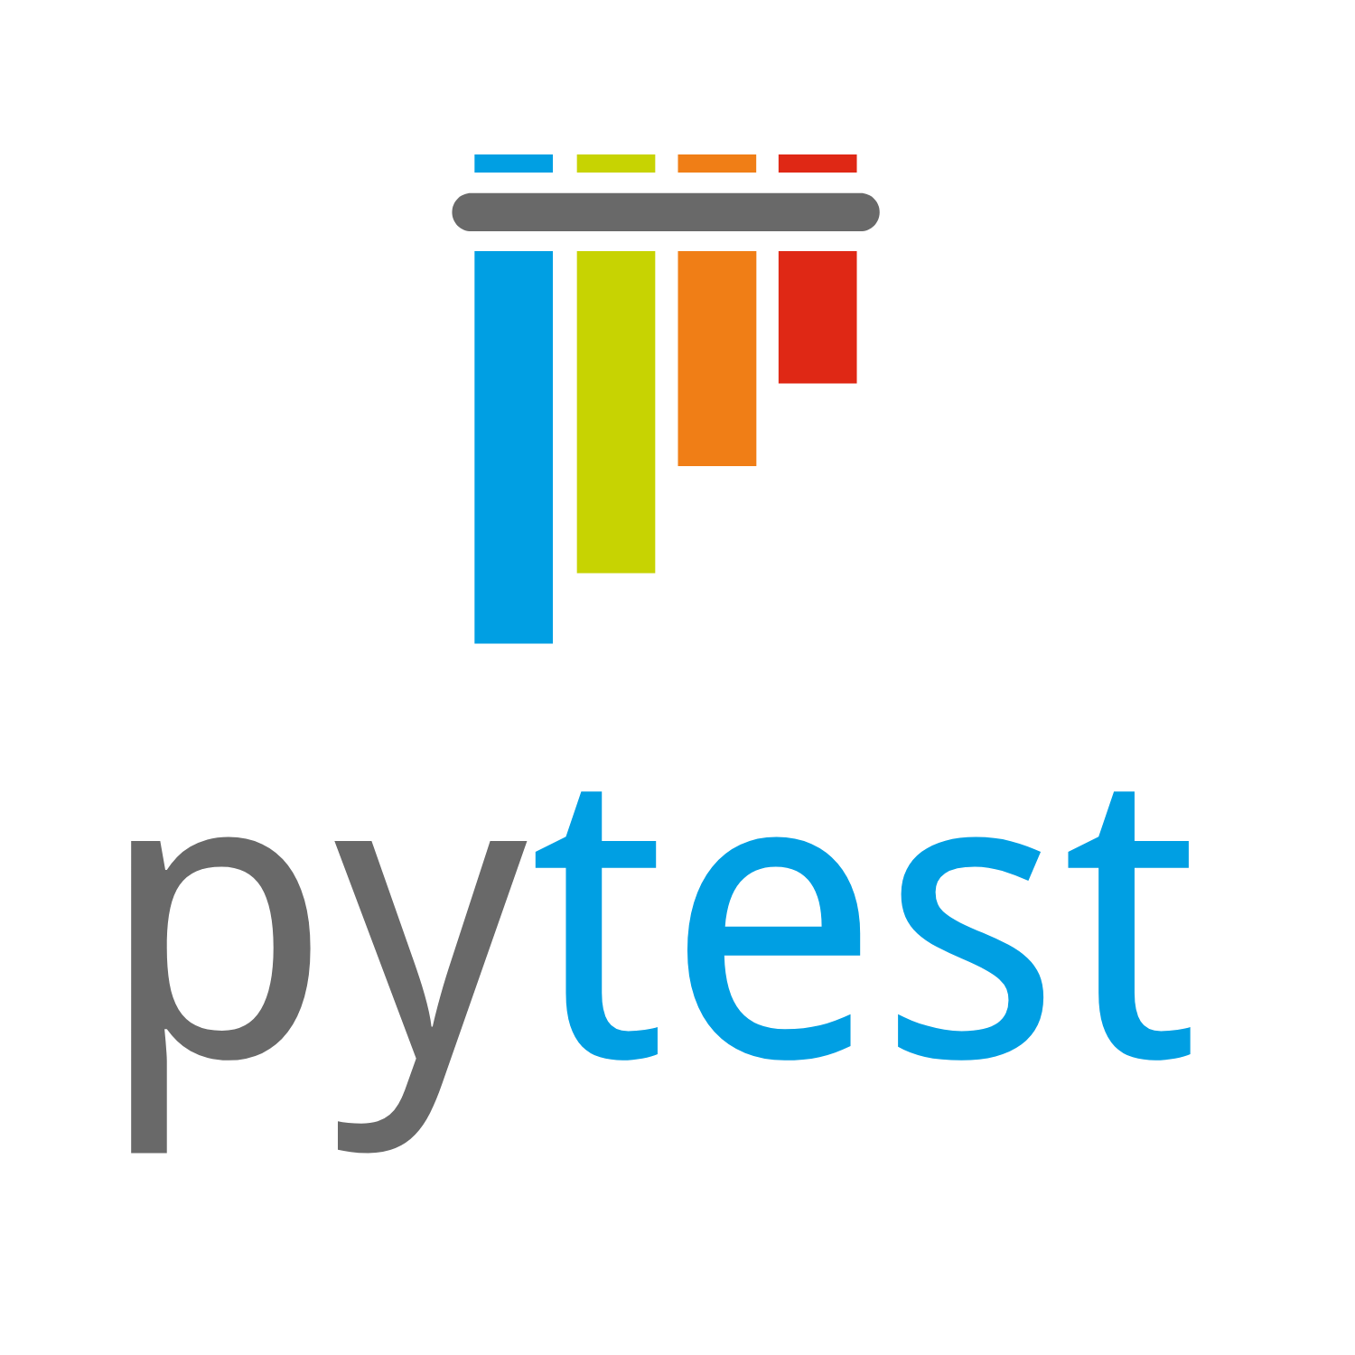
Improve project environment
Continuous integration
Packaging the project

Slide 2
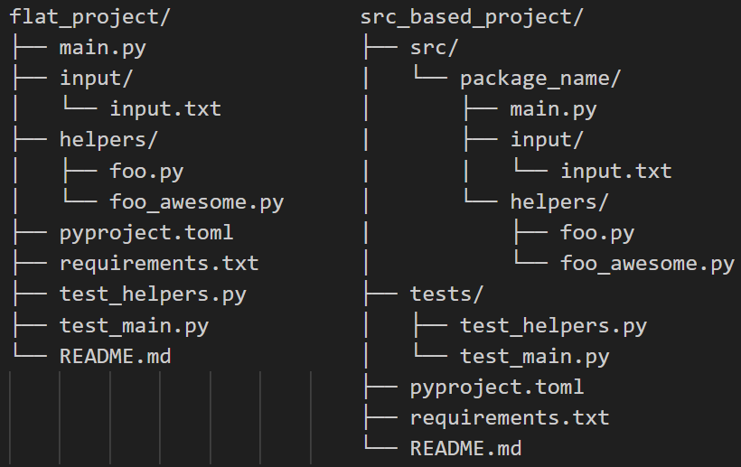
Packaging the project: Restructure
Adds unwanted project files
Requires installation

Slide 3
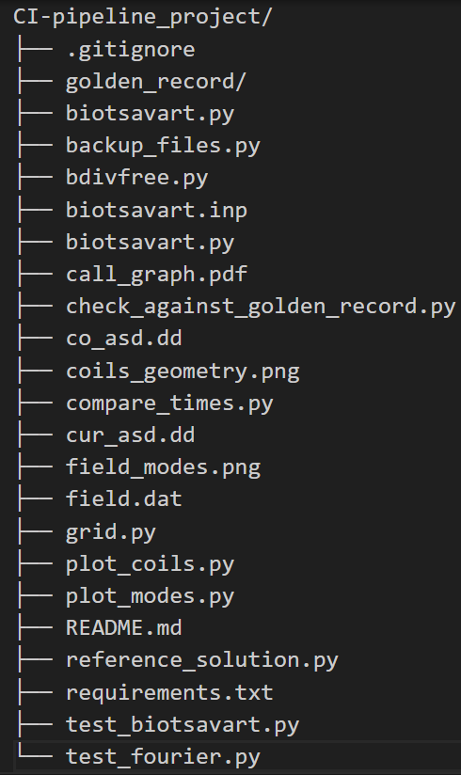
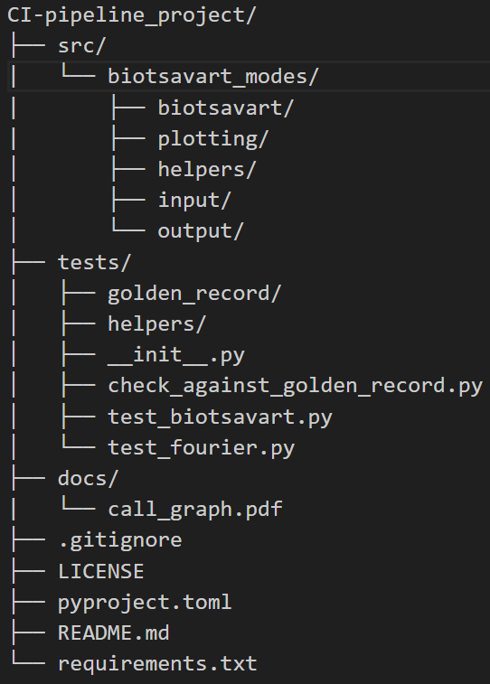

Slide 4
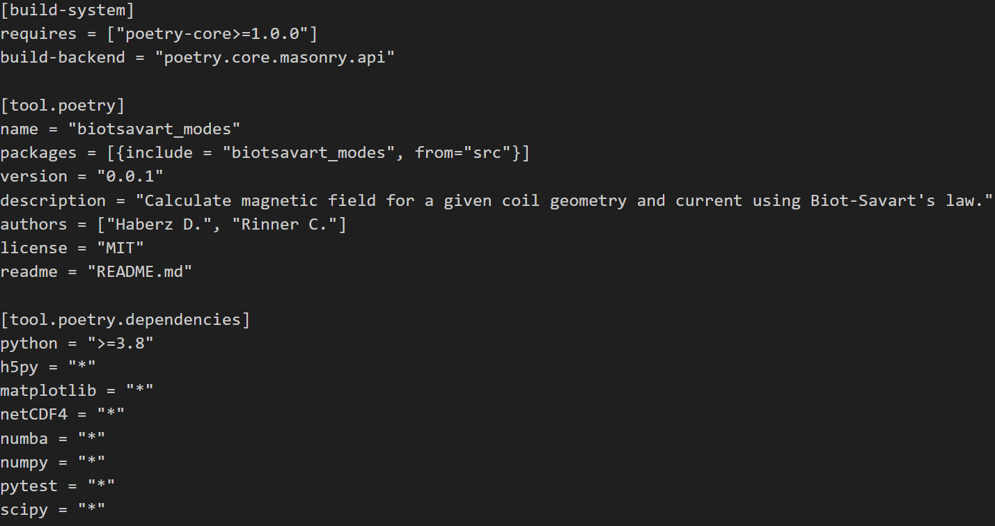
Packaging the project: pyproject.toml
PEP 518
PEP 621
PEP 631

Slide 5
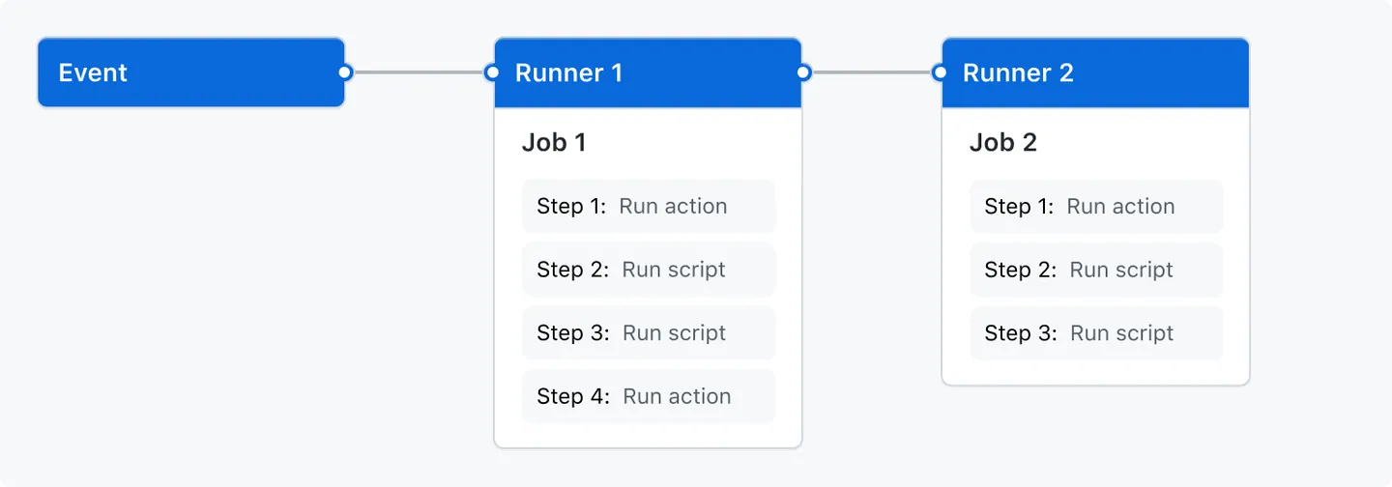
Workflows in GitHub Actions

Slide 6
YAML-files

Slide 7
Usage of requirements.txt

Slide 8
Artifacts

Slide 9
Matrices

Slide 10
Complications that occurred when implementing this

Slide 11
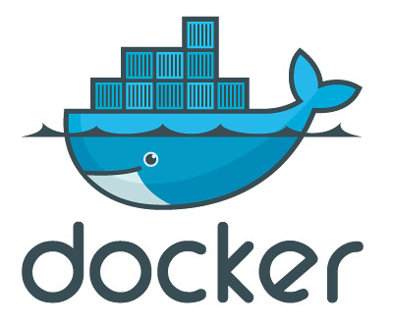
Think globally, act locally!
Install docker
Run: winget install nektos.act
That’s it! → Run: act push
Disadvantages:
It is not Github Actions
Limited runners: Ubuntu, self-host

