Slide 1
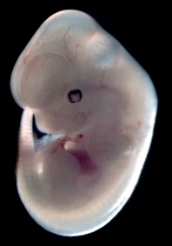
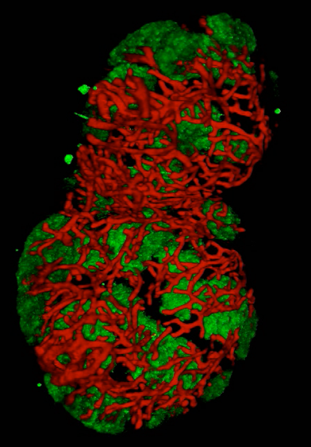
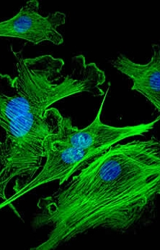
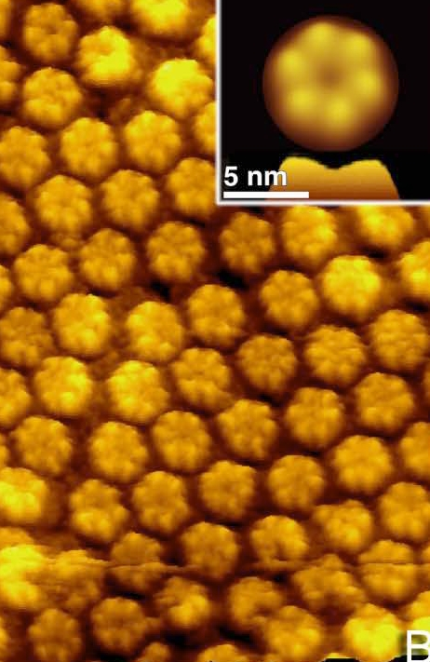
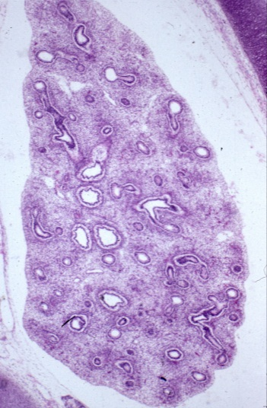
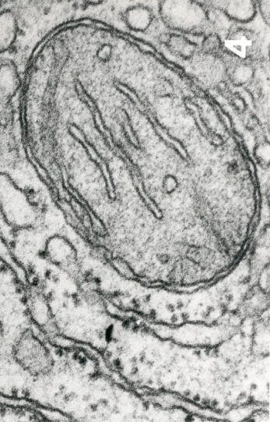

Available Microscopy Techniques: from Centi to Nano
1cm
1mm
100μm
10μm
1μm
100nm
10nm
1nm
Mesoscopy
OPT (Optical Projection Tomography)
Light Sheet Microscopy: Ultramicroscope/SPIM (Selective plane illumination microscopy)
Optical Microscopy
Wide-field
Bright/Dark
Fluorescence
Confocal
Laser Scanning
Spinning Disk
Two-/Multi Photon
Live imaging
Electron Microscopy
Transmission EM
Tomography TEM
Scanning EM
Micro CT (x-ray)
Atomic Force Microscopy
Correlative Microscopy
Organisms
Organs
Tissue
Cells
Organelles
Molecules
Notes:
Leaving now the administrative part I would like to present you the things that we microscopists are fascinated:
The bandwidth of microscopy techniques offered by the MIC and its members is really broad:
It starts with Mesoscopic imaging, a rather recent branch of microscopy deals in the range of centi- to milimeters.
With techniques like Optical projection tomographie or laser sheet technology whole organs or even small animals and embryos can be assessed.
In this spectrum falls also the newly acquired Micros-CT at the Anatomy
The classical microscopy range down to less than a micrometer resolution has nowadays wide variety of techniques in the wide field and confocal domains.
The MIC is proud to cover a wide range of these imaging techniques that focus mainly to depict cells within their environment.
With respect to ultrastructure a reasonable range of electron microscopes allow the insight into subcellular even molecular regions and by means of the atomic force microscope single molecules are visible to us.
A great challenge will be the establishment approaches representing correlative microscopy. This will allow to embed imaging techniques from one level to the next throughout the whole range of magnification.

Slide 2
Introduction into Cutting Edge Microscopy
1cm
1mm
100μm
10μm
1μm
100nm
10nm
1nm
Mesoscopy
Optical Microscopy
Electron Microscopy
Physical basics of light optical imaging M. Frenz (IAP)
Wide-field fluorescence microscopy, F. Blank, DBMR
Confocal laser scanning microscopy, F. Blank, DBMR
Atomic force microscopy, D. Fotiadis (IBMM)
Specific applications of fluorescence microscopy: CLSM & other specific applications, S. Yousefi (Pharmacology)
Transmission electron microscopy Application, D. Vanhecke (Anatomy)
Live cell imaging: The time factor, R. Lyck (TKI)
Total internal reflection fluorescence microscopy (TIRF), Y. Belyaev (MIC)
Cryo-electron microscopy, B. Zuber (Anatomy)
Scanning electron microscopy
M. Stoffel (Vet. Anatomy)
Multiphoton-intravital microscopy, T. Nevian (Physiology)
Intravital microscopy, G. Enzmann, (TKI)
Serial Block Face SEM, B. Zuber (Anatomy)
Calcium-imaging with CLSM E. Niggli (Physiology)
Super resolution imaging, T. Nevian (Physiology)
Light Sheet Microscopy N. Mercader, (Anatomy)
Stereology, S. Tschanz (Anatomy)

