Slide 1
EMPLOYEE MANAGEMENT SYSTEM
Presented By:-
Habibur Rahman
Delwar Hossain
BSc in CSE 23/1

Slide 2
Introduction with EMS
Employee Management System.

Slide 3

OBJECTIVE OF THE PROJECT
An easy way to manage all functionalities of the employees of Company.
Provides full functional reports to management of Company.
Collect the Necessary information about employee.
Show the Necessary information about employee according to the employee’s name and id.

Slide 4
PURPOSE
Manages the employees in a better way.
Easy to find the various information related to employees.
Easy to register a new employees.
Maintains the salary.
Easey to Remove employee.
Show Employee information by id or name.

Slide 5
SCOPE
Works in multiple pc’s with C or Turbo C
Employee’s & administrator both can use it with ease.
Can be used for Adding.
Can be used for Deleting.
Can be used for editing.

Slide 6
EXISTING SYSTEM
The records are maintained in registers.
Time consuming process.
Complicated searching, editing & updating.

Slide 7
ADVANTAGES
Provide computerized system for maintaining records.
More efficient & reliable.
Less time consuming and easy to use.
Huge data storage with less computer memory

Slide 8
SYSTEM REQUIREMENTS
Hardware Requirements
Processor : Pentium 3 or later.
RAM : 500MB or more
Hard Disk : 80GB or more

Slide 9
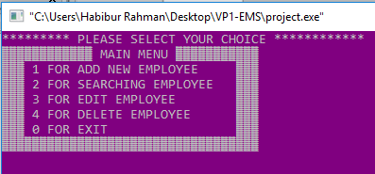
Main menu

Slide 10
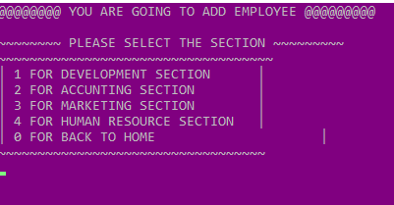
Different sections

Slide 11
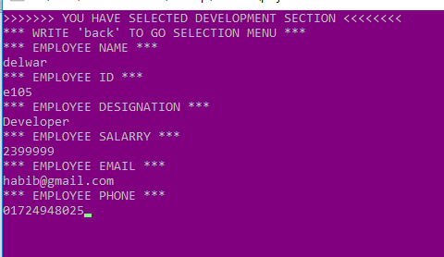
Add Employee

Slide 12
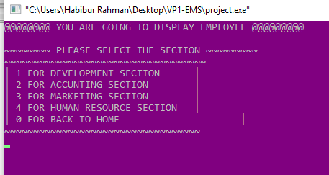
Display Employee

Slide 13
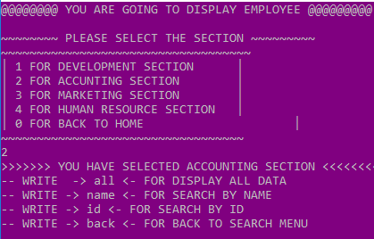
Display by name,id or all Employee

Slide 14
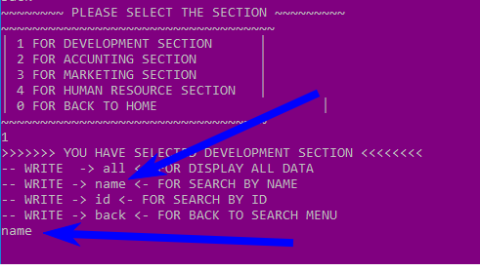
write name for display by name

Slide 15
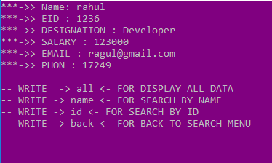
Display single employee by name

Slide 16
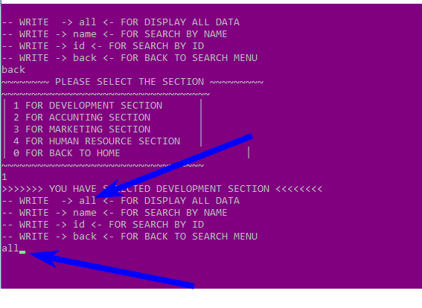
write all for display by all employee

Slide 17
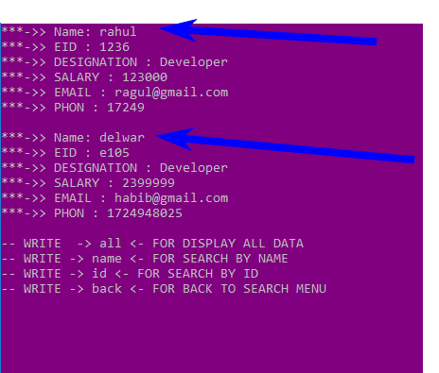
Display all employee by write all

Slide 18
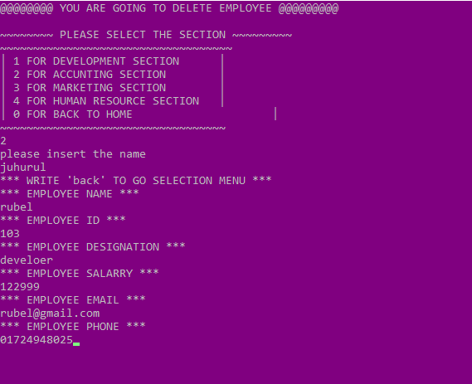
Edit emplyee by name

Slide 19


