Slide 1


Slide 2

TraceFake AI Base Image Authenticity Checker
Supervisor: Sonia Salman
Submitted By: F25PROJECT3B386
Habib Ur Rehman- BC220423776

Slide 3

INTRODUCTION OF PROJECT
Project Domain / Category
Artificial Intelligence (AI) / Image Forensics / Deepfake Detection
An AI-powered tool that analyzes digital images to determine whether they are real photographs or AI-generated synthetic content.
With tools like DALL·E, Midjourney, and Stable Diffusion, creating photorealistic fake images has never been easier — and never been more dangerous.
TraceFake uses deep learning and digital forensics to fight back.

Slide 4
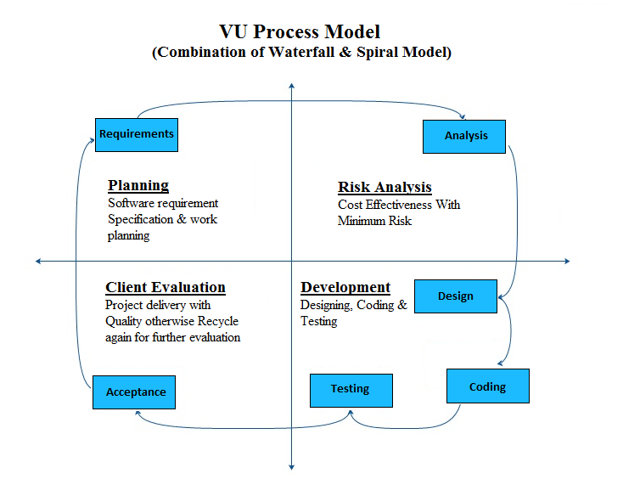
Process Model

Slide 5
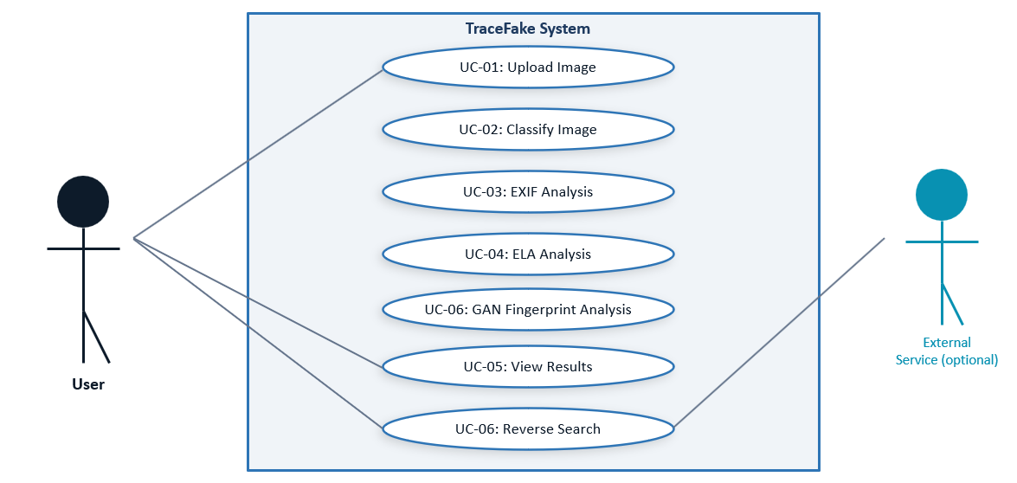
Use Case Diagram

Slide 6
Business Rules Catalog
Functional Requirements
Image Upload/Input
Allow upload of JPEG, PNG, JPG images for analysis
Image Classification
Classify images as Real or AI-Generated using CNN model with confidence score
EXIF Metadata
Extract and display camera model, creation date, editing software info
Error Level Analysis
Apply ELA to detect compression artifacts and tampered regions
Result Display
Show prediction label, confidence percentage, and forensic cues to user
Reverse Image Search (Optional)
Integrate with Bing/TinEye API to trace image origin on the web

Slide 7
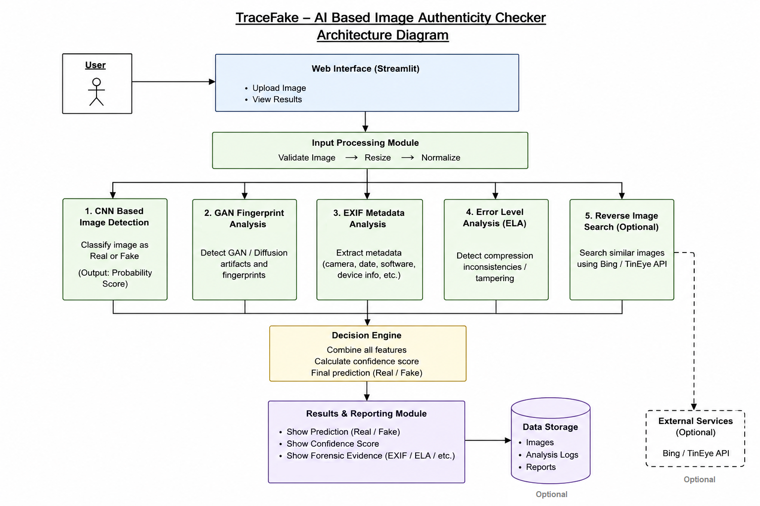
Architectural Design

Slide 8
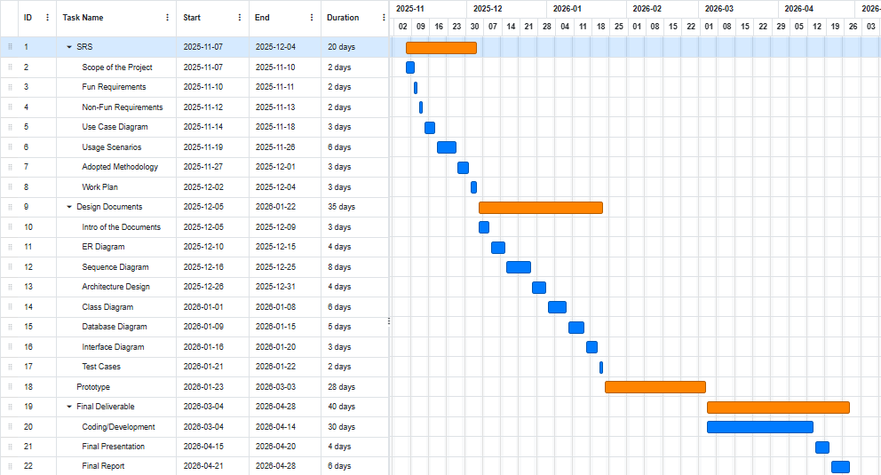
Project Schedule

Slide 9
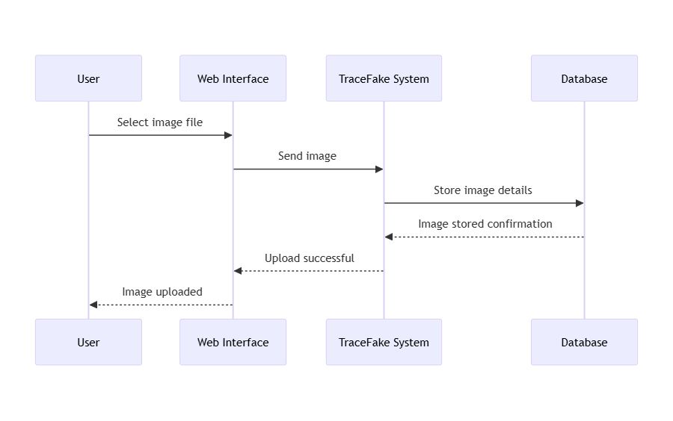
Sequence Diagrams
Upload Image

Slide 10
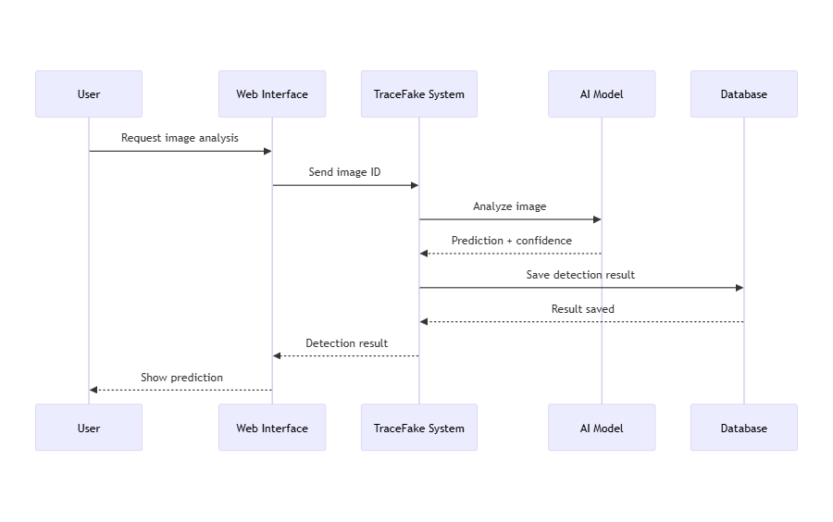
Sequence Diagrams
Classify Image

Slide 11
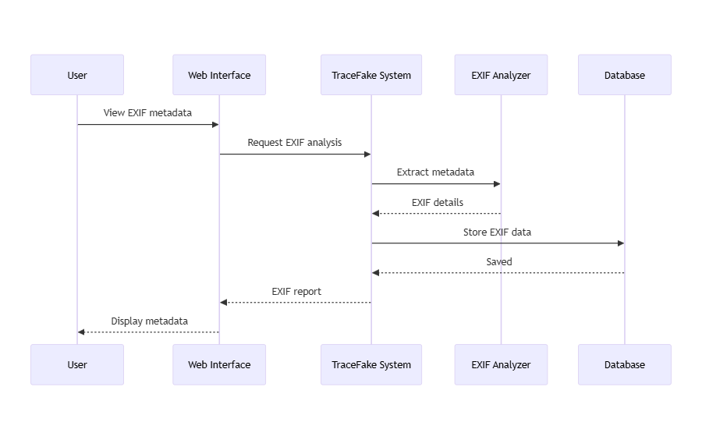
Sequence Diagrams
Exif Metadata Analysis

Slide 12
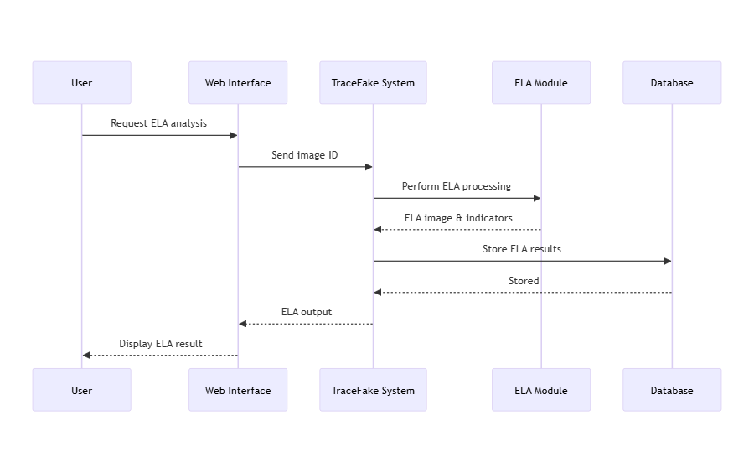
Sequence Diagrams
ELA – Error Level Analysis

Slide 13
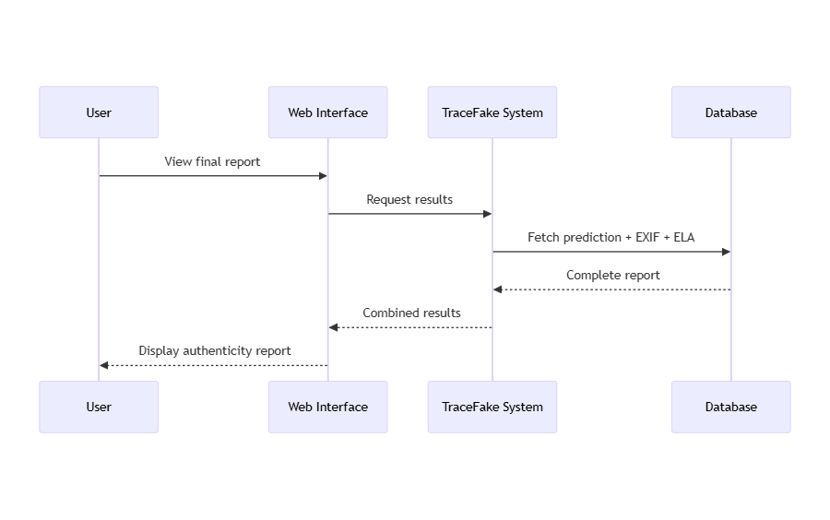
Sequence Diagrams
View Final result

Slide 14
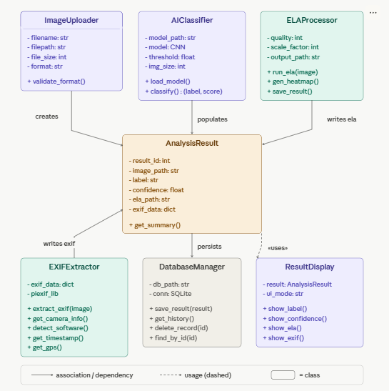
Logical Model/Class Diagram

Slide 15
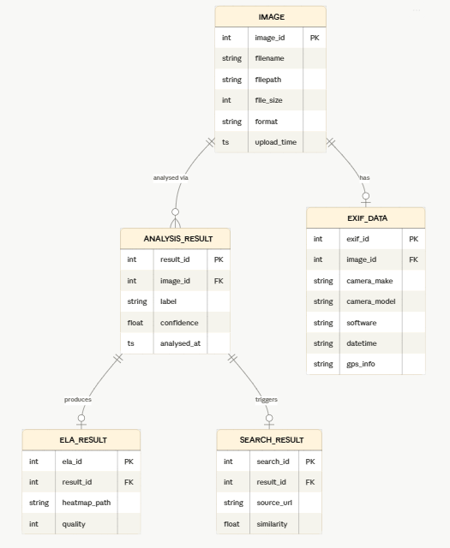
Entity-Relationship Diagram

Slide 16
Dataset Design:
140k Real vs Fake Dataset
70k Flickr real faces + 70k GAN-generated faces. Best for realistic deepfake training.
Source: Kaggle — xhlulu
Size: 140,000 images

Slide 17
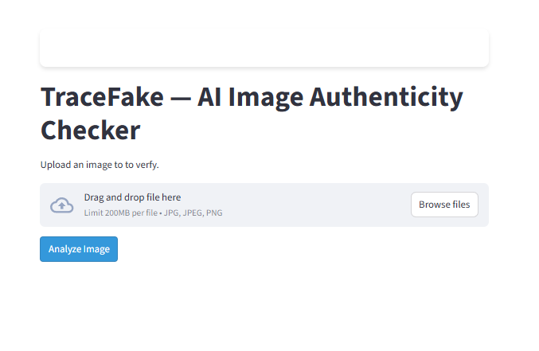
User Interfaces

Slide 18
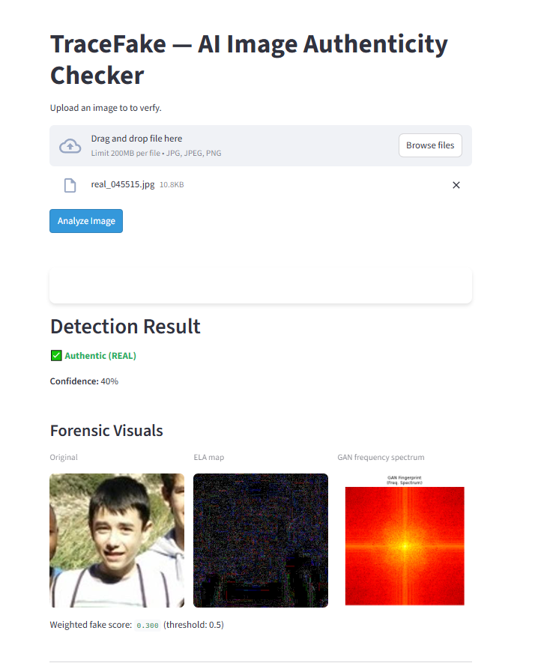
User Interfaces

Slide 19
User Interfaces

Slide 20
Tools
Language: Python
Deep Learning: Tensorflow
Models: MobileNetV2
UI: Streamlit
Dataset: Kaggle
Development Environment: Google Colab / Jupyter Notebook

