Slide 1


Information Security

Slide 2







Asset: Anything of Value to the company
Vulnerability: A weakness; the absence of a safeguard
Threat: Something that could pose loss to all or part of an asset
InfoSec:
General Definition
Threat Agent: What carries out the attack
Exploit: An instance of compromise
Risk: The probability of a threat materializing

Slide 3

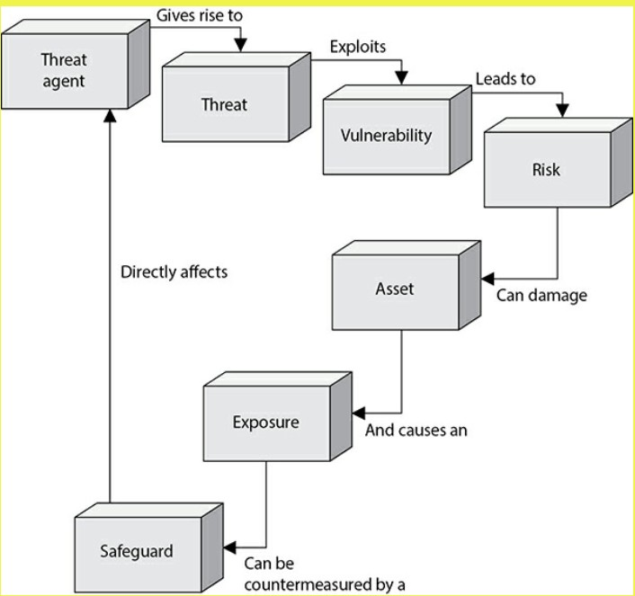
InfoSec: Relationship

Slide 4

InfoSec: Framework
A framework is a logical structure.
An Intent of a framework is to document and organize processes.
A Framework can also be the basis of a common evaluation by:
Internal Stakeholders
External Stakeholders
Third parties
Notes:
A security framework is a set of policies, guidelines, and best practices designed to manage an organization’s information security risks. As the name suggests, frameworks provide the supporting structure needed to protect internal data against cyber threats and vulnerabilities.

Slide 5
Information Sec- Framework
IT security framework is a series of documented processes that define policies and procedures around the implementation and ongoing management of information security controls. These frameworks are a blueprint for managing risk and reducing vulnerabilities.
Information security professionals use frameworks to define and prioritize the tasks required to manage enterprise security. Frameworks are also used to help prepare for compliance and other IT audits. Therefore, the framework must support specific requirements defined in the standard or regulation.
Organizations can customize frameworks to solve specific information security problems, such as industry-specific requirements or different regulatory compliance goals. Frameworks also come in varying degrees of complexity and scale.

Slide 6
Why are frameworks important?
Frameworks provide a starting point for establishing processes, policies and administrative activities for information security management.
Examples
ISO 27000 Series
ISO 27018 addresses cloud computing.
ISO 27031 provides guidance on IT disaster recovery programs and related activities.
ISO 27037 addresses the collection and protection of digital evidence.
ISO 27040 addresses storage security
2. NIST (National Institute of Standards and Technology)
3. COBIT (Control Objectives for Information and Related Technology)
4. CIS (Critical Security Controls)
5. COSO (Committee of Sponsoring Organizations)
6. HIPAA (Health Insurance Portability and Accountability Act)

Slide 7
InfoSec: ISMS
An Information Security Management System (ISMS) is a framework for designing, establishing ,implementing ,maintaining and monitoring an information security program in order to achieve the objectives of:
Confidentiality
Integrity
Availability

Slide 8
InfoSec: Frame Type
Type | Description
International | Promoted Globally Developed by representatives from participating areas
National | Designed for use in a specific country or consortium (E.U)
Regulatory | Refective of regulatory expectations and examination requirments
Industry Specific | Specific to a industry Developed promoted and enforced by industry members

Slide 9
InfoSec: Frame Type
Type | Description
International | ISO 2700 Family
National | NIST Cybersecurity Framwork
Regulatory | FDIC Cybersecurity Assesment Tools (CAT)
Industry Specific | PCI DSS Payment card Industry Data Security Standard
Notes:
Federal Deposit Insurance Corporation
CAT: computer-adaptive test

Slide 10
InfoSec: Benchmark
An information security benchmark is intended to help an organization identify their cybersecurity capabilities and initiatives and compare those efforts to peers or competitors of the same sector or size.
The snapshot is prepared either internally by the organization or by a thirth party

Slide 11
Benchmarking is the practice of comparing business processes and performance metrics to industry bests and best practices from other companies. Dimensions typically measured are quality, time and cost.
Benchmarking is used to measure performance using a specific indicator (cost per unit of measure, productivity per unit of measure, cycle time of x per unit of measure or defects per unit of measure) resulting in a metric of performance that is then compared to others.

Slide 12
The center for internet security (CIS) Benchmarks are consensus-based best practices for the secure configuration of a target sytem.
CIS benchmarks are widely accepted by the government ,business ,industry and academia.
CIS
Benchmarks

Slide 13

InfoSec: Session Review
Implementing Best Practices
Your company plans to migrate to windows server 2019 .You are tasked with advising the migration team. Your objective is to endure that the servers are configured in
accordance with industry recommendation and best practices .However you don’t
want to cause any unnecessary disruption. What is your process ?

Slide 14
InfoSec: Session Review
Start by compiling your organization server standard and baselines
(Know what you currently do).
Take advantage of the research and work that has already been done.eg. CIS, Publication etc.
Determine which setting align with organizational objectives and requirements.
Follow configuration management and change control process.

Slide 15
InfoSec :Corporate Governance
Corporate governance is the system by which organizations are directed and controlled
Governance structure and principle identify the distribution of rights and responsibility
Corporate governance is the system of rules, practices and processes by which a company is directed and controlled. Corporate Governance refers to the way in which companies are governed and to what purpose. It identifies who has power and accountability, and who makes decisions.

Slide 16

InfoSec :Corporate Governance
Objectives | Outcome
Strategic Alignment | Aligning departmental strategies with business strategy to support organizational goals
Risk Management | Mitigate risk to an acceptable level
Value Delivery | Optimize Investment in support of business objective
Resource Management | Efficient and efective use of resources
Performance Measurement | Monitoring and reporting on achivements
Process Integration | Achive operational synergies and efficiency.

