Slide 1


Slide 2
Digital Logic Design
Mr. Faisal Naeem

Slide 3
Logic Gates

Slide 4
Number Systems
The number system is simply a system to represent or express numbers.
There are various types of number systems and the most commonly used
Decimal number system (Base- 10)
Binary number system (Base- 2)
Octal number system (Base-8)
Hexadecimal number system (Base- 16)

Slide 5
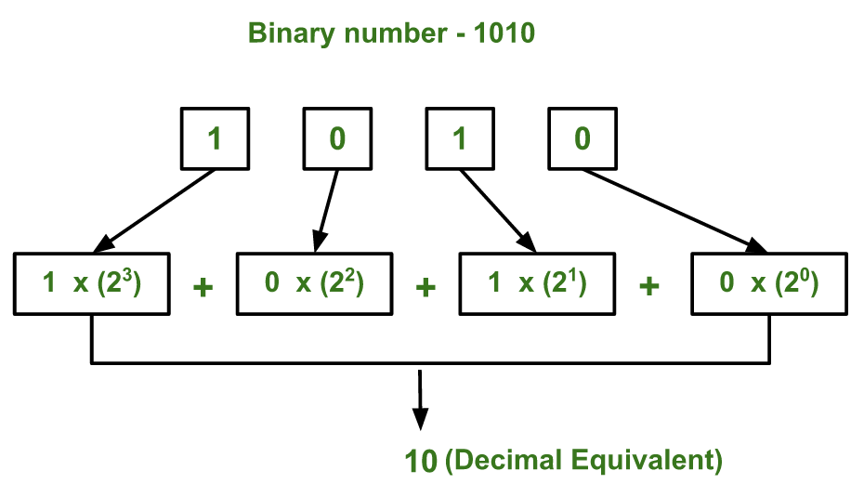
Binary to decimal conversions

Slide 6
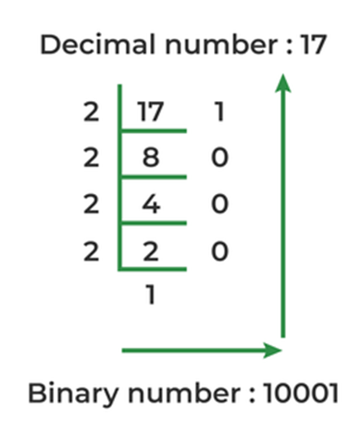
Decimal to Binary conversions

Slide 7
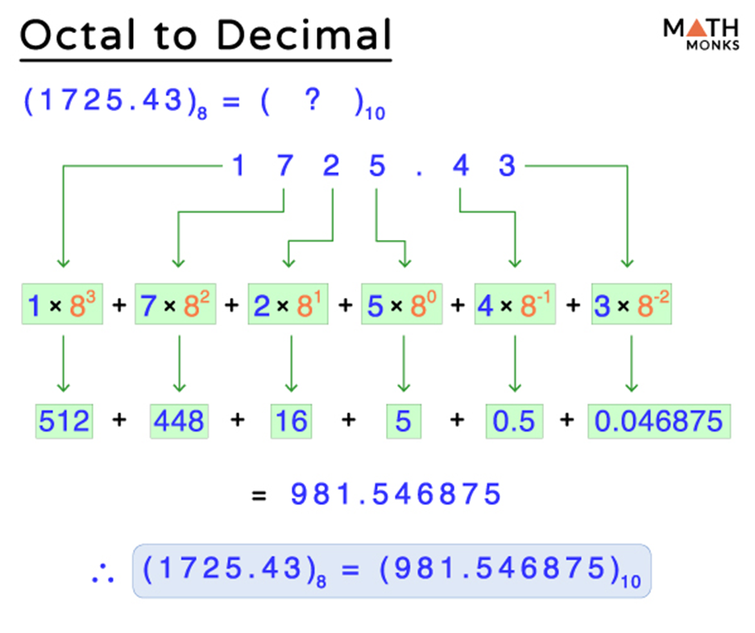
Octal to Decimal conversions

Slide 8
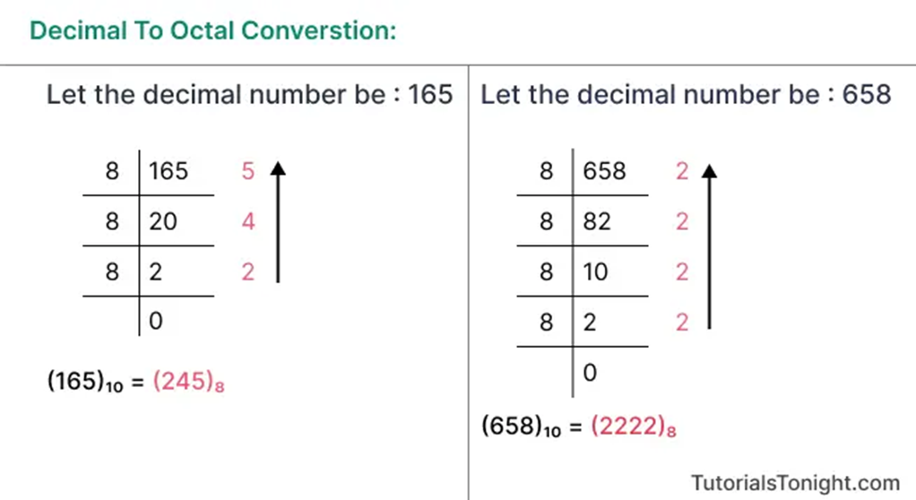
Decimal to Octal Conversions

Slide 9
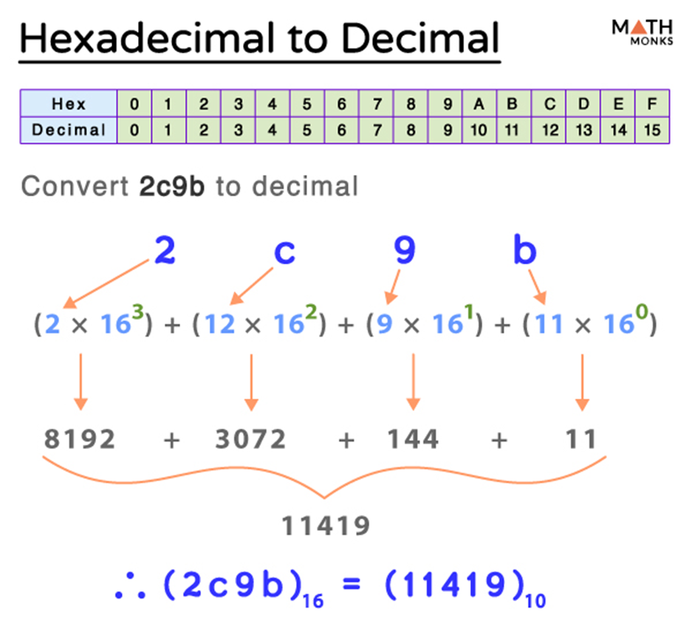
Hexa to Decimal Conversions

Slide 10
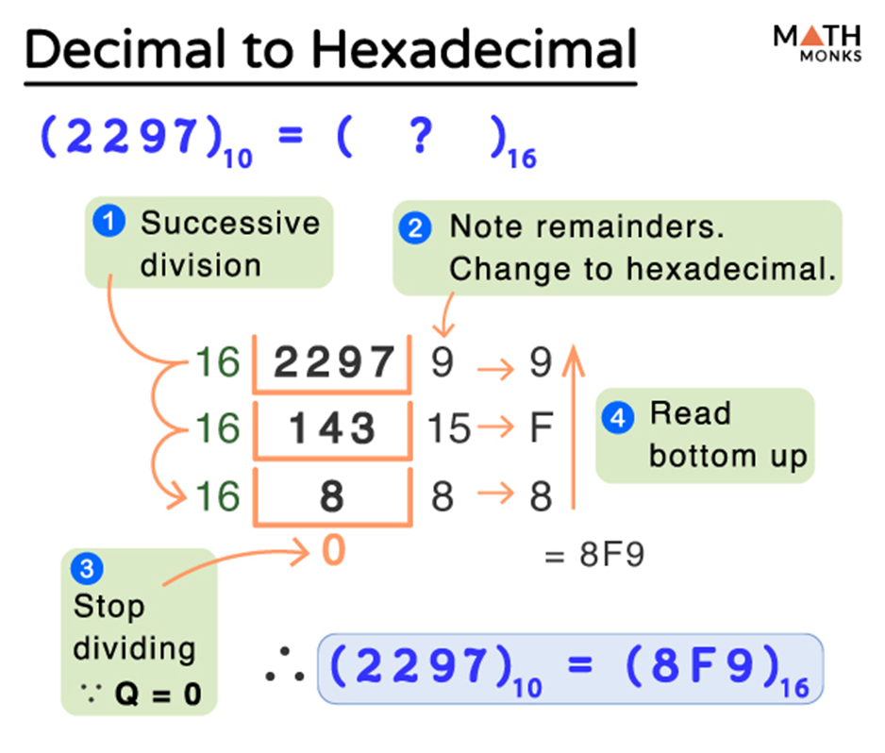
Decimal to Hexa Conversions

Slide 11
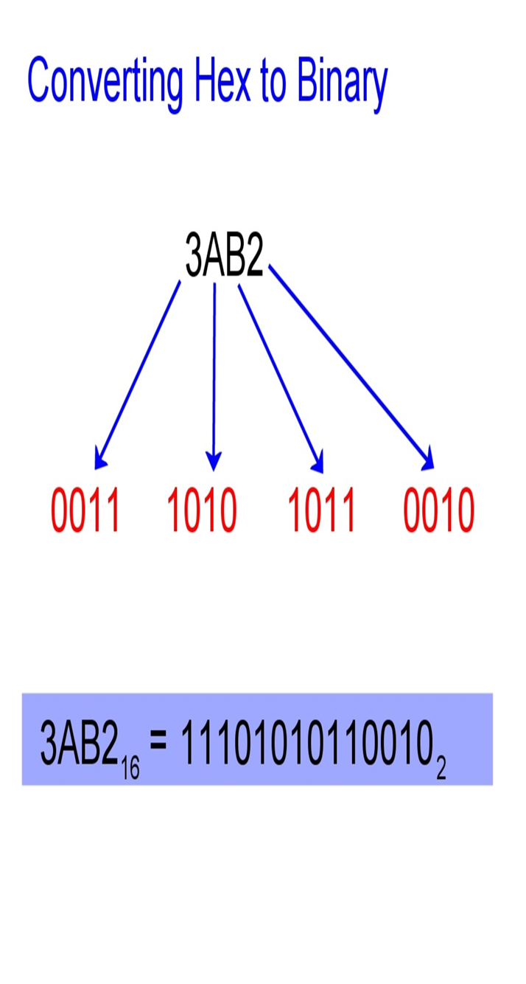
Hexa to Binary Conversions

Slide 12
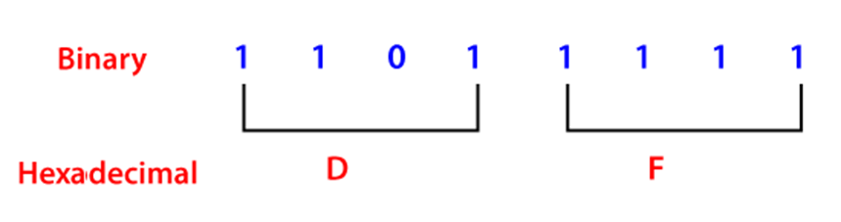
Binary to Hexa Conversions

Slide 13
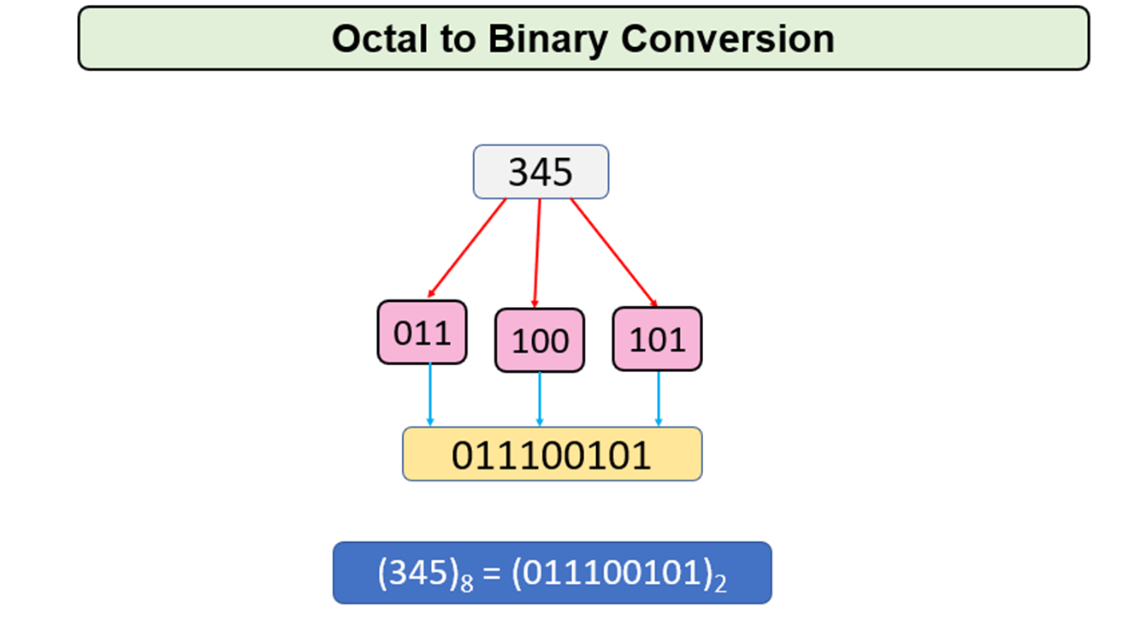
Octal to Binary Conversions

Slide 14
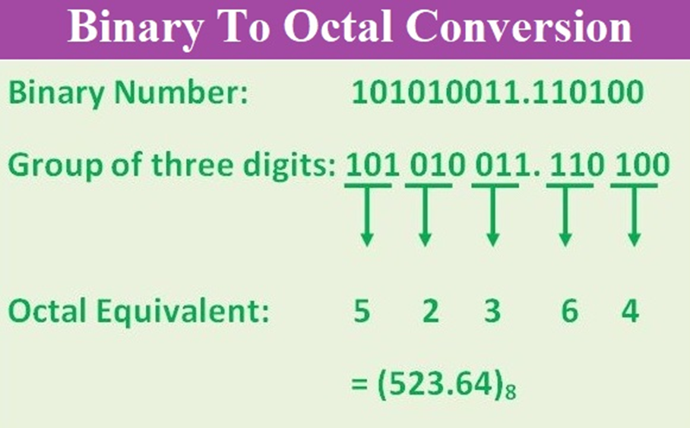
Binary to Octal Conversions

Slide 15
Boolean Algebra
Boolean algebra is the category of algebra in which the variable’s values are the truth values, true and false, ordinarily denoted 1 and 0 respectively.
It is used to analyze and simplify digital circuits or digital gates.
It is also called Binary Algebra or logical Algebra.
It has been fundamental in the development of digital electronics and is provided for in all modern programming languages. It is also used in statistics.

Slide 16
Boolean Expression
A logical statement that results in a Boolean value, either be True or False, is a Boolean expression.
Sometimes, synonyms are used to express the statement such as ‘Yes’ for ‘True’ and ‘No’ for ‘False’.
Also, 1 and 0 are used for digital circuits for True and False, respectively.

Slide 17
Boolean Algebra Terminologies
Boolean Algebra: Boolean algebra is the branch of algebra that deals with logical operations and binary variables.
Boolean Variables: A Boolean variable is defined as a variable or a symbol defined as a variable or a symbol, generally an alphabet that represents the logical quantities such as 0 or 1.
Boolean Function: A Boolean function consists of binary variables, logical operators, constants such as 0 and 1, equal to the operator, and the parenthesis symbols.
Literal: A literal may be a variable or a complement of a variable.
Complement: The complement is defined as the inverse of a variable, which is represented by a bar over the variable.

Slide 18
Boolean Algebra Terminologies
Literal: A literal may be a variable or a complement of a variable.
Complement: The complement is defined as the inverse of a variable, which is represented by a bar over the variable.
Truth Table: The truth table is a table that gives all the possible values of logical variables and the combination of the variables. The number of rows in the truth table should be equal to 2^{n}

Slide 19
Laws of Boolean Algebra
Commutative Law: Commutative law states that changing the sequence of the variables does not have any effect on the output of a logic circuit.
A. B = B. A
A + B = B + A
Associative Law: It states that the order in which the logic operations are performed is irrelevant as their effect is the same.
( A. B ). C = A . ( B . C )
( A + B ) + C = A + ( B + C)

Slide 20
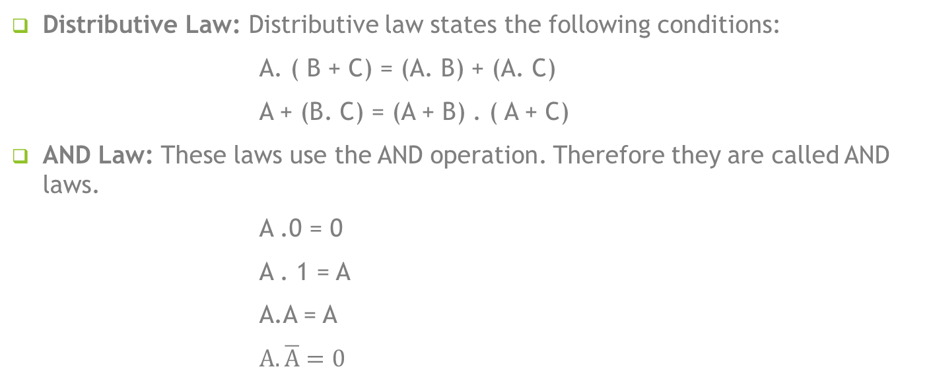
Laws of Boolean Algebra
Distributive Law: Distributive law states the following conditions:
A. ( B + C) = (A. B) + (A. C)
A + (B. C) = (A + B) . ( A + C)
AND Law: These laws use the AND operation. Therefore they are called AND laws.
A .0 = 0
A . 1 = A
A.A = A
$A.\overline{A}=0$

Slide 21
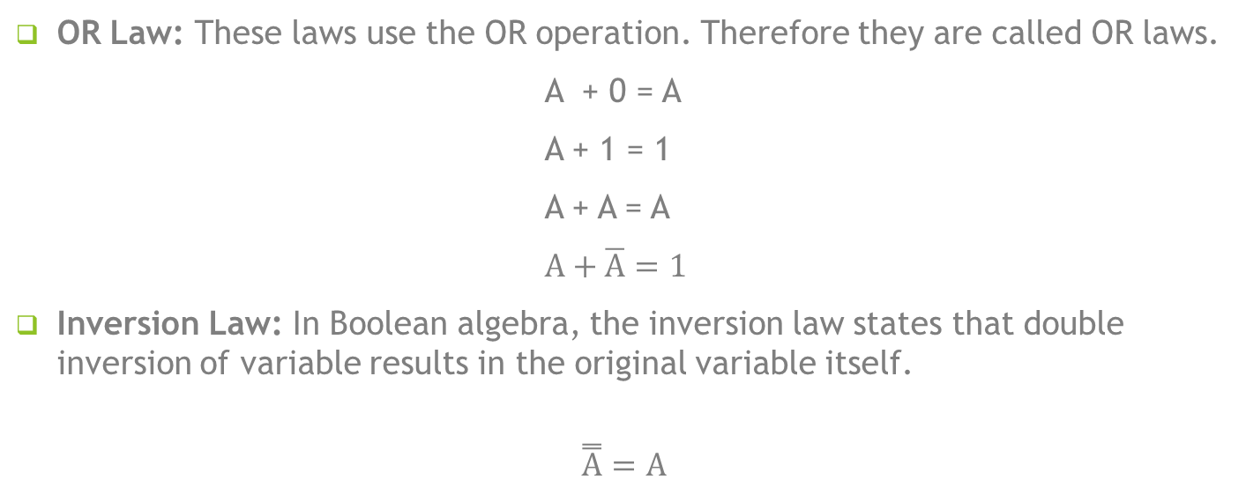
Laws of Boolean Algebra
OR Law: These laws use the OR operation. Therefore they are called OR laws.
A + 0 = A
A + 1 = 1
A + A = A
$A+\overline{A}=1$
Inversion Law: In Boolean algebra, the inversion law states that double inversion of variable results in the original variable itself.
$$\overset{̿}{A}=A$$

Slide 22
Boolean Algebra Theorems
The two important theorems which are extremely used in Boolean algebra are De Morgan’s First law and De Morgan’s second law.
These two theorems are used to change the Boolean expression.
De Morgan’s First Law: De Morgan’s First Law states that (A.B)’ = A’+B’.

Slide 23
De Morgan’s First Law
De Morgan’s First Law states that
(A.B)’ = A’+B’
Draw Truth Table?

Slide 24
De Morgan’s Second Law
De Morgan’s Second Law: De Morgan’s Second law states that
(A+B)’ = A’. B’
Draw Truth Table?

Slide 25
Example
Question 2: Draw a truth table for A(B+D)?

Slide 26
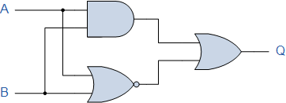
Example

Slide 27
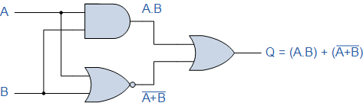
Example (Draw truth table)

Slide 28
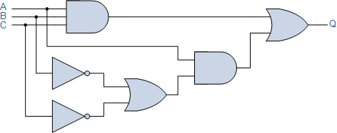
Example

Slide 29
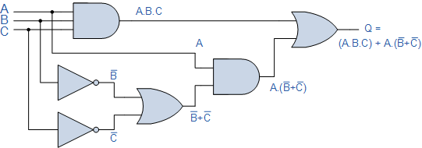
Example (Draw truth table) I/P = 8

Slide 30
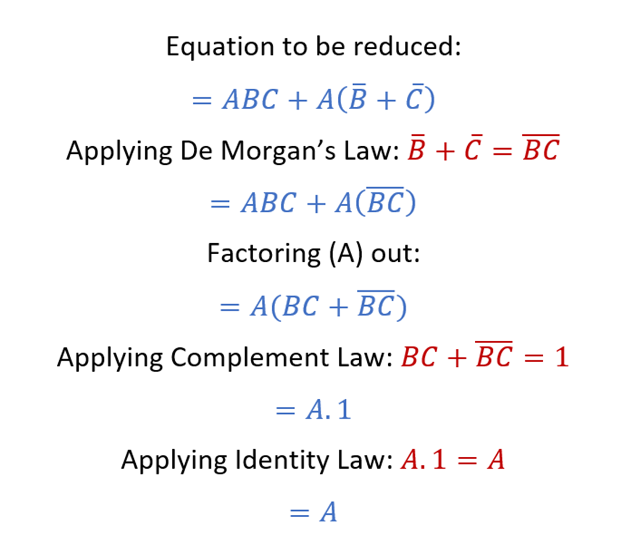
Example

Slide 31
Example
Check whether AC + ABC = AC is true or false?
Solution:
Given Boolean expression: AC + ABC = AC
AC (1+B) = AC
Now, using the null law 1+B = 1, the above expression can be written as:
AC.1 = AC
Thus, using the identity law, 1.A = A, the above expression becomes:
AC = AC
Hence, AC + ABC = AC is true.

Slide 32
Example
(X + Y) (X + Z)
= XX + XZ +YX + YZ
=X+ XZ +YX + YZ X.X=X
= X (1 + Z) + YX + YZ
= X + YX + YZ 1 + Z = 1
= X (1 + Y) + Y Z
= X + YZ 1 + Y = 1

Slide 33
Example
Proof by Perfect induction Method ( truth Table):
Truth Table for the
R.H.S. (X + Y) (X+ Z)
L.H.S. X + YZ

