Slide 1





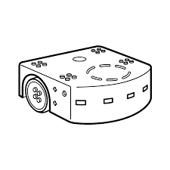
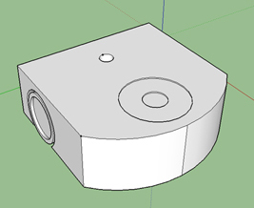
Thymio Suite 2
HUB Application
Blocs
Snap !
HTTP Rest API
WS://
Thymio
Controller
Javascript
Thymio
Server
Javascript
HTTP GET
HTTP PUT
Socket.io
Dashell
SIMULATION
USB
WIRELESS
ThymioHTTP Full Stack WebService
Thymio
Simulation
Real
Thymio
Code
Aseba
Code
Python

