Slide 1
Women Empowerment
Ummay Habiba

Slide 2
Presentation Outline
Introduction
Various dimension of women empowerment
Importance of women empowerment
Challenges to women empowerment
Ways to achieve women empowerment
Women empowerment in Bangladesh
Organizations for women empowerment
conclusion

Slide 3
Introduction:
Women empowerment is a process of enabling women to take control over their lives and make decisions in areas such as politics, economy, education and social issues.

Slide 4

What is empowerment?
“Empowerment is the process of increasing the authority and responsibility of individual or groups to make choices and to transform those choices into desired actions and outcomes.”
_World Bank

Slide 5

What is women empowerment?
According to Arrow(1995)women empowerment is the process by which women strengths their capacity individually & collectively to identify ,understand and overcome gender discrimination

Slide 6
Various dimensions of women empowerment:
Social empowerment
Economic empowerment
Political empowerment

Slide 7
Importance of women empowerment:
Women empowerment
Gender equality
Progress
Development
Human right

Slide 8
challenges to women empowerment:
Lack 0f education
Religious norms
Social norms & values
Weak economic condition

Slide 9
Ways to achieve women empowerment:
Self help groups
Government schemes
Micro finance
Self employment

Slide 10
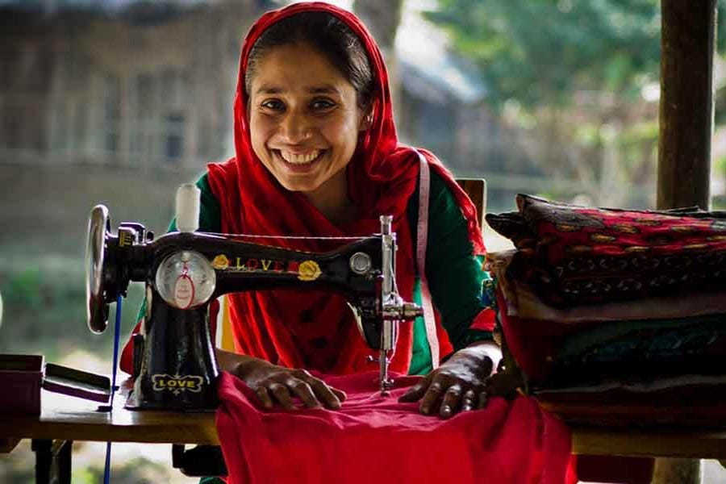
Women empowerment in Bangladesh:
Bangladesh has topped the South Asia countries in gender equality for the third consecutive year.

Slide 11
In 2018,a survey shows an empowerment status in Bangladesh.

Slide 12
Women empowerment schemes in India:
Women Police Volunteers Scheme
Working Women Hostel Scheme
Women Helpline Scheme
Beti Bachao Beti Padhao
Mahila Shakti Kendra

Slide 13
Organizations that fight for women rights:
UN Women
Womankind WORLDWIDE
IWDA
AWID
WE DO
Equality Now

Slide 14


UN Women VS Womankind Worldwide

Slide 15

IWDA
International Women’s Development Agency is an Australian non-profit organization that works to support women’s rights in Asia and the Pacific.

Slide 16

AWID
It is an international feminist membership and movement support organization.

Slide 17

Women for women international :
It is a non-profit organization that provides practical & moral support to female survivors of war.

Slide 18

WE DO:
Women’s Environment & Development Organization is a global women’s advocacy organization.

Slide 19

Equality Now:
It’s an international organization founded with the mission of using legal advocacy to protect and promote the human rights of women & girls.

Slide 20

CARE:
CARE has been working in India for over 70 years, for the development of marginalized women & girls through 53 pr0grammes in 18 states.

Slide 21
Conclusion:
Empowering women isn’t just important, it’s necessary for a fair & better future for everyone.

Slide 22
Do you have any questions?

Slide 23
Thank you

