Slide 1
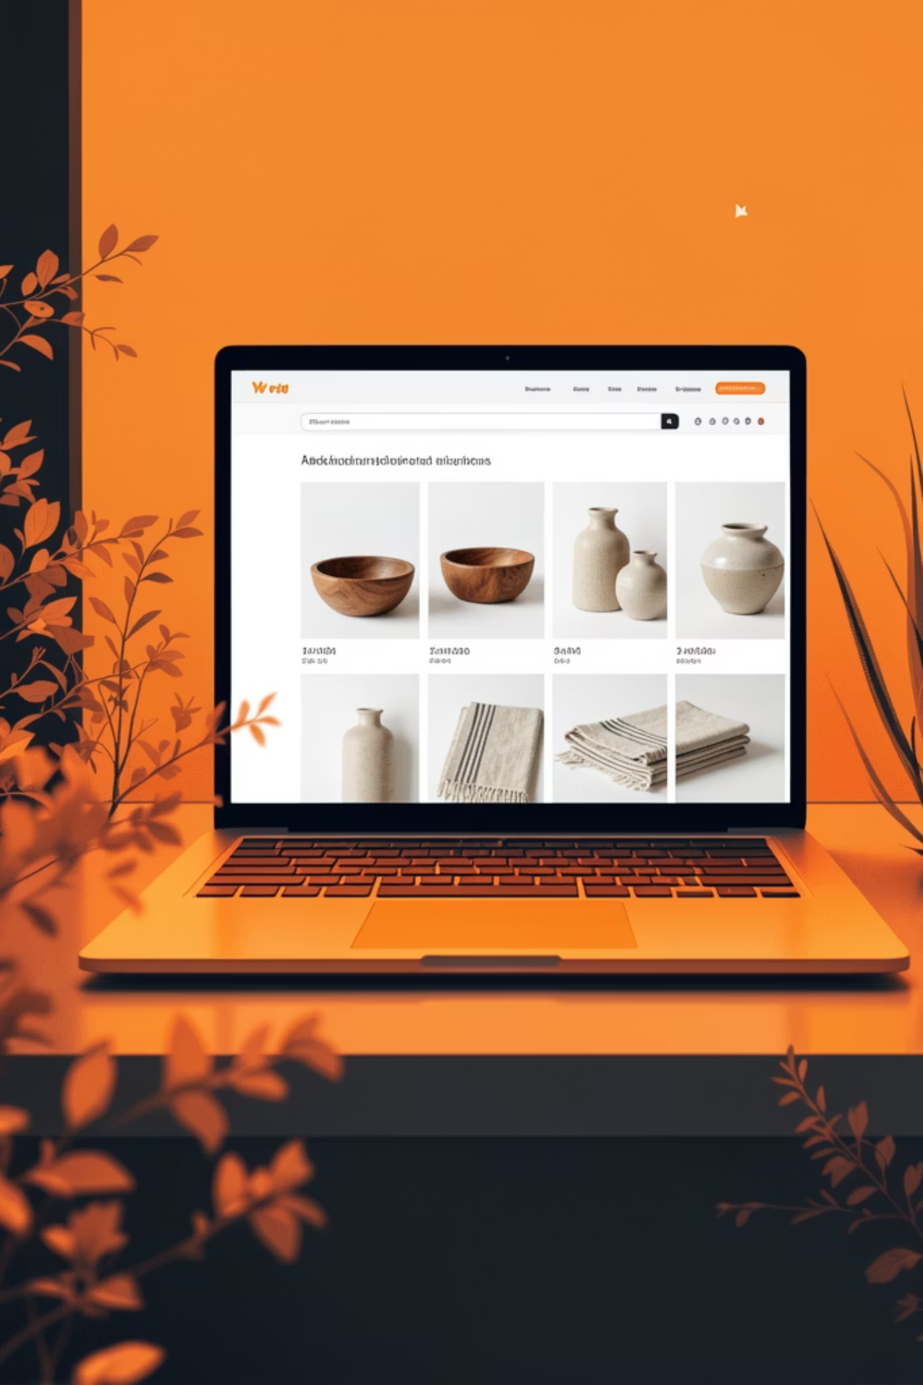
NORD – Modern E-Commerce Website
React + Bootstrap (Frontend) | Core PHP + MySQL (Backend)
Habiba Elsayed Salman - 30/3/2026

Slide 2
Project Idea
NORD is a modern e-commerce web application for Scandinavian-inspired homeware crafted from natural materials
Focuses on:
Clean UI
Simple shopping experience
Responsive design
Built as a real-world simulation of an online store

Slide 3

Design Concept
Minimal and modern layout
Grid-based product listing
Clear navigation
Cart icon with live item counter
Mobile-friendly using Bootstrap

Slide 4
Technologies Used
Frontend
Backend
React (Vite)
React Router
Bootstrap 5
Context API
Core PHP (no framework)
MySQL
REST-style PHP APIs

Slide 5
Key Features
Product listing page
Add to cart functionality
Cart quantity management (+ / − / remove)
Cart persistence using localStorage
Order summary with shipping logic
Responsive layout

Slide 6
Challenges Faced
1
Managing global cart state
2
Syncing UI updates across pages
3
Keeping cart data consistent
4
Handling quantity logic correctly
5
Fixing data structure bugs

Slide 7
Solutions
Used React Context API for cart state
Standardized cart item structure
Added defensive checks
Used Bootstrap utilities for layout
Stored cart in localStorage

Slide 8
Project Links
GitHub Repository: https://github.com/habiba-elsayed/nord.git
Live Demo : https://nord.free.nf/

Slide 9
Conclusion
Built a complete full-stack project
Used real production patterns
Project is scalable and deployable
Strong foundation for future features

