Slide 1
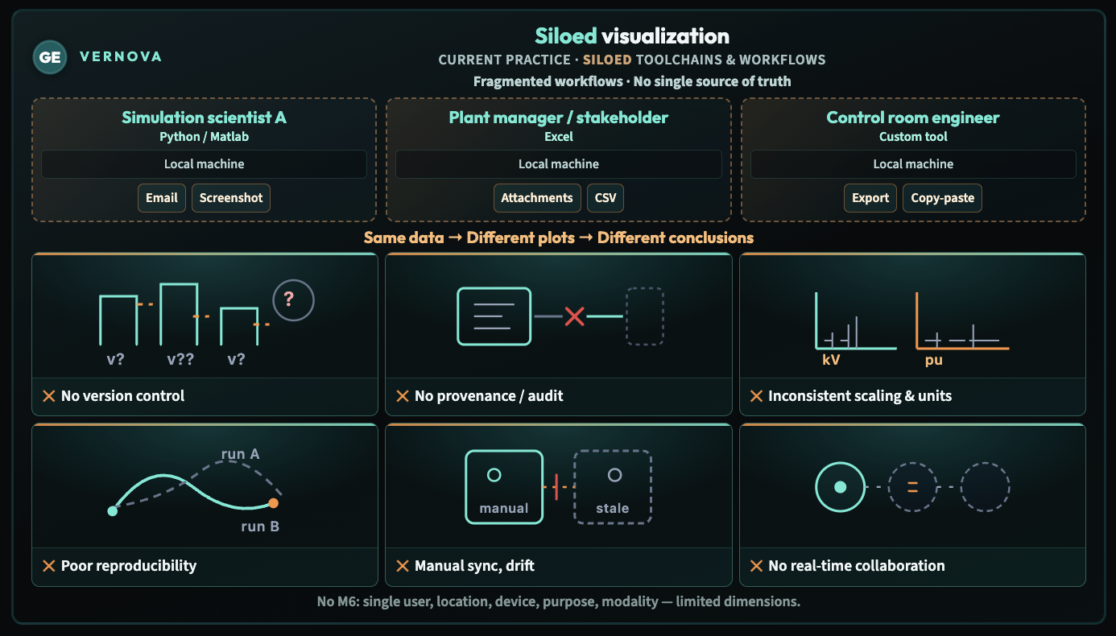
Notes:
Suggested narrative:
The current state of the art is that today, we have siloed visualization — in other words, current practice really is siloed toolchains and workflows spread across people who are all trying to decide something, which is why we end up with fragmented workflows and no single source of truth. Indeed, a simulation scientist A may live in Python / Matlab on a local machine and share by email or screenshot; separately, a plant manager / stakeholder may anchor the story in Excel, still on a local machine, passing attachments or CSV; and a control room engineer may rely on a custom tool, again local, and move data by export or copy‑paste — and that’s the everyday glue. When you add it up, you get what the slide says in one line: same data, different plots, different conclusions. Under that you see the consequences we’re naming out loud — no version control, no provenance / audit, inconsistent scaling & units, poor reproducibility, manual sync and drift, and no real-time collaboration — so we’re not pretending the pain is abstract. And that bottom line is deliberate too: today it’s no M6 — single user, location, device, purpose, modality — limited dimensions — which is exactly why the next slide has to be about breaking out of that box.

Slide 2
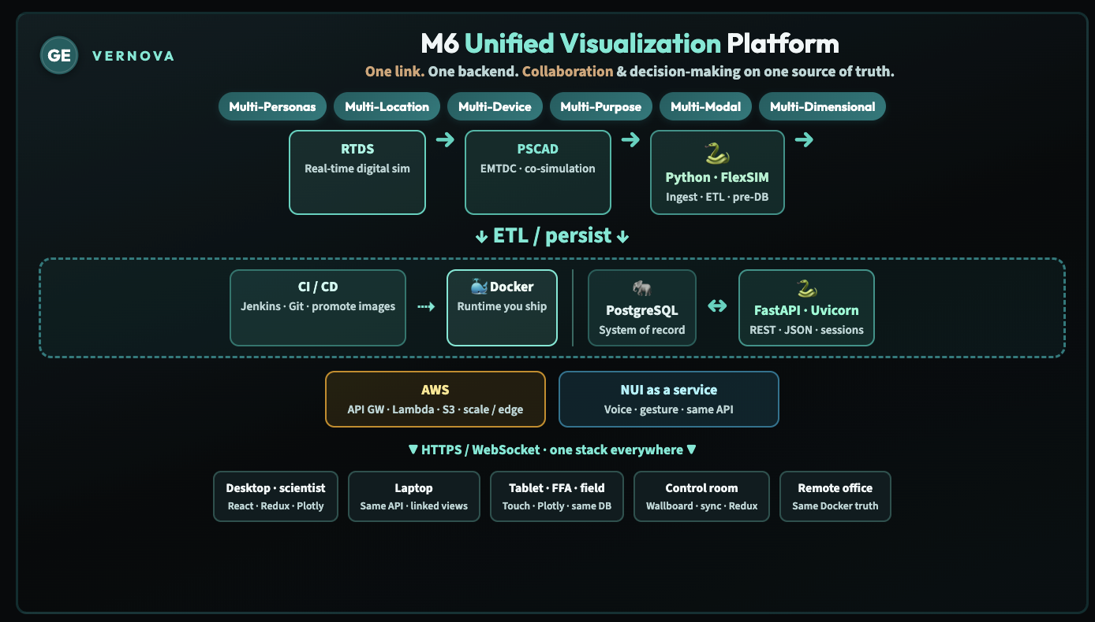
Notes:
We built M6 as the direct response to the siloed picture you just saw: one platform that unifies data and devices into a single system. What M6 encodes in practice is multi-persona / multi-user access, multi-device clients, use in multiple locations, and multi-dimensional presentation of the same underlying information—so we are not reconciling several local worlds after the fact. Multi-modality—voice, hand tracking, gesture recognition, eye tracking, and similar channels—is part of the forward path; today the emphasis is a shared analytical and visualization surface backed by one store. The stack is also deliberately multi-purpose: the dominant load today is simulation data, but the architecture is polymorphic in the sense that the same PostgreSQL foundation, running containerized on AWS, can support other domains without duplicating “official” views or forking the database. Operationally, that lets a simulation scientist present clearly to a stakeholder, and it lets an FFA or plant manager in a control room decide from data that the technical team has already exercised—same visualization layer, same plots, same scales, same form factors, same naming on the axes, same filters, same data-exploration context—so debate is about interpretation and risk, not about which file or screenshot happened to circulate.

Slide 3
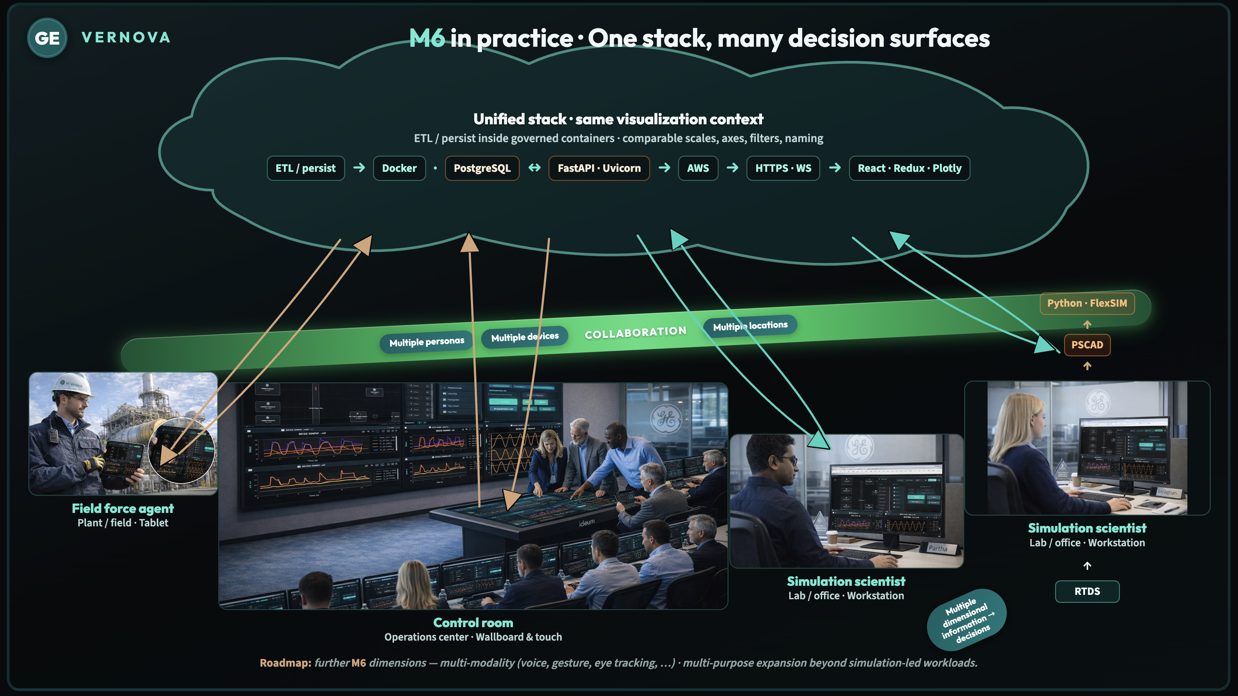
Notes:
Suggested Notes, speaking points:
operations, field, and lab still need the same truth, but they rarely share one visualization stack. Point to the cloud as the unified M6 backbone—ETL and persistence in governed containers, one API and web app pattern (FastAPI, React / Plotly), so everyone sees comparable scales, axes, filters, and naming. Walk the four decision surfaces left to right: field telemetry in, control room as the ops “surface,” then two simulation scientists—same role label on purpose—to show collaboration through the stack, not a separate tool per desk. Use the gold paths for field → cloud → control room (what happens in the plant surfaces in ops), and teal for scientists ↔ cloud ↔ scientists (models, data, and decisions shared, not siloed). Call out the collaboration strip (personas, devices, locations) as the human/organizational dimensions sitting on top of the same technical path, and the multi-dimensional cue as richer information turning into decisions—especially toward the lab-to-lab thread. Close with the roadmap line: this isn’t the end state—multi-modality and multi-purpose growth are the next horizon for M6.

Slide 4
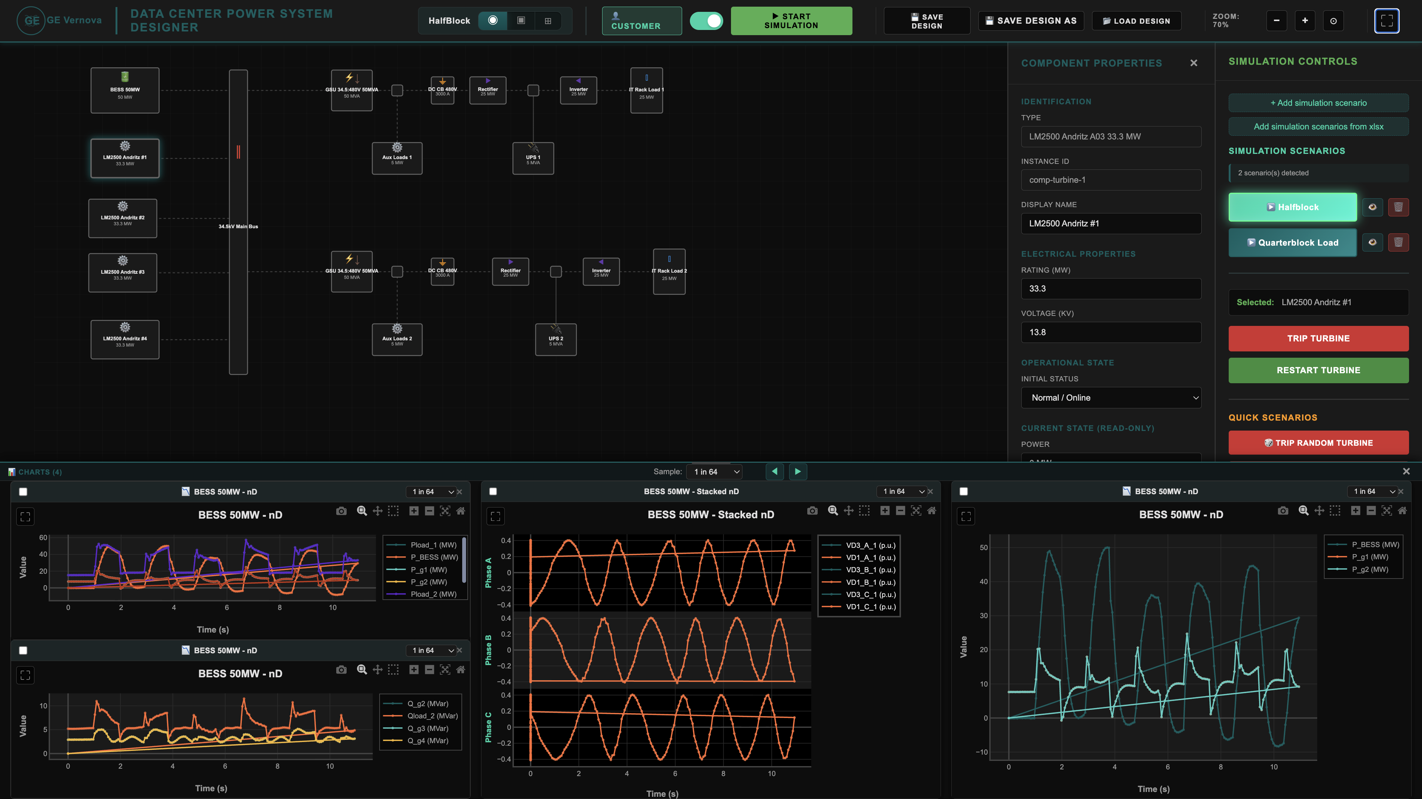
Notes:
Explaining difference between customer mode and designer mode, and the different modalities of stacked graphs

Slide 5
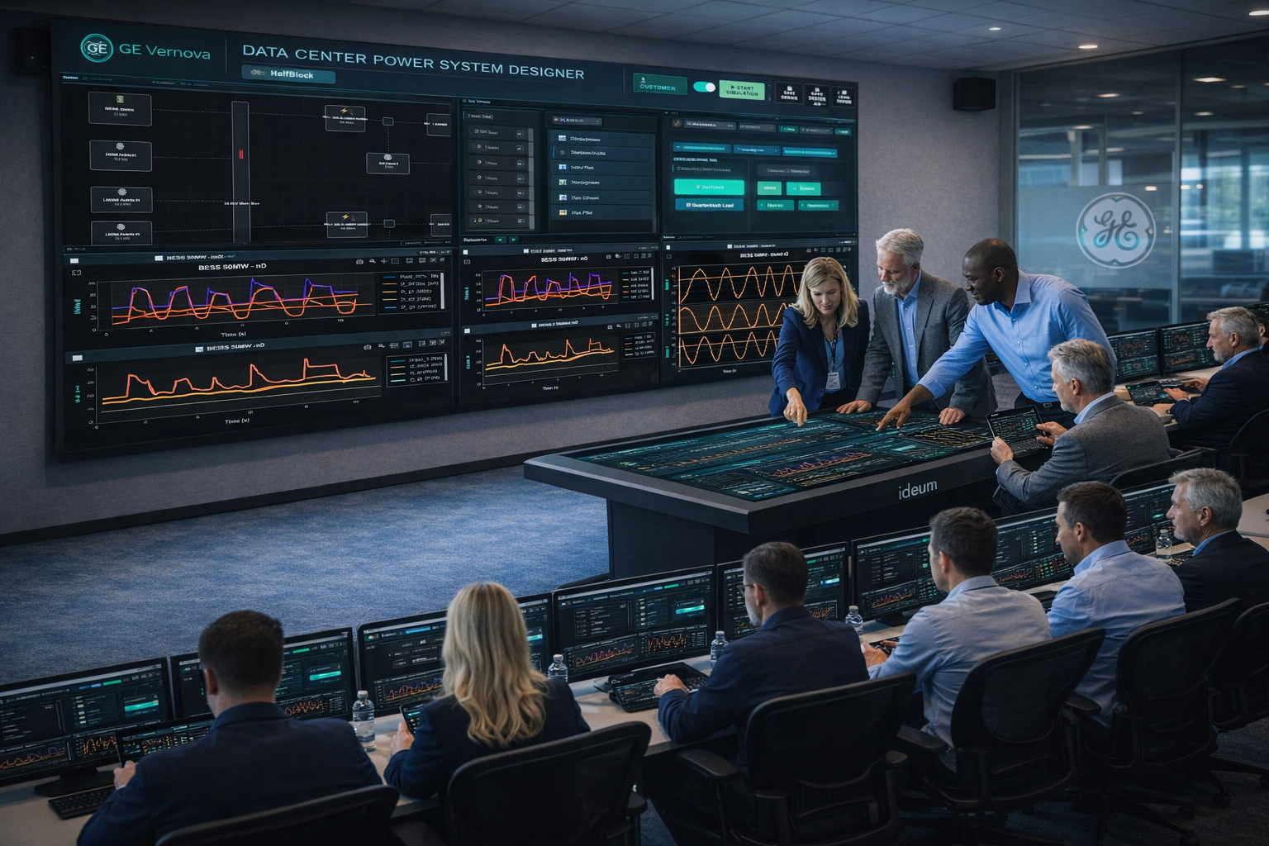

Slide 6
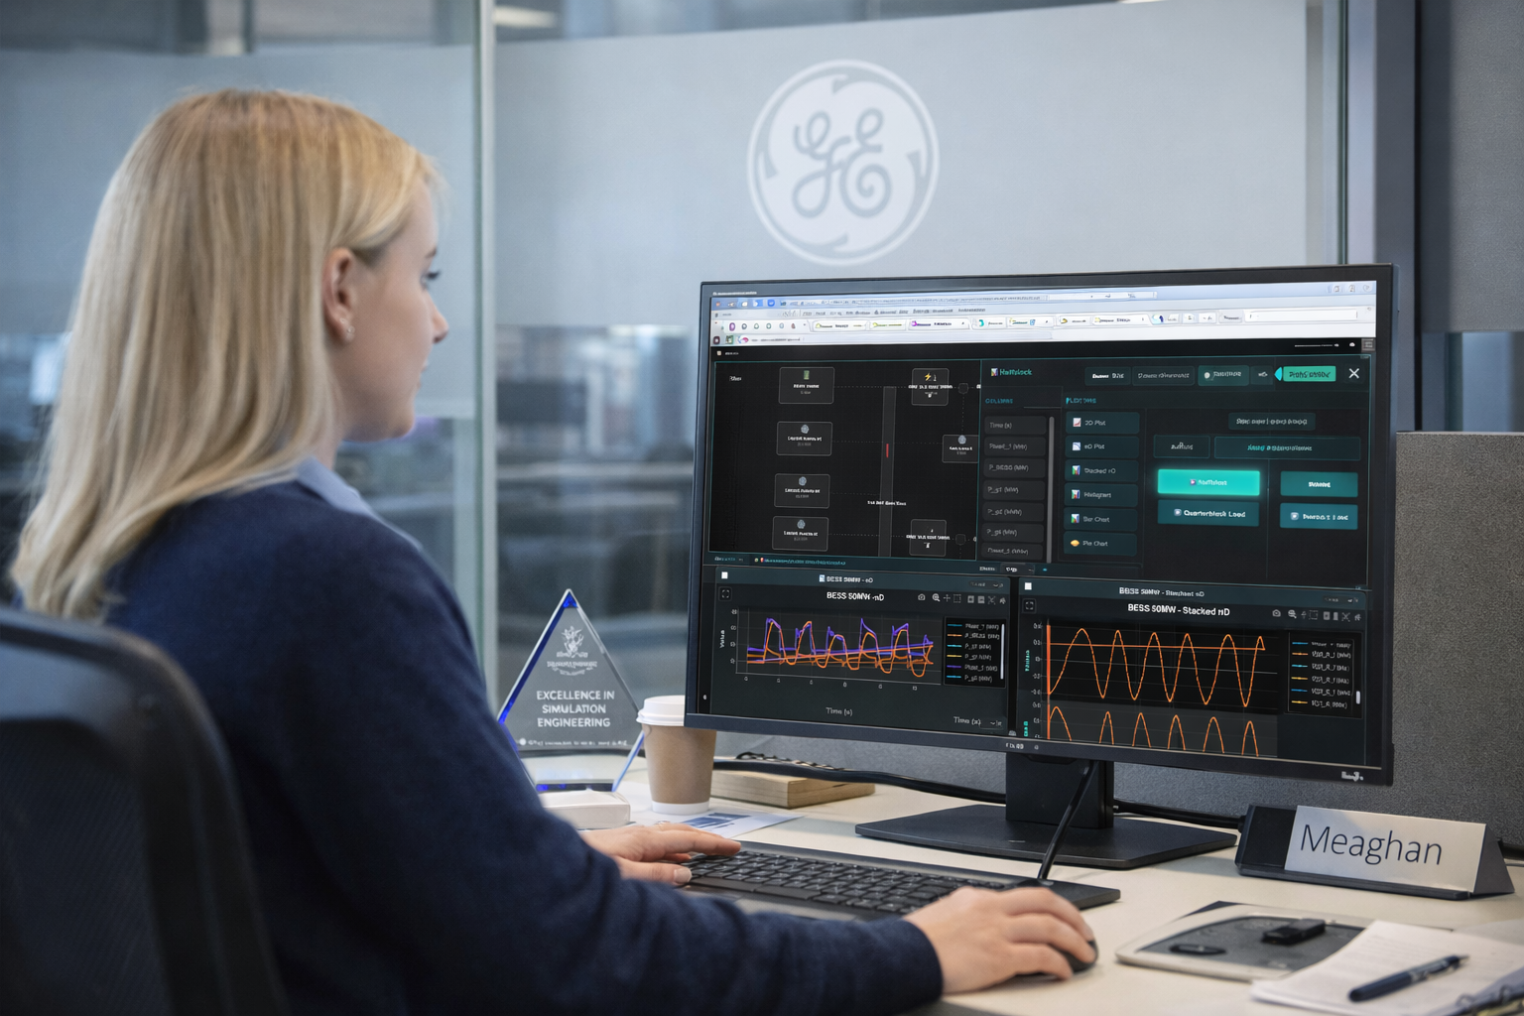

Slide 7
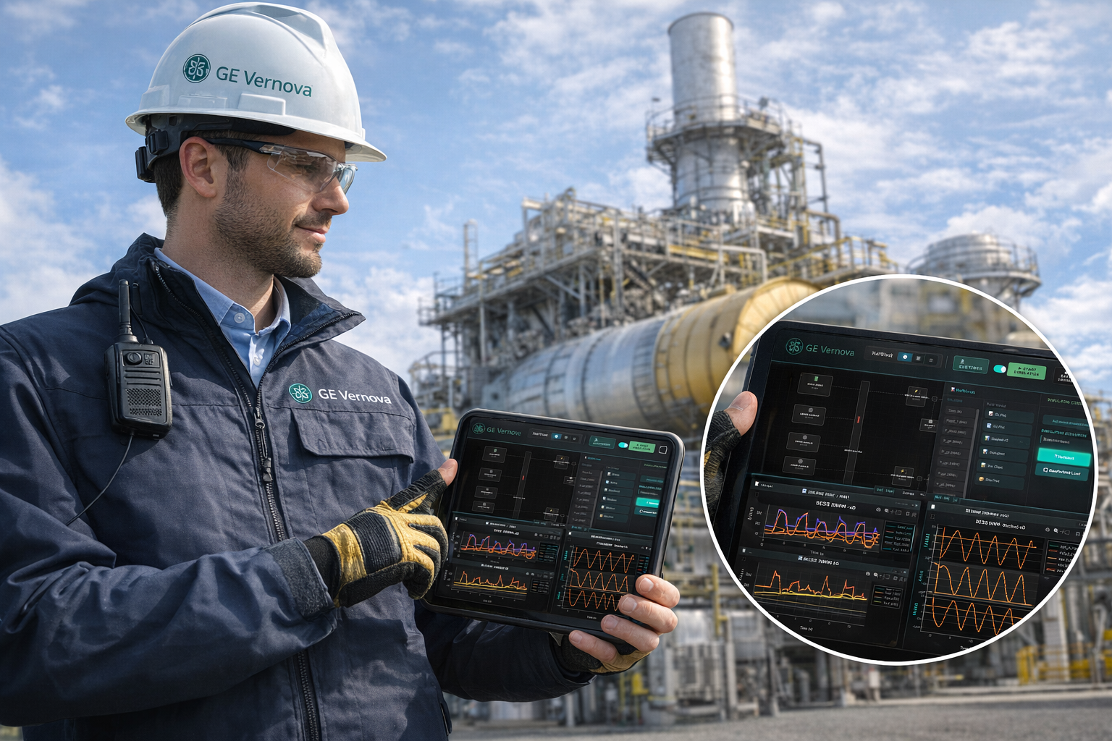

Slide 8
