Slide 1
200MW Round-the-clock power plant
2026-10-15

Slide 2
REVISIONS
Date | Note
2026-10-15 | 1st version, with Charu’s CAPEX values ($1650/kW_{ac} for Solar, $2000/kW for Wind, $3000 for LM2500) and hourly Badger Hollow Creek Wind Resource data.

Slide 3
DISCLAIMER NOTICE
This study is based on plant hourly plant operation simulation.
This study is not a substitute for a power system analysis.
This study is not a substitute for Wind Resource Analysis (WRA).
Equipment/system availability calculation is out of the scope for this study.
Redundant equipment unit calculation is out of the scope for this study.
The study is limited to evaluate maximum 2 different types of gas turbines together in individual configuration.
This study is not binding; and does not create any obligations on the part of GEV company or any of its affiliates. The recommended products or system design and budgetary pricing, contained in this Study, are subject to change, including, without limitation, as additional information comes to the attention of GEV.
Load Compliance Factor (LCF)
For individual hour:
  If plant output exactly meets load demand, LCF=1.
  If plant output fails to meet load demand, LCF =0.
Average a year’s 8760 hours’ LCF for the year to get annual LCF.

Slide 4
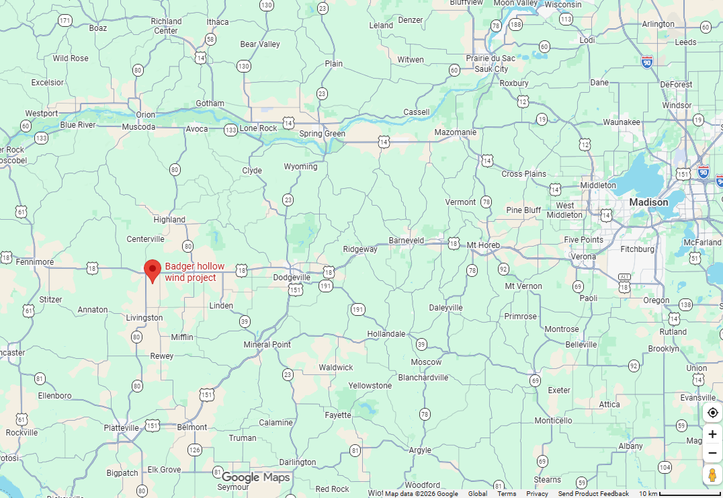
Hybrid Power Plant for 200MW Round-the-Clock Load
Wind + Solar + BESS + LM2500
Location: Badger Hollow Wind Farm (Dodgeville, WI)
Control Mitigations
EMS
Gas Generation
Solar Generation
BESS
Data Center
Architecture & Design Space: (Islanded)
Wind: 0 ~ 1000MW
Solar: 0 ~ 1000MW
BESS: 0 ~ 1000MW (4hr)
LM2500*: 0~ 7 units
Wind Generation
Islanded
* Notes on GTs.
LM2500:
  Nameplate**: 32MW
  Eff%**: 36.7%
**: Nameplate & eff% @ ISO condition (15°C, 1Bar)

Slide 5
Model Assumptions
Financial assumptions:
  70% debt @ 6% w/ 15yr tenor;
  30% equity @ 10% hurdle rate
  Project lifetime: 20 yr.
  Residual value @ project end: 0%
  Depreciation:
    5yr MACRS for Wind/Solar/BESS.
    15yr linear for GT.
  Inflation: 2.5% y/y.
  Federal tax: 21%
  State tax: 7.9% (WI)
  Subsidy:
    30% ITC for BESS.
    No PTC for Wind
    No ITC for Solar.
CAPEX assumptions : .
  Wind: $2000/kW.
  Solar: $ 1650/kW_{ac} @ DC/AC=1.4
  BESS: $238/kWh.
  LM2500: $3000/kW.
  Substation/BOP: $10M
OPEX assumptions (adjust w/ inflation yr over yr):
  Wind O&M: $18/kW/yr.
  Solar: $7.05/kW_{ac}/yr
  BESS O&M: $13/kw/yr.
  GT O&M: $15/ kW_{ac}/yr fixed, $10/MWh variable.
  NG: $3.5/MMBTU.

Slide 6
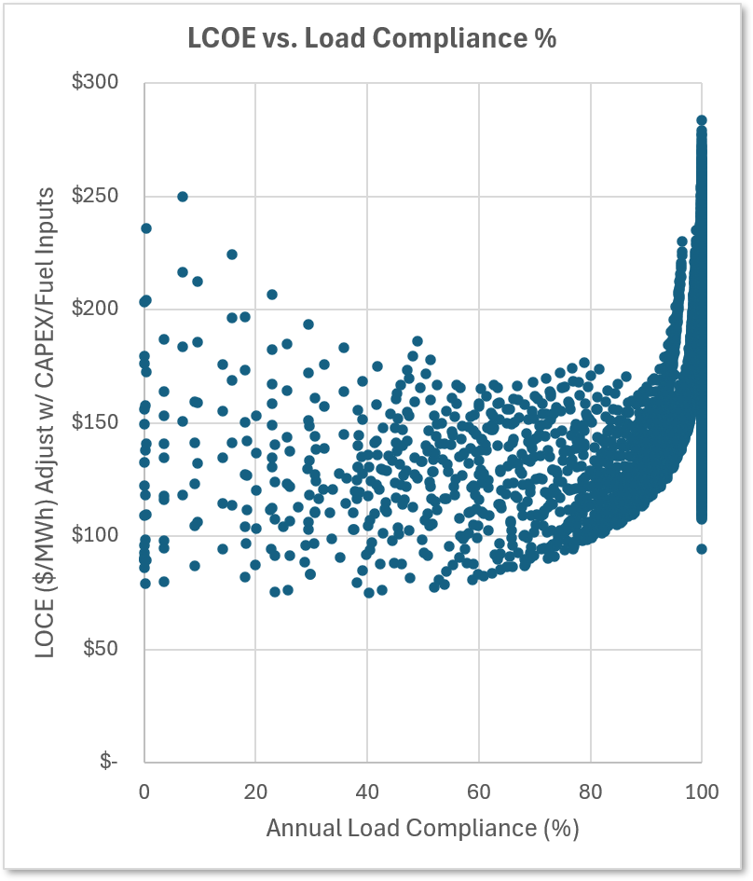
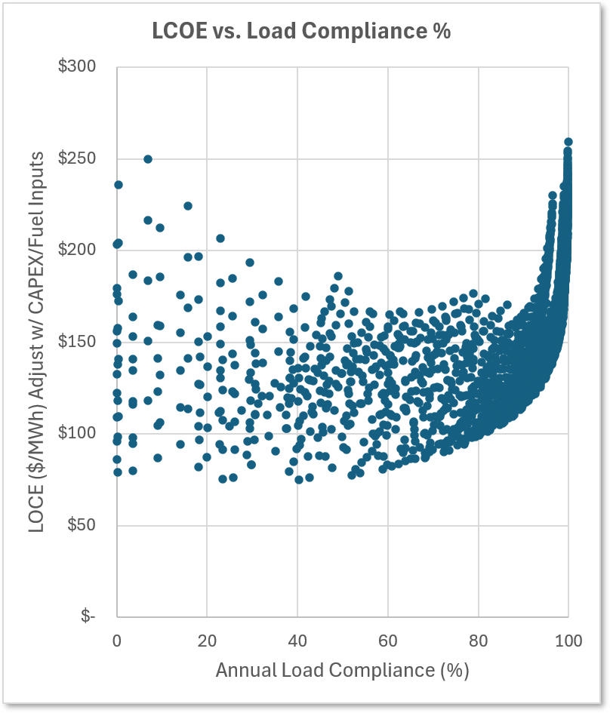
LCOE vs. Plant Load Compliance
Plot for All the Configurations
Plot for Renewable Only Configurations (no GT)

Slide 7
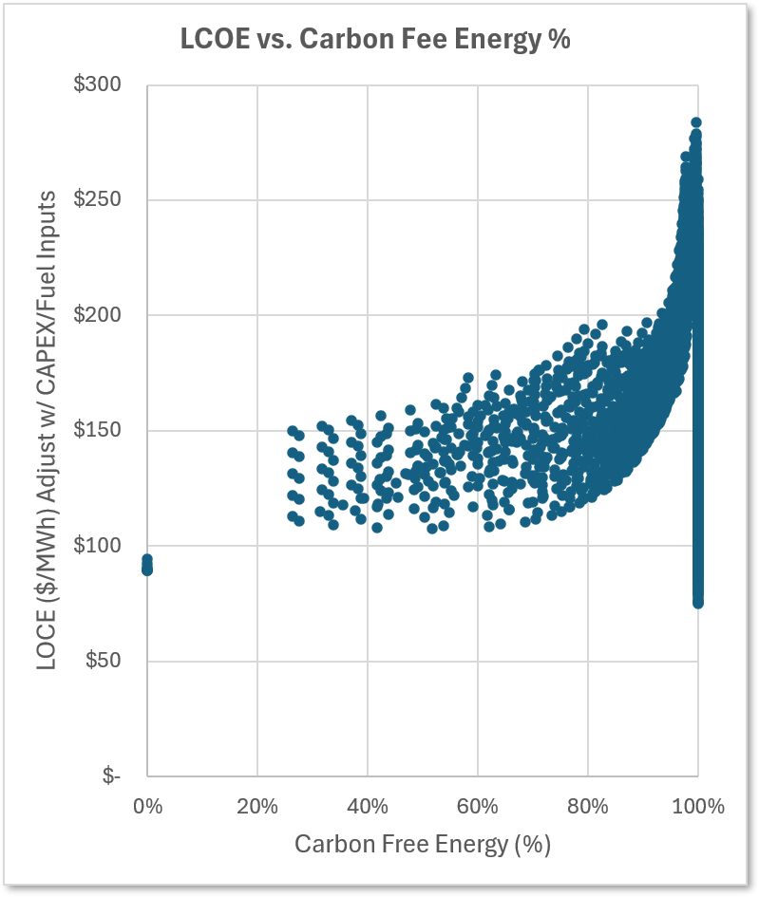
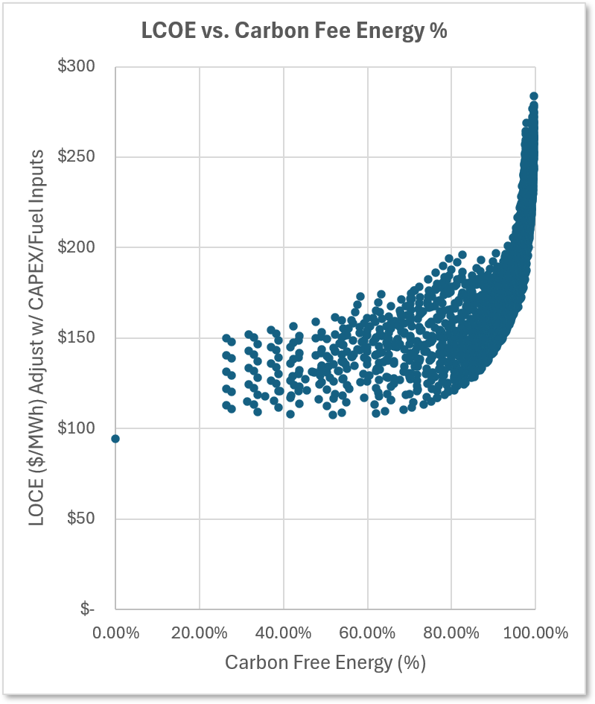
LCOE vs. Carbon Free Energy %
Plot for All the Configurations
Plot for 100% Load Compliance Configurations

Slide 8
Renewable Only Configuration with 100% Load Compliance
  Amount all the 4139 configurations analyzed, no renewable only configurations (on GT) has load compliance of 100%.
  The highest load compliance that renewable only configurations can provide is 99.87% with LCOE of $259/MWh. This Renewable Only configuration has:
    1000MW_{ac} Solar
    1000MW Wind
    1000MW 4000MWh BESS
  Please note that the analysis does not consider equipment availability/reliability and is based on only 1 year hourly Wind Resource data and on Typical Meteorological Year hourly Solar Resource data (P50).

