Slide 1

System Analysis Sec_2 git Tool
Pre bared By
Eslam Ahmed Yassin

Slide 2

Review _ Last _ Section (VCS)
What is Problems Without VCS ?
What is VCS ?
What is The Benefits of Using VCS ?
What is Type of VCS ?
What is Git Tool and History ?

Slide 3
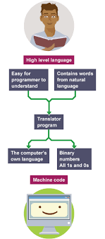
The Programmer Area

Slide 4

CLI : Command Line Interface
The command line is a text-based interface used to interact with a computer. Instead of using a graphical interface (like clicking icons and menus), you type commands to perform tasks.
Key Features:
Allows you to execute programs, manage files, and configure system settings.
Uses a shell, such as:
Command Prompt (cmd.exe) – Windows
PowerShell – Windows
Terminal (Bash, Zsh, etc.) – macOS & Linux
Commands follow a specific syntax and can include options/arguments

Slide 5
CLI _ Review
Navigating Directories
ls (Linux/macOS) / dir (Windows) – List files in the directory
pwd – Print the current working directory
Creating and Removing Directories
mkdir <directory> – Create a new directory.
rmdir <directory> – Remove an empty directory.
Change directory
cd <directory> – Change directory.
cd .. (move up one directory)

Slide 6
Task:
You need to create a folder, move into it, create a file inside, and then delete everything.
Step 1: Create a Folder
Step 2: Move Into the Folder
Step 3: Check the Contents
Step 4: Move Back and Delete Everything
You See The Problem
I can’t See What Happen Here

Slide 7
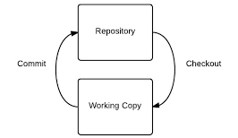
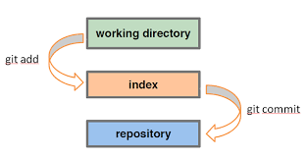
Git Architecture

Slide 8
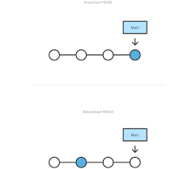
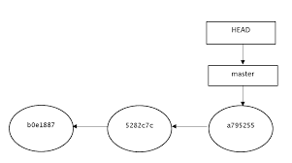
Git Head Architecture

Slide 9
Git Basics
Configure and initialize a repository
Begin and stop tracking files and stage and commit changes
Set up Git to ignore certain files and file patterns
Undo mistakes quickly and easily
Browse the history of your project
View changes between commits
Push and pull from remote repositories

Slide 10
First-Time Git Setup : Open Terminal Emulator (git Bash)
Identity
git config --global user.name “example“
git config --global user.email example@example.com
Undo
git config --global --unset user.name
git config --global --unset user.email

Slide 11
Task:
You need to create a folder, move into it, create a file inside, and then delete everything.
Step 1: Create a Folder
Step 2: Move Into the Folder
Step 3: Check the Contents
Step4:create Any Files That You Want To Track
You See The Problem
Initialize Now VCS
Getting a Git Repository
Initializing a Repository in an Existing Directory
->git init

Slide 12
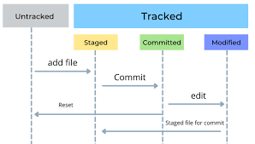
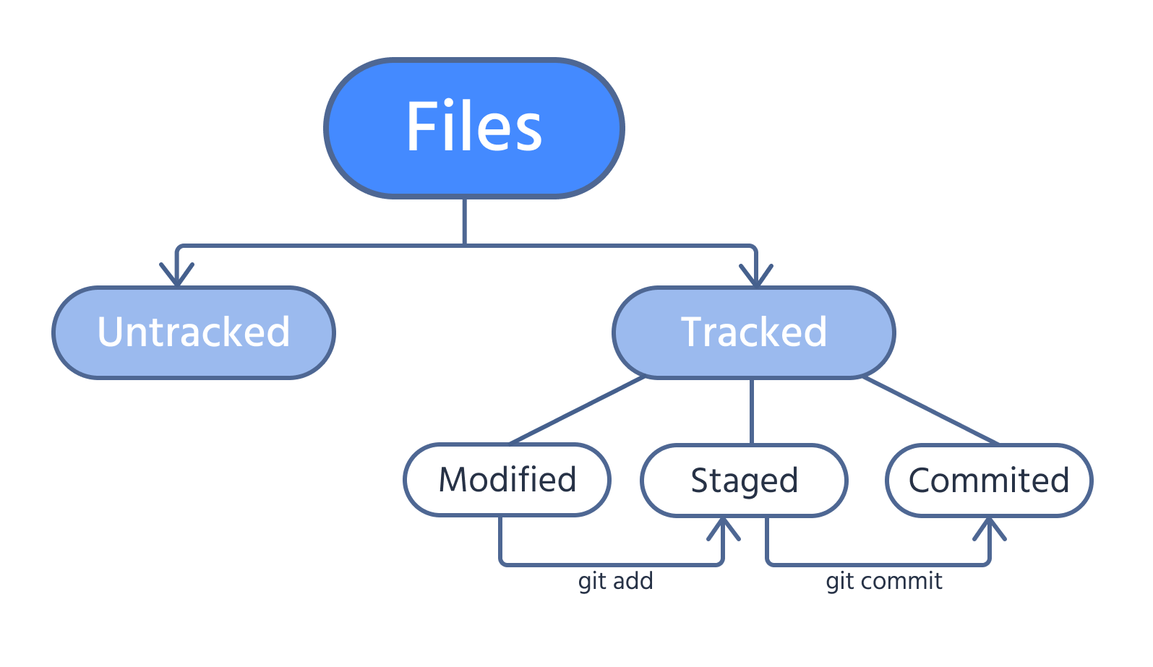
Tracked VS Un Tracked

Slide 13
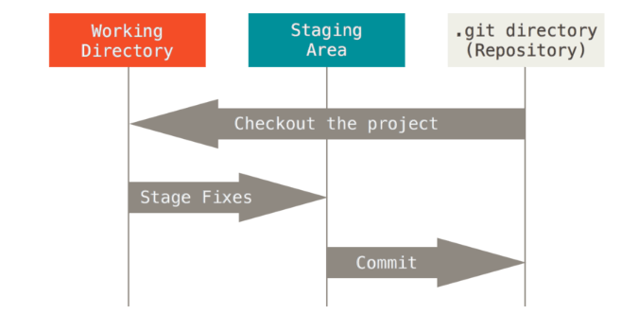
Files Can Be In One Of Three States After Being Added To Repo
Staged - Files are marked for committing (the snapshot)
Modified - Staged files have been modified, but not committed
Committed - Snapshot taken, file states stored to local database
Checking the Status of Your Files : ->git status
->git status -s
Task
Set up Git to ignore certain files and file patterns

Slide 14
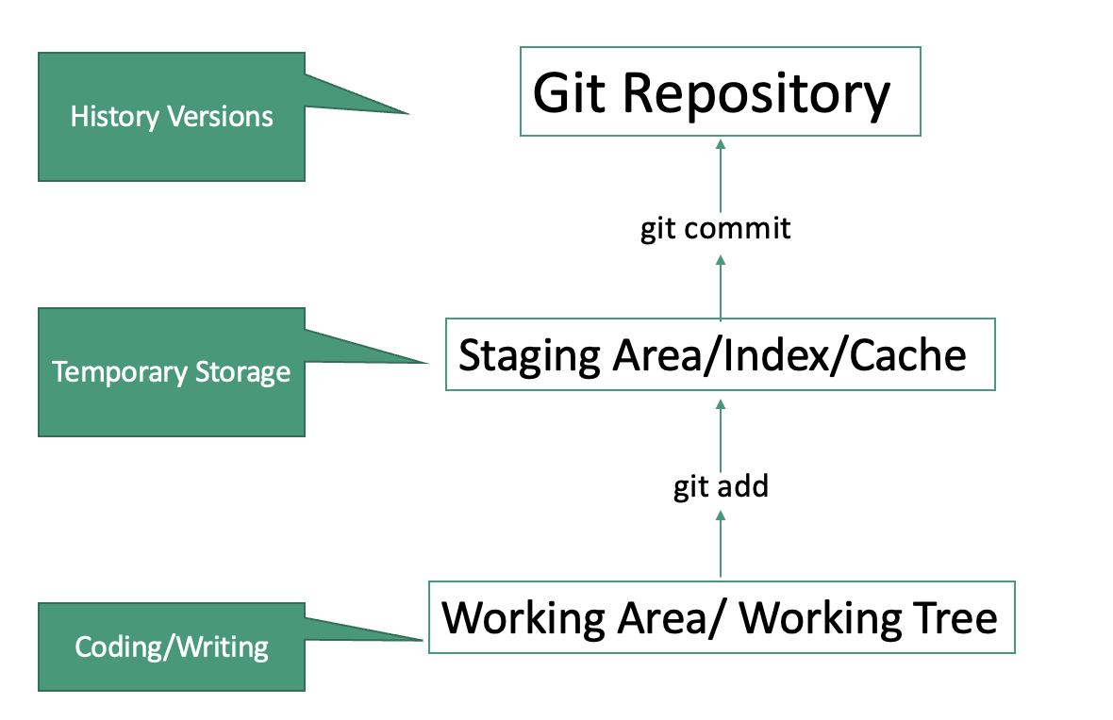
Follow The Files
Tracking New Files :
->git add filename (single folder)
2.Tracking Files :
-> git add . Or * Or -A
Undo
1-Un Tracking New Files :
->git reset filename
2.Un Tracking Files :
-> git reset

Slide 15
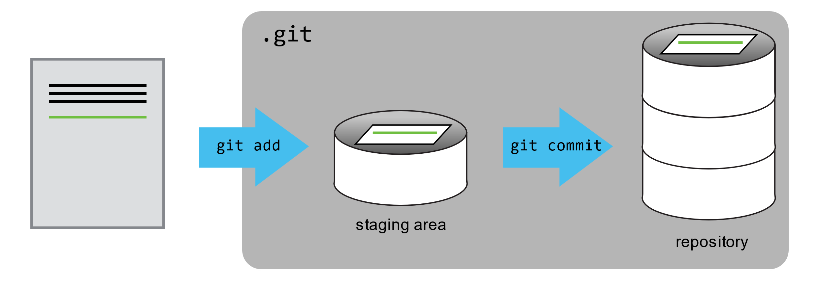
Git commit
Now we are ready to commit our first changes. Commit is similar to saving a file, but in addition to saving the contents of a file, git commit stores information about the file’s history, including what changes were made, when, and by whom
Files ready for commit will appear in green.
🡪git commit -m "Descriptive commit message"
Undo
Give me Your opinion

Slide 16
Viewing Changes in Git
Check Un staged Changes
To see what has changed in your working directory but is not staged yet:bash
🡪git diff
2. Check Staged Changes (Before Commit)
To see the differences between staged changes and the last commit:
🡪 git diff --staged
3. Compare Two Commits
To see what changed between two commits:
🡪git diff <commit1> <commit2>

Slide 17
Viewing the Commit History
Very simple!
🡪git log
If You want to brief History :
🡪 git log -- one line
This displays:
Commit hash (SHA)
Author
Date
Commit message
View Recent HEAD Changes
Show history of HEAD changes 🡪git reflog

Slide 18
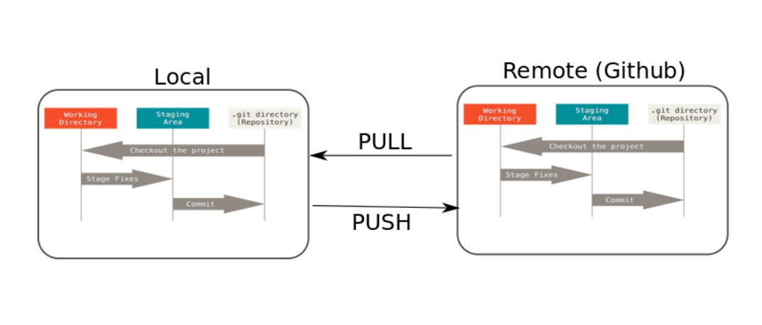
The Three File States continued
Repository snapshots are transferred between local and remote sessions using push and pull command
Task :
How to work Remote
Push and pull from remote repositories(Local Data Base )

Slide 19

Thank You
Task :
Can We use git to track Image and Videos ?

