Slide 1

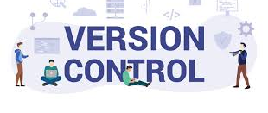
System Analysis Sec1
Prebared by Eslam Ahmed Yassin

Slide 2

What is problem ? A folder without version control refers to a directory or project that is not tracked by any version control system (VCS) like Git, SVN, or Mercurial. Here’s what that means: No Tracking of Changes: The files in the folder are not being tracked for any changes, so if you make modifications, the system won't record them. No History: There's no history of previous versions of the files. If something breaks, you can't easily go back to an earlier version. No Collaboration: It's difficult to work with others on the same project because there's no system to track and manage changes made by multiple people. No Backup: If your files are not tracked under version control, you won't have an easy way to back them up or roll back changes

Slide 3
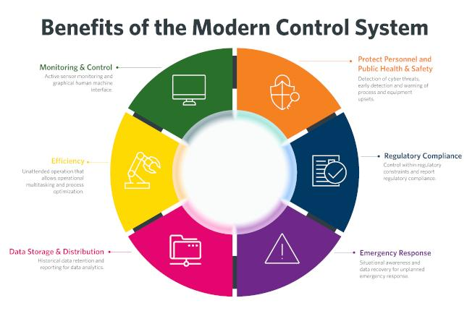
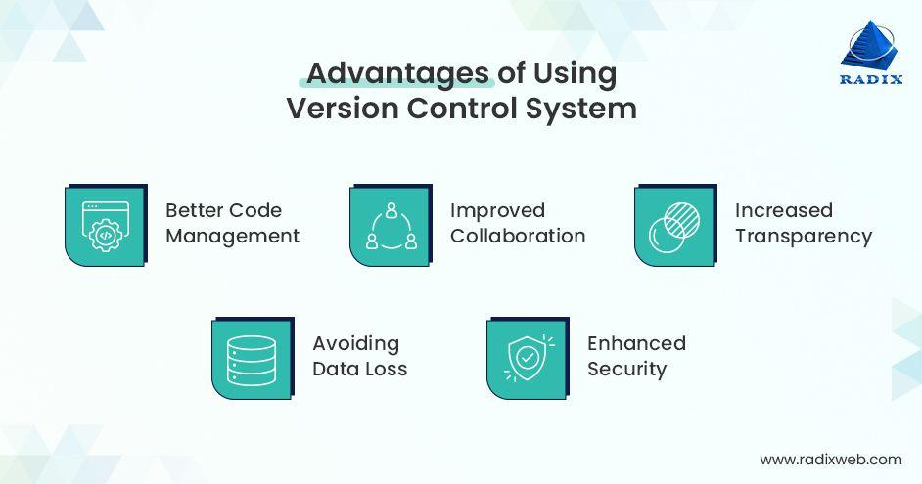







What is a “version control system”?
Version control systems are a category of software tools that helps in recording changes made to files by keeping a track of modifications done in the code.
ENHANCED COLLABORATION
SPEEDS UP DEVELOPMENT BY ENABLING EFFICIENT TEAMWORK.
INCREASED PRODUCTIVITY
:IMPROVES COMMUNICATION AND SUPPORT, EXPEDITING PRODUCT DELIVERY.
ERROR REDUCTION
:TRACKS EVERY CHANGE, REDUCING ERRORS AND CONFLICTS.
REMOTE WORK
:ALLOWS CONTRIBUTORS TO WORK FROM ANY LOCATION.
ISOLATED CHANGES:
EACH CONTRIBUTOR'S CHANGES ARE ISOLATED UNTIL VALIDATED AND MERGED.
DISASTER RECOVERY:
HELPS IN RECOVERING FROM ANY MISHAPS.
DETAILED TRACKING:
RECORDS WHO MADE CHANGES, WHAT CHANGES WERE MADE, AND WHY.

Slide 4
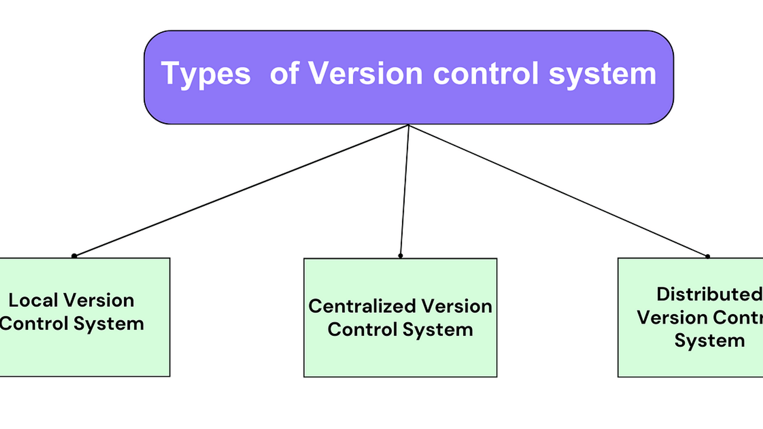
Version control systems (VCS) are tools that help track and manage changes to files over time.
There are several types of version control systems, each with its own approach to handling file revision

Slide 5
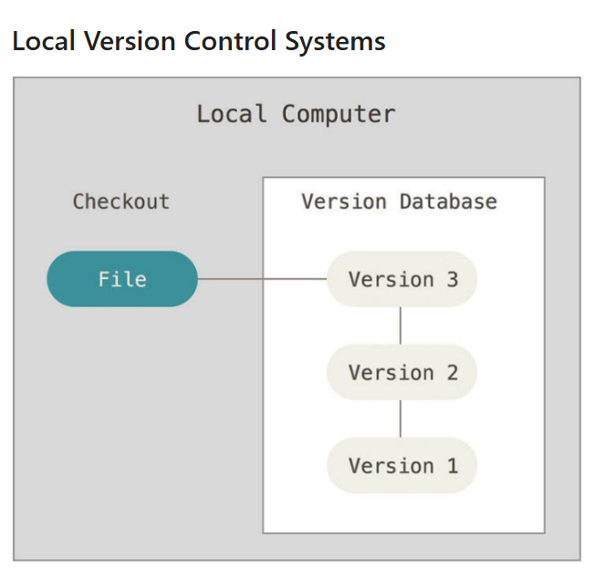
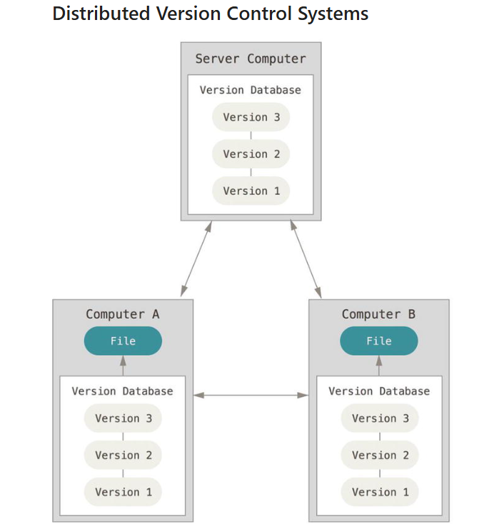
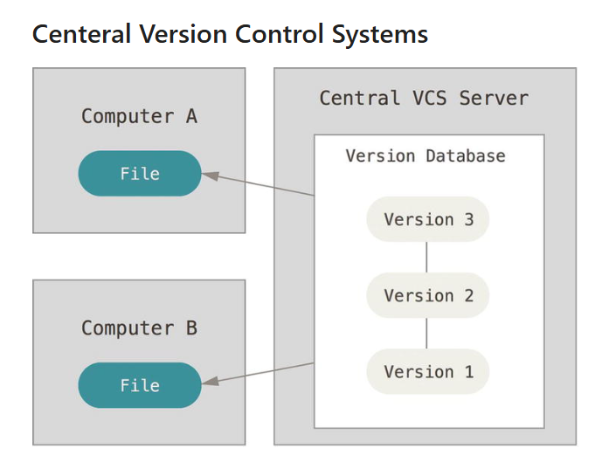
Local Version Control System
Tracks changes on a single machine.
Example:
RCS (Revision Control System).
Distributed Version Control System (DVCS)
Each user has a full copy of the repository, allowing offline work.
Example: Git, Mercuria
Centralized Version Control System (CVCS)
Uses a central server where all versions are stored.
Example: SVN (Subversion), Perforce.

Slide 6

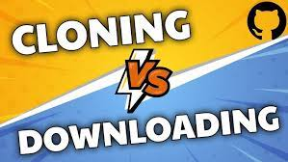

Download Vs clone
When you clone a repo, you make a copy of the complete history of the git repo including the . git folder (we learned in the earlier lesson). When you download the repo.
you just download the source files of the most recent commit of the default branch without the . git folder
Download:
Saves a static copy of files.
Clone:
Creates a version controlled copy with Git history

Slide 7
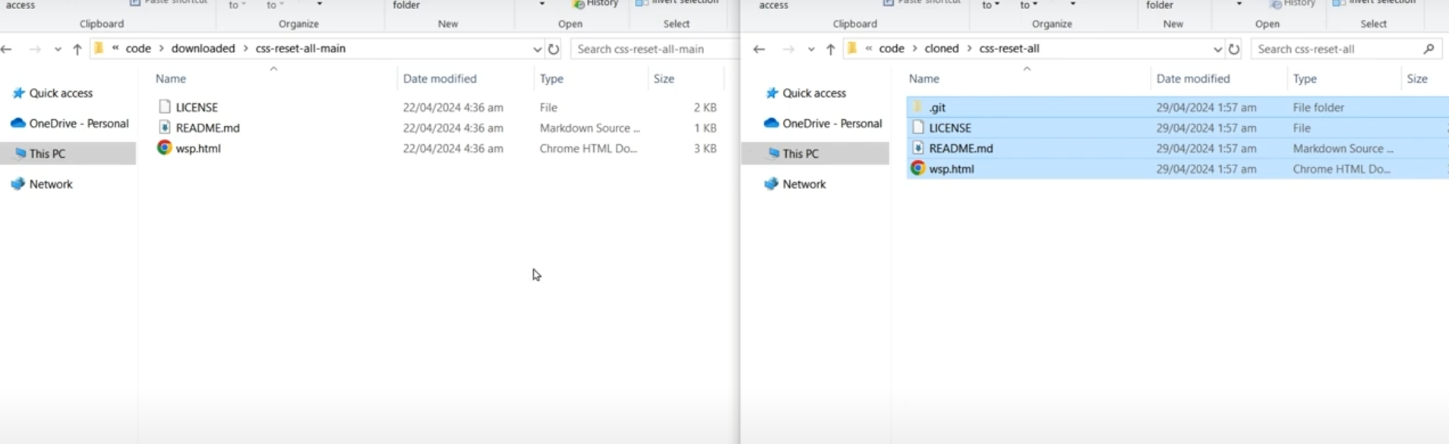
Link you tube :
https://www.youtube.com/watch?v=2IGNpFvNlJ4

Slide 8
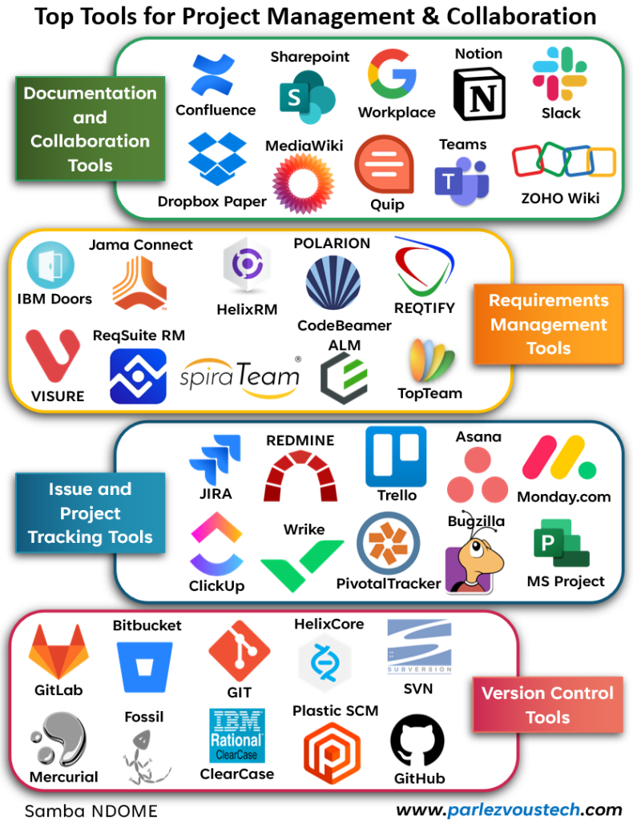

Slide 9
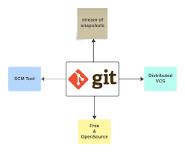
Welcome To Global Information Tracker(git).
Source code management (SCM) is used to track modifications to a source code repository

Slide 10

History of Git:
In the early 2000s, Linux used a version control system called Bit Keeper to manage the Linux Kernel source code. However, in 2005, Bit Keeper, a commercial tool, stopped being available for free to open-source developers. This caused a crisis for the Linux project, as many developers relied on it.
Faced with this problem, Linus Torvalds decided to quickly create a new version control system to manage the large and complex Linux codebase, leading to the creation of Git.

Slide 11
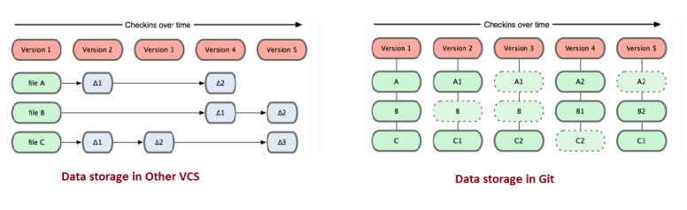
Why Git ?
So, Git is one such kind of open source Distributed Version Control System, developed by Linus Torvalds. Following are few reasons why Git is the most popular repository now a days.
Stores not only the Delta, but the Whole File :- Other version control systems, do use a file-based and file modification-based storage system. So, each revision is composed of a list of differences for each modified file, i.e the deltas of the files. Whereas in Git, the whole file is stored. Each revision in Git is like file system. In each new revision, the modified files are copied, and the files that are not modified, are linked with the previous revision. So below diagram illustrates the difference clearly

Slide 12
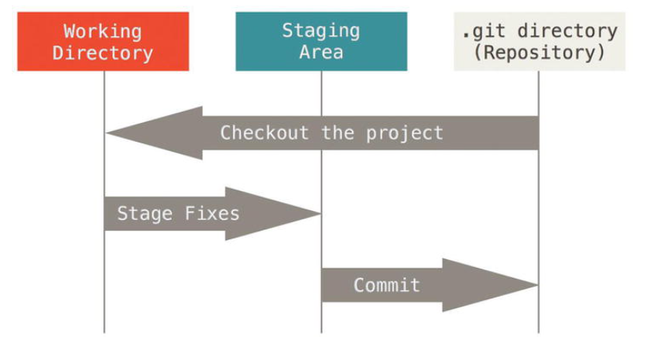
Git's Characteristics
Nearly Everything is Local
Git performs most operations locally, unlike centralized VCS that require constant server interaction.
Developers can commit, create branches, and view history without an internet connection.
Git Has Integrity
Every file and commit in Git is secured with SHA-1 hashing, ensuring data integrity and preventing corruption or accidental modification.
Git Generally Only Adds Data
Git is designed to append-only in its internal database. Once committed, data is never lost unless explicitly removed.
This makes history tracking and rollback easier and safer.
The Three States in Git
Modified → Files are changed but not yet staged.
Staged → Files are marked to be committed.
Committed → Files are safely stored in the Git database.

Slide 13
Key Git Keywords & Their Meanings
Repository (Repo) – A collection of files and their history tracked by Git.
Commit – A snapshot of changes recorded in the repository.
Branch – A separate line of development within a repository.
Merge – Combining changes from different branches.
Clone – Copying a remote repository to a local machine.
Pull – Fetching and merging changes from a remote repository.
Push – Sending local commits to a remote repository.
Fetch – Downloading changes from a remote repository without merging.
Reset – Moving HEAD and branch pointers to a previous commit.
Revert – Undoing a commit by creating a new commit.
Checkout – Switching between branches or commits.
HEAD – A reference to the current branch and commit.
Staging Area – Files prepared for commit but not yet committed.
Remote – A version of the repository hosted online (e.g., GitHub, GitLab).
Diff – Showing differences between files or commits.
Tag – A reference to a specific commit, often used for releases.
Conflict – Occurs when Git cannot automatically merge changes.
Fork – Creating a personal copy of a repository on a remote platform.
Rebase – Reapplying commits on top of another base commit.
Blame – Identifies who made changes to each line of a file.

Slide 14
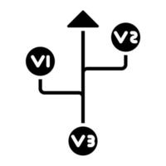
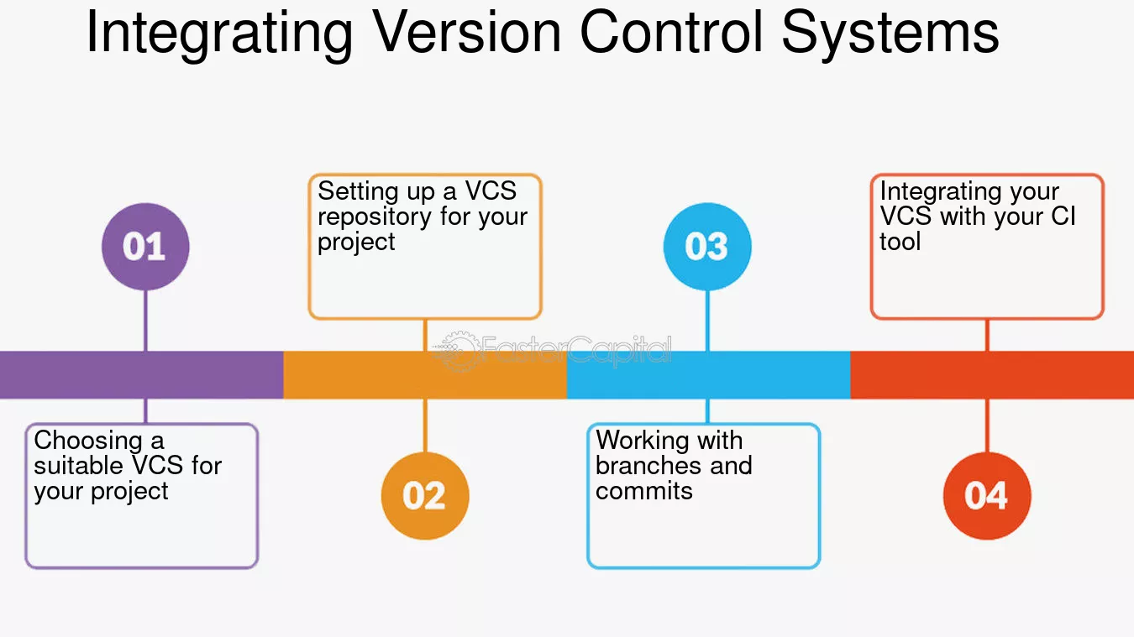

Slide 15

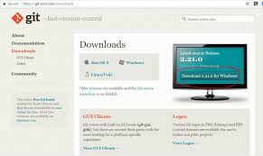
Installing git
https://git-scm.com/downloads

Slide 16
Thank You
Task
Search about git Archticture

