Slide 1

Smart Home Automation System

Slide 2

overview
The goal of this smart home project is to enhance residential security, safety, and convenience through the integration of multiple sensors and actuators. By using advanced technology.

Slide 3
Overview of the Smart Home Automation System
This smart home automation project integrates various advanced technologies to create a highly functional and secure living environment. The system utilizes a keypad for secure access control, triggering a buzzer after three incorrect password attempts to alert users of potential security breaches. IR sensors detect motion near entry points, activating LED lights to enhance visibility and security. Gas sensors continuously monitor for hazardous leaks, with a buzzer sounding to ensure immediate safety.

Slide 4
Advanced Features and Integration
he LDR sensor adjusts lighting based on ambient light levels, turning on LEDs when the environment is dark. Water sensors manage window operations based on rain detection, closing windows during adverse weather to prevent water damage. All these components are seamlessly integrated and controlled through Firebase for real-time data management and a Flutter app that allows users to monitor and manage the system from their mobile devices. This comprehensive approach enhances home security, safety, and automation, providing a smarter and more convenient living experience.

Slide 5
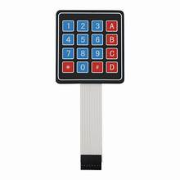
1) Keypad
Function: Allows users to enter a password for access control.
Alert: Buzzer sounds after 3 incorrect attempts.

Slide 6
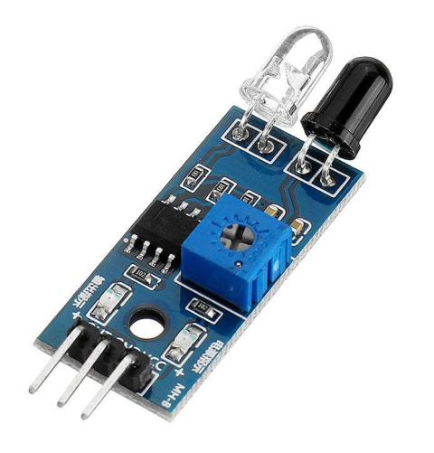
2) IR Sensor
Function: Detects motion near the door.
Action: Lights up an LED when movement is detected.

Slide 7
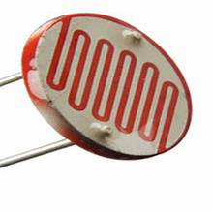
3) LDR Sensor
Function: Measures ambient light levels.
Action: Activates the LED when the environment is dark

Slide 8
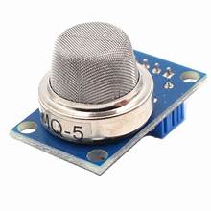
4) Gas Sensor
Function: Monitors for gas leaks.
Alert: Triggers the buzzer if a leak is detected.

Slide 9
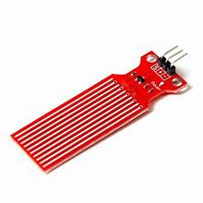
5) Water Sensor
Function: Detects rain or water presence.
Action: Controls window opening or closing based on rain detection.

Slide 10
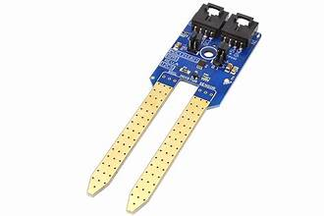
6) Soil Sensor
Function: Measures soil moisture levels.
Action: Activates the water pump if the soil is too dry.

Slide 11
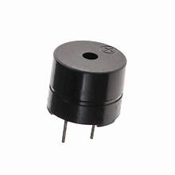
8) Buzzer
Buzzer
Function: Provides audible alerts for various events.
Alerts:
Sounds if the password is entered incorrectly three times.
Activates if a gas leak is detected.

Slide 12
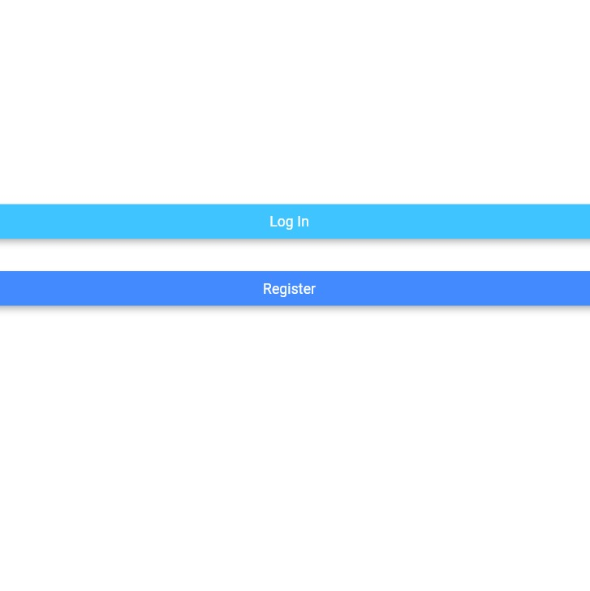
9) Login and signup page
he Flutter app features streamlined and intuitive login and signup pages designed for a seamless user experience. The login page allows users to access their accounts by entering their credentials (email and password). The signup page facilitates new user registration by requesting essential information, such as email, password

Slide 13
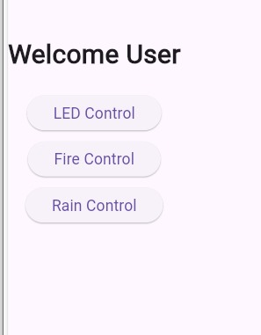
10) Home page
The home page of the Flutter app features an intuitive control panel designed for ease of use. It includes a LED Control Button for managing LED lights, a Fire Control Button for activating or deactivating fire-related features, and a Rain Control Button for determine if there rain or not.

Slide 14
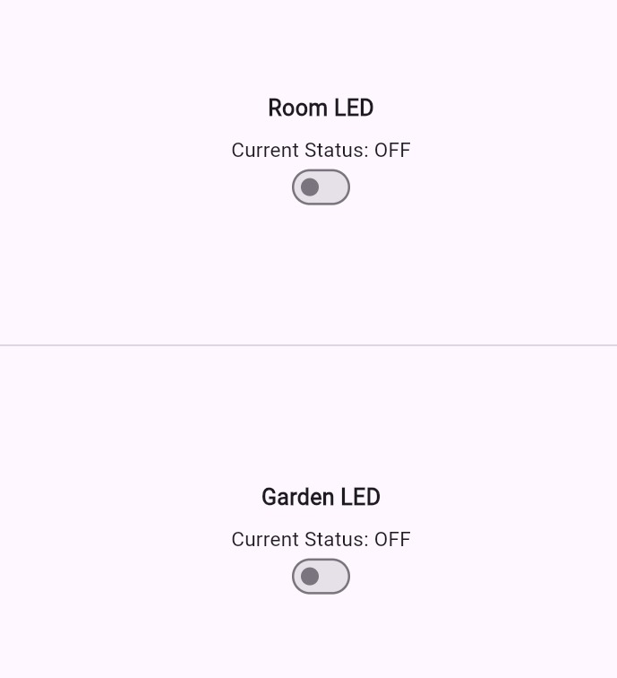
11) Led Screen
The LED control page enables users to manage garden lighting with ease. It provides real-time status updates for the LED lights, allowing users t.o turn the lights on or off

Slide 15
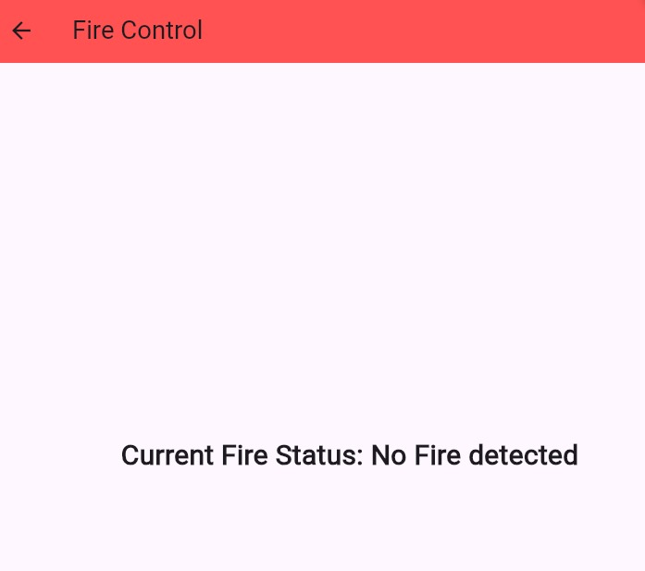
12) Fire Control page
he fire control page displays real-time data from the gas sensor, showing current gas levels and indicating whether there is a fire.

Slide 16
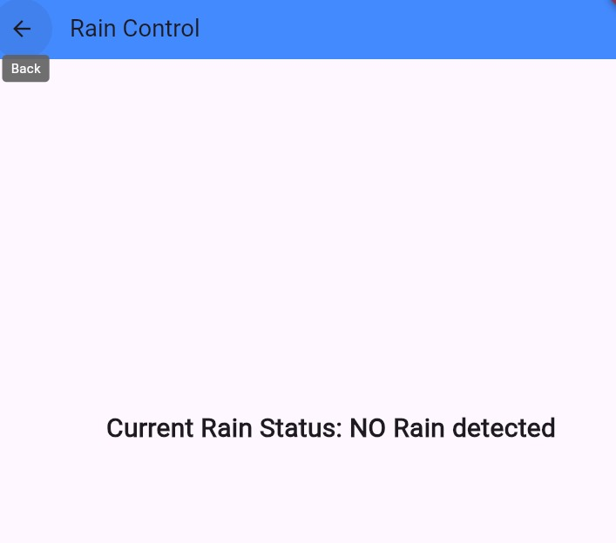
13) Rain Control page
The rain control page allows users to manage and monitor rain-related features. It displays real-time data from the rain sensor, showing current rainfall levels and conditions.

Slide 17
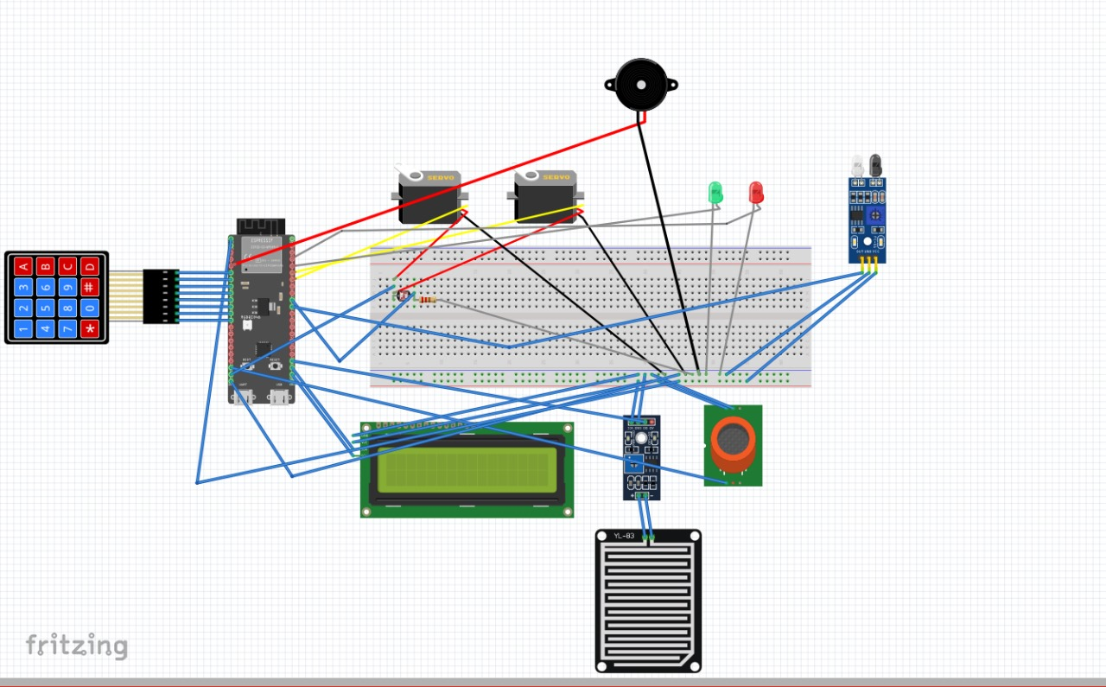
Wokwi
The Wokwi connection diagram visually represents the electronic components and their connections on a virtual breadboard. It typically features:
Components: Various electronic parts like LEDs, sensors, and microcontrollers.
Connections: Wires connecting the components, showing how they are interconnected.
Pins and Ports: Labels showing which pins or ports on the microcontroller or other components are used.

Slide 18
Thank you
Flora@contoso.com
http://www.contoso.com/

