Slide 1

Student Management System
Student Name: Salma Amr ID: 246645
Student Name: Habiba Wahid ID: 246207
Student Name: Jana Abdelazim ID: 245009
Student Name: Sarah Reda ID: 244469
Student Name: Fatma Alaa ID: 220499
Presented to: DR. Ahmed El Anany

Slide 2
Faculty of Engineering

Slide 3
Presentation Topic
The Student Management System is a desktop-based application developed using Java. It aims to automate and manage student academic records efficiently. This system allows educational institutions to manage student data like names, IDs, subjects, marks, and grades.
The application features a user-friendly GUI built with Java Swing and connects to a MySQL database through JDBC for data storage and retrieval. The project applies object-oriented programming principles and modular design to maintain scalability and ease of use.

Slide 4
Core Functionalities
The project provides a comprehensive set of functionalities:
1. Add Student Record: Administrators can enter new student details.
2. Search Student Record: Look up students using their ID or name.
3. Modify Student Record: Update existing data like name or marks.
4. Generate Mark Sheet: Automatically calculate and display grades.
5. Delete Student Record: Remove a student's entry from the system.
These features ensure streamlined management and quick access to academic information.

Slide 5
Technologies and Modules
This project combines multiple technologies:
- Java SE: The core programming language used.
- Swing: For building the GUI components like forms, buttons, labels.
- MySQL: Stores the student data in relational tables.
- JDBC: Enables communication between Java and the database.
Together, these modules ensure the software is interactive, persistent, and data-driven.

Slide 6
Database Handler Module
This module is responsible for all interactions with the database:
- saveDataBase(): Inserts new data into the student table.
- readDataBase(): Retrieves student records to display or process.
- updateDataBase(): Updates records during modifications.
It provides the foundation for ensuring all actions on student data are stored permanently and are retrieved accurately during application use.

Slide 7
GUI Functionalities
The graphical user interface is built using Swing components and provides a seamless user experience. Key methods include:
- displayMainMenu(): Shows options like Add, Search, Delete, Generate Sheet.
- displayRecordList(): Displays all student data in a tabular format.
The GUI allows non-technical users to easily manage student records without writing code.

Slide 8
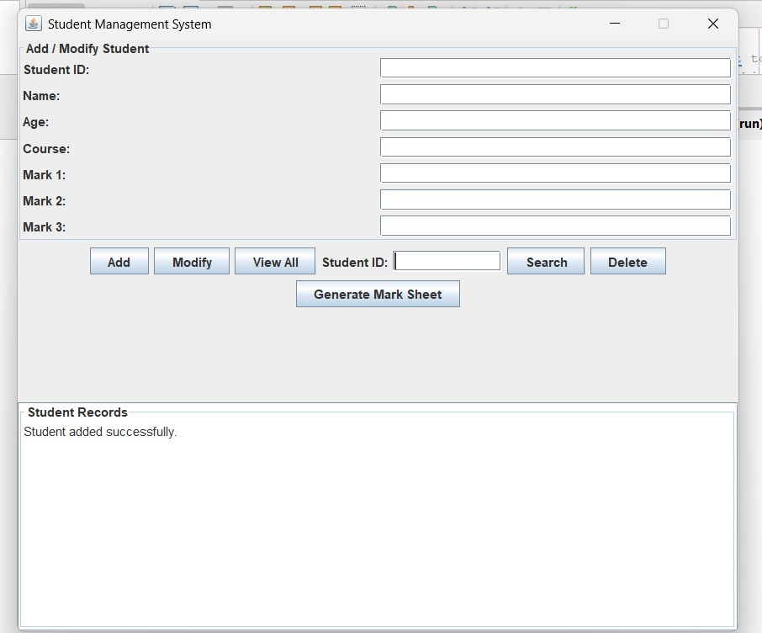
GUI

Slide 9
StudentManagementSystem Class
This is the control class that connects all modules. It maintains application logic and data consistency.
Attributes:
- students: A list holding Student objects.
- admin_password: Used to authenticate sensitive operations.
Methods:
- add_student_record(): Inserts a new student.
- search_student_record(): Finds a student (ID or Name)
- modify_student_record(): Edits student info.
- delete_student_record(): Removes a student.
- generate_mark_sheet(): Calculates and prints grades.

Slide 10
Student Class Details
The Student class models individual student data. It includes attributes and functions specific to a student's academic performance.
Attributes:
- student_id: Unique student identifier.
- name: Student’s full name.
- marks: Dictionary mapping subject to score.
- grade: Overall performance.
Methods:
- add_marks(): Adds subject-wise marks.
- calculate_grade(): Computes overall grade from marks.
This class encapsulates all necessary student-related operations.

Slide 11
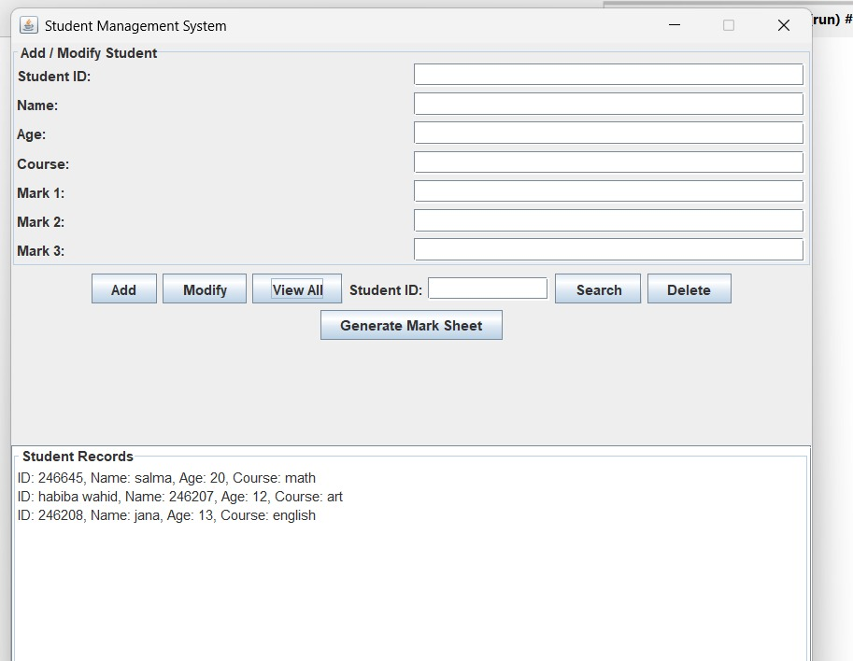
Output

Slide 12
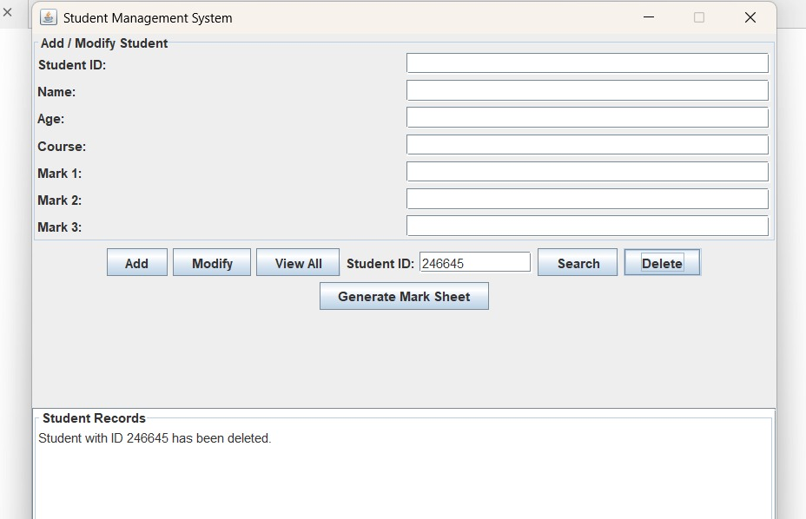
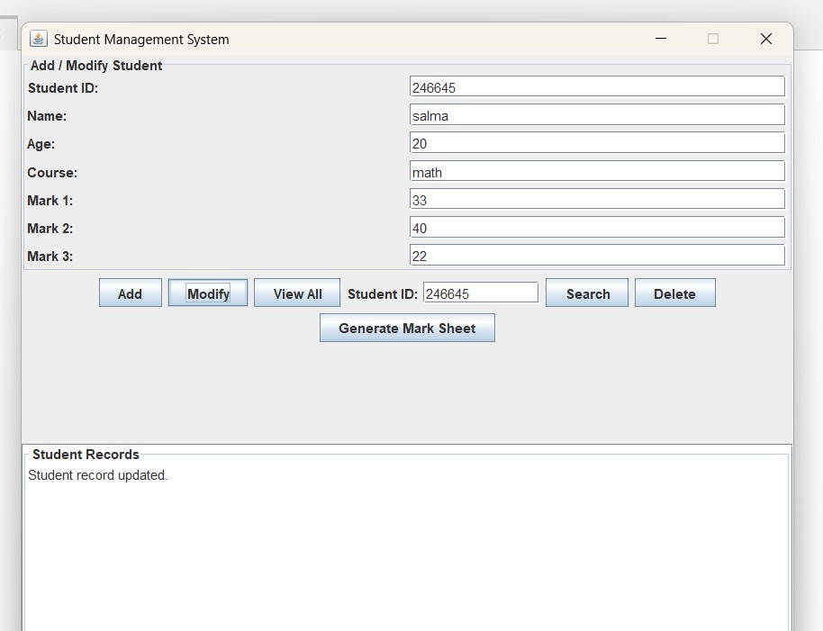
Output (Add, Delete, Modify)

Slide 13
MarkSheet Class
Handles all functionality related to generating student mark sheets.
Attributes:
- student: A reference to a Student object.
- marks_data: Subject-wise mark list.
- total_marks: Total of all marks.
Methods:
- generate(): Aggregates and processes marks.
- display(): Presents a formatted report.
This module abstracts mark sheet generation and keeps the logic organized.

Slide 14
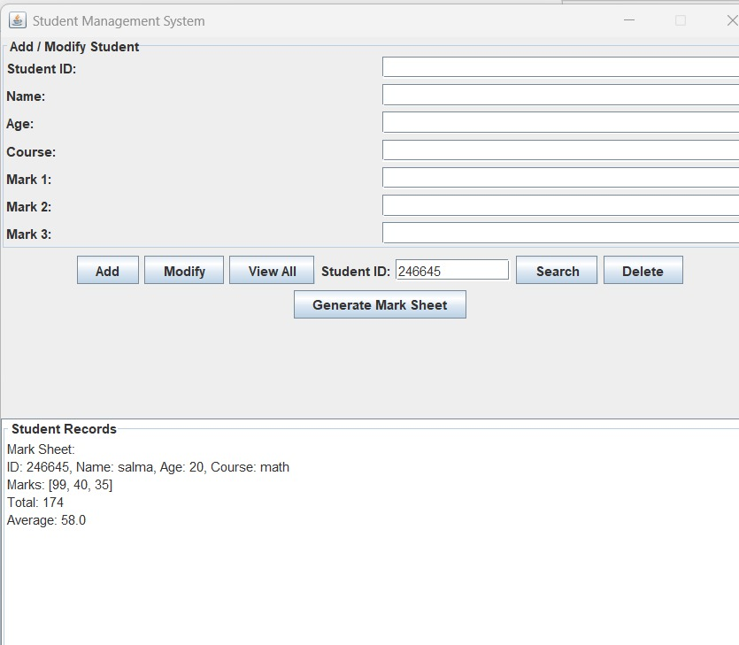
Output

Slide 15
SearchEngine Module
Enables search capability for student data. Efficient for large datasets.
Methods:
- search_by_id(): Returns the student record with the matching ID.
- search_by_name(): Searches all students and returns matches by name.
The search engine is a reusable component that enhances the user’s ability to find information quickly.

Slide 16
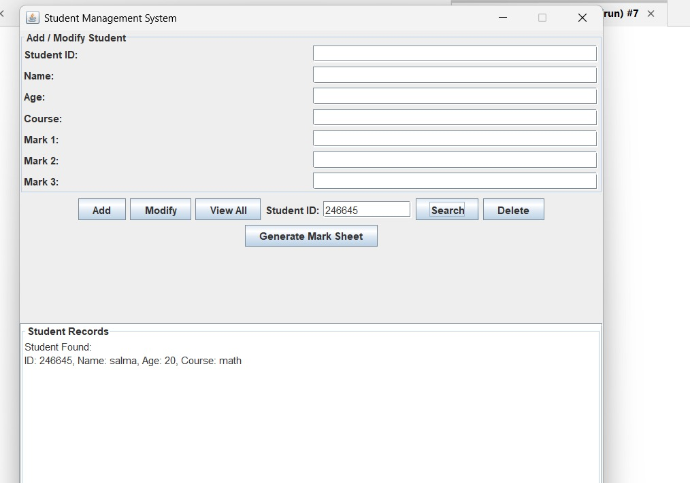
Output

Slide 17
Conclusion
The Student Management System project demonstrates full-stack development skills using Java. It integrates GUI design, backend logic, and database connectivity to form a functional and professional application. This project is ideal for learning modular programming, object-oriented design, and real-world software development practices.

