Slide 1

Web Application on Bangamata Hall Management
Presented by
Name: Md. Shariful Islam
Roll: CSE202301044
Session: 2023
Jahangirnagar University
Supervised by
Dr. Md. Imdadul Islam
Professor Department of Computer Science and engineering,
Jahangirnagar University
June 21

Slide 2
Abstract
Objective of this project work is to implement ‘digital watermarking’ algorithm using ‘complex number’ theory. Here each pixel of original image is considered as the real part of each complex number and imaginary part correspond to the pixel of watermark.
The matrix consists of absolute value of the complex number is treated as the watermarked image. The real and imaginary components of each complex number cannot be retrieved without the knowledge phase angle, which is treated as the key of secured watermarked image.

Slide 3
The phase angle of each complex number is transmitted through a secured channel. At receiving end when both the magnitude and phase angle of each pixel is estimated then the real and imaginary components of each complex number correspond to the pixel of original and watermarked images are determined with some accuracy.

Slide 4
Presentation Outline
1. Introduction
2. Asymmetric Cryptography
3. RSA algorithm
4. Algorithm of Complex Number
5. Results
6. Conclusions
7. References

Slide 5
Introduction
A digital watermarking is a pattern of bits inserted into a digital image, audio or video file that identifies the file's copyright information.
The watermarking techniques can be on four types of signal: Image Watermarking, Video Watermarking, Audio Watermarking, and Text Watermarking. Watermarking can be visible or invisible.
The project work emphasis on secure communication based on digital watermarking.

Slide 6
Literature review
In [2], short-term load forecasting is done based on fuzzy logic, to find electrical load loss in the generation end. The authors prepare fuzzy rules based on historical data.
A work is found about long term forecasting of power system in [3], where the authors use Artificial Neural Network (ANN) and Adaptive Neuro-Fuzzy Interference System (ANFIS). Six parameters are used as input, which are temperature, humidity, wind speed, rainfall, data of previous load and data of actual load. A table is presented to compare the error between ANN and ANFIS, where the average error is 6.7% and 0.096% respectively.
Research Gap:

Slide 7
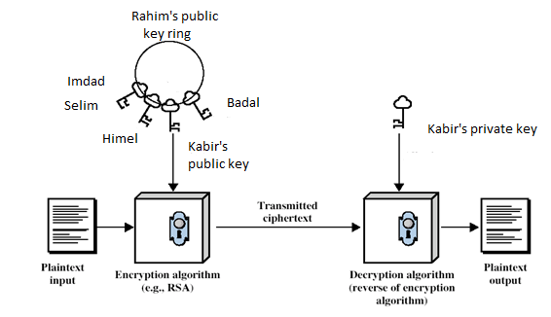
2. Asymmetric Cryptography
Under asymmetric cryptography, each user (for example Kabir) requires two key: ‘public key’ which is used by all users (Badal, Nasir, Belal, …) to encrypt the message to be sent to that user (Kabir) and a ‘private key’, which is used by that user (Kabir) to decrypt message. The idea of public-private key cryptography is visualized from fig.1.

Slide 8
The irreversible algorithm was developed by two researchers at Stanford University, Diffie and Hellman (1976. Under this algorithm, let the (keyed) encryption algorithm, E, and the (keyed) decryption algorithm, D, must satisfy:
1. D(E(P)) = P.
2. It is extremely difficult to derive D from E.
3. E cannot be broken by a chosen plaintext attack.

Slide 9
3. RSA algorithm
RSA algorithm discovered by three researcher: Rivest, Shamir, Adleman in 1978 satisfied above concept. The RSA method is based on some principles from number theory. The steps of the algorithm is below.
1. Choose two large primes, p and q (typically 1024 bits).
2. Compute n = p × q and z = (p - 1) × (q - 1).
3. Choose a number relatively prime to z and call it d.
4. Find e such that e × d = 1 mod z.
Example-1
Let, p = 3, q = 11
n = pq = 33, z = (p-1)(q-1) = 20
d = 7, since 20 and 7 does not have common factor
Now 7e = 1 mod 20 which provides e = 3
C = P³ (mod 33) which provides encoded value C

Slide 10
The table-1 shows the encryption of the plaintext ''SUZANNE'' as an example(n = 33, d = 7 and e = 3).
Table-1
Text recovery using RSA

Slide 11
The pixels of images can be encrypted and decrypted using RSA algorithm. An example regarding RGB image is shown in figure below.
Fig.1 Encryption and decryption of image

Slide 12
4. Algorithm of Complex Number
Read the original image O and watermark image W.
Determine magnitude
and phase angle
at (i, j); where O(i, j) and W(i, j) are the pixel at (i, j) of original and watermark image respectively and weighting factor 0 < α < 1.
Apply RSA algorithm on both M(i,j) and φ(i,j) like:
and

Slide 13
Transmit encrypted M(i, j) i.e. M_{RSA}(i, j) as the watermarked image to the receiver through public channel and φ_{RSA}(i,j) as the private (both phase angle itself and RSA parameters) key through the secured channel.
At receiving end decrypt the magnitude and phase angle at (i, j) as:
where n(t) and nʹ(t) are the noise of public and secured channels respectively at the instant of arrival of the pixel. Here and are the error of the decrypted data at (i, j).

Slide 14
Recover the pixels of original and watermark image as:
and
where and are the estimated value of pixels original and watermark image because of noisy channel.

Slide 15
5. Results
The original image, watermark, transmitted combined image, recovered watermak, recovered original image and received noisy image are shown in fig. 3-6 for -20dB, -25dB and -30dB awgn channel taking α = 0.05.
(a) Recovery of watermark under -12dB channel
(b) Recovery of watermark under -20dB channel

Slide 16
(c) Recovery of watermark under -25dB channel
(d) Recovery of watermark under -30dB channel

Slide 17
α = 0.05 α = 0.1 α = 0.2
α = 0.25 α = 0.3 α = 0.35
Fig.7 Impact of α on watermarked image

Slide 18
Fig.8 variation of cross-correlation coefficients against SNR taking α as a parameter

Slide 19
(c) -20dB (d) -25dB
(c) -30dB (d) -40dB
Fig.9 RGB watermarking on RGB image at different SNR

Slide 20
α = 0.3 α = 0.5
α = 0.75 α = 0.9
Fig.10 Impact of α on RGB watermarked image

Slide 21
Fig.11 Variation of cross-correlation coefficients against SNR on RGB image taking α as a parameter

Slide 22
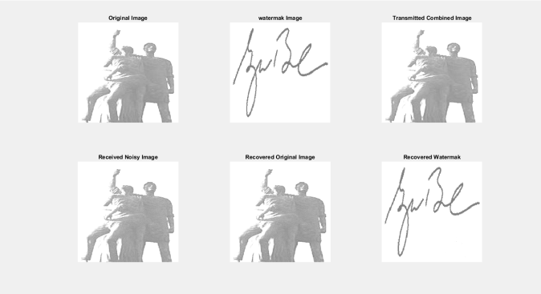
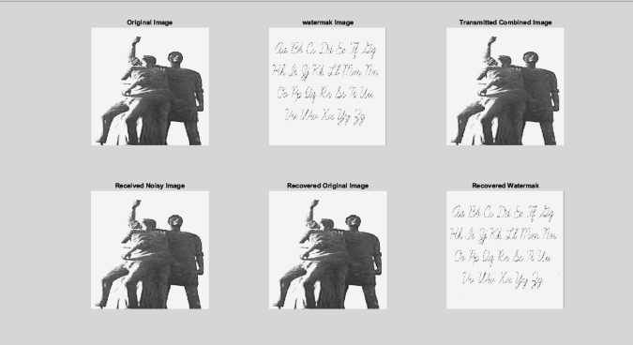
(a) Handwritten signature (b) Text
Fig.12. Recovery of handwritten signature and text under – 12 dB channel

Slide 23
6. Conclusion
In this project work digital watermarking technique is implemented with a simple algorithm. The result reveals the recovery of base and watermarking image effectively. Here the recovery of image is verified with cross-correlation coefficients but still we have the scope to verify it with other statistical parameters and features of image.
We can apply other encrypted algorithms for example: Elliptic curve cryptography, Triple DES, Blowfish, Twofish, AES etc. instead of RSA.

Slide 24
We can compare the model with other watermarking technique like: Discrete Cosine Transform (DCT) and DWT in context of accuracy and process time.
If we use channel coding (for example convolutional coding), it will give more immunity to additive white nose.
The tradeoff between the degree of security watermark and the complexity of encryption-decryption algorithm (specially process time) can be made to reach at an optimum point.

Slide 25
References
Hanaa A. Abdallah, Mohiy M. Hadhoud , Abdalhameed A. Shaalan and Fathi E. Abd El-samie, ‘Blind Wavelet-Based Image Watermarking,’ International Journal of Signal Processing, Image Processing and Pattern Recognition, Vol. 4, No. 1, pp.15-28, March 2011
Malika Narang and Sharda Vashisth, ‘ Digital Watermarking using Discrete Wavelet Transform,’ International Journal of Computer Applications (0975 – 8887) Volume 74– No. 20, pp.34-38, July 2013
Rafael C. Gonzalez and Richard E. Wood, Digital Image Processing, Third edition, Pearson education, 2013
V. Padmanabha Reddy and S. Varadarajan, ‘An Effective Wavelet-Based Watermarking Scheme Using Human Visual System for Protecting Copyrights of Digital Images,’ International Journal of Computer and Electrical Engineering, Vol. 2, No. 1, pp.32-40, February, 2010
Navnidhi Chaturvedi1, Dr.S.J.Basha, ‘Comparison of Digital Image watermarking Methods DWT & DWT-DCT on the Basis of PSNR,’ International Journal of Innovative Research in Science, Engineering and Technology Vol. 1, Issue 2, pp.147-153, December 2012
Afroja Akter, Muhammad Ahsan Ullah,‘Digital Watermarking with a New Algorithm,’ International Journal of Research in Engineering and Technology , Volume: 03 Issue: 03,pp212-217, Mar-2014
M. Kim1, D. Li and S. Hong, ‘ A Robust Digital Watermarking Technique for Image Contents based on DWT-DFRNT Multiple Transform Method,’ International Journal of Multimedia and Ubiquitous Engineering Vol.9, No.1 , pp.369-378, 2014
T. Liu and W. Tsai, ‘Generic Lossless Visible Watermarking-A New Approach’, IEEE Trans. on Image Processing, vol. 19, no. 5, pp. 1224-1235, 2010.
Y. Tsengand and H. Pan, ‘Data Hiding in 2-Color Images,’ IEEE Transactions on Computers, vol.51, no.7, pp.873-878, 2002.
L. Huang, ‘A Fragile Watermark Method for Improving Medical Images Security,’ Journal of Computers, vol.9, no. 9, pp. 2043-2049, 2014.
Hayam K. Al-Anie, Mohammad A. Alia and Adnan A. Hnaif, ‘E-VOTING PROTOCOL BASED ON PUBLIC-KEY CRYPTOGRAPHY,’ International Journal of Network Security & Its Applications (IJNSA), Vol.3, No.4, July 2011, pp.87-98
Nivedita Bisht , Sapna Singh,’ A Comparative Study of Some Symmetric and Asymmetric Key Cryptography Algorithms,’ International Journal of Innovative Research in Science, Engineering and Technology (An ISO 3297: 2007 Certified Organization) Vol. 4, Issue 3, March 2015, pp.1028-1031
Punita Meelu and Rajni Meelu, ‘IMPLEMENTATION OF PUBLIC KEY CRYPTOGRAPHIC SYSTEM: RSA,’ International Journal of Information Technology and Knowledge Management July-December 2012, Volume 5, No. 2, pp. 239-242
Aninda Majumder, Mohammad Raihan Ruhin, Tahsina Hashem, Md. Imdadul Islam, ‘Recovery of Image through Alamouti Channel with Incorporation of RSA Algorithm,’ Journal of Computer and Communications, 2016, 4, pp.1-10.

