Slide 1

STUDY ON DESIGN AND DEVELOPMENT OF BANGAMATA HALL MANAGEMENT SYSTEM
Presented by Md. Shariful Islam ID: CSE202301044 Batch: 31th | Supervised by Prof. Dr. Md Abul Kalam Azad Department of Computer Science & Engineering, Jahangirnagar University
Masters in CS, Intake Spring-2023

Slide 2
Outline
Introduction
Objectives
Tools And Technology
Working Process Flowchart
Use Case Diagram
Data Flow Diagram
ER Diagram
MVC Structure
Model Files
View Files
Controller Files
Database Table Structure
GUI - Graphical User Interface
User Access Control
Function and Modules
Project Demo screenshot
Results & Report
Conclusion
Future Work

Slide 3
Introduction
The University Hall Management Web App is designed and developed to facilitate the overall management of university hall, room allocation, student registration, maintenance tracking. It is intended to develop a user-friendly and scalable web application that meets the unique requirements of university hall management.
This web-based system can keep all residential student records, allocate/de-allocate room seats, can collect establishment charge with proper audit trail. Also, the application has admin control who can add, update staff, give permission, remove permission, deactivate staff, etc. Master data of the system is configurable from UI by the admin.
Student can visit their own information with default password. There is also mechanism for information security and credential management.
The system has been developed using C#, MVC, .NET Core 6, and repository pattern with backend MSSQL Database.

Slide 4
Objective Of The Project
The main objective of this Implementation of Bangamata Hall Management System project is to design and implement for the easy to maintain, data accuracy, large data control, high availability and ensure security. Here are the features implemented:
Student Info Add/Update,
Allocate/de-allocate seat,
Yearly establishment charge collect from student,
Hall Officials Add/Update,
System User Credentials Management
Master data configure from UI by admin user,
Information Access to Student with default password,
Dynamically menu accessibility by user role,
Password recovery,
Responsive design from mobile view.

Slide 5
Tools And Technology
Programming Languages: C#,
Framework: ASP.NET Core MVC, Repository Pattern,
Scripting Language: HTML5, CSS3, Bootstrap, JavaScript, jQuery,
Database: MSSQL,
Server: IIS,
API: SMS/Email integration,
Tools: MSSQL Server Management Studio, Tortoise git client,
IDE: Visual Studio 2022,
Version Control: github, git.

Slide 6
Working Process Flowchart
Start
Display home page
Already logged in?
Is Staff User?
Display Student Info details
Add/Update Student
Display Staff dashboard
Process Establishment Charge
Allocate/De-allocate seat
Process User Credentials
Configuration/Setting Master data
Add/Update Staff
end

Slide 7
Use case Diagram
8
Student Entry
Student Update
Show Student Details
Staff Entry
Admin
Staff Update
Establishment charge Entry
Establishment Charge Update
Student
User Credential Entry
User Credential deactivate
User Login
Password Reset
Home page
Dashboard

Slide 8
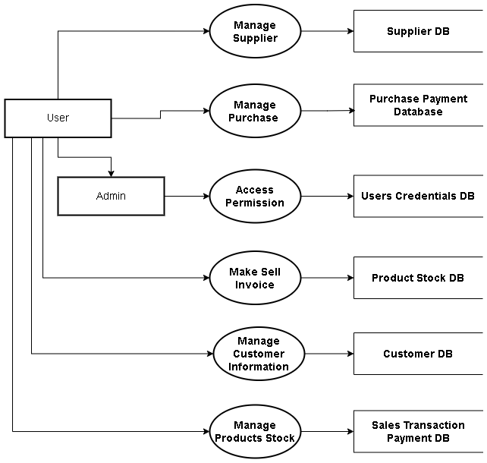
Level 2 DFD
9

Slide 9
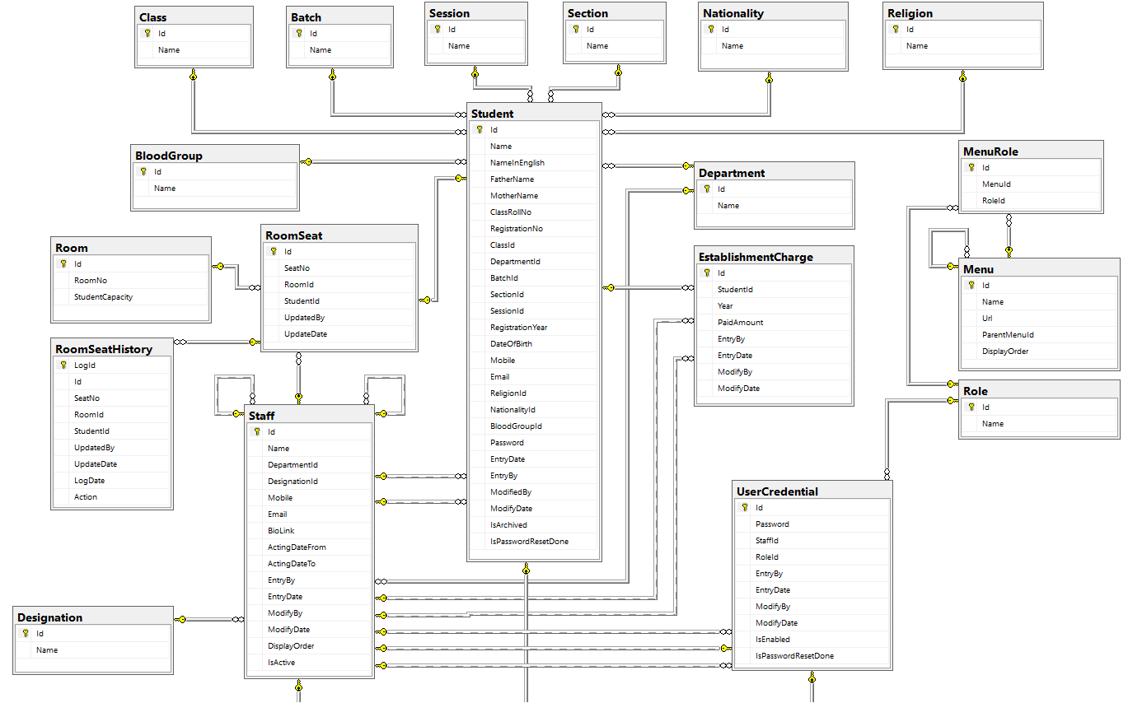
Entity Relationship Diagram
10

Slide 10
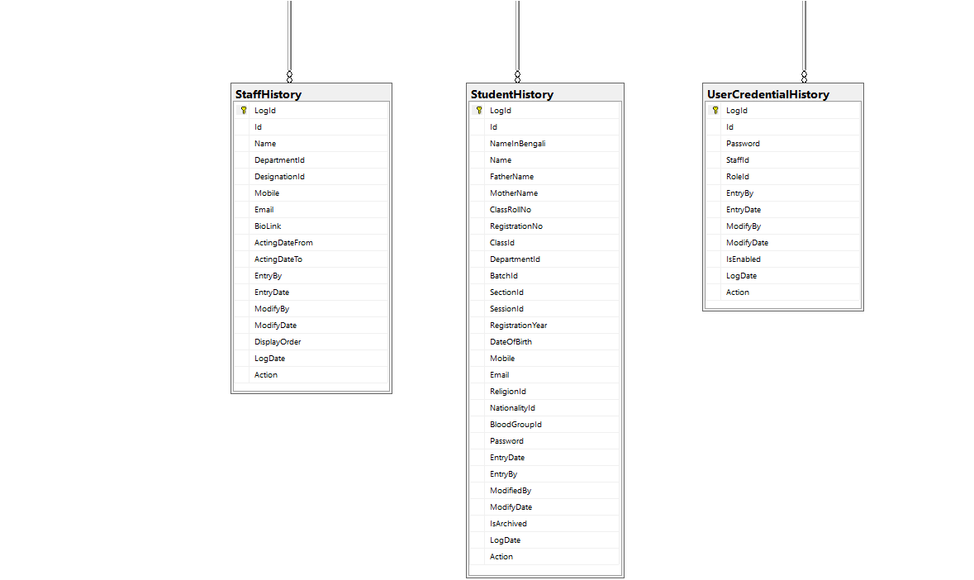
Entity Relationship Diagram(contd.)
11

Slide 11
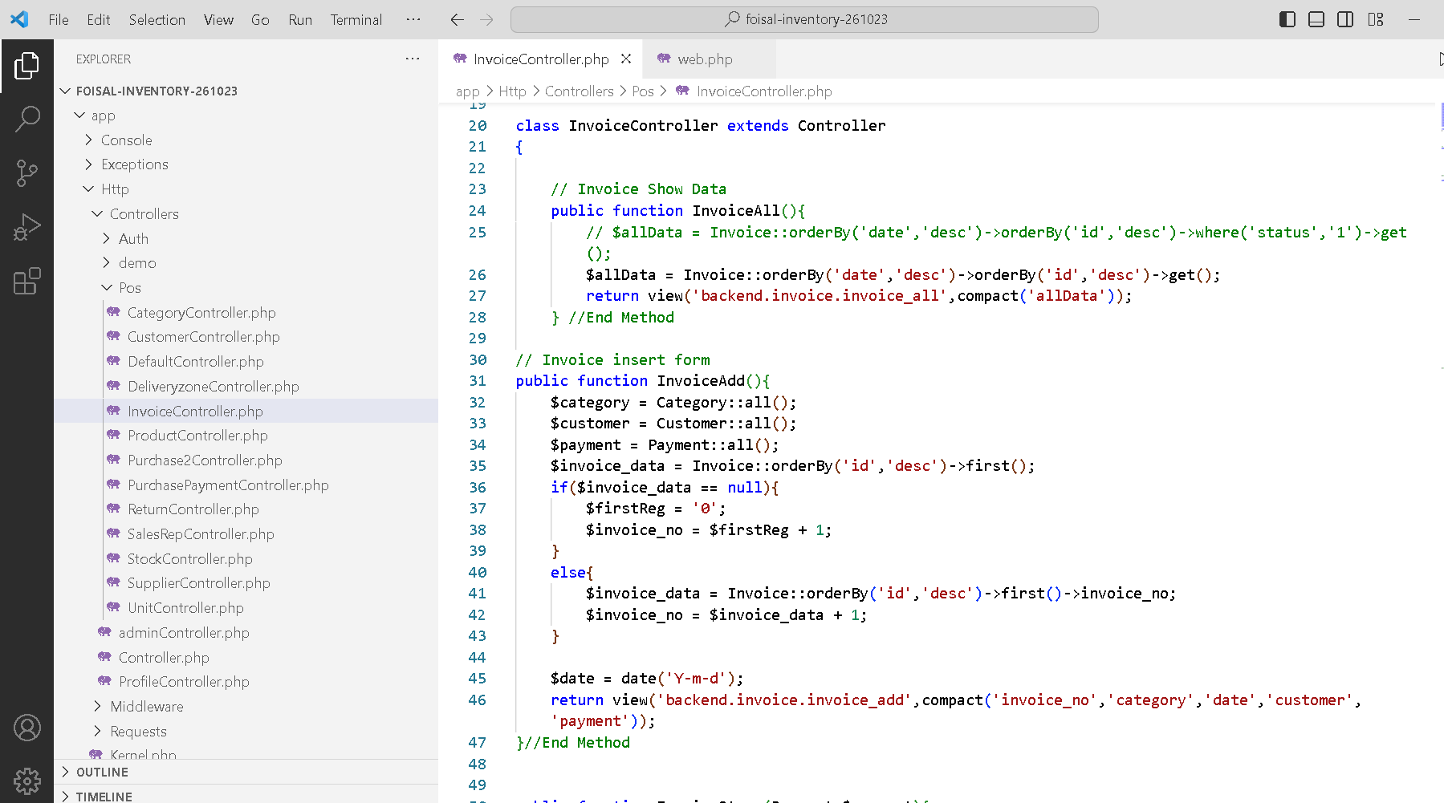
Controller Files
11

Slide 12
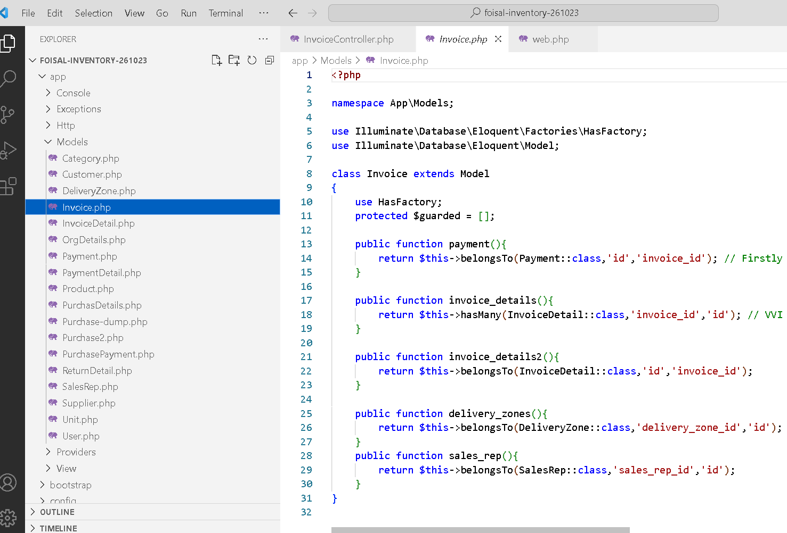
Model File
12

Slide 13
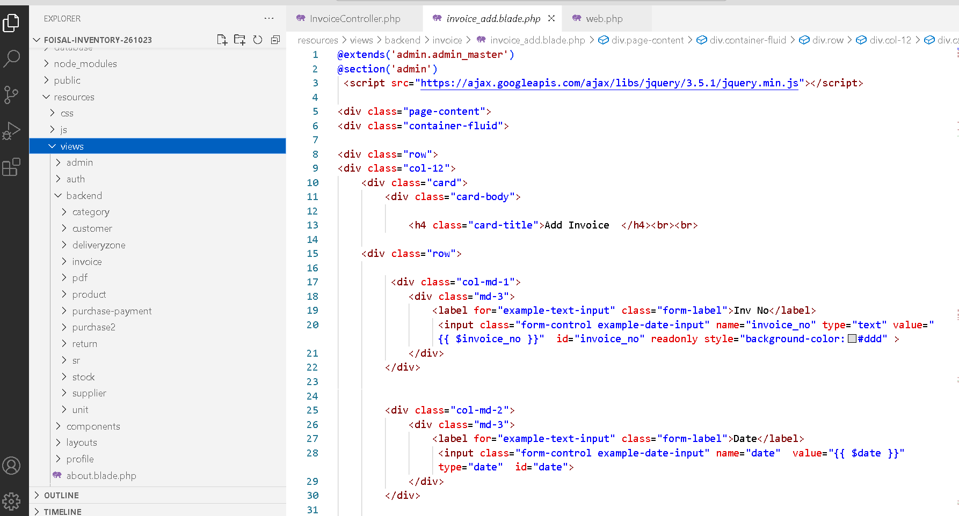
View Files
13

Slide 14
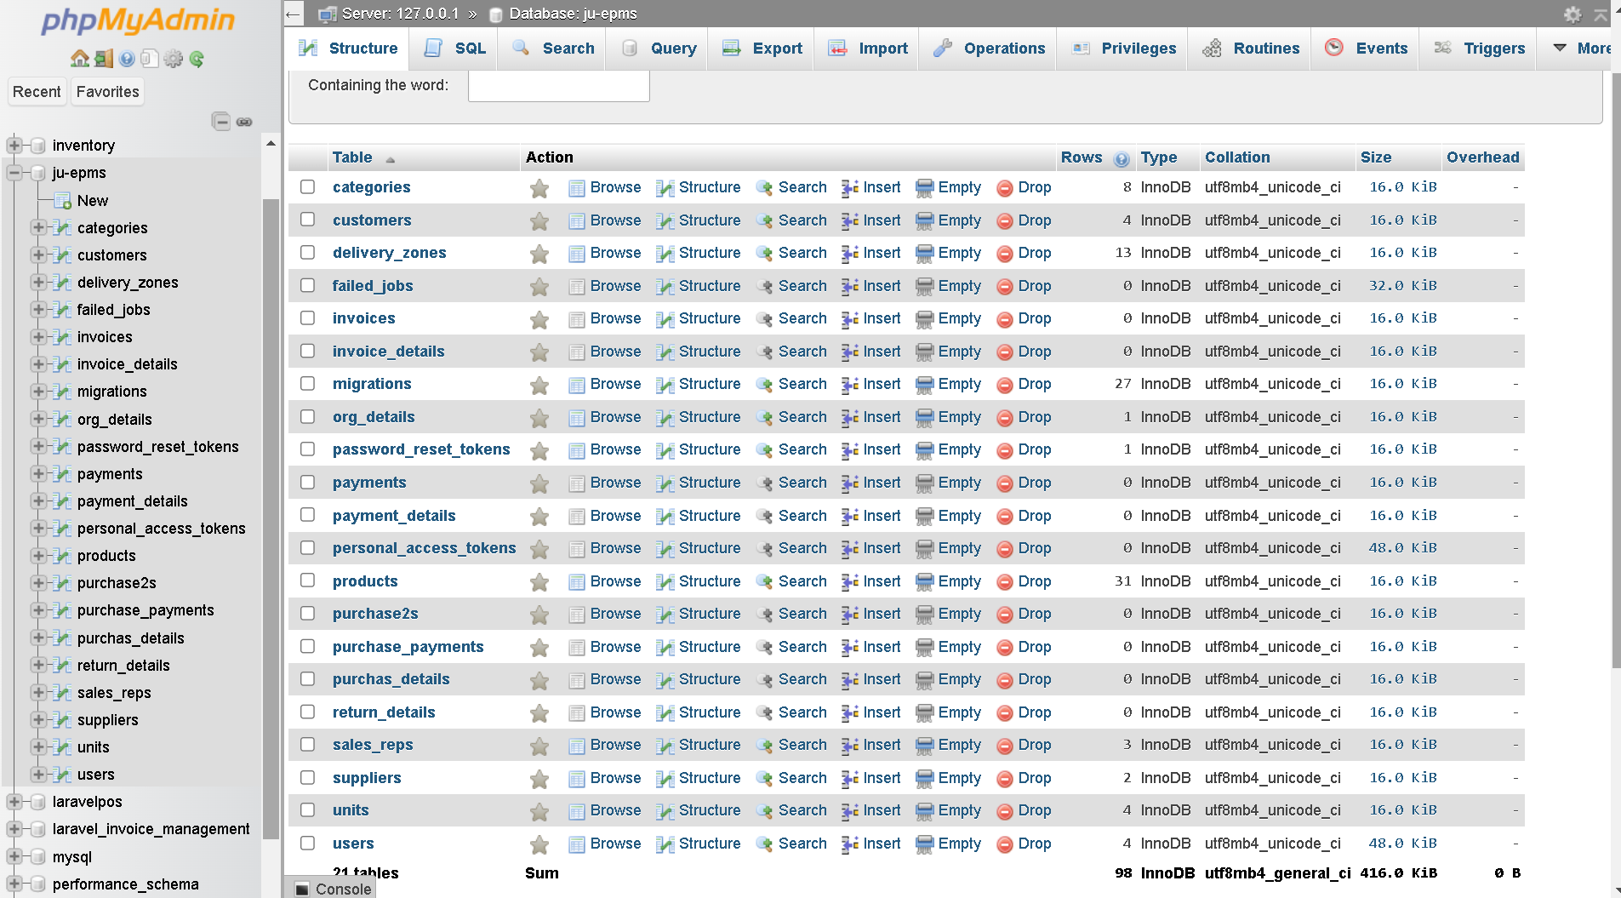
Database Tables Structure
14

Slide 15
GUI - Graphical User Interface
15
User Registration/Login Interface
Forget Password Reset interface
User Dashboard
Supplier Interface
add/remove/update Interface
Product Details Interface
add/remove/update Interface
Category and Units Interface
add/remove/update Interface
●
Purchase Receipt
Purchase Payment
Sales Invoice
Sales Payment
Customer Due Check
Product Stock
Custom Report

Slide 16
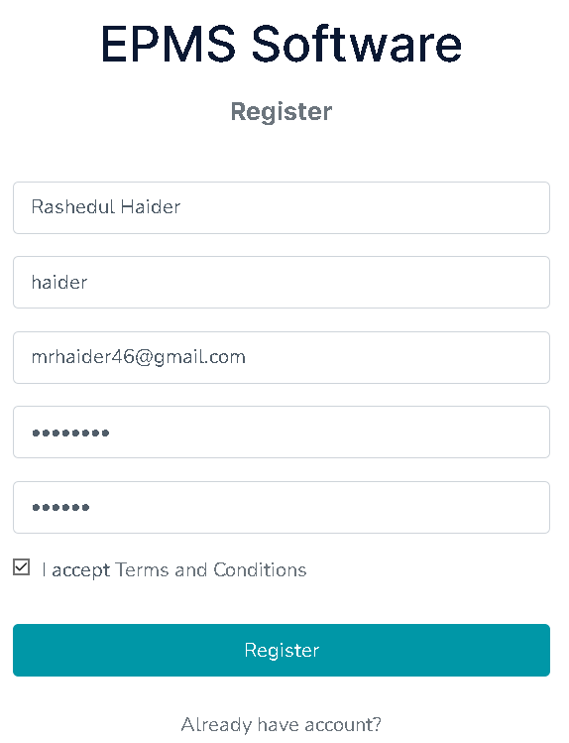
User Registraion
16
l Create new user
l Verified by Email
l Unique Username and email check authentication
l Password length minimum 6 digit
l Retype the same password

Slide 17
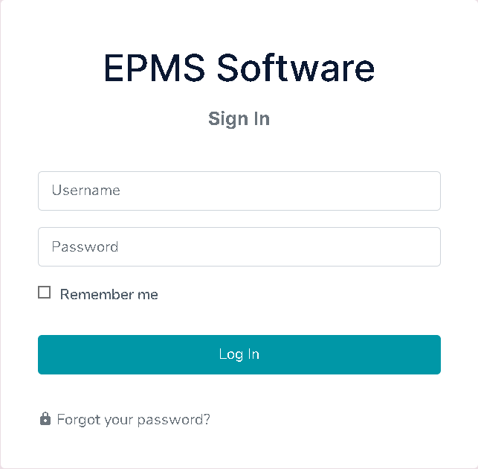
Login Panel
17

Slide 18
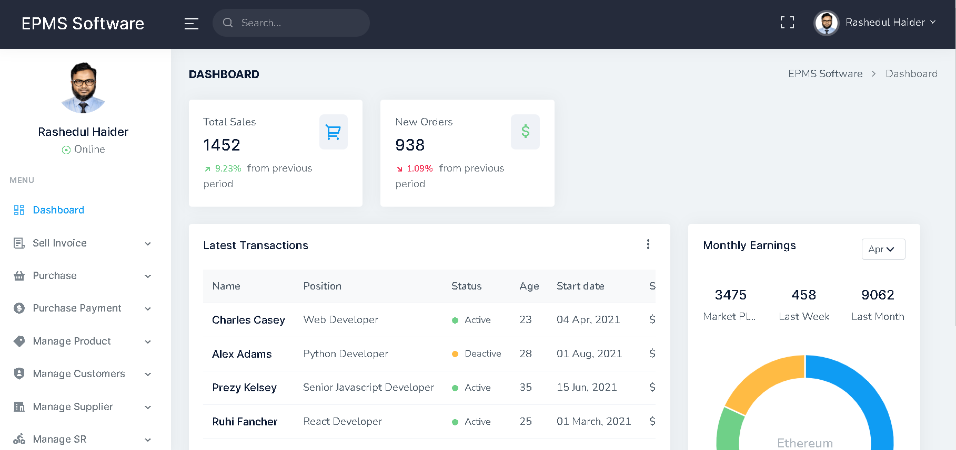
Dashboard
18
Menu Bar
Company Logo
User Name
User Profile image
Top Bar
User update button
Basic information
Footer

Slide 19
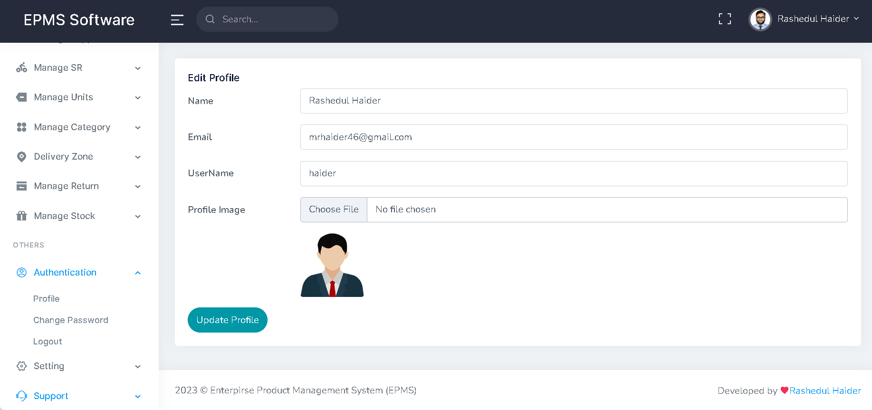
User Information update
19

Slide 20
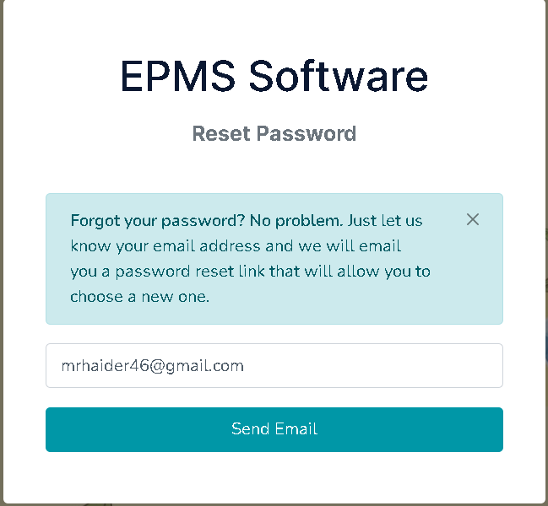
Forget Password
20
Step 1: Provide your valid Email to authenticate.
Step 2: Sent a Verification link to the Email
Step 3: Go to Email and validate the link
Step 4: Set a new password

Slide 21
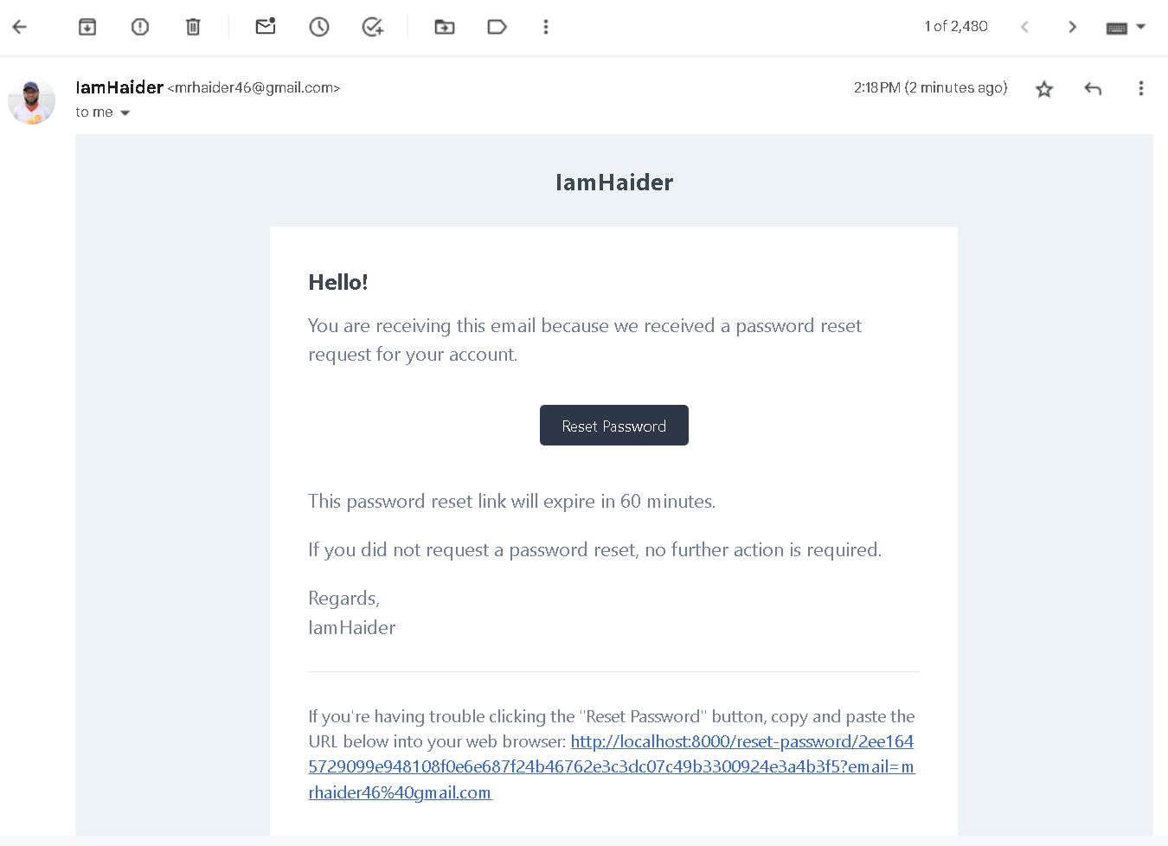
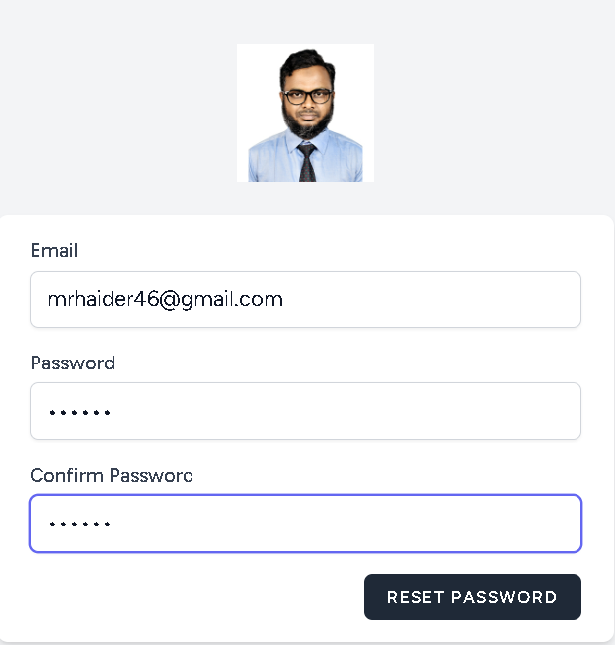
Forget Password Verification link
21

Slide 22
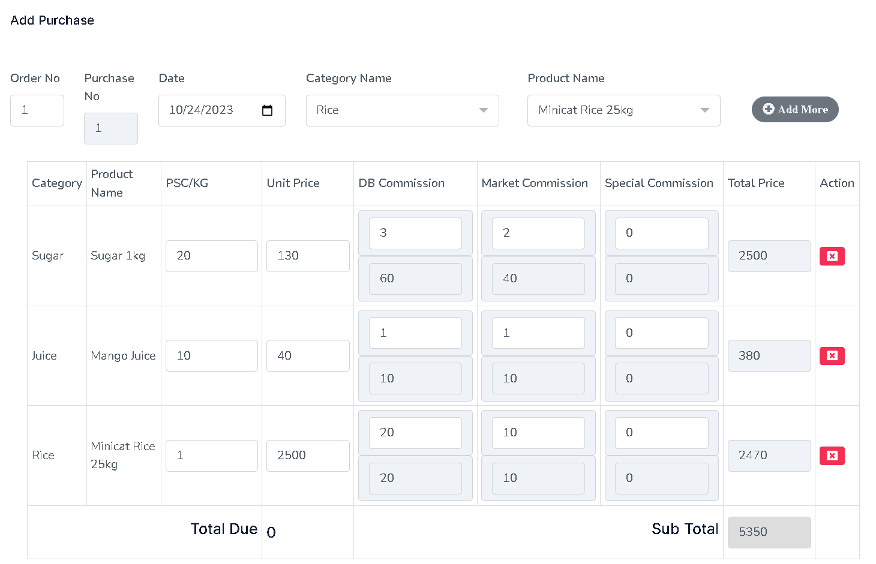
Purchase Receipt Interface
22

Slide 23
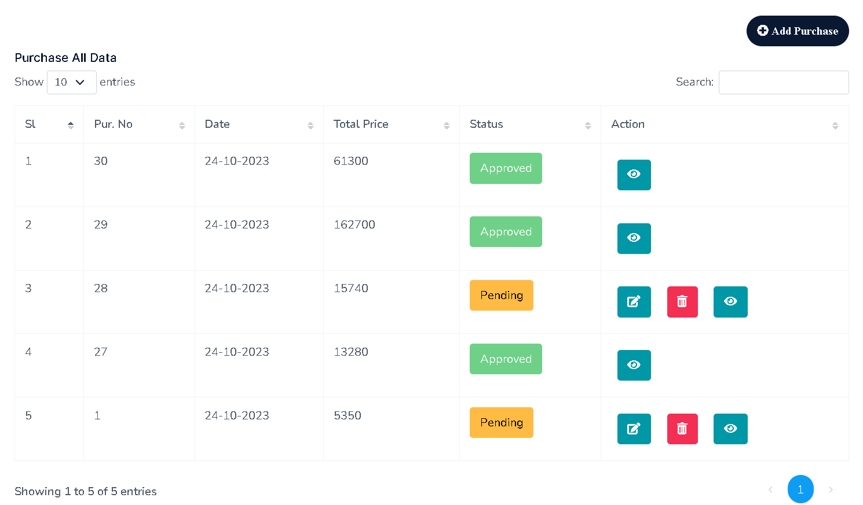
Status-wise Purchase Data
23

Slide 24
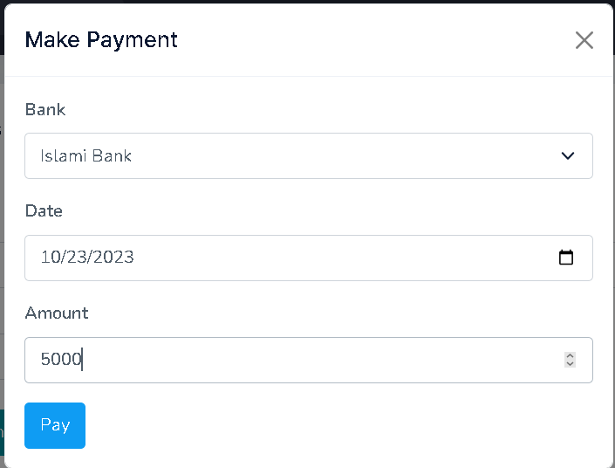
Purchase Payment
24

Slide 25
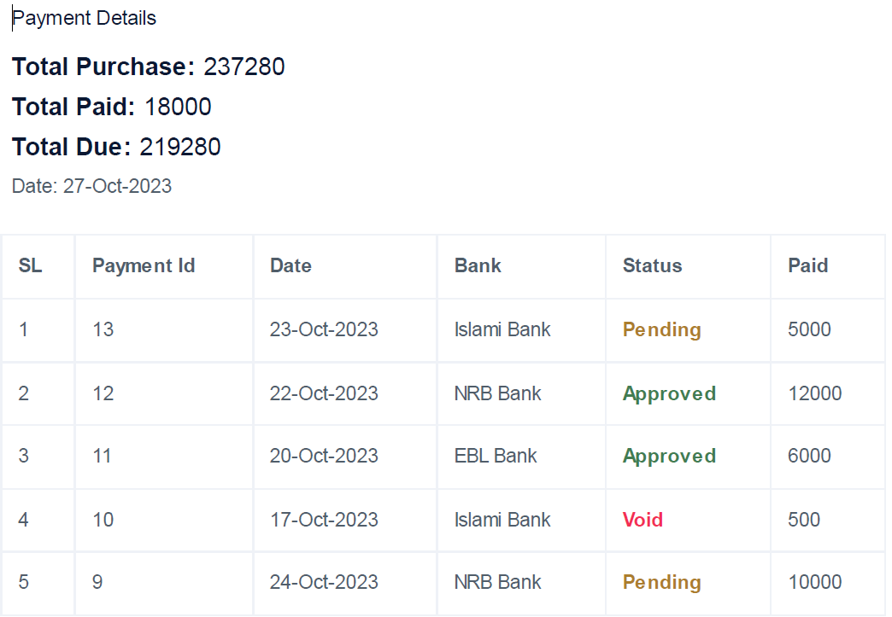
Purchase Payment
25

Slide 26
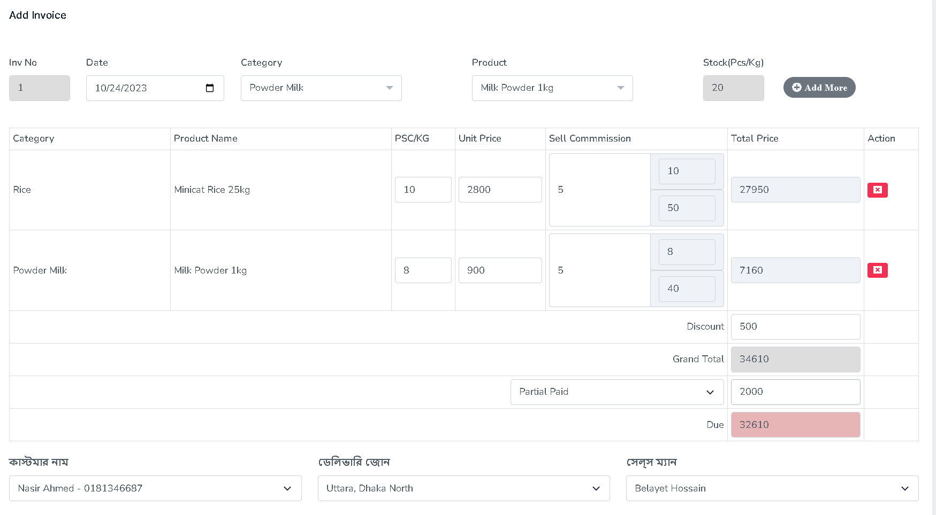
Sales Invoice
26

Slide 27
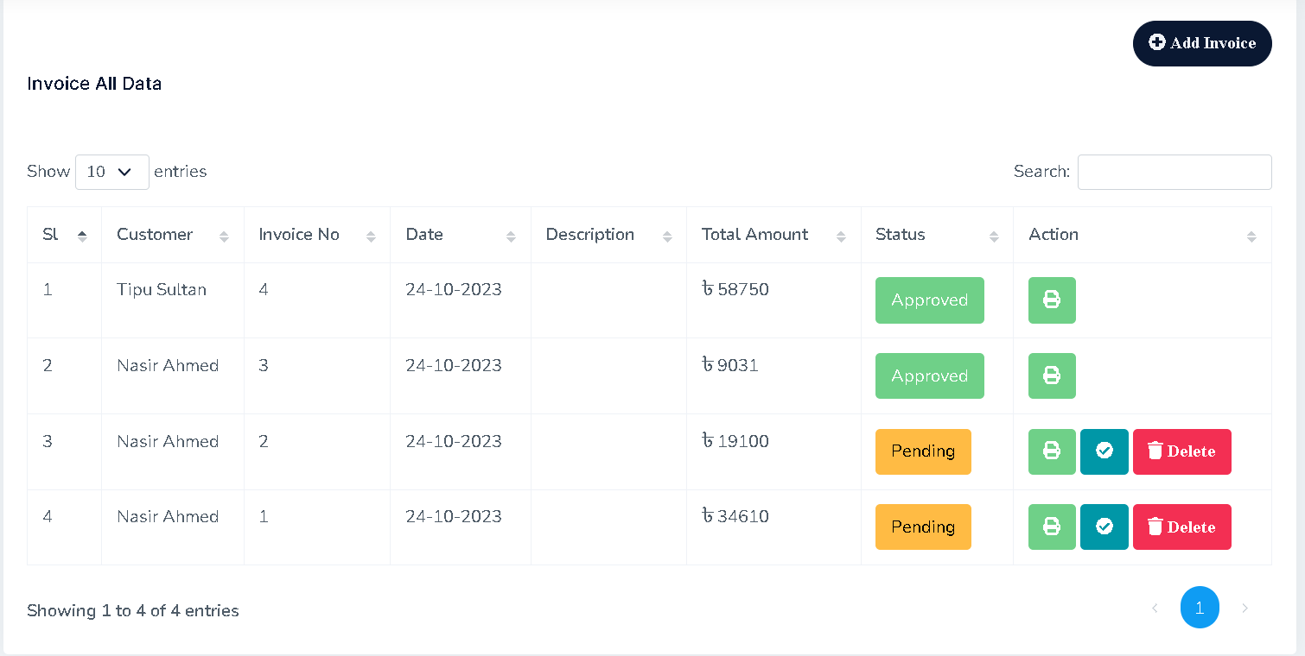
Sales Invoice Dashboard
27

Slide 28
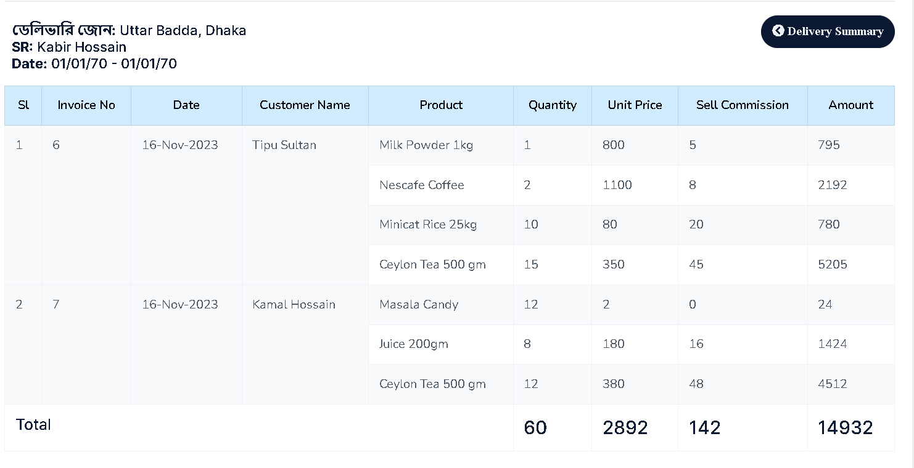
Product Delivery
28

Slide 29
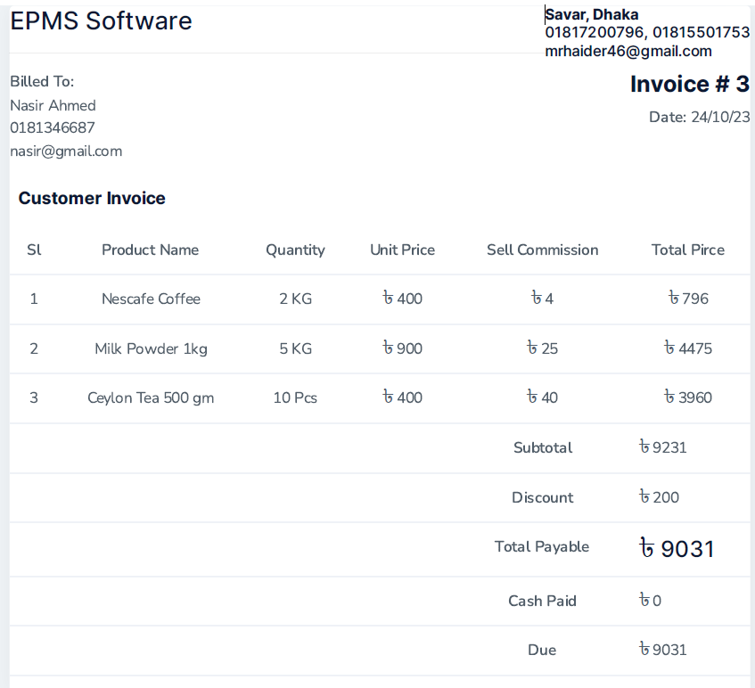
Custoerm Receipt
29

Slide 30
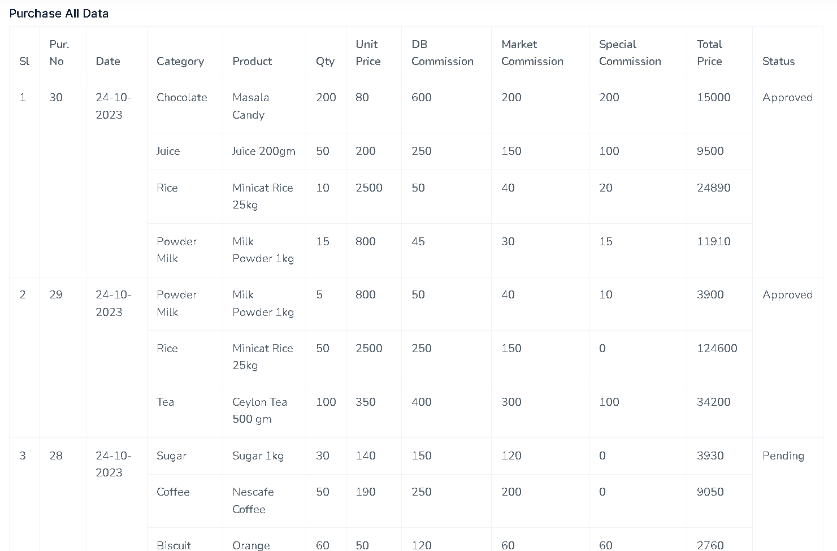
Sales Report
30

Slide 31
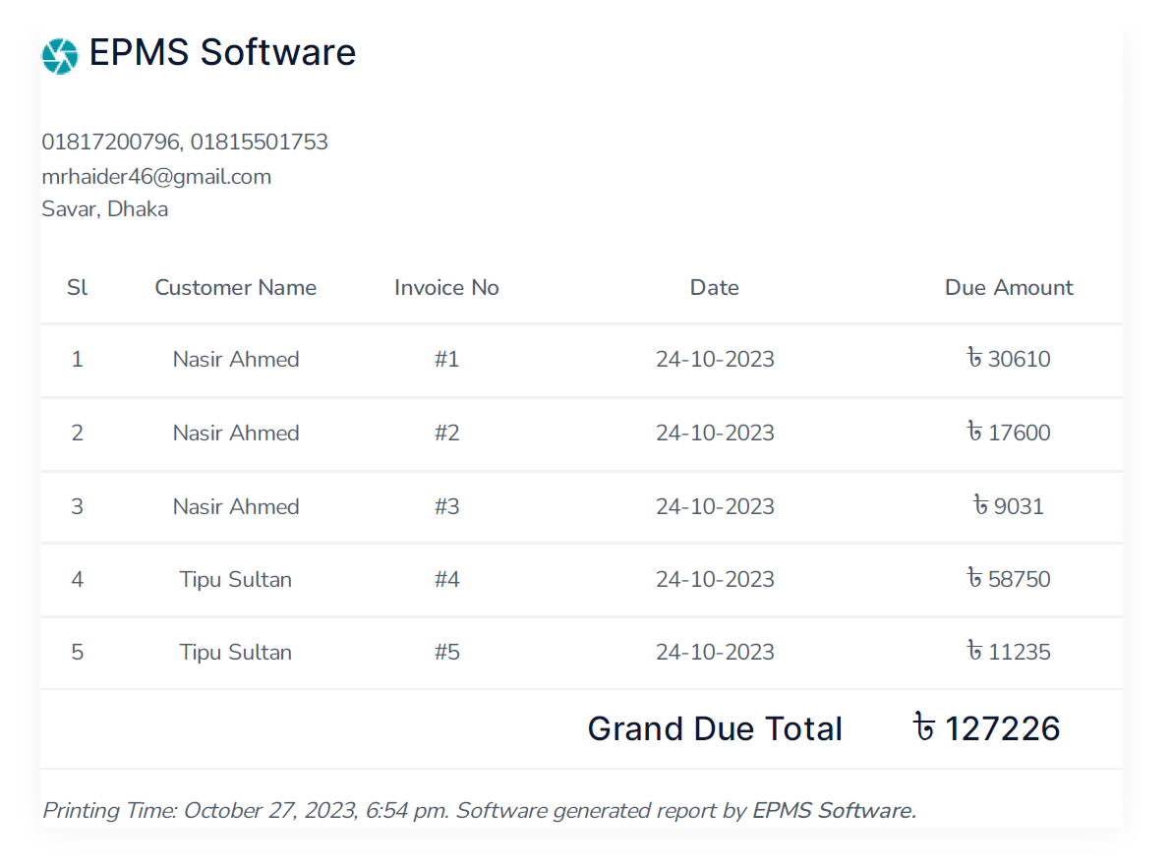
Customer Due Report
31

Slide 32
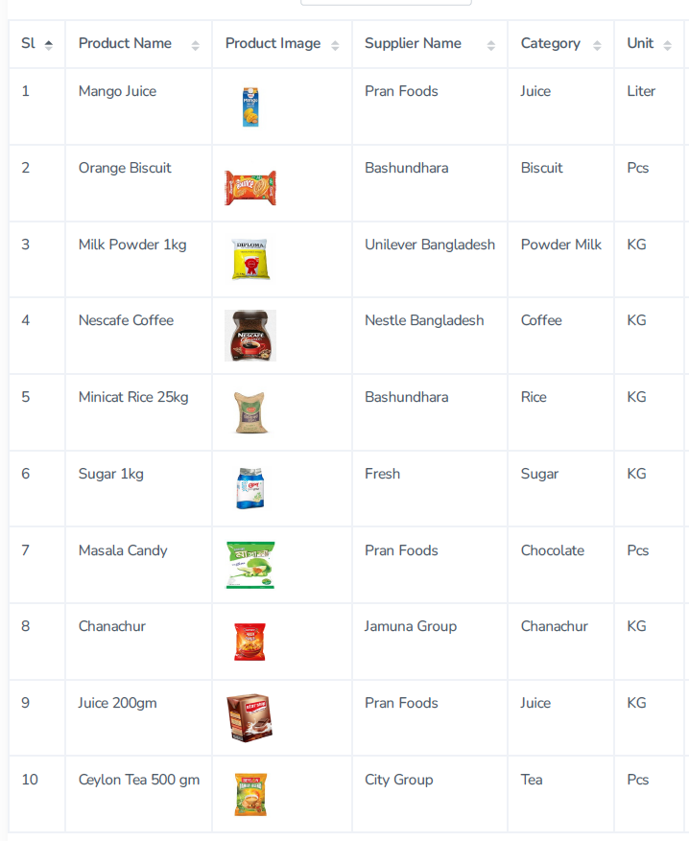
Product List Report
32

Slide 33
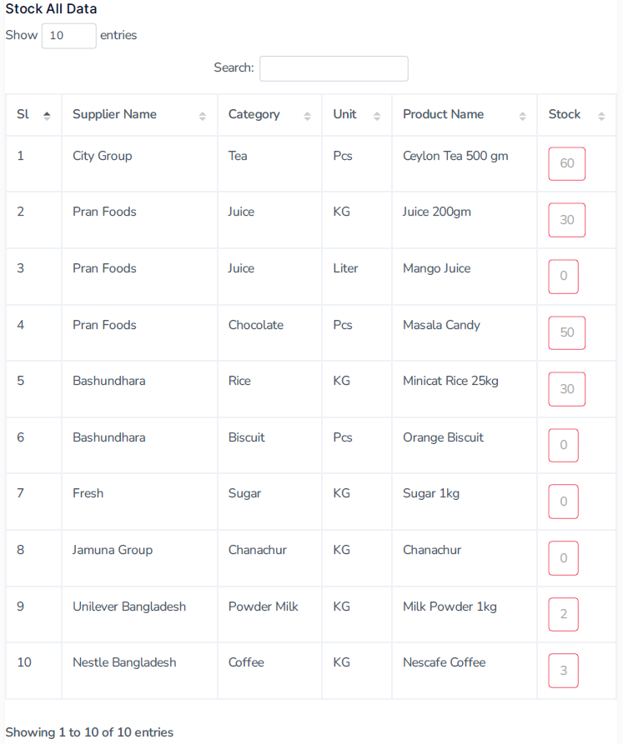
Product Stock Report
33

Slide 34
Conclusion
34
Enterprise Product Management System (EPMS) will be very useful and needful software for a medium level of business, especially a wholesales business or retailer business.
I think EPMS Software makes the business more profitable, more easier, and more accurate. The business improving and progressing day by day by using EPMS Software.

Slide 35
Future Work
35
Mobile Apps Integration: Android apps will be created by integrated with this EPMS.
Bar-code Scan: For sales invoices and purchase receipts, the Bar-code will make it faster and smoother products add.
SMS Integration: After sales, a customer can receive a digital receipt through SMS. Also, a customer will be notified by SMS about their total previous due.
Email Integration: By Email, a customer can receive an invoice receipt.
Payment Gateway: A digital payment gateway will be available for receipt of digital payment through eBanking payment, VISA/Master Card Payment, and Mobile banking like bKash, Rocket, and Nagad payment.
User-wise Access: Add more restrictions and rule by user-wise access control.

Slide 36
References
36
[1] | Shalom Adonai Huaraz Morales and Laberiano Andrade-Arenas, "Inventory Management Analysis under the System Dynamics Model," (IJACSA) International Journal of Advanced Computer Science and Applications,Vol. 12, No. 1, 2021
[2] | Thomas Muyumba and Jackson Phiri, "A Web based Inventory Control System using Cloud Architecture and Barcode Technology for Zambia Air Force," (IJACSA) International Journal of Advanced Computer Science and Applications, Vol. 8, No. 11, 2017
[3] | Hayder Sabah Salih, Mohanad Ghazi, Mohammad Aljanabi "Implementing an Automated Inventory Management System for Small and Medium-sized Enterprises", Journal IJCSM 'Iraqi Journal for Computer Science and Mathematics', (May, 2023), http://journal.esj.edu.iq/index.php/IJCM
[4] | Chan Chin, Sathiapriya Ramiah and Nurul Farhaini Razali "Inventory Management Systems (IMS)" Journal of Applied Technology and Innovation (e -ISSN: 2600-7304) vol. 7, no. 3, (2023), https://www.researchgate.net/publication/372653862_Inventory_Management_Systems_IMS
[5] | M.Mukherjee, "Object-Oriented Analysis and Design," International Journal of Advanced Engineering and Management”, Vol. 1, No. 1, pp. 18-24, 2016.
[6] | Novia Fuji Lestari and Yuanita Handayati "Analysis of Inventory Management in Order to Reduce Overstock", International Journal of Current Science Research and Review, Volume 05 Issue 09 September 2022
[7] | Sutini and Wisnu Yuwono "Implementing Inventory Management SystemAt Toko Sinar Pratama", Conference on Community Engagement Project, Vol. 2, No. 1, (2022), https://journal.uib.ac.id/index.php/concept
[8] | M.Mukherjee "Object-Oriented Analysis and Design", International Journal of Advanced Engineering and Management, Vol. 1, No.1, PP. 1-11, 2016
[9] | Tinuke O. Oladele, Roseline Oluwaseun Ogundokun, Adekanmi Adeyinka Adegun, Emmanuel Abidemi Adeniyi, Ayobami Tayo Ajanaku, "Development of an inventory management system using association rule", Indonesian Journal of Electrical Engineering and Computer Science, Vol. 21, No. 3, March 2021
[10] | Agboola, Malgwi, Mahmud, And Oguntoye, "Development Of A Web-Based Platform For Automating An Inventory Management Of A Small And Medium Enterprise", Fudma Journal Of Sciences (Fjs), Vol. 6 No. 5, October, 2022
[11] | Nwafor Chidinma Anulika, Idoko Nnmadi A, Agbo Jonathan Chukwuwike, Ogbene Nnaemeka Emeka, "Design and Optimization of An Inventory Management System for Central Stores", International Journal of Interdisciplinary Innovative Research &Development (IJIIRD) ISSN: 2456-236X Vol. 05 Issue 01 | 2020
[12] | Qiuying Han, "Inventory System Based on ThinkPHP and Bootstrap Framework", American Journal of Theoretical and Applied Research (AJTP), AJTAR, 2019
[13] | Laravel Official Website, https://laravel.com
[14] | Bootstrap Official Website, https://getbootstrap.com
[15] | Tutorial Point, https://www.tutorialspoint.com/laravel/laravel_overview.htm
[16] | jQuery Official Website, https://jquery.com/
[17] | Commerce Mates Study, https://www.shareyouressays.com/knowledge/7-main-scopes-of-product-control-and-management/116410
[18] | Share your Study, http://www.bondedservice.com/what-is-web-based-inventory-management
[19] | Bondedservice,http://www.bondedservice.com/what-is-web-based-inventory-management
[20] | Php Official, https://www.php.net

Slide 37

FAQ
Any Question?

Slide 38
38
Thank You All

