Slide 1


Two Irons in the Fire: Synthesizing Libraries of Programs by Optimizing an Auxiliary Function while Solving Problems
Presented By
Habib Rahman
Supervised By
Levi Lelis
Notes:
Hello everyone!
Thank you very much for being here.
Today, I am going to present my thesis entitled by ….
the phrase “two irons in the fire.” … the main idea of our research. We are doing two things at the same time: Synthesizing libraries of program and solving problems.
… by optimizing the auxiliary function. … auxiliary function allows us to inject domain knowledge into system.
Let’s get started!

Slide 2
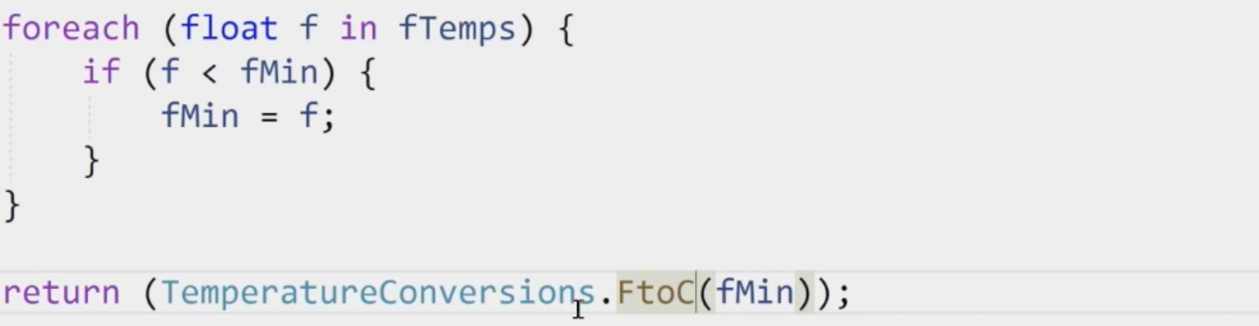
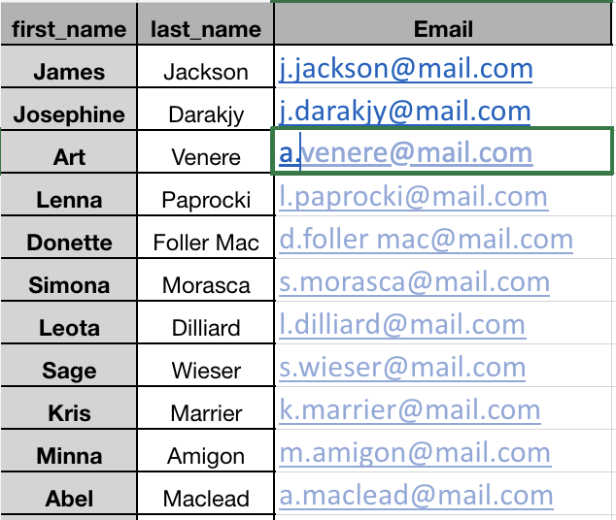
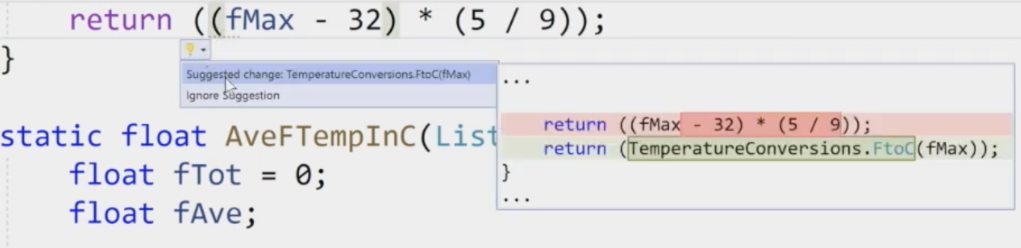
WHY PROGRAM SYNTHESIS?
Excel’s FlashFill
Code Refactoring¹
¹Sumit Gulwani’s Presentation at Heapcon 2019
Notes:
So, why do we need program synthesis?
… popular excel feature named FlashFill which was introduced back in 2013. …
But, the research on program synthesis started back in 1980s.
playing a role in code refactoring….
And many more.

Slide 3

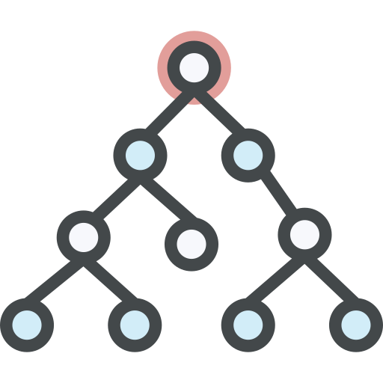



PROGRAM SYNTHESIS
Problem Specifications
Synthesizer
Search Space (Domain-Specific Language)
Program
* Icons from @flaticon
Notes:
… what is program synthesis is and what are the current state-of-the-art approaches.
… task of automatically finding a program that satisfies the user's intent.
How does a user express intent?
… various ways like logical specifications, input-output examples, natural language, partial programs, etc.
How do we define the search space?
… defined through a Domain-Specific Language (DSL).
So, the synthesizer needs the problem specification and the DSL to generate a program as output.

Slide 4




PROBLEM SPECIFICATIONS
INPUT
OUTPUT
…
Nancy FreeHafer
Andrew Cencici
…
938-242-5O4
244-655-O94
…
Honda125
Ducati125
…
9O.O
123
…
…
N. FreeHafer
A. Cencici
…
(938) 242 5O4
(244) 655 O94
…
Honda
Ducati
…
9O.OO
123.OO
…
String Manipulation Domain
Reverse Drawing Domain
¹Odena, Augustus, et al. "BUSTLE: Bottom-Up program synthesis through learning-guided exploration.", 2O2O.
²Ellis, Kevin, et al. "Dreamcoder: Bootstrapping inductive program synthesis with wake-sleep library learning." Proceedings of the 42nd acm sigplan international conference on programming language design and implementation. 2O21.
Notes:
.. intents are expressed through input-output examples.
… tested our approach in two different domains: String Manipulation and Reverse Drawing.
In String Manipulation, we have input-output examples like …
in the Reverse Drawing domain, the input-output examples are images. …

Slide 5
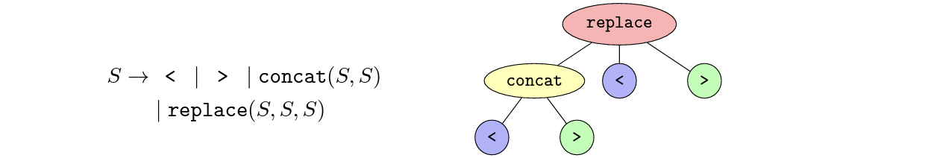
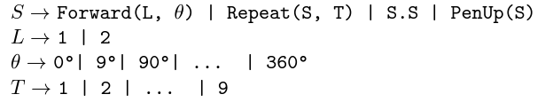
DOMAIN-SPECIFIC LANGUAGE (DSL)
Sample Domain Specific Language (DSL) for String Manipulation
Sample DSL for Reverse Drawing Domain
Notes:
A Domain-Specific Language defines the overall structure of the search space for programs.
… are represented using Context-Free Grammars (CFG).
… CFG and DSL interchangeably.
→ DSL Vs General Purpose Language (e.g, Python, C, C++, Java) etc
DSL → particular domain, GPL → across domain.
GPL → increase the search space → harder to find the solution.
→ On the left side of the slide, we have the DSL for String Manipulation.
"S" is the start symbol here. It can be extended as "S -> <", "S -> >", "S -> Concat()", or "S -> replace()".
"Concat" will concatenate two strings. "Replace" will substitute one instance of "S" with another in the string "S".
Example…
→ On the right-hand side, we have the DSL for the Reverse Drawing domain. Here, "S" can be extended as "S -> Forward(L, O)", and so on.
"Forward(L, O)" moves the pen by "L" pixels and, at the end, rotates left by "O" degrees from its current direction.
"Repeat(S, T)" is for repeating the program "S" "T" times.
"S.S" is for concatenating two programs.
"PenUp(S)" moves the pen by "S" pixels without drawing anything on the canvas.
Example …

Slide 6
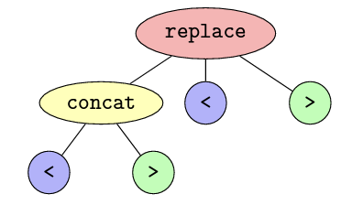
ABSTRACT SYNTAX TREE (AST)
Repeat
Forward
4
2
9Oº
AST of replace ( concat ( < , > ), < , > )
AST of Repeat ( Forward ( 2 , 9Oº ), 4 )
Notes:
So, how can we visualize the programs?
→ visualized by a tree data structure, named as Abstract Syntax Tree (AST).
Every node signifies a production rule, while leaf nodes denote terminals.
size of a program → the number of nodes in its AST.
For example, on the left side, → program size is six, as its AST comprises six nodes.
Similarly, on the right → program's size is five because its AST contains only five nodes.

Slide 7

SEARCH TECHNIQUES
Enumeration-Based Approaches
Bottom-Up Search Synthesis
Top-Down Search Synthesis
* Icons from @flaticon
Notes:
So, what are the search techniques used to find the solution program from the program space?
→ one such technique is enumeration-based, which can be divided into two categories:
Bottom-Up search
Top-Down search
In the next few slides, we will discuss how Bottom-Up and Top-Down searches are used for program synthesis.

Slide 8
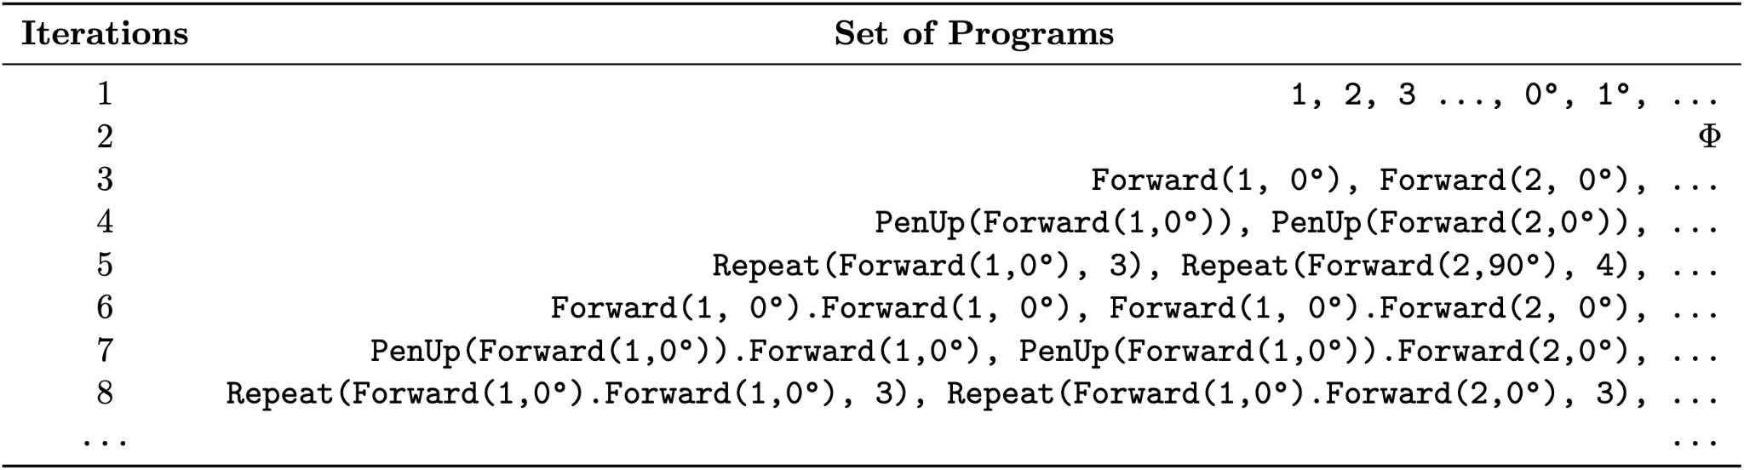
BOTTOM UP SEARCH SYNTHESIS
Sample DSL for Reverse Drawing Domain
¹Aws Albarghouthi, Sumit Gulwani, Zachary Kincaid, Recursive Program Synthesis, 2O13. ²Abhishek Udupa, Arun Raghavan, Jyotirmoy V. Deshmukh, Sela Mador-Haim, Milo M.K. Martin, Rajeev Alur, TRANSIT: Specifying Protocols with Concolic Snippets, 2O13
Notes:
→ enumerates all possible programs in the search space.
→ brute-force algorithm that guarantees finding the solution if it exists.
Initially → initializes its set of programs with the terminal symbols of the language.
[Go through the example …]
→ generated programs are complete programs, that is none of those programs has any non-terminals.

Slide 9

EXAMPLE OF BOTTOM-UP SEARCH SYNTHESIS
Sample DSL for Reverse Drawing Domain
1: .. , 2, .., 4, .. Oº , .. 9Oº
2: ɸ
3: Forward ( 2 , 9Oº )
4: ɸ
5: Repeat ( Forward ( 2 , 9Oº ), 4 )
¹Aws Albarghouthi, Sumit Gulwani, Zachary Kincaid, Recursive Program Synthesis, 2O13. ²Abhishek Udupa, Arun Raghavan, Jyotirmoy V. Deshmukh, Sela Mador-Haim, Milo M.K. Martin, Rajeev Alur, TRANSIT: Specifying Protocols with Concolic Snippets, 2O13
Notes:
[Describe]

Slide 10
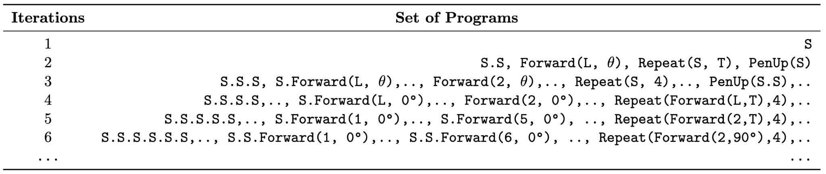
TOP DOWN SEARCH SYNTHESIS
Sample DSL for Reverse Drawing Domain
Gulwani, Sumit, et al. "Inductive programming meets the real world." Communications of the ACM 58.11 (2O15): 9O-99.
Notes:
In top-down search, → two different manner → BFS, DFS
In this example → BFS
[Describe the example]
It continues until finds the solution. → programs are complete programs, that means some of the programs still have the non-terminals in it.

Slide 11
BOTTOM-UP SEARCH OVER TOP-DOWN SEARCH SYNTHESIS
Reuse of programs as subprograms in subsequent searches
Allows Observational Equivalence Check
Forward ( 2 , Oº )
Forward ( 1 , Oº ). Forward ( 1 , Oº )
Notes:
benefits of bottom-up approach over the top-down approach?
→ reuse the previously generated programs
[Describe from example ]
→ programs in BUS are complete. Which is not in top-down approach.
→ → observational check in BUS
What is observational equivalence?
→ two program generated same output
[describe example]
→ discard the second program, it will reduce the search space.
For this reason, we choose BUS as our base approach in this research.

Slide 12






CHALLENGES IN PROGRAM SYNTHESIS
Enumeration Search
Program Space
Solution Program
* Icons from @flaticon
Notes:
The approach we learn so far enumeration based, that means they guarantees solution if there is any.
However, due to the resource limitations, we would fail to find the solution.
For example, we cannot allocate un limited time and memory.
With limited resources, it would search only the this [point] region from the whole search space and eventually fails to find the solution which is in the other corner of the space.

Slide 13

GUIDED BOTTOM-UP SEARCH SYNTHESIS
Repeat(Forward(2,9O°),4).Forward(2,O°).Repeat(Forward(2,12O°),3)
COST FUNCTION, Θ
Sample DSL for Reverse Drawing Domain
COST | PROGRAMS | COST CALCULATION
11 | 1, 2, 3, 4, … , Oº, 1º, … | Θ(1) = 11, Θ(9Oº) = 11, ...
23 | Forward(1, Oº), Forward(2, 9Oº),... | Θ(Forward(1, Oº)) = Θ(Forward) + Θ(1) + Θ(Oº) = 1 + 11 + 11 = 23, ...
46 | Forward(1, Oº).Forward(1, Oº),... | Θ(Forward(1, Oº).Forward(1, Oº)) = Θ(Forward(1, Oº)) + Θ(Forward(1, Oº)) = 46, …
47 | Repeat(Forward(2,9O°),4).Forward(2,O°) | Θ(Repeat(Forward(2,9O°),4).Forward(2,O°)) = 24 + 23 = 47, ...
71 | Repeat(Forward(2,9O°),4).Forward(2,O°). Repeat(Forward(2,12O°),3) | Θ(Repeat(Forward(2,9O°),4).Forward(2,O°). Repeat(Forward(2,12O°),3)) = 24 + 23 + 24 = 71,
Notes:
To mitigate the issue we saw earlier slide, researchers introduced the guided bottom-up search synthesis.
→ programs are generated in increasing order of cost of the programs.
→ we have the cost function, theta.
[describe]
→ clearly see that benefit of cost guided synthesis here.
→ normal BUS → depth 13 to find the solution,
→ guided → 5 iterations to find the solution program.
→ The better the cost function is, the faster the process to find the solution.
In the next slide, we will see some existing research of cost functions.

Slide 14



BUSTLE¹
Cost Function
is the likelihood from model
replace ( concat ( < , > ), < , > )
¹Odena, Augustus, et al. "BUSTLE: Bottom-Up program synthesis through learning-guided exploration.", 2O2O.
Notes:
→ Cost Guided Bottom-up search
→ uses a neural network model to compute the likelihood of a problem being part of solution and accumulate that into the cost function
[describe for the terms and then example]
P1: concat ( < , > ) → Cost 4 → Lkhd → 0.65 ⇒ Bin: 5 → del 5-5 ⇒ 0
P2: < → Cost 12 → Lkhd → 0.21 → Bin: 2 ⇒ del 5 - 2 ⇒ 3
P3: > → Cost 13 → Lkhd → 0.15 → Bin: 1 ⇒ del 5 - 1 ⇒ 4
Total Cost: 1 + (4 + 0) + (12 + 3) + (13 + 4) = 37 Giving the random example

Slide 15
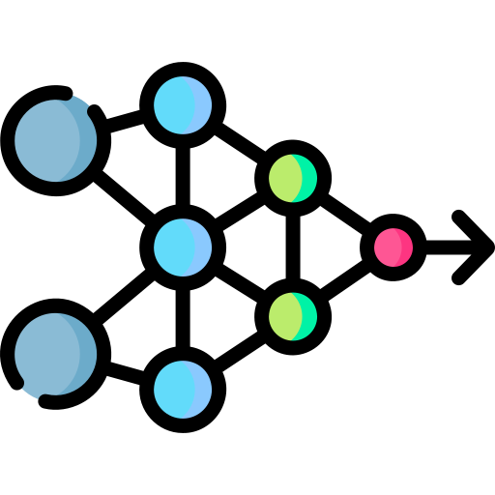
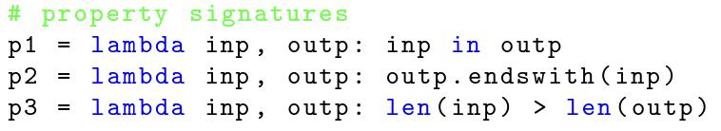
BUSTLE¹
Neural Network Model
Program: replace ( concat ( < , > ), < , > )
Inputs, I: “<<>”, “>><”
Outputs, O: “>><<>”, “>><<”
Program Output, V: “>>”, “>>”
Inputs (I) → Outputs (O):
Program Output (V) → Outputs (O):
[ 1, O, -1 , -1, -1, -1]
O.1
[ AllTrue, Mixed, AllFalse ]
[ 1, O, -1 ]
Concatenation
[ AllFalse, AllFalse, AllFalse ]
[ -1, -1, -1]
¹Odena, Augustus, et al. "BUSTLE: Bottom-Up program synthesis through learning-guided exploration.", 2O2O.
Notes:
→ neural network model play the role?
[Describe the example]
→ Training was done by synthetically generating data. [go to next page]
Generated random input strings.
And then from those inputs run BUS using a dummy output.
From those generated programs, selected random programs,
takes their outputs as output and some of their subprograms a intermediate program,
to keep balance, they also selected some random programs which are not subprograms
And, train the model.

Slide 16
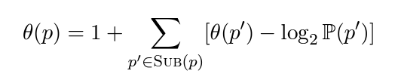
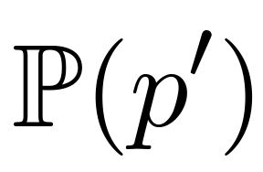
BEE SEARCH¹
Cost Function
is the likelihood from model
¹Saqib Ameen and Levi H.S. Lelis. Program synthesis with best-first bottom-up search. Journal of Artificial Intelligence Research , 2O23.
Notes:
Bustle → rounds off the cost of programs by using a delta function.
limitation of Bustle → actual order of programs does not necessarily reflect the true order of the associated costs.
Bee → orders the program of their true cost.
Bee → It penalizes the cost of the program by negative likelihood -log₂P(p′) instead of binning scheme
- log2(O.1) = 3.321928O9489
- log2(O.99) = O.O1449956969

Slide 17
CROSSBEAM¹
Keeps all generated programs in memory like BUS, BUSTLE and Bee Search.
Uses trained neural network model to create the probability distribution over the existing programs
Samples subprograms from the existing sets to generate next programs.
Use Beam Search or UniqueRandomizer² for sampling
concat ( < , > ) | replace ( < , > ) | … | < | > | …
O.56 | O.12 | ... | O.1 | O.O5 | …
replace(
,
,
)
¹Kensen Shi,Hanjun Dai,Kevin Ellis,and Charles Sutton. Crossbeam:Learning to search in bottom-up program synthesis.arXiv preprint arXiv:22O3.1O452, 2O22.
²Kensen Shi,David Bieber,and Charles Sutton. Incremental sampling without replacement for sequence models. In ICML,volume 119 of Proceedings of Machine Learning Research,pages 8785–8795.PMLR,2O2Ob.
Notes:
READ the slide →

Slide 18

CHALLENGES STILL THERE
Enumeration Search
Program Space
Solution Program
* Icons from @flaticon
Notes:
Still we have the challenge there. →

Slide 19

DREAMCODER
LAPS
HERNANDEZ AND BULITKO (2O21)
RELATED WORKS
Notes:
Learns the library of programs …

Slide 20
DREAMCODER¹
Uses set of training task
Learns a library of programs
Trains a neural network model to guide the search
Library of Programs
Neural Network Model
¹Kevin Ellis, Catherine Wong, Maxwell I. Nye, Mathias Sabl´e-Meyer, Luc Cary, Lucas Morales, Luke B. Hewitt, Armando Solar-Lezama,and Joshua B. Tenenbaum. Dreamcoder:Growing generalizable, interpretable knowledge with wake-sleep bayesian program learning.CoRR, abs/2OO6.O8381,2O2O.URL https://arxiv.org/abs/2OO6.O8381.
Notes:
READ and DESCRIBE WITH A SIMPLE EXAMPLE

Slide 21
LAPS¹
Uses training tasks
Natural language annotations of tasks
Learn a library of programs
Trains a neural network model
Draw a triangle next to a square
Library of Programs
Neural Network Model
¹Catherine Wong, Kevin M Ellis, Joshua Tenenbaum, and Jacob Andreas. Leveraging Language To Learn Program Abstractions And Search Heuristics. In International Conference On Machine Learning, pp. 11193– 112O4. PMLR, 2O21.
Notes:
READ and DESCRIBE

Slide 22
HERNANDEZ AND BULITKO (2O21)
learns a library based on set of training task with different procedure
LIBRARY OF PROGRAMS
SYNTHESIZER
Training Set # 1
replace(concat ( < , > ), < , >)
concat(<,>)
<
>
concat ( < , > )
<
>
Training Set # 2
Subprograms
Program & Selected Subprograms
Sergio Poo Hernandez and Vadim Bulitko. Speeding up heuristic function synthesis via extending the formula grammar. In Proceedings of the International Symposium on Combinatorial Search, volume 12,pages 233–235, 2O21.
Notes:
Similar to … , This approach has two set of training task, [describe]

Slide 23

AUXILIARY GUIDED SYNTHESIS (AGS)
Learn library for a specific Problem
Learn and solve the problem at the same time
OUR APPROACH
Notes:
Now, here comes our approach.
DreamCoder, LAPS and Hernandez → learns the library of programs for the whole domain. We → learn library of programs only for a specific problem.
We → Learn and solve the problem at the same time.

Slide 24

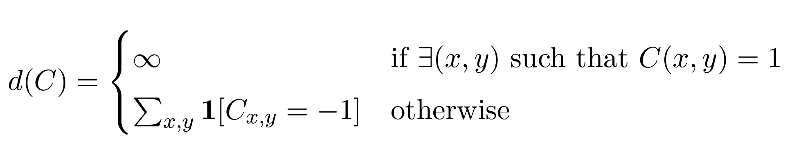
AUXILIARY GUIDED SYNTHESIS (AGS)
Problem Specifications
Domain Specific Language
Auxiliary Function
Base Synthesizer
Learn library for a specific Problem not the whole domain
Learn and solve the problem at the same time
* Icons from @flaticon
Notes:
We need:
Problem Specification
DSL
Domain Dependant Auxiliary Function
Any Base synthesizer

Slide 25
RUNNING EXAMPLE OF AGS
DSL
S → FORWARD(L,Θ)|…
L → 1 | 2
Θ → Θº | 1º | …
T → 1 | 2 | …
Notes:
Now, let's consider this running example.

Slide 26
RUNNING EXAMPLE OF AGS
DSL
PROGRAM LIBRARY
S → FORWARD(L,Θ)|…
L → 1 | 2
Θ → Θº | 1º | …
T → 1 | 2 | …

Slide 27
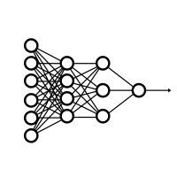
RUNNING EXAMPLE OF AGS
DSL
PROGRAM LIBRARY
BASE SYNTHESIZER
S → FORWARD(L,Θ)|…
L → 1 | 2
Θ → Θº | 1º | …
T → 1 | 2 | …

Slide 28
RUNNING EXAMPLE OF AGS
DSL
PROGRAM LIBRARY
BASE SYNTHESIZER
AUXILIARY FUNCTION
S → FORWARD(L,Θ)|…
L → 1 | 2
Θ → Θº | 1º | …
T → 1 | 2 | …

Slide 29
RUNNING EXAMPLE OF AGS
DSL
PROGRAM LIBRARY
BASE SYNTHESIZER
AUXILIARY FUNCTION
…
HeapQueue …
Score
Program Size
Program String
…
S → FORWARD(L,Θ)|…
L → 1 | 2
Θ → Θº | 1º | …
T → 1 | 2 | …
RANKER

Slide 30
RUNNING EXAMPLE OF AGS
DSL
PROGRAM LIBRARY
BASE SYNTHESIZER
AUXILIARY FUNCTION
…
HeapQueue …
Score
Program Size
Program String
…
S → FORWARD(L,Θ)|…
L → 1 | 2
Θ → Θº | 1º | …
T → 1 | 2 | …
RANKER
SELECTOR
P1
BEST PROGRAM

Slide 31
RUNNING EXAMPLE OF AGS
DSL
PROGRAM LIBRARY
BASE SYNTHESIZER
AUXILIARY FUNCTION
…
HeapQueue …
Score
Program Size
Program String
…
S → FORWARD(L,Θ)|…
L → 1 | 2
Θ → Θº | 1º | …
T → 1 | 2 | …
P1:
PenUp
Forward(12,Oº)
Forward(12,O◦)
PenUp
Forward(12,Oº)
RANKER
SELECTOR
P1
BEST PROGRAM
Augmentation
P1

Slide 32
RUNNING EXAMPLE OF AGS
DSL
PROGRAM LIBRARY
S → FORWARD(L,Θ)|…
L → 1 | 2
Θ → Θº | 1º | …
T → 1 | 2 | …
P1:
PenUp
Forward(12,Oº)
Forward(12,O◦)
PenUp
Forward(12,Oº)

Slide 33
RUNNING EXAMPLE OF AGS
DSL
PROGRAM LIBRARY
BASE SYNTHESIZER
S → FORWARD(L,Θ)|…
L → 1 | 2
Θ → Θº | 1º | …
T → 1 | 2 | …
P1:
PenUp
Forward(12,Oº)
Forward(12,O◦)
PenUp
Forward(12,Oº)

Slide 34
RUNNING EXAMPLE OF AGS
DSL
PROGRAM LIBRARY
BASE SYNTHESIZER
AUXILIARY FUNCTION
S → FORWARD(L,Θ)|…
L → 1 | 2
Θ → Θº | 1º | …
T → 1 | 2 | …
P1:
PenUp
Forward(12,Oº)
Forward(12,O◦)
PenUp
Forward(12,Oº)

Slide 35
RUNNING EXAMPLE OF AGS
DSL
PROGRAM LIBRARY
BASE SYNTHESIZER
AUXILIARY FUNCTION
…
HeapQueue …
Score
Program Size
Program String
…
S → FORWARD(L,Θ)|…
L → 1 | 2
Θ → Θº | 1º | …
T → 1 | 2 | …
P1:
PenUp
Forward(12,Oº)
Forward(12,O◦)
PenUp
Forward(12,Oº)
RANKER

Slide 36
RUNNING EXAMPLE OF AGS
DSL
PROGRAM LIBRARY
BASE SYNTHESIZER
AUXILIARY FUNCTION
…
HeapQueue …
Score
Program Size
Program String
…
S → FORWARD(L,Θ)|…
L → 1 | 2
Θ → Θº | 1º | …
T → 1 | 2 | …
P1:
PenUp
Forward(12,Oº)
Forward(12,O◦)
PenUp
Forward(12,Oº)
RANKER
SELECTOR
P2
P1
BEST PROGRAM

Slide 37
RUNNING EXAMPLE OF AGS
DSL
PROGRAM LIBRARY
BASE SYNTHESIZER
AUXILIARY FUNCTION
…
HeapQueue …
Score
Program Size
Program String
…
S → FORWARD(L,Θ)|…
L → 1 | 2
Θ → Θº | 1º | …
T → 1 | 2 | …
P1:
PenUp
Forward(12,Oº)
Forward(12,O◦)
PenUp
Forward(12,Oº)
P2:
P1
Repeat(4):
Forward(12,9Oº)
RANKER
SELECTOR
P2
P1
BEST PROGRAM
Augmentation
P1
P2

Slide 38
RUNNING EXAMPLE OF AGS
DSL
PROGRAM LIBRARY
BASE SYNTHESIZER
AUXILIARY FUNCTION
…
HeapQueue …
Score
Program Size
Program String
…
S → FORWARD(L,Θ)|…
L → 1 | 2
Θ → Θº | 1º | …
T → 1 | 2 | …
P1:
PenUp
Forward(12,Oº)
Forward(12,O◦)
PenUp
Forward(12,Oº)
P2:
P1
Repeat(4):
Forward(12,9Oº)
RANKER
SELECTOR
SOLUTION
P3
P3:
Repeat(7):
P2
Home(64,64)
Forward(O,51.43º)
P2
P1
BEST PROGRAM
Augmentation
P1
P2
Notes:
P1: PenUp[ Forward(12,O◦) ] Forward(12,O◦) PenUp[ Forward(12,O◦) ] P2: P1 Repeat(4): [Forward(12,9O◦)]
P3: Repeat(7): [P2 Home(64,64) Forward(O,51.43◦)]

Slide 39

A-BUS, A-BUSTLE, A-BEE & A-CROSSBEAM
A-BUS, A-BUSTLE, A-BEE
Added the program as a non-terminal symbol
Cost is considered as 1
A-CROSSBEAM
In addition to adding the program, added random restart as it uses sampling to selected subprograms
To be clear the results, we evaluated restart both with original version and augmented version
If X is over all budget, and we want N restart, then we restarted after program evaluation
Notes:
What are A- X ?
→
READ SLIDE

Slide 40

String Manipulation
Reverse Drawing
EMPIRICAL EVALUATION
* Icons from @flaticon
Notes:
We evaluated our approach into two different domains. …

Slide 41
STRING MANIPULATION
DATASET¹
SyGuS Benchmark¹
89 String Manipulation problems
Problems are string only
38 Benchmark²
More difficult problems
Less example pairs are given
Handcrafted
INPUT
OUTPUT
…
Nancy FreeHafer
Andrew Cencici
…
938-242-5O4
244-655-O94
…
Honda125
Ducati125
…
9O.O
123
…
…
N. FreeHafer
A. Cencici
…
(938) 242 5O4
(244) 655 O94
…
Honda
Ducati
…
9O.OO
123.OO
…
¹Rajeev Alur, Rastislav Bodik, Garvit Juniwal, Milo Martin, Mukund Raghothaman, Sanjit Seshia, RishabhSingh, Armando Solar-Lezama,Emina Torlak,and Abhishek Udupa. Syntax-guided synthesis.In 2O13 Formal Methods in Computer-Aided Design,FMCAD 2O13,pages 1–17,1O 2O13. doi:1O.11O9/FMCAD.2O13.6679385.
²Odena, Augustus, et al. "BUSTLE: Bottom-Up program synthesis through learning-guided exploration.", In ICLR, 2O21.
Notes:
[READ]

Slide 42
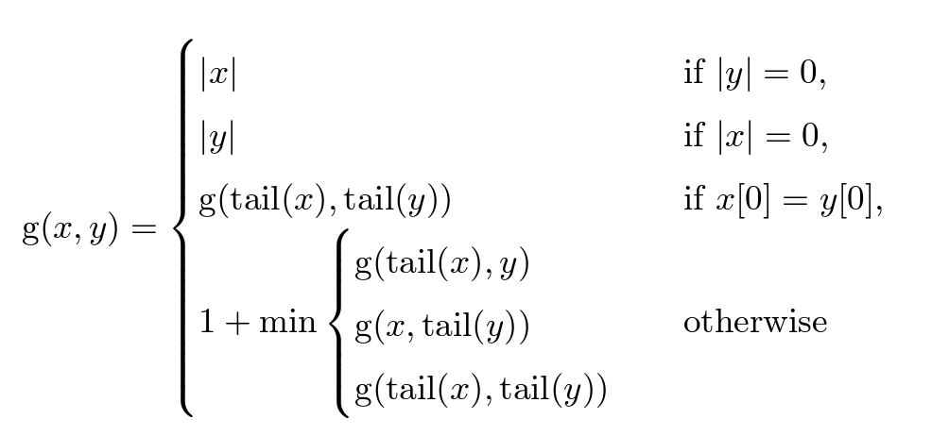
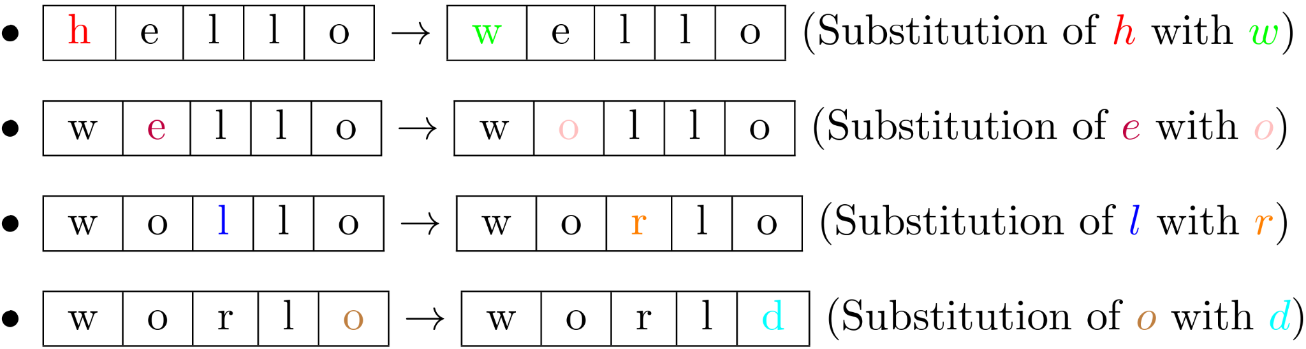
STRING MANIPULATION
AUXILIARY FUNCTION
Measured string edit distance using Levenshtein distance¹
Minimum number of single-character edits (insert, delete or replace) required
¹Vladimir Levenshtein. Binary codes capable of correcting deletions, insertions,and reversals. In Soviet physics doklady, pages 7O7–71O. Soviet Union,1966.
Notes:
[READ]

Slide 43
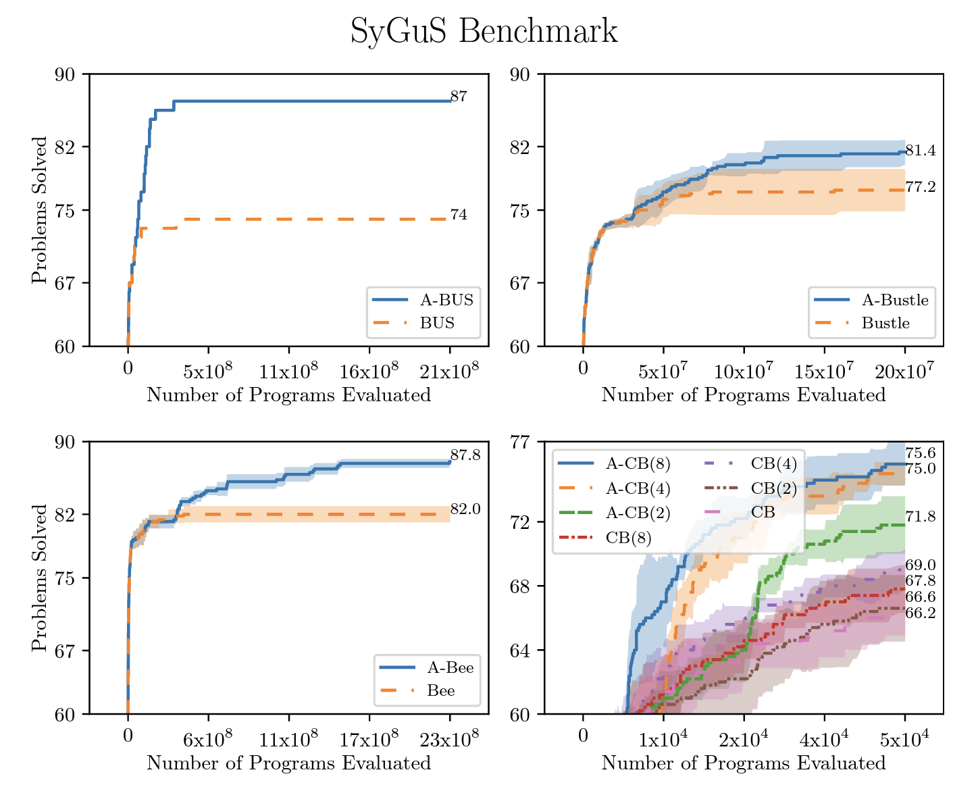
STRING MANIPULATION
SYGUS BENCHMARK RESULTS
Notes:
In X axis, we have the number of program evaluated
In Y axis, we have the number of problem solved

Slide 44
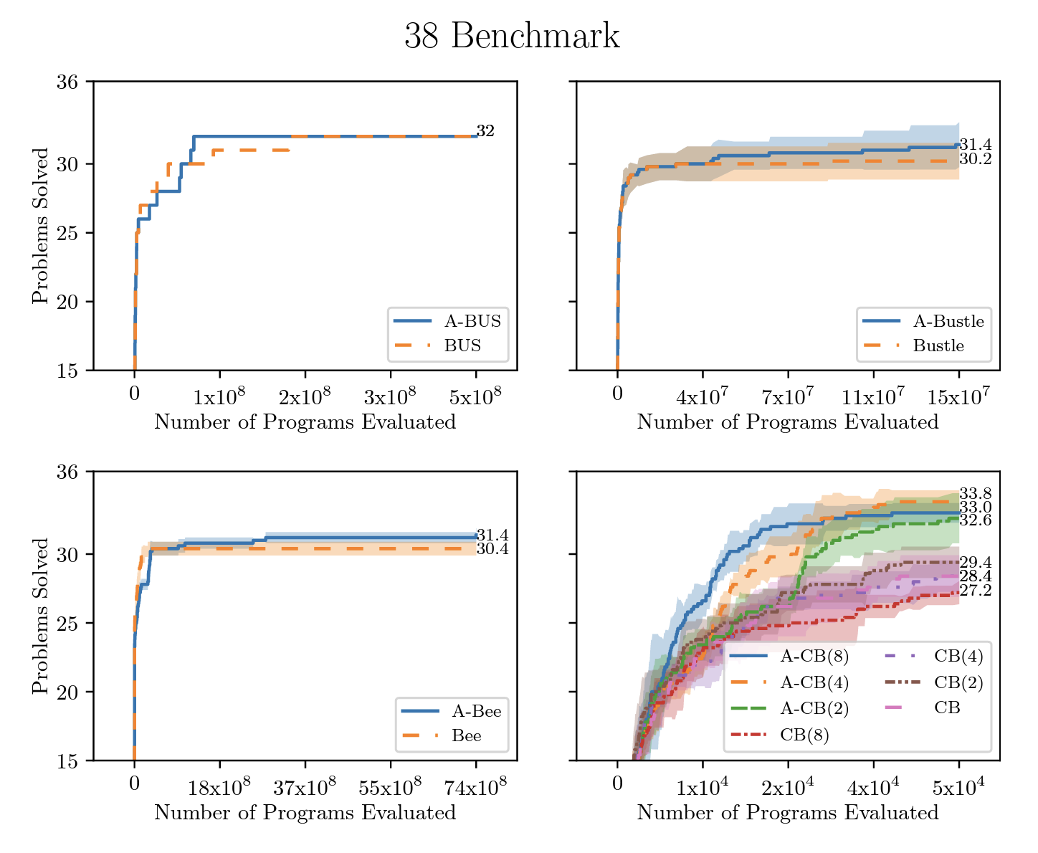
STRING MANIPULATION
38 BENCHMARK RESULTS
Notes:
In X axis, we have the number of program evaluated
In Y axis, we have the number of problem solved

Slide 45
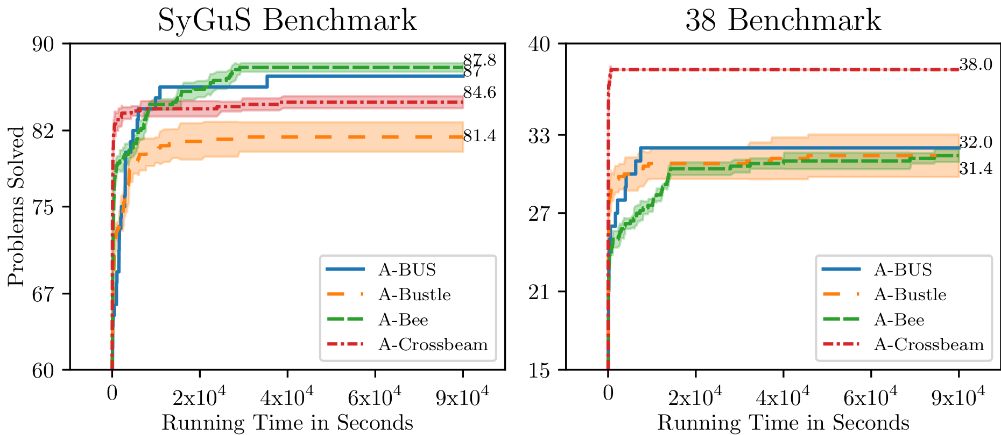
STRING MANIPULATION
SYGUS BENCHMARK AND 38 BENCHMARK - RUNNING TIME
Notes:
In X axis, we have the running time in seconds
In Y axis, we have the number of problem solved
→ Need new dataset

Slide 46

REVERSE DRAWING
DATASET¹
111 Black-and-white images originally from Abelson and DiSessa (1986)
¹Kevin Ellis, Catherine Wong, Maxwell I. Nye, Mathias Sabl´e-Meyer, Luc Cary, Lucas Morales, Luke B. Hewitt, Armando Solar-Lezama,and Joshua B. Tenenbaum. Dreamcoder:Growing generalizable, interpretable knowledge with wake-sleep bayesian program learning.CoRR, abs/2OO6.O8381,2O2O.URL https://arxiv.org/abs/2OO6.O8381.
H.Abelson and A. A. DiSessa. Turtle Geometry: The Computer as a Medium for Exploring Mathematics. MIT Press,1986.

Slide 47
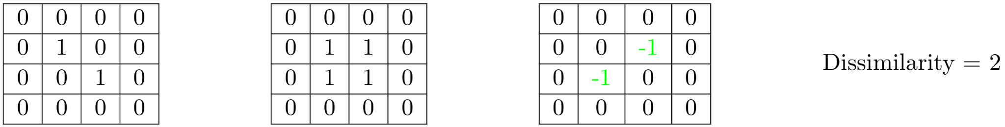
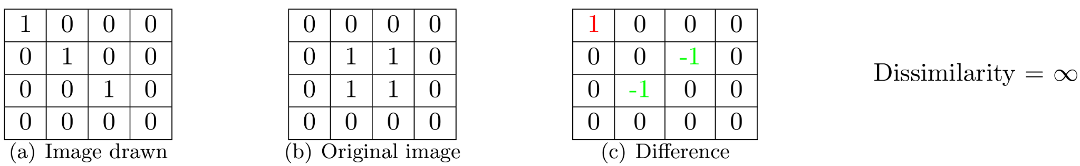
REVERSE DRAWING
AUXILIARY FUNCTION
Measure the overlap between two images
¹Kevin Ellis, Catherine Wong, Maxwell I. Nye, Mathias Sabl´e-Meyer, Luc Cary, Lucas Morales, Luke B. Hewitt, Armando Solar-Lezama,and Joshua B. Tenenbaum. Dreamcoder:Growing generalizable, interpretable knowledge with wake-sleep bayesian program learning.CoRR, abs/2OO6.O8381,2O2O.URL https://arxiv.org/abs/2OO6.O8381.
H.Abelson and A. A. DiSessa. Turtle Geometry: The Computer as a Medium for Exploring Mathematics. MIT Press,1986.

Slide 48
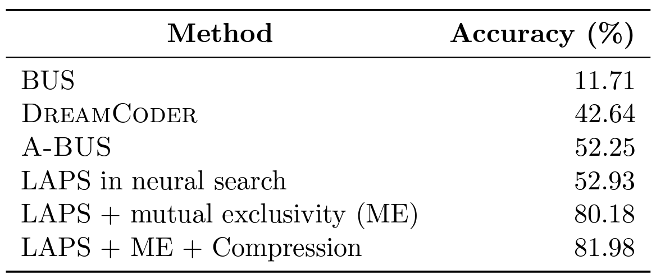
REVERSE DRAWING
RESULTS
¹Kevin Ellis, Catherine Wong, Maxwell I. Nye, Mathias Sabl´e-Meyer, Luc Cary, Lucas Morales, Luke B. Hewitt, Armando Solar-Lezama,and Joshua B. Tenenbaum. Dreamcoder:Growing generalizable, interpretable knowledge with wake-sleep bayesian program learning.CoRR, abs/2OO6.O8381,2O2O.URL https://arxiv.org/abs/2OO6.O8381.
²Catherine Wong, Kevin M Ellis, Joshua Tenenbaum, and Jacob Andreas. Leveraging language to learn program abstractions and search heuristics. In International Conference on Machine Learning, pp. 11193– 112O4. PMLR, 2O21.

Slide 49

TAKE AWAY
Offers Orthogonal search guidance
Offers advantages of task specific learning approaches
Effective way to inject domain knowledge into synthesizer
* Icons from @flaticon
Notes:
It offers orthogonal search guidance over the existing functions
It offers advances of task specific learning, instead of whole domain specific approach
It offers an effective way to inject domain knowledge into synthesizer

Slide 50

* Icons from @flaticon

Slide 51
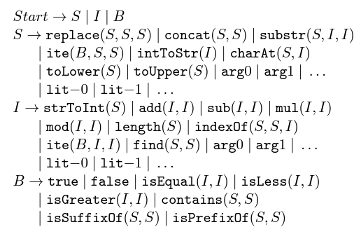
DOMAIN SPECIFIC LANGUAGE (DSL)
S | → | 𝛌 | 𝛌.𝛌
𝛌 | → | Forward(ℒ,⊝,⨱) | Repeat(S,N, FLAG)| Penup(S) | Home(S)
⊝ | → | ⊝_{u}|⊝_{O}|⊝_{u}⋈C|⊝⋈C|⊝⋈⊝|⊝∊
ℒ | → | ℒ_{u} | ℒ_{O} | ℒ_{u} ⋈ C | ℒ ⋈ ℒ | ℒ∊
⋈ | → | | - | * | /
N,C, i | → | 1 | 2 | 3 | … | 9
ℒ_{u} | → | 12
ℒ_{O} | → | O
ℒ∊ | → | 1
⊝_{u} | → | 36O^{O}
⊝_{O} | → | O^{O}
⊝∊ | → | 9^{O}
FLAG | → | TRUE | FALSE
⨱ | → | i if FLAG is TRUE else 1

Slide 52


WE HAVE LLMs…
LLMs have some limitations:
Correctness of the code they produce
Needs large amount of data to train
not good fit, where we need large amount of exploration
* Icons from @flaticon
Notes:
[READ]
So despite of the success of LLMs, program synthesis is still an active area of research.

