Slide 1


LE’S BOOK STORE
LE’S BOOK STORE
Presented By
Presented By
Presented By
Supervised By
HABIBUR RAHMAN
18CSE048
DEPT. CSE, BSMRSTU
Abu Bakar Muhammad Abdullah
Assistant Professor
Dept. CSE, BSMRSTU
HABIBUR RAHMAN
18CSE048
DEPT. CSE, BSMRSTU
Abu Bakar Muhammad Abdullah
Assistant Professor
Dept. CSE, BSMRSTU

Slide 2








OUTLINE
Introduction
1
2
Objective
Related Work
3
4
Contribution
Problem Definition
5
6
System model
Experimental Results
7
8
Conclusion

Slide 3

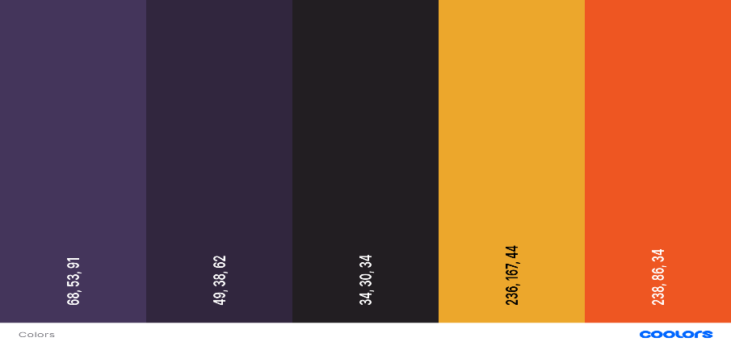
A web application that allows users to browse and purchase books.
Developed using Spring Boot.
INTRODUCTION
What is Le’s Book Store?

Slide 4
INTRODUCTION
Anyone who wants to buy books from online.
What is Le’s Book Store?
What are the target audience?

Slide 5
INTRODUCTION
What is Le’s Book Store?
Lightweight and easy-to-use framework.
Quick and easy to develop web applications.
What is the target audience?
Why spring boot?

Slide 6




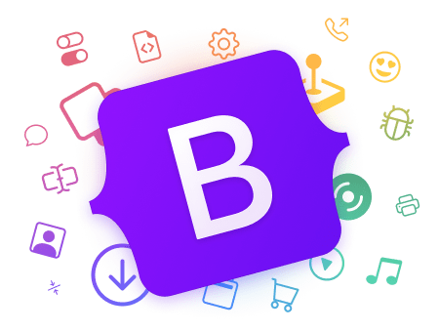
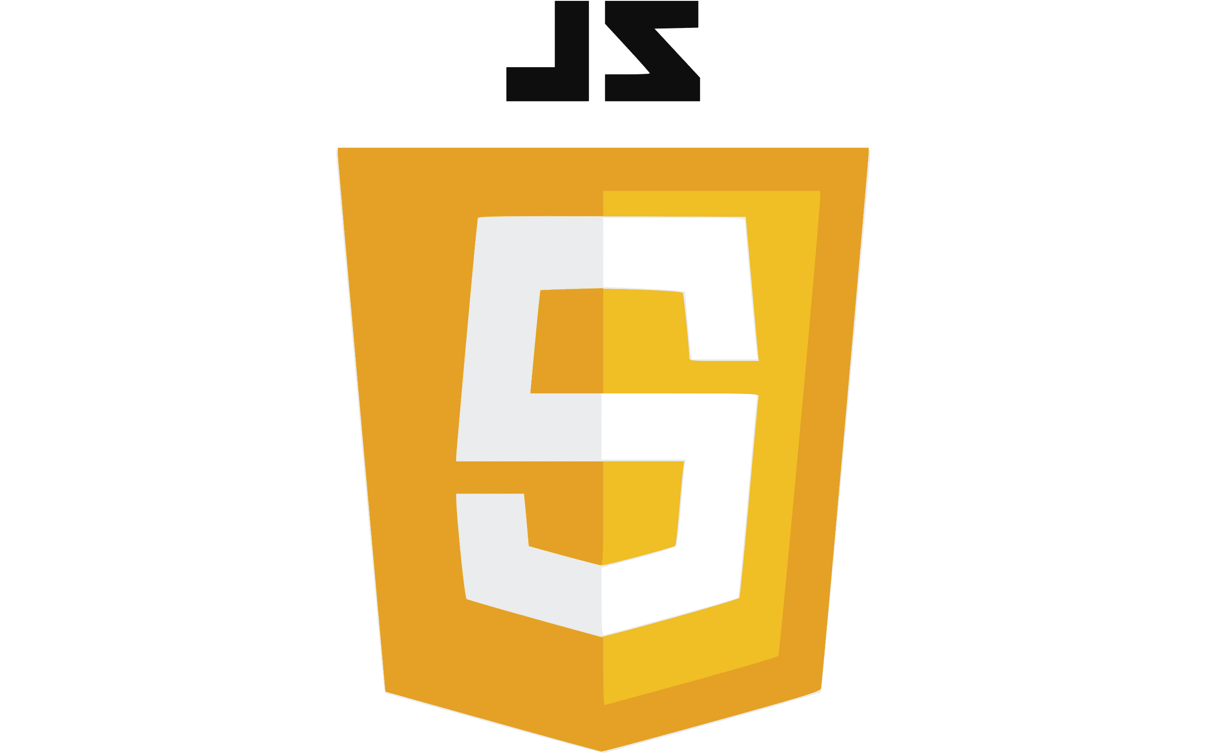
INTRODUCTION
What is Le’s Book Store?
What is the target audience?
Why spring boot?
Technology Stack ?

Slide 7

OBJECTIVE
1
2
3
4
To develop a web application that allows users to browse and purchase books
To provide a simple and easy-to-use interface for users to find and buy books.
To use Spring Boot to develop a lightweight and scalable application
To host the application on cloud to make it accessible to users around the world

Slide 8

RELETAD WORKS
Some Related Works helps me to do the project
FINCAR/JAVA BOOK STORE
NISIB/BOOKSTORE
CRUD OPERATION
BOOK STORE MANAGEMENT
The project uses a number of Spring Boot features, including JPA, Thymeleaf, and Spring Security.
01
The project uses a number of different technologies, including MySQL, Lombok, and Swagger.
02
This article provides a step-by-step guide on how to develop a book store API using Spring Boot and MySQL.
03
This demonstrates how to create a simple book store application using Spring Boot, MySQL, Thymeleaf, and JPA.
04

Slide 9



The application could demonstrate the use of Spring Boot, JPA, Thymeleaf, and other popular technologies. This could help to educate other developers about these technologies and how they can be used to develop web applications.
CONTRIBUTION
Software Development
Book Industry
Community

Slide 10
COTRIBUTION
CONTRIBUTION
CONTRIBUTION
The application could provide a new way for people to buy books. This could help to increase the visibility of independent bookstores and other small businesses.
Software Development
Book Industry
Community

Slide 11
CONTRIBUTION
CONTRIBUTION
CONTRIBUTION
Software Development
The application could provide a platform for people to share their love of books. This could help to build a sense of community among book lovers.
Book Industry
Community

Slide 12



PROBLEM DEFINATION
Problem
Solution
Benefits
There is a need for a simple and easy-to-use web application that allows users to browse and purchase books where user information's are authenticated and protected.
01
The book store application is developed using Spring Boot, JPA, and Thymeleaf. The application will provide a user-friendly interface for users to find and buy books where their informations are protected with high level security.
02
The book store application will provide a convenient and user-friendly way to purchase books.
03

Slide 13
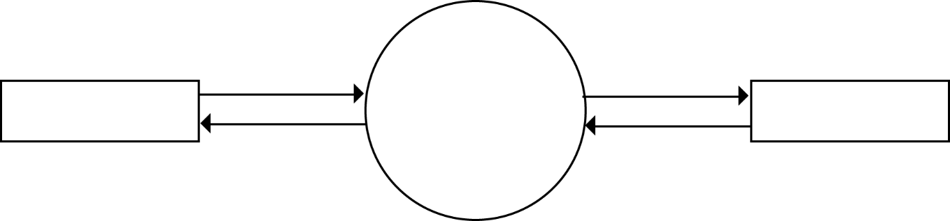
System Model
Data Flow Diagrams
0 - Level
Admin Process
Books & other
details
Orders receipt &
confirmation
Admin
Book
Store
User
User Registration
Orders & Details
Personal details &
Select product
Shopping & Checkout
Use Case Diagram

Slide 14
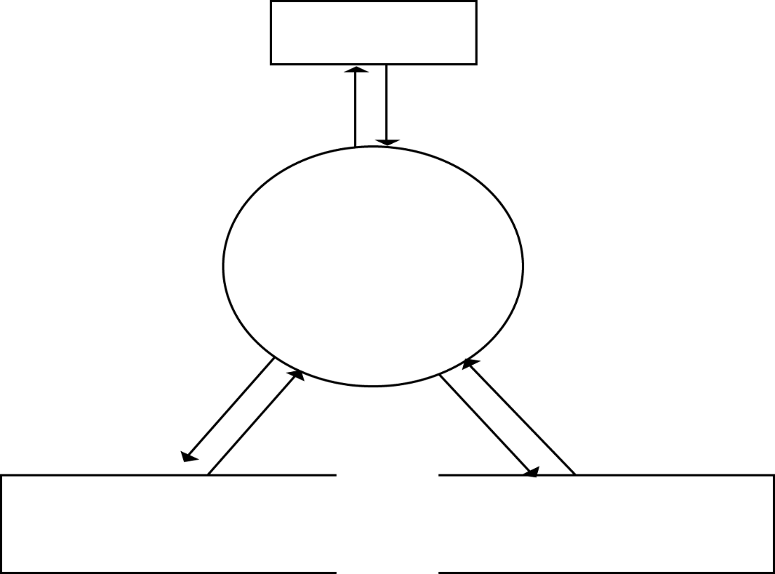
System Model
Data Flow Diagrams
Admin
0 - Level
status
Data
Admin Process
Admin
Process
User Registration
store
Shopping & Checkout
access
review
process
Book
Order
Use Case Diagram

Slide 15
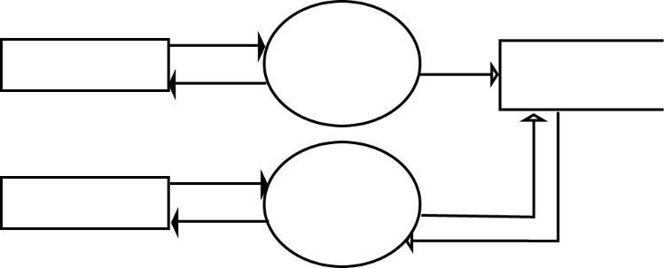
System Model
Data Flow Diagrams
0 - Level
Enter data
Registration
Process
User
User
Details
Register
Admin Process
status
User Registration
Edit data
Data
User
Profile
Update
View Profile
Shopping & Checkout
status
Updates
Use Case Diagram

Slide 16
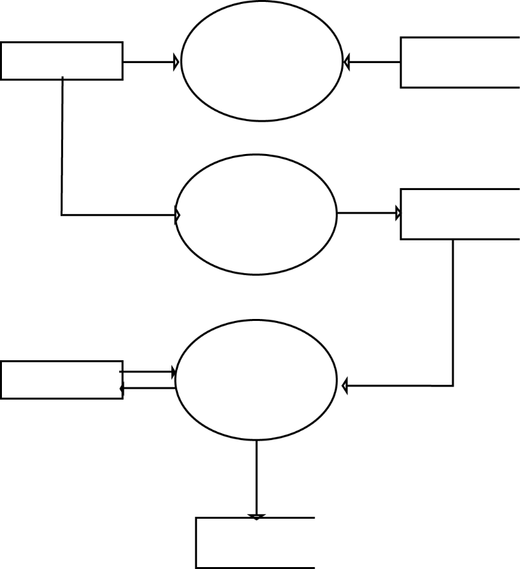
System Model
Login
Select
Product
Data Flow Diagrams
User
Book
Book Info
0 - Level
Enter data
Add to Cart
Select
Product
Cart
Admin Process
User Registration
Shipping address & Confirmation
Cart Details
Admin
Checkout
Shopping & Checkout
Confirmation&
receipt
Use Case Diagram
Place Order
Order

Slide 17
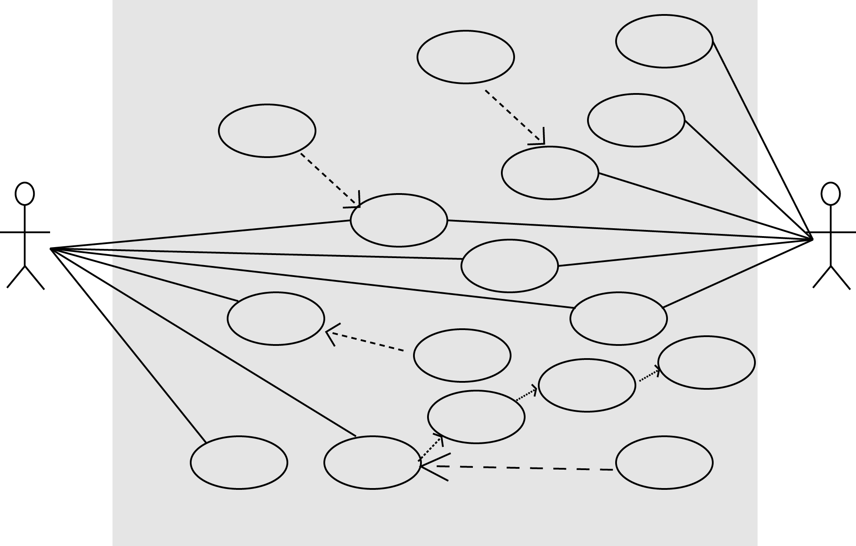

System Model
Data Flow Diagrams
Update
Price
View
Orders
0 - Level
Update
Price List
Update
Books
View
Price List
Admin Process
View
Profile
Contact
Supplier
User Registration
View
Orders
Make
Inquiry
Customer
Cancel
Order
Admin
Billing
Address
Shopping & Checkout
Shipping
Address
Payment
Method
View
Books
Place
Orders
Register
Customer
Use Case Diagram
Login

Slide 18
EXPERIMENTAL RESULT
Some bugs are solved during the experimental debugging.
Images doesn’t loading from the database
Some user information are not updated
Ambiguous Information make system error during registration and update information

Slide 19
CONCLUSION
I am proud of the book store application that I have created. I learned a lot about Spring JPA and other technologies while developing this project. I also learned how to identify and fix bugs. I am confident that this project will be a valuable addition to my portfolio.

Slide 20
Future work
Add a review system
Add wish list
Add a notification system
Add a mobile app
Add some AI
Add a voice search and image search feature

Slide 21
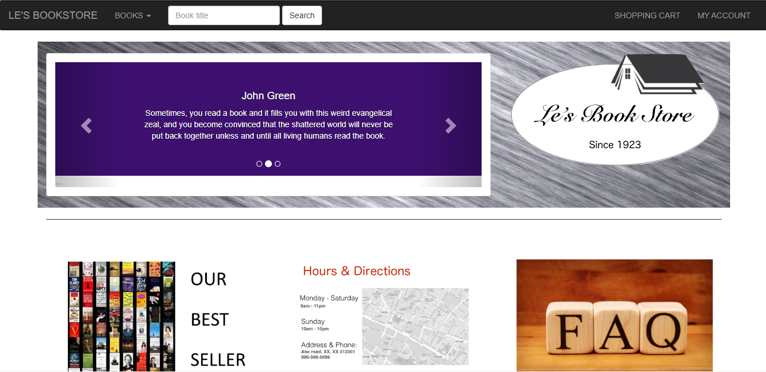
Thank You

