Slide 1
Abstractive Text Summarization
Major project
Submitted To: Submitted By:
Mr. Faiyaz Ahmad Khan Mohd Arquam(17BCS008)
Habibur Rahman(17BCS071)
Saman Rashid(17BCS094)
Department of Computer Engineering,
Jamia Millia Islamia
Session: 2020-21

Slide 2
Table of contents:
Topic
1.Introduction
2.Literature review
3.Problem statement
4.Proposed methodology
5.Dataset description
6.Implementation
7.Experimental Results
8.Conclusion
9.Suggestions for Future work
10.Programming Environment & Tools used
11.References

Slide 3
Introduction: Why do we need a text summarizer?
Reduces human labour.
Saves reading time.
Helps avoid confusion in reading long and complex texts.
Easy to understand.
Enables good retention of information.

Slide 4
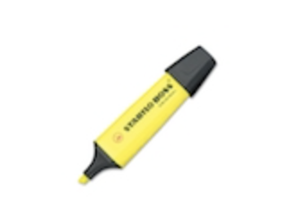

Introduction: What are the types of text summarizers?
Text Summarizers can be broadly classified into two types:
Extractive text summarizers.
Abstractive text summarizers.

Slide 5
Introduction: Extractive Text Summarizers
It is based on “Text Extraction”.
It picks up sentences/phrases from the original text.
The important information from the source text is picked.
Hence, in this type of summarization, every word and phrase of the summary generated belongs to the original text.

Slide 6
Introduction: Limitations of Extractive summarizers
Extractive summarizers have the following limitations:
Since extractive summarizers use the exact same sentences/phrases as in the original text, sometimes this may generate a summary containing less important information because a part of a sentence may contain useful information, but the rest of it may be useless.
Another issue is the use of pronouns in the original text. When a certain sentence/phrase in the text containing a pronoun is included in the summary, it may be ambiguous to what the pronoun is referring to.

Slide 7
Introduction: Abstractive Text Summarizers
Unlike extractive summarizers, abstractive summarizers do not select exact sentences from the original text.
This type of summarizers generate new sentences from the original text without missing any relevant/important information.
The generated summary may contain words/phrases that do not appear in the original text.

Slide 8
Introduction: Abstractive Text Summarizers
These summarizers use a vocabulary set different from the original text.
These summarizers follow a similar approach as that of humans.
Humans generate a semantic representation of the text in their brains. Then they pick words from their general vocabulary to fit into the semantics and thus generate a short summary that includes all the important/relevant information.

Slide 9
Introduction: Evaluation metrics
We used ROUGE scores for evaluating the performance of our model.
ROUGE is a set of metrics used for evaluating automatic text summarization and machine translation in NLP.
We used the following three metrics:
ROUGE-1
ROUGE-2
ROUGE-L

Slide 10
Literature Review: Application of Sequence-to-Sequence RNNs
Most of the work on abstractive summarizers is based on sequence to sequence RNNs.
Recurrent Neural Networks(RNNs) are a class of neural networks that use previous outputs as inputs for each step.
Sequence-to-Sequence models are often used to solve problems involving sequential data. E.g.: Text translation, Question answering, and Text summarization.
An encoder-decoder architecture is used when input and output texts are of different lengths as in our case of text summarizer.
To remember the inputs having significant impact on the summary, an attention mechanism is used.

Slide 11
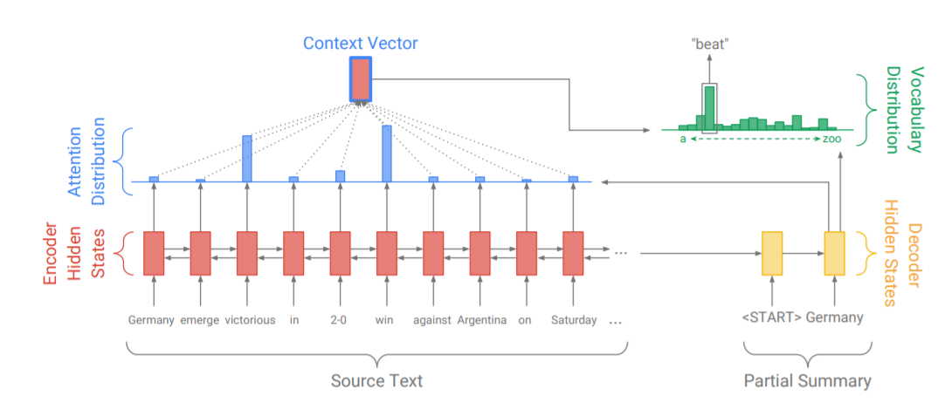
Literature Review: Application of Sequence-to-Sequence RNNs

Slide 12
Literature Review: Application of Sequence-to-Sequence RNNs
Tokens of the original text (w_{i}) are fed one by one into the encoder, which is a single layer bi-directional LSTM (Long Short Term Memory).
The encoder outputs a sequence of encoder hidden states (h_{i}).
On each step t, the decoder receives the word embedding of the previous word and has decoder state s_{t}.

Slide 13
Literature Review: Application of Sequence-to-Sequence RNNs
The attention distribution is calculated as,
e^{t}_{i} = v^{T} tanh( W_{h}h_{i} + W_{s}s_{t} + b_{attn})
a^{t} = softmax( e^{t} )
Where v, W_{h}, W_{s}, and b_{attn} are learnable parameters.
The attention distribution can be considered as a probability distribution over the source words, that tells the decoder where to look to produce the next word.
-Information source: “NEURAL MACHINE TRANSLATION BY JOINTLY LEARNING TO ALIGN AND TRANSLATE”: Dzmitry Bahdanau, KyungHyun Cho, Yoshua Bengio

Slide 14
Literature Review: Application of Sequence-to-Sequence RNNs
The weighted sum of the encoder hidden states is calculated using the attention distribution. This is known as context vector h_{t}*
This vector is then concatenated with the decoder state s_{t} and fed through two linear layers to produce the vocabulary distribution, P_{vocab}.
P_{vocab} = softmax (V’ (V[s_{t}, h_{t}*]+b)+b’)
Where V’, V, b, and b’ are learnable parameters.

Slide 15
Literature Review: Application of Sequence-to-Sequence RNNs
P_{vocab} gives the final distribution from which to predict words w.
P(w) = P_{vocab}(w)
Information Source: “Get To The Point: Summarization with Pointer-Generator Networks”: Abigail See, Peter J. Liu, Christopher D. Manning

Slide 16
Problems Statement
There are two major problems with using Sequence-to-Sequence models for text summarization:
Sometimes the generated summary contains inaccurate facts due to encountering of out of vocabulary words.
Sometimes phrases/words get repeated multiple times in the summary.

Slide 17
Proposed methodology
To tackle the problem of inaccurate facts, we will use a hybrid pointer generator that can copy words from the original text via pointing. This helps deal with the problem of out of vocabulary words. However, it is ensured that the ability to generate new words is not compromised.
To avoid the repetition of words/phrases in the summary, we use a coverage vector to track and control the coverage of the original text. This will avoid repetition.

Slide 18
Proposed methodology: Pointer-generator networks
The pointer-generator enables copying words from the original text via pointing as well as generate words from a fixed vocabulary.
In this model the attention distribution (a^{t}) and the context vector (h_{t}*) are calculated as before.
Also a ‘generation probability’ (p_{gen}), whose value is either 0 or 1, is calculated for timestep t using the context vector (h_{t}*), decoder state (s_{t}), and the decoder input (x_{t}):
p_{gen} = sigmoid(w_{h}^{T} h_{t}* + w_{s}^{T} s_{t} + w_{x}^{T} x_{t} + b_{ptr} )
Where w_{h}, w_{s}, w_{x}, and b_{ptr} are learnable parameters.

Slide 19
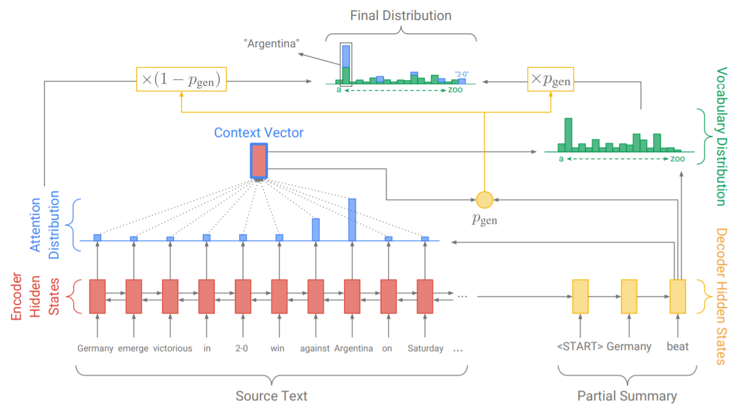
Proposed methodology: Pointer-generator networks

Slide 20
Proposed methodology: Pointer-generator networks
After calculating p_{gen}, we use it as a switch to choose between generating a word from the available vocabulary by sampling from P_{vocab} or copying a word from the original text by sampling from the attention distribution.
Thus we obtain the following probability distribution:
P(w) = (p_{gen}*P_{vocab} (w)) + ((1 - p_{gen}) * ∑a^{t}_{i})
Information Source: “Get To The Point: Summarization with Pointer-Generator Networks”: Abigail See, Peter J. Liu, Christopher D. Manning

Slide 21
Proposed methodology: Coverage Vector
We use the coverage mechanism to avoid repetition of words/phrases.
In this model, we maintain a coverage vector (c^{t}) which is the sum of attention distribution all previous decoder steps.
c^{t} = ∑a^{t}
Hence, the coverage vector can be said as the distribution over the original text words.
Hence it represents the degree of coverage that those words have received from the attention mechanism so far.

Slide 22
Proposed methodology: Coverage Vector
The coverage vector is added to the equation of attention distribution:
e^{t}_{i} = v^{T} tanh( W_{h}h_{i} + W_{s}s_{t} + W_{c}c^{t}_{i} + b_{attn})
Information Source: “Get To The Point: Summarization with Pointer-Generator Networks”: Abigail See, Peter J. Liu, Christopher D. Manning

Slide 23
Dataset description: Dataset Used
The dataset used contains over 3,00,000 news articles.
These news articles belong to two prominent news agencies:
CNN
Dailymail
The source of the dataset is: www.tensorflow.org/datasets/catalog/cnn_dailymail

Slide 24
Dataset description: Dataset Used
The distribution of the dataset will be as follows:
Testing: 10,000 articles.
Validation: 10,000 articles.
Training: Rest of the dataset (Around 2,90,000).
Also, since the number of Dailymail articles(2,19,000) is greater than the number of CNN articles(92,000), the data from both sets have been divided proportionately in the aforementioned distribution (Testing, Validation, and Training).

Slide 25
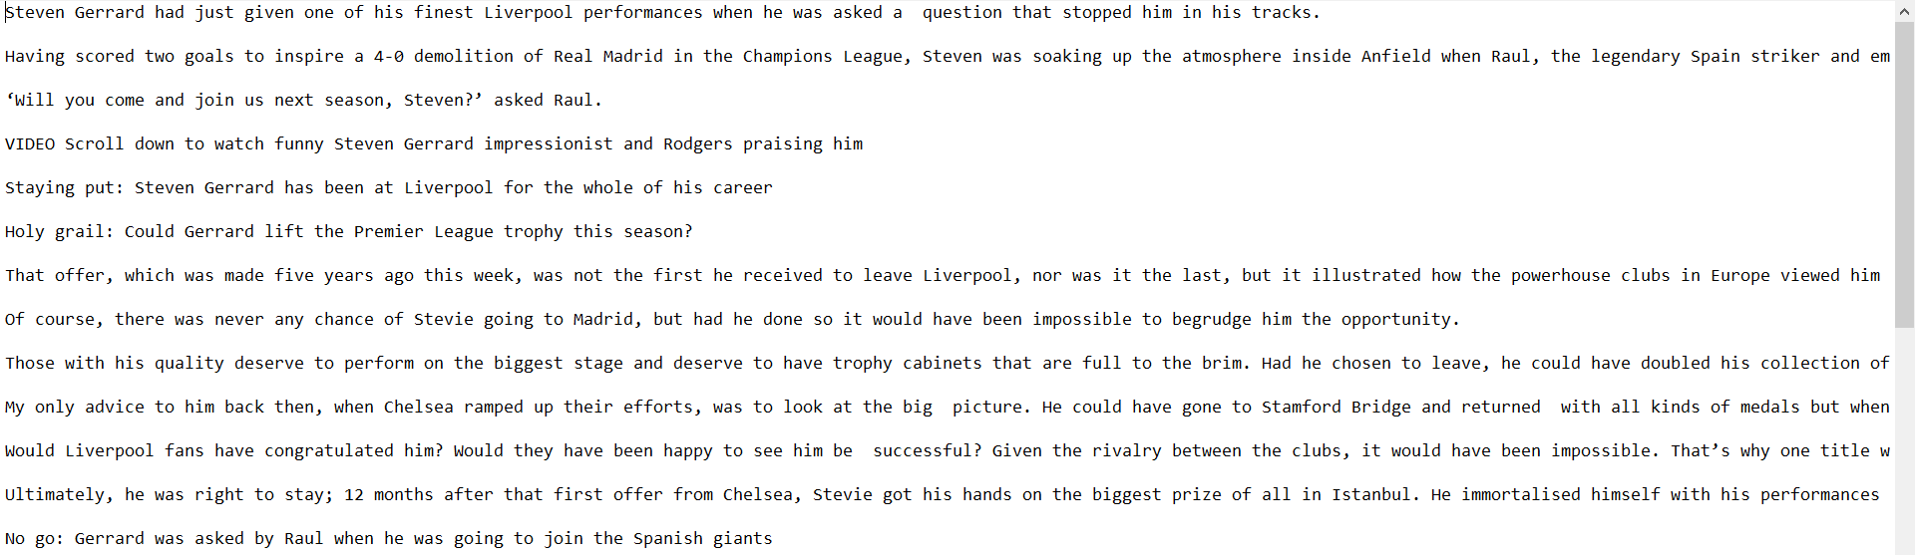
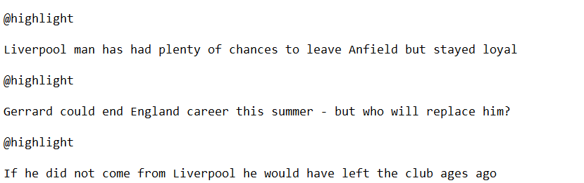
Sample from Dataset
News Article:
Reference summary:

Slide 26
Implementation: Data Preparation
Before using the dataset we first prepare the data to be ready for fast and efficient processing.
We first tokenize the data, then we convert our data into binary format, and then we divide the data into many files for our convenience.

Slide 27
Implementation: Tokenization
Since we are using Recurrent Neural Networks, we use sequential data in the form of tokens.
To generate these tokens we perform tokenization of our articles as well as reference summaries.
For tokenization, we use Stanford NLP Tokenizer which is a software that has been developed by Stanford University.

Slide 28

Sample from Dataset after tokenization

Slide 29
Implementation: Creating vocabulary
We also count the number of time each token appears in the dataset.
With this we create a vocabulary file which list the token(word) and its frequency over the dataset.

Slide 30
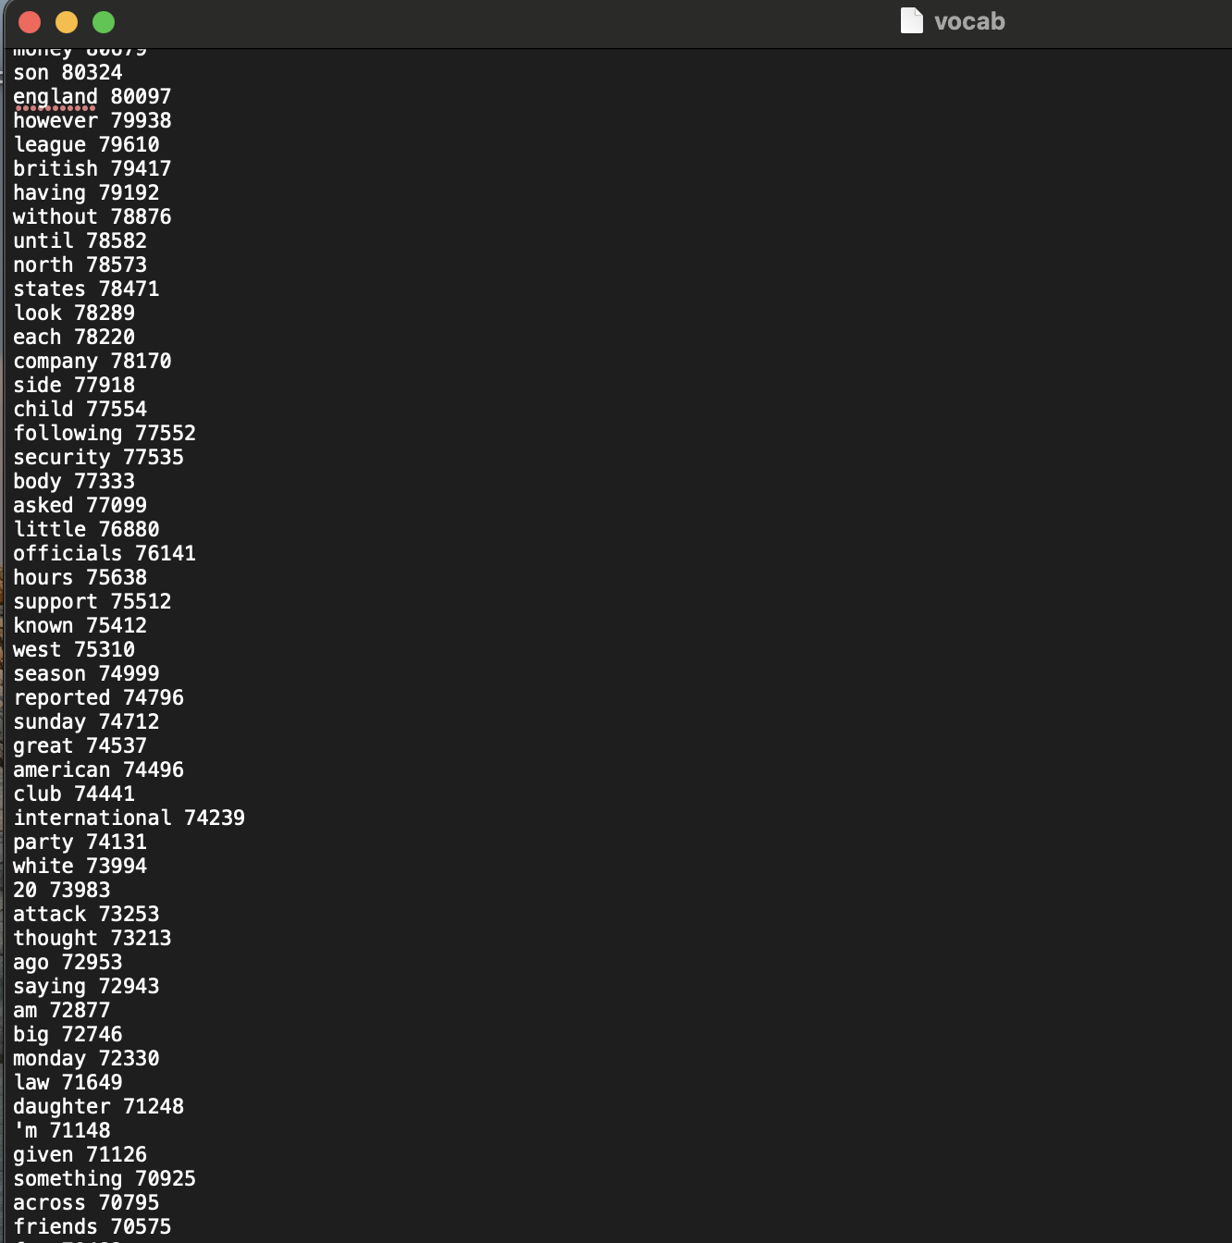
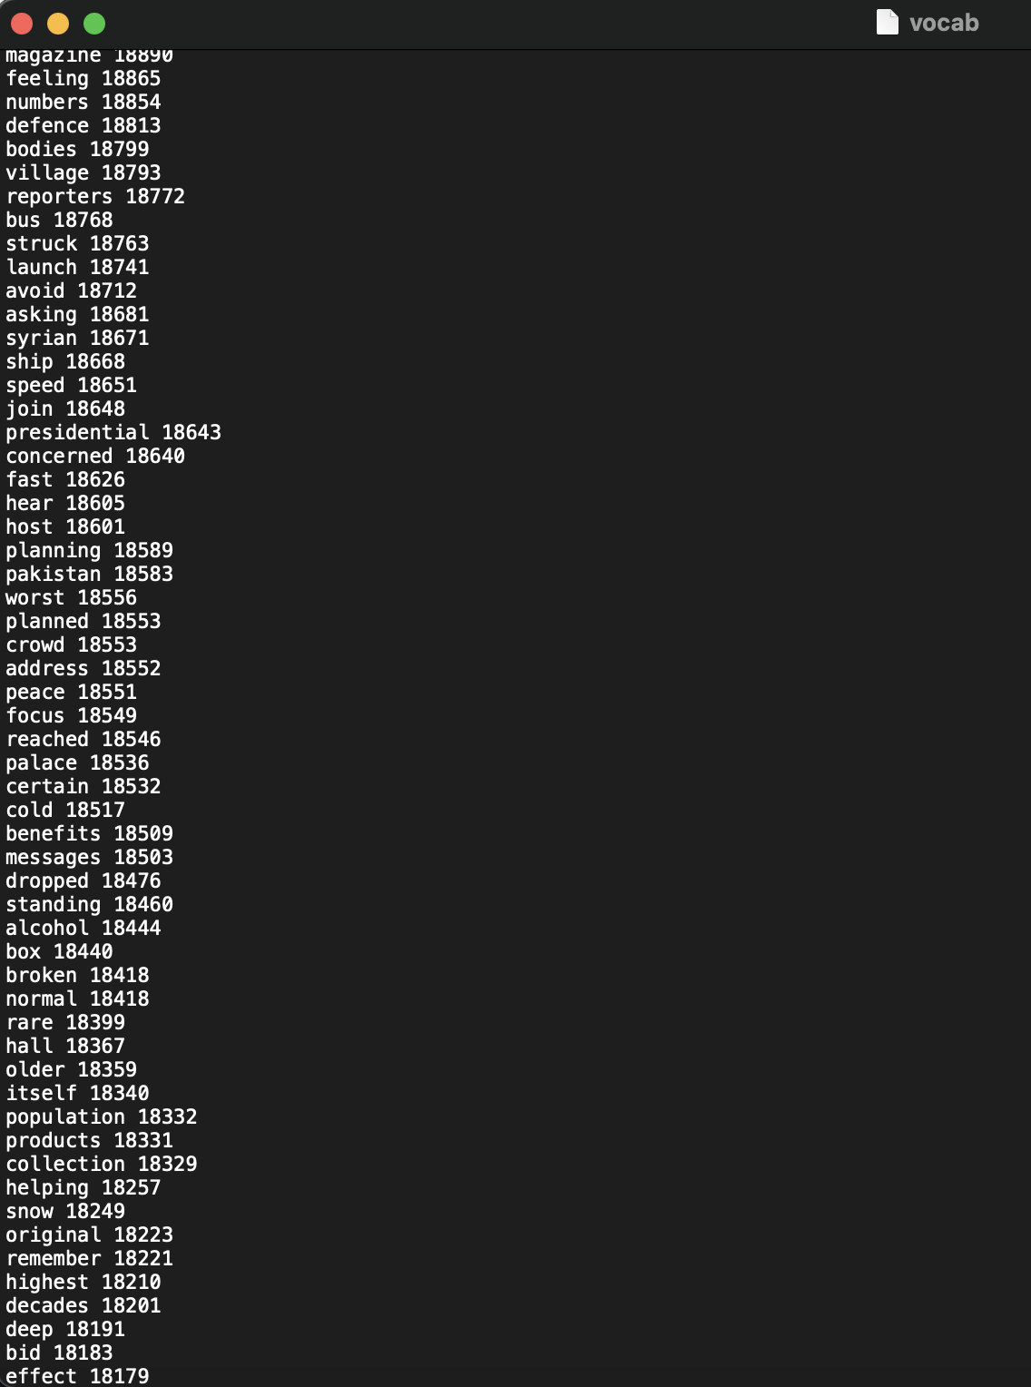
Implementation: Vocabulary File

Slide 31
Implementaion: Creating binary files
Next, we convert the tokenized files into .bin(binary) files.
This is done to enable better efficiency and speedup the training process.
We generate three files:
Train.bin
Valid.bin
Test.bin

Slide 32
Implementaion: Hyperparameters values
The following are the values of hyperparameters used in our model:
Batch size= 16
Word embeddings dimension= 128
Vocabulary size= 50,000
Learning rate= 0.25
Maximum encoder steps= 400
Maximum decoder steps= 100

Slide 33
Implementation: Tensorflow Model
Tensorflow is a library in python which enables us to build machine learning models.
We created a tensorflow model for our summarization training and validation.
This model is training the dataset to generate weights and thus give us the optimal text summarizer.
We use the function: tensorflow.nn.bidirectional_rnn() for our bidirectional LSTM encoder.

Slide 34
Experimental Results
The model was trained using Google Colaboratory on around 3,00,000 news articles.
It was trained for around 2,50,000 iterations (around 15 epochs).
The model was validated on another 10,000 articles to check for overfitting.
The model was also tested on 10,000 articles.

Slide 35
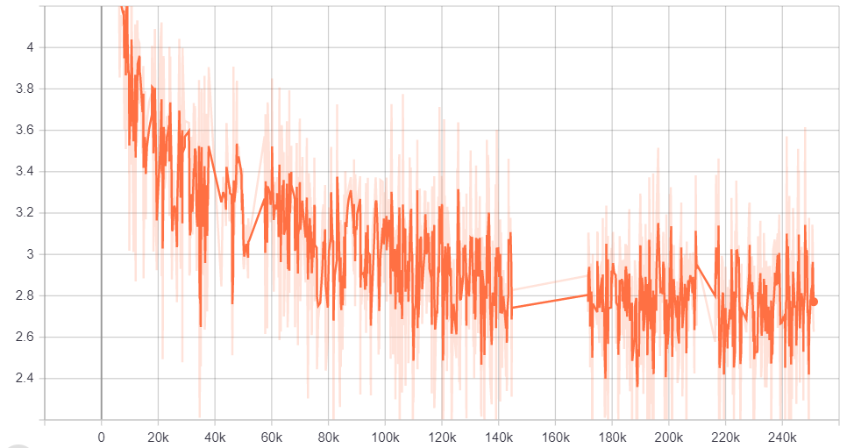
Experimental Results:Training Loss

Slide 36
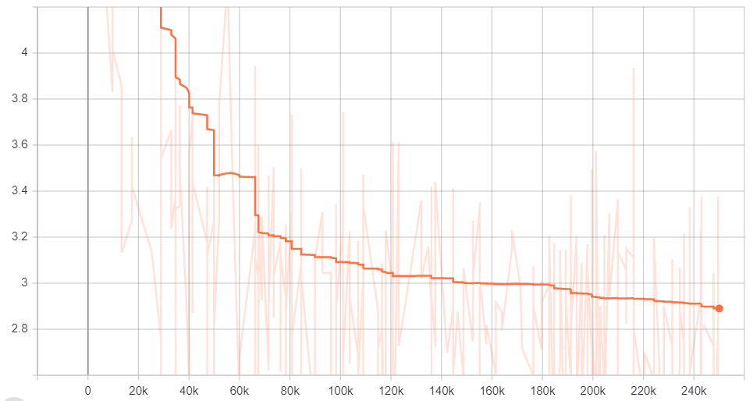
Experimental Results:Validation Loss

Slide 37
Experimental Results: ROUGE Results
 | F-score | Recall | Precision
ROUGE-1 | 0.3856 | 0.3891 | 0.4069
ROUGE-2 | 0.1672 | 0.1679 | 0.1779
ROUGE-L | 0.3539 | 0.3570 | 0.3737

Slide 38
Experimental Results: A brief comparison with some other models
Model | ROUGE-1 | ROUGE-2 | ROUGE-L
Words-lvt2k-temp-att (2016) | 35.46 | 13.30 | 32.65
Maximum-likelihood + RL, with intra-attention (2017) | 39.87 | 15.82 | 36.90
BiSum (2018) | 37.01 | 15.95 | 33.66
TRANS-ext + filter + abs (2019) | 41.89 | 18.90 | 38.92
DAPT + imp-coverage (RL + MLE (ss)) (2020) | 40.72 | 18.28 | 37.35
Our model | 38.56 | 16.72 | 35.39

Slide 39
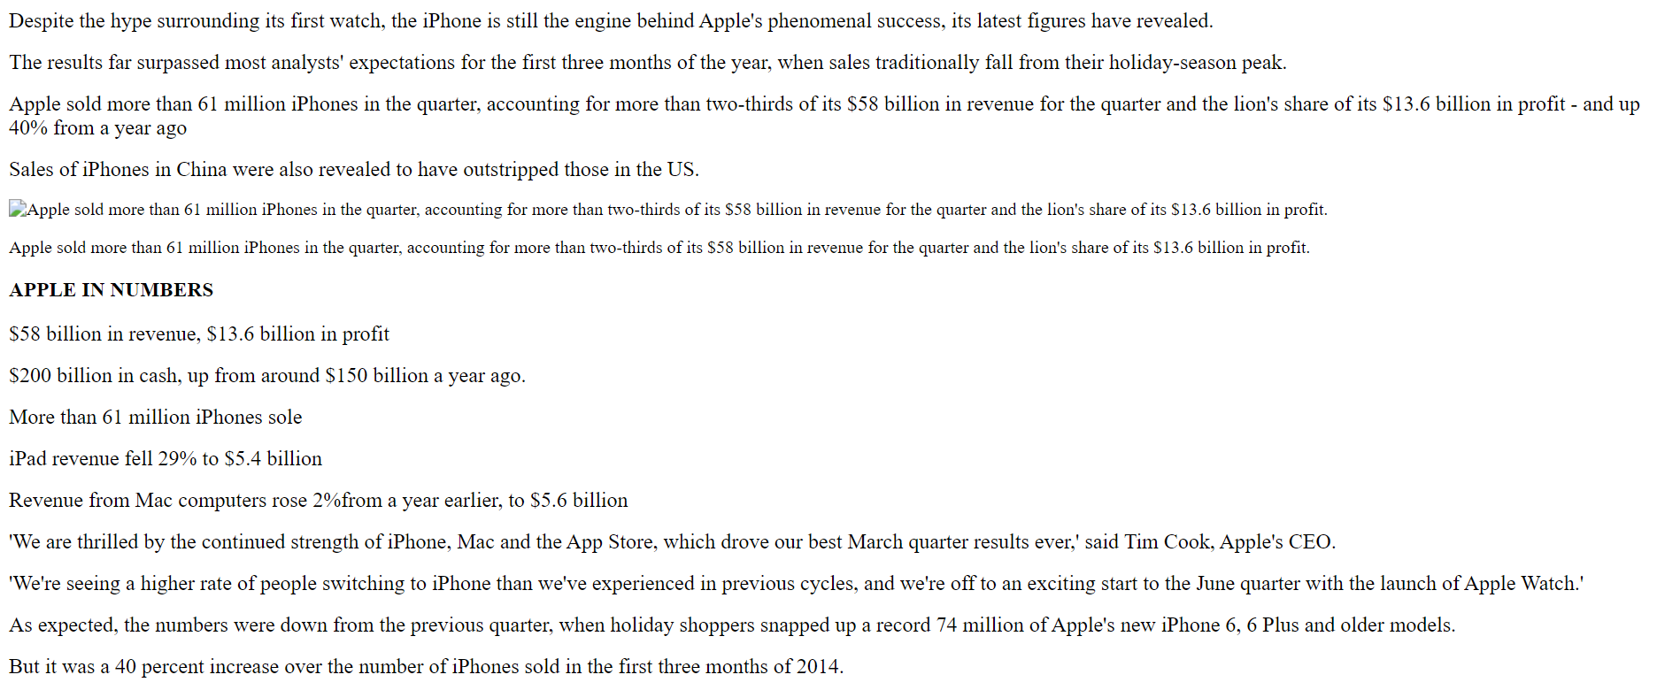
News Article
Experimental Results: Sample Result

Slide 40
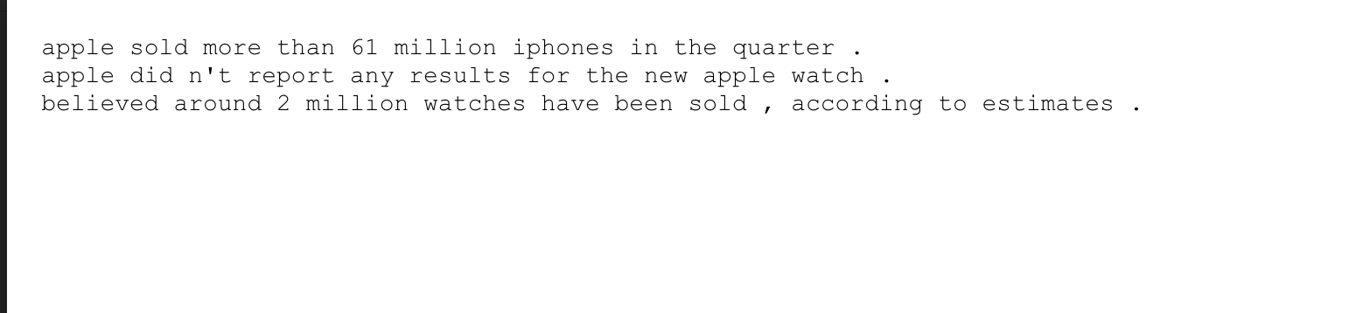
Experimental Results: Sample Result
Reference Summary

Slide 41
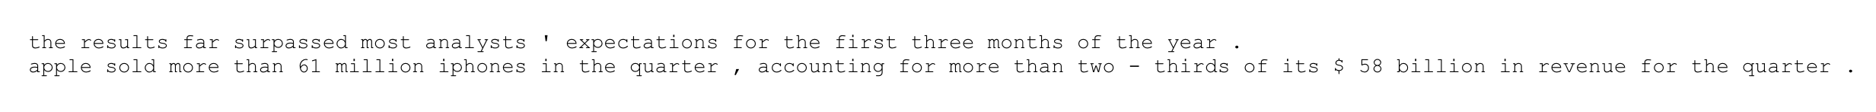
Experimental Results: Sample Result
Generated Summary

Slide 42
Conclusion
In this project we used a hybrid pointer- generator model to reduce inaccuracies in generated summaries.
We also used coverage mechanism to avoid repetition of phrases and words.
Our model exhibits some abstractive abilities, but achieving more abstraction without compromising inaccuracies is yet to be achieved.

Slide 43
Suggestions for future work
We first need a more detailed dataset containing multiple reference summaries. This will enable much better ROUGE evaluation and comparison with other models.
Need to address the issue of difference in vocabulary probabilities and attention probabilities.

Slide 44
Programming Environment and Tools Used
Programming Language: Python3
Libraries Used: Tensorflow, Numpy, Tensorboard
Operating System: Windows 10, Linux
Software Tools: Jupyter Notebook, Anaconda, Google Colaboratory
Technology: Machine Learning and Natural Language Processing

Slide 45
References
“Get To The Point: Summarization with Pointer-Generator Networks” : Abigail See, Peter J. Liu, Christopher D. Manning , 2017.
Dataset: www.tensorflow.org/datasets/catalog/cnn_dailymail
Sho Takase, Jun Suzuki, Naoaki Okazaki, Tsutomu Hirao, and Masaaki Nagata. 2016. Neural headline generation on abstract meaning representation. In Empirical Methods in Natural Language Processing.
Ramesh Nallapati, Bowen Zhou, Cicero dos Santos, C¸ aglar Gulc¸ehre, and Bing Xiang. 2016. Abstrac- tive text summarization using sequence-to-sequence RNNs and beyond. In Computational Natural Lan- guage Learning.
Philipp Koehn. 2009. Statistical machine translation. Cambridge University Press.

Slide 46
References
Oriol Vinyals, Meire Fortunato, and Navdeep Jaitly. 2015. Pointer networks. In Neural Information Processing Systems.
Ramesh Nallapati, Feifei Zhai, and Bowen Zhou. 2017. SummaRuNNer: A recurrent neural network based sequence model for extractive summarization of documents. In Association for the Advancement of Artificial Intelligence.
Dzmitry Bahdanau, Kyunghyun Cho, and Yoshua Ben- gio. 2015. Neural machine translation by jointly learning to align and translate. In International Con- ference on Learning Representations.
Alexander M Rush, Sumit Chopra, and Jason Weston. 2015. A neural attention model for abstractive sen- tence summarization. In Empirical Methods in Nat- ural Language Processing.

Slide 47
Thank You

