Slide 1
Detecting COVID-19 with Chest X-Ray

Slide 2
B.TECH SEMESTER VII MINOR PROJECT
Supervisor: Dr. Sarfaraz Masood
Department of Computer Engineering, Jamia Millia Islamia
Session: 2020-21
PRESENTERS | ROLL NOS
Khan Mohd Arquam | 17BCS008
Habibur Rahman | 17BCS071
Saman Rashid | 17BCS094

Slide 3
Basic Introduction of Covid-19
Coronavirus disease (COVID-19) is an infectious disease caused by a newly discovered coronavirus.
Currently infected more than 183 million people worldwide leading to more than 3.9 million deaths
Most people infected with the COVID-19 virus will experience mild to moderate respiratory illness and recover without requiring special treatment.
It spreads primarily through droplets generated when an infected person coughs or sneezes, or through droplets of saliva or discharge from the nose.

Slide 4
Modes of Prevention
The best way to prevent and slow down transmission is be well informed about the COVID-19 virus, the disease it causes and how it spreads – WHO
Apart from this, some possible ways of reducing the number of daily cases are:
TRACING: Trace all the people who have been in contact with a COVID positive person
TESTING: Test them for possible COVID infection
ISOLATION: Isolate/Quarantine the people who have tested positive so as to prevent further infection in the community

Slide 5
Covid Tests Available Presently
Dominant ways that global healthcare systems are testing citizens for COVID-19 at present: Polymerise Chain Reaction (PCR) and Rapid antigen test (RAT).
However, both of them are quite time consuming and labour intensive, making them unsuitable practically as well as economically.
This has hit multiple industries, especially the travel industry as all countries/states now require a COVID negative test report before allowing a passenger into their country/state.
But unavailability of a quick way of testing COVID is causing a huge problem and causes chaos at airports/railway stations.
Also, delay in test reports allows the infection to spread further as the person is unaware of his COVID status.

Slide 6
Covid-19 Detection With Chest X-rays
X-ray images of the chest can be used to diagnose COVID-19 with technological advancements made in the field of machine learning.
One of the most important methods of machine learning is deep learning.
Deep learning focuses on extracting features and classifies images which are applied in detecting objects or in medical cases, classification of tasks.
Machine learning and deep learning have become established disciplines in applying AI to mine, analyze, and recognize patterns from datasets.

Slide 7
Previous Work
A lot of work has been done on Covid detection using Chest X rays.
Some of them are:
Article | Algorithm/Technique | Accuracy achieved
Ozturk et al. (2020) | DarkNet | 87.02%
Panwar et al. (2020) | nCOVnet | 88.10%
Wang et al. (2020) | COVID-Net | 93.30%
Abbas et al. (2020) | DeTraC | 95.12%
Asnaoui El Chawki and Idri (2020) | VGG16, VGG19, Inception_V3, Xception | 96.61%

Slide 8
Problem Statement
As we already know, testing is one of the most important steps towards inhibiting the spread of Covid-19.
Even though a lot of work has already been done on Covid-19 detection using Chest X-rays, we need a more accurate and efficient model to detect Covid cases.

Slide 9
Proposed Model
To achieve higher accuracy in the detection of Covid-19 using Chest X-rays, the following model was used:
We used Transfer Learning approach to train the following models:
Densenet201
InceptionV3
Resnet50V2
An ensemble model, consisting of the three models, is created.
According to the accuracy yielded by the models individually, weights were assigned to ensemble model.

Slide 10
About Densenet201
DenseNet-201 is a convolutional neural network that is 201 layers deep.
It has higher computational efficiency and memory efficiency.
It has several compelling advantages: It alleviates the vanishing-gradient problem, strengthens feature propagation, encourages feature reuse, and substantially reduces the number of parameters.

Slide 11
About InceptionV3
InceptionV3 is a convolutional neural network that is 48 layers deep.
It is a widely-used image recognition model that has been shown to attain greater than 78.1% accuracy on the ImageNet dataset.
The model is the culmination of many ideas developed by multiple researchers over the years.
The model is made up of symmetric and asymmetric building blocks, including convolutions, average pooling, max pooling, concats, dropouts, and fully connected layers.

Slide 12
About Resnet50V2
ResNet, short for Residual Networks is a classic neural network used as a backbone for many computer vision tasks.
ResNet-50V2 is a convolutional neural network that is 50 layers deep.
It is a modified version of ResNet50 that performs better than ResNet50 and ResNet101 on the ImageNet dataset.

Slide 13
Calculation of weights:
If the accuray of i^{th} model is found to be a_{i} , the weights are calculated as follows:
e_{i} = 100 - a_{i}
E=∑(e_{i})²
n_{i}= (e_{i})²/E
Weight of i^{th} model is:
w_{i}=(1/(n_{i})²)/∑(1/(n_{i})²)
Formula source: Ju C, Bibaut A, van der Laan M- The relative performance of ensemble methods with deep convolutional neural networks for image classification. (2018)

Slide 14
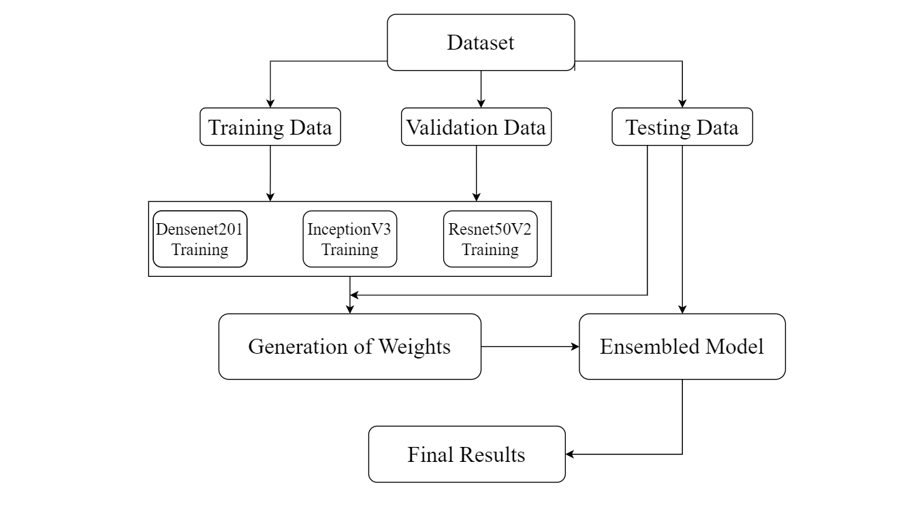
Diagrammatic representation

Slide 15
About the Dataset Used
The dataset used for the project consists:
Chest X-ray images of COVID-19 patients: 3600 images
Chest X-ray images of other patients and healthy people: 3600 images
For training, we used 2800 Covid +ve images and 2800 Covid –ve images.
For validation, we used 400 Covid +ve images and 400 Covid –ve images
For validation, we used 400 Covid +ve images and 400 Covid –ve images
The source of the dataset is: https://www.kaggle.com/tawsifurrahman/covid19-radiography-database

Slide 16
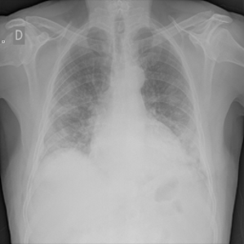
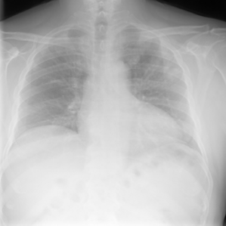
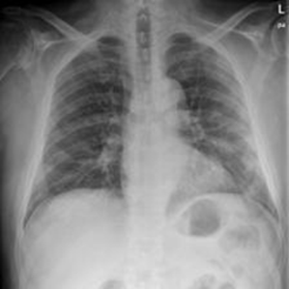
Sample Data
The following figure shows 3 sample images from the dataset of which all are COVID positive

Slide 17
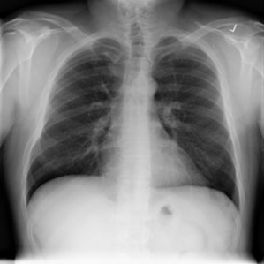
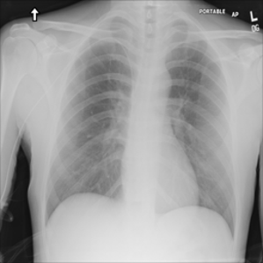
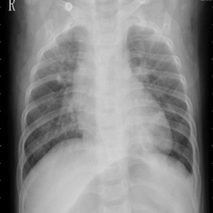
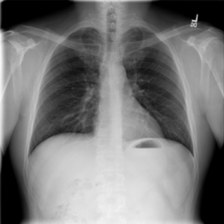
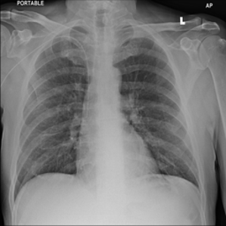
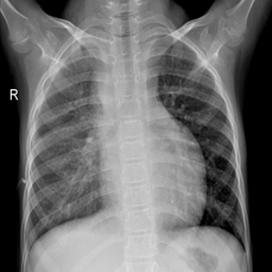
Sample Data
The following figure shows 8 sample images from the dataset of which all are either normal or patients of different lungs related diseases other than COVID:

Slide 18
Data Preparation:
The images are divided into three distinct groups: one for training, one for validation and another for testing.
All images are resized to 224x224.
The images as well as their labels are converted into a numpy array.

Slide 19
Training the models
All three models (Densenet201, InceptionV3, Resnet50V2) were trained for 30 epochs.
After each epoch, the model was validated.
Early stopping callbacks were placed to check for improvement in validation loss.
The value of patience was set to 10 epochs.

Slide 20
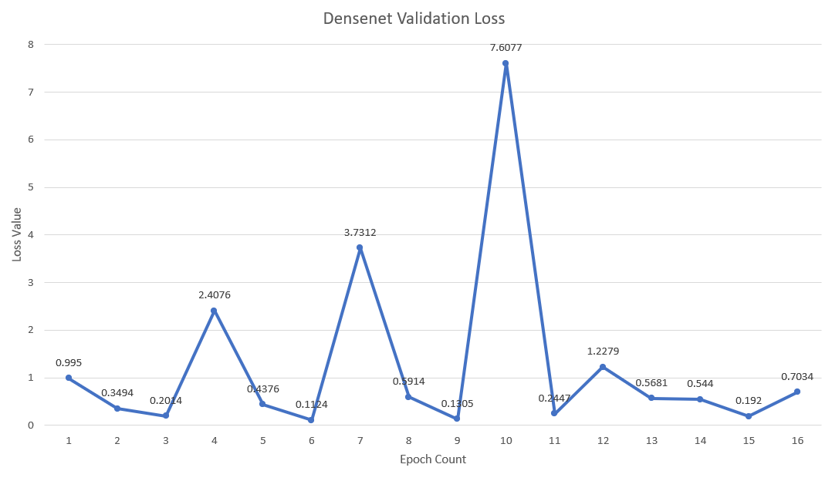
Densenet201 Validation

Slide 21
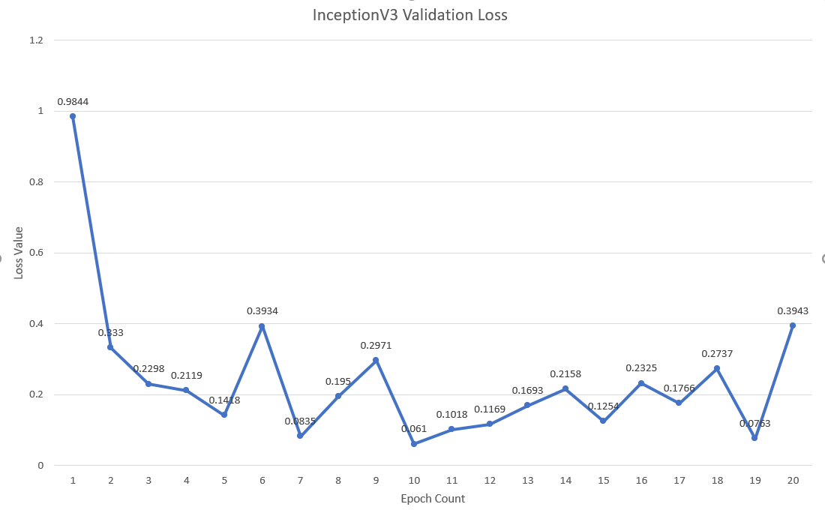
InceptionV3 Validation

Slide 22
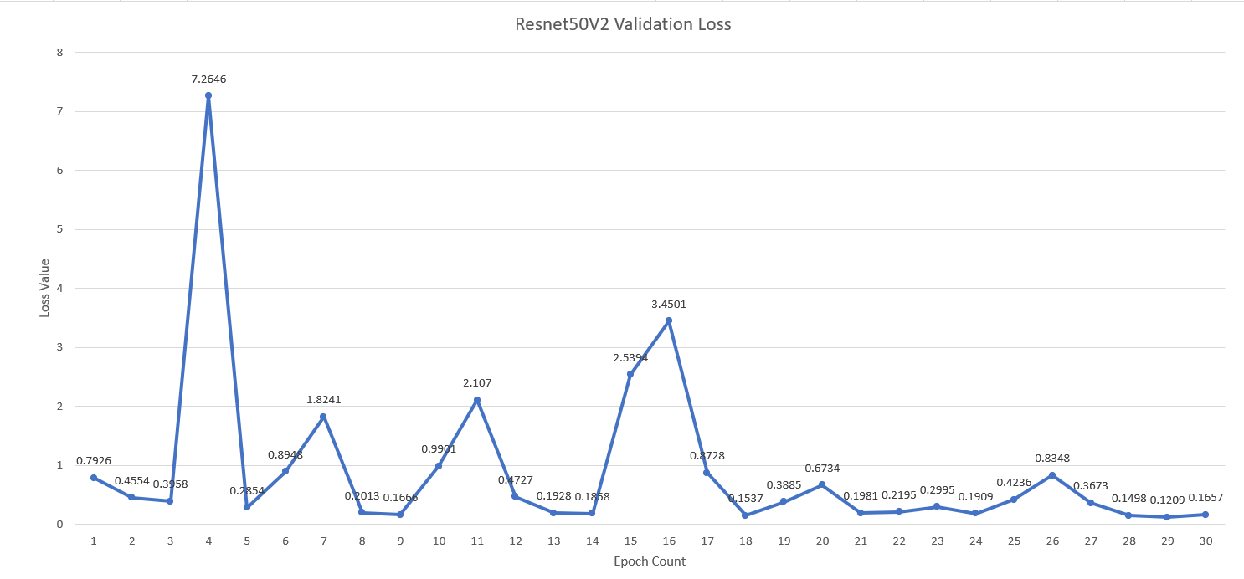
Resnet50V2 Validation

Slide 23
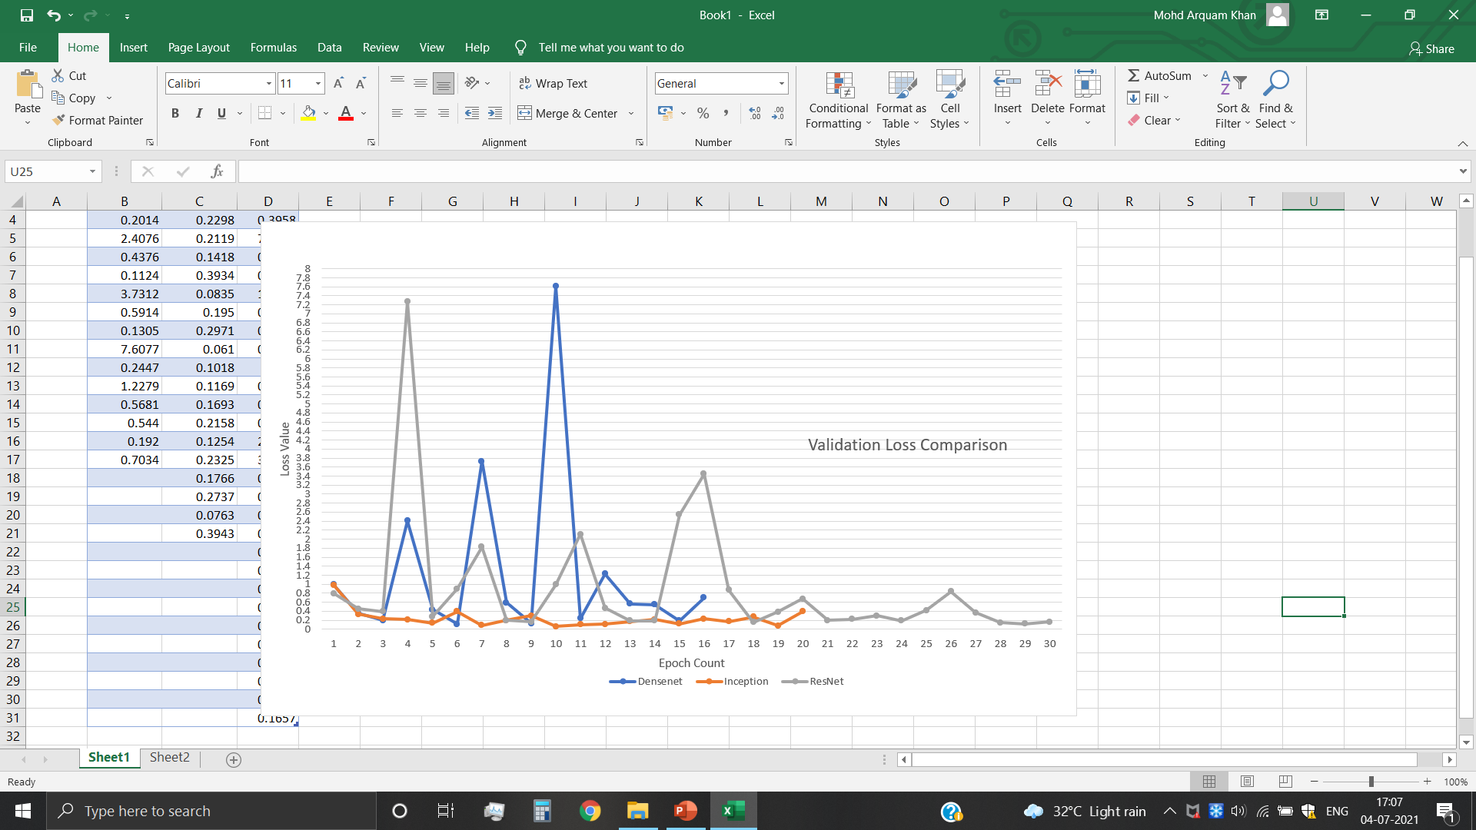
Comparison of the three models

Slide 24
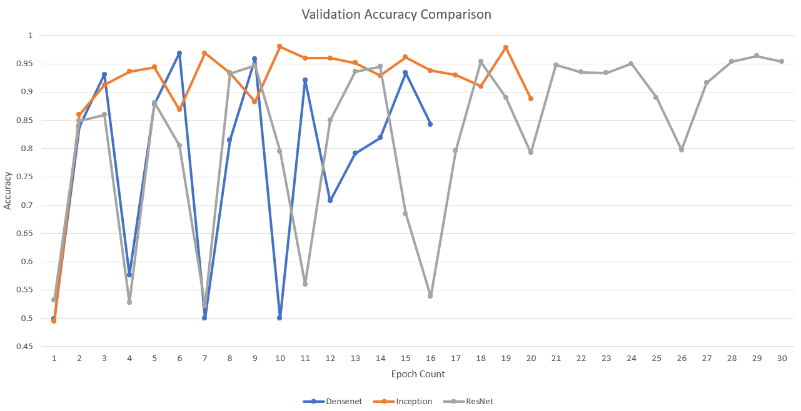
Comparison of the three models

Slide 25
Validation Accuracies of the models
The following validation accuracies were found:
Model | Validation Accuracy
Densenet201 | 0.9688
InceptionV3 | 0.9800
Resnet50V2 | 0.9638

Slide 26
Test Accuracies of the models
The following test accuracies were found:
Model | Test Accuracy
Densenet201 | 0.9638
InceptionV3 | 0.9675
Resnet50V2 | 0.9700

Slide 27
Confusion Matrices of the models
Densenet201 | Predicted Positive | Predicted Negative
Actual Positive | 387 | 13
Actual Negative | 16 | 384
InceptionV3 | Predicted Positive | Predicted Negative
Actual Positive | 385 | 15
Actual Negative | 11 | 389
Resnet50V2 | Predicted Positive | Predicted Negative
Actual Positive | 398 | 2
Actual Negative | 22 | 378

Slide 28
Classification Reports of the models
Densenet201 | Precision | Recall | F1-Score | Support
Covid +ve | 0.9602 | 0.9675 | 0.9638 | 400
Covid –ve | 0.9672 | 0.9600 | 0.9635 | 400
InceptionV3 | Precision | Recall | F1-Score | Support
Covid +ve | 0.9722 | 0.9625 | 0.9673 | 400
Covid –ve | 0.9629 | 0.9725 | 0.9676 | 400
Resnet50V2 | Precision | Recall | F1-Score | Support
Covid +ve | 0.9476 | 0.9950 | 0.9707 | 400
Covid –ve | 0.9947 | 0.9450 | 0.9692 | 400

Slide 29
Assigned Weights
Based on the test accuracies, the following weights were assigned to the models:
Model | Weights Assigned
Densenet201 | 0.2137
InceptionV3 | 0.3307
Resnet50V2 | 0.4555

Slide 30
Accuracy of Final Model
Accuracy of final model: 0.9800
Confusion Matrix:
 | Predicted Positive | Predicted Negative
Actual Positive | 397 | 3
Actual Negative | 13 | 387

Slide 31
Classification Report of the Final Model
Classification report:
 | Precision | Recall | F1-Score | Support
Covid +ve | 0.9683 | 0.9925 | 0.9802 | 400
Covid –ve | 0.9923 | 0.9675 | 0.9797 | 400

Slide 32
Comparison with Previous Work
Article | Algorithm/Technique | Accuracy achieved
Ozturk et al. (2020) | DarkNet | 87.02%
Panwar et al. (2020) | nCOVnet | 88.10%
Wang et al. (2020) | COVID-Net | 93.30%
Abbas et al. (2020) | DeTraC | 95.12%
Asnaoui El Chawki and Idri (2020) | VGG16, VGG19, Inception_V3, Xception | 96.61%
Our model | Densenet201, InceptionV3, Resnet50V2 | 98.00%

Slide 33
Implementation of Grad-Cam
Grad-CAM is a form of post-hoc attention, meaning that it is a method for producing heatmaps that is applied to an already-trained neural network after training is complete and the parameters are fixed.
It uses the gradients of any target concept flowing into the final convolutional layer to produce a coarse localization map highlighting the important regions in the image for predicting the concept.

Slide 34
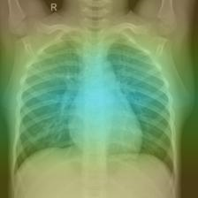
Implementation of Grad-Cam: Sample Image

Slide 35
Web based GUI
A web based GUI was also created.
This will allow anyone to browse a chest X-ray image and upload it to the web application. The application will execute the ensembled model and classify the uploaded Chest X-Ray image.

Slide 36
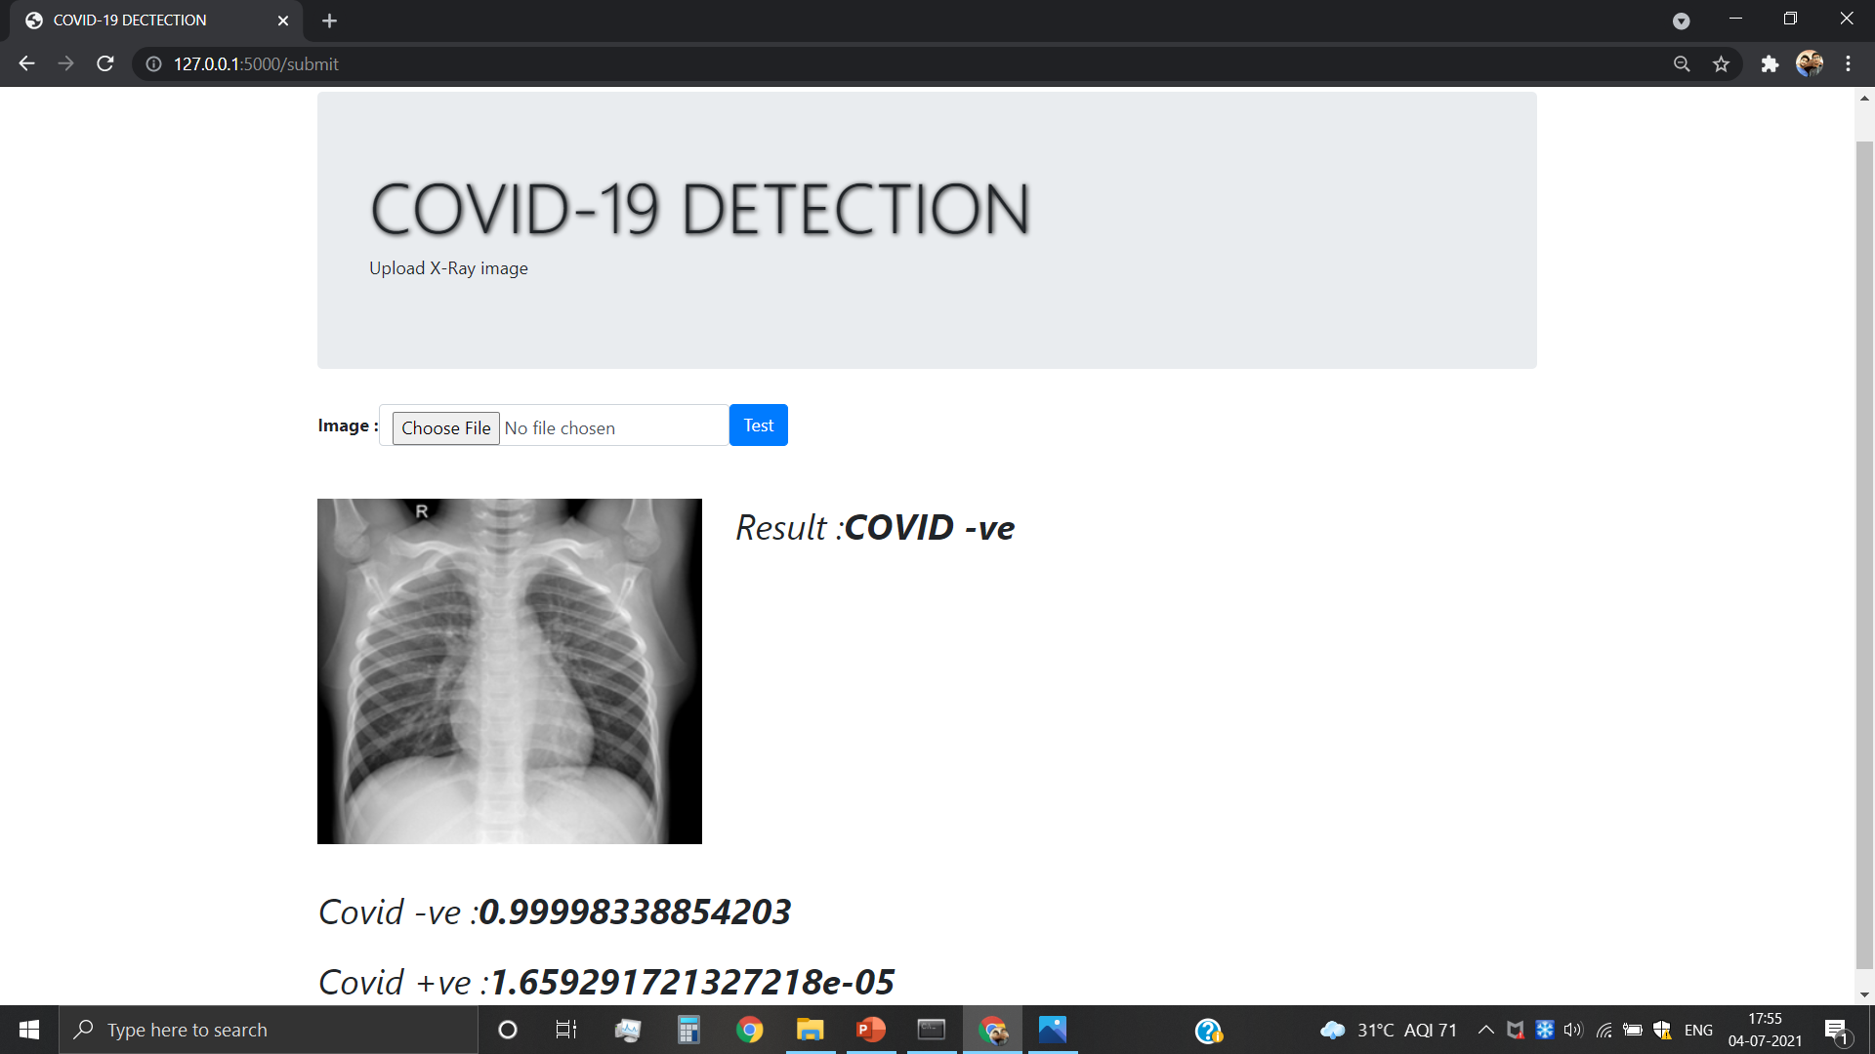
Web based GUI: Screenshot

Slide 37
Conclusion & Suggestions for Future Work
Hence, we can conclude that an ensemble model, which predicts 98% of the test data correctly, has been created.
A web based GUI has also been created as a tool for COVID-19 testing.
For works in the future, a much larger dataset is needed to create a more improved and better model.
We also need data of patients infected with different strains of the virus and people belonging to different regions of the world.

Slide 38
Programming Environment and Tools Used
Operating System: Windows, Ubuntu
Programming Language: Python3
Libraries used: Numpy, Tensorflow, Keras, Scikit-learn.
Technologies Used: Machine Learning, Convolutional Neural Networks (CNN).

Slide 39
References
Makris, A., Kontopoulos, I., & Tserpes, K. : COVID-19 detection from chest X-Ray images using Deep Learning and Convolutional Neural Networks. (2020)
Tulin Ozturk, Muhammed Talo, Eylul Azra Yildirim, Ulas Baran Baloglu, Ozal Yildirim, and U. Rajendra Acharyaf : Automated detection of COVID-19 cases using deep neural networks with X-ray images. (2020)
Ju C, Bibaut A, van der Laan M: The relative performance of ensemble methods with deep convolutional neural networks for image classification. (2018)
Amit Kumar Das, Sayantani Ghosh, Samiruddin Thunder, Rohit Dutta, Sachin Agarwal, Amlan Chakrabarti : COVID-19 Detection from X-Ray with Convolutional Neural Networks. (2020)
Harsh Panwar, P.K. Gupta, Mohammad Khubeb Siddiqui, Ruben Morales-Menendez, and Vaishnavi Singh : Application of deep learning for fast detection of COVID-19 in X-Rays using nCOVnet. (2020)
Asmaa Abbas, Mohammed M. Abdelsamea, Mohamed Medhat Gaber : Classification of COVID-19 in chest X-ray images using DeTraC deep convolutional neural network. (2020)
Wenling Wang, Yanli Xu, Ruqin Gao : Detection of SARS-CoV-2 in Different Types of Clinical Specimens. (2020)

Slide 40
THANK YOU

