Slide 1
Naive set theory
empty set
{}
set-builder notation (or "set comprehension")
{x: P(x)} or {x | P(x)}
{x ∈ A : P(x)}
{F(x) : x ∈ A}
{F(x) : P(x)}

Slide 2
Russell's paradox
let R = {x | x ∉ x }, then R ∈ R <=> R ∉ R

Slide 3
Lambda calculus
The lambda calculus was introduced by mathematician Alonzo Church in the 1930s
Russell's paradox in terms of lambda calculus
R = λx.not(xx)
RR

Slide 4
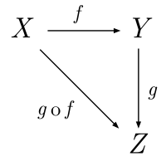
Category theory

Slide 5

Category theory in Haskell
Philip Wadler
Professor of Theoretical Computer Science, Laboratory for Foundations of Computer Science, School of Informatics, University of Edinburgh (2003—)
Author of generics in Java
Expression problem
Category in Haskell

Slide 6
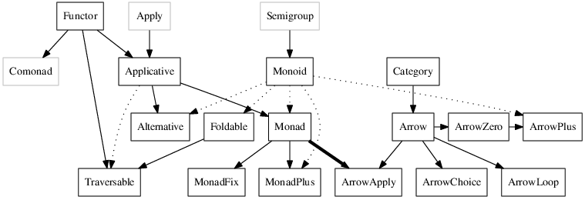
type classes
http://www.haskell.org/haskellwiki/Typeclassopedia

Slide 7
Functor
class Functor(object):
@classmethod
def fmap(cls, f, fa):
"""fmap :: (a -> b) -> f a -> f b"""
return fa.fmap(f)
fmap = Functor.fmap
http://www.haskell.org/haskellwiki/Functor

Slide 8
Applicative functor
class Applicative(Functor):
def apply(self):
"""(<*>) :: f (a -> b) -> f a -> f b """
raise NotImplementedError
def pure(self):
"""pure :: a -> f a"""
raise NotImplementedError

Slide 9
Monad
class Monad(Applicative):
def __init__(self, value):
self._value = value
def __repr__(self):
return "<%s %s>" % (self.__class__.__name__, self._value)
@classmethod
def mreturn(cls, val):
"""mreturn :: a -> m a"""
return cls(val)
def bind(self, func):
"""(>>=) :: m a -> (a -> m b) -> m b"""
raise NotImplementedError
def then(cls, mb):
"""(>>) :: m a -> m b -> m b"""
raise NotImplementedError
http://www.haskell.org/haskellwiki/Monad

Slide 10
Monad Maybe
class Maybe(Monad):
def __eq__(self, other):
return (type(self) == type(other)) and (self._value == other._value)
def then(self, mobj):
return mobj
class Just(Maybe):
def fmap(self, func):
return Just(func(self._value))
def bind(self, func):
return func(self._value)
def apply(self, mobj):
return self.mreturn(self._value(mobj._value))
class Nothing(Maybe):
def __repr__(self):
return "<%s>" % self.__class__.__name__
def __init__(self):
super(Nothing, self).__init__(None)
def fmap(self, func):
return self
def bind(self, func):
return self

Slide 11
Monad Maybe
>>> Just(2).bind(lambda x: Just(x*2))
.bind(lambda x: Just(x+2))
Just(6)
>>> Just(lambda x: x*2).apply(Just(2))
Just(4)
>>> Just(2).bind(lambda x: Nothing())
.bind(lambda x: Just(x+2))
Nothing()

Slide 12
Monad List
class List(Monad, list):
def __init__(self, *args):
return list.__init__(self, args)
def __repr__(self):
return "<%s %s>" % (self.__class__.__name__,
list.__repr__(self))
def map(self, func):
return List(*map(func, self))
def concat(self):
return List(*reduce(lambda x, y: x + y, self, List()))
fmap = map
def bind(self, func):
"""xs >>= f = concat (map f xs)"""
return self.map(func).concat()
def apply(self, val):
return List(*[val.map(fn) for fn in self]).concat()
def then(self, mobj):
return List(*[mobj for t in self]).concat()

Slide 13
Monad List
>>> fmap(lambda x: x*2, List(2,3))
List(4,6)
>>> List(2, 3).bind(lambda x: List(x*2))
.bind(lambda x: List(x+1))
List(5, 7)
>>> List(lambda x: x*2, lambda x: x+1).apply(List(2, 3))
List(4, 6, 3, 4)

Slide 14
Links
http://learnyouahaskell.com/chapters
http://habrahabr.ru/post/183150/
http://www.haskell.org/haskellwiki/Monad

Slide 15

Contacts
Verbitsky Alexander
Email: habibutsu@gmail.com

