Slide 1

DECODE – 2024 Data Exploration, COnceptualization and DEmystification Programming Track – Final Round
E DEVANANDA
UNNIMAYA B
HABIS RIZVI P C
PONDICHERRY UNIVERSITY

Slide 2
INTRODUCTION
Datasets Provided - ADSL( Subject Level Analysis Dataset of Baseline grouping variables, ADAE(Adverse Event Analysis Dataset of subjects), ADLB(Laboratory Analysis Dataset of lab parameters of subjects).
Datasets created - Merged Dataset of ADSL and ADAE, ADSL and ADLB.
Datasets Preprocessed - ADAE( for duplication of same adverse events with different severity ) and ADLB (for repetition of lab tests for same subject ID in end of treatment week and the corresponding week).
1
Tools Used
Google Colab
HTML
Power BI
Libraries Used
Pandas
Numpy
Matplotlib
2
Microsoft Excel
Microsoft Word
Seaborn
Ploty
Exploratory Data Analysis (EDA)
Static Visualizations
Interactive HTML Visualizations
Detailed Interpretations
Interactive Dashboards
3

Slide 3
Task 1 - Demographics Exploration
Table 1.1 Summary of Baseline grouping Variables
Variables | Safety population |  |  |  |  | Efficacy Population
 | Count | Mean | SD | Median | Range | Count | Mean | SD | Median | Range
AGE | 254 | 75.09 | 8.25 | 77 | 51 - 89 | 234 | 75.01 | 8.12 | 76.5 | 51 - 88
HEIGHTBL | 254 | 163.94 | 10.76 | 162.85 | 135.9 - 195.6 | 234 | 164.27 | 10.78 | 163.65 | 135.9 - 195.6
WEIGHTBL | 253 | 66.65 | 14.13 | 66.7 | 34.0 - 108.0 | 233 | 67.18 | 13.88 | 67.1 | 34.0 - 108.0
BMIBL | 253 | 24.67 | 4.09 | 24.2 | 13.7 - 40.1 | 233 | 24.78 | 4.06 | 24.6 | 13.7 - 40.1
SEX* | MALE | FEMALE |  |  |  | MALE | FEMALE
Count ( %) | 111 (43.7%) | 143 (56.3%) |  |  |  | 106 (45.3%) | 128 (54.7%)
RACE* | WHITE | BLACK | AI/AN** |  |  | WHITE | BLACK | AI/AN
Count (%) | 230 (90.55%) | 23 (9.06%) | 1 (0.39%) |  |  | 213 (91.03%) | 20 (8.55%) | 1 (0.43%)
ETHNICITY* | NOT HISP | HISP |  |  |  | NOT HISP | HISP
Count (in %) | 242 (95.28%) | 12 (4.72%) |  |  |  | 222 (94.87%) | 12 (5.13%)
* Indicates categorical variables.
**Indicates the race American Indian(AI) or Alaska Native(AN).

Slide 4
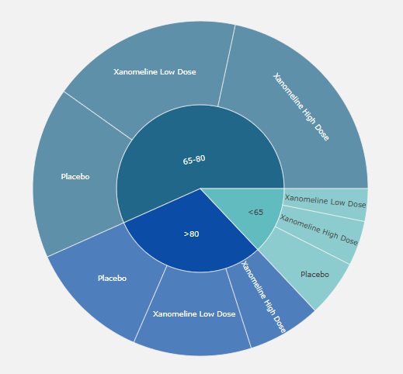
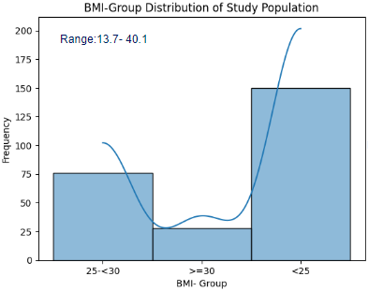
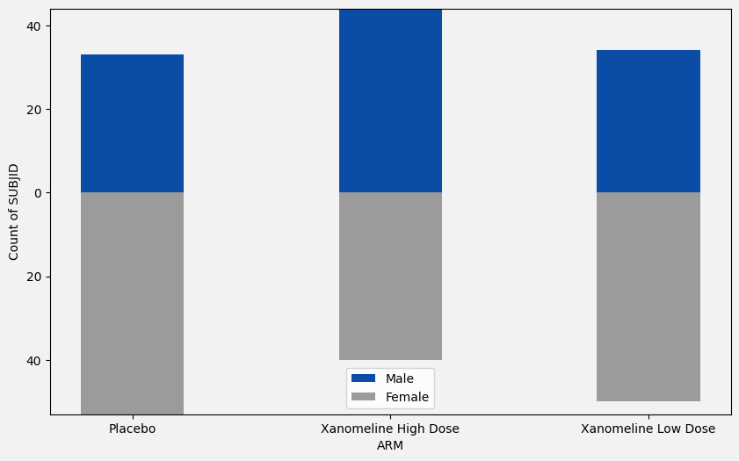
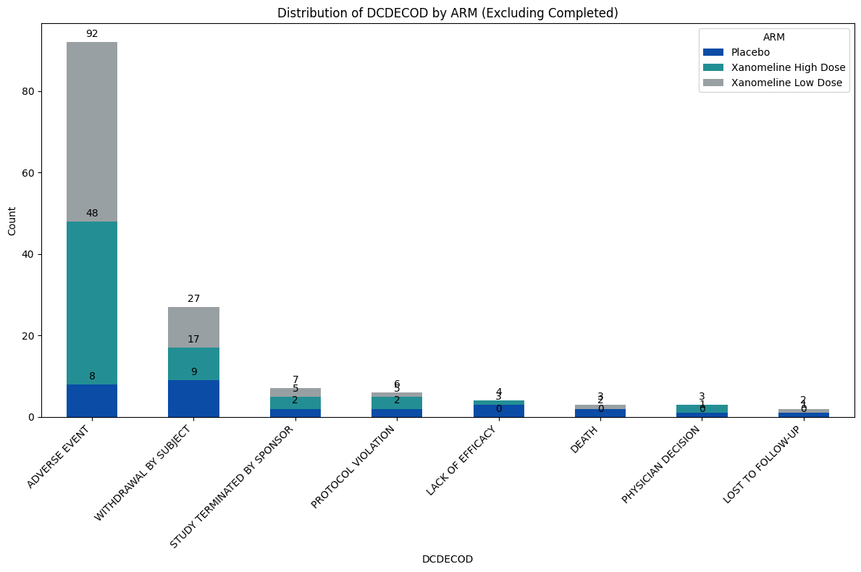
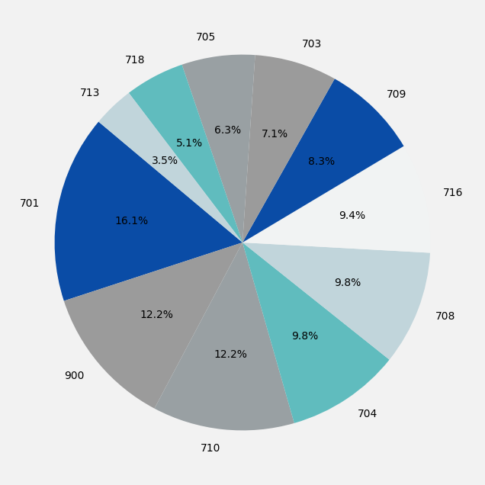
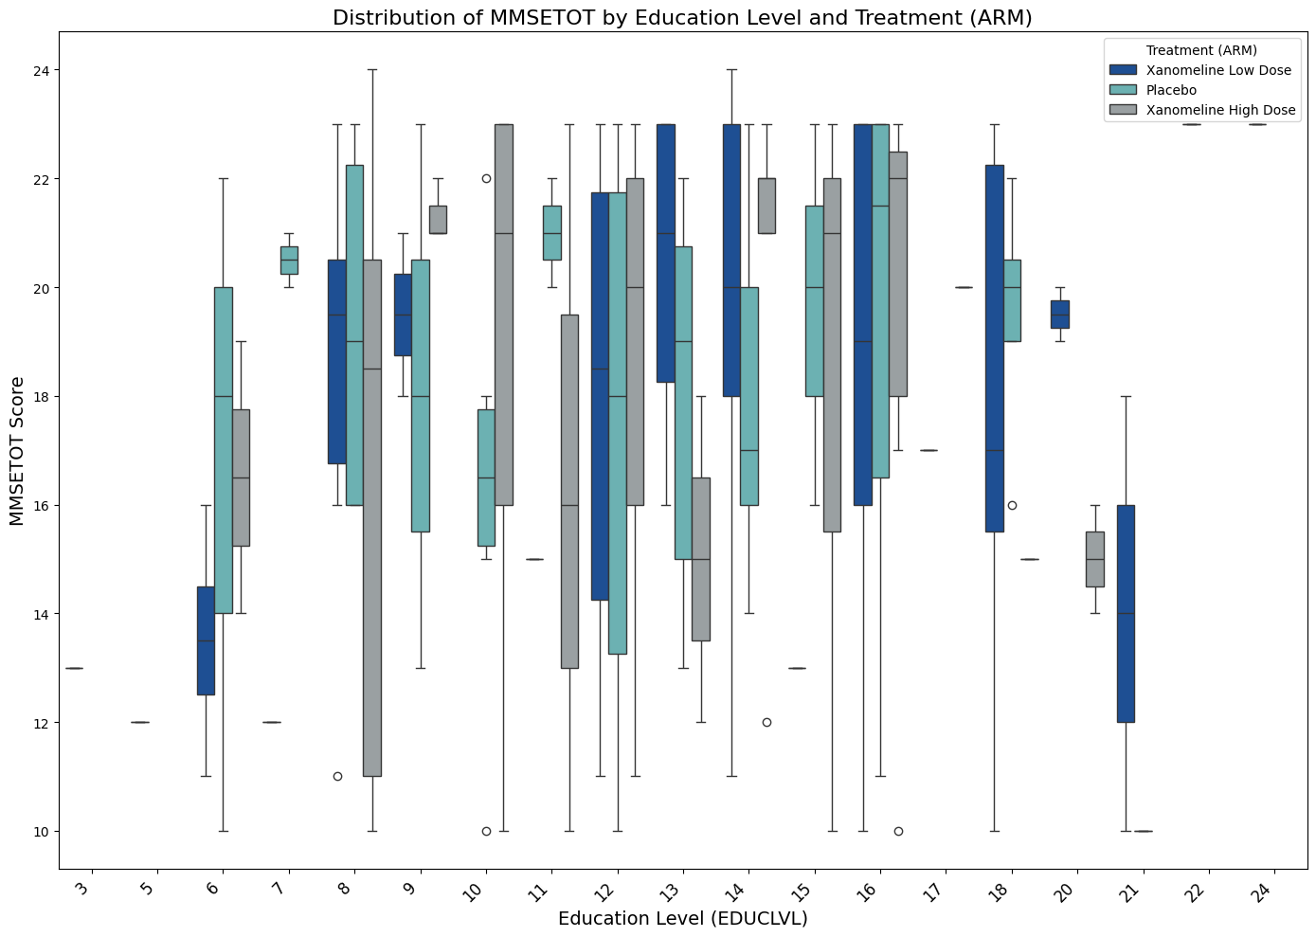
Figure 1.1
Distribution of age groups in different treatment groups.
Figure 1.2
Population pyramid by SEX and Treatment
Figure 1.3
BMI- Group Distribution of Population
Figure 1.3
33
44
34
54
40
50
Figure 1.4
Distribution of DECECOD by Treatment(Excluding completed)
Figure 1.5
Figure 1.6
Distribution of MMSETOT by EDUCLVL and Treatment
Figure 1.4
Distribution of subjects by Site ID
Figure 1.6

Slide 5
FINDINGS
There 254 unique subject IDs.
The average daily dose of Xanomeline Low dose is a constant value (54) but varying doses have been given for Xanomeline High Dose(54 - 78.6).
For the USUBID 01-702-1082, BMIBL and HEIGHTBL values are missing but BMIBLGR1 is given to be <25.
4 Subjects discontinued due to lack of efficacy and they were marked Yes for the efficacy flag.
Table 1.1 gives the summary statistics for the continuous and categorical variables.
From figure 1.1, Majority of the study population belongs to the age group of 65 – 80(144).
From figure 1.2,Majority subjects in placebo and Xanomeline Low dose are females while in Xanomeline High dose it is males.
From figure 1.3,Range of BMI group is 13.7-40.1 and majority of study population has BMI <25 which is the normal range for BMI.
From figure 1.6, Interquartile range of MMSE of subjects is more in Xanomeline High dose.
From figure 1.7, Major reason for discontinuation is adverse events and adverse events are more in Xanomeline Low dose and least important reason is lost to follow-up.

Slide 6
Task 2- Adverse Events Overview
Table 2.1 Summary of adverse events(Top 10 prevalent) grouped by treatments
 | Overall |  | Placebo |  | Xanomeline High Dose |  | Xanomeline Low Dose
AEBODSYS | Count of Subjects | Average duration of AE | Count of Subjects | Average duration of AE | Count of Subjects | Average duration of AE | Count of Subjects | Average duration of AE
GENERAL DISORDERS AND ADMINISTRATION SITE CONDITIONS | 108 | 21.6 | 21 | 21.1 | 40 | 19.9 | 47 | 24.1
SKIN AND SUBCUTANEOUS TISSUE DISORDERS | 105 | 31.9 | 21 | 26 | 42 | 33.7 | 42 | 32.6
NERVOUS SYSTEM DISORDERS | 59 | 6.9 | 12 | 12.7 | 27 | 7.5 | 20 | 5.3
GASTROINTESTINAL DISORDERS | 53 | 11.6 | 17 | 9.75 | 21 | 11.9 | 15 | 13.5
CARDIAC DISORDERS | 44 | 18.4 | 13 | 16.8 | 18 | 16.5 | 13 | 21.5
INFECTIONS AND INFESTATIONS | 39 | 12.2 | 16 | 11.8 | 13 | 10.2 | 10 | 16
RESPIRATORY, THORACIC AND MEDIASTINAL DISORDERS | 30 | 10.4 | 10 | 11.4 | 10 | 7 | 10 | 14.1
PSYCHIATRIC DISORDERS | 29 | 18.8 | 10 | 52.7 | 9 | 4.6 | 10 | 2.5
INVESTIGATIONS | 23 | 14.2 | 10 | 21 | 6 | 6.2 | 7 | 12.7
MUSCULOSKELETAL AND CONNECTIVE TISSUE DISORDERS | 20 | 12.6 | 5 | 2 | 8 | 20.7 | 7 | 8.7
INJURY, POISONING AND PROCEDURAL COMPLICATIONS | 14 | 14.9 | 4 | 34.5 | 5 | 10 | 5 | 6.6
HTML Visualisation
Table 2.2 : Count of subjects under severity, causality and recovery

Slide 7
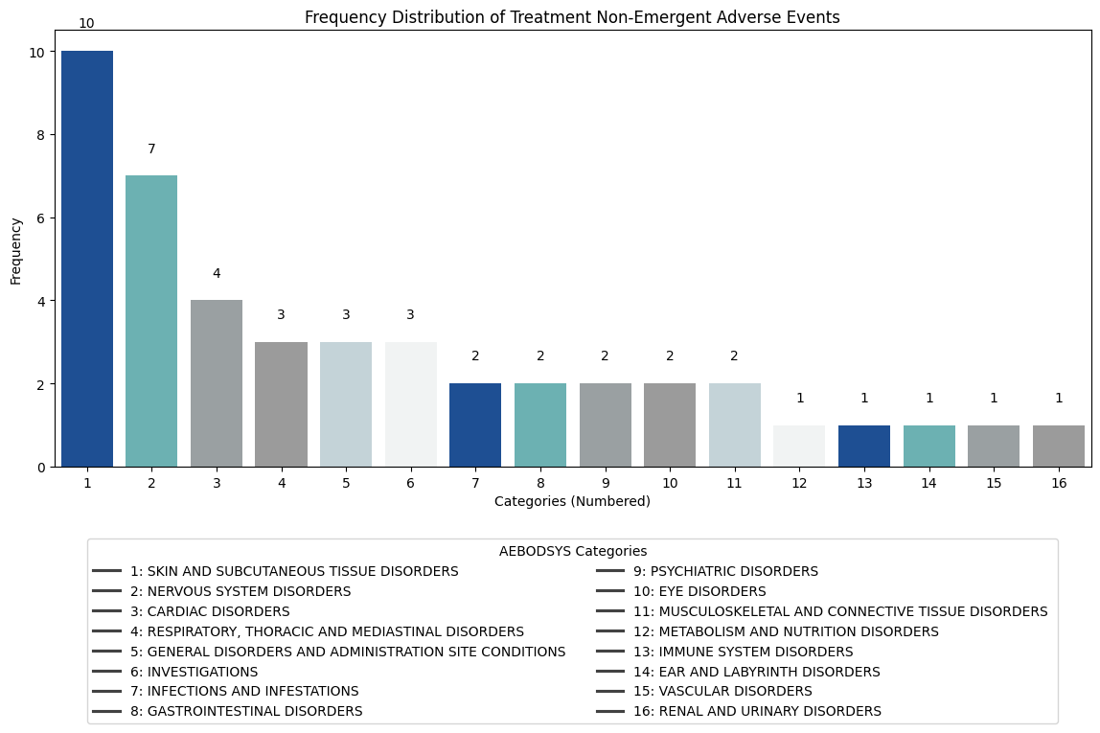
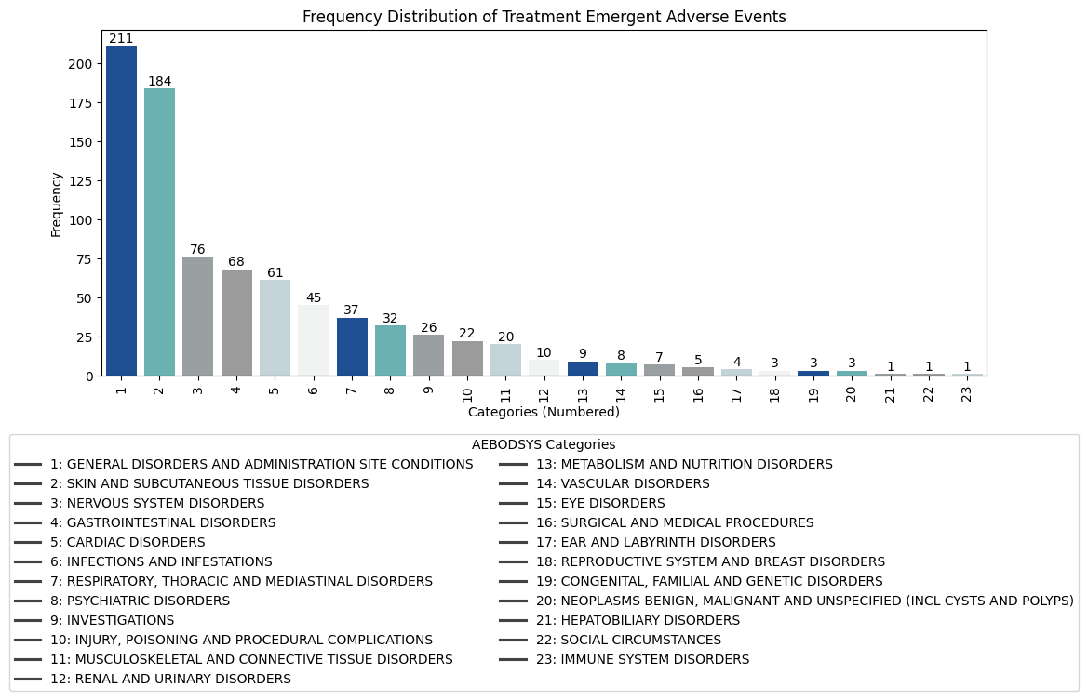
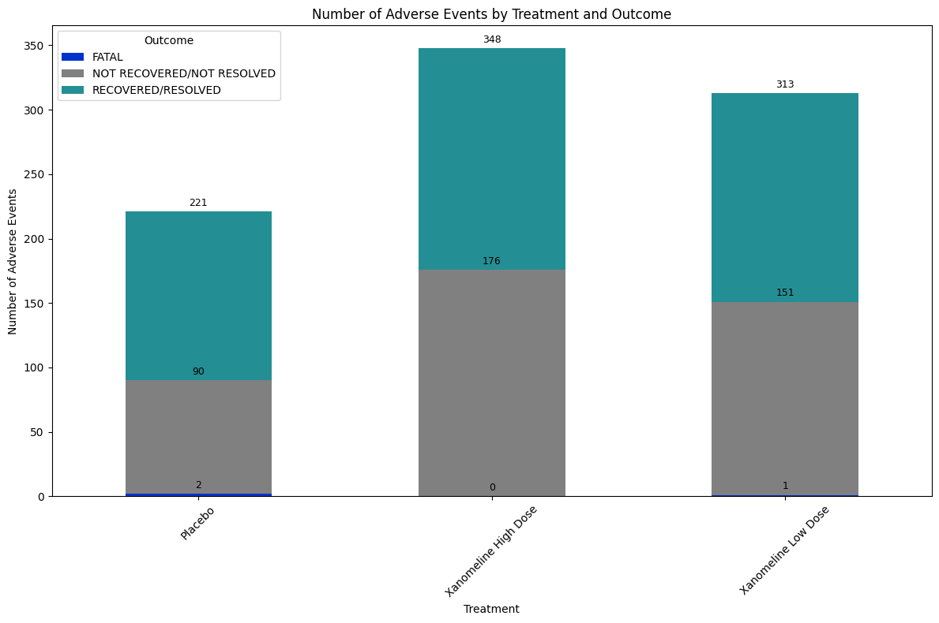
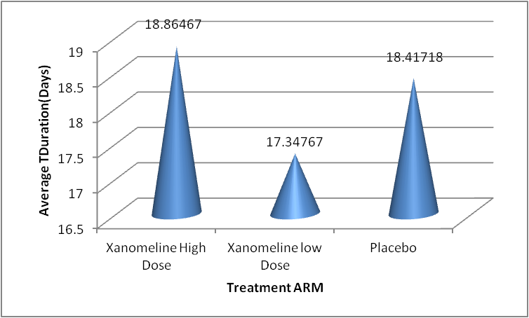
Figure 2.1.1
Figure 2.1.2
Figure 2.2 : Average duration of days in treatment groups.
Figure 2.3 : Treatment - wise distribution of adverse events and outcomes.

Slide 8
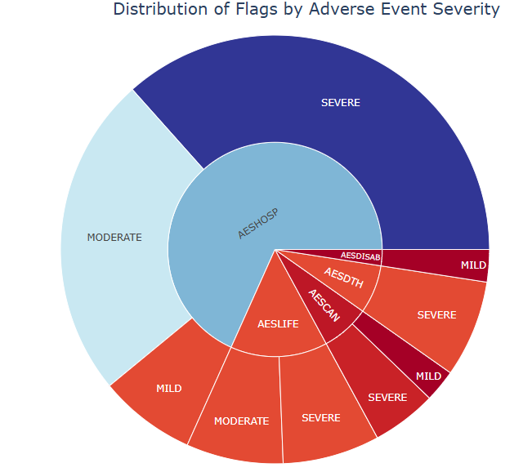
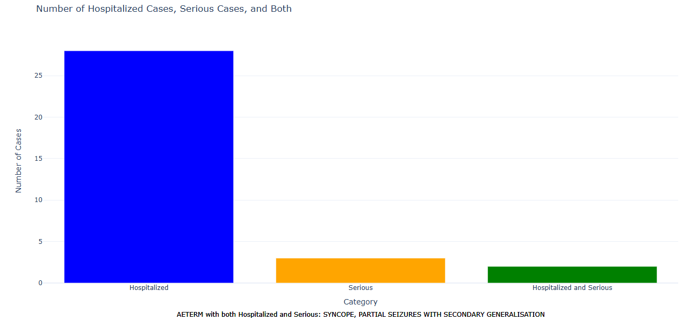
HTML VISUALISATIONS
Figure 2.4 : Distribution of Flags by adverse event severity
Figure 2.5 : Life cycle of prevalent adverse events
FINDINGS
225 unique subject IDs.
Alcohol use is termed as an adverse event for 01-708-1178.
TRTEMFL(Treatment Emergent Flag is used to find out whether the adverse event was caused due to treatment or not.
It was found that overdose did not cause severity.
ASTDY(Analysis Sart Relative Day) has negative values indicating that analysis started days prior to the treatment.
From table 2.1, the most prevalent adverse event is general disorders and administration site conditions.
From figures 2.1.1 and 2.1.2 there are a total of 23 treatment emergent adverse events and 16 treatment non-emergent adverse events indicating majority of adverse events in the study population is caused from the treatment.
From figure 2.2, Average treatment duration is highest for Placebo and treatment with High dose is more efficient in reducing the average duration as compared to low dose.
From table 2.2,Maximum number of severe cases is produced in Xanomeline Low dose, maximum number of moderate cases in Xanomeline High dose and maximum number of mild cases in Placebo.
From figure 2.3, Fatal adverse events resulted from treatments is very less and number of adverse events recovered is greater in treatment with Xanomeline High Dose.
From figure 2.4, Majority of the mild, moderate and severe cases requires or prolongs hospitalization.

Slide 9
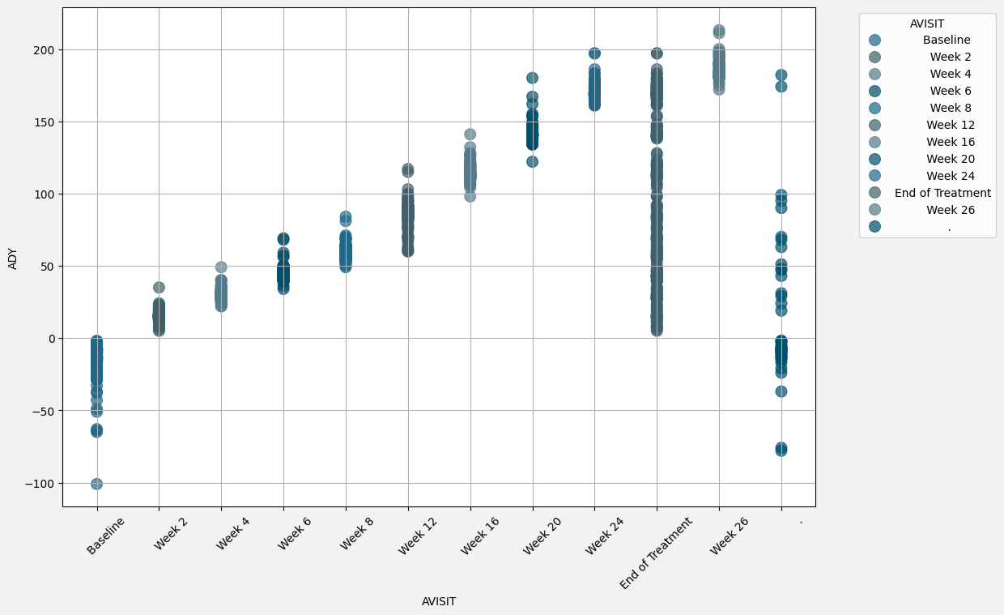
Task 3- Laboratory Results Overview
Table 3.1: Summary of laboratory tested parameters
PARAMCD | Count | Mean | Median | SD | Range
ANISO | 154 | 1 | 1 | 0 | 1.0-1.0
BASO | 1758 | 0.05 | 0.04 | 0.03 | 0.0-0.23
EOS | 1758 | 0.17 | 0.11 | 0.16 | 0.0-1.51
HCT | 1741 | 0.42 | 0.42 | 0.04 | 0.32-0.54
HGB | 1759 | 8.51 | 8.44 | 0.78 | 6.08-10.93
LYM | 1758 | 1.75 | 1.66 | 0.58 | 0.46-4.86
MACROCY | 99 | 1 | 1 | 0 | 1.0-1.0
MCH | 1759 | 1.91 | 1.92 | 0.11 | 1.31-2.29
MCHC | 1741 | 20.31 | 20.48 | 0.82 | 17.38-23.59
MCV | 1741 | 94.29 | 94 | 5.45 | 67.0-112.0
MICROCY | 2 | 1 | 1 | 0 | 1.0-1.0
MONO | 1758 | 0.45 | 0.43 | 0.15 | 0.0-1.17
PLAT | 1740 | 24.41 | 237 | 58.53 | 92.0-582.0
POIKILO | 2 | 1 | 1 | 0 | 1.0-1.0
POLYCHR | 28 | 1 | 1 | 0 | 1.0-1.0
RBC | 1759 | 4.47 | 4.52 | 0.43 | 3.12-5.93
WBC | 1759 | 6.63 | 6.38 | 1.75 | 2.51-14.77
Figure 3.1:Analysis visits v/s Analysis Relative day
HTML VISUALISATIONS
Table 3.2 : CHG and PCHG values of the parameters.
Figure 3.4 : Average CHG and PCHG values in Treatment groups

Slide 10
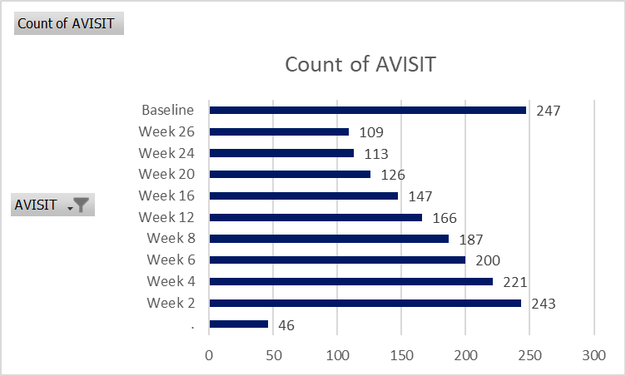
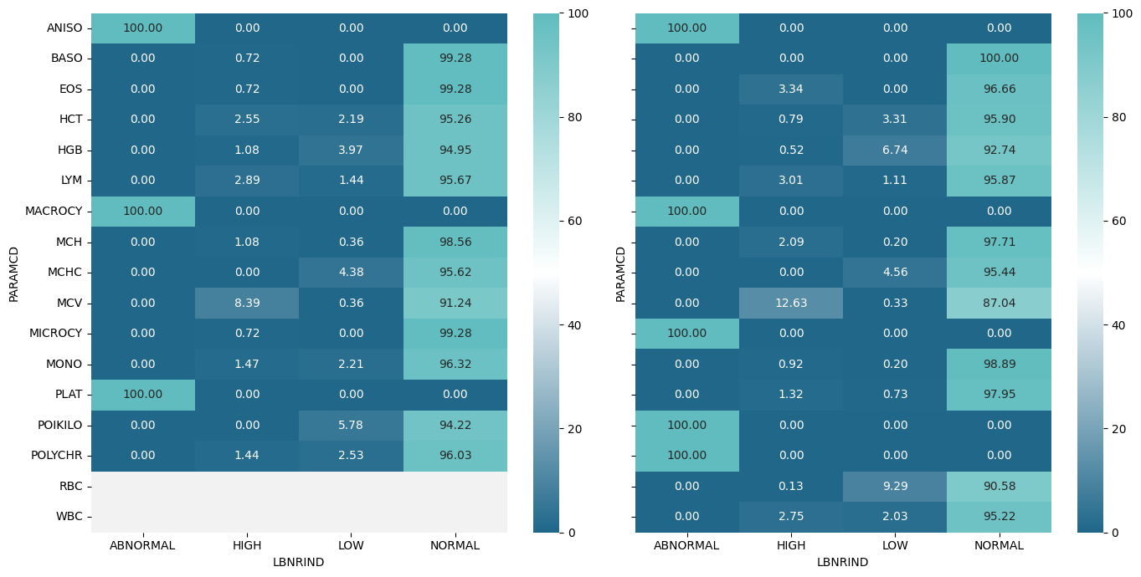
Figure 3.3 :Count of subjects in different parameters marked according to reference range indicator.
Figure 3.2 Count of subjects in different visit weeks.
254 unique subject IDs.
FINDINGS
There are 15 parameters checked in the dataset and 254 unique subjects.
From table 3.1, 1. ,Parameters ANISO, MACROSY, MICROSY, POIKILO, POLYCHR show constant values.The parameter PLAT has the maximum range.
From table 3.2, Even though the mean CHG don't change much over time in MCH there are minor variations in the mean percent change (PCHG), with some weeks showing slight positive or negative shifts
Figure 3.1, 1.,Visits have been done from almost 100 days prior to the treatment and there are unscheduled visits prior to and during the treatment but it gradually decreases as analysis duration increases.
From figure 3.2, 1.,Largest number of subject visit is during Baseline week and 46 subject visits are unscheduled and can be between any visits.
From figure 3.3, 1.,Majority of subjects have remained normal pre and post treatment.
There has been an increase in the number of records in the high value in parameter ‘MCV’ (116 - 187),’RBC’ (90 - 132) and ‘HGB’(54 -96).

Slide 11
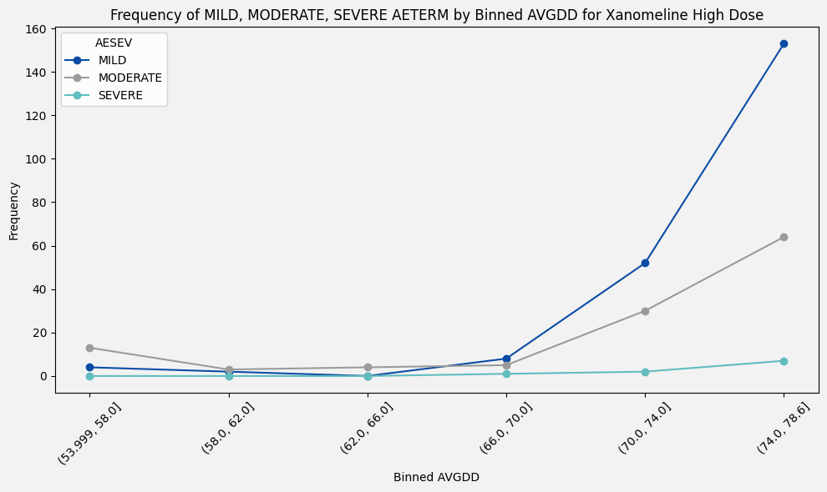
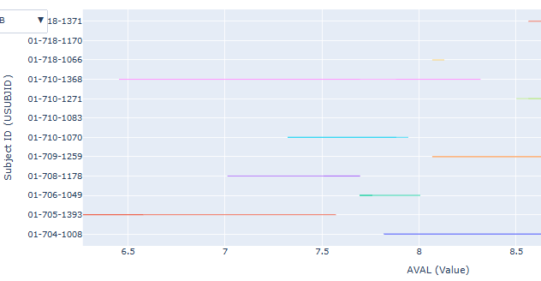
Task 4- Bonus Task
Figure 4.1
Figure 4.2
Range of lab parameters for hospitalised subjects
MILD - 153
MODERATE - 64
SEVERE - 7
MILD - 4
MODERATE - 13
SEVERE - 0
MILD - 2
MODERATE - 3
SEVERE - 0
MILD - 0
MODERATE - 4
SEVERE - 0
MILD - 8
MODERATE - 5
SEVERE - 1
MILD - 52
MODERATE - 30
SEVERE - 2
FINDINGS
We merged the datasets ADSL and ADAE and ADSL and ADLB.
In figure 4.1, we intend to explore the counts of severe adverse events under the varying doses of Xanomeline High Dose.
As the average dose increases, the count of mild, moderate and severe cases are increasing.
In the case of mild and severe adverse events, the frequency increase in the range of (74 - 78.5).
In moderate adverse events, it is more in (53.9-58 )it then decreases and gradually increases in the range(74 - 78.6).
In figure 4.2, The range of 12 lab parameters of subjects is visualized and the remaining parameters have been omitted due to constant values or missing values.
Under hospitalized cases, there are 3 subjects in mild, 6 subjects in moderate and 12 subjects in severe.
For example, in HGB parameter, in severe cases the highest range is observed for subject ID 01-710-1368 and lowest range is observed for 01-710-1066.

Slide 12
Q&A
TEAM MEMBERS
Habis Rizvi P C - habisrizvi30@gmail.com | E Devananda - devananda2701@gmail.com | Unnimaya B - unnimayabala25@gmail.com
REFERENCES
Colab Notebooks | Detailed Interpretations | Interactive Dashboards | MedDRA Dictionary

