Slide 1
M55339A Module 2 C# Language Concepts

Slide 2
Module Overview
Methods
Method Overloading
Exception Handling
Monitoring
Notes:
This is an introductory module that should serve as a recap for most students. Most students should already be familiar with most, if not all, of the concepts covered in this module.
This module does not contain any formal demonstrations. Instead, keep Visual Studio open and use it to perform ad hoc demonstrations.
20740C
1: Installing, upgrading, and migrating servers and workloads

Slide 3
Lesson 1: Methods
What Is a Method?
Creating Methods
Invoking Methods
Debugging Methods
Demonstration: Creating, Invoking, and Debugging Methods
Notes:
This lesson introduces methods, and describes how to create, invoke, and debug them.
This lesson does not mention static methods, which are discussed in module 4 of this course.
There is a demonstration in this lesson showing students how to create, invoke, and debug a method.
10975A
1: Introduction to Core Programming Concepts

Slide 4
What Is a Method?
A method is a code block that contains a series of statements. A program causes the statements to be executed by calling the method and specifying any required method arguments. In C#, every executed instruction is performed in the context of a method.
Notes:
Explain that methods are a fundamental concept in object-orientated programming because they enable you to encapsulate and protect data.
Explain that all desktop applications have a method named Main. Don’t mention that it is a static method.
20483C
2: Creating Methods, Handling Exceptions, and Monitoring Applications

Slide 5
What Is a Method?
Methods encapsulate operations that protect data
.NET Framework applications contain a Main entry point method
The .NET Framework provides many methods in the base class library
Notes:
Explain that methods are a fundamental concept in object-orientated programming because they enable you to encapsulate and protect data.
Explain that all desktop applications have a method named Main. Don’t mention that it is a static method.
20483C
2: Creating Methods, Handling Exceptions, and Monitoring Applications

Slide 6
Creating Methods
Methods comprise two elements:
Method specification (return type, name, parameters)
Method body
Use the ref keyword to pass parameter references
Use the return keyword to return a value from the method
void StartService(int upTime, bool shutdownAutomatically)
{
// Perform some processing here.
}
string GetServiceName()
{
return "FourthCoffee.SalesService";
}
Notes:
Explain the two parts to a method, the signature and the body.
Use the code example on the slide to explain how to create a method that does not return data, but does accept two parameters.
Explain the purpose of the ref keyword and how you can use it when defining parameter.
Explain that the return keyword is required when the method is expected to return a response.
20483C
2: Creating Methods, Handling Exceptions, and Monitoring Applications

Slide 7
Invoking Methods
To call a method specify:
Method name
Any arguments to satisfy parameters
var upTime = 2000;
var shutdownAutomatically = true;
StartService(upTime, shutdownAutomatically);
// StartService method.
void StartService(int upTime, bool shutdownAutomatically)
{
// Perform some processing here.
}
Notes:
Explain that to invoke a method, you specify the method name and any parameters the method accepts. Use the example on the slide to explain this.
20483C
2: Creating Methods, Handling Exceptions, and Monitoring Applications

Slide 8
Debugging Methods
Visual Studio provides debug tools that enable you to step through code
When debugging methods you can:
Step into the method
Step over the method
Step out of the method
Notes:
Explain that when debugging a method, you can use the step into, step over, and step out debug tools.
The following demonstration shows students how to use these tools when debugging a method.
20483C
2: Creating Methods, Handling Exceptions, and Monitoring Applications

Slide 9
Demonstration: Creating, Invoking, and Debugging Methods
In this demonstration, you will create a method, invoke the method, and then debug the method
Notes:
Demonstration Steps
Demonstrate the steps in the lab
20740C
1: Installing, upgrading, and migrating servers and workloads
(More notes on the next slide)

Slide 10
Lesson 2: Method Overloading
Creating Overloaded Methods Creating Methods that Use Optional Parameters Calling a Method by Using Named Arguments Creating Methods that Use Output Parameters
Notes:
20483C
2: Creating Methods, Handling Exceptions, and Monitoring Applications

Slide 11
Creating Overloaded Methods
Overloaded methods share the same method name
Overloaded methods have a unique signature
void StopService()
{
...
}
void StopService(string serviceName)
{
...
}
void StopService(int serviceId)
{
...
}
Notes:
Explain that overloaded methods enable you to provide different versions of a method.
Explain that each overload will share the same method name, but must have a unique signature—the parameters they accept.
Ensure students are aware that the method return type does not form part of the method’s signature. A student who does not know this might try to compile a class with overloads that differ only in the return type.
20483C
2: Creating Methods, Handling Exceptions, and Monitoring Applications

Slide 12
Creating Methods that Use Optional Parameters
Define all mandatory parameters first
Satisfy parameters in sequence
void StopService(
bool forceStop,
string serviceName = null,
int serviceId =1)
{
...
}
var forceStop = true;
StopService(forceStop);
// OR
var forceStop = true;
var serviceName = "FourthCoffee.SalesService";
StopService(forceStop, serviceName);
Notes:
Explain that optional parameters were introduced into the Visual C# language as an alternative to method overloading because COM does not support method overloading.
Point out that when defining optional parameters, you specify the default value alongside the parameter definition in the method signature.
Emphasize that you must define all mandatory parameters first. Similarly, when invoking a method with optional parameters, you must provide arguments for all mandatory parameters.
Do not be tempted to introduce named arguments in this topic, as they are discussed in detail in the following topic.
20483C
2: Creating Methods, Handling Exceptions, and Monitoring Applications

Slide 13
Calling a Method by Using Named Arguments
Specify parameters by name
Supply arguments in a sequence that differs from the method’s signature
Supply the parameter name and corresponding value separated by a colon
StopService(true, serviceID: 1);
Notes:
Explain that you can use named arguments to satisfy method parameters by name. Use the example on the slide and point out how the example satisfies the serviceID parameter by name.
20483C
2: Creating Methods, Handling Exceptions, and Monitoring Applications

Slide 14
Creating Methods that Use Output Parameters
Use the out keyword to define an output parameter
Provide a variable for the corresponding argument when you call the method
bool IsServiceOnline(string serviceName, out string statusMessage)
{
...
}
var statusMessage = string.Empty;
var isServiceOnline = IsServiceOnline(
"FourthCoffee.SalesService",
out statusMessage);
Notes:
Explain that you can use output parameters to return data from a method; this data is in addition to any data that might be returned by using a return statement.
Use the code example on the slide to explain how to define an output parameter by prefixing the parameter with the out keyword.
20483C
2: Creating Methods, Handling Exceptions, and Monitoring Applications

Slide 15
Lesson 3: Exception Handling
What Is an Exception? Handling Exception by Using a Try/Catch Block Using a Finally Block Throwing Exceptions
Notes:
This module explains the purpose of exceptions and how you can handle exceptions in applications.
20483C
2: Creating Methods, Handling Exceptions, and Monitoring Applications

Slide 16
What Is an Exception?
An exception is an indication of an error or exceptional condition
The .NET Framework provides many exception classes:
Exception
SystemException
ApplicationException
NullReferenceException
FileNotFoundException
SerializationException
Notes:
Provide a brief overview of what an exception is and why they are actually a very useful feature of the .NET Framework.
Describe some of the exception classes that the NET Framework provides.
n C#, an exception is a runtime occurrence that disrupts the normal flow of program execution. It represents an abnormal condition or an error that occurs while a program is running. When an exceptional situation occurs, the program creates an exception object that contains information about the error, such as its type and message, and then it "throws" the exception.
Errors, on the other hand, encompass a broader category that includes both compile-time errors and runtime exceptions:
Compile-time errors: These are also known as syntax errors. They occur when the code violates the language rules and cannot be compiled successfully. The compiler identifies these errors and prevents the program from being executed until the issues are fixed.
Runtime exceptions: These are errors that occur during the execution of a program when an unexpected condition arises. Common examples include attempting to divide by zero, accessing an invalid index in an array, or trying to read from a file that doesn't exist. These errors are not caught by the compiler during the compilation phase but are detected at runtime.
20483C
2: Creating Methods, Handling Exceptions, and Monitoring Applications

Slide 17
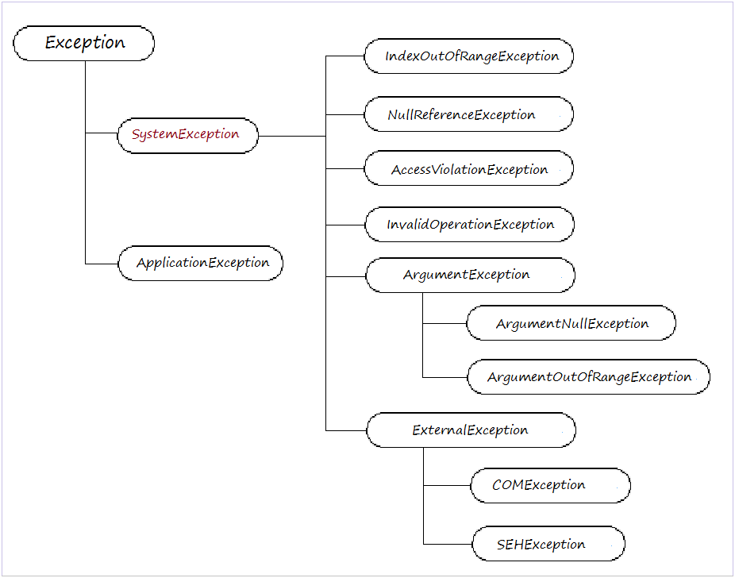
Notes:
Provide a brief overview of what an exception is and why they are actually a very useful feature of the .NET Framework.
Describe some of the exception classes that the NET Framework provides.
n C#, an exception is a runtime occurrence that disrupts the normal flow of program execution. It represents an abnormal condition or an error that occurs while a program is running. When an exceptional situation occurs, the program creates an exception object that contains information about the error, such as its type and message, and then it "throws" the exception.
Errors, on the other hand, encompass a broader category that includes both compile-time errors and runtime exceptions:
Compile-time errors: These are also known as syntax errors. They occur when the code violates the language rules and cannot be compiled successfully. The compiler identifies these errors and prevents the program from being executed until the issues are fixed.
Runtime exceptions: These are errors that occur during the execution of a program when an unexpected condition arises. Common examples include attempting to divide by zero, accessing an invalid index in an array, or trying to read from a file that doesn't exist. These errors are not caught by the compiler during the compilation phase but are detected at runtime.
20483C
2: Creating Methods, Handling Exceptions, and Monitoring Applications

Slide 18
Handling Exception by Using a Try/Catch Block
Use try/catch blocks to handle exceptions
Use one or more catch blocks to catch different types of exceptions
try
{
}
catch (NullReferenceException ex)
{
// Catch all NullReferenceException exceptions.
}
catch (Exception ex)
{
// Catch all other exceptions.
}
Notes:
Explain the syntax of using a try/catch block.
Explain the importance of ordering catch blocks (most specific first).
20483C
2: Creating Methods, Handling Exceptions, and Monitoring Applications

Slide 19
Using a Finally Block
Use a finally block to run code whether or not an exception has occurred
try
{
}
catch (NullReferenceException ex)
{
// Catch all NullReferenceException exceptions.
}
catch (Exception ex)
{
// Catch all other exceptions.
}
finally
{
// Code that always runs.
}
Notes:
Explain the syntax for using a finally block. Explain that you can use a finally block with or without a catch block (try/finally OR try/catch/finally)
Explain that the code you specify in a finally block will always run, regardless of whether an exception occurs.
20483C
2: Creating Methods, Handling Exceptions, and Monitoring Applications

Slide 20
Throwing Exceptions
Use the throw keyword to throw a new exception
Use the throw keyword to rethrow an existing exception
var ex =
new NullReferenceException("The 'Name' parameter is null.");
throw ex;
try
{
}
catch (NullReferenceException ex)
{
}
catch (Exception ex)
{
...
throw;
}
Notes:
Explain that you can use the throw keyword to raise a new exception or to rethrow an existing exception.
20483C
2: Creating Methods, Handling Exceptions, and Monitoring Applications

Slide 21
Lesson 4: Monitoring
Using Logging and Tracing Using Application Profiling Using Performance Counters Demonstration: Extending the Class Enrollment Application Functionality Lab
Notes:
Explain that this lesson introduces the concepts of logging and tracing.
20483C
2: Creating Methods, Handling Exceptions, and Monitoring Applications

Slide 22
Using Logging and Tracing
Logging provides information to users and administrators
Windows event log
Text files
Custom logging destinations
Tracing provides information to developers
Visual Studio Output window
Custom tracing destinations
Notes:
Be prepared to explain the difference between Debug and Release builds if questions arise.
Windows event log: https://www.youtube.com/watch?v=cKy6rlXOQ5M
Use can simply create a new event and log that in windows event log. Check the video above to implement it
Console.WriteLine("Hello World!");
Debug.WriteLine("file create and logged in output");
Trace.WriteLine("File create using trace");
Debug.Assert(true, "something bad happened");
Debug.WriteLineIf(true, "example for writelineIf");
Trace.Listeners.Add(new ConsoleTraceListener());
Trace.WriteLine("This is a trace message.");
20483C
2: Creating Methods, Handling Exceptions, and Monitoring Applications

Slide 24
Using Application Profiling
Create and run a performance session
Analyze the profiling report
Revise your code and repeat
Notes:
Mention that the additional reading link provides comprehensive information on every aspect of the Visual Studio Profiling Tools.
Its really simple: Open the console app . Click on the debug and performance profiler. In the profilig tab choosing the sampling(CPU usage). click okay and run your application. Look at the report generate.
20483C
2: Creating Methods, Handling Exceptions, and Monitoring Applications

Slide 25
Using Performance Counters
Create performance counters and categories in code or in Server Explorer
Specify:
A name
Some help text
The base performance counter type
Update custom performance counters in code
View performance counters in Performance Monitor (perfmon.exe)
Notes:
Mention that the PerformanceCounter and PerformanceCounterCategory classes are in the System.Diagnostics namespace, along with all the other classes you have discussed in this lesson. Mention that creating performance counter categories and performance counters require access to the registry.
Check this: https://www.youtube.com/watch?v=ya1WYiGWNSI
20483C
2: Creating Methods, Handling Exceptions, and Monitoring Applications

Slide 26
Demonstration: Extending the Class Enrollment Application Functionality Lab
In this demonstration, you will learn about the tasks that you will perform in the lab for this module
Notes:
Demonstration Steps
Demonstrate the lab steps
20740C
1: Installing, upgrading, and migrating servers and workloads
(More notes on the next slide)

Slide 27
Lab: Extending the Class Enrollment Application Functionality
Lab scenario
You have been asked to refactor the code that you wrote in the lab exercises for module 1 into separate methods to avoid the duplication of code in the Class Enrollment Application.
Also, you have been asked to write code that validates the student information that the user enters and to enable the updated student information to be written back to the database, handling any errors that may occur.
Objectives
Exercise 1: Refactoring the Enrollment Code
Exercise 2: Validating Student Information
Exercise 3: Saving Changes to the Class List
Notes:
Estimated Time: 90 Minutes
Point out to students that they must complete the steps to set up the SchoolDB database even if they still have the database running from the previous lab. This is to ensure that the data is reset and in a known state.
Exercise 1: Refactoring the Enrollment Code
In this exercise, you will refactor the existing code to avoid writing duplicate code.
The application currently enables a user to edit a student’s details by pressing Enter, but you now want them to also be able to initiate the edit process by double-clicking on a student in the list. You will begin by creating a new method that contains the code for editing a student’s details. This will avoid duplicating and maintaining the code in both event handlers. You will then call the new method from both the studentsList_MouseDoubleClick and StudentsList_Keydown events. While doing this, you also decide to refactor the code for adding and deleting students into separate methods, so that it can be called from other parts of the application if the need arises. You will then run the application and verify that users can press Enter or double-click on a student to edit the student’s details, can press Insert to add a new student, and can press Delete to remove a student.

Slide 28
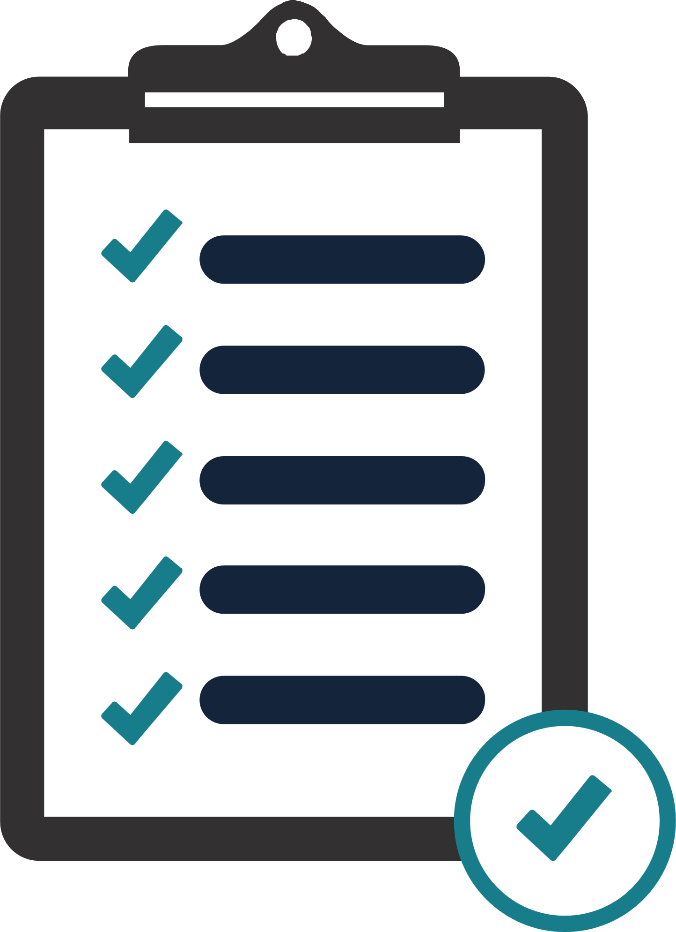
Module Review and Takeaways
Review Questions Tools Common Issues and Troubleshooting Tips
Notes:
Review Questions
Question
The return type of a method forms part of a methods signature.
( )False
( )True
Answer
(√)False
Feedback
The return type of a method does not form part of a methods signature.
Question
When using output parameters in a method signature, which one of the following statements is true?
( )Option 1: You cannot return data by using a return statement in a method that use output parameters.
( )Option 2: You can only use the type object when defining an output parameter.
( )Option 3: You must assign a value to an output parameter before the method returns.
( )Option 4: You define an output parameter by using the output keyword.
Answer
(√) Option 3: You must assign a value to an output parameter before the method returns.
Feedback
You must assign a value to an output parameter before the method returns, otherwise your code will not compile.
20740C
1: Installing, upgrading, and migrating servers and workloads
(More notes on the next slide)

Slide 29
End of presentation

