Slide 1
Firebase
Bünyamin Coşkuner
@Habltalks 12.01.2018

Slide 2


What is Firebase?
Founded by James Tamplin and
Andrew Lee in 2011
Chat API
Real-time communication between apps
Firebase services in April 2012
Acquired by Google in October 2014
Divshot acquired and merged with
Firebase in October 2015
In Jan 2017, Fabric and Crashlytics acquired

Slide 3
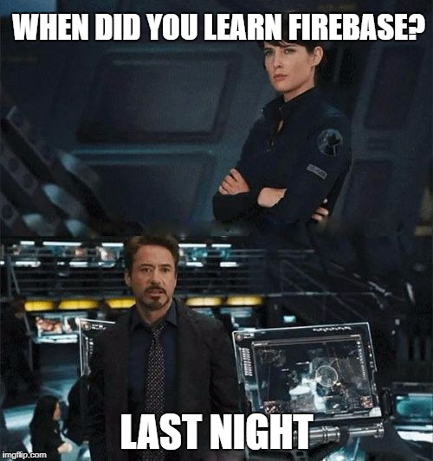

Slide 4
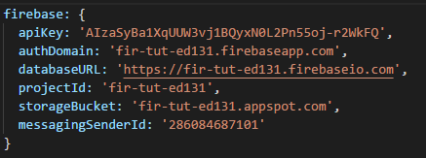
What does it do?
Realtime Database
Serverless architecture
Direct access to database from client
Offline interaction
NoSql Database
Remote Config
Hosting
Cloud Storage
Firebase Functions (Beta)

Slide 5
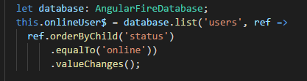
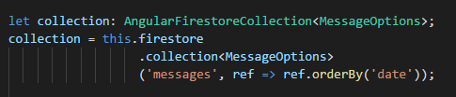
Realtime Database
Realtime Database
Cloud Firestore (Beta)

Slide 6
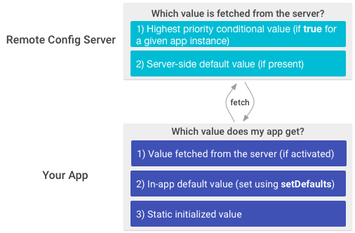
Remote Config
Instrument your app with Remote Config
Set default parameter values
Add logic to fetch, activate, and get parameter values
(As needed) Update service-side default and conditional parameter values

Slide 7
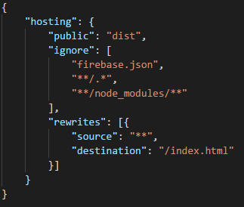
Hosting
Served over a secure connection
Fast content delivery
Rapid deployment
One-click rollbacks

Slide 8


Slide 9
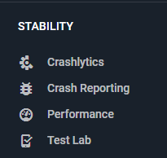
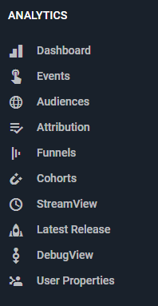
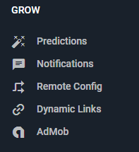
What else?

Slide 10
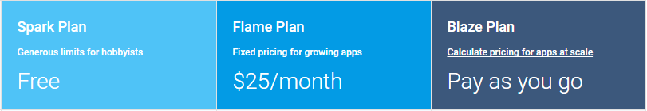
Pricing
Be careful tho!

Slide 11


