Slide 1
Kronogram
Harry Bos
Anna Huisinga
Kasey Nagle
Nicholas Vanhaute

Slide 2
Project Focus
Creating a timeline and map of a user’s and their friends posts from multiple social media platforms in one place for easy access to look back through time at what was happening in the user’s life on that day years ago.

Slide 3
Sprint Goals
The main objectives for this sprint:
Integrate the new UI
Store a user’s timeline in the database
Display different post types

Slide 4
Major Sprint Achievements
Merged the UI with the existing functionality
Can display posts from Facebook, Instagram, and Twitter, including photos
Figured out how to store a user’s timeline in the database
Added search and settings pages

Slide 5
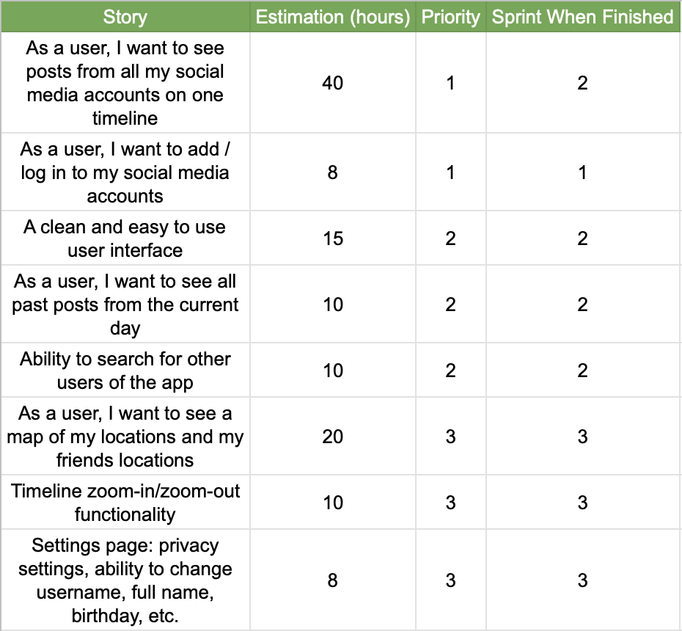
Project Backlog

Slide 6
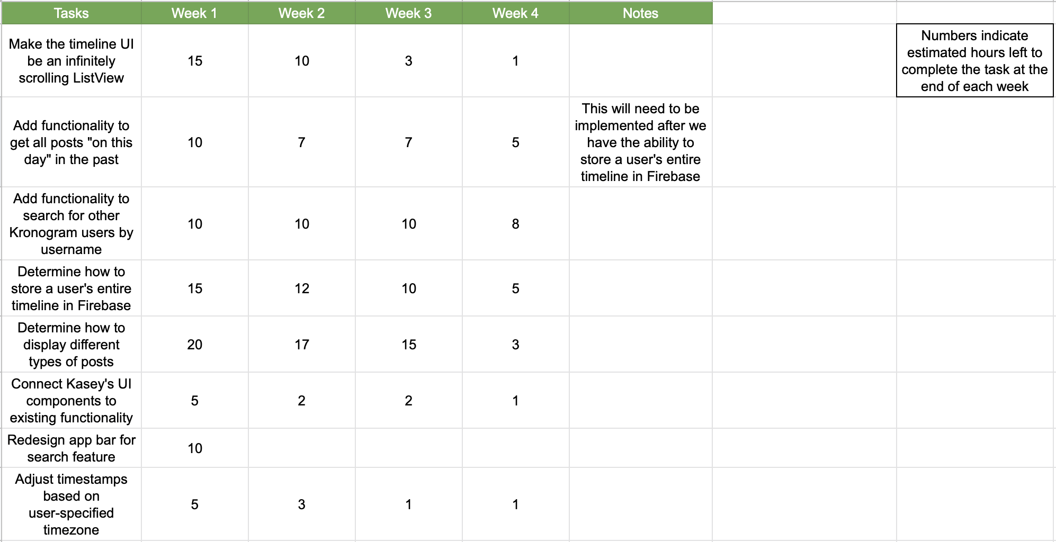
Sprint Backlog

Slide 7
Not Completed/Lessons Learned
Not Yet Completed:
Displaying videos still needs some work - they appear, but don’t play
Creating a feed for each day
Lessons Learned:
Use Providers instead of parameters to pass data between pages
Serializing certain objects is difficult

Slide 8
Test Cases and Demo

